Slide 1
K-3 Numeracy Screener: Grade 1
BOY Remote Administration
Fall 2025

Slide 2
Prior to reading the remote screening agreement, please ensure video and audio are working and the session is being recorded. To ensure reliability of the K-3 Numeracy Screener remote administration, the following expectations must be read aloud by the test administrator and verbally acknowledged by the parent/guardian and student. If the parent/guardian and/or student refuses to agree or breaks one of the following requirements then remote testing shall not begin or must be stopped immediately and on-site testing will be required. Personnel from school districts and/or the LDOE may monitor this screening session.
Parents/Guardians
May assist with providing a quiet work space with limited distractions.
May ensure the student is following along in the correct section.
May not prompt or solicit a response from the student.
May not disclose screening materials to the student prior to their testing session.
May not show the answer key to the student at any time.
Webcams and audio must stay on the entire testing session with the student in view.
Student
May not ask a parent or guardian for assistance with answering the screening items.
May not review test materials prior to screening.
May not review the answer key at any time prior to screening.
Should follow the directions from the test administrator for each subtest and answer to the best of their ability.
Webcams and audio must stay on the entire testing session with the student in view.
Please contact assessment@la.gov

Slide 3

Notes:
TA Directions
TA says, "Count forward by ones starting with the number seventy-five. I will tell you when to stop. Go!"
Start Timer.
When the red "Time is up!" button appears, TA says "STOP!"
Record Student Response

Slide 4
Notes:
TA Directions
TA says, "Count backward by ones starting with the number thirty. I will tell you when to stop. Go!"
Start Timer.
When the red "Time is up!" button appears, TA says "STOP!"
Record Student Response

Slide 5
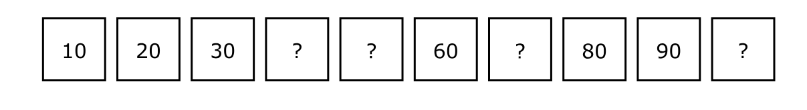
Notes:
TA Directions
TA says, "Count to complete the pattern. Start with the number 10."
Record Student Response

Slide 6

Notes:
TA Directions: TA says, "What number is this?"
Record Student Response

Slide 7
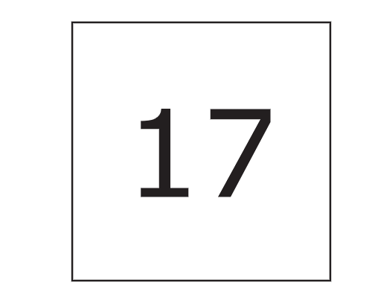
Notes:
TA Directions: TA says, "What number is this?"
Record Student Response

Slide 8

Notes:
TA Directions: TA says, "What number is this?"
Record Student Response

Slide 9

Notes:
TA Directions: TA says, "What number is this?"
Record Student Response

Slide 10

Notes:
TA Directions: TA says, "What number is this?"
Record Student Response

Slide 11

Notes:
TA Directions: TA says, "What number is this?"
Record Student Response

Slide 12
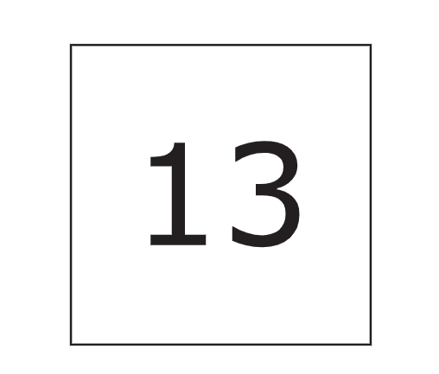
Notes:
TA Directions: TA says, "What number is this?"
Record Student Response

Slide 13
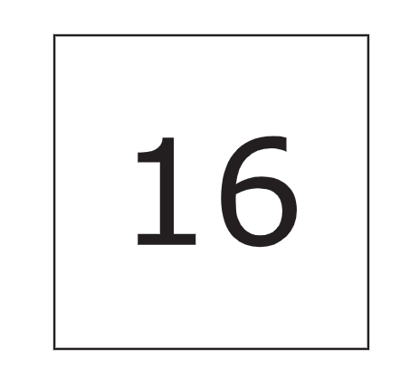
Notes:
TA Directions: TA says, "What number is this?"
Record Student Response

Slide 14

Notes:
TA Directions: TA says, "What number is this?"
Record Student Response

Slide 15

Notes:
TA Directions: TA says, "What number is this?"
Record Student Response

Slide 16
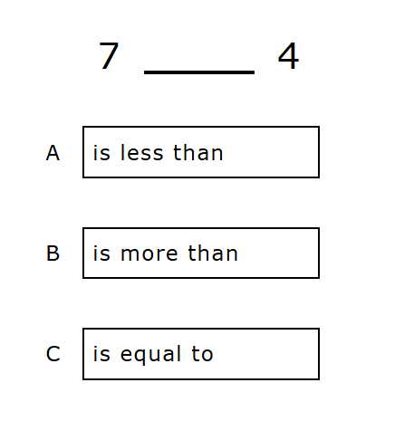
Notes:
TA Directions
TA says, "Seven [is less than, is more than, is equal to] four. Which statement makes the comparison true?"
Record Student Response

Slide 17
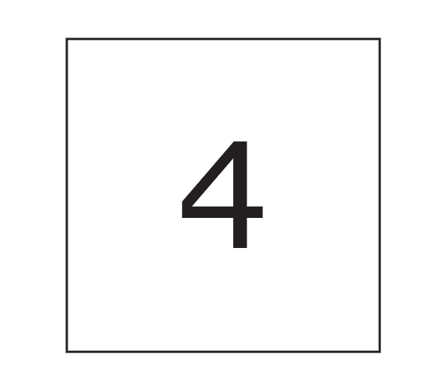
Notes:
TA Directions
TA says, "This is the number four. How many more are needed to make ten?"
Record Student Response

Slide 18

Notes:
TA Directions
TA says, "This is the number seven. How many more are needed to make ten?"
Record Student Response

Slide 19
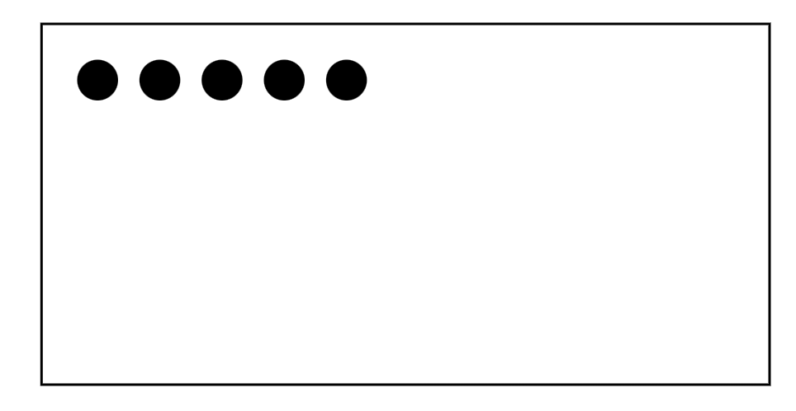
Notes:
TA Directions
TA says, "Here are five dots. I will hide all five dots."
Click Next.

Slide 20

Notes:
TA Directions
Click Next.

Slide 21
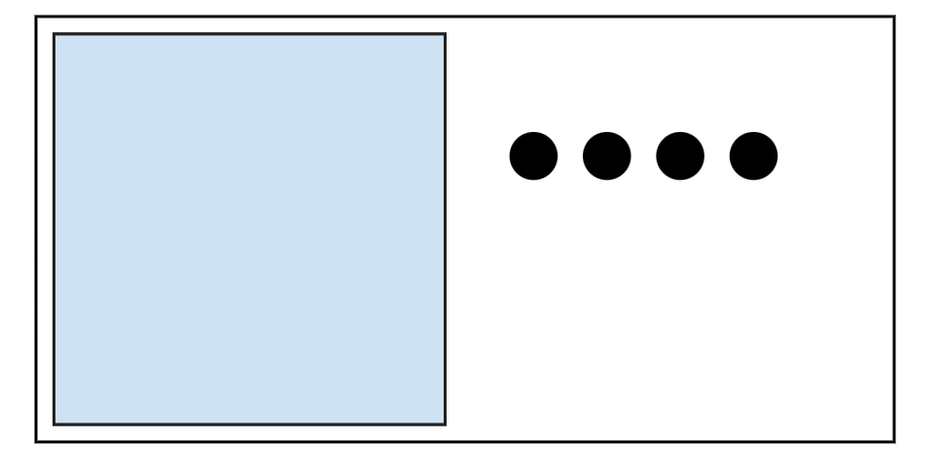
Notes:
TA Directions
TA says, "Here are four more dots. I will hide the four dots with the five dots."
Click Next.

Slide 22

Notes:
TA Directions: TA says, "How many dots are hidden in total?"
Record Student Response

Slide 23
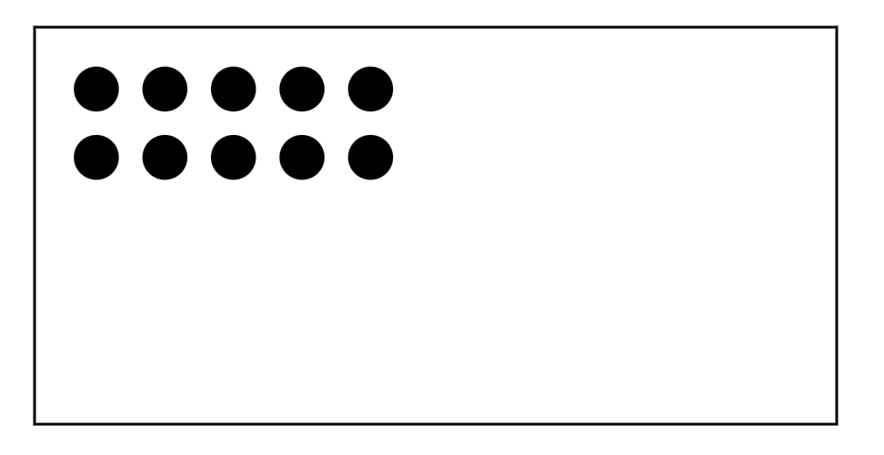
Notes:
TA Directions
TA says, "Here are ten dots. I will hide all ten dots."
Click Next.

Slide 24

Notes:
TA Directions
TA says, "I will unhide three of the ten dots."
Click Next.

Slide 25
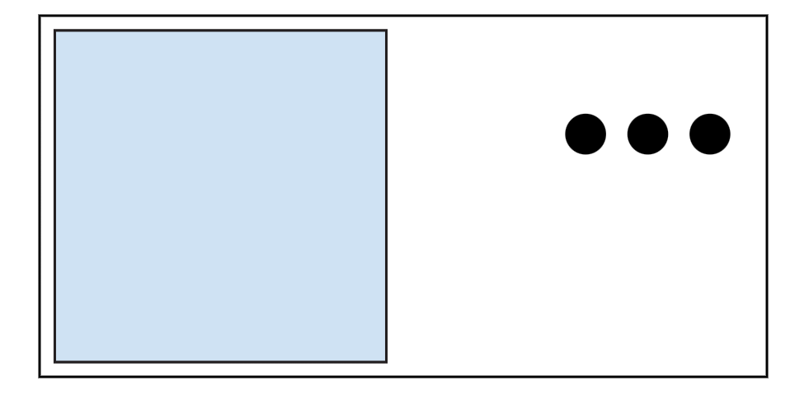
Notes:
TA Directions
TA says, "How many dots are still hidden?"
Record Student Response

Slide 26
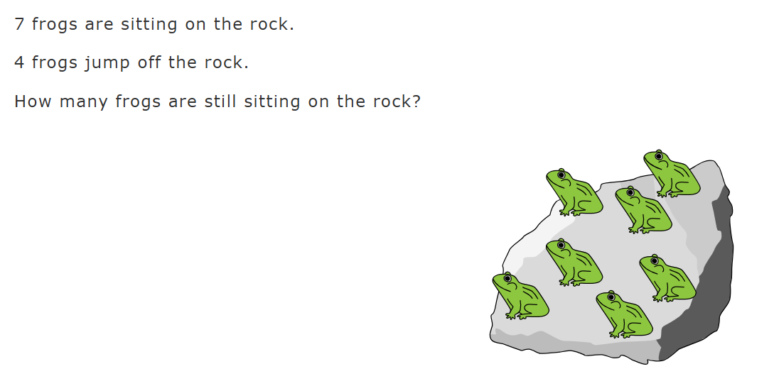
Notes:
TA Directions
TA says, "Seven frogs are sitting on the rock. Four frogs jump off the rock. How many frogs are still sitting on the rock?"
Record Student Response

Slide 27
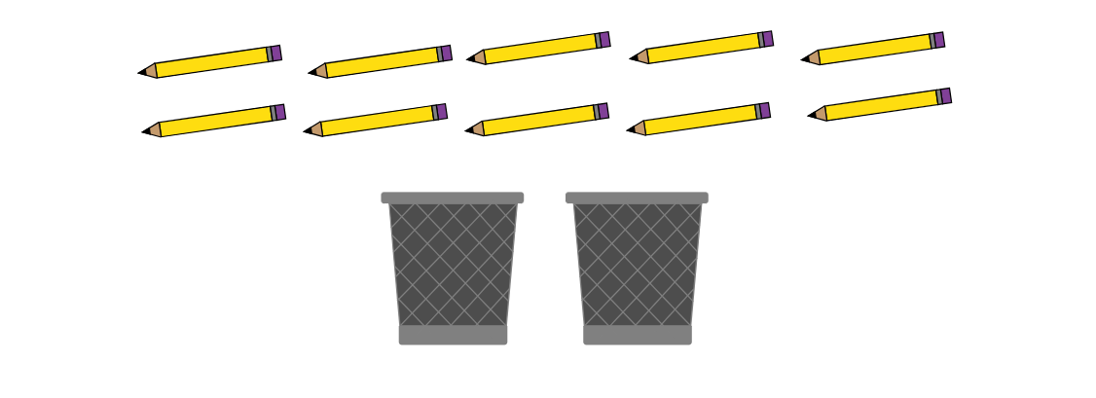
Notes:
TA Directions
TA says, "Lin has ten pencils. Using numbers, what is one way Lin could put all ten pencils into two cups?"
Record student answer.
TA says, "Using numbers, what is another way Lin could put all ten pencils into two cups?"
Record answer.
Record Student Response
If the student states the same answer twice, only one box should be checked. Example: The student answers 4 and 6 for the first answer and then 6 and 4 for the second answer.

Slide 28
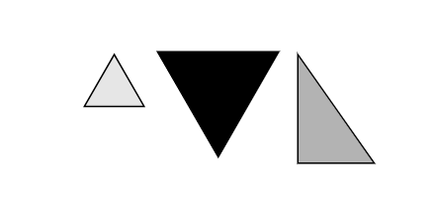
Notes:
TA Directions: TA says, "Are the three objects the same shape? Yes or No."
Record Student Response

Slide 29
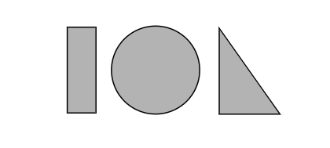
Notes:
TA Directions: TA says, "Are the three objects the same shape? Yes or No."
Record Student Response

Slide 30
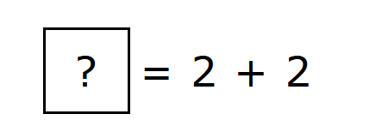
Notes:
TA Directions: TA says, "Solve the equation."
Record Student Response

Slide 31
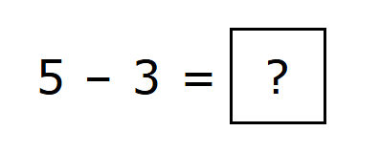
Notes:
TA Directions: TA says, "Solve the equation."
Record Student Response

