Slide 1
K-3 Numeracy Screener: GRADE 1
MOY Remote Administration - TA Led Session
Winter 2025

Slide 2
Prior to reading the remote screening agreement, please ensure video and audio are working and the session is being recorded. To ensure reliability of the K-3 Numeracy Screener remote administration, the following expectations must be read aloud by the test administrator and verbally acknowledged by the parent/guardian and student. If the parent/guardian and/or student refuses to agree or breaks one of the following requirements then remote testing shall not begin or must be stopped immediately and on-site testing will be required. Personnel from school districts and/or the LDOE may monitor this screening session.
Parents/Guardians
May assist with providing a quiet work space with limited distractions.
May ensure the student is following along in the correct section.
May not prompt or solicit a response from the student.
May not disclose screening materials to the student prior to their testing session.
May not show the answer key to the student at any time.
Webcams and audio must stay on the entire testing session with the student in view.
Student
May not ask a parent or guardian for assistance with answering the screening items.
May not review test materials prior to screening.
May not review the answer key at any time prior to screening.
Should follow the directions from the test administrator for each subtest and answer to the best of their ability.
Webcams and audio must stay on the entire testing session with the student in view.

Slide 3

Notes:
TA Directions
TA says, “Starting with the number eighty-two, count forward by ones. I will tell you when to stop. Go!”
TA will start the 30 second timer in Student Portal. When the red “Time is up!” button appears, TA says, “STOP!”
Record Student Response

Slide 4
Notes:
TA Directions
TA says, “Starting with the number fifty, count backward by ones. I will tell you when to stop. Go!”
TA will start the 30 second timer in Student Portal. When the red “Time is up!” button appears, TA says, “STOP!”
Record Student Response

Slide 5
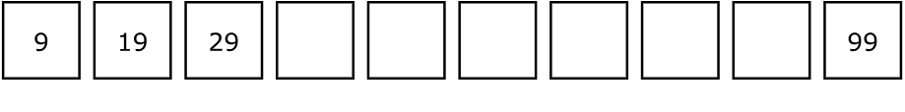
Notes:
TA Directions
TA says, "Starting with the number nine, count to complete the pattern."
Record Student Response

Slide 6
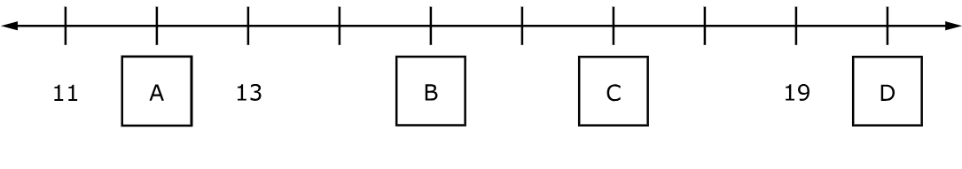
Notes:
TA Directions
TA says, "Which letter represents seventeen on the number line?"
Record Student Response

Slide 7
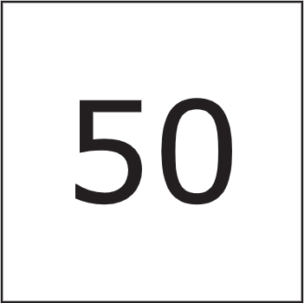
Notes:
TA Directions
TA says, "What number is this?"
Record Student Response

Slide 8
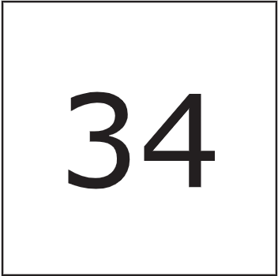
Notes:
TA Directions
TA says, "What number is this?"
Record Student Response

Slide 9
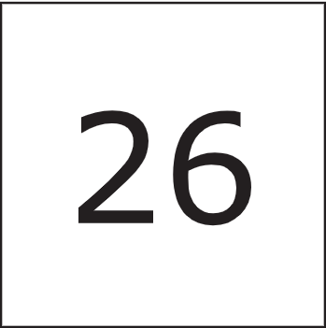
Notes:
TA Directions
TA says, "This is the number twenty-six. What is ten less than twenty-six?"
Record Student Response

Slide 10
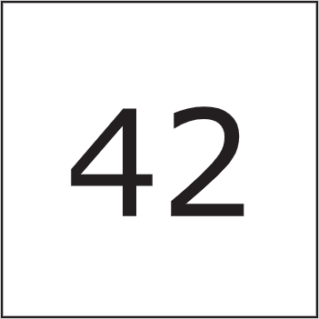
Notes:
TA Directions
TA says, "This is the number forty-two. What is ten more than forty-two?"
Record Student Response

Slide 11
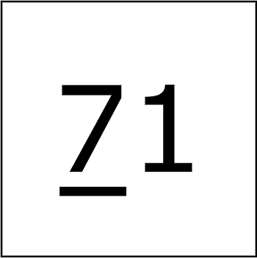
Notes:
TA Directions
TA says, "What is the value of the underlined digit?"
Record Student Response

Slide 12
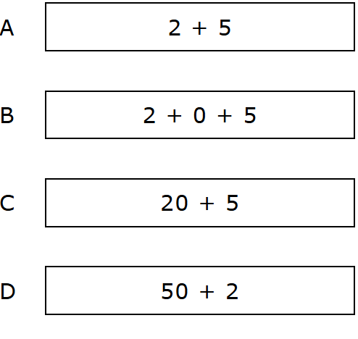
Notes:
TA Directions
TA says, "Which expression represents twenty-five? A, B, C, or D?"
Record Student Response

Slide 13
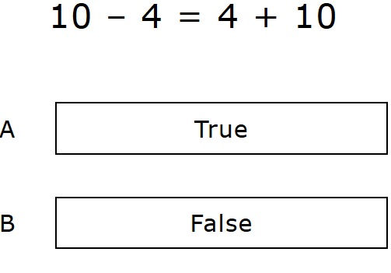
Notes:
TA Directions
TA says, "Is the equation true or false?"
Record Student Response

Slide 14
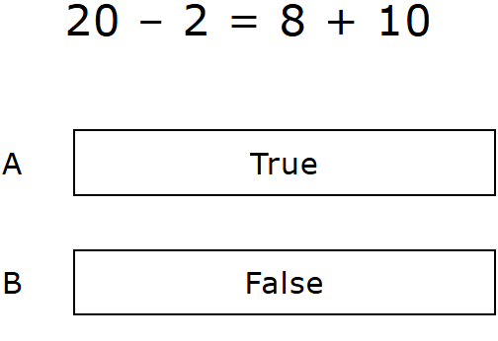
Notes:
TA Directions
TA says, "Is the equation true or false?"
Record Student Response

Slide 15
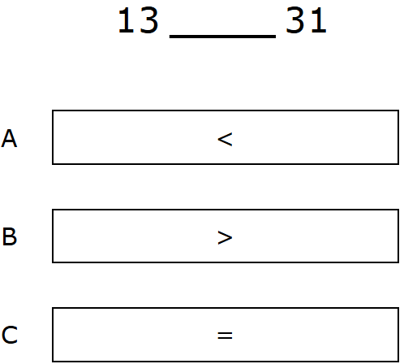
Notes:
TA Directions
TA says, "Which symbol makes the comparison true? A, B, or C?"
Record Student Response

Slide 16
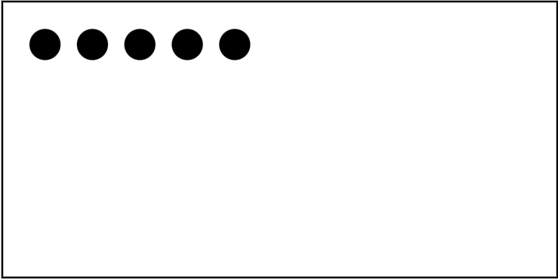
Notes:
TA Directions
TA says, "Here are five dots. I will hide all five dots."
Click Next.

Slide 17

Notes:
TA Directions
Click Next.

Slide 18
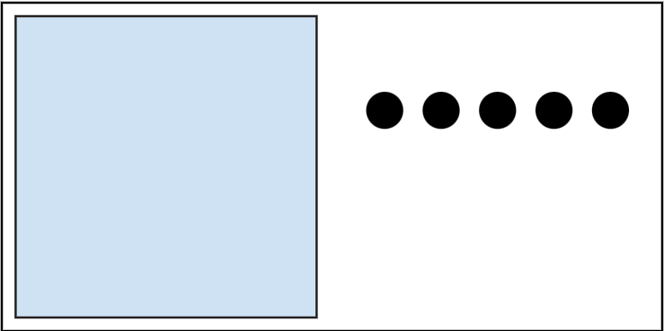
Notes:
TA Directions
TA says, "Here are five more dots. I will hide the five dots with the first five dots."
Click Next.

Slide 19

Notes:
TA Directions
TA says, "How many dots are hidden in total?"
Record Student Response

Slide 20
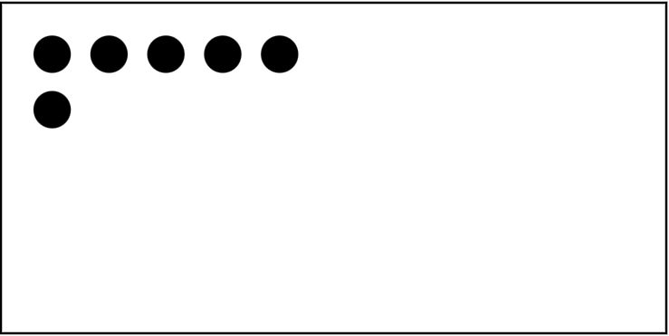
Notes:
TA Directions
TA says, "Here are six dots. I will hide all six dots."
Click Next.

Slide 21
Notes:
TA Directions
TA says, "I will unhide two of the six dots."
Click Next.

Slide 22
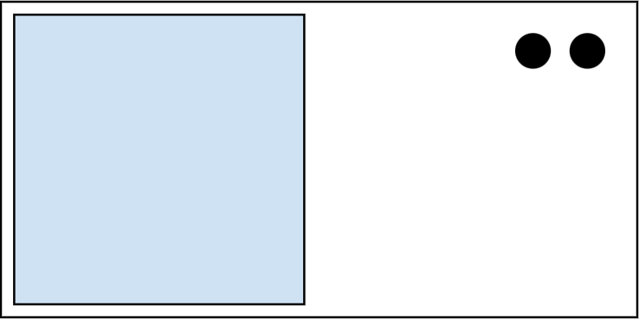
Notes:
TA Directions
TA says, "How many dots are still hidden?"
Record Student Response

Slide 23
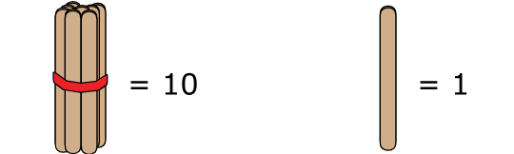
Notes:
TA Directions
TA says, "Each bundle of sticks has a value of ten. Each single stick has a value of one."
Click Next.

Slide 24
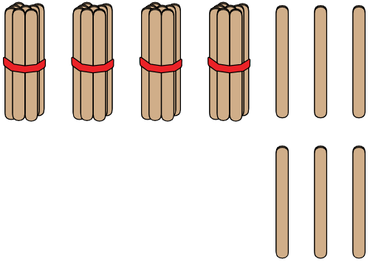
Notes:
TA Directions
TA says, "How many sticks are there in total?"
Record Student Response

Slide 25
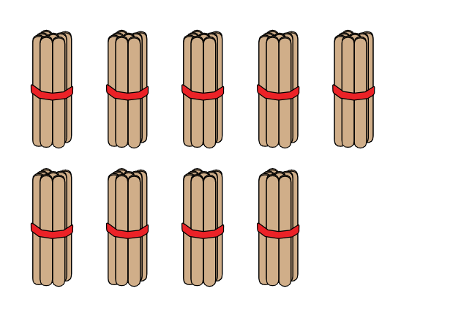
Notes:
TA Directions
TA says, "How many sticks are in nine groups of ten?"
Record Student Response

Slide 26
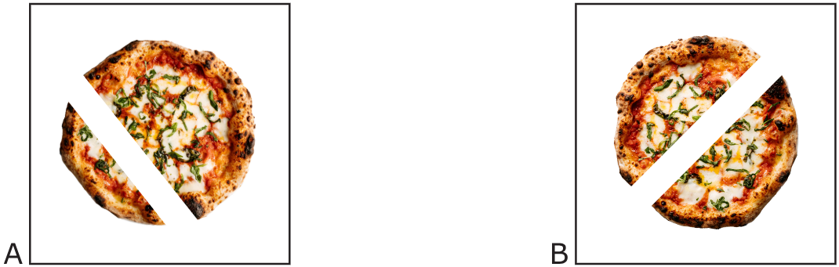
Notes:
TA Directions
TA says, "Which pizza is cut into equal shares? A or B?"
Record Student Response

Slide 27
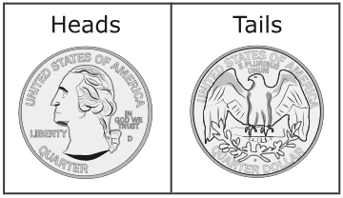
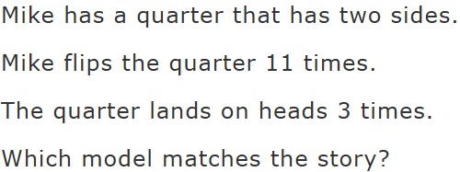
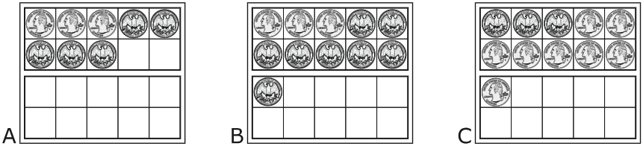
Notes:
TA Directions
TA says, "Mike has a quarter that has two sides. Mike flips the quarter eleven times. The quarter lands on heads three times. Which model matches the story? A, B, or C?"
Record Student Response

Slide 28
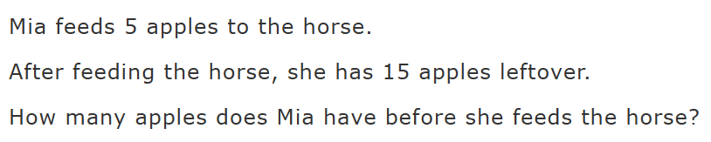
Notes:
TA Directions
TA says, "Mia feeds five apples to the horse. After feeding the horse, she has fifteen apples leftover. How many apples does Mia have before she feeds the horse?"
Record Student Response

Slide 29

Notes:
TA Directions
TA says, “Solve the equation.”
Record Student Response

Slide 30

Notes:
TA Directions
TA says, “Solve the equation.”
Record Student Response

Slide 31

Notes:
TA Directions
TA says, “Solve the equation.”
Record Student Response

Slide 32

Notes:
TA Directions
TA says, “Solve the equation.”
Record Student Response

