Slide 1
K-3 Numeracy Screener: Grade 2
BOY Remote Administration - Interview
Fall 2025

Slide 2
Prior to reading the remote screening agreement, please ensure video and audio are working and the session is being recorded. To ensure reliability of the K-3 Numeracy Screener remote administration, the following expectations must be read aloud by the test administrator and verbally acknowledged by the parent/guardian and student. If the parent/guardian and/or student refuses to agree or breaks one of the following requirements then remote testing shallnot begin or must be stopped immediately and on-site testing will be required. Personnel from school districts and/or the LDOE may monitor this screening session.
Parents/Guardians
May assist with providing a quiet work space with limited distractions.
May ensure the student is following along in the correct section.
May not prompt or solicit a response from the student.
May not disclose screening materials to the student prior to their testing session.
May not show the answer key to the student at any time.
Webcams and audio must stay on the entire testing session with the student in view.
Student
May not ask a parent or guardian for assistance with answering the screening items.
May not review test materials prior to screening.
May not review the answer key at any time prior to screening.
Should follow the directions from the test administrator for each subtest and answer to the best of their ability.
Webcams and audio must stay on the entire testing session with the student in view.
Please contact assessment@la.gov

Slide 3

Notes:
TA Directions
TA says, "Count forward by tens starting with the number seventy. I will tell you when to stop. Go!"
Start Timer.
When the red "Time is up!" button appears, TA says "STOP!"
Record Student Response

Slide 4
Notes:
TA Directions
TA says, "Count backward by tens starting with the number fifty. I will tell you when to stop. Go!"
Start Timer.
When the red "Time is up!" button appears, TA says "STOP!"
Record Student Response

Slide 5
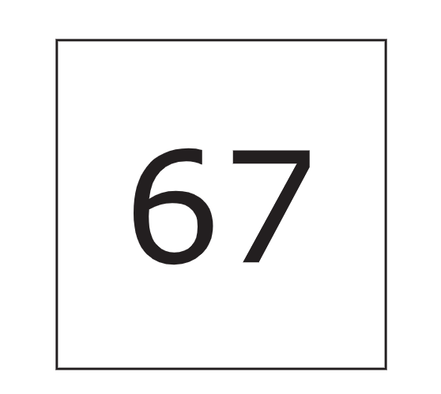
Notes:
TA Directions: TA says, "What number is this?"
Record Student Response

Slide 6

Notes:
TA Directions: TA says, "What number is this?"
Record Student Response

Slide 7
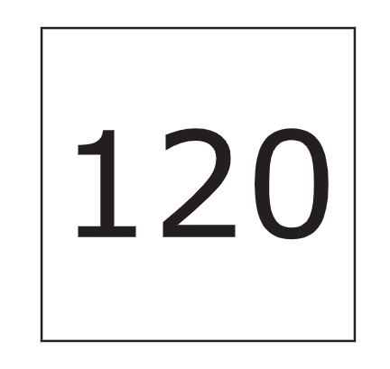
Notes:
TA Directions: TA says, "What number is this?"
Record Student Response

Slide 8
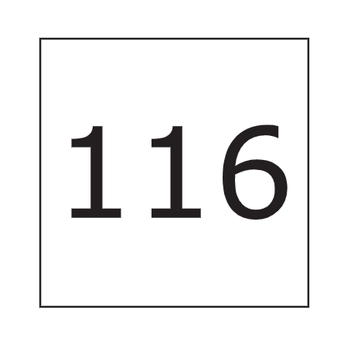
Notes:
TA Directions: TA says, "What number is this?"
Record Student Response

Slide 9
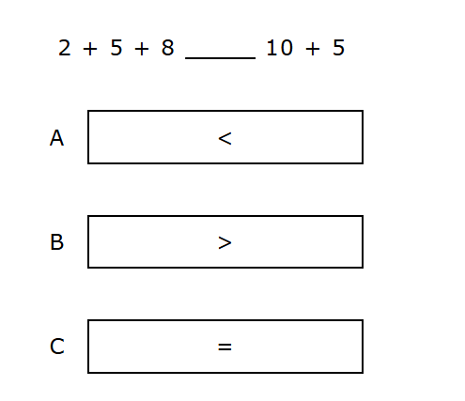
Notes:
TA Directions
TA says, "Which symbol makes the comparison true?"
Record Student Response

Slide 10
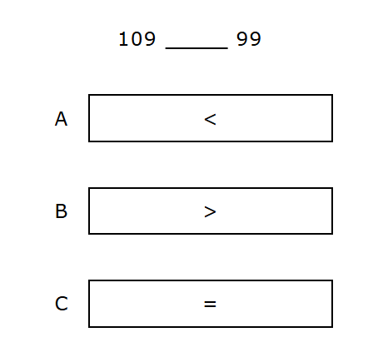
Notes:
TA Directions
TA says, "Which symbol makes the comparison true?"
Record Student Response

Slide 11
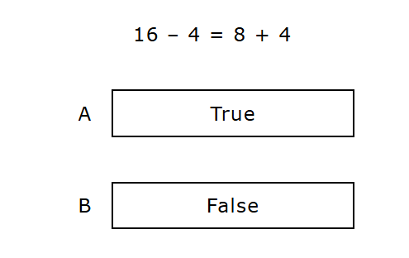
Notes:
TA Directions: TA says, "Is the equation true or false?"
Record Student Response

Slide 12
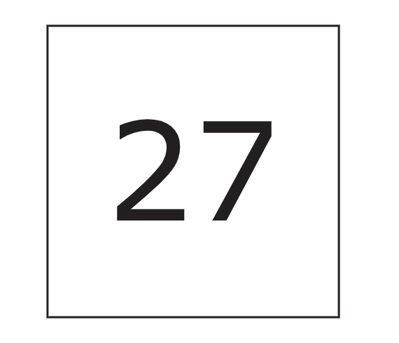
Notes:
TA Directions
TA says, "This is the number twenty-seven. What is ten more than twenty-seven?"
Record Student Response

Slide 13
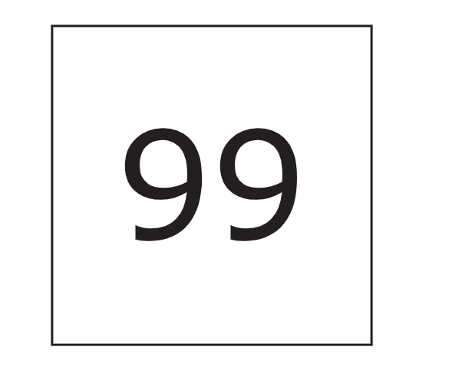
Notes:
TA Directions
TA says, "This is the number ninety-nine. What is ten less than ninety-nine?"
Record Student Response

Slide 14
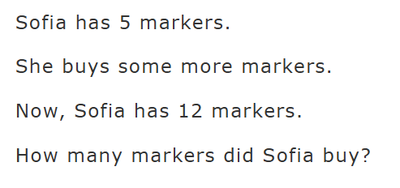
Notes:
TA Directions
TA says, "Sofia has five markers. She buys some more markers. Now, Sofia has twelve markers. How many markers did Sofia buy?"
Record Student Response

Slide 15
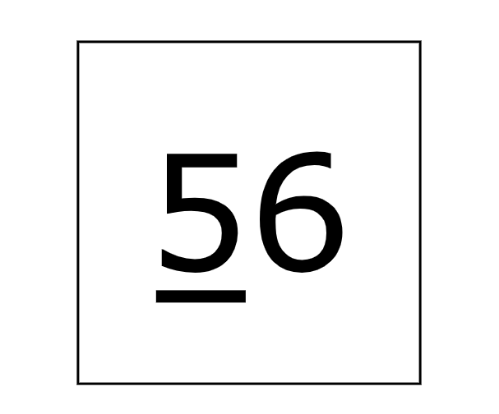
Notes:
TA Directions: TA says, "What is the value of the underlined digit?"
Record Student Response

Slide 16
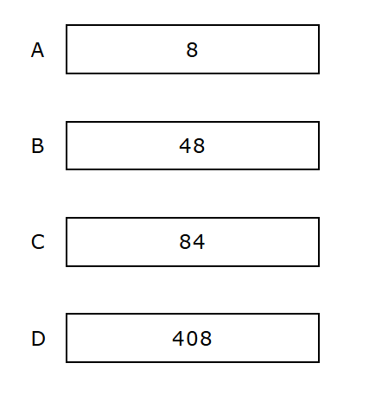
Notes:
TA Directions
TA says, "Which number card shows forty-eight?"
Record Student Response

Slide 17
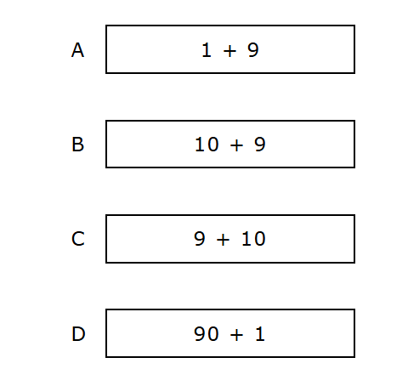
Notes:
TA Directions
TA says, "Which two expressions represent nineteen?"
Record Student Response

Slide 18
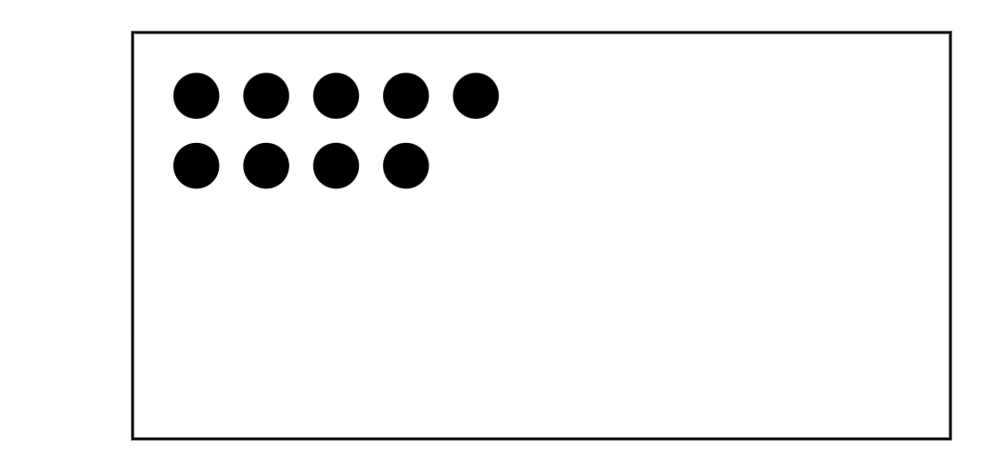
Notes:
TA Directions
TA says, "Here are nine dots. I will hide all nine dots."
Click Next.

Slide 19
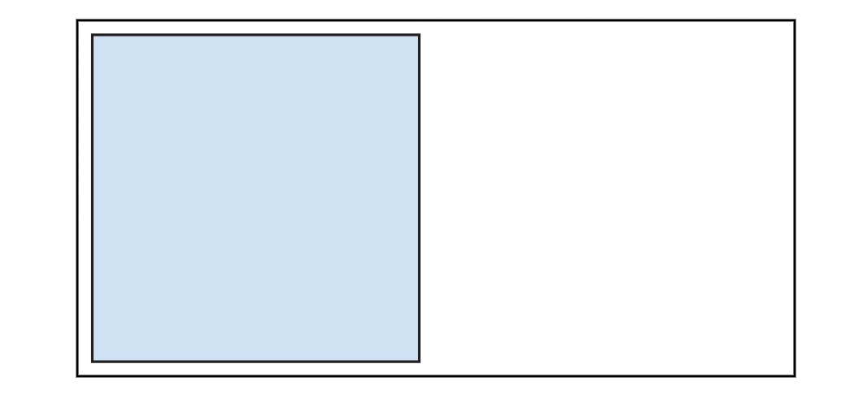
Notes:
TA Directions
Click Next.

Slide 20
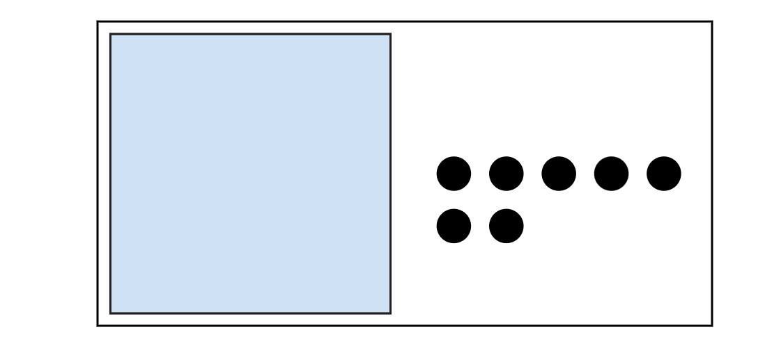
Notes:
TA Directions
TA says, "Here are seven more dots. I will hide the seven dots with the nine dots."
Click Next.

Slide 21

Notes:
TA Directions: TA says, "How many dots are hidden in total?"
Record Student Response

Slide 22
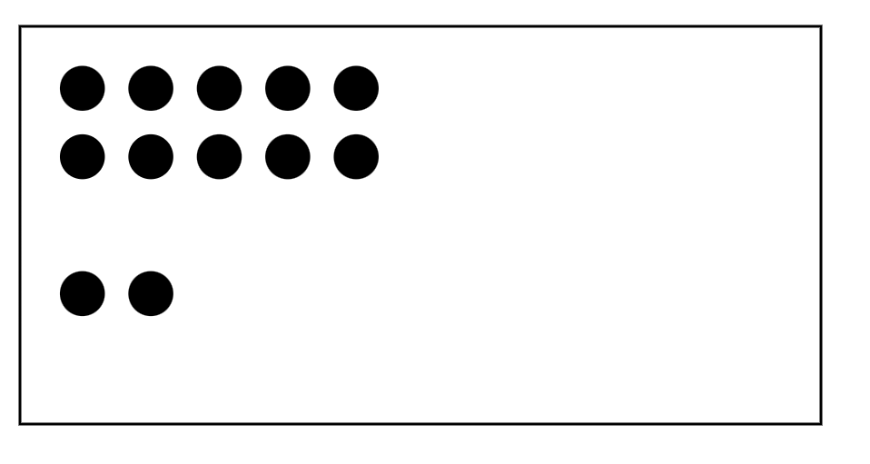
Notes:
TA Directions
TA says, "Here are twelve dots. I will hide all twelve dots."
Click Next.

Slide 23

Notes:
TA Directions
TA says, "I will unhide six of the twelve dots."
Click Next.

Slide 24
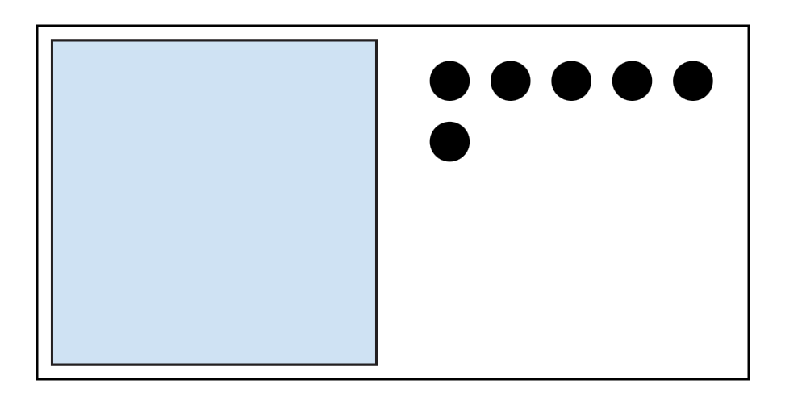
Notes:
TA Directions: TA says, "How many dots are still hidden?"
Record Student Response

Slide 25
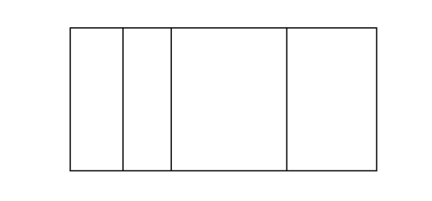
Notes:
TA Directions: TA says, "Is the rectangle partitioned into equal shares? Yes or No?"
Record Student Response

Slide 26
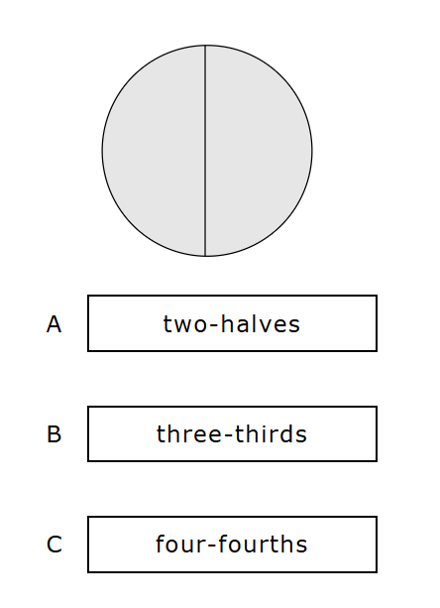
Notes:
TA Directions
TA says, "The circle is partitioned into [two-halves, three-thirds, four-fourths]. Which statement makes the description true?"
Record Student Response

