Slide 1
K-3 Numeracy Screener: GRADE 2
MOY Remote Administration - TA Led Session
Winter 2025

Slide 2
Prior to reading the remote screening agreement, please ensure video and audio are working and the session is being recorded. To ensure reliability of the K-3 Numeracy Screener remote administration, the following expectations must be read aloud by the test administrator and verbally acknowledged by the parent/guardian and student. If the parent/guardian and/or student refuses to agree or breaks one of the following requirements then remote testing shall not begin or must be stopped immediately and on-site testing will be required. Personnel from school districts and/or the LDOE may monitor this screening session.
Parents/Guardians
May assist with providing a quiet work space with limited distractions.
May ensure the student is following along in the correct section.
May not prompt or solicit a response from the student.
May not disclose screening materials to the student prior to their testing session.
May not show the answer key to the student at any time.
Webcams and audio must stay on the entire testing session with the student in view.
Student
May not ask a parent or guardian for assistance with answering the screening items.
May not review test materials prior to screening.
May not review the answer key at any time prior to screening.
Should follow the directions from the test administrator for each subtest and answer to the best of their ability.
Webcams and audio must stay on the entire testing session with the student in view.

Slide 3

Notes:
TA Directions
TA says, “Starting with the number fifty-five, count forward by fives. I will tell you when to stop. Go!”
TA will start the 30 second timer in Student Portal. When the red “Time is up!” button appears, TA says, “STOP!”
Record Student Response

Slide 4
Notes:
TA Directions
TA says, “Starting with the number one hundred, count forward by hundreds. I will tell you when to stop. Go!”
TA will start the 30 second timer in Student Portal. When the red “Time is up!” button appears, TA says, “STOP!”
Record Student Response

Slide 5
Notes:
TA Directions
TA says, “Starting with the number two hundred, count backward by tens. I will tell you when to stop. Go!”
TA will start the 30 second timer in Student Portal. When the red “Time is up!” button appears, TA says, “STOP!”
Record Student Response

Slide 6

Notes:
TA Directions
TA says, "What number is this?"
Record Student Response

Slide 7

Notes:
TA Directions
TA says, "What number is this?"
Record Student Response

Slide 8
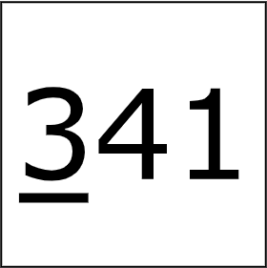
Notes:
TA Directions
TA says, "What is the value of the underlined digit?"
Record Student Response

Slide 9

Notes:
TA Directions
TA says, "This is the number three hundred five. What is one hundred more than this number?"
Record Student Response

Slide 10

Notes:
TA Directions
TA says, "This is the number one hundred eighty-seven. What is one hundred less than this number?"
Record Student Response

Slide 11

Notes:
TA Directions
TA says, "This is the number one hundred ninety-two. What is ten more than this number?"
Record Student Response

Slide 12

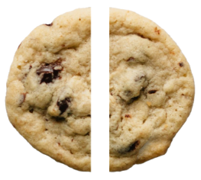
Notes:
TA Directions
TA says, "Emma cuts her cookie into two equal parts. What is each part called?"
Record Student Response

Slide 13


Notes:
TA Directions
TA says, "Amanda cuts her cookie into four equal parts. What is each part called?"
Record Student Response

Slide 14
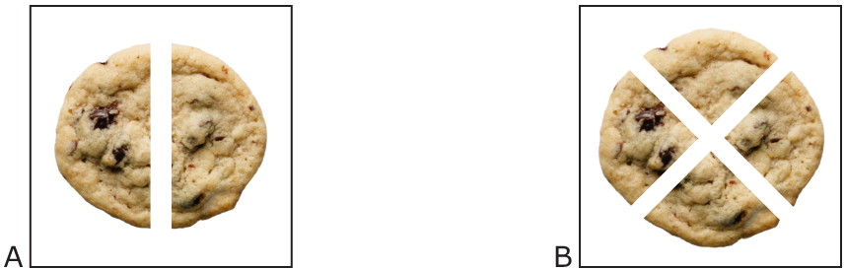
Notes:
TA Directions
TA says, "Which cookie is cut into bigger parts? A or B?"
Record Student Response

Slide 15

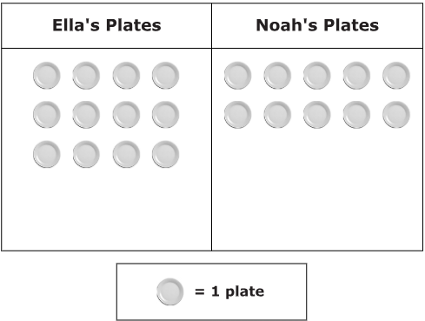
Notes:
TA Directions
TA says, "The table below shows Ella's plates and Noah's plates. Who has more plates, Ella or Noah?"
Record Student Response

Slide 16
Notes:
TA Directions
TA says, "How many more plates does Ella have than Noah?"
Record Student Response

Slide 17

Notes:
TA Directions
TA says, “Solve the equation.”
Record Student Response

Slide 18

Notes:
TA Directions
TA says, “Solve the equation.”
Record Student Response

Slide 19

Notes:
TA Directions
TA says, “Solve the equation.”
Record Student Response

Slide 20

Notes:
TA Directions
TA says, “Solve the equation.”
Record Student Response

