Slide 1
K-3 Numeracy Screener: Grade 3
BOY Remote Administration - Section 1: Interview
Fall 2025

Slide 2
Prior to reading the remote screening agreement, please ensure video and audio are working and the session is being recorded. To ensure reliability of the K-3 Numeracy Screener remote administration, the following expectations must be read aloud by the test administrator and verbally acknowledged by the parent/guardian and student. If the parent/guardian and/or student refuses to agree or breaks one of the following requirements then remote testing should not begin or should be stopped immediately and on-site testing will be required. Personnel from school districts and/or the LDOE may monitor this screening session.
Parents/Guardians
May assist with providing a quiet work space with limited distractions.
May ensure the student is following along in the correct section.
May not prompt or solicit a response from the student.
May not disclose screening materials to the student prior to their testing session.
May not show the answer key to the student at any time.
Webcams and audio must stay on the entire testing session with the student in view.
Student
May not ask a parent or guardian for assistance with answering the screening items.
May not review test materials prior to screening.
May not review the answer key at any time prior to screening.
Should follow the directions from the test administrator for each subtest and answer to the best of their ability.
Webcams and audio must stay on the entire testing session with the student in view.
Please contact assessment@la.gov

Slide 3
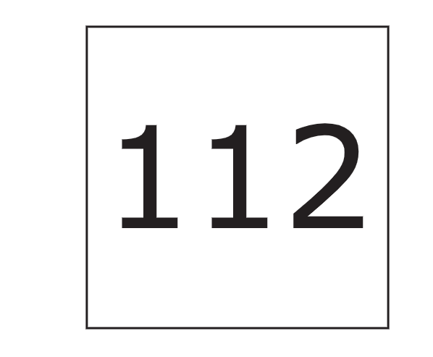
Notes:
TA Directions: TA says, "What number is this?"
Record Student Response

Slide 4

Notes:
TA Directions: TA says, "What number is this?"
Record Student Response

Slide 5
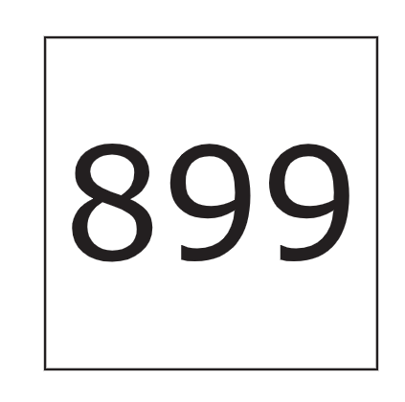
Notes:
TA Directions: TA says, "What number is this?"
Record Student Response

Slide 6
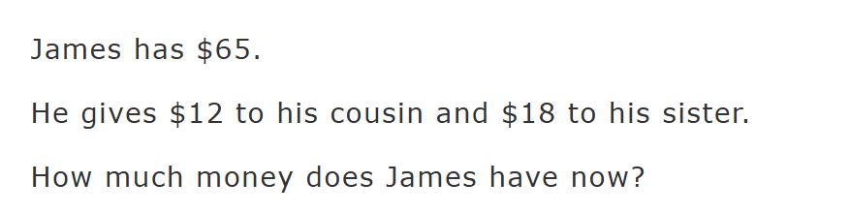
Notes:
TA Directions: TA says, "James has $65. He gives $12 to his cousin and $18 to his sister. How much money does James have now?"
Record Student Response

Slide 7
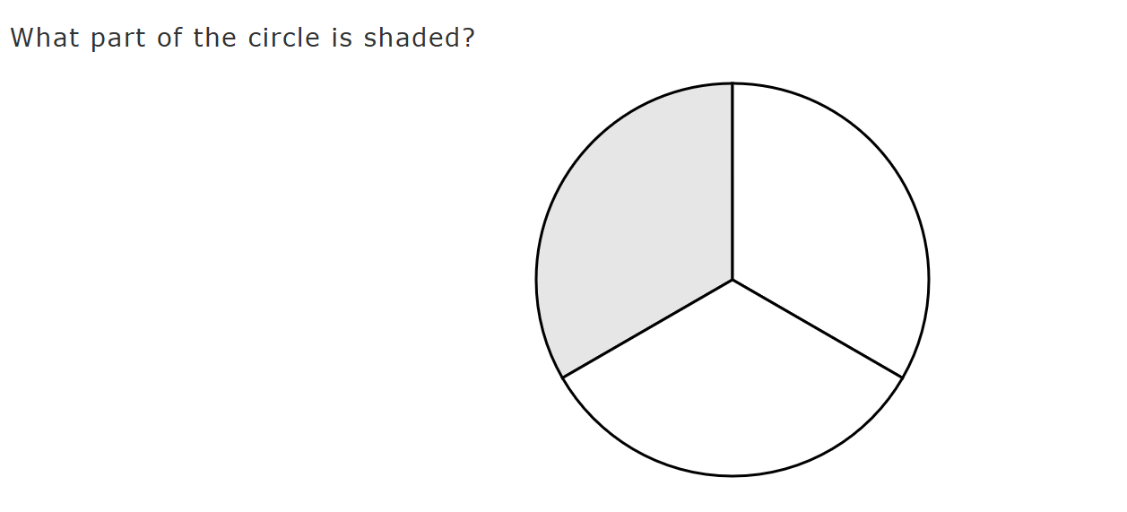
Notes:
TA Directions: TA says, "How much of the circle is shaded?"
Record Student Response

Slide 8
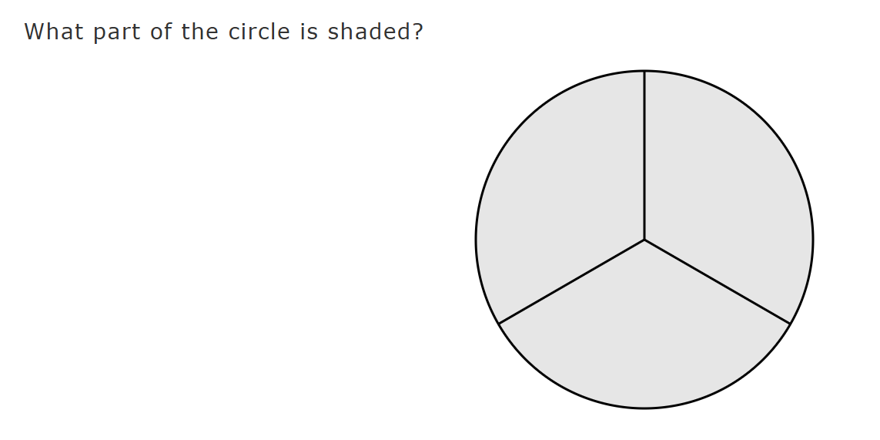
Notes:
TA Directions: TA says, "How much of the circle is shaded?"
Record Student Response

Slide 9

Notes:
TA Directions
TA says, "Two points are shown on the number line. What is the distance between the two points?"
Record Student Response

