Slide 1
K-3 Numeracy Screener: Grade 3
BOY Remote Administration - Section 2: Student Led
Fall 2025

Slide 2
Prior to reading the remote screening agreement, please ensure video and audio are working and the session is being recorded. To ensure reliability of the K-3 Numeracy Screener remote administration, the following expectations must be read aloud by the test administrator and verbally acknowledged by the parent/guardian and student. If the parent/guardian and/or student refuses to agree or breaks one of the following requirements then remote testing shall not begin or mustbe stopped immediately and on-site testing will be required. Personnel from school districts and/or the LDOE may monitor this screening session.
Parents/Guardians
May assist with providing a quiet work space with limited distractions.
May ensure the student is following along in the correct section.
May not prompt or solicit a response from the student.
May not disclose screening materials to the student prior to their testing session.
May not show the answer key to the student at any time.
Webcams and audio must stay on the entire testing session with the student in view.
Student
May not ask a parent or guardian for assistance with answering the screening items.
May not review test materials prior to screening.
May not review the answer key at any time prior to screening.
Should follow the directions from the test administrator for each subtest and answer to the best of their ability.
Webcams and audio must stay on the entire testing session with the student in view.
Please contact assessment@la.gov

Slide 3
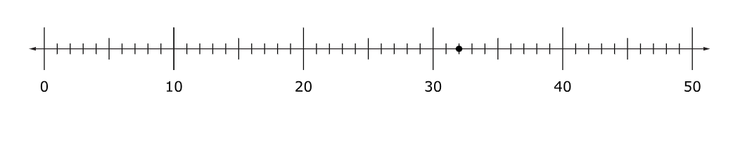
Using the number line below, which point should be selected to plot the number 13 greater than 32.
Notes:
Using the number line below, which point should be selected to plot the number 13 greater than 32.

Slide 4
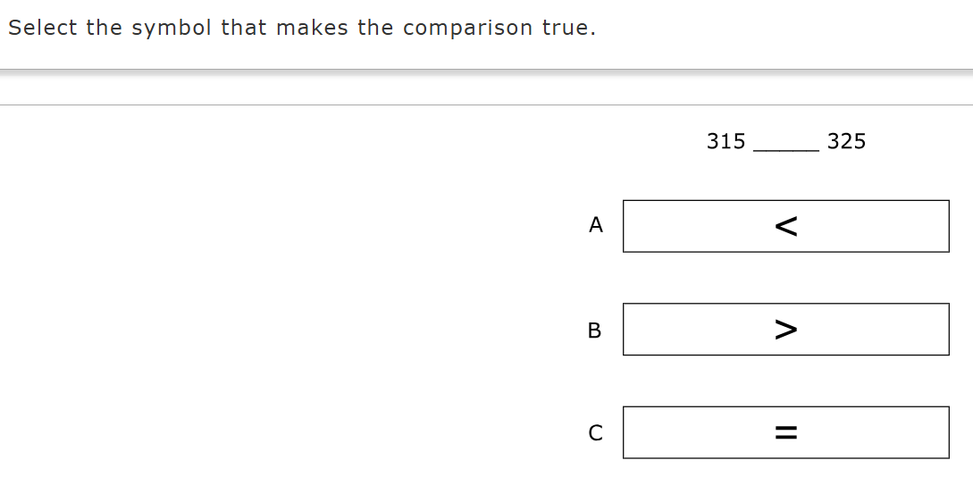

Slide 5
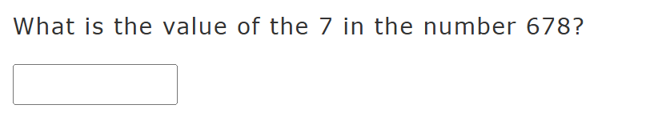

Slide 6
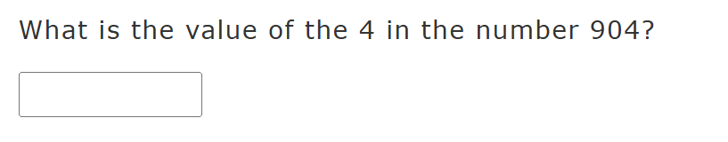

Slide 7
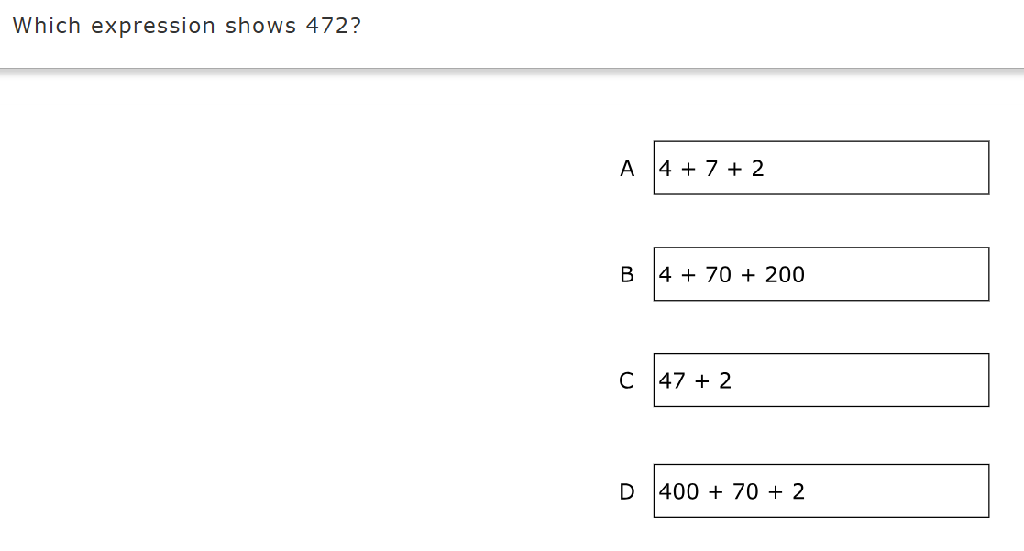

Slide 8
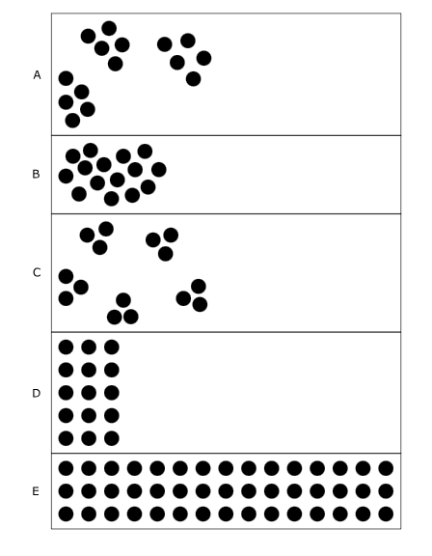

Slide 9

What number should be entered into the box to solve the equation?

Slide 10

What number should be entered into the box to solve the equation?

Slide 11

What number should be entered into the box to solve the equation?

Slide 12



Slide 13
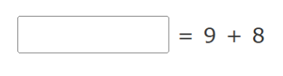
What number should be entered into the box to solve the equation?

Slide 14
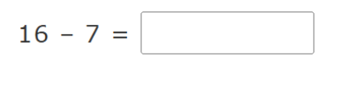
What number should be entered into the box to solve the equation?

Slide 15

What number should be entered into the box to solve the equation?

Slide 16

What number should be entered into the box to solve the equation?

Slide 17

What number should be entered into the box to solve the equation?

Slide 18
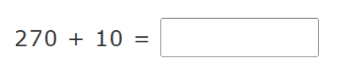
What number should be entered into the box to solve the equation?

Slide 19

What number should be entered into the box to solve the equation?

Slide 20

What number should be entered into the box to solve the equation?

Slide 21

What number should be entered into the box to solve the equation?

Slide 22

What number should be entered into the box to solve the equation?

