Slide 1
K-3 Numeracy Screener: GRADE 3
MOY Remote Administration - TA Led Session
Winter 2025

Slide 2
Prior to reading the remote screening agreement, please ensure video and audio are working and the session is being recorded. To ensure reliability of the K-3 Numeracy Screener remote administration, the following expectations must be read aloud by the test administrator and verbally acknowledged by the parent/guardian and student. If the parent/guardian and/or student refuses to agree or breaks one of the following requirements then remote testing shall not begin or must be stopped immediately and on-site testing will be required. Personnel from school districts and/or the LDOE may monitor this screening session.
Parents/Guardians
May assist with providing a quiet work space with limited distractions.
May ensure the student is following along in the correct section.
May not prompt or solicit a response from the student.
May not disclose screening materials to the student prior to their testing session.
May not show the answer key to the student at any time.
Webcams and audio must stay on the entire testing session with the student in view.
Student
May not ask a parent or guardian for assistance with answering the screening items.
May not review test materials prior to screening.
May not review the answer key at any time prior to screening.
Should follow the directions from the test administrator for each subtest and answer to the best of their ability.
Webcams and audio must stay on the entire testing session with the student in view.

Slide 3
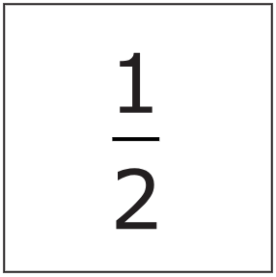
Notes:
TA Directions
TA says, "What number is this?"
Record Student Response

Slide 4
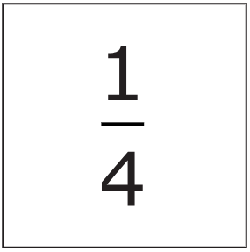
Notes:
TA Directions
TA says, "What number is this?"
Record Student Response

Slide 5
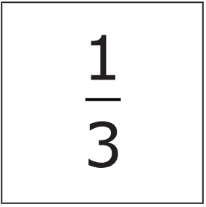
Notes:
TA Directions
TA says, "What number is this?"
Record Student Response

Slide 6
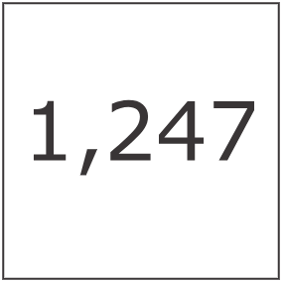
Notes:
TA Directions
TA says, "What number is this?"
Record Student Response

Slide 7
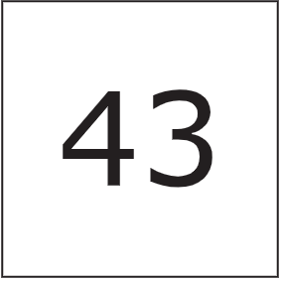
Notes:
TA Directions
TA says, "This is the number forty-three. Round this number to the nearest ten."
Record Student Response

Slide 8
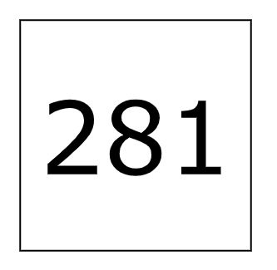
Notes:
TA Directions
TA says, "This is the number two-hundred eighty-one. Round this number to the nearest hundred."
Record Student Response

Slide 9
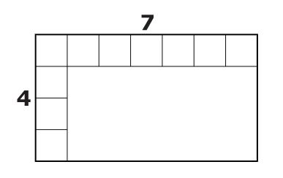
Notes:
TA Directions
TA says, "What is the area of the rectangle?"
Record Student Response

Slide 10

Notes:
TA Directions
TA says, “Solve the equation.”
Record Student Response

Slide 11

Notes:
TA Directions
TA says, “Solve the equation.”
Record Student Response

Slide 12

Notes:
TA Directions
TA says, “Solve the equation.”
Record Student Response

Slide 13

Notes:
TA Directions
TA says, “Solve the equation.”
Record Student Response

Slide 14

Notes:
TA Directions
TA says, “Solve the equation.”
Record Student Response

Slide 15

Notes:
TA Directions
TA says, “Solve the equation.”
Record Student Response

Slide 16

Notes:
TA Directions
TA says, “Solve the equation.”
Record Student Response

Slide 17

Notes:
TA Directions
TA says, “Solve the equation.”
Record Student Response

