Slide 1
K-3 Numeracy Screener: GRADE 3
MOY Remote Administration - Student Led Session
Winter 2025

Slide 2
Prior to reading the remote screening agreement, please ensure video and audio are working and the session is being recorded. To ensure reliability of the K-3 Numeracy Screener remote administration, the following expectations must be read aloud by the test administrator and verbally acknowledged by the parent/guardian and student. If the parent/guardian and/or student refuses to agree or breaks one of the following requirements then remote testing shall not begin or must be stopped immediately and on-site testing will be required. Personnel from school districts and/or the LDOE may monitor this screening session.
Parents/Guardians
May assist with providing a quiet work space with limited distractions.
May ensure the student is following along in the correct section.
May not prompt or solicit a response from the student.
May not disclose screening materials to the student prior to their testing session.
May not show the answer key to the student at any time.
Webcams and audio must stay on the entire testing session with the student in view.
Student
May not ask a parent or guardian for assistance with answering the screening items.
May not review test materials prior to screening.
May not review the answer key at any time prior to screening.
Should follow the directions from the test administrator for each subtest and answer to the best of their ability.
Webcams and audio must stay on the entire testing session with the student in view.

Slide 3
Additional Directions for Administration Grade 2 and Grade 3 Student Sessions
A script has been provided for Test Administrators when administering the Remote Test Student Sessions. These sessions were designed for Grade 2 and Grade 3 students to respond independently. Due to this, Human Reader Directions should only be used for students who receive Human Reader/Text-to-Speech (TTS) accommodations. Otherwise, the script on the next page will give students the directions for this portion of the screener. Record the student’s response for each question in the student portal and then flip to the next slide.
Test Administrators must have the Student Portal Student Session screen open while administering the student session to record student responses.
Human Reader Directions
The Human Reader Directions should ONLY be provided to students who receive Human Reader/Text-to-Speech (TTS) Accommodations.
The Human Reader Directions are provided in the note section below each powerpoint slide.

Slide 4
Directions Script
Read each question carefully. Respond with the answer out loud and I will record your answers.
To answer test questions, you may have to inform me to click on an answer or what to type in a response box. Some response boxes require you to use the virtual keyboard that can be accessed by clicking the virtual keyboard icon in the short answer box.
There are online tools available as you move through the test session. For example, you can use the Flag button to mark any question you want to return to, the Next and Back buttons to move from question to question, and the Review/End Test button to review your answers. When you would like to use these tools, let me know and I will add them to the portal for you.
If you have questions about any of the online tools, ask your test administrator for assistance. When you have completed the test session, follow the directions on the screen to submit the test session. Keep in mind that once you submit the test session, you cannot go back into the test session.
Do not begin the test session until you are instructed to do so by the Test Administrator. Please let me know now if you have any questions about these directions.
Notes:
TA Directions: TA reads these directions to the student prior to beginning the Student-led Session.

Slide 5
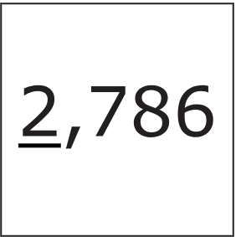
Notes:
Human Reader Directions
TA says, "What is the value of the underlined digit?"
Record Student Response

Slide 6

Notes:
Human Reader Directions
TA says, "Solve the equation."
Record Student Response

Slide 7

Notes:
Human Reader Directions
TA says, "Solve the equation."
Record Student Response

Slide 8

Notes:
Human Reader Directions
TA says, "Solve the equation."
Record Student Response

Slide 9
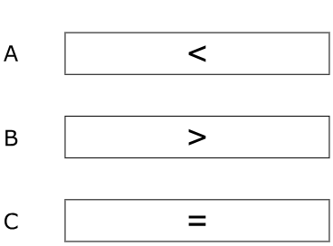
Notes:
Human Reader Directions
TA says, "Which symbol makes the comparison true? A, B, C."
Record Student Response

Slide 10

Notes:
Human Reader Directions
TA says, "Which symbol makes the comparison true? A, B, C."
Record Student Response

Slide 11
Notes:
Human Reader Directions
TA says, "Which symbol makes the comparison true? A, B, C."
Record Student Response

Slide 12

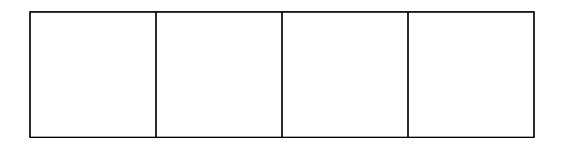
Explain how to shade the model to show .
Notes:
Human Reader Directions
TA says, "Explain how to shade the model to show one-half."
Record Student Response

Slide 13

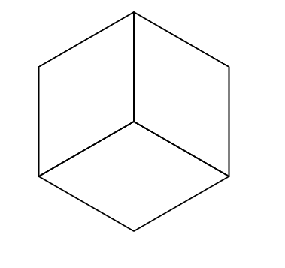
Explain how to shade the model to show .
Notes:
Human Reader Directions
TA says, "Explain how to shade the model to show one-third."
Record Student Response

Slide 14
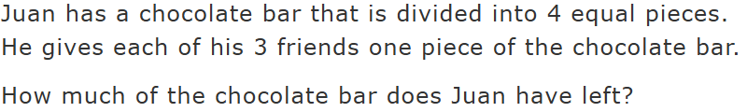
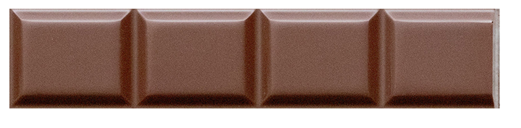
one-fourth
three-fourths
four-fourths
seven-fourths
Notes:
Human Reader Directions
TA says, "Juan has a chocolate bar that is divided into 4 equal pieces. He gives each of his three friends one piece of the chocolate bar. How much of the chocolate bar does Juan have left? There is one drop down menu to complete the sentence. Juan has [one-fourth, three-fourths, four-fourths, seven-fourths] of the chocolate bar left."
Record Student Response

Slide 15
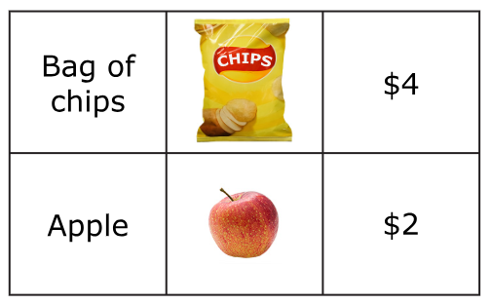
Notes:
Human Reader Directions
TA says, "A store sells bags of chips for four-dollars each and apples for two-dollars each. How much money does Tom need, in total, to buy three bags of chips and one apple?
Record Student Response

Slide 16
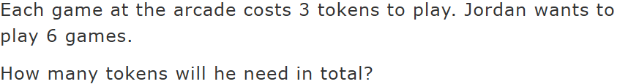
Notes:
Human Reader Directions
TA says, "Each game at the arcade cost three tokens to play. Jordan wants to play six games. How many tokens will he need in total?"
Record Student Response

Slide 17
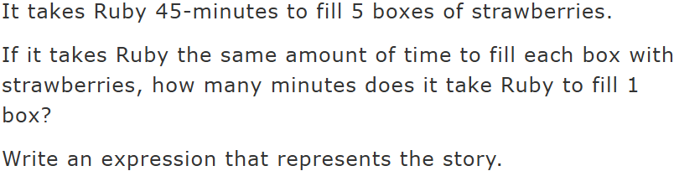
Notes:
Human Reader Directions
TA says, "It takes Ruby forty-five minutes to fill five boxes of strawberries. If it takes Ruby the same amount of time to fill each box with strawberries, how many minutes does it take Ruby to fill one box? Write an expression that represents the story."
Record Student Response

Slide 18

Notes:
Human Reader Directions
TA says, "The chocolate bar is cut into thirty-six small squares. How many square of chocolate are hidden under the wrapper?"
Record Student Response

Slide 19
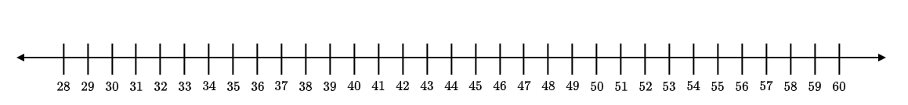
Explain where to plot a point at 31 on the number line. Then, explain where to plot a point that is 26 greater than 31.
Notes:
Human Reader Directions
TA says, "Explain where to plot a point at thirty-one on the number line. Then, explain where to plot a point that is twenty-six greater than thirty-one. The number line ranges from twenty-eight to sixty in increments of one."
Record Student Response

Slide 20
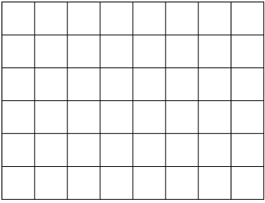
Explain how to shade the model below to show an area of 12 square units.
Notes:
Human Reader Directions
TA says, "Explain how to shade the model below to show an area of twelve square units."
Record Student Response

