Slide 1
K-3 Numeracy Screener: Grade K
BOY Remote Administration
Fall 2025

Slide 2
Prior to reading the remote screening agreement, please ensure video and audio are working and the session is being recorded. To ensure reliability of the K-3 Numeracy Screener remote administration, the following expectations must be read aloud by the test administrator and verbally acknowledged by the parent/guardian and student. If the parent/guardian and/or student refuses to agree or breaks one of the following requirements then remote testing shall not begin or must be stopped immediately and on-site testing will be required. Personnel from school districts and/or the LDOE may monitor this screening session.
Parents/Guardians
May assist with providing a quiet work space with limited distractions.
May ensure the student is following along in the correct section.
May not prompt or solicit a response from the student.
May not disclose screening materials to the student prior to their testing session.
May not show the answer key to the student at any time.
Webcams and audio must stay on the entire testing session with the student in view.
Student
May not ask a parent or guardian for assistance with answering the screening items.
May not review test materials prior to screening.
May not review the answer key at any time prior to screening.
Should follow the directions from the test administrator for each subtest and answer to the best of their ability.
Webcams and audio must stay on the entire testing session with the student in view.

Slide 3
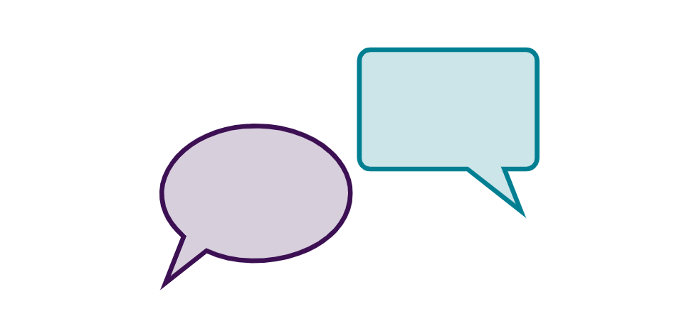
Notes:
TA Directions
TA says, "Count forward by ones starting with the number one. I will tell you when to stop. Go!"
Start Timer.
When the red "Time is up!" button appears, TA says "STOP!"
Record Student Response

Slide 4
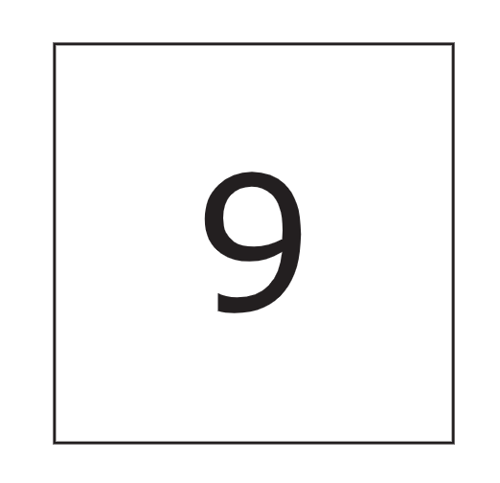
Notes:
TA Directions: TA says, "What number is this?"
Record Student Response

Slide 5

Notes:
TA Directions: TA says, "What number is this?"
Record Student Response

Slide 6
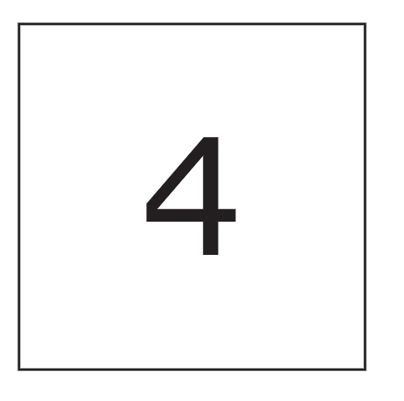
Notes:
TA Directions: TA says, "What number is this?"
Record Student Response

Slide 7

Notes:
TA Directions: TA says, "What number is this?"
Record Student Response

Slide 8

Notes:
TA Directions: TA says, "What number is this?"
Record Student Response

Slide 9

Notes:
TA Directions: TA says, "What number is this?"
Record Student Response

Slide 10

Notes:
TA Directions: TA says, "What number is this?"
Record Student Response

Slide 11

Notes:
TA Directions: TA says, "What number is this?"
Record Student Response

Slide 12

Notes:
TA Directions: TA says, "What number is this?"
Record Student Response

Slide 13

Notes:
TA Directions: TA says, "What number is this?"
Record Student Response

Slide 14
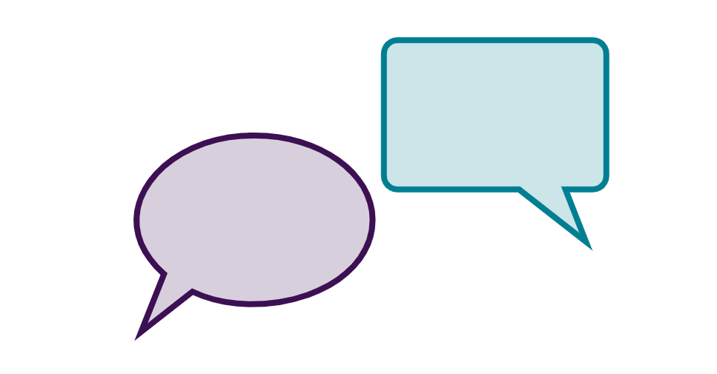
Notes:
TA Directions
TA says, "Dots will appear on the screen."
Click Next.

Slide 15

Notes:
Next slide

Slide 16
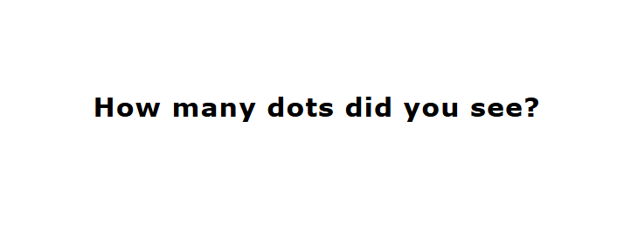
Notes:
TA Directions
After the dots disappear on the screen, TA reads the red words on the screen "How many dots did you see?"
Record Student Response

Slide 17
Notes:
TA Directions
TA says, "Dots will appear on the screen."
Click Next.

Slide 18

Notes:
Next slide

Slide 19
Notes:
TA Directions
After the dots disappear on the screen, TA reads the red words on the screen "How many dots did you see?"
Record Student Response

Slide 20
Notes:
TA Directions
TA says, "Dots will appear on the screen."
Click Next.

Slide 21
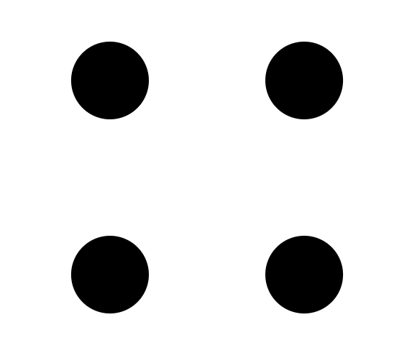
Notes:
Next slide

Slide 22
Notes:
TA Directions
After the dots disappear on the screen, TA reads the red words on the screen "How many dots did you see?"
Record Student Response

Slide 23
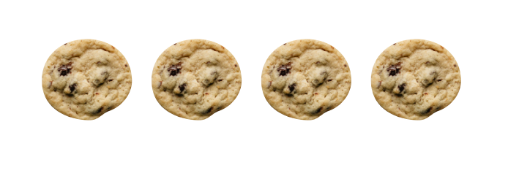
Notes:
TA Directions: TA says, "Sam has three cookies. He gets one more cookie. How many cookies does Sam have now?"
Record Student Response

Slide 24
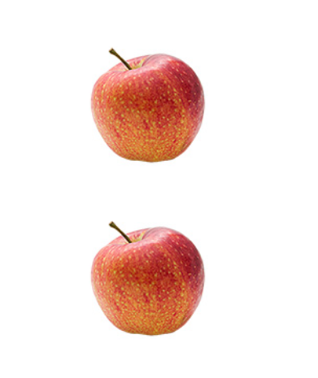
Notes:
TA Directions
TA says, "Count each apple out loud.”
Record Student Response

Slide 25
Notes:
TA Directions
TA says, "How many apples did you count?"
Record Student Response

Slide 26
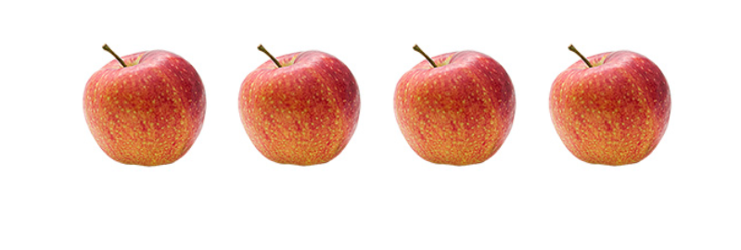
Notes:
TA Directions
TA says, "Count each apple out loud”
Record Student Response

Slide 27
Notes:
TA Directions
TA says, "How many apples did you count?"
Record Student Response

Slide 28
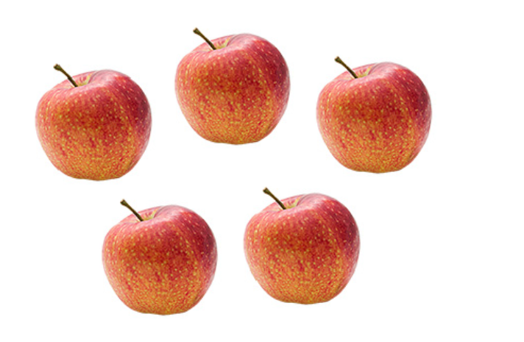
Notes:
TA Directions
TA says, "Counteach apple out loud.”
Record Student Response

Slide 29
Notes:
TA Directions
TA says, "How many apples did you count?"
Record Student Response

Slide 30
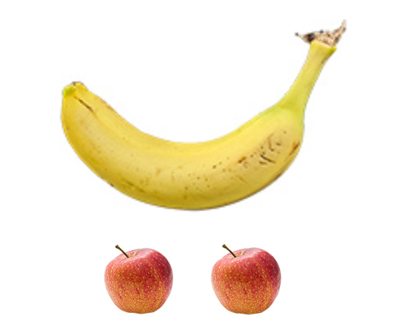
Notes:
TA Directions: TA says, "Are there more bananas or more apples?"
Record Student Response

Slide 31
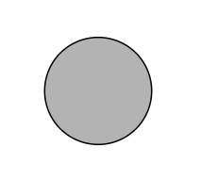
Notes:
TA Directions: TA says, "What shape is this?"
Record Student Response

Slide 32
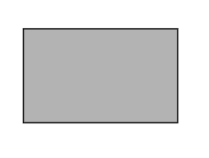
Notes:
TA Directions: TA says, "What shape is this?"
Record Student Response

Slide 33
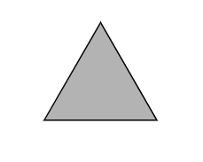
Notes:
TA Directions: TA says, "What shape is this?"
Record Student Response

Slide 34
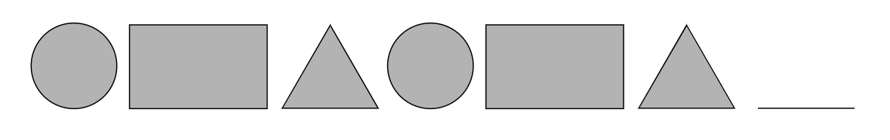
Notes:
TA Directions: TA says, "Look at the pattern, what shape comes next?"
Record Student Response
Mark YES if student points to the circle or says "circle".

