Slide 1
K-3 Numeracy Screener: KINDERGARTEN
MOY Remote Administration - TA Led Session
Winter 2025

Slide 2
Prior to reading the remote screening agreement, please ensure video and audio are working and the session is being recorded. To ensure reliability of the K-3 Numeracy Screener remote administration, the following expectations must be read aloud by the test administrator and verbally acknowledged by the parent/guardian and student. If the parent/guardian and/or student refuses to agree or breaks one of the following requirements then remote testing shall not begin or must be stopped immediately and on-site testing will be required. Personnel from school districts and/or the LDOE may monitor this screening session.
Parents/Guardians
May assist with providing a quiet work space with limited distractions.
May ensure the student is following along in the correct section.
May not prompt or solicit a response from the student.
May not disclose screening materials to the student prior to their testing session.
May not show the answer key to the student at any time.
Webcams and audio must stay on the entire testing session with the student in view.
Student
May not ask a parent or guardian for assistance with answering the screening items.
May not review test materials prior to screening.
May not review the answer key at any time prior to screening.
Should follow the directions from the test administrator for each subtest and answer to the best of their ability.
Webcams and audio must stay on the entire testing session with the student in view.

Slide 3

Notes:
TA Directions
TA says, “Starting with the number thirty, count forward by ones. I will tell you when to stop. Go!”
TA will start the 30 second timer in Student Portal. When the red “Time is up!” button appears, TA says, “STOP!”
Record Student Response

Slide 4
Notes:
TA Directions
TA says, “Starting with the number ten, count backward by ones. I will tell you when to stop. Go!”
TA will start the 30 second timer in Student Portal. When the red “Time is up!” button appears, TA says, “STOP!”
Record Student Response

Slide 5
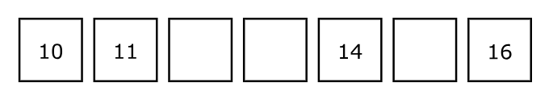
Notes:
TA Directions
TA says, "Starting with the number ten, count to complete the pattern."
Record Student Response

Slide 6
Notes:
TA Directions
TA says, "Dots will appear on the screen."
A 3 second timer will automatically start in Student Portal when the “Next” button is clicked.
Click Next.

Slide 7

Notes:
TA Directions
Show dots for 3 seconds
Once the 3 second timer in Student Portal expires, TA must progress the powerpoint screen to the next slide and record student response.

Slide 8
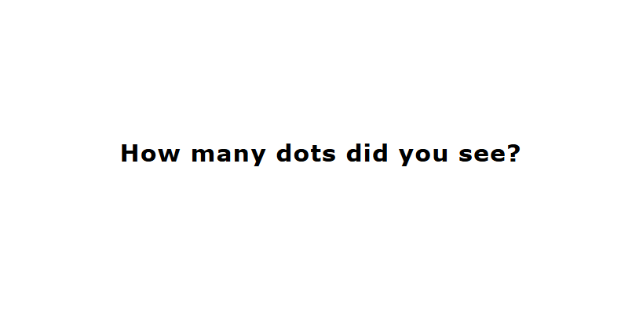
Notes:
TA Directions
TA says, "How many dots did you see?"
Record Student Response

Slide 9
Notes:
TA Directions
TA says, "Dots will appear on the screen."
A 3 second timer will automatically start in Student Portal when the “Next” button is clicked.
Click Next.

Slide 10

Notes:
TA Directions
Show dots for 3 seconds
Once the 3 second timer in Student Portal expires, TA must progress the powerpoint screen to the next slide and record student response.

Slide 11
Notes:
TA Directions
TA says, "How many dots did you see?"
Record Student Response

Slide 12
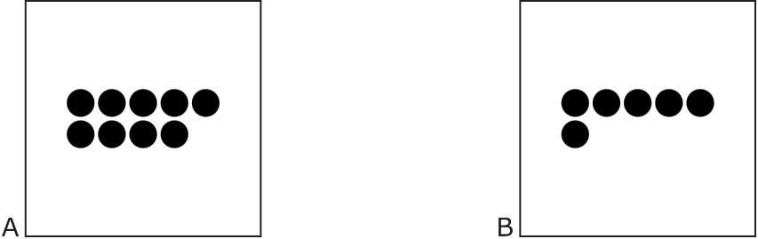
Notes:
TA Directions
TA says, "Which group has more? A or B?"
Record Student Response

Slide 13
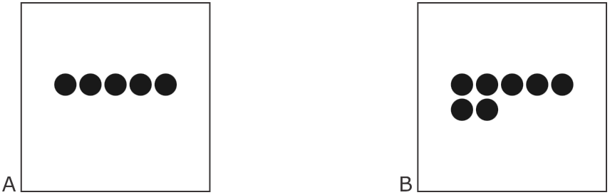
Notes:
TA Directions
TA says, "Which group shows seven? A or B?"
Record Student Response

Slide 14
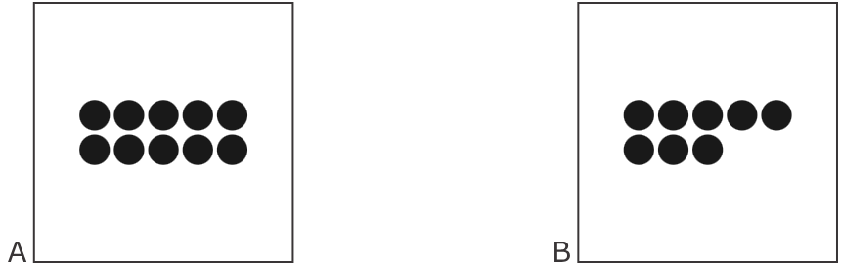
Notes:
TA Directions
TA says, "Which group shows ten? A or B?"
Record Student Response

Slide 15
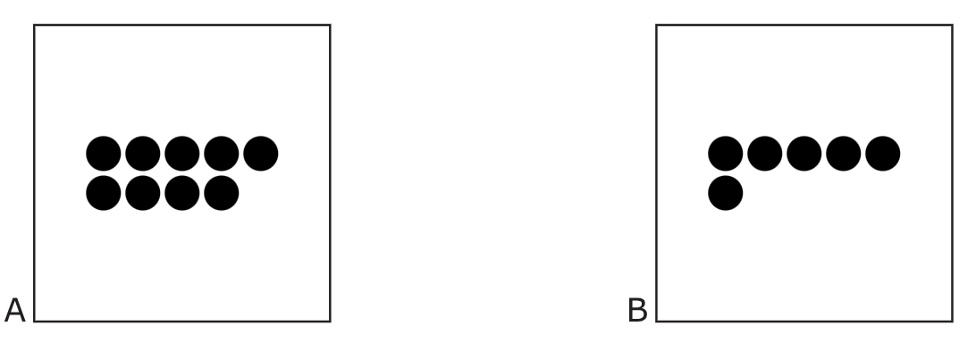
Notes:
TA Directions
TA says, "Which group shows six? A or B?"
Record Student Response

Slide 16
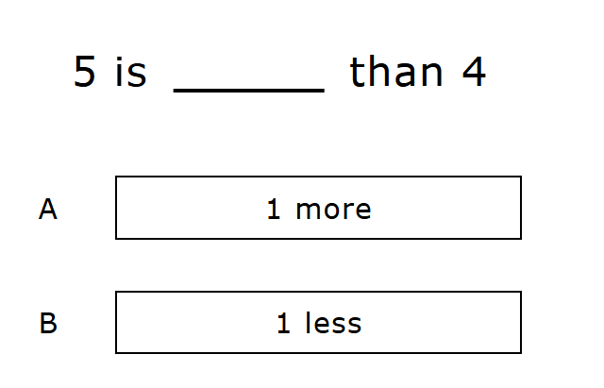
Notes:
TA Directions
TA says, "Five is [one more, one less] than four. Which statement makes the comparison true?"
Record Student Response

Slide 17
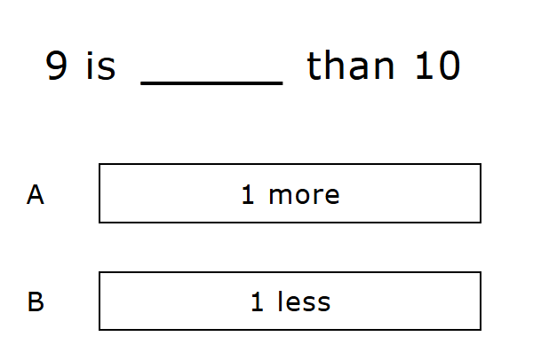
Notes:
TA Directions
TA says, "Nine is [one more, one less] than ten. Which statement makes the comparison true?"
Record Student Response

Slide 18

Notes:
TA Directions
TA says, "Here are three dots. I will hide all three dots."
Click Next.

Slide 19

Notes:
TA Directions
Click Next.

Slide 20

Notes:
TA Directions
TA says, "Here are two more dots. I will hide the two dots with the three dots."
Click Next.

Slide 21

Notes:
TA Directions
TA says, "How many dots are hidden in total?"
Record Student Response

Slide 22

Notes:
TA Directions
TA says, "Here are four dots. I will hide all four dots."
Click Next.

Slide 23
Notes:
TA Directions
TA says, "I will unhide one of the four dots."
Click Next.

Slide 24

Notes:
TA Directions
TA says, "How many dots are still hidden?"
Record Student Response

Slide 25
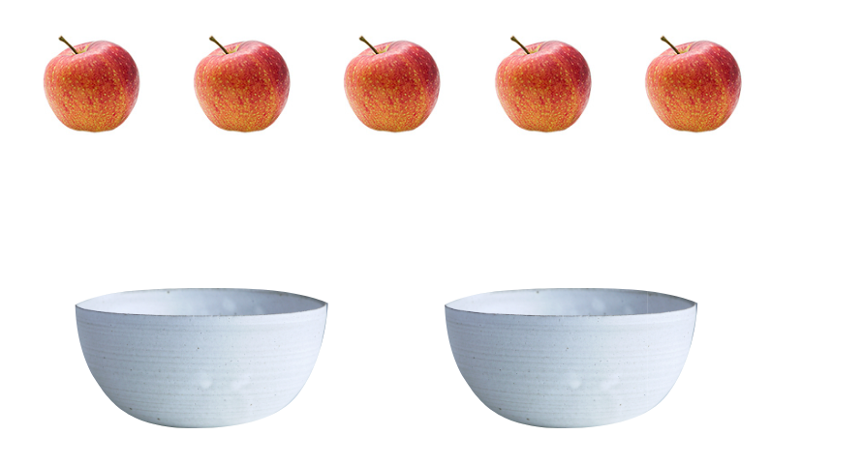
Notes:
TA Directions
TA says, "Amanda has five apples. Using two numbers, what is one way Amanda could put all five apples into the two bowls?"
Record Student Response

Slide 26
Notes:
TA Directions
TA says, "Using two different numbers, what is another way Amanda could put all five apples into the two bowls?"
Record Student Response

Slide 27
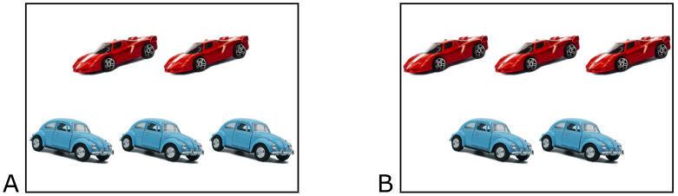
Notes:
TA Directions
TA says, "Ben has three red cars. He finds two blue cars. Which picture matches the story? A or B?"
Record Student Response

Slide 28
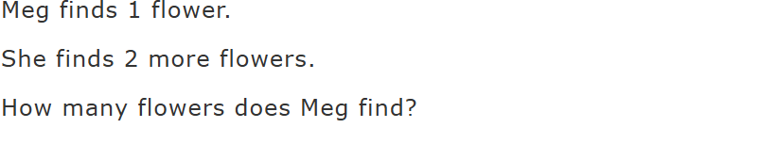
Notes:
TA Directions
TA says, "Meg finds one flower. She finds two more flowers. How many flowers does Meg find?"
Record Student Response

Slide 29
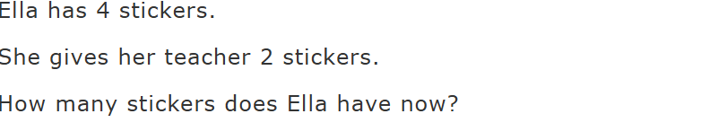
Notes:
TA Directions
TA says, "Ella has four stickers. She gives her teacher two stickers. How many stickers does Ella have now?"
Record Student Response

Slide 30

Notes:
TA Directions
TA says, “Solve the equation.”
Record Student Response

Slide 31

Notes:
TA Directions
TA says, “Solve the equation.”
Record Student Response

