Slide 1
2020-2021 Cohort Graduation Data Certification

Slide 2
Agenda
Part I: Cohort Graduation Policy and Data Certification
Define a Graduation Cohort
Review how students are identified as graduates
Determining Credentials
Identify and Verify Legitimate Leavers
Cohort Graduation Indices Used in SPS
Inclusion of Students in Alternative School Indices
Part II: Louisiana Data Review Online System
Access the system
Request Changes
Use of the dashboard
Preparing For Data Certification Checklist

Slide 3
Part I: Cohort Graduation Policy and Data Certification

Slide 4
Defining a Graduation Cohort
Bulletin 111, Chapter 7 defines a cohort as all students who entered regular 9th grade for the first time in the state of Louisiana in a given academic year. All students must be included in the state cohort unless they transfer out as legitimate leavers. Each cohort of students will be tracked for four years, from entry as first-time regular ninth graders through four academic years (see other rule for students participating in alternate assessment).
Students must graduate no later than August 31st of the fourth year to be counted as an on-time graduate. This date aligns with the Student Transcript System (STS) and LOSFA requirements.

Slide 5
Assigning New Graduation Cohort Members
A graduation cohort changes across the four year timeline. It is adjusted by students who transfer into and out of Louisiana public schools.
Dropouts must be included in the graduation cohort and are assigned to the last school of record. Students are added to cohorts if they have one full day of enrollment. A school that sends a request for records becomes the last school even if the student is never enrolled, unless the student was expelled.
 | 3rd Year | 4th Year
Counts at LEA | Enrolled on October 1 | Enrolled on October 1
Counts at School | Enrolled at any school in LEA on October 1 | Enrolled at school on October 1 and no break of 45+ days
Dropout | Enrolled any time in four year period for at least one full day; counts at last LEA and school of record

Slide 6
Defining a Cohort: Non-Traditional Grade Progression
Louisiana public high school record is not grade 9:
Students who are enrolled in high school for the first time in grade 10 are assigned to the cohort for other 10th grade students (3 years to graduate).
Students in T9 will enter a graduation cohort the year after they are enrolled in T9 and will have four years to graduate regardless of next grade level assignment.
Transfers in:
The high school entry date from other states and nonpublic schools is not used to determine cohort. Grade assignment on the first Louisiana high school public record is an important decision that will affect cohort assignment.

Slide 7
Defining a Cohort: First High School Record
The department uses the first year in a high school grade in Louisiana to determine cohort year assignment. There are some important things to remember about the first record:
A student must be enrolled for one full day to count in cohort. If the first high school record is same day in/same day out, then the student will not be placed in the cohort.
A student who is assigned to a new grade mid-year with the first high school record will be assigned to a different cohort. For example, if the first high school record is grade 9 for the first semester and grade 10 in the second semester, the student will be place in the cohort with other grade 10 students.
For records that are not the first high school record, mid year grade acceleration does not affect cohort membership.

Slide 8
Defining a Graduation Cohort: Timelines
Some students may take more or less than four years to graduate.
Diploma earned in summer:
Students are considered on time graduates if they earn a diploma no later than August 31 of their fourth year in high school.
Diploma earned in 3 years:
Students who graduate in three years will be banked and included with their regular cohort at the end of their fourth year of school.
Diploma earned after more than 4 years:
Students who graduate in five or six years can earn points in the strength of diploma index, but they must be counted as a non-graduate with their cohort in the year they are expected to graduate.

Slide 9
Defining a Graduation Cohort: Students who Participate in Alternate Assessments
Cohort Assignment
Most rules are the same as for other graduates. Per federal and state guidelines, students must take all high school level LEAP Connect assessments to be eligible for this pathway.
Extended Timeline
Counts the year that they exit and do not enroll the following October or
Counts the year that they turn 22, following SIS/EdLink rule
Must remain continuously enrolled to be eligible for extended graduation timeline
May be eligible for 5th or 6th year points if exiting and returning after October 1

Slide 10
Identifying Students as Graduates

Slide 11
Identifying Students as Graduates
SIS/EdLink record
A student must be exited in the Student Information System (SIS) or EdLInk with exit code reason 04 and exit date no later than August 31 of expected graduation year.
STS record
A student must have a graduation date on the official transcript in the Student Transcript System (STS)
Students who are not exited correctly or who do not have a graduation date on the transcript in STS will be listed as non-graduates on the cohort graduation roster.

Slide 12
Assessment Requirement Substitutions
In 2020-2021, assessment requirements were not waived for students taking regular assessments. However, students could meet the requirements through one of the approved substitutions below if they met all other graduation requirements and graduated not later than August 31, 2021.
ACT scores
WorkKeys scores for Jump Start students
20 additional hours of remediation
There are currently no substitutions for graduation and no additional exemptions beyond the out-of-state/nonpublic school transfer and the Covid-19 policies. Both of these exemptions are applied by subject, and application to only one subject in a pair is not sufficient to meet pair requirements in most cases.

Slide 13
Identifying 5th and 6th Year Graduates
In addition to requirements for all graduates, the 5th or 6th year graduates will count in the SPS if:
The student is exiting from the same LEA (school system) in which they were enrolled at the end of the cohort period based on Student Information System (SIS) enrollment.
The student is not exiting from the same LEA (school system) but has been continuously enrolled in the school for 45 or more days based on SIS enrollment.
The points awarded for 5th or 6th year graduation will be included with the cohort that was expected to graduate the same year that the student actually graduated.
The student will not be included in the graduation rate again (counted as non-graduate in their expected graduation year).

Slide 14
Determining Credentials

Slide 15
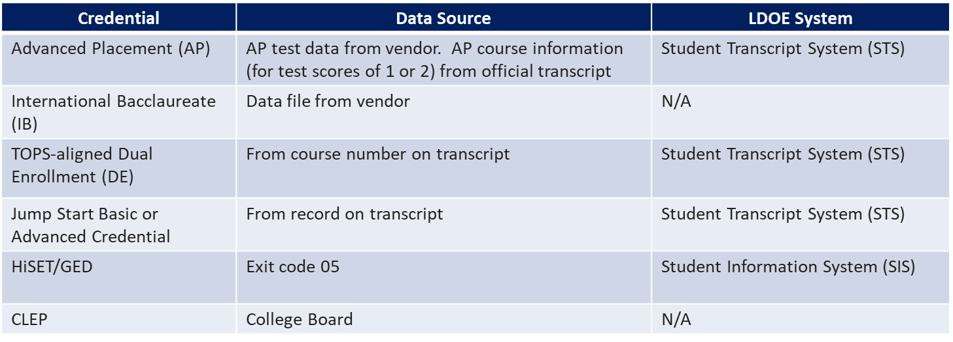
Determining Additional Credentials
The table below provides information on how the LDOE determines when a student is eligible for additional points in the Strength of Diploma Index.

Slide 16
Earning HiSET
Students must earn a HiSET no later than October 1 of the academic year following the student’s last exit. Students do not necessarily have the entire cohort window.
Example:
A student in the 2020-2021 graduation cohort exited on February 18, 2019. The student earned a HiSET on November 3, 2019. This student will not be credited for earning a HiSET because the student only had until October 1, 2019 to complete it.
Students who are not properly exited in SIS/EdLink with 05 will need a copy of the test report that shows when the student earned the HiSET.
Students who earn a HiSET are counted as non-graduates in the graduation rate.
Districts are provided with completer lists in secure ftp site.

Slide 17
Identifying and Verifying Legitimate Leavers

Slide 18
Legitimate Leavers
Per federal and state guidelines, students can be removed from the cohort for five reasons.
Exit Reason | Exit Code | Required Documentation
Student is deceased | 07 | Obituary, death certificate
Student moved out of state and transferred to a diploma-awarding school. | 10 | Requests for records from an out-of-state school that awards diploma or note written and signed by the parent. Cannot use this code for online program operated from another state.
Student transferred to an approved non-public school | 14 | Request for records from an approved nonpublic school or note written and signed by the parent
Student transferred to BESE approved home study | 16 | Quarterly report, approval letter. By state law, only parent may submit the application.
Early college enrollment | 20 | Verification of enrollment

Slide 19
Online Program Diplomas
Diplomas earned by students in an online program are only recognized if the student was approved for BESE-approved home study.
It is not appropriate to use code 10 for students who did not actually move but are participating in an online program that is hosted by another state.

Slide 20
Auditing Legitimate Leavers
Each year, the LDOE audits students who have been exited using one of three legitimate leaver codes.
Out of State and Nonpublic School Transfers
Districts are provided with a list of randomly-selected students who exited to an out-of-state or nonpublic school. The only acceptable documentation includes:
an official request for records from the receiving school or official verification of enrollment from the receiving school or
a note written by the parent and signed by the parent that clearly indicates the reason that the student is transferring
Approved BESE Home Study Transfers
Districts are provided with a complete list of students who exited to BESE-approved home study and do not have an approval on file with the LDOE. The only acceptable documentation includes an approved application submitted by the parent and signed by BESE or the quarterly report sent to school systems.

Slide 21
Cohort Graduation Indices Used in Accountability

Slide 22
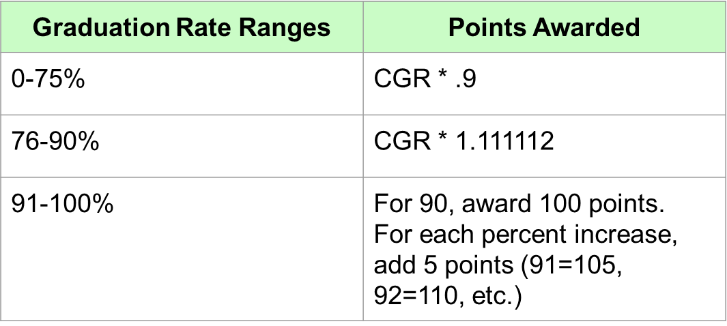
Accountability: Graduation Rate Index
This index uses the school graduation rate for the SPS and subgroup graduation rate for subgroup performance scores.

Slide 23
Accountability: Strength of Diploma Index
The strength of diploma index averages the points awarded to schools for each student in the cohort based on their final exit from high school. The table to the right (also found in Bulletin 111, Chapter 7 and in the SPS calculator) describes all categories and point awards.
Student Result | Points
HS Diploma plus Associate’s Degree | 160
HS Diploma plus (a) AP score of 3 or higher, IB Score of 4 or higher, or CLEP score of 50 or higher OR (b) Advanced statewide Jump Start credential *Students achieving both (a) and (b) will generate 160 points. | 150
HS Diploma plus (a) At least one passing course grade for TOPS core curriculum credit of the following type: AP**, college credit, dual enrollment, or IB** OR (b) Basic statewide Jump Start credential *Students achieving both (a) and (b) will generate 115 points. **Students must take the AP/IB exam and pass the course to earn 110 points. | 110
Four-year graduate (includes Career Diploma student with a regional Jump Start credential) | 100
Five-year graduate with any diploma *Five-year graduates who earn an AP score of 3 or higher, an IB score of 4 or higher, a CLEP score of 50 or higher, or an Advanced statewide Jump Start credential will generate 140 points. Five-year graduates who earn an Associate’s Degree will generate 150 points. | 75
Six-year graduate with any diploma | 50
HiSET plus Jump Start credential | 40
HiSET | 25
Non-graduate without HiSET | 0

Slide 24
Inclusion of Students in Alternative School Credential Attainment Index

Slide 25
Students Included in the Alternative School Credential Attainment Index
The cohort graduation rosters will include some students that are included in the credential attainment index for alternative schools.
The credential attainment index measures the outcomes of students in grade 12 attending alternative schools, using the customary strength of diploma index point table.
Unlike the usual accountability model, the index includes all students beginning the year in grade 12 regardless of 4-year cohort assignment.
Students who graduate directly from grade 11 will also be included.
Students must meet a full academic year rule: enrolled on October 1 and exit from the alternative school by the end of the academic year.
In some cases, students may also be members of the school system’s 4-year graduation cohort. These students will have two records on the roster.

Slide 26
Louisiana Data Review Online System

Slide 27
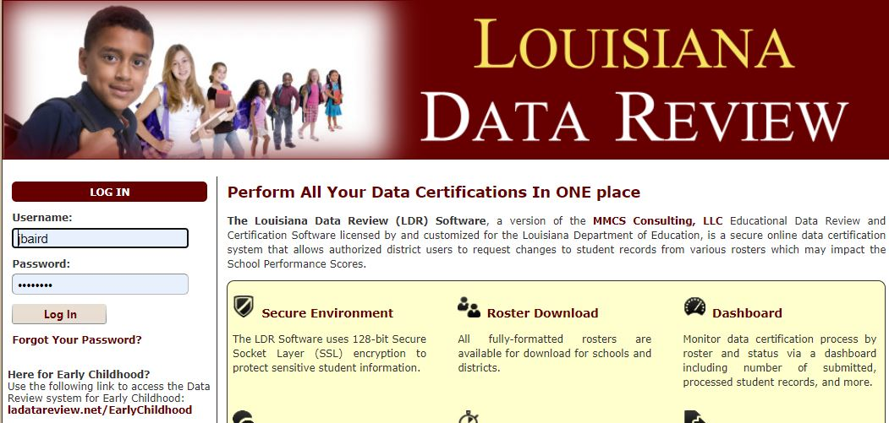
Using LA Data Review to Certify Data
Process: Each year in spring, school systems
receive cohort rosters through a
secure web-based platform known as
Louisiana Data Review.
Access: Individual emails with login information are sent only to accountability contacts and backup contacts of record, along with:
Directions on how to use the system
Guides that provides policy information, documentation requirements, file layout
Deadlines for completion of review and requests for change

Slide 28
Certifying Cohort Graduation Data: Review
When users log in into the system, they will be able to download rosters in Excel format for each school in their LEA. The accountability contact is responsible for providing the rosters to schools and developing their own system for receiving requests for change.
Accountability contacts will need to develop a timeline with school personnel that allows them sufficient time to complete all requests by the deadline.
First Name | Last Name | Birth Date | Gender | Ethnicity | Economically Disadvantaged | LEP | Special Education Code | Homeless | Military Affiliation | Foster | Last Grade Placement | Exit Date | Exit Code | Drop Flag | Grad Flag | End Category Description | Site Flag | LEA Flag
X | XXX | 17 | F | Black (not Hispanic) | Y | 01 | 0 | N | N | N | 12 | 05/24/2019 | 04 | N | Y | Graduate | Y | Y
Y | YYY | 06 | M | Black (not Hispanic) | Y | 01 | 0 | N | N | N | 12 | 05/24/2019 | 04 | N | Y | Graduate | Y | Y

Slide 29
Certifying Cohort Graduation: Requests for Change
For each student on the roster, accountability contacts are provided with important data elements, some of which can be edited by a documented request.
Data Element | What Do the Data Indicate? | How is the data provided?
Student Inclusion | Does this student count in the graduation rate of the school and/or school system? | Student records include an LEA flag to indicate inclusion in school system and a Site flag to indicate inclusion at school.
Graduation Status | Did this student graduate with an AP score of 3, a CLEP score of 50+; Tops Core-aligned DE or a Jump Start credential? | Columns are provided for all student records with flags of Yes to indicate individual credentials earned and points awarded
Enrollment Records | Of which subgroups is the student a member? What was the first and last high school record? | Student records include demographics, dates used to initiate cohort membership and exit dates and types.

Slide 30
Submitting Requests for Changes to Data
In order to submit a request to change data, the accountability contact must ALWAYS take three steps for each student record request:
Change at least one data element field on the Data Certification Fields tab page.
On the Description and Support Documents tab page, do two things:
Include a description of the requested change
Attach documentation
The department will not be able to receive or review any requests that do not include all three steps.

Slide 31
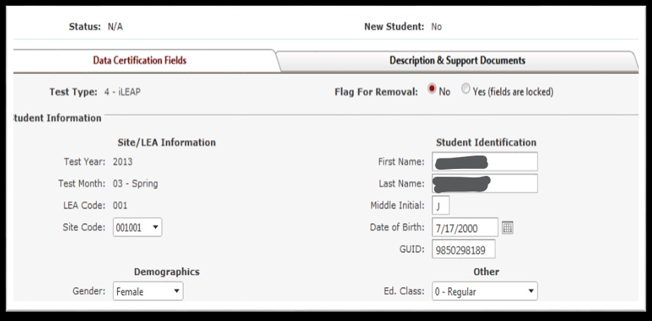
Data Certification Fields Tab
In order for the LDOE to approve and apply a change, the school system must complete ALL of the following steps for each request.
Select a school
Select a student and locate the edit screen
On the first tab of the screen labeled “ Data Certification Fields”
Make at least one change to a data element on the screen
Click SAVE at the bottom of the page.

Slide 32
Description and Support Documents Tab
6. Select the second tab labeled “Description and Support Documents”
Provide a brief description of the request in the text box
Attach documentation that supports the request
SAVE this page as well.

Slide 33
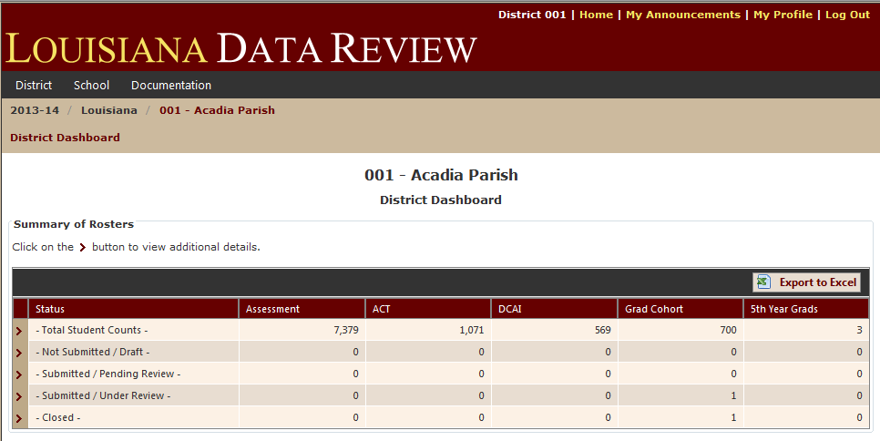
Using the Dashboard to Monitor Requests
The dashboard provides important information that is constantly updated, including:
Number of records that are included on rosters
Number of records that are submitted to the LDOE
Number of submissions that have been reviewed and are complete
Number of submissions that have not been completed
IMPORTANT: LDOE reviewers cannot see or access incomplete submissions

Slide 34
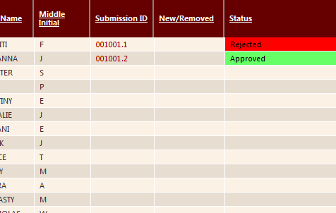
LDOE Decisions for Requested Changes
Users can see when a student’s status has been updated. On the roster in the system, the status will be updated to show when a submission exists under the column labeled Submission ID and when it is reviewed under the column labeled Status.

Slide 35
Submitting Records with Full PII
Louisiana Data Review is considered an audit process, and school systems can send documents with full PII. Full PII is preferred by reviewers since it provides them with additional details that will help with the review.
Please do not send any documents via email for data certification. Department staff are not permitted to accept full PII through email.

Slide 36
Preparing For Data Certification

Slide 37
Cohort Graduation Data Certification Checklist
Notify the LDOE of changes to the official accountability contact for your school system. These are the only individuals who will be assigned log-in permissions.
Ensure that all graduates have graduation dates no later than August 31, 2021 on transcripts in STS.
Ensure that all students have appropriately-named credentials added to the Student Transcript System (STS).
Identify a contact at each school who will be responsible for viewing the roster.
Review policy with school staff who will review the rosters and remind them to be ready to provide documentation for exit code reviews and any other change requests.
Locate quarterly reports or approval letters provided to the school system for students exited to BESE-approved home study/locate parent signatures for opting out of FAFSA.
Retrieve the HiSET/GED completer file posted to the ftp.
Discuss upcoming data certification with your STS data manager who may need to assist with updates in STS before requests can be approved.

Slide 38
Contacts
Jennifer Baird, Deputy Assistant Superintendent
Assessment and Accountability Administration
Jennifer.Baird@la.gov
PHONE: 225.695.6778 or 985.981.6445
Assessment@la.gov
Data and Systems:
SystemSupport@la.gov

