Slide 1
Louisiana Literacy Advisory Commission
October 23, 2023

Slide 2
Agenda
Call to Order
Roll Call
Approval of minutes of the meeting held August 28, 2023
Consideration of an update report regarding Educator Preparation Providers
Consideration of proposed revisions to Bulletin 1566 - Pupil Progression Policies and Procedures in response to Act 422 of the 2023 Regular Legislative Session
Consideration of an update report regarding LLAC Subcommittees
Notes:
DeJunne’
Call to Order
Roll Call
Approve minutes

Slide 3
Call to Order
Roll Call
Approval of minutes from August 28, 2023
Notes:
De’Junne

Slide 4
IV. Consideration of an update report regarding Educator Preparation Providers
Notes:
Em and Dr. Joffrion

Slide 5
Literacy Policy
In alignment with 2021 Legislation, literacy policy updates were approved regarding the Science of Reading competencies. Policy updates included:
Science of Reading competencies included for all literacy coursework
Teacher Preparation Programs must align literacy coursework.
  Beginning with the 2024-2025 school year, program completers are required to have the updated literacy foundations/Science of Reading-aligned coursework.
  Mild/Moderate Special Education areas now require 9 semester hours of literacy coursework.
These updates are applicable to both initial and add-on requirements beginning September 1, 2024.
Notes:
Em
In alignment with 2021 legislation, literacy policy updates were approved regarding the science of reading competencies. Those competencies are required for all literacy coursework. Teacher preparation providers have some time to design and restructure teacher preparation literacy coursework including for add-on requirements. The changes for add-on literacy coursework include the requirement for 9 semester hours of literacy coursework for special education areas are now also effective beginning in the fall of 2024.
Beginning with the 2024-2025 school year, program completers are required to have the updated literacy foundations/science of reading-aligned coursework
For initial preparation, semester or contact hours only may be accepted for the literacy requirements. However, for add-ons, semester hours, contact hours, the adopted TOR exam, or literacy foundations training may be accepted for the number of hours approved per program.

Slide 6
Literacy Coursework Timelines
Beginning September 1, 2024, completers in teacher preparation programs must have the required number of semester hours or contact hour equivalent in the teaching of reading and literacy in alignment with the science of reading competencies as listed for the certifications below:
9 semester hours for Birth-K, PK-3, 1-5
6 semester hours for middle grades 4-8
3 semester hours for secondary 6-12 content areas, all-level K-12 areas
9 semester hours for certification in special education areas (early interventionist, hearing impaired, significant disabilities, visually impaired M/M special education 1-5, M/M special education 4-8, or M/M special education 6-12)
Notes:
Em
In addition to the required Science of Reading training hours, students who enter a teacher education program during the 2024-2025 school year and thereafter must also have the required dyslexia coursework which is a 3 credit hour course that gives an overview of the scientific work regarding dyslexia, including the history, epidemiology, and clinical presentation, including early clinical indicators of dyslexia and common, persistent classroom presentation; as well as an overview of evidence-based instruction for individuals with dyslexia including remediation of weaknesses, fortification of strengths, and common accommodations to help mediate between the two; and finally an introduction to the process of becoming a dyslexia practitioner or dyslexia therapist.

Slide 7
Literacy Competencies Overview
In 2022, LDOE convened a literacy competencies work group that consisted of content experts, elementary and secondary educators, special education experts, school system leaders, and postsecondary education leaders. The work group:
Developed the elementary ELA and Literacy Competencies in partnership with the LDOE.
Ensured the competencies align with certification and licensure requirements.
Notes:
Em
The Louisiana competencies for initial teacher certification define what a teacher candidate must know and be able to do in order to be eligible for certification upon completion of a BESE-approved teacher preparation program. The competencies were developed in collaboration with content experts, elementary and secondary educators, and postsecondary education leaders. Preparation providers and their school system partners co-construct preparation experiences that develop these competencies through quality practice experiences, including a yearlong residency. These competencies were updated after the 2021 legislation to include the Science of Reading which was put in policy in 2022.

Slide 8
Literacy Competencies Overview
In March 2022, BESE approved updated teacher preparation competencies to include the revisions endorsed by the workgroup. The teacher preparation competencies in literacy are required to be implemented across literacy courses. They identify essential knowledge and skills for teacher candidates seeking certification in:
birth to kindergarten,
pre-kindergarten – third grade,
elementary grades 1-5,
elementary grades 1-5 integrated to merged,
English Language Arts grades 4-8,
English Language Arts grades 4-8 integrated to merged,
English Language Arts 6-12, and
English Language Arts grades 6-12 integrated to merged.
Notes:
Em
In March of 2022, BESE approved the updates to the competencies with the revisions from the workgroup. The competencies identify essential knowledge and skills for candidates seeking certification in [READ SLIDE}
Integrated to Merged is an approved blended general/special education mild/moderate program.

Slide 9
Literacy Competencies Overview
Aligned with the statute, the foundational literacy skills embedded in the teacher preparation competencies include:
Systematically addressing and teaching phonological awareness, phonics, fluency, vocabulary, and comprehension;
Differentiating instruction for teaching students with advanced literacy skills and students with significant literacy deficiencies, including dyslexia;
How to implement effective literacy instruction using high-quality instructional materials and administer literacy assessments to students and use the resulting data to improve literacy instruction for students;
Systematically and explicitly address behavior management, trauma-informed principles and practices for the classroom, and other developmentally-appropriate supports to ensure that students can effectively access literacy instruction.
Notes:
Em
The literacy competencies cover content knowledge, which focuses on what teachers should know about foundational literacy skills, and content pedagogy, which focuses on teachers’ ability to develop students in the understanding of complex texts and the demonstration of crafting language through various writing styles using appropriate grade-level conventions, spelling, and structure.

Slide 10
Literacy Competencies Implementation
March 2022 | BESE approved literacy competencies
Summer 2022 | Training on competencies to preparation programs began
June 2023 | ETS conducted standard setting committee on updated assessment to include literacy competencies
June 2023 | Program assurances and approval process reflect literacy competencies
TBD | Updated Praxis assessment available
January 2024 | Updated Praxis assessment required
Notes:
Em
The new multi-subjects exam hasn't gone to BESE yet
stand alone tests and adoption dates- to meet science of reading literacy requirements
5204 (9/1/2011 -7/31/2020
5206 (9/1/2019 - current)
5205 (elementary only) 1/1/2023
Policy does not require the 5205 or multi-subjects exam until approximately 1/1/2025 for in-state completers.
5204, 5206, and 5205 were adopted to meet old literacy requirements (in lieu of semester hours) for alt cert completers in private preparation providers like LRCE, iTeach, etc. for initial preparation. They will not be accepted for literacy requirements in lieu of semester hours for initial preparation after Sept. 2024.

Slide 11
Program Assurances and Approvals
In June 2023, approved Teacher Preparation Providers signed assurances that included the training of teacher candidates in the science of reading. In August 2023, BESE received signed assurances from all 31 preparation providers including the literacy competencies’ assurance below.
Act 438, of the 2021 Regular Legislative Session, requires coursework specific to the teaching of reading and literacy. Beginning September 1, 2024, program completers will have the required hours of instruction in the science of reading.
Beginning in October 2023, all newly approved Teacher Preparation Providers will sign these assurances as part of the program approval process.
Notes:
Em
In order to ensure that all teacher candidates are appropriately trained in the science of reading, assurances were submitted to BESE in August 2023. The assurances guarantee that beginning September 1, 2024, all completers will have the required hours of instruction in the science of reading. Additionally, all newly approved teacher preparation providers sign these assurances as part of the program approval process.

Slide 12
ELA Collaborative Overview and Outcomes
The ELA Collaborative brought together the best minds from both higher education and K-12 to design teaching methods syllabi for elementary and secondary literacy courses that, in turn, is available for public use. This collaborative was led by the National Center for Teacher Residencies in partnership with Teaching Lab during the 2020-2021 school year.
The Model Methods Course Outline, created by the collaborative, is intended to provide teacher preparation programs with appropriate guidance to ensure that teacher candidates completing their program are well prepared to engage elementary students in standards-aligned English language arts instruction using high-quality curriculum materials based on the Science of Reading.
Notes:
Em
In order to support teacher preparation providers in the implementation of literacy competencies, during the 2020-2021 school year, the ELA Collaborative, led by the National Center for Teacher Residencies in partnership with Teaching Lab, brought together experts from both higher education and K-12 to design teaching methods syllabi for elementary and secondary literacy courses. The product of that collaboration is the Model Methods Course Outline offers guidance to ensure that teacher candidates are prepared to engage students in standards-aligned English language arts instruction using high-quality instructional materials based on the Science of Reading.

Slide 13
Training Provider to Preparation Program Faculty
All preparation provider faculty were offered Act 108 training at no cost, the same training K-3 teachers and leaders are required to take. 57 participants across 23 preparation providers attended training from one of the approved providers below.
LETRS
AIMS Pathways
Keys to Literacy
A+PEL
Notes:
Em

Slide 14
Literacy Exam Update
In 2022, the State Legislature passed Act No. 448, which requires Kindergarten through third-grade teachers seeking initial licensure to pass an examination of the teaching of reading that is scientifically researched and evidence-based. Louisiana has adopted the Praxis® Teaching of Reading Assessment to fulfill this requirement.
Louisiana is working with Educational Testing Services (ETS) to incorporate the teaching of reading assessment into the Elementary Education: Multiples Subjects Praxis® exam. This assessment will replace the existing Reading Language Arts exam, which will be a part of the Louisiana Elementary Education: Multiple Subjects Praxis® exam.
A new bundle will be available for use in the Spring of 2024, allowing for a four test option, instead of a five test option.
Notes:
Beginning January 1, 2024, per R.S. 17:7.1 (Act 448), any applicant applying for initial certification to teach Kindergarten through Third grade shall pass a rigorous test of scientifically researched, evidence-based reading instruction and intervention, including data-based decision-making principles related to reading instruction and intervention, as approved by the Department of Education.
The adopted exam currently is the 5205 Teaching Reading: Elementary exam, with a passing score of 159. The LDOE is also working with ETS to make available an elementary multiple subjects exam that includes the teaching of reading portion as part of the ELA subtest so educators will not have to take an additional exam. The exam will be available as a bundle of the multiple exams or as the individual subtests.
For any educator that has already completed the Elementary Subjects multiple subject exam, the stand-alone Teaching of Reading exam will be available. We will provide more updates as we get them.

Slide 15
Continued: Literacy Exam Update
Policy has been updated to include the following statement: Beginning January 1, 2024, as required per R.S. 17:7.1(A)(1), an applicant applying for initial certification to teach kindergarten through third grade shall pass the BESE-approved Teaching of Reading: Elementary or Teaching of Reading: Elementary Subtest exam in accordance with §303 of this part. Candidates already enrolled in the year-long residency and holding either the PL or R prior to January 1, 2025 are not subject to this provision.
Clarification:
K-12 certification candidates do not need to take the exam.
All special education certification candidates must take the exam.
Notes:
Essentially, if an educator is required to take the 9 hours, then the TOR exam is required. If the educator is not required to have the 9 hours, then the TOR is not required. Further updates to policy will be provided in the coming months, likely when we bring add-on policy.

Slide 16
V. Consideration of proposed revisions to Bulletin 1566 - Pupil Progression Policies and Procedures in response to Act 422 of the 2023 Regular Legislative Session
Notes:
Shanna and Ashley T.

Slide 17
Act 422
Prohibits promotion to the fourth grade of certain students whose reading deficiencies have not been remediated by the end of the third grade.
literacy screening
individual reading plan
exceptions for good cause
required instructional services to retained students

Slide 18
VI. Consideration of an update on LLAC Subcommittees
Notes:
Shanna

Slide 19
LLAC Subcommittees
Adolescent Literacy Subcommittee
Data Subcommittee
Dyslexia Subcommittee
Early Childhood Subcommittee
Funding Subcommittee

Slide 20
Adolescent Literacy Subcommittee
Current initiatives in Louisiana around adolescent literacy
  MS/HS Literacy PD Series
  Content Literacy Series
  LIFT Library
  Grades 3-12 Literacy PD Series
Initiatives that are launching
  syllable types added to LIFT
  multisyllabic word reading
  small group/intervention guidance

Slide 21
Next Steps for Adolescent Literacy Subcommittee
The subcommittee recommended exploring:
technology as an aid for students who need read-alouds
subcommittee members voiced a desire to dive into LIFT to determine next steps
training and alignment of intervention programs across the state and within districts
alignment guidance between programs in a district

Slide 22
Data Subcommittee
The data subcommittee discussed the following:
Determining a way to compare end-of-year screener data from last year to beginning-of-year data from this year;
  Which measures can be compared?
  Is there a way to compare data from different screeners?
Bringing LEAP data into the conversation;
Comparing curriculum use (both Tier 1 curriculum and Intervention curriculum);
Notes:
DeJunne’

Slide 23
Data Subcommittee
The data subcommittee requested the following:
Number of teachers who have received ancillary certification as dyslexia therapists/practitioners and how many dyslexia therapists are hired across the state
Number of districts and schools that have successfully submitted their literacy plans
Number of teachers and leaders by LEA that have completed their Act 108 training
Analysis of literacy proficiency rates at schools with literacy coaches compared to those without.
Notes:
DeJunne’

Slide 24
Dyslexia Subcommittee
Current initiatives in Louisiana around Dyslexia:
Act 266 (2023) Dyslexia screening, educator prep programs dyslexia content requirements, school level training, and dyslexia ancillary certifications.
Two cohorts of 25 dyslexia practitioners will be trained by the Dyslexia Resource Center.
Building out LDOE Dyslexia Guide to update A Guide to Dyslexia in Louisiana (July 2021).
RFI for dyslexia screener for kindergarten.
Notes:
Andromeda Cartwright-member

Slide 25
Dyslexia Subcommittee
The subcommittee recommended exploring:
  Parent guide on how to navigate dyslexia
  Future dyslexia trainings to build out:
      Schools and their staff members
      SBLC & Pupil Appraisal
      Parents
  Placement support for Dyslexia Therapists
The subcommittee requested the following information:
  Evidence aligned interventions and IMR process-update from ELC recommendation

Slide 26
Early Childhood Subcommittee
The subcommittee discussed the current priorities:
  Provide effective classroom interactions and instruction connected to content and routines.
  Use high-quality resources, including curriculum materials and assessment tools, to strengthen children’s development and learning.
  Utilize high-quality assessments to measure children’s progress, support each child’s learning, and plan ongoing instruction and activities based on children’s needs and interests.

Slide 27
Early Childhood Subcommittee
Current initiatives in Louisiana around Early Childhood:
  Actively developing initiatives to provide comprehensive curriculum and instructional support for early childhood providers.
  Providing guidance to providers on selecting high-quality materials to enhance early childhood education.
  Building a robust professional development program aligning with early childhood teacher competencies.
  Developing a crosswalk to align Kindergarten entry assessment measures with other early childhood assessment measures.
  Refining the assessment process to improve the accuracy of readiness predictions, in order to benefit the early childhood education system.

Slide 28
Early Childhood Subcommittee
The subcommittee recommended exploring:
Create specialized workgroups to assess and define the essential competencies required for early childhood educators.
Gather pre-kindergarten participation/attendance data to inform kindergarten readiness assessments, facilitating a better understanding of students' early educational backgrounds.
Design and offer professional development opportunities focusing on foundational literacy instruction for early childhood teachers.

Slide 29
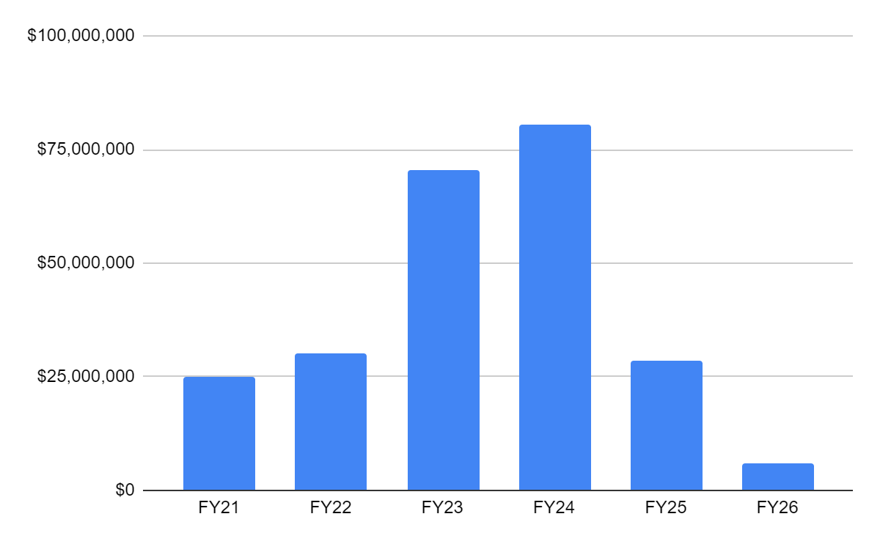
Funding Subcommittee
Notes:
Michael Faulk-member

Slide 30
LLAC Report
Due to BESE and Education Committees in January 2024
What to include in first report

Slide 31
Future Meeting Dates
November 28, 2023 at 12:30 PM
December 19, 2023 at 10:00 AM
  Endorse LLAC Report

