Slide 1

Assessment and Accountability Monthly Call

Slide 2
Agenda
Month-by-Month Checklist
2016-2017 Accountability
2016-2017 Assessment Administration
2017-2018 Assessment Updates
Support and Communication

Slide 3
2017-2018 Month-by-Month Checklist
The 2017–2018 Assessment and Accountability Month-by-Month Checklist
  identifies key dates and deadlines for statewide assessment programs and accountability processes for next school year;
  provides action steps to ensure readiness for administering statewide assessments; and
  recommends resources for district and school staff.
The checklist includes information on the following areas:
  Communication and Support
  Accessibility and Accommodations
  Assessment Preparation and Administration
  Accountability
  Reports
The 2017-2018 Assessment Month-by-Month Checklist is located in the Assessment Library.

Slide 4
April Assessment and Accountability Checklist
Communication and Support
Apr: Assessment and Accountability Office Hours—Tuesdays at 1:00 p.m.
Apr 12: Data Coordinator Monthly Webinar at 1:00 pm
Apr 11: School System Monthly Planning Call
Apr 17: DTC Monthly Call
Accountability and Assessment Preparation
Apr: Assist as needed all appropriate staff, STCs and school leaders with amendments to
IEPs, IAPs, PNPs that must be final 30 days prior to LEAP 2025 testing; assignment of
appropriate accommodations to students during testing
Apr: Submit makeup orders for standard time ACT test materials
Apr: Access Test Administrator Upload System in eDIRECT for LEAP 2025 high school tests
Late Mar–Mid Apr: Order additional test materials in eDIRECT for spring testing
Early–Mid Apr: LEAP 2025 paper materials delivered to LEAs

Slide 5
April Assessment and Accountability Checklist
Accountability and Assessment Preparation
Mid-Apr: Final deadline for schools to order AP exams
Apr: Order additional test materials in eDIRECT for LEAP 2025
Apr: LEAP 2025 PBT materials delivered to districts
Apr: Final ACT national test date for grade 12 students to earn highest score included the High School SPS ACT index
Apr 7: Extension Deadline for AP exam ordering
Apr 6: Order additional ACT standard time materials for makeup testing (only for students retesting due to administrative error from the initial testing date)
April 13: WorkKeys online testing window closes for all students
Apr 14: Final Deadline for AP exam ordering
Apr 18: Deadline to order ACT accommodations materials for makeup testing by calling ACT

Slide 6
April Assessment and Accountability Checklist
April 24: Deadline to add students and update student information in PAnext for ACT makeup testing
April 16-20: Receive ACT test materials for makeup testing
April 23: Deadline to conduct sessions for examinees to complete non-test information on the answer documents for paper testing
April 24: Administer the makeup ACT on paper with standard time
April 24-30: Administer the makeup ACT on paper with accommodations and/or supports (only students retesting due to an administrative error during the initial testing date)
April 26: Pre-scheduled FedEx pickup of standard time makeup ACT materials (answer documents received after May 4th will not be scored)
May 2: Pre-scheduled FedEx pickup of accommodations makeup ACT materials (answer documents received after May 10th will not be scored)

Slide 7
April Assessment and Accountability Checklist
Assessment Administration and Reporting
Apr 2-May 31: ICILS and TIMSS testing for selected schools
Once materials arrive-April 4: Conduct sessions for examinees to complete non-test
information for the ACT taken online or provide the information to examinees to
complete on their own
Apr 4–May 4: Administer grades 3-8 computer-based LEAP 2025 assessments
Apr 13: WorkKeys online test administration window closes
Apr 24-30: ACT Paper Accommodated Makeup Window
Apr 23–May 18: Administer high school LEAP 2025 Spring 2017 test
Apr 24: ACT Paper Makeup Test

Slide 8
May Assessment and Accountability Checklist
Communication and Support
May 3: Data Coordinator Monthly Webinar
May 9: School System Monthly Planning Call
May 15: Monthly Assessment and Accountability Call
May 30-June 1: Teacher Leader Summit
Accountability and Assessment Preparation
May: ELPT and LEAP Connect School Rosters, Student Reports, and CSV files available
May 5: Contact courier agency. Scheduled pickup of ACT secure and non-secure make up
materials from LEA/district office
May 11: Last day for College Level Examination Program (CLEP) test scores included in SPS
for graduation cohort members

Slide 9
May Assessment and Accountability Checklist
Assessment Administration and Reporting
Apr 2-May 31: ICILS and TIMSS testing for selected schools
Apr 9–May 4: Administer grades 3–8 LEAP 2025 computer-based testing
Apr 23–May 18: Administer high school LEAP 2025 Spring 2018 tests
Apr 30–May 4: Administer grades 3–4 LEAP 2025 paper-based tests
May 1–12: Administer Advanced Placement (AP) test
May 9: Report all LEAP 2025 3-8 test irregularities to assessment@la.gov
May 23: Report all LEAP 2025 high school test irregularities to assessment@la.gov

Slide 10

Accountability

Slide 11
Third Year Assessment Cohort Files
ESSA law requires that all students take an ELA and mathematics test at least one time in high school grades. In Louisiana, policy requires that all students must have taken English II and Algebra I or LAA I ELA and mathematics even if they are never enrolled in the courses.
The LDOE posted a roster of students who have not taken an ELA and/or math high school assessment by their third year of high school (students must have taken both) in district ftps. The file name is 2017-18_EOC_Third_Year_Assessment_Cohort. Also posted to the ftp is a third year assessment cohort FAQ that explains the roster.
Students have been pre-loaded in eDIRECT and must either be tested or assigned an appropriate accountability code. Students not tested and not coded will be assigned a zero for each subject in the assessment and progress indices used to calculate school performance scores.

Slide 12
Third Year Assessment Cohort Codes
A student who takes the English III or Geometry test in spring will not need to participate in English II and/or Algebra if they are not enrolled in the English II and/or Algebra I course.
The following codes may be used to excuse a student from testing as part of the third year assessment cohort:
01-44, 97: The student is no longer enrolled in the school at the time of testing
80: The student has a doctor’s letter indicating illness for the entire testing window
94: The student participated in ELA and math LAA I testing
96: The student earned a credit for English II and/or Algebra I from an out of state or nonpublic school as evidenced by the official transcript in STS
Please note that code 99 cannot be used to excuse third year assessment cohort students.

Slide 13
2017-2018 Assessment Administration

Slide 14
Technology Readiness

Slide 15
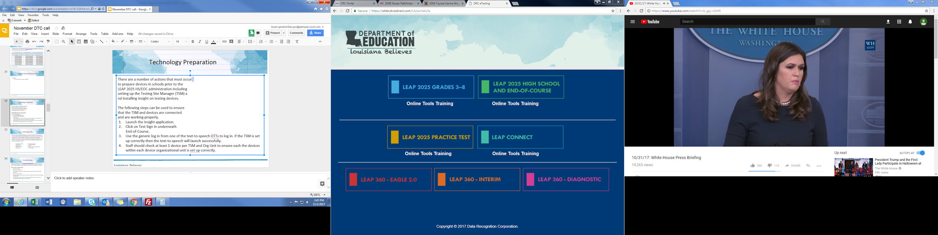
Technology Preparation
There are a number of actions that must occur
to prepare devices in schools prior to the
testing administration including setting up the
Testing Site Manager (TSM) and installing INSIGHT
on testing devices.
The following steps can be used to ensure that the
TSM and devices are connected and are working
properly.
Launch the Insight application.
Click on Test Sign In.
Use the generic log in from one of the text-to-speech OTTs to log in. If the TSM is set up correctly then the text-to-speech will launch successfully.
Staff should check at least 1 device per TSM and Org Unit to ensure each the devices within each device organizational unit is set up correctly.

Slide 16
System Readiness Check
Before testing begins each day, students should run the system readiness check by following the steps below:
Open DRC INSIGHT.
Select the purple check mark in the bottom left corner.
Type 7745.
If the screen does not show all green check marks, alert your STC or technology coordinator.

Slide 17
Reminder: Windows 10 Devices
If students will be testing on Windows 10 devices, please ensure those devices have had access turned off to the Cortana search feature or the Internet search within Cortana disabled. This can be accomplished manually, using group policy, or using the registry editor.

Slide 18
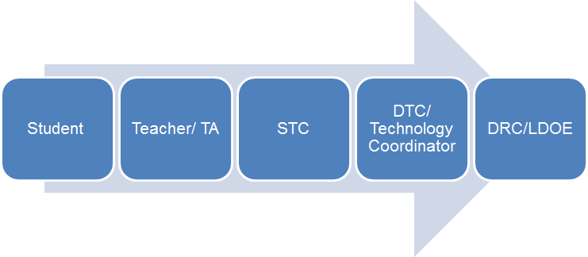
Technical Assistance
If technical problems occur during testing, school and district staff should follow the LEAP 2025 reporting protocol presented below. Technical problems include, but are not limited to, problems connecting INSIGHT, the inability to load test items, or missing buttons.
DRC Louisiana Customer Service LDOE
1-888-718-4836 1-844-268-7320 LAHelpdesk@datarecognitioncorp.com assessment@la.gov

Slide 19
Online Scheduling Guidance
The Online Scheduling Guidance in available in the Assessment Library. The guidance allows schools and districts to view best practices for reducing testing time. Districts can decide how long they want their computer-based testing window to be based on the following:
Number of devices
Internet speeds
Number of sessions given in a day
The following guidelines for online administration still apply:
No more than 3 sessions in a day
Extended response sessions should not be given on the same day
Sessions within a content area must be given in order

Slide 20
Technology FAQ
District Test and Technology Coordinators can access the Statewide Assessments FAQ about Technology document. The information contained in this document should be used to guide District Technology and Test Coordinators as they prepare for Spring assessments. It is suggested to review the eDIRECT Technology User Guide before reviewing this document. The questions represent questions District Technology Coordinators frequently have after reviewing the Technology User Guides. The Frequently Asked Questions are sorted into the following sections:
Testing Site Manager
Insight Client
Netbook Devices
Android Devices
iPad Devices
Chromebook Devices
nComputing Devices
eDirect
Load Simulation and Ping Trends
Error Messages

Slide 21
Troubleshooting
Districts and schools can use the Technical Troubleshooting Tips if technical issues occur during testing. This document is for school sites to use in order to eliminate common errors prior to contacting DRC for technical support.
If you run into a system message…
Reboot the machine
Does the error still occur?
Can you move the student to another computer within the same lab or mobile laptop cart?
Does the error still occur?
Mark the affected computer with a sticky note and notify your Information Technology (IT) department.
If IT staff cannot resolve the issue, have them call DRC Customer Service with the reporting information on page 3 of the document.

Slide 22
Training Accounts
Each LEA has a Sample School (777) in eDIRECT to use for training purposes only.
The training school will only be placed in the Practice Test 2018 Administration.
Ten sample students have been added to each 777 site and should be used to practice creating test sessions.

Slide 23
Testing Homebound Students
Policy requires that homebound students participate in state testing unless it is determined by a doctor in writing that they are too ill to test. The doctor’s letter must include all dates of testing, including makeup days.
Secure materials must be checked in and out daily by homebound test administrators. When possible the test administrator should be the regular homebound teacher. Tests should be administered in accordance with all rules for test administration and security. Any accommodations should be documented on an the IEP.
The four options for testing homebound students are:
Install both the TSM and Insight client on a single laptop to be transported to the testing location
Install Virtual Private Network (VPN) software and the client software on a laptop to be transported to the testing location
Utilize the district’s virtual desktop infrastructure (VDI) to set up and deliver a web-based login to access the district’s internal TSM and client software
Purchase a hosted VDI as a service solution to deliver TSM and client software access

Slide 24
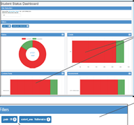
Student Status Dashboard
  The Student Status Dashboard allows you to display student testing status by school and administration. You can filter information on the Dashboard by testing status, grade, content area and assessment (or any combination of these). The Student Status Dashboard User Guide is located in eDIRECT.
  Note: Dashboard data displays in real time as test scores are populated in the database.
  You need the student status permission in eDIRECT to use the Dashboard.

Slide 25
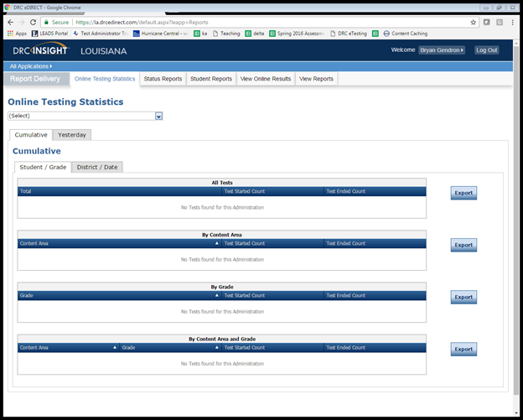
Testing Statistics Reports
eDIRECT has a number of reports to help District Test Coordinators assess the status of their schools during testing. These reports are located in the Online Testing Statistics tab. These reports include:
Online Testing Statistics
Shows the number of students
by school and subject that have
completed testing for the current
and previous day only.

Slide 26
Testing Statistics Reports
Below are other reports that are located under the Status Reports tab.
Daily Cumulative Student Status Reports
Displays all students in a test session and the ticket status of those students
Daily Student Status Report
Displays the start and submit times of each student that logs into a test
Daily School Resets Report
Displays all unlocked test sessions
Excessive Login Report
Shows the number of times a student logged in
Daily State Summary of Test Times Report
Displays the duration in which students completed the test
Daily District Report of Testing Status by School
Displays the number of tests started and ended for the district and school

Slide 27
Online Tools Training
The Online Tools Training (OTT) should be utilized in order to become familiar with the online testing tools (e.g., highlighter, magnification, etc.) used for the operational test. Additionally the OTT:
may be reviewed as many times as desired;
is not to be considered representative of an actual test; and
is available once Insight is installed or by link using Google Chrome browser.

Slide 28
Test Security

Slide 29
Investigations
According to Bulletin 118, the District Test Coordinator (DTC) is responsible for initiating the investigation of any severe irregularity in the district including, but not limited to, those resulting in the voiding of a student’s test score or lost secure materials. The investigation report template represents the minimum that the LEA must report to the LDOE regarding voided tests. LDOE reserves the right to conduct any additional investigations it deems necessary.
Investigations are due to assessment@la.gov 30 days after notification to the LEA.

Slide 30
Test Security
Student tests should be voided if there is an instance of cheating—whether by a student or by anyone else. In the case of student cheating:
The Test Administrator should give the School Test Coordinator a written account of the incident, with any available additional documentation, including the lithocode number of the answer document or consumable test booklet and the domain to be voided.
The School Test Coordinator should convene a school-level test security committee consisting at a minimum of the principal, the School Test Coordinator, and the test administrator to determine whether a test should be voided. The STC will complete the Void Notification form and notify the District Test Coordinator of any voided test.
The District Test Coordinator should complete and email the Void Verification form to LDOE at assessment@la.gov.

Slide 31
Caveon Test Security Services
In order to help districts and schools improve test security, the LDOE has negotiated an agreement with Caveon, the nation’s leading test security experts, to provide the following services:
Monitoring
Provides two Caveon monitors on campus on one day of testing
Provides districts with accurate information of every testing room at the school
Investigations
Provides districts with professional investigators to investigate and report on any testing irregularity that occurred in the district.
Training
Provides districts with active online training modules created by Caveon
A full explanation of the services and the fee schedules can be found here. Districts and schools can purchase these services by contacting Caveon directly.

Slide 32
K-3 Assessments

Slide 33
KEA and K-3 Literacy Assessments
2018-2019
The 2018-2019 Guidance on the Kindergarten Entry Assessment and K-3 Literacy Screening Assessment can be found here.
Each fall, public schools must administer a kindergarten-readiness screener and a K-3 Literacy screener within the first 30 days of school.
  A KEA must be given to all first-time kindergarten students. Two KEA assessment options are approved: DRDP and TS Gold.
  A K-3 Literacy screener must be administered to all kindergarten, 1st, 2nd, and 3rd grade students. Three assessment options are approved: DIBELS Next, STEEP, and STEP.
School systems will submit KEA and K-3 Literacy data with the SIS October 1 MFP Collection.
In order to provide better support and training to teachers, the Department is asking school systems to communicate their assessment choices by completing this short survey here by April 27.

Slide 34
KEA and K-3 Literacy Assessments
2018-2019
Grade Band | Available Assessments | Key Skills Measured | Resources | Testing Window | Reporting
K-Readiness (First-time Kindergarten children) | DRDP Gold | Language/Literacy Math Social-Emotional Approaches to Learning Physical | KEA FAQs | First 30 days of school | Submit with SIS October 1 MFP Collection
K-3 Literacy Screening (All children) | DIBELS Next STEEP STEP | Social-Emotional First Sound Fluency (K) Work Fluency (1st)* Oral Reading Fluency (2nd) Comprehension (3rd**) *Nonsense Words for DIBELS and STEEP **DIBELS Daze for 3rd grade | Guidelines for Students with Special Needs Score Guidelines

Slide 35
LEAP 2025

Slide 36
Communicating 2018 Assessment Results
Below is the timeline for the release of the 2017-2018 school- and school system-level assessment results. School systems should develop a plan for communicating these results to principals, teachers, and families.
Assessment | Student Report Timeline and Location | District-Level Results Time and Location
ELPT | May in AIR Portal | May in AIR Portal
LAA 1/LEAP Connect | May in eDIRECT | May in eDIRECT
LEAP Online Cleanup | not applicable | June in eDIRECT
LEAP 2025 (3-8, HS) | Grade 3-8: June in eDIRECT HS: 5-level ELA and math at end of testing window | June in eDIRECT
EOC (Eng III, Bio, US History) Final Reports | HS 4-level all subjects: In window | summer in eDIRECT
ACT | spring, state administered student and school results from ACT sent to schools | summer iCD and district profile from ACT in summer; additional reporting in FTP
Advanced Placement | summer, sent to schools | early fall in FTP
LEAP 2025 US History | early fall in eDIRECT | early fall in eDIRECT

Slide 37
Testing Home Study Students
State law requires that home study students be provided access to state tests. Districts must offer testing to home study students for LEAP 2025 or EOC testing when it is requested. Districts can charge up to $35.00 for testing; however, if the student enrolls in the district in the fall, the testing fee should be returned to the family.
Districts can set up an application process with a deadline in order to meet any special requirements such as accommodations and to plan for needed materials and technology.
Districts determine where students are tested and when they are tested (within approved window).
When adding home study students in eDIRECT districts/schools should use 998 sitecode.
The LASID for home study students is the SSN with a leading “0”.
Test reports will be returned with other student reports in eDIRECT and should be provided to parents using the district’s policy for distribution (i.e. mail, direct pickup).
Since these students are not enrolled in the district or a school, the scores for students enrolled in a home study program will not count in the SPS or DPS.
If students are uploaded incorrectly using a school site code, their scores will be included in assessment reporting.
The FAQ about Testing Home Study and Nonpublic School Students is available in the Assessment Library.

Slide 38
Testing Students from Nonpublic Schools
State law does not require testing of students in nonpublic schools. The FAQ about Testing Home Study and Nonpublic School Students and Participation Form for Nonpublic School Students are available in the Assessment Library. Some highlights from those documents include:
Nonpublic school students who have a scholarship or TDR should test at their scholarship or TDR school.
Other nonpublic school students can be tested if the district is willing to pay DRC directly for testing them. The cost per student is $50.00.
The district can determine how and where the students are tested.
The tests must be given in accordance with all guidelines for test administration and test security.
DRC will provide a nonpublic/nonscholarship participation form that will need to be completed by the district, providing the names of students being tested.
These students should be tested under the 997 site code.
The LASID for non-public, non-scholarship students is the SSN with a leading “0”.
Reports will be returned with all other student reports in eDIRECT. If students are incorrectly loaded under a school sitecode, then the scores will be included in the school’s assessment reporting.

Slide 39
Testing Reminders
LEAP 2025
Scholarship students will take all four tests: ELA, Math, Social Studies, and Science. Tuition Donation Rebate students will take only Math and ELA. The FAQ for Testing Home Study and Nonpublic Students and Participation Form for Nonpublic School Students 2017-2018 are posted in the Assessment Library. The participation form was submitted by the LEA last week to DRC.
Nonpublic, non-scholarship students and TDR students must be tested under the 997 site code. TDR students will be automatically uploaded to eDIRECT with the student’s LASID. Students that are not pre-identified must be manually uploaded to eDIRECT. Nonpublic, non-scholarship students must be loaded to eDIRECT by the School Test Coordinator using the student’s SSN with a leading “0”.

Slide 40
Assessment Development Educator Review Committees
Assessment Development Educator Review Committees
convene from May through September
selected educators review potential assessment items or provide recommendations for scoring tasks
Interest survey links, specific information about the different committees, and contact information for the assessment coordinators can be found at Assessment Development Educator Review Committees in the Assessment Guidance library. The Assessment Development Educator Review Committees webinar recording is located in the Assessment Guidance library.
Vendor provides: lodging, breakfast, lunch, and stipend Vendor reimburses: mileage and substitutes
The following interest surveys will close soon.
Closing April 20: Closing May 4:
Item Content and Bias Reviews: All math Data Review: All math, all ELA, and Biology
Rangefinding: social studies 6-8, math 3-8, science 3-8 U.S. History Standard Setting

Slide 41
LEAP 2025 Grade 3-8

Slide 42
LEAP 2025 Grades 3-8: Key Dates
Action | Key Dates
Manuals posted in eDIRECT | February 2
Manuals Delivered | March 9
Printed accommodation materials for CBT delivered to districts | March 9
Test Setup Opens (TA numbers assigned to CBT and PBT) | March 19
Computer-based Testing Window | April 9 - May 4
PBT materials delivery | April 16
Additional Materials Window opens | March 10 - CBT April 17 - PBT
Last day to order additional materials prior to the paper testing window, including large print, braille, and communication assistance scripts | April 24
Deadline to invalidate test in eDIRECT/communicate testing irregularities to assessment@la.gov | May 9

Slide 43
LEAP Key Dates
Action | Key Dates
Paper-based testing window (see manual for daily schedule) | April 30 - May 4
Makeup Testing | May 7 – 8
Materials pickup 1 (scorables) | May 8
Test Invalidations and Void Forms due to LDOE | May 9
Materials pickup 2 (scorables and nonscorables) | May 10
Materials pickup 3 (administration materials) | May 12 – 19

Slide 44
LEAP 2025 High School

Slide 45
Spring High School Administration Key Dates
eDIRECT Manage Users available | March 14
eDIRECT Test Setup available with preidentified students | March 26 - May 18
Assign and Enter TA numbers | March 26 - May 18
Materials delivered to School System | April 10
Window for ordering additional materials | April 11 - May 17
End-of-Course/LEAP 2025 HS testing window | April 23 - May 18
Test Ticket invalidations must be completed; Void Notification and Verification forms due to the Louisiana Department of Education | May 21
All secure accommodated materials returned to DRC including braille instructions | May 23
All rescore requests are due to DRC | June 15

Slide 46
Spring High School Administration
Scheduling Reminders:
When scheduling test sessions, school test coordinators must enter the designated begin and end dates for each test session.
LEAP 2025 tests are timed; EOC tests are not timed.
The only students who are eligible to take the 4-level U.S. History EOC are students who are graduating in 2017–2018 and retesters who are not repeating the course. EOC tests taken for courses earned prior to 2017–2018 will be accepted. For more information consult the 2017–2018 High School Assessment Frequently Asked Questions.

Slide 47
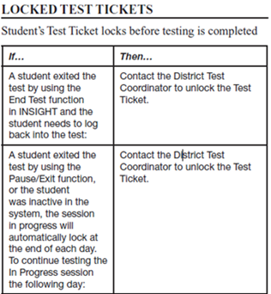
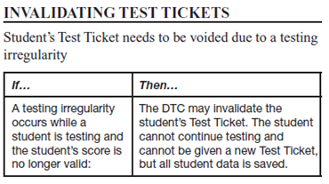
Spring High School Administration
Unlocking and Invalidating Test Tickets:
Only the District Test Coordinator should have the permission to unlock and invalidate test tickets. Every time a DTC takes either of these actions a Testing Irregularity form must be sent to assessment@la.gov.

Slide 48
Spring High School Administration
Accommodations Reminders:
Students with accommodations in SER and SIS will be uploaded by DRC. Nonpreidentified students must be added to eDIRECT manually.
Test coordinators need to manually enter Read Aloud accommodations for students with accommodations in SIS. Students with Read Aloud accommodations in SER will be populated in eDIRECT.
STCs will manually select accommodations or accessibility features in eDIRECT for students that have PNP or LEP accommodations.
School test coordinators must assign and/or verify accommodations of all Education Classification, Section 504, and Limited English Proficient (LEP) students BEFORE students are placed into eDIRECT test sessions so students with accommodations receive the correct forms.

Slide 49
Spring High School Administration
Accommodations Reminders:
STCs should review and verify accommodations for all students in eDIRECT.
New: Student accommodations will display on the Student Test Rosters so STCs can verify accommodations before handing out Test Tickets.
The English III reading passages in sessions 2 and 3 and their related questions may not be read aloud or signed; doing so is a violation of test security, which will result in voiding of the tests. All parts of the LEAP 2025 English I and English II tests are read aloud for students with the read aloud accommodation.

Slide 50
Spring High School Administration
Reports:
Reports for all EOC subjects (EOC English III, EOC U.S. History, EOC Biology) become available four days after a student completes all sessions of a test and exits the test properly.
Seniors receiving an automatic rescore of a 4-level EOC test will receive scores eight days after taking the test.
Reports for 5-level LEAP 2025 high school assessments, except for the LEAP 2025 5-level U.S. History, will be available at the end of the window. School test coordinators should use the reports available in eDIRECT to ensure students have completed the LEAP 2025 5-level U.S. History test.
All scores from the LEAP 2025 U.S. History 5-level assessments will be available in the summer of 2018.

Slide 51
Spring High School Administration
Other Reminders:
Students must be provided scratch paper (blank, lined, or graph). Scratch paper used during administration of the assessments must be collected at the end of the administration of each session and turned in to the school test coordinator to be destroyed. Used scratch paper should be treated as secure materials.
The protocol below should be used for students that transfer.
If… | Then…
A new student moves into the district | If it is just one student transferring, the designated DTC should email DRC customer support and request the transfer.If you are requesting a transfer for more than one student, the designated DTC should download the Student Transfer Form in eDIRECT, complete the form and then email it to DRC customer support. The DTC will receive an update on the request within 24 hours.
A student moves from one school to another school within the same district prior to testing | The DTC should edit the student’s information in eDIRECT before the student begins testing so that the student’s scores report to the correct school. The DTC must move the student to a different test session in eDIRECT.

Slide 52
Accountability Codes
District and school test coordinators should wait until the very end of the testing window to complete all accountability coding in the eDIRECT system.
At the end of the window accountability code students should be placed into a test session for each subject and have the appropriate accountability code applied. Documentation for a code should be available for review during an audit.
Steps to pull up list of applied accountability codes:
Manage Test Session
  Select District and School
  Export student details
Applied accountability codes will be in the column labeled testing codes.

Slide 53
Technical Assistance Protocol
If technical problems occur during testing, school and district staff should follow the technical assistance protocol presented below. Technical problems include, but are not limited to, problems connecting to INSIGHT, the inability to load test items, or missing buttons.
DRC Louisiana Customer Service
1-888-718-4836 LAHelpDesk@datarecognitioncorp.com
LDOE
1-844-268-7320
assessment@la.gov

Slide 54
Preparing for Summer 2018 High School Testing
The summer testing window for high school students is June 18-22.
District Test Coordinators must work with District Technology Coordinators to ensure preparation for testing is completed. A plan for support should be in place prior to and during spring assessments. Technology Coordinators should use the Technology User Guide for steps to prepare devices and the TSM. Technology Coordinators should be aware of the following responsibilities:
Before Testing:
attending relevant monthly webinars,
becoming familiar with Technology User Guide,
installing secure web browser,
ensuring computers are configured prior to testing,
completing the System Readiness Check in INSIGHT to ensure computers are ready for testing, and
creating a Communication Plan with School Test Coordinator to support test administrators during testing.
During Testing:
being readily available while testing is in process.

Slide 55
ACT and WorkKeys

Slide 56
ACT and WorkKeys Support
The following resources for ACT and WorkKeys can be found on the ACT State Testing Website:
ACT Schedule of Events (PDF)
Student Data Upload (SDU) Template (Excel)
Student Data Upload (SDU) File Layout and Loading Instructions (PDF)
Student Data Upload (SDU) Troubleshooting Guide (PDF)
Ordering Additional Materials Guide (PDF)
Welcome to the Accommodations Q&A Session for Spring 2018 Testing (Recorded Webinar)
Welcome to the Louisiana Test Administration Q&A Session for the ACT Test (PowerPoint)
Instructions for Retesting with Accommodations (PDF)
Test Accessibility and Accommodations (TAA) User Guide (PDF)
ACT helpdesk - 800-553-6244 ext. 2800 (standard time) ext. 1788 (accommodations) State Code 19
WorkKeys helpdesk - 800-967-5539 State Code 19

Slide 57
ACT and WorkKeys
Important Dates and Resources
Dates | Resources
April 18 | Deadline to order ACT accommodations materials for makeup testing by calling ACT, 800-553-6244 ext. 1788
April 24 | Administer the makeup ACT on paper with standard time
April 24-30 | Administer the makeup ACT on paper with accommodations and/or supports (only for students retesting due to administrative error from the initial testing date)
April 26 | FedEx pre-scheduled pickup for ACT standard time makeup materials. (answer documents received after May 4th will not be scored)
May 2 | FedEx pre-scheduled pickup for ACT accommodated makeup materials. (answer documents received after May 10th will not be scored)

Slide 58
ELPT and LEAP Connect/LAA 1

Slide 59
ELPT Results
Results will be available in May 2018.
Results will be posted in the AIR Online Reporting System (ORS) that is accessed through the ELPT portal.
Online Reporting System (ORS)
The Online Reporting System User Guide will be posted in the ELPT Portal under resources prior to results being released.
The user guide provides information about all ORS features, including instructions for viewing score reports, downloading student results, creating and editing rosters, and searching for students.
ORS login will be the same login as TIDE and the TA Interface.

Slide 60
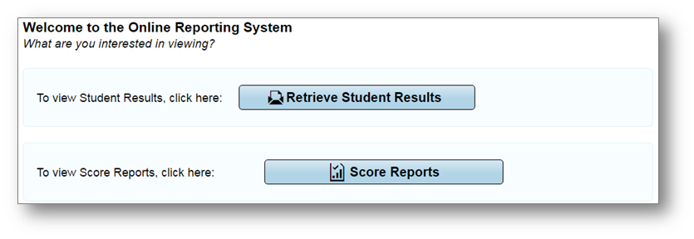
Overview of the ORS
ORS contains two major features: Score Reports and Reports and Files
Score Reports: Provides score data for each Louisiana ELPT. You can compare score data between individual students and the school, district, or overall state average scores. ORS also provides information about performance on domains when applicable.
Retrieve Student Results: Provides summary statistics (count and percentages) of students who tested in a selected subject and grade level. Enables you to download student data files containing test scores and demographic information.

Slide 61
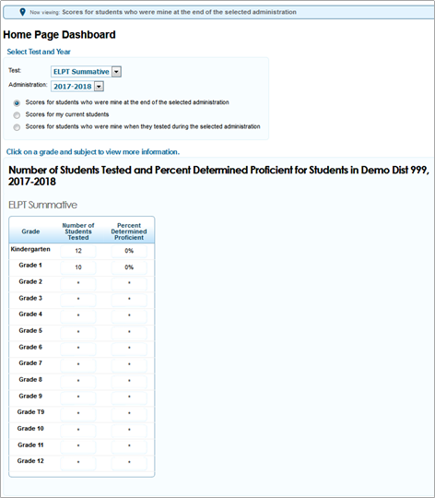
ORS: Score Reports
Score Reports: links to the Home Page Dashboard page which displays the overall summary of score data and testing progress for your state, district, or school, and is the starting point for data analysis.
An asterisk (*) on the summary table indicates that less than 10 students were reported in scoring.

Slide 62
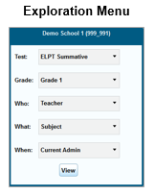
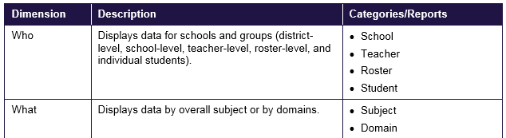
ORS: Score Reports
The Exploration Menu lets you navigate to different types of score reports by grade.
Reports can be navigated by making different selections from the Who and What drop-down lists.

Slide 63
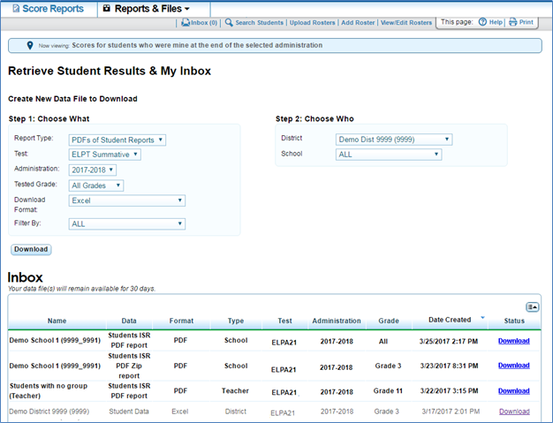
ORS: Reports and Files
Retrieve Student Results allows a user to download student data for a selected administration by district, school, teacher, or roster.
The data includes students’ information, including enrolled school and district, grade level, and the selected test scores and domain scores (if applicable).
You can also generate PDFs of Individual Student Reports in a Zip file.

Slide 64
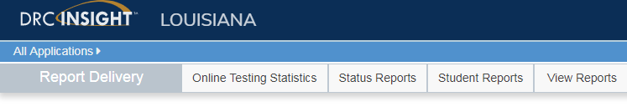
LEAP Connect/LAA1 Results
LEAP Connect/LAA1 results will be available in eDIRECT in May 2018. Reports can be accessed through Report Delivery under All Applications.

Slide 65
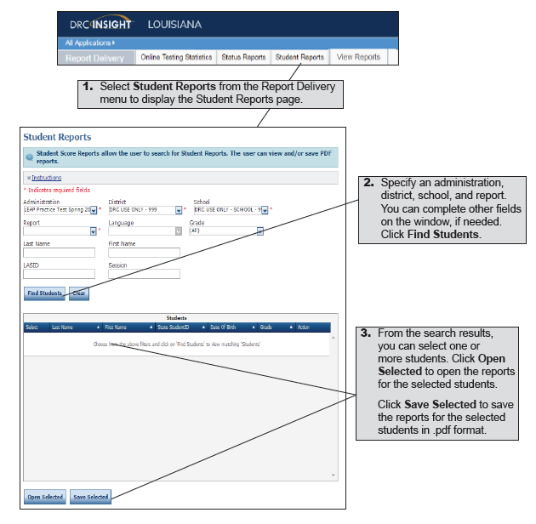
Report Delivery Options
Student Reports
eDIRECT users can display testing scores for students and save the results in Portable Document Format (.pdf).

Slide 66
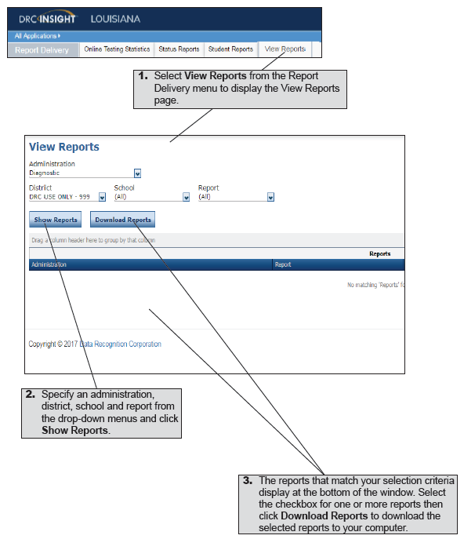
Report Delivery Options
View Reports
eDIRECT users can display reports by administration, district, school, and report name.

Slide 67
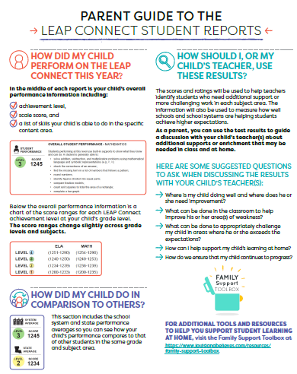
Parent Guides to the LEAP Connect and ELPT Student Reports
The Department released parent guides provides to the LEAP Connect student reports for grades 3-8 and the English Language Proficiency Test student reports for grades K-12.
The guides provide families with information on:
student achievement level by content or domain;
a comparison of the student’s progress to others; and
information to help parents understand how to use these results to guide discussions with their child’s teacher.
Schools should send the parent guides home to parents along with the student reports in May.
Both of these guides, and all other assessment resources, can be found in the Family Support Toolbox.

Slide 68
LEAP 360

Slide 69
LEAP 360 Reporting
Interim reports for all forms were posted in eDIRECT on April 9 including:
LEAP 360 Interim Assessment District Item Response Files
School Test Session Summary Reports
Test Session Summary Reports
Future scheduled report postings will be:
April 23
May 7
May 21
June 4
June 18

Slide 70
LEAP 360 (2018-2019)
The Department is preparing for the second year of LEAP 360 implementation. School systems that signed a LEAP 360 Memorandum of Understanding (MOU) for the 2017-2018 school year may choose to continue using LEAP 360 through June 30, 2019, under the same terms and conditions.
LEAP 360 will be available to districts in the 2018-2019 at no cost.
Year two provides school systems with an opportunity to:
re-evaluate existing practices,
reduce duplicative testing, and
transition to a more comprehensive assessment system that yields valid and reliable information on student performance throughout the school year.

Slide 71
LEAP 360 (2018-2019)
Next Steps
The Department is continuing to gather feedback from school systems and school level users through focus groups, site visits, and assessment@la.gov. Enhancements across usability, administration, and reporting will be implemented for the 2018-2019 school year.
To opt-in and amend your school system’s existing agreement, each Superintendent must sign an amendment to the original agreement.
Please click here to download the LEAP 360 MOU Amendment (2018-2019) form. Complete, sign, and return an electronic copy to assessment@la.gov by July 7, 2018.
Note: School systems should anticipate a cost for the 2019-2020 school year.

Slide 72
Improvements for 2018-2019
During the first year of LEAP 360 implementation, feedback was collected from multiple avenues, including focus groups, district and school leaders, and teachers. Feedback was categorized into five focus areas:
Data Management
Educator Scoring
Reporting
Content
EAGLE
Details about upcoming improvements were provided at the March Supervisor Collaborations and additional details will be reviewed at the annual Teacher Leader Summit.

Slide 73
Assessment Updates

Slide 74
Data Systems: Closing Out the School Year
Forward to Data Coordinators: Key data coordinator action items in April include submitting data to close out the school year and providing feedback/updates to the Department for next school year.
End-of-year data is important to:
students (meeting graduation, TOPS, and/or post-secondary enrollment requirements),
funding (updates to October and February enrollments),
Accountability (Early Childhood and K12), and
Career/Tech work.
It is important for school system program teams to work with data managers to ensure submissions are accurate.
Details on closing out the school year will be provided at the Data Coordinator’s monthly webinar April 12 at 1:00 p.m. All staff responsible for submitting school system data to state data systems should attend. No pre-registration required.

Slide 75
Data Systems: 2018-2019 Enhancements
Data Systems
Details about the upcoming enhancements were provided at the March Supervisor Collaborations.
Data Coordinators reviewed changes to the data systems and submitted feedback.
Changes of interest to DTCs include the following:
  Online Sponsor Site (SPS) update forms
  Clean LEADS Inquiry (LIQ) Assessment Data and Build Better Report Options
  eScholar and DRC Change
  504 Accommodations

Slide 76
Assessment Resources

Slide 77
LEAP 2025 Assessment Resources
Assessment Guidance library
LEAP 2025 Assessment Guides*
Science Field Test Guides*
Reference sheets, rubrics, and checklists*
Webinars - presentations and recordings
Sample social studies item sets and task sets
Equation builder guides
Link to Desmos online graphing calculator
Assessment library
LEAP 2025 Technology Enhanced Item Types
LEAP 2025 Accessibility and Accommodations Manual
INSIGHT™
Computer-based practice tests
Online Training Tools
*Also found in eDIRECT

Slide 78
LEAP 2025 Resource Availability Timeline
Resource | Available | Purpose
Assessment Guides | Currently available in Assessment Guidance library | Explain the test designs and types of items included on the assessments. The guides also include information about testing times as well as sample items and links to additional resources.
LEAP 2025 High School Assessment Webinars | Currently available in the Assessment Guidance library | Explain the changes to high school assessments for 2017-2018 and how these changes inform instruction.
Practice Tests | Currently available in INSIGHT and eDirect | Grade- or course-level, paper-based (grades 3 and 4 ELA, math, social studies) and computer-based (grades 3-8 ELA, math, social studies; English I, English II, Algebra I, Geometry, US History) help prepare students for the spring assessments; accessed through INSIGHT.

Slide 79
LEAP 2025 Resource Availability Timeline
Resource | Available | Purpose
Practice Test Guidance | Currently available in the Practice Test library | Provide teachers with information regarding best practices when using the practice tests. Updated to include information about the new high school practice tests.
Practice Test Webinars |  | Provide teachers/district personnel direct links to resources for setup, administration, scoring, reporting, and guidance on how to use practice test results.
LEAP 2025 Social Studies Assessment Framework |  | Demonstrates how the LEAP 2025 social studies assessments connect to classroom instruction. Includes annotated sets from the practice tests showing how content and claims are assessed.
LEAP 2025 Social Studies grades 3-8 Practice Test Answer Keys |  | Updated to include annotated student responses. Demonstrates how to score student responses to social studies constructed-response and extended-response tasks.

Slide 80
LEAP 2025 Resource Availability Timeline
Resource | Available | Purpose
Guides to the Online Equation Builders | Currently available in Assessment Guidance library | Provide information to teachers and students about how to enter equations and symbols in the online platform.
Social Studies Extended-Response Checklists |  | Provide students with support when responding to the extended-response tasks.
ELA Rubrics |  | Define how the prose constructed-response portion of the Literary Analysis, Narrative Writing, and Research Simulation Tasks is scored.
Online Tools Training (OTT) | Available in INSIGHT or here using the Chrome browser | Provide teachers and students examples of interactive, technology-enhanced items so they can become familiar with the computer-based testing format.

Slide 81
Support and Communication

Slide 82
2018-2019 School System Planning Calendar
The Department released the 2018-2019 school system planning calendar containing dates for:
Supervisor, Principal and Teacher Leader Collaborations
Monthly Planning Calls: School System, Assessment & Accountability, Data Coordinator, Special Education, Ed Technology
Newsletter distribution: Superintendents, Charter, Nonpublic, Teacher Leader, Believe and Prepare, Counselor Connect and Early Childhood
BESE and Advisory Council meetings
Email districtsupport@la.gov with questions.

Slide 83

Professional Development:
Teacher Leader Summit
The 2018 Louisiana Teacher Leader Summit will take place Wednesday, May 30 through Friday, June 1 at the Morial Convention Center in New Orleans.
Sessions will focus on the theme “meaningful growth for every student, every day.” In addition to presentations from hundreds of Louisiana educators, this year’s Summit will feature presentations from esteemed national experts.
Refer to the 2018 Teacher Leader Summit overview for information about the schedule, recommended attendees, and lodging.

Slide 84
Professional Development:
Teacher Leader Summit
Registration will open in WisdomWhere on April 23. Start planning for who will attend.
Registration for the event will be first come, first served. This means school systems will not receive specific allotments of seats.
The Department will release the session list when registration opens on April 23.
The majority of individual sessions will be first come, first served, but a handful will require pre-registration. Pre-registration for these sessions will also take place via WisdomWhere beginning on April 23.
Approximately 70 percent of the sessions will target classroom teachers, therefore school system leaders should ensure that about 70 percent of their attendees are current classroom teachers.
Contact louisianateacherleaders@la.gov with questions.

Slide 85
Professional Development:
LEAP 360 TL Summit Sessions
The upcoming Teacher Leader Summit will provide LEAP 360 sessions that will focus on the connection between standards, instruction, and assessment. These sessions will provide information regarding:
LEAP 360 Overview
LEAP 360 guidance documents
ELA specific data and resources
Math specific data and resources

Slide 86
Professional Development:
LEAP 2025 TL Summit Sessions
All Assessment Content Teacher Leader Summit sessions will focus on helping students develop skills in written communication of content knowledge and conceptual understanding. Highlights
ELA | ELA Assessment Results Make the Case: How to Build ELA Knowledge in Writing and Reading (grades 3-5; grades 6-10)
Math | Math Assessment Results Make the Case: Creating Type II and Type III Tasks (grades 3-5; grades 6-8; Algebra I and Geometry) Charge up your math classes with the Desmos Calculator! Facilitating Productive Classroom Conversations Using Desmos Activity Builder
Social Studies | Social Studies Assessment Results Make the Case: Scoring Student Responses to Extended-Response Tasks (grades 3-5; grades 6-8 & U.S. History) Join the Revolution! Build Your Own Social Studies Assessments
Science | New LEAP 2025 Grades 3-8 Science & Biology Assessment Overview Engineer Your Own Multi-Dimensional Science Assessments

Slide 87
Professional Development:
English Learner TL Summit Sessions
The upcoming Teacher Leader Summit will provide a set of English learner sessions that build upon the strategies in the forthcoming English Learner Guidebook, including integrating learning around curriculum, classroom practice, and content knowledge with an EL’s lens.
All EL sessions for Wednesday and Thursday will require pre-registration and have seat limitations.
Please prepare to register as soon as registration opens on April 23.
Strategy 1 Integrated Instruction Strategy 3 Immersion Model | Sheltered English Framework (SIOP) Lesson Preparation Building Background Knowledge and Comprehensible Input Strategies and Interaction Connectors for ELs—Introduction:1.1 ELA Guidebook Lesson Model—Fully Scaffolded
Strategy 2 Progress Monitoring | ELPT Results—Next Steps: Individual Learning Plan Reveal of the NEW EL screener: ELPS
Please contact beverly.diaz@la.gov with any questions

Slide 88
Professional Development:
Students with Disabilities TL Summit Sessions
The upcoming Teacher Leader Summit will provide sessions that address and build upon the four strategies included in the Guidebook for Supporting Students with Disabilities. All participants will have the opportunity to increase their pedagogical content knowledge in special education. Highlights include:
Strategy 1 Early & Accurate ID | Using screening data to select and implement interventions aligned to students’ needs
Strategy 2 High Quality Instruction | Implementing the Louisiana Science Connectors for students with significant disabilities Using Universal Design for Learning (UDL) and AT to increase access for SWD in ELA and Math Diverse Learners + ELA Guidebooks + Kurzweil 3000 = Success Every Student, Every Day: Supporting Meaningful Reading Growth ELA Guidebooks: A Deeper Dive into 3-8 Diverse Learner Updates LEAP Connect at High School Assessment Overview
Strategy 3 Supports and Related Services | Implementing function-based intervention strategies to support students with behavioral needs Partnering with Your Parent Center
Strategy 4 Transition | Leveraging LRS funds to support vocational programs for SWD Using community partnerships to build vocational programs for students with significant disabilities

Slide 89
DTC and Accountability Contact Update
If during the academic year the person appointed as district test coordinator changes, the district superintendent must notify the LODE. The notification must be in writing and must be submitted within 15 days of the change in appointment.
Due to the secure nature of the data accessed by accountability contacts and district test coordinators, changes have been made to the submission process for any updates to DTC and accountability contacts:
Superintendent signature now required
The DTC and Accountability Contact Update Form must be submitted from the superintendent’s district email account.
The revised DTC and Accountability Contact Update Form is located under the Resources + Forms section in the Assessment Library.

Slide 90
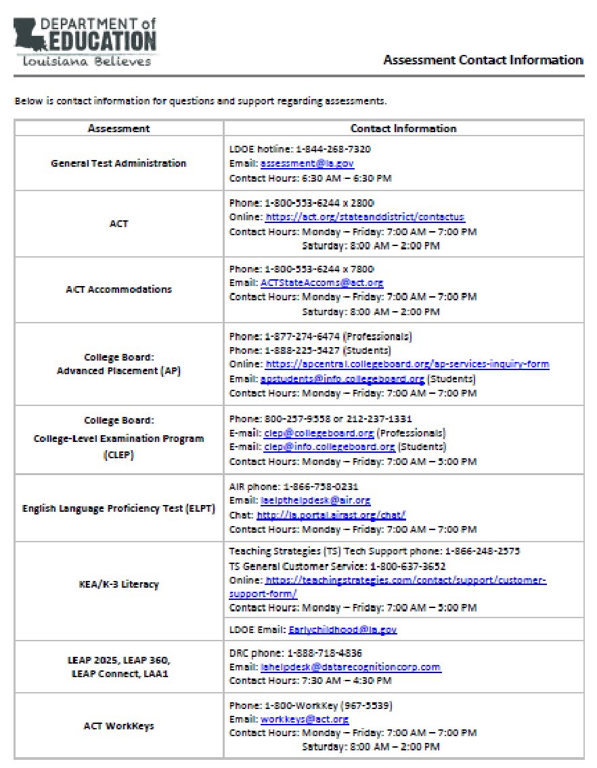
Assessments Customer Service
The Assessments Customer Service Contact Information has been posted to the Assessment Library. This provides all customer service contact information for all assessments.

Slide 91
District Support
The Assessment team offers multiple avenues of support to districts, schools, and teachers seeking information or assistance about assessment administration and accountability.
Weekly Newsletters
Assessment and accountability information and deadlines are released each week in the district newsletter.
Weekly Assessment & Accountability Calls
Each Tuesday at 1:00 PM these webinars are held to provide training, updates, and important information to DTCs and Accountability Contacts.
Assessment Library and Accountability Library
The Assessment Library contains resources for DTCs including the Assessment Schedule and the Assessment and Accountability Month-by-Month Checklist. The Accountability Library contains resources for accountability contacts including the School Performance Score (SPS) calculators as well as information on data certification and federal accountability.

Slide 92
District Support
Monthly Educational Technology Calls
Each month a webinar is held for district technology personnel to provide training, updates, and important information related to technology readiness and digital literacy.
Assessment@
All stakeholders are encouraged to email assessment and accountability questions and/or concerns to assessment@la.gov.
Assessment Hotline
For immediate assistance regarding assessment and accountability, district-level staff may call the Assessment Hotline at 1-844-268-7320.
EdTech@
All stakeholders are encouraged to email technology readiness questions and/or concerns to edtech@la.gov.

Slide 93
Next Steps

Slide 94
Next Steps
Key Dates | Action
April | Train STCs for spring assessments
March 19 - May 4 | Complete Test Setup for grades 3-8 assessments
March 23 - May 18 | Complete Test Setup for high school assessments
April 10 | Last day to submit changes to LA Data Review for graduation cohort rosters
Next Assessment and Accountability Monthly Call: May 15, 2018

