Slide 1

Assessment and Accountability Monthly Call
January 2018

Slide 2
Agenda
Month-by-Month Checklist
Accountability
Assessment Administration
Support and Communication

Slide 3
2017-2018 Month-by-Month Checklist
The 2017–2018 Assessment and Accountability Month-by-Month Checklist
  identifies key dates and deadlines for statewide assessment programs and accountability processes for next school year;
  provides action steps to ensure readiness for administering statewide assessments; and
  recommends resources for district and school staff.
The checklist includes information on the following areas:
  Communication and Support
  Accessibility and Accommodations
  Assessment Preparation and Administration
  Accountability
  Reports
The 2017-2018 Assessment Month-by-Month Checklist has been updated to include additions to ACT, ELPT, and LEAP Connect action items.

Slide 4
January Assessment Checklist
Communication and Support
Beginning Jan 9: Assessment and Accountability Office Hours—Tuesdays at 1:00 PM
Jan 16: Monthly Assessment and Accountability Call
Jan 30: Winter Collaboration Events begin
Jan: ACT (paper and online) and ACT WorkKeys Paper Test Administration Q & A webinar
Accountability and Assessment Preparation
Jan: Coordinate distribution of LEAP Connect and ELPT test coordinator manuals (TCMs),
test administrator manuals (TAMs), and training video modules
Jan: Deliver test security, preparation, and administration training for LEAP Connect to STCs
and other applicable school and district personnel, available in the Assessment Library
Jan: Begin TSDL Spring data submission of class schedules for first time high school testers

Slide 5
January Assessment Checklist
Jan: AP coordinators receive an email containing exam ordering information and can begin
ordering exams online
Jan: AP Studio Art Digital Submission Web application becomes available
Jan: Complete setup for LEAP Connect
Jan: Test Administrator Upload System available for LEAP Connect
Jan: LEAP Connect assessment materials delivered to sites
Jan: LEAP Connect Additional Materials System available in eDIRECT
Jan: ELPT browser should be installed on all devices used for ELPT testing
Jan 6: Finalize IEP, IAP, and LEP accommodations plans for LEAP Connect and ELPT
Jan 24: LEAP Connect Electronic Security Checklists available in eDIRECT
Jan 31: AP course audit deadline

Slide 6
February Assessment Checklist
Communication and Support
Feb 1, 6, and 8: Winter Collaborations
Feb 1: Data Coordinator Monthly Webinar
Feb 2: Accountability Commission 1pm, Thomas Jefferson, Claiborne Bldg.
Feb 7: School System Monthly Planning Call
Feb 20: Monthly Assessment and Accountability Call
Accountability and Assessment Preparation
Feb: Support continuous evaluation of accessibility/ accommodations effectiveness; revise
IEP, IAP, LEP, and PNP documents as needed
Feb: Utilize SER accommodation reports to plan for spring test administrations
Feb: Verify testing enrollment and order WorkKeys Accommodated materials online
Feb 5-March 14: Order additional WorkKeys accommodations materials

Slide 7
February Assessment Checklist
Accountability and Assessment Preparation
Nov–Feb : Submit ACT approved accommodations in the TAA System
Feb: STCs ensure that TAs, proctors, and monitors are appropriately assigned to testing groups for ELPT and LEAP Connect testing
Feb: Verify testing enrollment and order WorkKeys Accommodated materials online
Feb: Deadline for submitting to College Board complete disability documentation for students with disabilities who will take a 2018 AP exam
Feb: LASID Audit #4 - Data coordinators will review retirement/split IDs and make updates in applicable systems
Feb: Audit of spring high school LEAP 2025 testers (TSDL)
Feb: Deadline to submit class schedule corrections for high school LEAP 2025 testers
Late Feb: Download ACT Match-No Match lists second release from FTP for distribution to STCs to ensure testing of all grade 12 students with no ACT score on record

Slide 8
February Assessment Checklist
Feb 5-March 16: Submit Late Consideration Form for ACT-approved accommodations on
the ACT for eligible examinees through TAA
Feb 5-March 16: All LEAP Connect and ELPT voids should be emailed to assessment@la.gov
at the end of the week.
Feb 9-March 14: Add students and update student information in PearsonAccess^{next} and
place additional orders for initial ACT test materials
Feb 16: Request reconsideration of ACT-approved accommodations on the ACT in TAA
Feb 19-Feb 23: Receive ACT and WorkKeys test materials for initial testing (if this shipping
week was chosen)
Feb 20: Attend Q&A session about test administration for ACT and WorkKeys
Feb 26-March 2: Receive ACT and WorkKeys test materials for initial testing (if this
shipping week was chosen)
Feb 27: ACT delivers standard time and accommodation(s) materials to LEAs/districts on
holiday break in March

Slide 9
February Assessment Checklist
Assessment Administration and Reporting
Feb 5–March 16: ELPT Testing Window
Feb 5–March 16: LEAP Connect/LAA1 Testing Window
Oct 3-April 13: WorkKeys online test administration window

Slide 10

Accountability

Slide 11
ACT Match/No Match Lists
The annual ACT Match/No match Lists will be distributed to schools and systems via secure ftp the week of January 15th.
The ACT Match List provides names of students in grade 12 who already have an ACT score and can only be retested in spring at the expense of the school or system.
The ACT No Match list provides names of students in grade 12 for whom the state does not have an ACT score, and should be tested. A zero will be applied to the ACT index portion of the school performance score for any student on this list who does not test.
The only students who are exempted from ACT testing are those who participate in LAA 1 or LEAP connect assessment.
ACT scores for these students can be updated during data certification in August. Please do not submit requests for changes at this time.

Slide 12
2017-2018 Assessment Administration

Slide 13
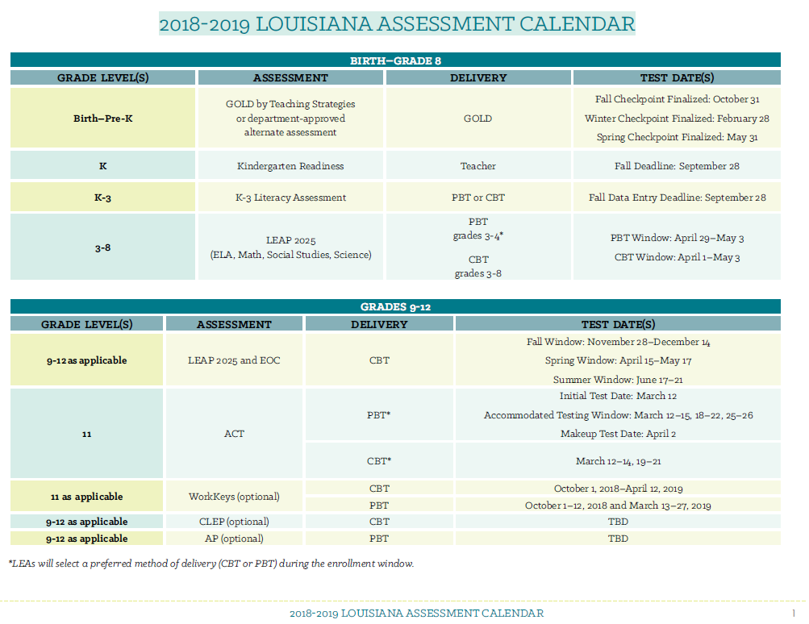
2018-2019 Assessment Calendar
The Department released the 2018-2019 Assessment Calendar in last week’s school system newsletter.
It can also be found in the Assessment Library under “Assessment Calendar”.

Slide 14
Technology Readiness

Slide 15
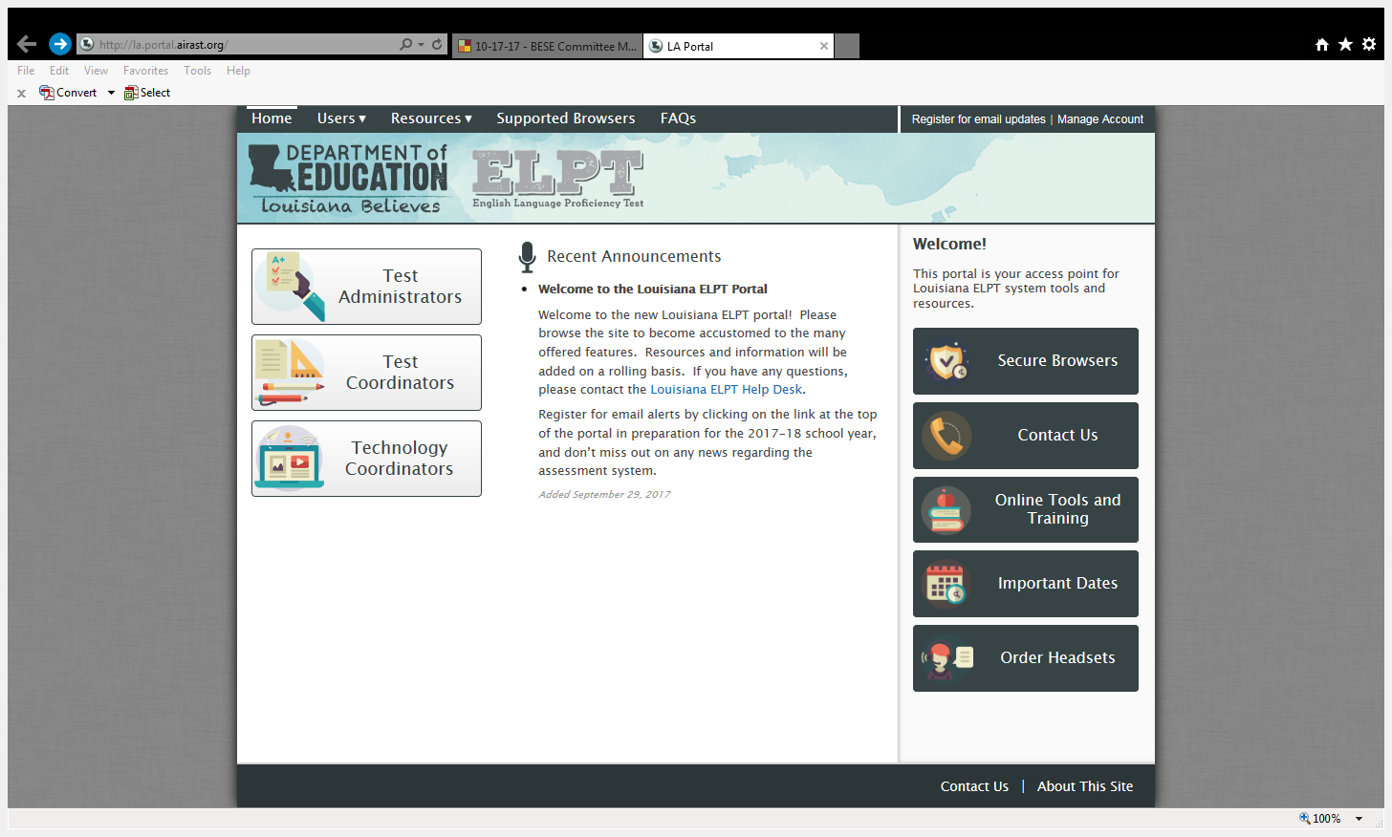
ELPT Secure Browser
The AIR Secure Browser must be installed on any computers used for the ELPT. Click on the Secure Browsers link on the Portal to access the Secure Browser download page. Directions can be found in the Assessment Library.

Slide 16
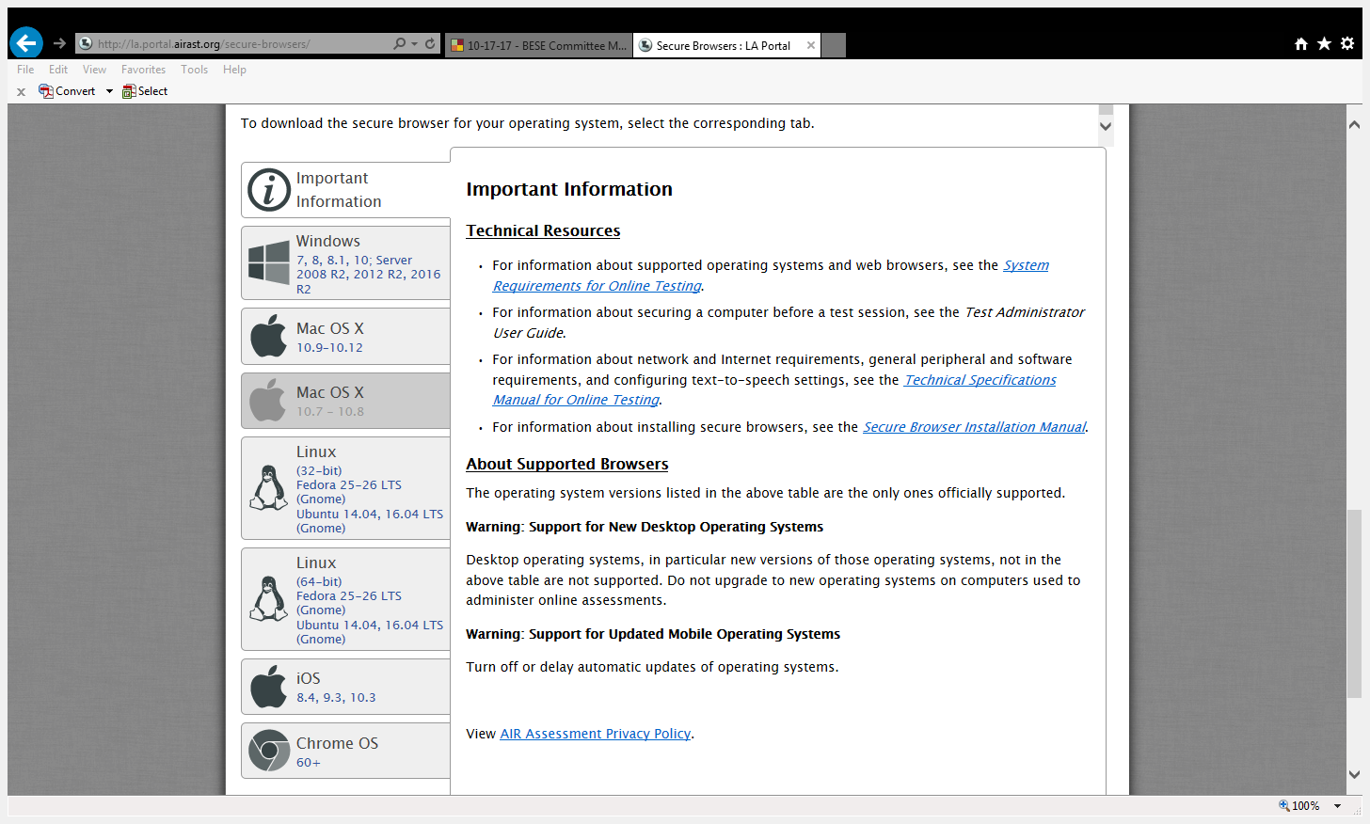
Downloading the Secure Browser
In order to download the secure ELPT browser, scroll down the Secure Browser page and choose the appropriate tab for information about downloading the Secure Browser for your operating system.

Slide 17
Installing the Secure Browser
Each tab on the Secure Browsers page of the Portal includes a link to download the Secure Browser and an overview of the process for installing that Secure Browser.
The Important Information link includes additional resources:
  Secure Browser Installation Manual: detailed information about Secure Browser installation including instructions for installing the Secure Browser on multiple computers from a central network location.

Slide 18

Network Diagnostic Tool
The main page of the Secure Browser includes a link to a network diagnostic tool:

Slide 19
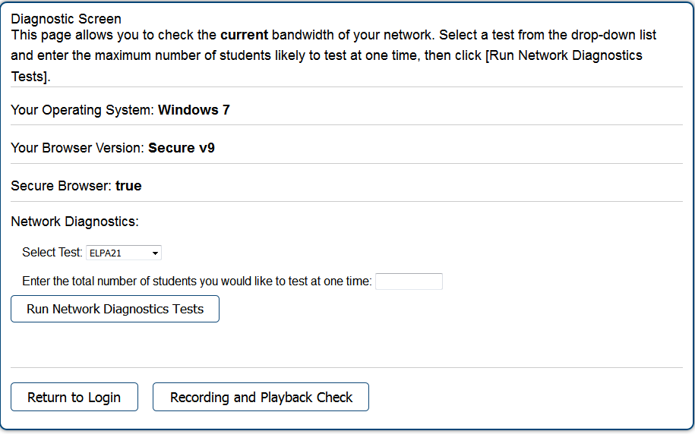
Network Diagnostic Tool
The network diagnostic tool allows you to run two checks:
  Network Diagnostics Test checks for bandwidth
  Recording and Playback checks confirm that your computer’s recording system is working correctly for testing ELPT speaking.

Slide 20
Technology Checklist: ELPT
Checklist Item | Reference Documents
Verify that all devices to be used for testing meet the minimum technology specifications. | System Requirements for Online Testing
Verify that your school’s network and Internet are properly configured for testing. | Technical Specifications Manual for Online Testing
Enable pop-up windows and microphone settings on all ELPT computers. | Technical Specifications Manual for Online Testing

Slide 21
User Guide Updates
The eDIRECT User Guide has been updated with the following information:
Sample Schools used for Training
LEAP Connect added in Permission Matrix, What's in this guide section, and test setup
Test Coordinators can access the eDIRECT refresher presentation from the November collaboration session here.

Slide 22
Assessment Technology Specifications
Updated technology specifications for the 2018-2019 school year have been posted in the Assessment Library. Any devices used for testing during the 2017-2018 school year will continue to run properly, and schools can expect to see the same level of performance.
Districts looking to purchase new devices should use the specifications to guide future purchasing.
The current 9.2 TSM will remain active for the 2018-2019 school year. Please ensure your TSM is set to automatic updates.

Slide 23
Test Security

Slide 24
Investigation Support
Student tests should be voided if there is an instance of cheating—whether by a student or by anyone else. In the case of student cheating:
The Test Administrator should give the School Test Coordinator a written account of the incident, with any available additional documentation, including the lithocode number of the answer document or consumable test booklet and the domain to be voided.
The School Test Coordinator should convene a school-level test security committee consisting at a minimum of the principal, the School Test Coordinator, and the test administrator to determine whether a test should be voided. The STC will complete the Void Notification form and notify the District Test Coordinator of any voided test.
The District Test Coordinator should mark the test invalid in the appropriate online system and email a completed testing irregularity form to assessment@la.gov.

Slide 25
Investigation Support
The following items are required by Bulletin 118 for any test security investigation:
Explanation of the incident in complete detail.
A list of all people involved.
Description of the secure storage area and a list of people with access to the secure storage area.
Transcripts of interviews with the following people:
  Principal
  School Test Coordinator
  Test Administrator(s)
  Proctor(s)
Transcripts of interviews with multiple students regarding the information below:
  Testing procedures
  Layout of the classroom
  Access to test materials before the test
  Access to unauthorized materials during testing

Slide 26
Investigation Support
The following are recommendations based on best practices in conducting investigations:
Collect/view all evidence prior to conducting any interviews.
Schedule a plagiarism/answer change analysis viewing by emailing assessment@la.gov, if applicable.
View security camera footage if available.
Obtain oaths of security and confidentiality, test security and administration sign-in sheets and training materials.
Interview test administrators, proctors, and students in question last. Interview other personnel first.
Questions should include general procedures and about the incident.
Ask as many open-ended questions as possible; limit the number of yes and no questions.

Slide 27
Investigation Support
Interview all individuals who were in the room but not directly involved in the event.
All interviews should be conducted at least twice across multiple days.
Questions should include general procedures and questions about the incident.
Ask as many open-ended questions as possible; limit the number of yes and no questions.
Individuals in this group should not be told who is being investigated.
Interview all individuals who were directly involved in the event.
All interviews should be conducted at least twice across multiple days.
Questions should include general procedures and questions about the incident.
Ask as many open-ended questions as possible; limit the number of yes and no questions.
Individuals in this group should not be told they are under investigation until absolutely necessary.
Avoid being overly aggressive. Investigators who are friendly and helpful get better results.

Slide 28
Off Grade Voids
All students should take the appropriate grade level or grade span assessment.
All official grade assignments are in SIS, and changes must be documented in SIS.
Students who take a grade level test lower than their enrolled grade or grade span will have their test voided.

Slide 29
Caveon Test Security Services
In order to help districts and schools improve test security, the LDOE has negotiated an agreement with Caveon, the nation’s leading test security experts, to provide the following services:
Monitoring
Provides two Caveon monitors on campus on one day of testing
Provides districts with accurate information of every testing room at the school
Investigations
Provides districts with professional investigators to investigate and report on any testing irregularity that occurred in the district
Training
Provides districts with active online training modules created by Caveon
A full explanation of the services and the fee schedules can be found here. Districts and schools can purchase these services by contacting Caveon directly.

Slide 30
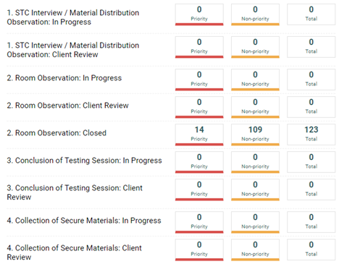
Caveon Core
LEAs utilizing Caveon will receive access
to Caveon Core. Caveon Core allows
DTCs to track the findings of the Caveon
monitors in real time. Caveon Core is
the only way for DTCs to receive real
time monitor feedback.

Slide 31
ELPT/LEAP Connect Reminders
Any staff members involved in testing must be trained in test security and administration prior to testing beginning at the school. All staff members involved in testing must sign the pre and post Oath of Security and Confidentiality.
Voids should be entered into eDIRECT for LEAP Connect or TIDE for ELPT at the conclusion of each testing week. Directions on how to void a test can be found in the TIDE User Guide for ELPT and the eDIRECT User Guide for LEAP Connect.
All testing irregularities are due to assessment@la.gov by March 16th.

Slide 32
LEAP 2025

Slide 33
LEAP 2025 High School Assessments
This year, Louisiana is transitioning to five-level high school assessments, which include:
Providing an English I exam, allowing accurate assessment of ELA success in earlier years, and reduction of testing in upper grades as students are exploring a variety of pathways.
Reporting a greater differentiation of performance and allowing high schools to earn recognition for three levels of performance rather than the two, as is true in elementary and middle schools.
Allowing consistent measurement of achievement and growth/progress from grade 3 through high school.
Maintaining consistency in graduation requirements. The passing score is comparable. The second lowest achievement level is comparable across four and five level tests (Fair or Approaching Basic).

Slide 34
Winter 2017 LEAP 2025 High School Population
The Winter 2017 LEAP 2025 administration consisted of a small population of students.
Course | Initial Testers | Retesters | Total Population
English I | 4,660 (100%) | 0 (0%) | 4,660
English II | 6,051 (65%) | 3,240 (35%) | 9,291
Algebra I | 2,968 (34%) | 5,640 (66%) | 8,608
Geometry | 5,471 (80%) | 1,359 (20%) | 6,830

Slide 35
LEAP 2025 High School Assessments:
Impact on Students and Schools
The percent of students meeting graduation requirements (scoring Approaching Basic or better) on the five-level high school LEAP 2025 assessments remained steady or increased from prior years.
High school performance measures will include equal measures for both student growth (12.5%) and student performance (12.5%) on math and English LEAP 2025 high school initial assessments. This means that high schools will earn credit for how well they are improving student achievement throughout the year, rather than on absolute performance alone.

Slide 36
Release of Winter 2017
LEAP 2025 High School Results
Reporting timelines for Winter 2017 LEAP 2025 results include:
CSV data files post to eDIRECT last week
Student reports, class rosters, and school reports post to eDIRECT this week
Refer to the 2017-2018 High School Assessment FAQ for answers to the most frequently asked questions.

Slide 37
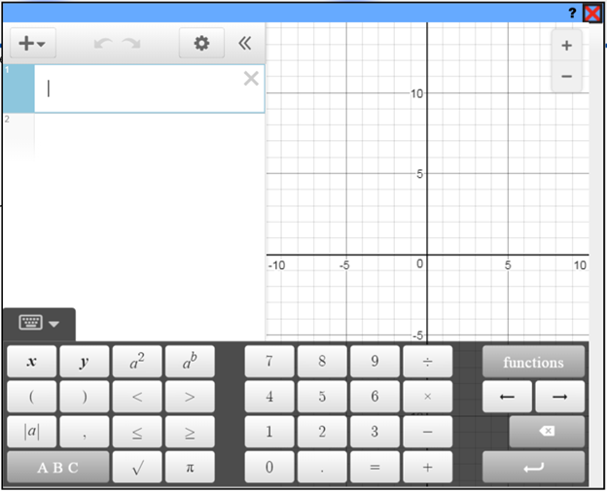
Online Graphing Calculator for
LEAP 2025 Algebra I and Geometry Tests
What’s new:
Replaces graphing tool
Fully functional graphing calculator
Desmos free online - access outside testing platform
What’s unchanged:
Online scientific calculator
Handheld calculators recommended
Calculator Policy
Available in all LEAP 2025 and LEAP 360 Algebra I and Geometry tests.

Slide 38
Testing Students from Nonpublic Schools
State law does not require testing of students in nonpublic schools. The FAQ about Testing Home Study and Nonpublic School Students and Participation Form for Nonpublic School Students are available in the Assessment Library. Some highlights from those documents include:
Nonpublic school students who have a scholarship or TDR should test at their scholarship or TDR school.
Other nonpublic school students can be tested if the district is willing to pay DRC directly for testing them. The cost per student is $50.00.
The district can determine how and where the students are tested.
The tests must be given in accordance with all guidelines for test administration and test security.
DRC will provide a nonpublic/nonscholarship participation form that will need to be completed by the district, providing the names of students being tested.
These students should be tested under the 997 site code.
The LASID for non-public, non-scholarship students is the SSN with a leading “0”.
Reports will be returned with all other student reports in eDIRECT. If students are incorrectly loaded under a school sitecode, then the scores will be included in the school’s assessment reporting.

Slide 39
Science Field Test
All LEAs must participate in the Science Field Test. LEAP 2025 Science Field Test Guides are available in the Assessment Guidance library. On January 9-11, 2018, the Department hosted science field test webinars for teachers. These guides and webinars included:
the new science assessment vision,
the shifts in science instruction necessary for mastery of the new science standards,
administration of the science field tests, and
science field test design.
Science field test webinars were recorded. The presentations and recordings are available in the Assessment Guidance library.

Slide 40
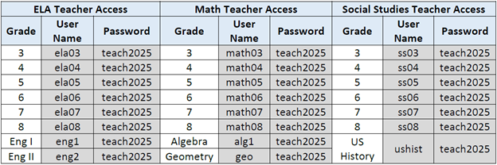
LEAP 2025 Practice Tests
Teacher access is available for ELA, Math, and Social Studies assessments. Teachers may access the online practice tests by copying and pasting the links into Google Chrome: http://tinyurl.com/LDE3-8pt (grades 3-8) and https://tinyurl.com/LDEHS-PT (high school). Below are the usernames and passwords by content area and grade level.

Slide 41
LEAP 2025 Practice Test Resources
Social studies, ELA, and math practice tests for grades 3-8 are now available for student use in INSIGHT. Districts and schools should use the resources below to prepare for the use of the practice tests.
Practice Test Quick Start Guide
LEAP 2025 English Language Arts Practice Test Guidance
LEAP 2025 Mathematics Practice Test Guidance
LEAP 2025 Social Studies Practice Test Guidance
LEAP 2025 Social Studies Assessment Framework

Slide 42
ACT and WorkKeys

Slide 43
ACT and WorkKeys: Important Dates
Dates | Resources
Nov. 6 – Feb. 2 | STC requests ACT-approved accommodations on the ACT for eligible examinees through the Test Accessibility and Accommodations System (TAA)
Dec. 4 – Feb. 2 | DTC/STC verify student information and upload additional student information in PearsonAccess^{next} for ACT
Dec. 4 – Feb. 2 | STC order WorkKeys accommodations materials in PearsonAccess^{next}
Dec. 4 – Feb. 2 | STC/IT install ProctorCache software and set up proctor caching in PearsonAccess^{next} for ACT online only (test administration will be switched from online to paper if ProctorCache software is not installed by this deadline)
Dec. 4 – Feb. 2 | Complete mock administration for ACT online only
Week of Jan 15 | ACT Match-No Match lists will be placed in the district FTP (See the district data coordinator for access)
Jan 16, 1 p.m. | Attend Q&A session about test administration. Registration link: https://act.ilinc.com/register/shzxtxk
Jan. 23, 1 p.m. | Attend Q&A session about test accommodations. Registration link: https://act.ilinc.com/register/wzrhwht
The Schedule of Events for ACT and WorkKeys is posted on the ACT State Testing website. Refer to the ACT State Testing website for information on trainings, manuals, and other resources.

Slide 44
ACT Reminders
The Using PearsonAccess^{next™} for the ACT Test Guide provides instructions on how to submit a request to enroll or unenroll an examinee. This is only used to:
UNENROLL any 11th grade student or 12th grade student taking ACT for the first time who transfers within the district AND can be verified in the local information system. Accountability codes must be applied for all other students no longer enrolled or not testing.
ENROLL any 11th grade student or 12th grade student taking ACT for the first time who entered a school from anywhere not on the original roster.
The Using PearsonAccess^{next™} for the ACT Test Guide provides instructions on Student Data Upload (SDU) and the SDU template. This is only used to:
ENROLL 12th grade students retesting ACT.
STCs and DTCs should check:
All 11th grade students and 12th grade students testing ACT for the first time are in PA Next and confirm that all demographic information is correct.
Enroll students for the state testing date who have previously been approved for accommodations in TAA.

Slide 45
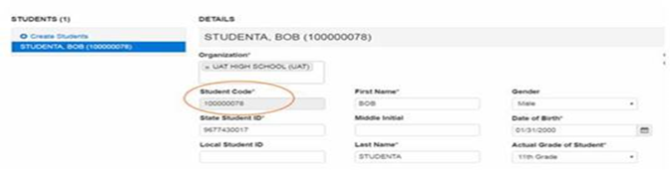
ACT Reminders
Students added to PearsonAccess^{next™} after Feb. 2nd will not have pre-identified barcode labels. These answer documents must be hand coded.
The ACT Student Code is generated when students are entered into PearsonAccess^{next™}.
The ACT Student Code must be on the hand coded answer document for scoring.
Important Coding Information: The 9 digit ACT Student Code is used to match records. Pre-identified barcode labels will have this information. Hand coded documents will need this information coded.
* Block U on the answer document: Use the 9 digit ACT Student Code shown here.
found in PearsonAccess^{next™}.

Slide 46
ACT Online
Site Readiness
During the site readiness process, Dec. 4-Feb 2, 2018, DTCs will work with district IT staff to configure computers to ensure online testing is successful.
To Do
Completing site readiness can take a few hours or several days, depending on the specific needs. To get started:
Make sure systems meet the technical requirements, can do proctor caching, and can handle a mock administration. If not, paper administration will be necessary.
Make sure the test rooms used can meet the facility requirements.
If examinees need accommodations or English learner supports, identify what is available in the online vs. paper formats. Even if testing online, some examinees may need to test on paper.
Note: See your Schedule of Events for certain site readiness task deadlines.
Resources
The Site Readiness Plan presents a graphic overview of this process.
The technical requirements webpage contains hardware, software, and network requirements.
The Technical Guide provides proctor caching instructions.
The Mock Administration Guide has instructions for conducting a trial run.
The Administration Manual for Online Testing has information about accommodations, test rooms, and other preparations for online testing.
Your State testing website has more resources under Configuration, Verification, and Preparation in the ACT® section.
Preparing to take the ACT® has resources for students preparing to take the ACT®
For questions about the differences between administering ACT® online or on paper, please refer to The ACT Taken on Paper or Online document located on the ACT State Testing website.

Slide 47
ACT and WorkKeys: Support and Reminders
WorkKeys Reminders
Use only the 10 digit Louisiana Secure Identification Number (LASID) for the examinees ID number when enrolling students for WorkKeys tests.
DTCs and STCs need to update the materials quantities needed for ACT WorkKeys accommodations using PearsonAccess^{next}.
Allow 30 days between tests is to allow for remediation.
ACT and ACT WorkKeys Resources
Here are some resources for ACT and ACT WorkKeys that can be found on the ACT State Testing Website:
Verifying Student Information for Initial ACT Materials
Ordering Initial ACT WorkKeys Materials
Using PearsonAccess^{next™} for the ACT® Test
ACT Customer Service may be reached at 800.553.6244, ext. 2800. For questions specific to accommodations or supports, call 800.553.6244, ext. 1788 or email ACTStateAccoms@act.org with State Code 19.
WorkKeys Customer Service: 800-(WorkKey)967-5539
All customer service hours (excluding ACT holidays): Monday - Friday: 7:00 a.m. - 5:00 p.m. Central Time

Slide 48
ELPT

Slide 49
Key Dates
Testing Window | February 5 – March 16
OTT | Available Now
Manage Users | Available Now
Student upload | All students have been uploaded
Manuals posted | TAM: Available Now TA User Guide and TIDE User Guide: Available Now
Receipt of K and 1 Materials | January 23
Additional Materials Window | February 5 – March 15
Create Test Sessions | On Demand (20 minutes or less prior to beginning test)

Slide 50
Overview of AIR Systems
Test Information Distribution Engine (TIDE)
Stores student demographic information and test settings
Used to manage user accounts for all systems
Test Delivery System (TDS)
Used by TAs to administer tests and monitor students
Includes interface used by students to navigate through test

Slide 51
ELPT User Guides and Manuals
ELPT Summative TAM
Provides specific instructions for the administration of the ELPT. Details include information on security, coding, and logistical requirements and the Test Administrator directions to students.
TIDE User Guide
Provides directions for registering students for assessments, establishing test settings and accommodations, associating students with districts, schools, and rosters, and creating and approving testing appeals
ELPT TA User Guide
Directions to help users navigate the Test Delivery System (TDS) including the Student Interface and the Test Administrator Interface, and help support Test Administrators manage and administer testing for students participating in the ELPT. Additionally, this guide will provide information to help users access and administer the Online Tools Training available in TDS.

Slide 52
Accommodations and Accessibility
ELPT Accessibility and Accommodations Manual
Details the ELPT’s universal features, designated features, and accommodations
ELPT Accommodation Information
Test administrators cannot translate.
No EL accommodations are permitted.

Slide 53
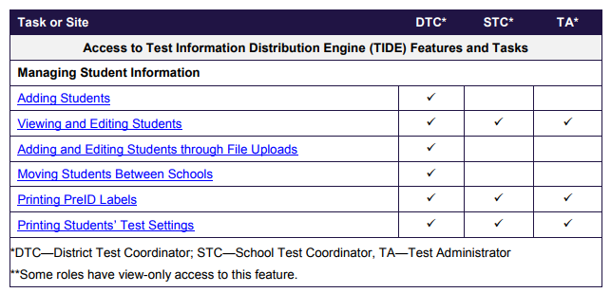
ELPT: Preparing to Test
Each user in TIDE has a role, such as a district coordinator or a test administrator. Each role has an associated list of permissions to access certain features within TIDE.

Slide 54
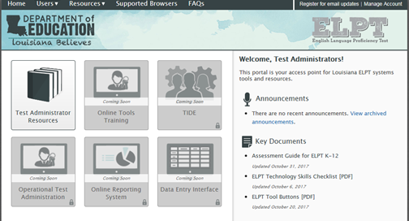

Logging in to TIDE
In order to log into TIDE, DTCs should complete the following steps in the ELPT Portal:
Select Test Coordinators
Select TIDE

Slide 55
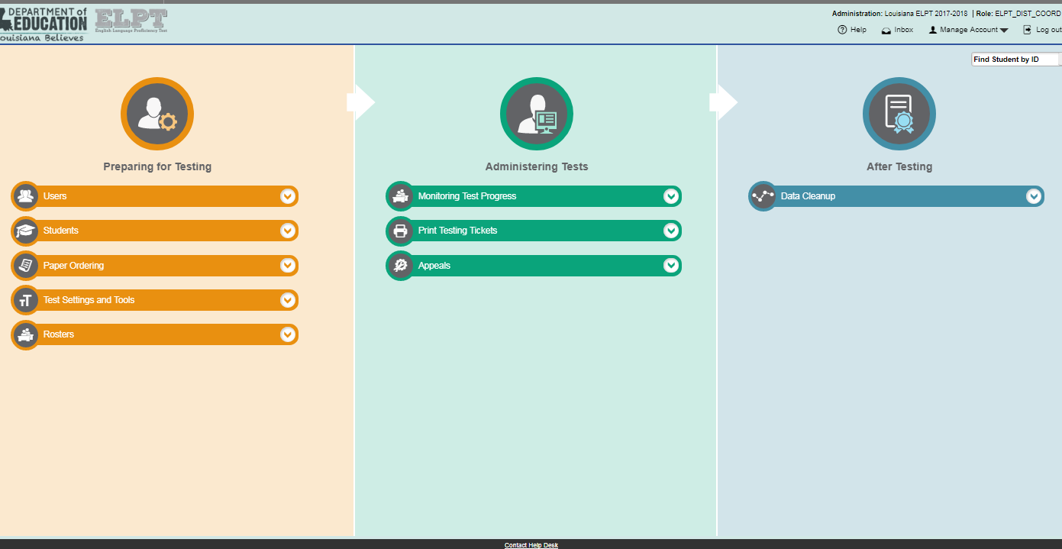
TIDE Home Page
Each of TIDE’s two sections list menus for the tasks available in that section. To expand a task menu and view its set of related tasks, click the down arrow on the end of that menu. To perform a task, click the name of that task listed in the menu.

Slide 56
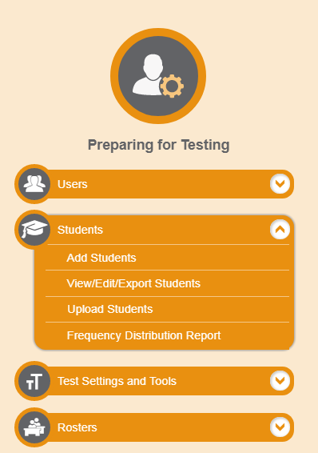
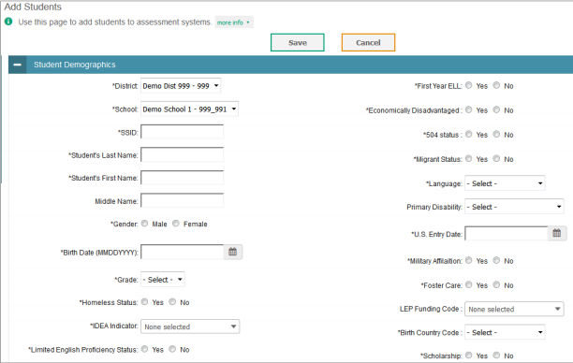
Adding Students

Slide 57
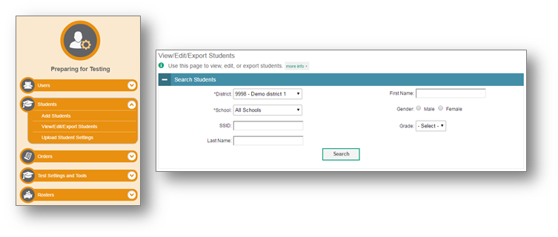
View/Edit/Export Students
The View/Edit/Export Students page includes a form for setting selection criteria to retrieve students. The fields for District and School are mandatory and marked with an asterisk.
The students you can retrieve on this page are limited by your role’s scope.

Slide 58
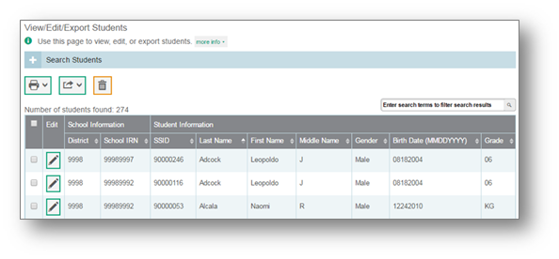
View/Edit/Export Students
TIDE will display all the students satisfying the search criteria. You can edit a student’s information, including test settings and accommodations by clicking the green pencil icon.
Print or export student information or delete students from TIDE by selecting the desired students and clicking the Print, Export, or Delete button above the search results.

Slide 59
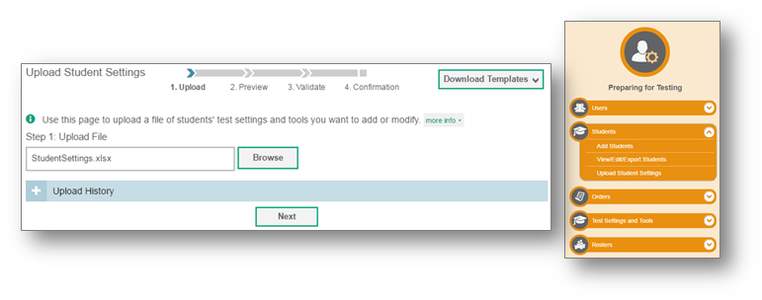
Upload Student Settings
District and STCs may also edit test settings and tools in TIDE by using the Upload Student Settings page to compose an upload file in Excel or CSV format.
The easiest way to compose an upload file is to download an available template, which you can do by clicking Download Templates and selecting either Excel or CSV.

Slide 60
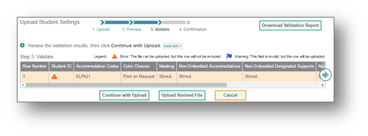
Upload Student Settings
TIDE will validate the file and display any errors or warnings according to the legend on the page. Click the orange error icons and blue warning icons in the validation results to view the reason a field is invalid. If a record contains an error, that record will not be included in the upload. If a record contains a warning, that record will be uploaded, but the field with the warning will be invalid.
If your file contains a large number of records, TIDE will process it offline and send you a confirmation e-mail when complete.
When the upload is complete, a confirmation page will appear with a message that summarizes how many records were committed and how many were excluded.

Slide 61
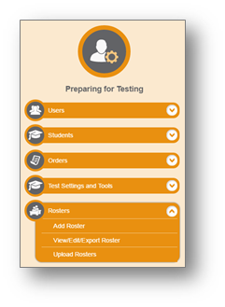
Rosters
The Rosters task menu allows you to add rosters; view, edit, or export rosters; and upload rosters from an external file.
Once test scores are calculated, roster information is used to generate reports of how students in the roster performed as a group.

Slide 62
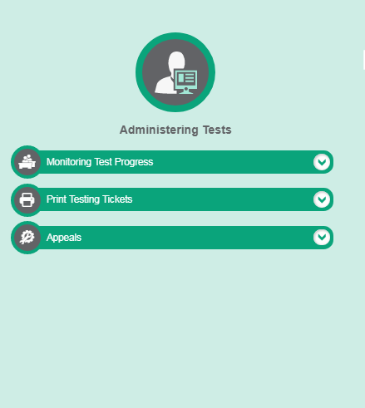
ELPT Testing Tickets
A test ticket is a hard-copy form that includes a student’s SSID for logging in to a test. DTCs and STCs can print tickets through the Administering Tests section of the TIDE.

Slide 63
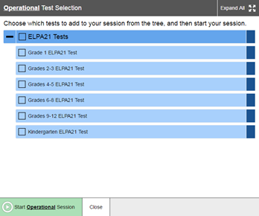
ELPT Administering Testing
Test Administrator Interface in the TDS shows the Test Selection window open by default. From the Test Administrator Interface, you can do the following:
Create and manage test sessions
Look up students
Access help information

Slide 64
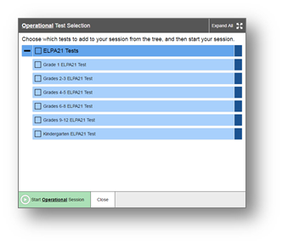
Create a Test Session
The first step to administer a test is to create a test session. Test sessions should be created less than 20 minutes prior to the start of testing. To create a test sessions use the following steps:
Select the test(s) to administer.
Select the start session button in the lower left corner.
Write down the session ID for students to enter in the
test delivery system.

Slide 65
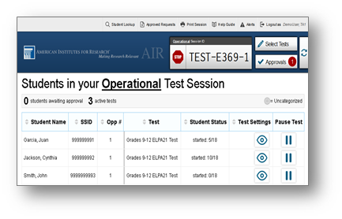
Create a Test Session
Once a test session is started the session ID will appear at the top of the TA interface.
The test administrator must approve the students for testing. The test session table appears in the center of the TA interface, displaying students’ testing progress.

Slide 66
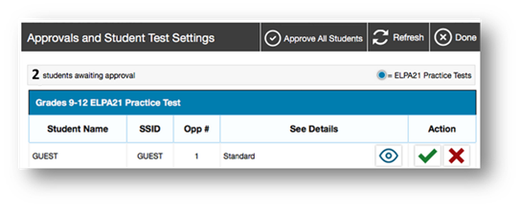
Approving Student Entry
Once the Test Administrator starts the test session and students log in, he or she must approve students’ test settings before they can access their tests. It is very important to pay close attention to the test name prior to approving to be sure that students selected the appropriate test.

Slide 67
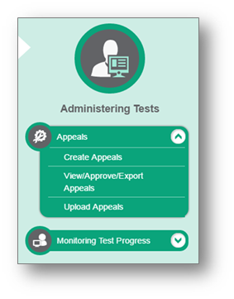
ELPT Appeals Process
In the Administering Tests section of the TIDE dashboard, the Appeals task menu allows you to view pending appeals; create new appeals; view, approve, or export appeals; and upload appeals.

Slide 68
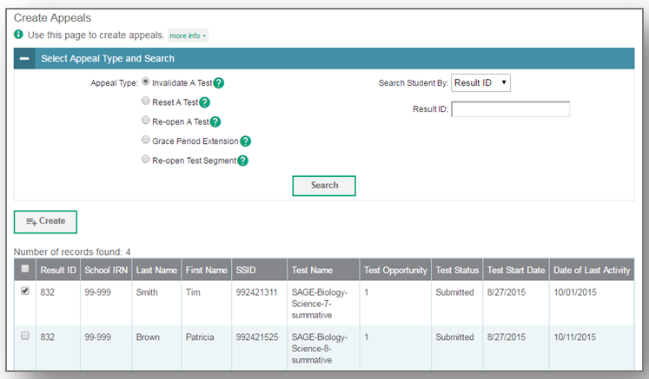
Creating Appeals
The Create Appeals page is where District and School Test Coordinators can create an appeal for a test.
Steps to creating an appeal:
Select the type of appeal
Search for the test result
Mark the checkbox next
to each test result
Enter a reason for the appeal
and hit submit

Slide 69
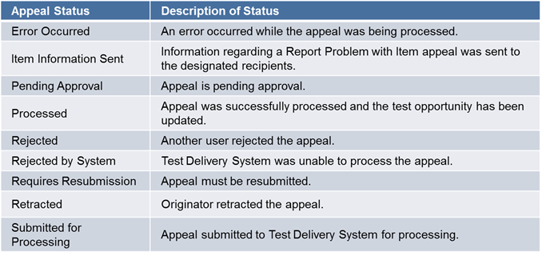
Status of Appeals

Slide 70
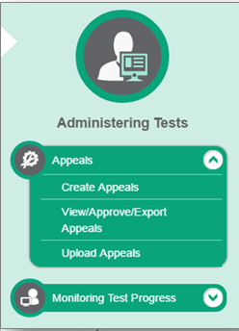
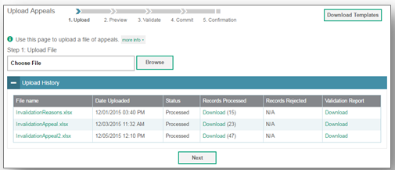
Upload Appeals
District Coordinators may also create new appeals in TIDE by using the Upload Appeals page to compose and upload a file in Excel or CSV format. This task is performed by following the same steps used to upload student test settings.

Slide 71
ELPT OTT
The ELPT Online Tools Training and TA User Guide are now available.
The Student Online Tools Training can be accessed using supported web browsers or the Louisiana Secure Browser.
The TA Online Tools Training Administration site can be accessed using supported web browsers.
Students should take the appropriate Online Tools Training for their grade prior to taking the ELPT Summative Assessment so they become familiar with the structure of the test and the item types. For more information on administering the Online Tools Training, see the TA User Guide.
Google Chrome site settings must be set to “allow” microphones for the speaking function of the OTT to work.

Slide 72
Training Modules
The following trainings modules are available in the Webinars and Trainings section of the ELPT portal:
Technology Requirements for Online Testing
Test Delivery System-Online Test Administration
Data Entry Interface-Paper Test Administration
Participation Reports
Online Reporting System
Test Information Delivery Engine (TIDE)

Slide 73
ELPT Webinar
The LDOE hosted a webinar for EL teachers and specialists on the English Language Proficiency Test (ELPT). Information included:
a summary of presentations from the September and November collaborations and
information on the assessment guide and administration.
The presentation and recording will be uploaded to the Assessment Library, Assessment Guidance Library, and LDOE English Learners pages.

Slide 74
ELPT Resources
ELPT Achievement Level Descriptors | guide to the achievement levels for each grade and domain
ELPT Assessment Guide | overview of assessment design, rubrics, alignment, and more
ELPT Assessment Guide Webinar | ELPT Teacher Training presentation
ELPT DTC Training | training on ELPT administration for test coordinators
ELPT FAQ | list of Frequently Asked Questions for teachers and administrators
ELPT Portal | Administrative portal for ELPT

Slide 75
ELPT Resources
ELPT OTT | access to the online testing platform for students/teachers to practice using the system
ELPT TA Training | training for test administrators and test coordinators on the role of the TA
English Learners Library | LDOE website for English Learner Specialists/Teachers
Parent Guide to ELPT | two-page document outlining the ELPT that is also available in Arabic, Spanish, and Vietnamese
TA User Guide | guide for ELPT Test Administrators
TIDE User Guide | guide for the ELPT TIDE system

Slide 76
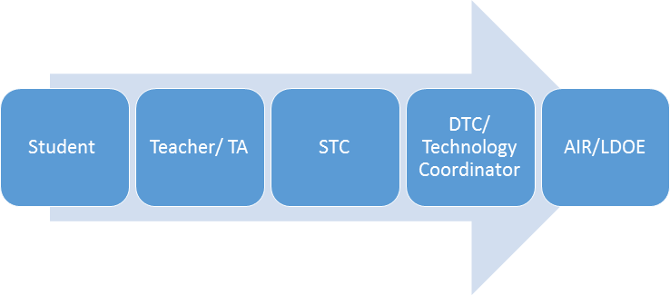
Technical Assistance Protocol
If technical problems occur during testing, school and district staff should follow the ELPT Technical Assistance Protocol presented below. Technical problems include, but are not limited to, problems connecting to INSIGHT, the inability to load test items, or missing buttons.
AIR Contact Info
7:00 AM – 7:00 PM
1-866-758-0231
laelpthelpdesk@air.org
Chat: http://la.portal.airast.org/chat/
LDOE
1-844-268-7320
assessment@la.gov

Slide 77
LAA 1 and LEAP Connect

Slide 78
Key Dates
Testing Window | February 5 – March 16
OTT | Available Now
SRC | Available Now
Manage Users | Available Now
Test Setup | Available Now
Manuals posted | Available Now
Receipt of Materials | January 26
Additional Materials Window | January 29 - March 15

Slide 79
LAA 1 TCM Alerts
LAA 1 Program
LEAP Alternate Assessment, Level 1 (LAA 1), is an assessment for students with significant cognitive disabilities in grades 4, 8, and 11 who will not participate in general statewide assessments. The LAA 1 assesses students in Science only.
Security Numbers
All Administrator Booklets, Student Booklets, response documents, and Task Descriptions have security numbers. The security numbers, located on the back covers alongside the bar codes, are used to inventory and track secure materials.
Administration of Tasks
Students should have the opportunity to take all tasks. However, if after attempting at least five tasks within a content area the student is unresponsive on all of the items resulting in a score of zero, the test administrator may stop testing. No scores should be marked on the response document for the remaining items. Note: If the student is unresponsive because he or she is having a bad day, the test administrator should try administering the test on another day.

Slide 80
LEAP Connect Alerts
Directions for Test Administration
The Directions for Test Administration (DTA) provide the Test Administrator (TA) with specific instructions for administration of the particular test. Each DTA provides the exact wording of the items to be used by the TA, the materials needed in preparation of the test, and guidelines for how to present the items to the student. Prior to testing, this must be reviewed in a controlled setting with the school test coordinator. After the review, the school test coordinator must collect the Directions for Test Administration and securely store until testing begins. After testing, these secure materials must be returned to DRC. Even if text to speech is used, the DTA MUST be used by the test administrator.
Verbal and Nonverbal Assessments for ELA Grades 3 and 4
Students in grades 3-4 will have a Foundational Reading section on the ELA assessment. eDIRECT test sessions will need to be assigned by students who are verbal or nonverbal. When creating test sessions, under the Assessment dropdown, select either the verbal or nonverbal assessments to ensure the group of students who are verbal or nonverbal receive the correct form. Students in grades 5-8 do not have this section on the ELA test, so there isn’t two options for test setup for ELA.

Slide 81
LEAP Connect Alerts
Student Response Check (SRC)
The Student Response Check is available for students to take prior to testing. This is a 3-question task which a student is asked to demonstrate their preferred mode(s) of communication. The purpose of the SRC is to ensure that a TA can clearly identify which answer a student indicates in response to a selected-response test item. If the student’s response is not observable by the TA, the TA cannot enter the students response in DRC INSIGHT. The SRC is accessed through the LEAP Connect Online Tools Training, under the link “Student Response Check”.
Answers Recorded and Augmentative and Alternative Communication
If a student is unable to write due to his or her disability, the student can dictate orally or sign his or her responses to selected-response and constructed-response items to the test administrator or other qualified individual, who must record them on the online form. Qualifications, preparations, and protocols for transcribing student responses are detailed in Appendix A and Appendix B of the TAM in eDIRECT.
End of Test Survey
At the end of each student’s test in INSIGHT, there is a survey for TAs to complete and submit. This will provide useful feedback on the experience of each TA administering LEAP Connect.

Slide 82
LEAP Connect Alerts
Procedures for Assessing Students Who Are Blind, Deaf, or Deaf-Blind
The Procedures for Assessing Students Who Are Blind, Deaf, or Deaf-Blind: Additional Guidance for Test Administration includes (1) tasks to complete before, during, and after the assessment; (2) strategies that may be used by the Test Administrator (TA) as appropriate for individual students to enhance access; and (3) appendices with information for accessing the Foundational Reading Items in Grades 3 and 4 and additional resources.
Test Delivery Method
Test administrator provides a one-to-one test administration using the online test platform (INSIGHT) and Directions for Test Administration for grade specific item presentation and response collection. All passages, items, and response options are designed to be read to the student through text-to-speech or by the test administrator.
Administration of Tasks
If after attempting at least four tasks in a content area the student is unresponsive on all of the items, you may exit and close the test. Note: If the student is unresponsive because he or she is having a bad day, try administering the test on another day.

Slide 83
LEAP Connect OTT and DTA
The Online Tools Training (OTT) Directions for Test Administration (DTA) can be accessed on eDIRECT under General Information by clicking on Documents, then LEAP Connect/LAA1 Spring 2018 in the Administration field and Manual in the Document Type field.
The OTT DTA provides the test administrator of the LEAP Connect specific instructions for administration of a particular Online Tools Training. Each DTA provides the exact wording of the items to be used by the test administrator.

Slide 84
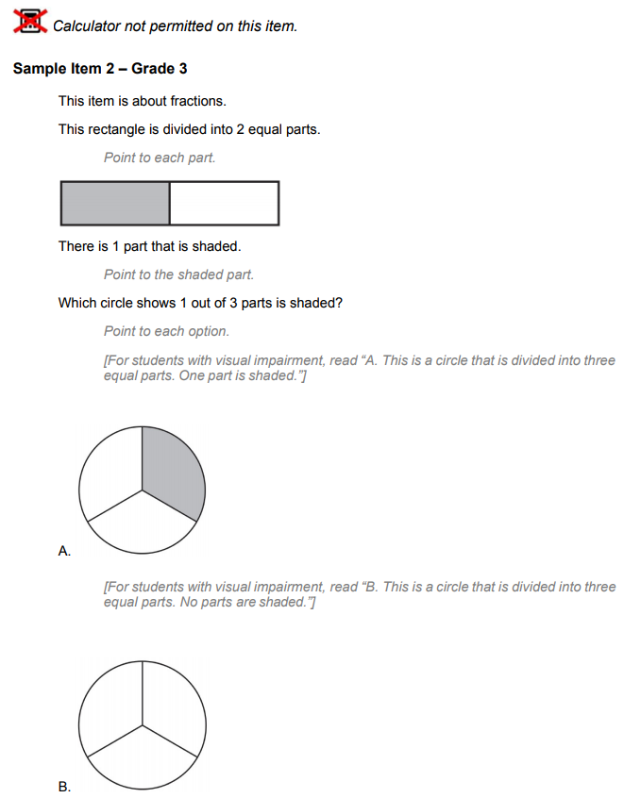
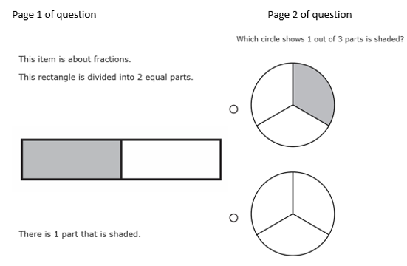
LEAP Connect OTT DTA
Student Screen DTA

Slide 85
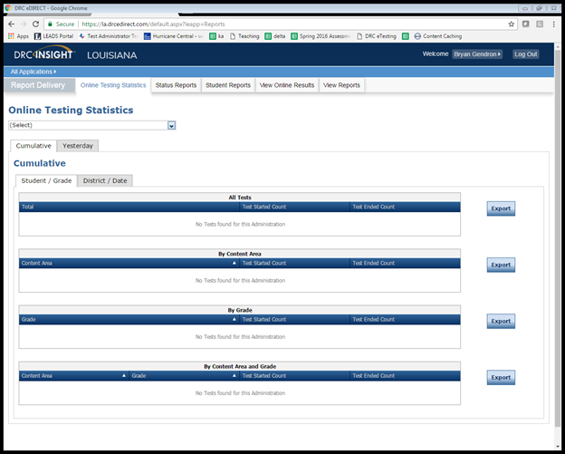
Testing Statistics Reports
eDIRECT has a number of reports to help District Test Coordinators assess the status of their schools during testing. These reports are located in the Online Testing Statistics tab. These reports include:
Online Testing Statistics
Shows the number of students
by school and subject that have
completed testing for the current
and previous day only.

Slide 86
Testing Statistics Reports
Below are other reports that are located under the Status Reports tab.
Daily Cumulative Student Status Reports
Displays all students in a test session and the ticket status of those students
Daily Student Status Report
Displays the start and submit times of each student that logs into a test
Daily School Resets Report
Displays all unlocked test sessions
Excessive Login Report
Shows the number of times a student logged in
Daily State Summary of Test Times Report
Displays the duration in which students completed the test
Daily District Report of Testing Status by School
Displays the number of tests started and ended for the district and school

Slide 87
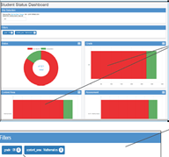
Student Status Dashboard
The Student Status Dashboard allows you to display student testing status by school and administration. You can filter information on the Dashboard by testing status, grade, content area and assessment (or any combination of these). The Student Status Dashboard User Guide is located in eDIRECT.
Note: Dashboard data displays in real time as test scores are populated in the database.
You need the student status permission in eDIRECT to use the Dashboard.

Slide 88
Accountability Codes
District and school test coordinators should wait until the very end of the testing window to do all accountability coding in the eDIRECT system.
At the end of the testing window, students who do not test must be placed into a test session for each subject and coordinators must apply the appropriate accountability code for the student (should have documentation on file). Failure to apply a code could result in a forced zero for each subject test that the students did not complete.
Steps to pull up list of applied accountability codes:
Manage Test Session
  Select District and School
  Export student details
Applied accountability codes will be in the column labeled Testing Codes.

Slide 89
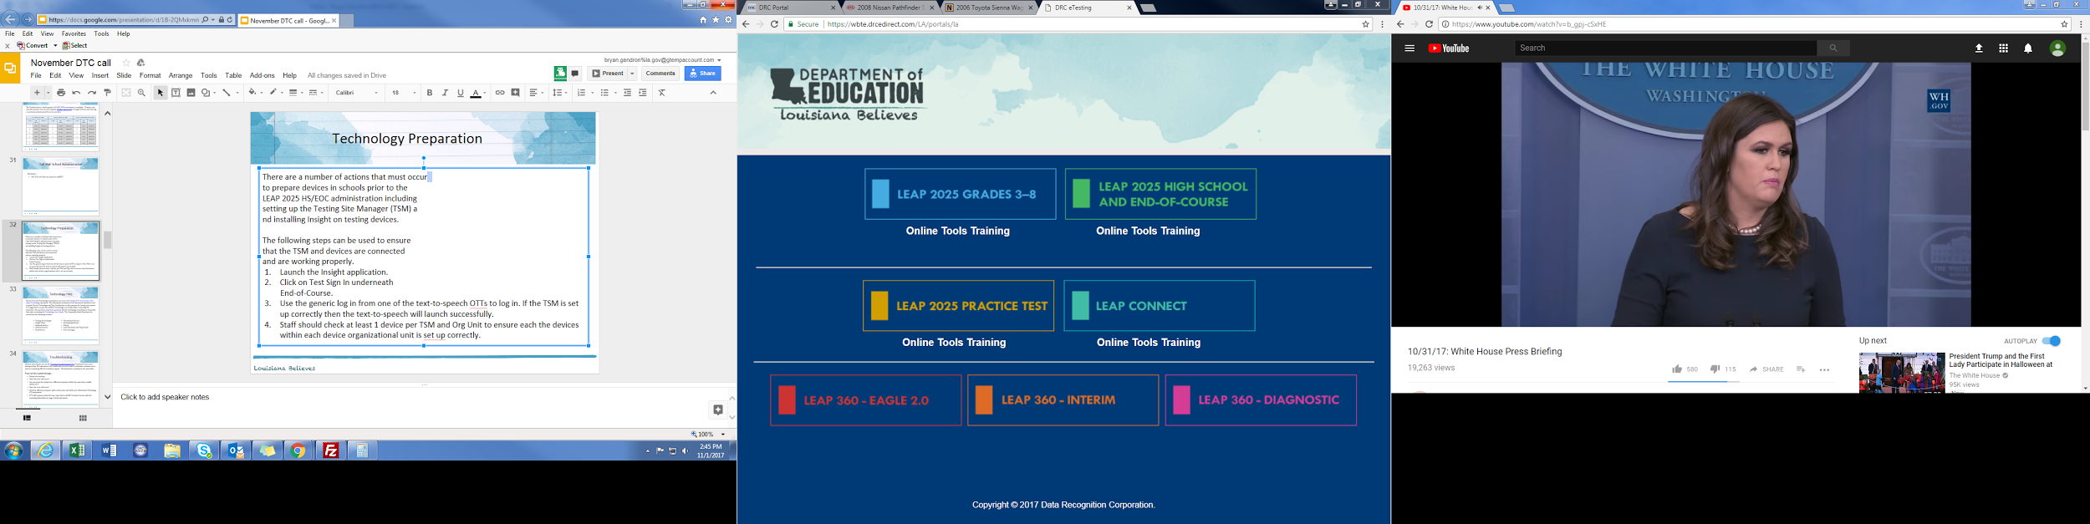
Technology Preparation
There are a number of actions that must occur
to prepare devices in schools prior to the
Testing administration including setting up the
Testing Site Manager (TSM) and installing INSIGHT
on testing devices.
The following steps can be used to ensure that the
TSM and devices are connected and are working
properly.
Launch the INSIGHT application.
Click on Online Tools Training In underneath LEAP Connect.
Use the generic log in from one of the OTTs to log in. If the TSM is set up correctly then the text-to-speech will launch successfully.
Staff should check at least 1 device per TSM and Org Unit to ensure each the devices within each device organizational unit is set up correctly.

Slide 90
Technology FAQ
District Test and Technology Coordinators can access the Statewide Assessments FAQ about Technology document. The information contained in this document should be used to guide District Technology and Test Coordinators as they prepare for Spring assessments. It is suggested to review the eDIRECT Technology User Guide before reviewing this document. The questions represent questions District Technology Coordinators frequently have after reviewing the Technology User Guides. The Frequently Asked Questions are sorted into the following sections:
Testing Site Manager
Insight Client
Netbook Devices
Android Devices
iPad Devices
Chromebook Devices
nComputing Devices
eDirect
Load Simulation and Ping Trends
Error Messages

Slide 91
Troubleshooting
Districts and schools can use the Technical Troubleshooting Tips if technical issues occur during testing. This document is for school sites to use in order to eliminate common errors prior to contacting DRC for technical support. The document is outlined in the next slides.
If you run into a system message…
Reboot the machine
Does the error still occur?
Can you move the student to another computer within the same lab or mobile laptop cart?
Does the error still occur?
Mark the affected computer with a sticky note and notify your Information Technology (IT) department.
If IT staff cannot resolve the issue, have them call DRC Customer Service with the reporting information on page 3 of the document.

Slide 92
Troubleshooting
Common System Message | Troubleshooting Action
Invalid Username and Password | The student has either typed in the information incorrectly or has logged into the wrong testing location. Back out to the main menu and verify the location where the student is logging in. This is not a technical error.
Internet/Network Connection Error – There was an interruption in the internet connection and the testing device cannot reach DRC servers or the TSM. | Did the district technical department whitelist both the URLs and the IP addresses on all content filters, firewalls, and antivirus software?
 | If wireless, check the access point to computer ratio. Are there too many devices connecting to one access point?
 | Conduct a speedtest at www.speedtest.net to Minnetonka, MN. What is the upload and download speed? If it is less than 10 mbps, it is too slow to test.

Slide 93
Troubleshooting
Common System Message | Troubleshooting Action
TSM Connection Error – Workstation cannot connect to the TSM internally on the network. | Proceed with Internet Connection Error Troubleshooting
 | Contact local IT staff to confirm the local machine firewall is turned off if using a Windows OS TSM.
 | Contact local IT staff to confirm that the TSM service is running.
 | If no one can test, restart or reboot the service.
Configuration Not Found, Configuration Error – The testing device is not registered to the Device Toolkit and cannot proceed with testing until assigned an ORG Unit ID. | Contact local IT staff to register the device to the Device Toolkit
No TSM Configured – The Testing Site Manager has not been installed on the local network or configured in the Device Toolkit | Contact local IT staff to install or configure a Testing Site Manager.
The next button is grayed out. | The student has not completed the question on the test. This is not a technical error.
Frozen or Gray Screen with spinning wheel | Exit the test and reboot the machine. This is typically due to temporary overloaded internet traffic or maxed out memory on the computer.

Slide 94
Troubleshooting
Common System Message | Troubleshooting Action
Connection Error Retrieving Content – Testing Device cannot connect to the TSM or content servers to access test content. | Contact local IT staff to confirm that all content files are on the TSM management portal.
 | Contact local IT staff to confirm content files are up to date.
 | Proceed with Internet Connection Error Troubleshooting
Proxy 336 Error – This is an issue with configuration within the Device Toolkit. | Contact local IT staff to confirm that there is nothing in the proxy host field within the Device Toolkit. If so, erase, and redeploy a new configuration file with no proxy server settings.

Slide 95
Troubleshooting
No Audio | Does the audio stop after “Begin test?” Is the machine sound dialed more than halfway up? Does the audio work outside the software? Does the audio work from the speakers? Are the headphones plugged in before launching the software? Is the latest sound card driver installed? Is the TTS button checked in the TSM? Does the student have the text-to-speech accommodation checked in eDIRECT?

Slide 96
Troubleshooting
If after troubleshooting there are still issues with testing, contact DRC Customer Service with the information below. Write down the following information to prepare for your call with customer service:
Reporter/school/district/state
Phone or email
Student IDs (username and password if a phone call)
Number of students affected out of how many students
Date and description of the issue
Specific system or error message (e.g. “Internet Connect Error” or “TSM Connection Error During Login”)
When does the error message occur (e.g. when they select “Sign In?” or in the middle of testing)
Operating system/version (Mac/Windows/iOS/Chromebook/Android)
ORG Unit ID
Wired or wireless
Do the System Readiness Check. Are there red exclamation points? Which settings?

Slide 97
Troubleshooting
Contact DRC Customer Service at LAHelpDesk@datarecognitioncorp.com or 1-888-718-4836 with the following issues:
LEAP 2025 Platform Functionality:
    User Administration (Adding and Editing Users in eDIRECT)
    Materials Ordering and Additional Materials
    Adding and editing students in Test Setup
    Adding and editing test sessions and printing
    Test tickets
    Data Validation
    Viewing and Downloading Student Reports
Materials Receipt, Inventory, and Return
Labeling of test booklets (Pre ID, District-School, and Do Not Process labels)
INSIGHT and TSM Installation, Functionality, and Troubleshooting

Slide 98
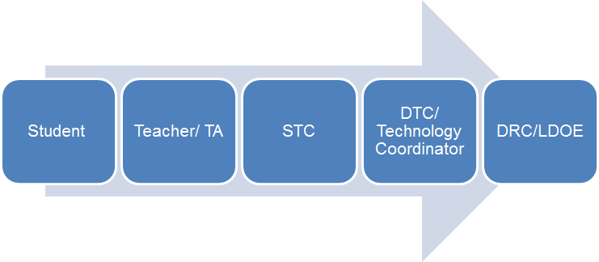
Technical Assistance Protocol
If technical problems occur during testing, school and district staff should follow the LEAP 2025 and LEAP Connect Technical Assistance Protocol presented below. Technical problems include, but are not limited to, problems connecting to INSIGHT, the inability to load test items, or missing buttons.
DRC Louisiana Customer Service
1-888-718-4836 LAHelpDesk@datarecognitioncorp.com
LDOE
1-844-268-7320
assessment@la.gov

Slide 99
LEAP Connect/LAA1 Resources
LEAP Connect Webinar-the recording of the assessment overview webinar presented in December.
LEAP Connect Assessment Guide—access the LEAP Connect Assessment Guide
LEAP Connect Achievement Level Descriptors—a guide to the Achievement Levels with a list of the skills and knowledge students at each level are generally able to demonstrate
LEAP Connect Sample Items-a webinar/presentation with sample items
LEAP Connect Online Tools Training-a chance to preview the testing platform and practice the online tools that will be available during testing.
Strategies for Success: A Guidebook for Supporting Students with Disabilities-the SPED Guidebook
LA Connectors for Students with Significant Disabilities—list of SWSD connectors for K-12 ELA and math
LA Connectors Essential Elements Cards—cards that assist educators with individualizing instruction for SWSD both in inclusive and self-contained environments
Parent Guide to LEAP Connect-a two page guide for parents on the LEAP Connect

Slide 100
LEAP 360

Slide 101
LEAP 360 Resource Availability Timeline
Resource | Available | Purpose
K-2 Formative Tasks | Currently available in eDIRECT Kindergarten, grade 1: 6 math tasks, 6 ELA tasks Grade 2: 4 math tasks, 4 ELA tasks | Aid and enhance student learning while allowing teachers to make timely interventions to adjust instruction throughout the year
Diagnostics | Currently available in eDIRECT Grades 3-8: ELA and math, English I, English II, Algebra I, and Geometry | Help educators identify prerequisite skills students need for success in the current grade level
Interims | Form 1: currently available in eDIRECT Form 2 ELA (3-8): coming mid February (Teacher Access currently available in eDIRECT) Form 2 Math (3-8): currently available in eDIRECT Forms 2 and 3 (HS): currently available in eDIRECT | Help educators identify students’ misconceptions and learning patterns to adjust instruction and target support (grades 3-8 ELA and math, English I, English II, Algebra I, and Geometry)

Slide 102
LEAP 360 Updates
Interim 2 grades 3-8 Math and ELA Teacher Access are available. Math Teacher Access versions and answer keys have been posted in eDIRECT.
Thirteen new Social Studies passages with items are now available in EAGLE.
Five for Grade 3
Four for Grade 6
Three for Grade 7
One for Grade 8
Notes:
This slide shows LEAP 360 changes that have occured over the past month.
Note: LEAP 360 Interim 2 ELA answer keys and Teacher Access versions will also be posted this month. Interim Form 2 for Math Grades 3-8 will be available later this month, and Interim Form 2 for ELA Grades 3-8 will be available next month.
New Social Studies passage sets have been added to EAGLE. In the upcoming months, new content will be added for ELA, Math, and Social Studies.

Slide 103
Support and Communication

Slide 104
DTC and Accountability Contact Update
If during the academic year the person appointed as district test coordinator changes, the district superintendent must notify the LODE. The notification must be in writing and must be submitted within 15 days of the change in appointment.
Due to the secure nature of the data accessed by accountability contacts and district test coordinators, changes have been made to the submission process for any updates to DTC and accountability contacts:
Superintendent signature now required
The DTC and Accountability Contact Update Form must be submitted from the superintendent’s district email account.
The revised DTC and Accountability Contact Update Form is located under the Resources + Forms section in the Assessment Library.

Slide 105
January/February Collaboration
Sessions at the January/February Supervisor and Principal Collaborations will focus on topics relevant to school system leaders including but not limited to accountability, school system planning, content area instruction, assessment, early childhood, and data systems. Registration closes January 19, 2018 in Wisdomwhere, and the overview documents are posted on the website.
Date | Location
Tuesday, January 30 | Claiborne Building 1201 N.3rd St. Baton Rouge, LA 70802 | Baton Rouge
Thursday, February 1 | Jefferson Parish Public School Board 501 Manhattan Blvd. Harvey, LA 70058 | Harvey
Wednesday, February 7 | Bayou Church 2234 Kaliste Saloom Rd. Lafayette, LA 70508 | Lafayette
Thursday, February 8 | Trinity Methodist Church 1000 Woodward Ave. Ruston, LA 71270 | Ruston

Slide 106
District Support
The Assessment team offers multiple avenues of support to districts, schools, and teachers seeking information or assistance about assessment administration and accountability.
Weekly Newsletters
Assessment and accountability information and deadlines are released each week in the district newsletter.
Weekly Assessment & Accountability Calls
Each Tuesday at 1:00 PM these webinars are held to provide training, updates, and important information to DTCs and Accountability Contacts.
Assessment Library and Accountability Library
The Assessment Library contains resources for DTCs including the Assessment Schedule and the Assessment and Accountability Month-by-Month Checklist. The Accountability Library contains resources for accountability contacts including the School Performance Score (SPS) calculators as well as information on data certification and federal accountability.

Slide 107
District Support
Monthly Educational Technology Calls
Each month a webinar is held for district technology personnel to provide training, updates, and important information related to technology readiness and digital literacy.
Assessment@
All stakeholders are encouraged to email assessment and accountability questions and/or concerns to assessment@la.gov.
Assessment Hotline
For immediate assistance regarding assessment and accountability, district-level staff may call the Assessment Hotline at 1-844-268-7320.
EdTech@
All stakeholders are encouraged to email technology readiness questions and/or concerns to edtech@la.gov.

Slide 108
Assessments Customer Service
The Assessments Customer Service Contact Information has been posted to the Assessment Library. This provides all customer service contact information for all assessments.

Slide 109
Next Steps

Slide 110
Next Steps
Key Dates | Action
January | Train STCs for ELPT and LEAP Connect Students and teachers must use the ELPT and LEAP Connect OTT prior to testing Use LEAP 2025 Practice Test resources to make district and school planning decisions
Week of January 15 | Use the ACT Match/No Match list to determine which students need to take the ACT Distribute fall high school LEAP 2025 score reports
January/February | Plan to attend January/February Collaboration Events January 30: Baton Rouge February 1: Jefferson February 7: Lafayette February 8: Ruston
Next Assessment and Accountability Monthly Call: February 20, 2018

