Slide 1

Assessment and Accountability Monthly Call
July 2018

Slide 2
Agenda
Month-by-Month Checklist
Accountability
Assessment Administration
Assessment Updates
Support and Communication

Slide 3
Month-by-Month Checklist
The 2018–2019 Assessment and Accountability Month-by-Month Checklist
  identifies key dates and deadlines for statewide assessment programs and accountability processes for next school year;
  provides action steps to ensure readiness for administering statewide assessments; and
  recommends resources for district and school staff.
The checklist includes information on the following areas:
  Communication and Support
  Accessibility and Accommodations
  Assessment Preparation and Administration
  Accountability
  Reports
NEW: The 2018-2019 Assessment Month-by-Month Checklist is located in the Assessment Library.

Slide 4
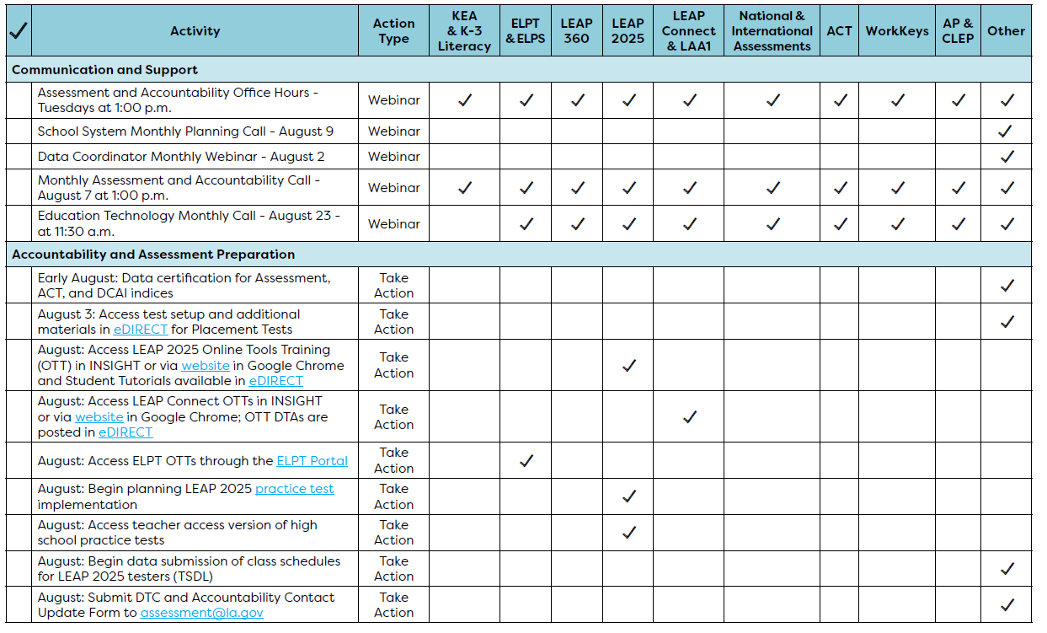
August Assessment and Accountability Checklist

Slide 5
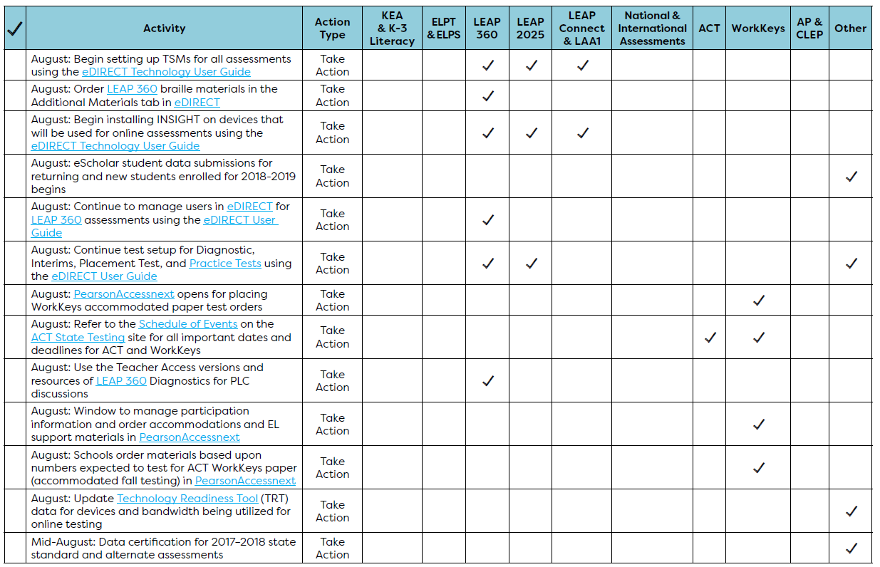
August Assessment and Accountability Checklist

Slide 6
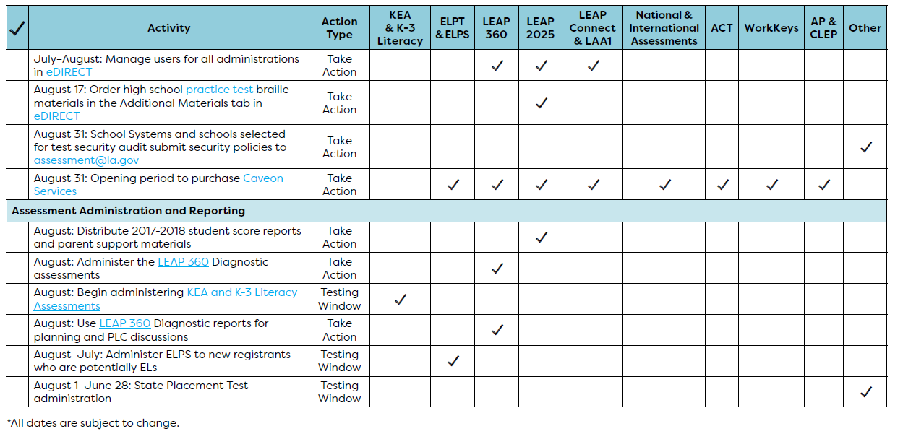
August Assessment and Accountability Checklist

Slide 7

Accountability

Slide 8
LEAP 2025 Release
By 2025, the average “A” school in Louisiana is one in which students are fully mastering key concept and skills.
Today’s release is the first in a series of reports over the course of the next several months that use results from the grade 3-12 LEAP 2025 assessment to provide educators and families with information on student’s progress towards these goals:
Subject-area proficiency rates of students, schools, and school systems (today)
2. Annual rates of progress from one year to the next for students, schools, and school systems (August)
3. School performance scores that combine proficiency rates and progress rates, reported in School Finder (fall)

Slide 9
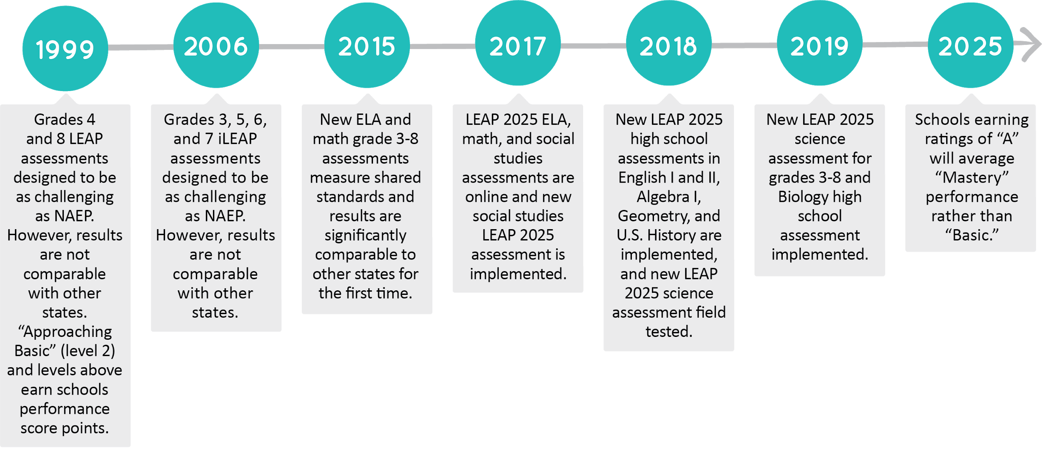
How Have LEAP Tests Changed Over Time?

Slide 10
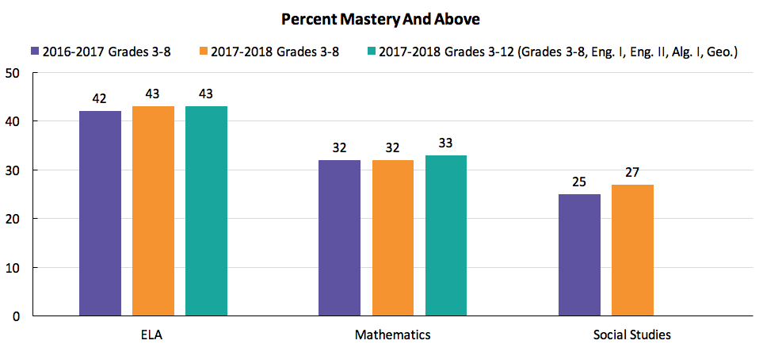
Step 1: 2018 LEAP 2025 Results
Overall, results on ELA and mathematics assessments remained steady from 2016-2017 to 2017-2018. As expected, the percentage of student scoring Mastery and above in the second year of the new standards-aligned social studies assessment saw a larger increase, by two percent, from 2017.

Slide 11
2018 LEAP 2025 Key Trends
Historically disadvantaged students are improving, but achievement gaps persist: The percentage of economically disadvantaged and African-American students scoring Mastery and above improved by two and one percentage points respectively, however these gains lag behind their non-disadvantaged peers.
Mathematics results are lower and improving slower than literacy results: This trend highlights a need for stronger mathematics instruction statewide, particularly in later elementary and middle grades.
Students are progressing in social studies: As is typical in the second year of a new assessment, the percent of students scoring Mastery or above on the social studies assessment increased two percentage points.

Slide 12

How are LEAP 2025 Results Used?
Families receive individual student scores through student-specific reports that detail academic strengths and challenges. Parents can also use School Finder to locate information about school and school system performance.
Teachers use student performance and progress data to identify gaps in learning and instruction, provide targeted interventions to students, and set meaningful goals for their classrooms at the start of each school year.
School and school system leaders review achievement and progress data in the principal and superintendent secure reporting portal, and they use the data to identify and implement strategies to support improvement in struggling schools.
The state uses test results as one factor in evaluating school and district performance. Struggling schools complete improvement plans as part of Louisiana’s ESSA plan and compete for funding to support these plans. The state also determines charter school renewal and RSD status in light of ratings.

Slide 13
Next Step: Analyzing Annual Student Progress
Release of Student Progress Results
Student progress results at the classroom, school, and school system levels will be released in August to provide educators and administrators with information on the extent to which students make progress toward content mastery, and how well they progressed relative to their peers, during the 2017-2018 school year.
Both school leaders and Teacher Leaders were provided with support during the 2018 Teacher Leader Summit on how to use these data to impact instruction. Additional support will be provided at the September Teacher Leader Collaborations.

Slide 14
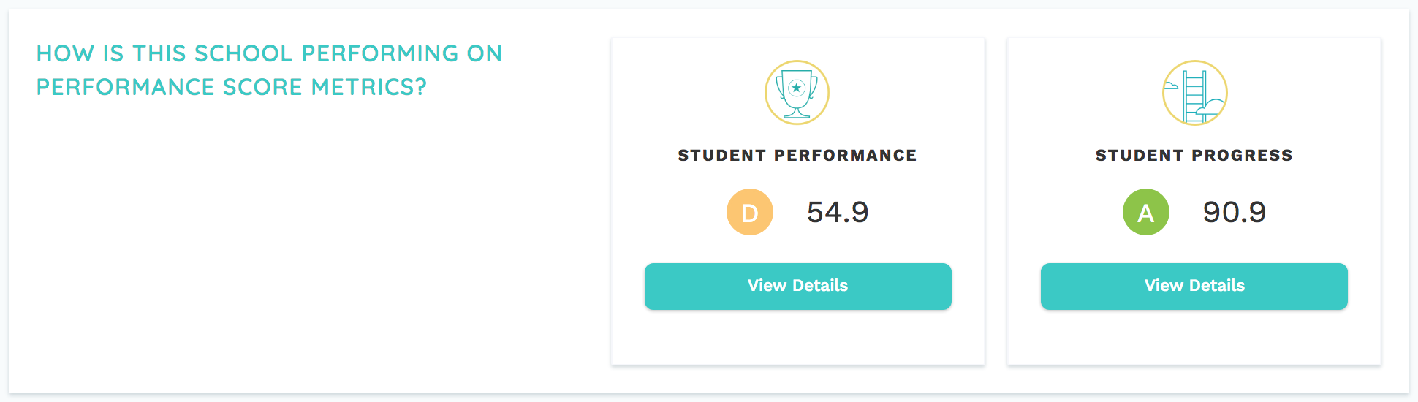
Next Step: Reporting on Overall School Performance
Release of 2018 School Performance Scores
This fall, as part of Louisiana’s ESSA plan, schools will also receive a score and letter grade equivalent for both student performance and student progress, in addition to a comprehensive grade and score.

Slide 15
Growth To Mastery: Targets for 2019
The department will provide two files to schools and systems related to student growth and the School Performance Score Progress Index.
The new K8 2018-2019 Growth to Mastery Student Rosters were shared in DRC eDIRECT to facilitate planning for the upcoming academic year. These files provide the annual target scale score that students will need to earn in 2019. The files will be updated with new site codes after the October 1, 2018 enrollment period closes. Progress points fact sheets for both K8 and high schools can be found in the Accountability Library.

Slide 16
Growth to Mastery: Progress Index Results for SPS
In August, the 2017-2018 Progress Index Points Rosters will be provided in the La Data Review System. These files provide the final results from Step 1 and 2, including the number of points that are awarded to schools in the SPS for the growth of each eligible student from 2017 to 2018.
  For K-8 schools, two years of data will be used to calculate the progress index. The points awarded to schools for each student’s growth from 2016 to 2017 are available on a growth index roster in the secure portal.
  For high schools, the progress index will be calculated with the growth data from one year (2017 to 2018). Beginning in 2018-2019, the high school index will include two years of growth data.
2) The department will report the growth of schools and systems to the public in a release planned for August.

Slide 17
August Data Certification
Each year, the department provides an opportunity for schools and systems to review the data used in the school performance score. In early August, review will begin for the following indices using the La Data Review online System that has been used in past years.
ACT/WorkKeys
Dropout/Credit Accumulation Index (DCAI)
Assessment
The final results of the progress points index will be posted as a downloadable file.
A detailed PowerPoint will be provided to each accountability contact in early August, which provides instructions on how to access the system and manage data certification. It is very important that the LDOE have the most current contact information for accountability staff. Accountability contacts will receive emails with secure login information and resources to assist with the process.

Slide 18
WorkKeys Policy Updates
Bulletin 118 has been updated to include the policy below and is effective beginning in 2018-2019.
Students shall be subject to a 30-day wait period before retesting on WorkKeys assessments, during which time LEAs shall provide remediation.
Earlier this month, schools and school systems were provided an opportunity to sign and return a new addendum to the ACT data sharing agreement. For systems who returned the addendum by the due date:
ACT will report the scores from non-LDOE WorkKeys realms directly to the LDOE.
The number of individual WorkKeys submissions that will need to be sent in during ACT data certification will be greatly reduced.
For school systems that did not return the addendum, the department will not have access to scores or certificates that were earned in a non-LDOE realm, and any updates to a student record will require individual documentation during ACT data certification.

Slide 19
State Assessment Policy Reminder
Bulletin 118 policy requires schools and school systems to administer all assessments according to the testing schedule dates approved by SBESE.
In 2018-2019, WorkKeys assessments must be administered in the windows listed below regardless of the realm used to test students.
  October 1, 2018 - April 12, 2019 (CBT)
  October 1-12, 2018 (PBT for fall accommodated paper tests)
  March 13-27, 2019 (PBT for spring accommodated paper tests)
The official testing dates for all state assessments can be found on the 2018-2019 Assessment Calendar.

Slide 20
2017-2018 Assessment Administration

Slide 21
2017-2018 Reporting: Communicating Assessment Results
Assessment | Student Reports | School System-Level Results
ELPT | May 15 in AIR Portal | May in AIR Portal
LAA 1/LEAP Connect | May 15 in eDIRECT | May in eDIRECT
CLEP | ongoing | Spring in FTP
LEAP 2025 (3-8, HS) | Grade 3-8: By June 30 in eDIRECT HS: 5-level ELA and math at end of testing window | By June 30 in eDIRECT
EOC (Eng III, Bio, US History) | HS 4-level all subjects: In window | summer in eDIRECT
ACT | spring, state administered student and school results from ACT sent to schools | iCD and district profile from ACT in summer; additional reporting in FTP
Advanced Placement | summer, sent to schools | August in FTP
LEAP 2025 US History | Summer in eDIRECT | early fall in eDIRECT

Slide 22
Technology Readiness

Slide 23
Online Tools Training
The Online Tools Training (OTT) should be utilized in order to become familiar with the online testing tools (e.g., highlighter, magnification, etc.) used for the operational test. Additionally the OTT:
may be reviewed as many times as desired;
is not to be considered representative of an actual test; and
is available once INSIGHT is installed or by link using Google Chrome browser.

Slide 24
INSIGHT Client Update
An update to the student INSIGHT client was released on June 28, 2018. For the update to automatically be pushed to Windows and Mac devices, the devices will need to be powered on and connected to the network. For Google Chrome and iPads, the update can be downloaded from the respective App Stores and pushed via the Chrome or iOS management tool used by the school/district.
Technology teams should ensure all devices are updated prior to school starting.

Slide 25
TSM Version 9 and TSM Central Office
For the 2018-19 school year, districts and schools can still use the Version 9.2 TSM.
Any district wishing to pilot the new Central Office TSM should email assessment@la.gov.
Benefits of Central Office:
It provides easy monitoring of your TSM devices and testing devices.
It opens directly from eDIRECT allowing you to easily access other functions.
It simplifies the process of testing with more than one DRC testing program.
The full list of benefits on Central Office can be found here.

Slide 26
Technology User Guide
An updated Technology User Guide has been posed to eDIRECT.
This guide describes how to configure, install, manage, and troubleshoot the DRC INSIGHT.

Slide 27
eDIRECT User Guide
The eDIRECT User Guide is being updated and will be posted this month. Key updates include:
Student Group Management: Associates teachers and students within eDIRECT to allow for quick access to their students’ information, testing status, and Interactive reports for LEAP 360 assessments
Educator Scoring: Allows the batch printing of student responses prior to educator scoring and resetting of scores at the student and session levels
Ending Incomplete Tests: Allows DTC to force submit when a student is not going to complete a part or a session of a multipart assessment or test for LEAP 360 and Practice Test assessments
Student Corrections: Process to identify student demographic and test result records that could potentially contain errors and provide the opportunity for corrective action for LEAP 2025 and LEAP Connect assessments

Slide 28
Training Accounts
Each LEA has a Sample School (777) in eDIRECT to use for training purposes only.
This is located under the Diagnostic/Interim administration.
Ten sample students have been added to each 777 site and should be used to practice creating test sessions.

Slide 29
Assessment Technology Specifications
Technology specifications for the 2018-2019 school year are located in the Assessment Library. Any devices used for testing during the 2017-2018 school year will continue to run properly, and schools can expect to see the same level of performance.
Districts looking to purchase new devices should use the specifications to guide future purchasing.
The current 9.2 TSM will remain active for the 2018-2019 school year. Please ensure your TSM is set to automatic updates.

Slide 30
Test Security

Slide 31
Caveon Test Security Services
In order to help districts and schools improve test security, the LDOE has negotiated an agreement with Caveon, the nation’s leading test security experts, to provide the following services:
Monitoring
Provides two Caveon monitors on campus on one day of testing
Provides districts with accurate information of every testing room at the school
Investigations
Provides districts with professional investigators to investigate and report on any testing irregularity that occurred in the district
Training
Provides districts with active online training modules created by Caveon
A full explanation of the services and the fee schedules can be found here. Districts and schools can purchase these services by contacting Caveon directly.

Slide 32
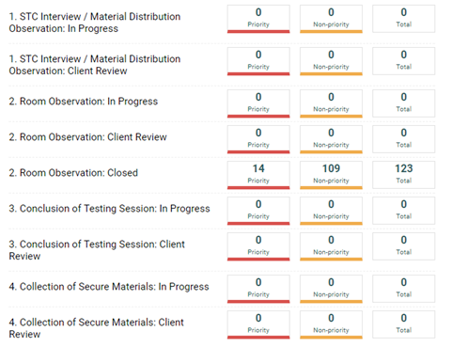
Caveon Core
LEAs utilizing Caveon will receive access
to Caveon Core. Caveon Core allows
DTCs to track the findings of the Caveon
monitors in real time. Caveon Core is
the only way for DTCs to receive real
time monitor feedback.

Slide 33
BESE Test Security Policy Update
At the June BESE meeting the board approve a Test Irregularity Review Committee. The revisions to Bulletin 118, Statewide Assessment Standards and Practices, contain the following:
School systems are no longer required to investigate every void. However, school systems wishing to contest a void must submit a request in writing, including a report resulting from an investigation pursuant to Bulletin 118 §5305.A.3.
  The LDE shall provide a list of recommended investigators that may be used by school systems to support this process. The list of recommended investigators can be found in the Assessment Library.
  The investigation shall produce verifiable evidence that corroborates, with a high degree of certainty, that a testing irregularity did not occur.
Annually, at a public meeting, the Test Irregularity Review Committee shall conduct a records review of the investigative results from the school system as well as any relevant evidence from LDE.
The committee - made up national, state, and district experts and representatives - will make recommendations regarding any potential void reversals.
Any school system wishing to appeal must submit notification by August 13, 2018.
Any superintendent/charter leader wishing to nominate their accountability representative should email the individual’s resume to assessment@la.gov by July 31, 2018.

Slide 34
Test Security Audits
In order for LEAs to be in compliance with Bulletin 118, LEAs must develop a test security policy. All LEAs should have their test security plans accessible and available at all times. For 2018–2019, the Department will only require the following types of LEAs to submit a test security policy:
New LEAs participating in statewide assessments
LEAs that experienced a break of one or more years in participation in statewide assessments
LEAs involved in the monitoring/audit process
LEAs that voluntarily submit a test security policy
All submitted policies will be reviewed using the checklist available here. The Department will review test security policies and provide feedback. August 31, 2018 is the deadline to submit test security policies to assessment@la.gov.

Slide 35
LEAP 2025

Slide 36
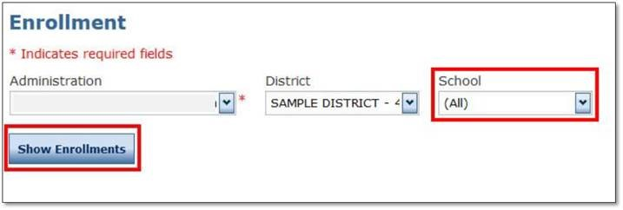
2018-2019 Enrollment Window
From October 1 - October 31, each school system is required to enter enrollments for each school for paper or online testing in grades 3-4 into the eDIRECT Enrollment System. School systems will also verify enrollment numbers.
To enter enrollments in eDIRECT:
Select All Applications and then select Materials.
Select Enrollments within Materials.
Under the Administration drop‐down box, select the appropriate Administration.
Under School, select the school for which enrollments will be entered.
Click Show Enrollments.

Slide 37
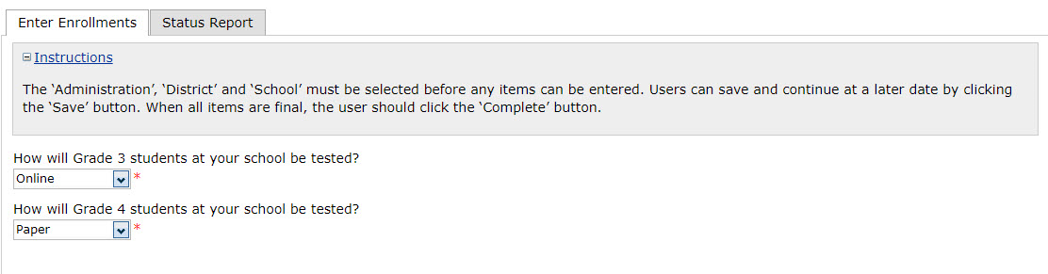
2018-2019 Enrollment Window
Confirm all schools’ testing mode for grades 3 and 4.

Slide 38
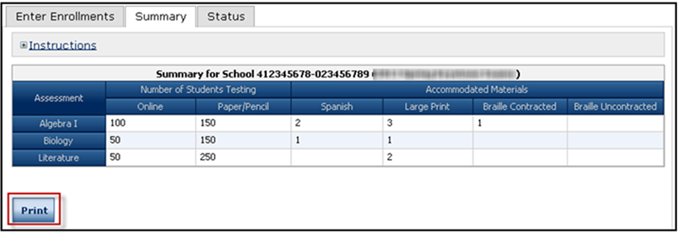
2018-2019 Enrollment Window
Confirm or update counts in the grid.
Enrollment numbers are prepopulated with 2018 initial enrollments.
Verify or update the 2018 counts with the enrollments for 2019. This will ensure that accurate materials quantities are available for your schools and included in your schools’ initial shipment.
If a school no longer hosts a grade, zero out any numbers that appear.
Note: It is important to include all students that require the consumable test booklet accommodated version, including English Learner and PNP students requiring test read aloud.
Click Complete.
Assessments listed here

Slide 39
2018-2019 Enrollment Window
Select the Summary tab to view the information you have previously designated for your school.
Click Print if you would like to print the screen you are currently viewing.
Assessments listed here

Slide 40
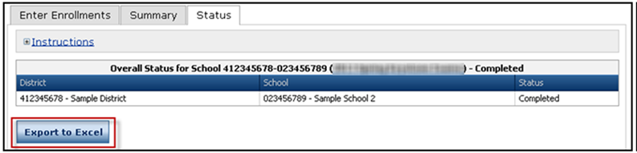
2018-2019 Enrollment Window
Select the Status tab to view the progress of your schools’ registration process.
Click Export to Excel if you would like to view this information in Microsoft Excel.

Slide 41
LEAP 2025 Achievement Level Descriptors
Achievement Level Descriptors (ALDs)
describe what the average student should know and be able to do at the Advanced, Mastery, Basic, and Approaching Basic achievement levels
provide a more complete picture of student performance in relation to reporting categories and sub-categories
located in the Assessment library
available for 3-8 ELA, math, and social studies; English I, English II, Algebra I, and Geometry
currently developing ALDs for U.S. History, to be available Fall 2018
will develop ALDs for 3-8 science and Biology in Summer 2019, to be available Fall 2019

Slide 42
LEAP 2025 Achievement Level Descriptors
Content Area | How ALDs Complement Information in LEAP 2025 Test Reports
ELA | Provide additional information about general strengths and weaknesses in Reading and Writing Increase understanding of relationship between rubrics used to score responses and writing expectations Provide more specific expectations around types of text (Readily Accessible, Moderately Complex, and Very Complex) and student success with each type
Math | Highlight shifts in conceptual and procedural comprehension between achievement levels Identify (and group) related standards that can strengthen instructional practices Provide understanding of the expectations for student responses on constructed-response tasks Provide information to help support struggling learners and develop intervention
Social Studies | Provide additional information about general strengths and weaknesses in History, Geography, Civics, and Economics Further understanding of the expectations for student responses on expectations-response tasks Increase understanding of connections between instructional shifts and assessment

Slide 43
High School Practice Test Teacher Access
The Practice Test Library includes:
Guidance documents for each subject
Answer keys
Practice Test Quick Start Guide
The High School Practice Test Teacher Access versions are live. Teachers may access the online practice tests by copying and pasting the teacher access link into Google Chrome: https://wbte.drcedirect.com/LA/#portal/la/510848/ott/8/username/password/false.
The usernames and passwords are located in the Practice Test Quick Start Guide.

Slide 44
ACT and WorkKeys

Slide 45
ACT and WorkKeys Resources
Superintendents and financial contacts have received a reconciliation invoice for ACT and/or WorkKeys. DTCs were copied on the email.
The invoice indicates either a refund for an overpayment or payment due for the remaining balance.
The Districts will remit the payment for the remaining balance by July 15, 2018 to:
Louisiana Department of Education
Division of Appropriation Control
PO Box 94064
Baton Rouge, LA 70840-9064
The State will refund the overpayment to the District by July 30, 2018.
Both ACT and WorkKeys rosters are in the district FTP.
.

Slide 46
ACT and WorkKeys Resources
The ACT WorkKeys Score Reports Available in Online Reports Portal document tells you what score reports are available in the portal.
The State Testing website has information about score reports, including how to understand and use the test results, under Interpretation in the ACT and ACT WorkKeys sections.
The ACT website has resources to help educators and administrators learn more about ACT score reports, including webinars, tutorials, and workshops.

Slide 47
LEAP Connect/LAA 1

Slide 48
Vision for Students with Significant Disabilities
Louisiana believes that all students, including those with the most significant cognitive disabilities, deserve an education that prepares them to be independent and successful in life after high school.
Through quality and clear alignment of standards, instructional resources, and assessments, our students can achieve academically and leave high school with the skills for lifelong success.
BESE adopted the new Louisiana Connectors for students with significant cognitive disabilities that replace what were formerly known as the Extended Standards. LEAP Connect replaced what was formerly referred to as LAA1 for ELA and Math in Grades 3-8 and 11.

Slide 49
LEAP Connect Overview
Each year, students enrolled in grades 3-8 and high school who meet the participation criteria for alternate assessments take a LEAP Connect to measure their academic progress in English Language Arts (ELA) and mathematics. The test is an alternative assessment to LEAP 2025.
What is LEAP Connect?
A computer-based assessment that measures the knowledge and skills of students with significant disabilities in English Language Arts and math;
An alternate assessment for those students who cannot participate in LEAP 2025 assessments even with accommodations; and
One measure of progress toward the goal of our students achieving academically and leaving high school with the skills for lifelong success.

Slide 50
LEAP Connect Overview
LEAP Connect is aligned to the K-12 Louisiana Connectors for Students with Significant Disabilities and provides built-in supports.
Results will be used to make instructional decisions and to decide what supports are needed for additional learning.
The LEAP Connect assessment provides access to the statewide assessment system and its focus is to measure the progress that students are making while participating in high-quality standards-based content.

Slide 51
Built-in Supports
LEAP Connect is designed with several built-in supports. These include:
Reduced passage length for the English Language Arts (ELA) reading passages;
Pictures and other graphics to help students understand
Models for students to use during the ELA and mathematics tests;
Common geometric shapes and smaller numbers on the mathematics tests;
The entire test delivered one-to-one and read aloud by Test Administrator (TA) or computer;
Detailed directions and reference materials for TAs to provide support on items;
Untimed test that can be paused and spread out throughout the testing window; and
TA supports such as scribing, recording answers, and utilizing manipulatives.
Test design allows for both verbal and nonverbal responses.

Slide 52
LEAP Connect Administration Documents
In addition to the Test Coordinator Manual (TCM) and Test Administrator Manual (TAM), LEAP Connect has additional documents required for test administration:
Directions for Test Administration
The Directions for Test Administration (DTA) provide the Test Administrator (TA) with specific instructions for administration of the particular test. DTAs are provided for each grade level and content area. Each DTA provides the exact wording of the items to be used by the TA, the materials needed in preparation of the test, and guidelines for how to present the items to the student. DTAs are secure materials that must be returned after testing.
Prior to testing, DTAs must be reviewed in a controlled setting with the school test coordinator.
After the review, the school test coordinator must collect the Directions for Test Administration and securely store until testing begins.

Slide 53
LEAP Connect Administration Documents
Reference Materials
The Reference Materials provide additional support for testing items, including writing stimuli for constructed response items and answer choices for each question to support students using communication boards. Reference materials may be duplicated as needed to support students in testing. Reference materials must be securely destroyed after testing is completed.
Procedures for Assessing Students who are Blind, Deaf, or Deaf-Blind
Document includes tasks to complete before, during, and after the assessment; strategies that may be used by the Test Administrator (TA) as appropriate for individual students to enhance access; and appendices with information for accessing the Foundational Reading Items in Grades 3 and 4 and additional resources.

Slide 54
LEAP Connect OTT and OTT DTA
The Online Tools Training (OTT) Directions for Test Administration (DTA) provides the test administrator of the LEAP Connect specific instructions for administration of a particular Online Tools Training. Each DTA provides the exact wording of the items to be used by the test administrator.
The LEAP Connect Online Tools Training (OTT) is now updated to include items for grade 11 ELA and math.
The OTT can be accessed through the INSIGHT Portal or through the OTT site in Google Chrome.
The OTT DTAs - which include detailed, scripted directions for administering all items in the OTT- are available through eDIRECT.
Reference Materials which include all answer options for each item in the ELA and math OTT are also available in eDIRECT. These can be reproduced and cut out for use with eye gaze boards or other related communication devices.

Slide 55
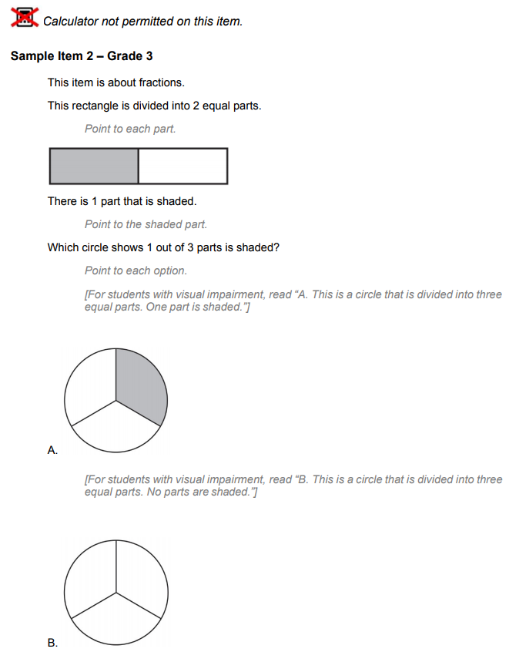
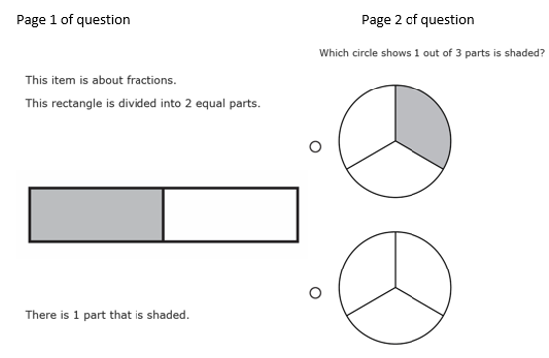
LEAP Connect OTT DTA
Student Screen DTA

Slide 56
LEAP Connect 2018-2019
February 4 - March 15, 2019 is the LEAP Connect/LAA1 window. For the 2018-2019 school year, LEAP Connect will have the following improvements/changes:
LEAP Connect will include Grades 3-8 and 11 for both ELA and math.
Reference materials will include answer options for each question to accommodate students using eye gaze boards or communication devices.
The Online Tools Training (OTT) will include items for Grades 3-8 and 11 for both ELA and math.
The OTT Reference Materials and DTA are available under General Information in eDIRECT.

Slide 57
LEAP Connect Resources
Online Tools Training: provides students and teachers opportunities to become familiar with the tools available in the online testing platform; available in INSIGHT or here using the Chrome browser;
Parent Guide to LEAP Connect: a guide for parents to understand the LEAP Connect assessment.
ELA Guidebooks 2.0 Diverse Learner Guide: Contains information about using the ELA Guidebooks with diverse learners.
The Louisiana Connectors for Students with Significant Disabilities, which are aligned with Louisiana Student Standards, presents the Louisiana Connectors and represent the most salient grade-level, core academic content in English language arts and mathematics.
Essential Elements Cards, which are a primer for differentiating instruction for students with significant disabilities, break down the instructional task into knowledge and skills, suggested instructional strategies, and possible supports and scaffolds for student learning.
Case Studies provide models for how teachers and specialists may best modify objectives, assessments, activities, and materials for students with significant cognitive disabilities based on LDOE’s available resources.
Parent Guide to LEAP Connect Score Reports: a guide for parents to understand the LEAP Connect student reports Also available in Arabic, Spanish, and Vietnamese.
specialeducation@la.gov: email address for content and resources related the LA Connectors.

Slide 58
ELPS

Slide 59
ELPS Key Dates
Key Dates
AIR Secure Browser Install | Available Now
ELPS training modules | Available Now
ELPS administration manuals posted | Mid July
TIDE closed | July 16
ORS closed | July 18 - July 20
TIDE opens for user and student management | July 23
ELPS opens for district use | August 1
ELPS Additional Materials Ordering (Braille, large print) | August 1 (orders placed through assessment@la.gov)
ORS closed for initial ELPS score processing | First few weeks of August

Slide 60
ELPS Overview
The ELPS is a tool for determining if students entering Kindergarten through grade 12 are English Learners (ELs) who require language support services to continue developing proficiency in English.
Students who do not score proficient on the ELPS will be identified as an EL and can receive an EL Accommodations Form.
The ELPS is designed to assess a student’s English proficiency in the four language domains: listening, speaking, reading, and writing.
The 2018-2019 school year will be a transitional year. Beginning on August 1, 2018, the ELPS will be available for district use.
The ELPS will be free of charge for districts.

Slide 61
Screener Setup
The ELPS is a computer-based assessment that will be taken in the AIR Portal, the same testing system used for the English Learner Proficiency Test (ELPT). Prior to testing, the AIR Secure Browser must be installed on computers. Reference the Secure Browser Installation Manual for detailed directions.
Test administrators, students, and accommodations are managed in the TIDE Portal. See the TIDE User Guide for detailed directions on test setup requirements.
Both District and School Test Coordinators have permission to add students into TIDE.
Students must have a LASID in order to be entered into TIDE and take ELPS.
Students taking the ELPS will need headsets with microphones for interacting with the online platform. The headsets are the same ones required for taking the ELPT. Specifications for headsets are located on pages 5-6 of the Technology Requirements document in the Assessment Library.
*Enable pop-up windows and microphone settings on all ELPS computers prior to screening.

Slide 62
ELPS Administration Systems Overview
All ELPS systems can be accessed in the ELPT Portal under ELPS.
TIDE
Stores student demographic information and test settings
Used to manage user accounts for all systems
Test Delivery System (TDS)
Used by TAs to administer tests and monitor students (Test Administrator Interface)
Used by students to take ELPS (AIR Secure Browser)
ORS
Used to view and download student assessment reports
Data Entry Interface (DEI)
Used by TAs to enter responses for students using accommodated forms of ELPS.

Slide 63
ELPS Administration Documents
All ELPS administration documents can be found in the ELPT Portal under ELPS.
TIDE User Guide
Provides directions for registering students for assessments, establishing test settings and accommodations, associating students with districts, schools, and rosters, and creating and approving testing appeals
TA User Guide
Directions to help users navigate the Test Delivery System (TDS) including the Student Interface and the Test Administrator Interface, and help support Test Administrators manage and administer ELPS.
ELPS TAM
Provides specific instructions for the administration of the ELPS. Details include information on test security, logistical requirements, and the Test Administrator directions to students.

Slide 64
ELPS Administration Documents
All ELPS administration documents can be found in the ELPT Portal under ELPS.
ELPS Step Two Speaking Scoring Document
Used to assist school and school system personnel with the immediate (“on the fly”) scoring of the first operational Speaking task
Online Reporting System (ORS) Manual
Provides information on how to use the Online Reporting System (ORS) to view student performance and participation data.
Accessibility and Accommodations Manual
Used to guide the selection and administration of appropriate universal features, designated features, and accommodations for individual students to produce valid assessment results
Data Entry Interface (DEI) Manual
Provides specific instructions for using the DEI which allows authorized users to enter student assessment data, such as item responses and scores. Entering student data is required for the ELPS Braille forms

Slide 65
ELPS Technology Documents
All ELPS technology manuals can be found in the ELPT Portal under Technology Coordinators.
Secure Browser Installation Manual
Provides instructions for installing the secure browsers on computers and devices used for online assessments
System Requirements for Online Testing
Used to verify that all devices to be used for testing meet the minimum technology specifications
Technical Specifications Manual for Online Testing
Used to verify that your school’s network and Internet are properly configured for testing.

Slide 66
Identifying an English Learner
Individuals who do not speak English as their primary language and who have a limited ability to read, speak, write, or understand English can be considered English Learners (ELs).
To identify if a student is an EL:
The school will provide a Home Language Survey (HLS) to all parents as part of the registration process.
If a language other than English is listed on the HLS, the student will be given an English language proficiency screener within 30 days of enrollment.
If the student is not proficient in English, parents will receive a notification letter from the school/LEA that indicates the student’s EL status and asks for permission to give student English language supports.
This student will be identified as an EL until exiting the program.

Slide 67
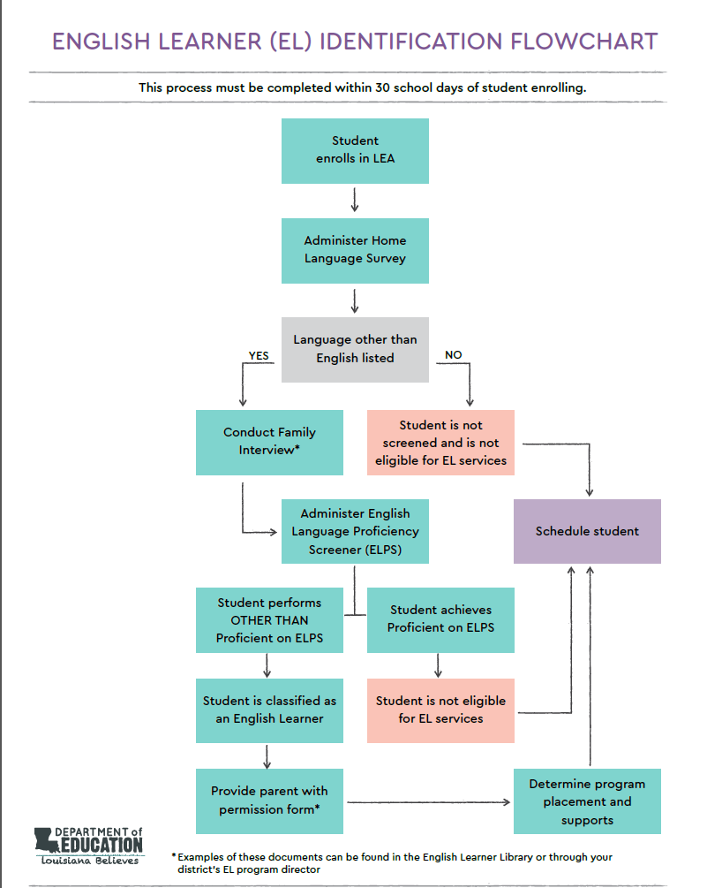
Identification FlowChart
The EL Identification Flowchart can be used to determine if a student is to be screened and provides the steps to take after a student screens.
For further information regarding EL classification, reference the EL Frequently Asked Questions (FAQ).

Slide 68
Pre-K and Kindergarten
Pre-K students are not eligible for EL services until they enter Kindergarten. Pre-K screening usually takes place the spring and summer before an eligible student begins Kindergarten.
Enrolling Kindergarten students will be screened as the following:
Months | Test to Take
August - December | Grade K takes Future Kindergarten
January – March | Grade K takes Grade K
March – July | Pre-K takes Future Kindergarten Grade K takes Grade K
*Future Kindergarten = Pre-K

Slide 69
ELs and SPED
If a student enrolls at an LEA with an accommodations plan (IEP, 504), the accommodations plan should be consulted to see if screening for language proficiency is feasible.
Applicable accommodations for statewide testing listed on an accommodations plan should be applied to the administration of ELPS. See the EL Accessibility and Accommodations manual posted in the ELPT Portal for information on applicable accommodations.
For questions on accommodations for ELPS, please contact assessment@la.gov.
If a student enrolls and has evidence of hearing or vision impairment that might impact certain domains on ELPS, but no accommodations plan, a domain exemption can be requested.
All domain exemption requests should be emailed to assessment@la.gov.

Slide 70
Grade Level Screening
Most students should take the screener in the grade band the coincides with the grade they will potentially enter.
* New students who might be identified as T9 should take the Grades 9-12 screener.
ELPS Grade Bands
Future Kindergarten/Grade 00
Kindergarten
Grade 1
Grade 2-3
Grades 4-5
Grades 6-8
Grade 9-12 *

Slide 71
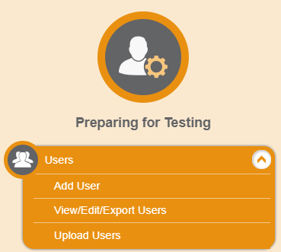
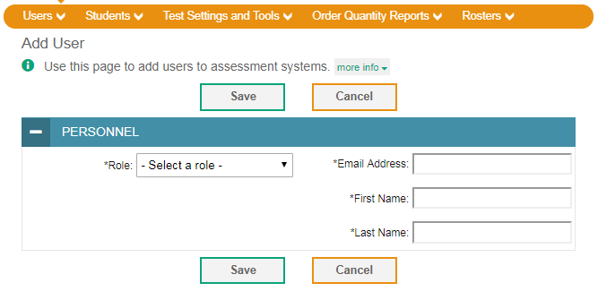
Adding Users to TIDE
Beginning July 23, TIDE will open for test setup for the 2018-2019 school year.
DTCs will receive an email from AIRAST-DoNotReply@airast.org to create an account.
DTCs/STCs add users for ELPS administration under Preparing for Testing. Available roles for ELPS:
District Test Coordinator
School Test Coordinator
Test Administrator

Slide 72
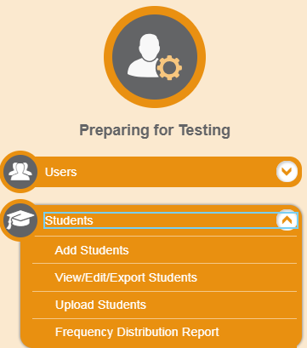
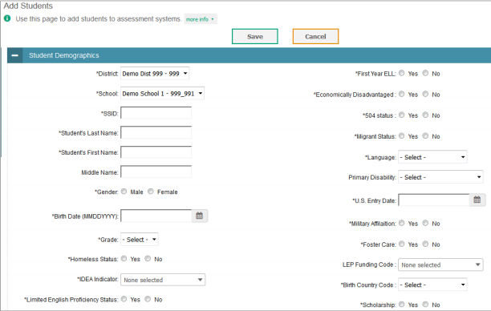
Adding Students
DTCs and STCs can add/upload students into TIDE under Preparing for Testing.
Students must have a LASID to take the ELPS.
If a student enrolls with an accommodations plan, applicable accommodations can be entered into TIDE when adding the student or through the View/Edit Students tab.

Slide 73
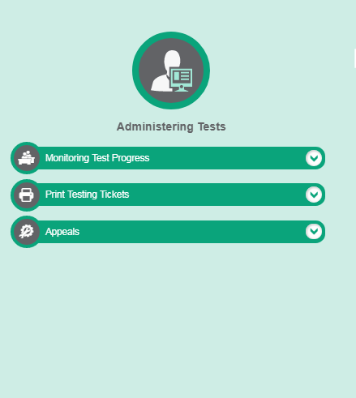
ELPS Testing Tickets
A test ticket is a hard-copy form that includes a student’s LASID for logging in to a test.
Students will use their first name, LASID and the Session ID to login to the TDS.
DTCs and STCs can print tickets through the Administering Tests section of the TIDE.
See the TIDE User Guide for detailed instructions on printing the testing tickets.

Slide 74
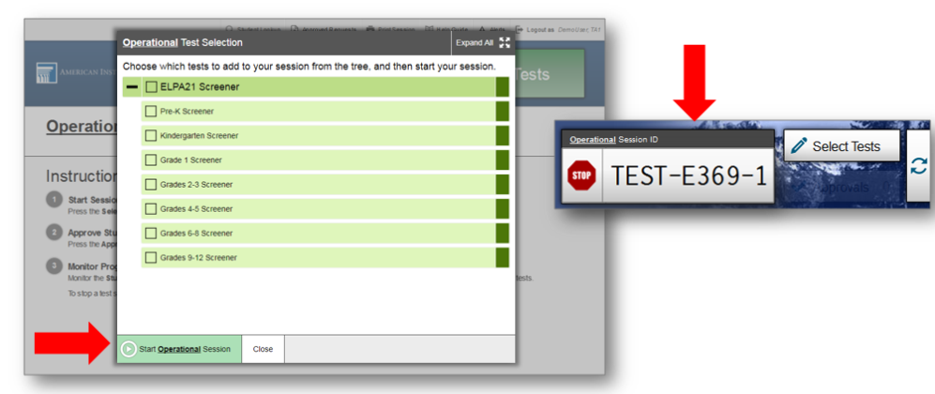
Accessing the TA Interface (TDS)
Test Administrators will administer the test through the Test Administrator Interface accessed through the EL Portal under ELPS.
TAs will login to the TA Interface with their TIDE Username and Password.
Test sessions must be created less than 20 minutes prior to starting the test in order to prevent the system from timing out.
In the TA Interface, the TA will select the grade band of the student taking ELPS: Future Kindergarten, Kindergarten, Grade 1, Grades 2-3, Grades 4-5, Grades 6-8, or Grades 9-12.

Slide 75
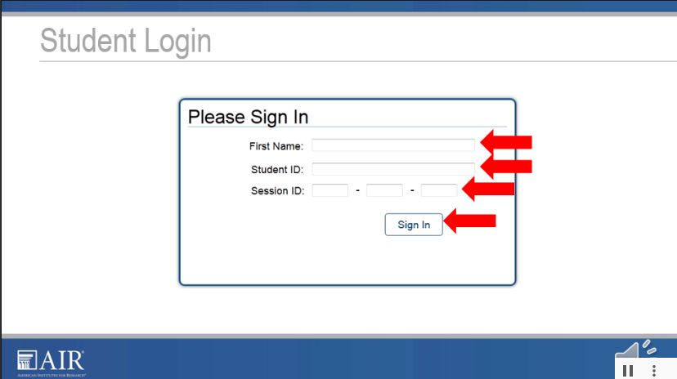
Accessing ELPS
Once a grade band is selected, the ELPS Session ID will be generated in the TA Interface.
Provide the Session ID to the student for the student to access the screener.
Students will access the ELPS through the AIR Portal using their first name, LASID, and teacher provided Session ID.
After 4 days if the ELPS is not submitted for a student, the test will auto submit and be scored.
Students will be required to conduct an Audio Playback Check and Recording Device Check prior to beginning the screener.

Slide 76
Steps Review
Step | Student… | Test Administrator… | Mode of Administration
Practice Step One | Orients to test. Does headset and mic check. Learns test navigation. Takes practice items | Assists student. Determines student comfort with technology. Starts testing session. | One-on-one
Step Two (Speaking) | Takes one set of speaking items. | Assists student with recording. Scores speaking set “on-the-fly”. | One-on-one
Step Two | Takes remaining Step 2 items. | Assists student if needed; otherwise step away. | Student may work independently if assistance is not needed.
Only students who scored proficient on Steps One and Two will move on to Step Three.
Step Three | Continues testing. | Assists if needed, especially on CR items | Student may work independently if assistance is not needed.

Slide 77
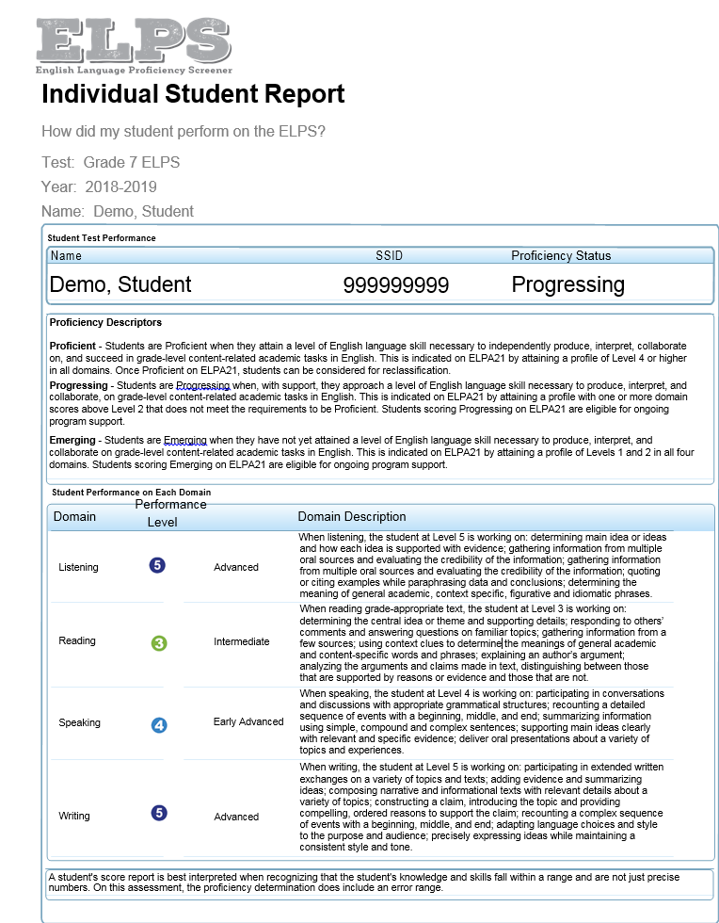
The Results
Students who attempt at least 1 question
on the ELPS will receive a student report.
The majority of these will be available the
same day the test is submitted.
The reports will show an overall Proficiency status
(which is used to determine EL eligibility) and
Domain Performance Levels (used for instructional
planning).
Parents/Guardians should be notified of results
through a letter or permission form.

Slide 78
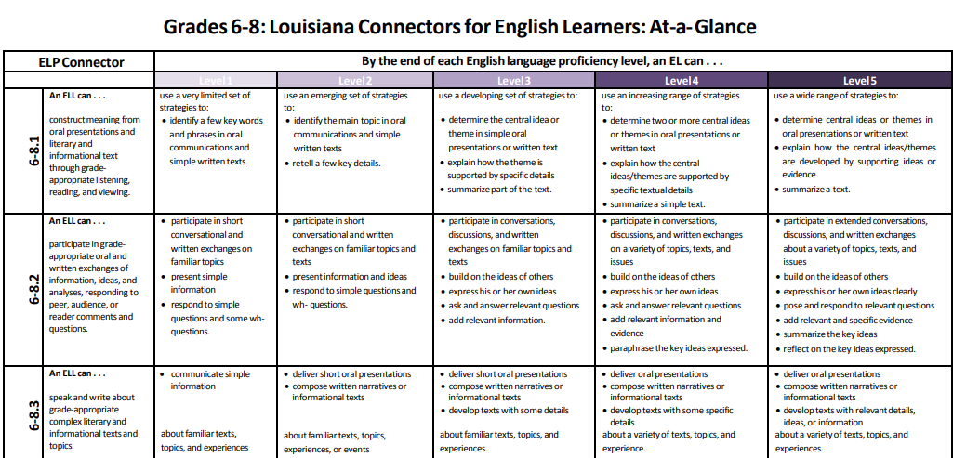
The Results
Screener results are used to determine EL program eligibility, but they should also be used to make instructional decisions.
The Domain Performance Levels give a basic overview of what an EL might be able to do in regards to reading, writing, listening and speaking. Consult the LA Connectors for ELs to see how these levels correspond with the EL standards.
Results will also be used to determine the level of support a student will need in content classes and when taking assessments. Use this information to fill out the EL Accommodation Form.

Slide 79
ELPS Proficiency Levels
Proficiency Level | Descriptor | EL?
Emerging | Students are Emerging when they have not yet reached a level of English language skill to produce, interpret, and collaborate on grade-level content-related academic tasks in English. | Yes
Progressing | Students are Progressing when, with support, they are approaching a level of English language skill necessary to produce, interpret, and collaborate on grade-level academic tasks in English. | Yes
Proficient | Students are Proficient when they demonstrate a level of English language skill necessary to independently produce, interpret, collaborate on and succeed in grade-level academic tasks in English. | No
Proficiency Not Demonstrated | Students receive a status of Proficiency Not Demonstrated when screening is stopped in Step One due to the student not participating. | Yes

Slide 80
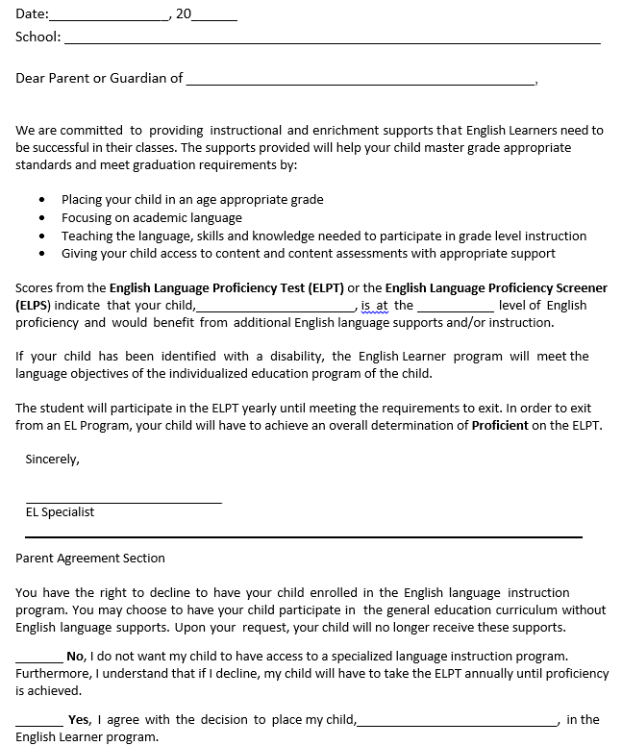
Classifying a Student as an EL
A student who does not score proficient on the ELPS should be classified as an English learner (EL).
Make sure that the EL classification is updated in the School Information System for the student.
Within 30 days of a student registering, the school must assess and inform the student’s parent/guardian(s) of the student’s EL eligibility, as described in Every Student Succeeds Act (ESSA). An sample EL Parent Notification letter is available in the English Learners Library.

Slide 81
Supporting the EL student
The EL student should receive supplementary support services to continue developing English language proficiency. The LA Connectors for ELs can be used to provide guidance to content teachers when determining what an EL is able to do based on a student’s proficiency level in each domain
An English Learner Accommodations Form should be developed to assist the student in acquiring the English Language.
These accommodations should be used in class and on statewide assessments.
Students will not be able to use EL accommodations on the English Language Proficiency Test (ELPT).

Slide 82
Additional Resources
ELPS Test Administrator Overview and Training Webinar: provides an overview of the test design and administration procedures
ELPS Administration Modules: provide detailed directions for key administration procedures
ELPS Summit Presentation: provides an overview of the EL screener administration
ELPS Guidance: provides an overview of the EL screener
LA EL Portal: how to access all EL assessments (including ELPS), reports and manuals
LDOE English Learner Library: link to the LDOE’s English Learner web page to access materials and forms to support ELs
English Learner Guidebook: provides guidance to school systems and school-site leaders in implementing high-quality instruction for ELs
LA Connectors for ELs: a list of the English Learner Connectors for use collaboratively with EL and content teachers
EL Accommodation Form: the form used to document an EL’s classroom and assessment accommodations. Also available in Arabic, Spanish, and Vietnamese

Slide 83
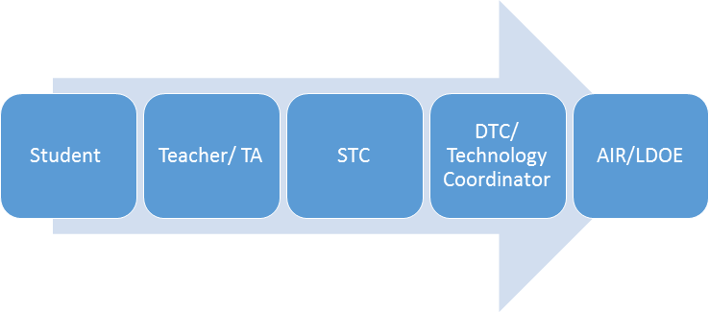
Technical Assistance Protocol
If technical problems occur during testing, school and district staff should follow the ELPT Technical Assistance Protocol presented below. Technical problems include, but are not limited to, problems connecting to INSIGHT, the inability to load test items, or missing buttons.
AIR Contact Info
7:00 AM – 7:00 PM
1-866-758-0231
laelpthelpdesk@air.org
Chat: http://la.portal.airast.org/chat/
LDOE
1-844-268-7320
assessment@la.gov

Slide 84
ELPT

Slide 85
ELPT 2018-2019
The 2018-2019 ELPT Testing Window is February 4 - March 15.
Students who are classified as EL are required to take the English Learner Proficiency Test (ELPT) each year to assess their progress in English language acquisition.
The ELPT is administered through the same AIR platform as the ELPS.
  Headsets with microphones are required for ELPT. Specifications for headsets are located on pages 5-6 of the Technology Requirements document in the Assessment Library.
The results from this assessment will be included in school accountability.
For more information on the process of classifying a student as EL, reference the 2018-2019 ELPT Frequently Asked Questions (FAQ) and the EL Identification Flowchart.
For more information on ELPT, view the ELPT Assessment Guide.

Slide 86
ELPT Improvements
For the 2018-2019 school year, ELPT will have the following improvements/changes:
ELPT Portal was redesigned to separate ELPT and ELPS materials
STCs will have permissions to add/upload students into TIDE
Updated Special Education Codes to include a code for students who are deaf
Copy of all school box materials will be provided with district level materials
Window to order Additional Materials will open the day after materials arrive
Districts will be able to pull testing status reports for up to 20 schools at a time

Slide 87
ELPT Administration Systems Overview
All ELPS systems can be accessed in the ELPT Portal under ELPT.
TIDE
Stores student demographic information and test settings
Used to manage user accounts for all systems
Test Delivery System (TDS)
Used by TAs to administer tests and monitor students (Test Administrator Interface)
Used by students to take ELPS (AIR Secure Browser)
Data Entry Interface (DEI)
Used by TAs to enter responses for students using accommodated forms of ELPS.
Online Reporting System (ORS)
Used to view and download student assessment reports

Slide 88
ELPT Administration Documents
All ELPS administration documents can be found in the ELPT Portal under ELPT.
TIDE User Guide
Provides directions for registering students for assessments, establishing test settings and accommodations, associating students with districts, schools, and rosters, and creating and approving testing appeals
ELPS TAM
Provides specific instructions for the administration of the ELPT. Details include information on test security, logistical requirements, and the Test Administrator directions to students.
TA User Guide
Directions to help users navigate the Test Delivery System (TDS) including the Student Interface and the Test Administrator Interface, and help support Test Administrators manage and administer ELPT.

Slide 89
ELPT Administration Documents
All ELPS administration documents can be found in the ELPT Portal under ELPT.
Accessibility and Accommodations Manual
Used to guide the selection and administration of appropriate universal features, designated features, and accommodations for individual students to produce valid assessment results
Data Entry Interface (DEI) Manual
Provides specific instructions for using the DEI which allows authorized users to enter student assessment data, such as item responses and scores. Entering student data is required for the ELPT Braille forms
Online Reporting System (ORS) Manual
Provides information on how to use the Online Reporting System (ORS) to view student performance and participation data.

Slide 90
ELPT Technology Documents
All ELPS technology manuals can be found in the ELPT Portal under Technology Coordinators.
Secure Browser Installation Manual
Provides instructions for installing the secure browsers on computers and devices used for online assessments
System Requirements for Online Testing
Used to verify that all devices to be used for testing meet the minimum technology specifications
Technical Specifications Manual for Online Testing
Used to verify that your school’s network and Internet are properly configured for testing.

Slide 91
LEAP 360

Slide 92

LEAP 360 2018-2019
eDIRECT is now open for LEAP 360 test setup for Diagnostics, Interims, and EAGLE 2.0.
Webinars with accompanying one-pagers for different eDIRECT and LEAP 360 functions will be posted in A District’s Guide to LEAP 360.

Slide 93
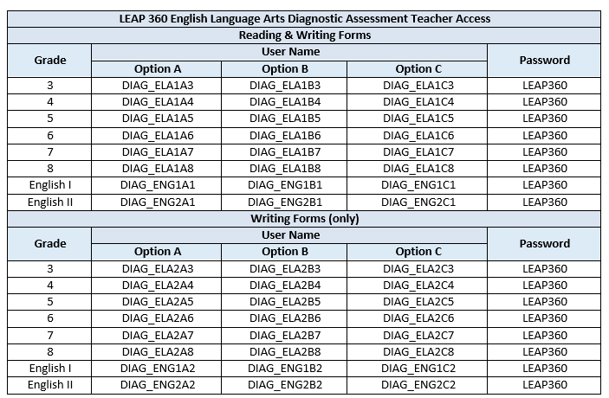
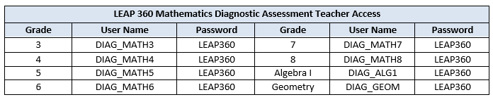
Diagnostic Quick Start Guide 2018-2019
The Diagnostic Quick Start Guide is updated for the 2018-2019 school year. Using Google Chrome, teachers may use the LEAP 360 Teacher Access link.

Slide 94

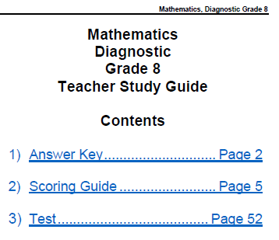
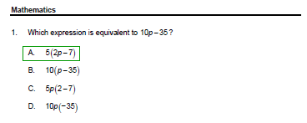
LEAP 360 Teacher Study Guide

Slide 95
LEAP 360 Improvements
During the first year of LEAP 360 implementation, feedback was collected from focus groups, site visits, district and school leaders, and teachers. Feedback was categorized into five focus areas:
Student Management
Educator Scoring
Reporting
Content
EAGLE
The next few slides will highlight some of the improvements in these areas. For more information, districts should review the Teacher Leader Summit sessions.
The eDIRECT User Guide posted in eDIRECT under Documents will be updated to include information on improvements in Student Management, Educator Scoring, and Reporting.

Slide 96
Student Management
Student Management
For nonsummative assessments, student data will be uploaded directly to eDIRECT from eScholar.
Districts will use existing procedures to upload files to eScholar. Student data will then be uploaded to eDIRECT.
New students and student transfers will be managed through eScholar.
  Student updates should be made in the district’s Student Information System and the data uploaded to eScholar.
Updates to eScholar data will be refreshed in eDIRECT nightly.
eDIRECT will begin populating with student data from escholar on July 16th.
Accommodations uploaded by districts to SIS and SER will be uploaded to eDIRECT.
Students, student information, and accommodations can be viewed under Student Management in eDIRECT.

Slide 97
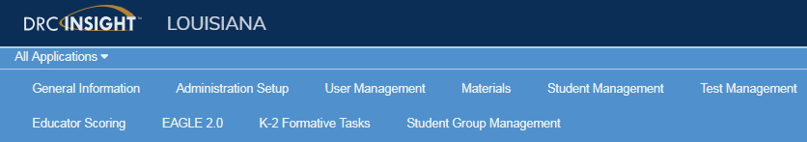
Student Groups
Student groups are created to associate students and teachers within eDIRECT. Through this association, teachers can quickly access their students’ information, testing status, and reports.
Allows test results for students to be reported together.
Any teacher participating in the LEAP 360 - Diagnostic/Interim assessments should create student groups for their students.
Teachers must be added to eDIRECT via Test Administrator Management to obtain a TA number before student groups can be created.

Slide 98
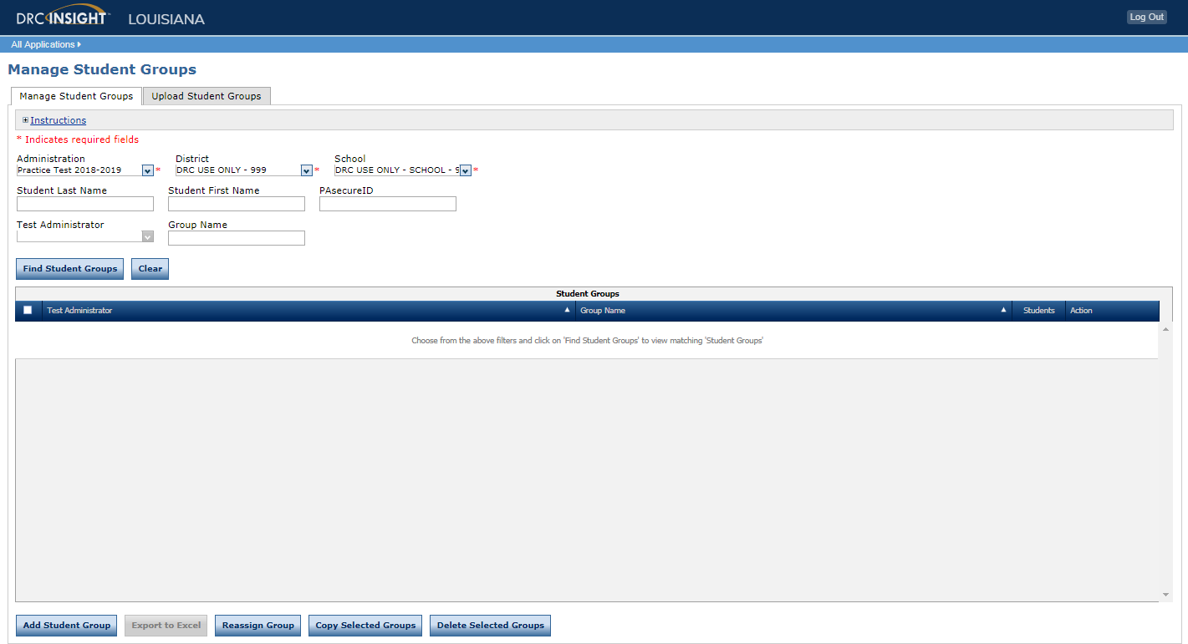
Student Groups
From the Student Group Management option, eDIRECT users can search for students and perform the following tasks:
Add a student group
Upload multiple student groups
Edit student group information
Create a test session from a student group
Reassign a test administrator to multiple student groups

Slide 99
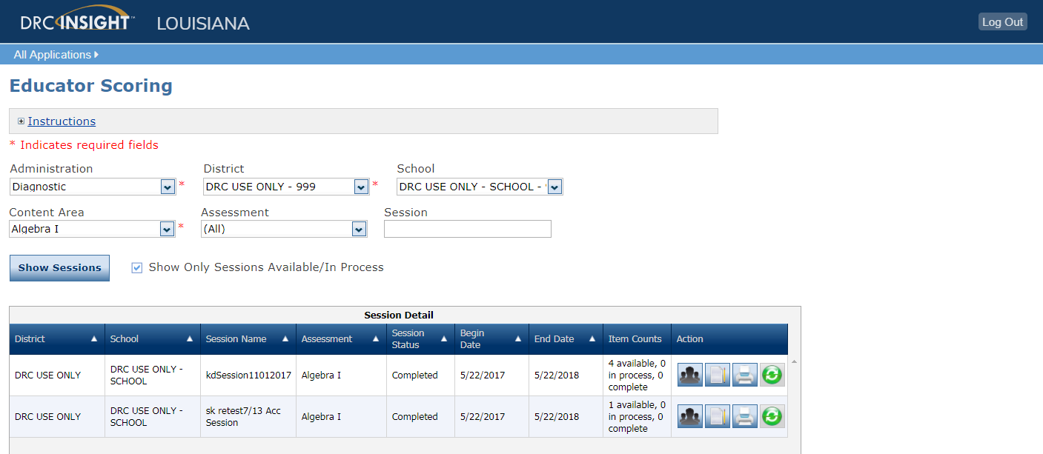
Educator Scoring Improvements
Viewing Test Statuses
On the Educator Scoring page, teachers can select to only view items that need scoring.

Slide 100
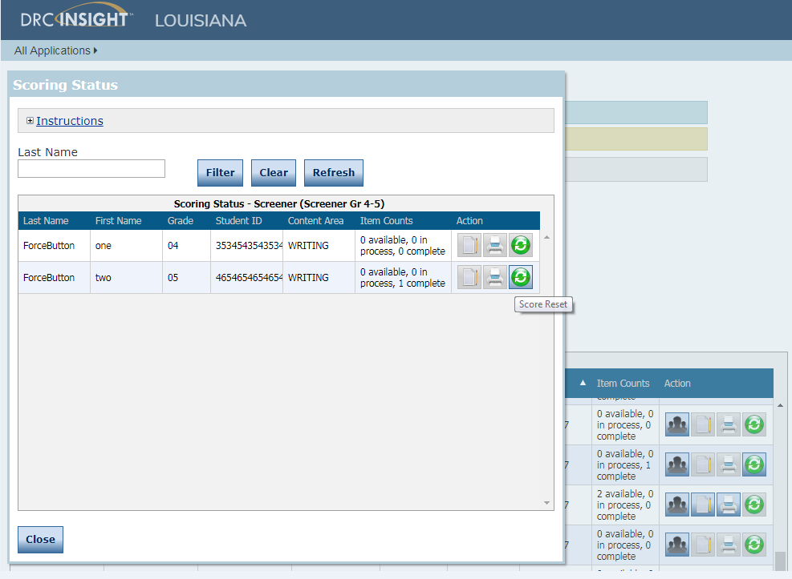
Educator Scoring Improvements
Printing Student Responses
When testing is complete, you can batch print student responses at the session level, or student level, and hand score them before entering the scores in Educator Scoring.
Note: You cannot print student responses after scoring them in Educator scoring

Slide 101
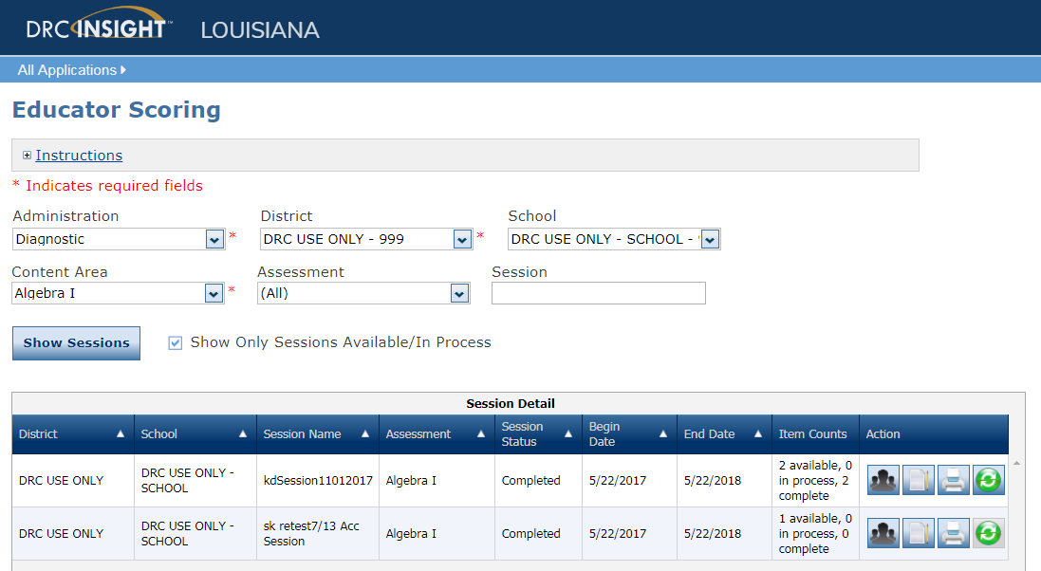
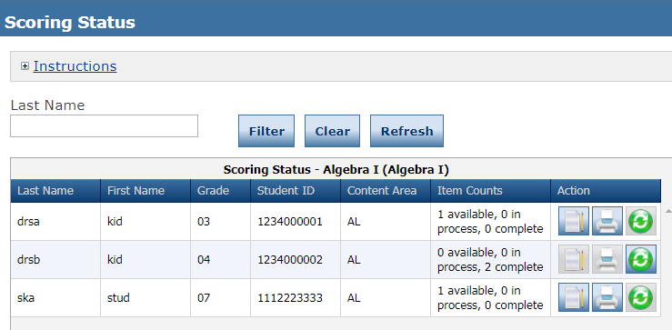
Educator Scoring Improvements
Scoring Reset: Individual Student
If necessary, Test Administrators can reset the score for select questions and re-score for a individual student.

Slide 102
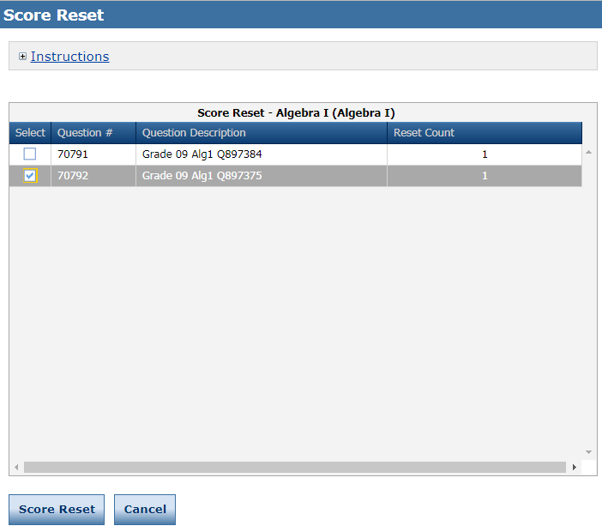
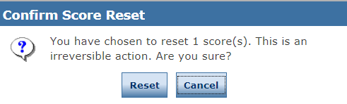
Educator Scoring Improvements
Scoring Reset: Test Session
Additionally, Test Administrators can reset the score for select questions and re-score for an entire test session.

Slide 103
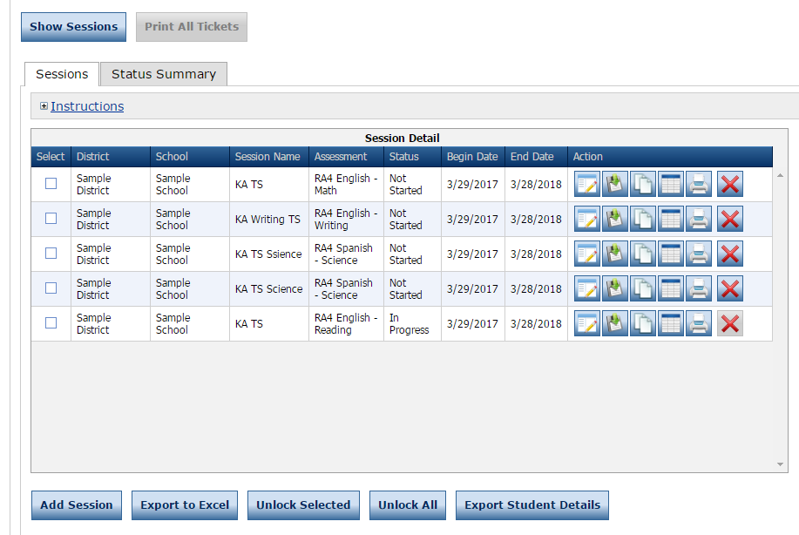
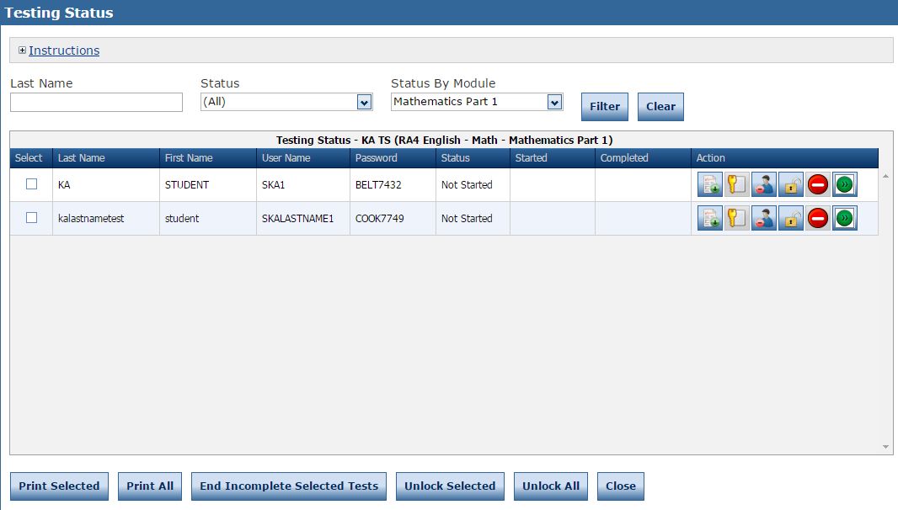
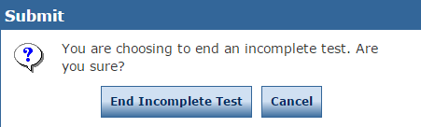
Ending Incomplete Tests
Beginning August 31, the End Incomplete Test option under the Test Management tab allows the DTC to force submit when a student is not going to complete a part of an assessment for LEAP 360 and Practice Test assessments.

Slide 104
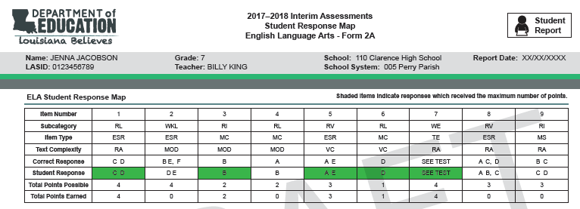
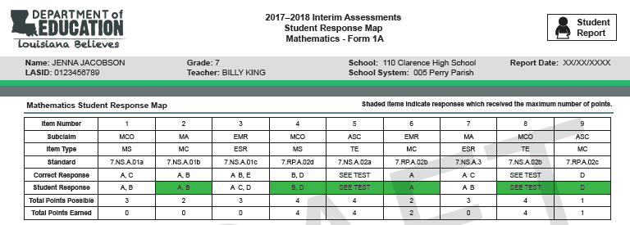
Response Map Improvements
Improvements to existing reports:
Teacher name,
Standards for math,
Percent of points earned by student, and
ELA text complexity

Slide 105
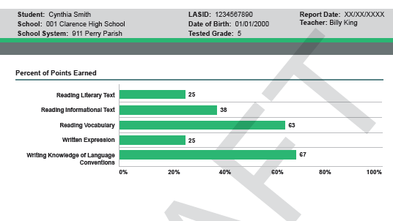
Student Summary Improvements
The percentage of points
earned in each subcategory
were added to bars
in the graph.

Slide 106
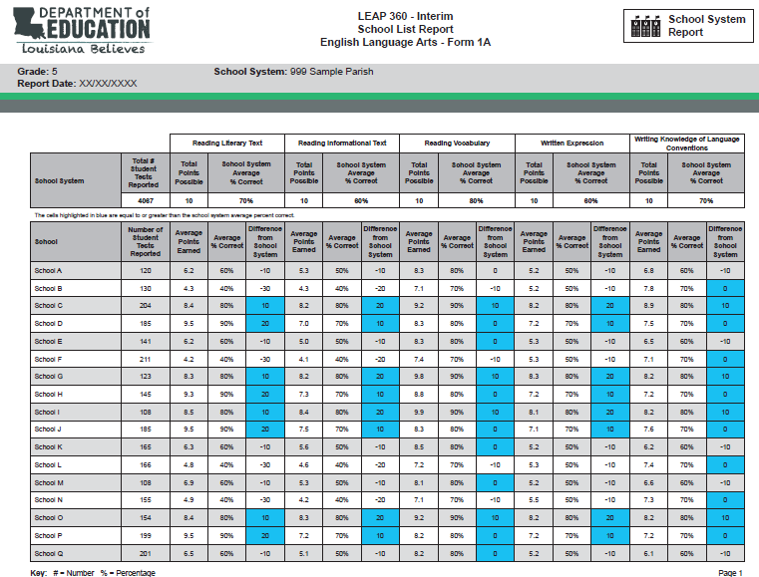
New School List Report
New School List Report: View how school averages compare to district averages

Slide 107
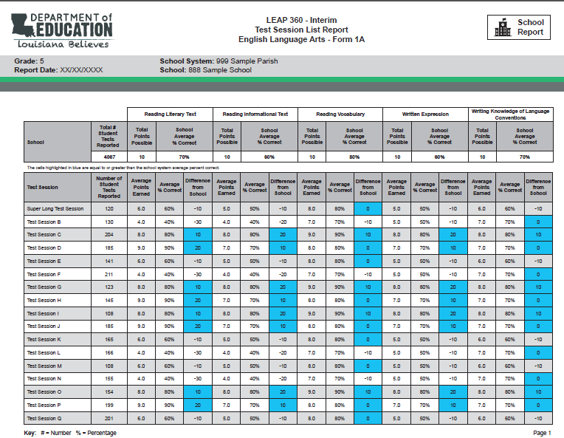
New Test Session List Report
New Test Session List Report: Compares test session performance to school performance

Slide 108
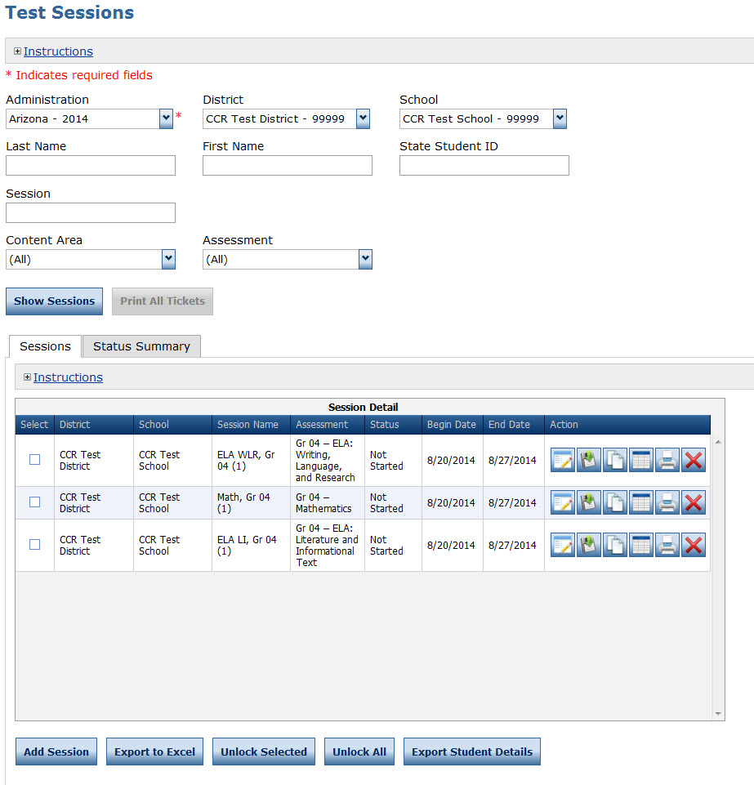
Test Session Management
Once test administrators numbers have been created and student accommodations have been added/checked, test sessions must be created. One test session is created within the system for each group of students taking a test.
For example, a group of students taking Algebra I would be grouped into one test session which would generate a test ticket for each student for each part of the test.

Slide 109
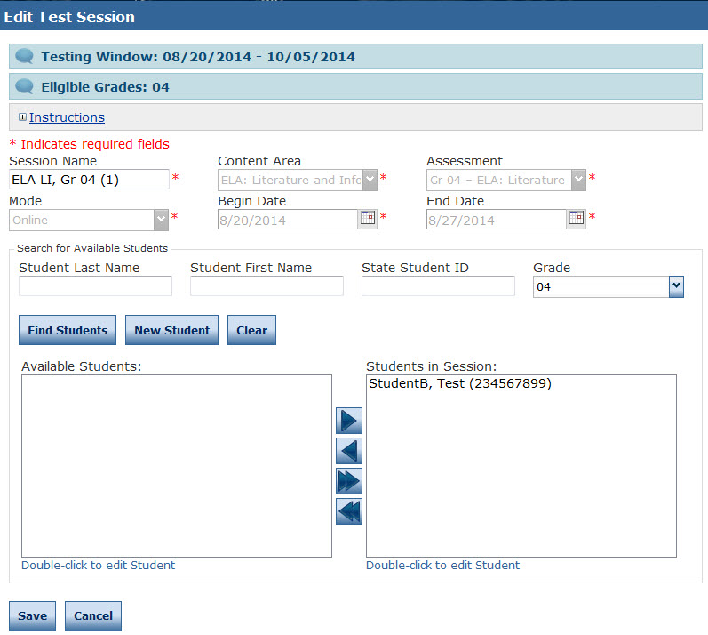
Creating and Editing Test Sessions
To create a Test Session, click on Add Session from the Test Session screen.
Populate the session details, then click on Find Students. This will display all the available students for the test session, by grade and content area.
To add the students to the test session, select the student, then click on the right facing arrow to add the students to the session.
Complete the above steps until all students are added to test sessions.

Slide 110
Assessment Updates

Slide 111
2018-19 Accommodation Forms Update
All accommodation forms listed have been updated to reflect the 2018-2019 state assessments.
Individual Education Plan (IEP) - Coming in August
Individual Accommodation Plan (IAP)
English Learner Plan (EL)
Personal Needs Profile (PNP)
Unique Accommodations
The updated forms will be accessible in the Assessment Library in July.

Slide 112
Assessment Accommodations 2018-2019
For non-summative assessments, DRC will connect to SIS and SER for accomodations.
Work with your SIS and SER coordinators to ensure student accommodations are entered correctly into these systems.

Slide 113
Assessment Updates for 2018-2019
The High School Assessments FAQ will be updated by the end of July and will be available in the Assessment Library.
US History will only be available as a 5-level LEAP 2025 assessment. Results will be reported in window.
Biology will be offered as a 4-level EOC only to students who:
  Are graduating in 2019
  Need to retest and are not enrolled in a Biology class

Slide 114
Data Systems: Preparation for 2018-19
Forward to Sponsor Site Coordinators: School systems may continue submitting requests to the Department for changes to their district and school information.
Online Sponsor Site (SPS) forms are now available for submitting Sponsor Site (SPS) change requests. Note - Forms are not needed for changing information on school/LEA administrator, social media links, or clubs/sports. Those can be made directly in the system.
Please refer to the 2018-19 Sponsor Site System (SPS) User guide posted on INSIGHT for guidance regarding the new electronic forms and how to certify.

Slide 115
Data Systems: Preparation for 2018-19
Forward to Data Managers: Beginning Sunday, July 1, through Friday, September 28, school systems may begin uploading their initial 2018-19 student enrollment information to the Louisiana Secure ID System (eScholar).
All students expected to be enrolled at the beginning of the 2018-19 school year should be submitted to eScholar for a Louisiana Secure ID (LASID) match.
After this period, districts should only send records of active students that are either new to the district or have a change in information.

Slide 116
Data Systems: 2018-19 Enhancements
Details about the 2018-19 enhancements were reviewed with vendors and data managers and are posted on INSIGHT. Changes of interest to DTCs include the following:
Clean LEADS Inquiry (LIQ) Assessment Data and Build Better Reporting Options
Collecting K-3 Entry Assessment Data
Online Sponsor Site (SPS) update forms
eScholar and DRC Changes
504 Accommodations

Slide 117
Support and Communication

Slide 118
2018-2019 Educator Resource Guide
Later this month, the Department will release the 2018-2019 Educator Resource Guide to provide teachers, principals and school system leaders with the tools they need the most to start the new school year.
Each page of the guide (teacher, principal or school system leader) contains a list of:
meetings and events;
communication streams; and
planning, instructional, goal-setting, assessment and family engagement resources.
Please view the 2017-2018 Educator Resource Guide, available in the School System Support Toolbox, for examples of the types of resources that will be included.
Once released, please review the assessment resources provided and share these resources with principals, school test coordinators and teachers. Updated versions will be released in the newsletter throughout August and September.

Slide 119
End of Year Survey
The DTC and Accountability Contact End-of-Year Survey collects feedback from the current school year on various assessment and accountability topics. This feedback is used to make improvements for next school year.
DTCs, Backup DTCs, Accountability Contacts, and Backup Accountability Contacts should complete the survey by July 20, 2018. The survey will be released in the weekly newsletter.

Slide 120
DTC and Accountability Contact Update
If during the academic year the person appointed as district test coordinator changes, the district superintendent must notify the LDOE. The notification must be in writing and must be submitted within 15 days of the change in appointment.
Due to the secure nature of the data accessed by accountability contacts and district test coordinators, changes have been made to the submission process for any updates to DTC and accountability contacts:
Superintendent signature now required
The DTC and Accountability Contact Update Form must be submitted from the superintendent’s district email account.
The revised DTC and Accountability Contact Update Form is located under the Resources + Forms section in the Assessment Library.

Slide 121
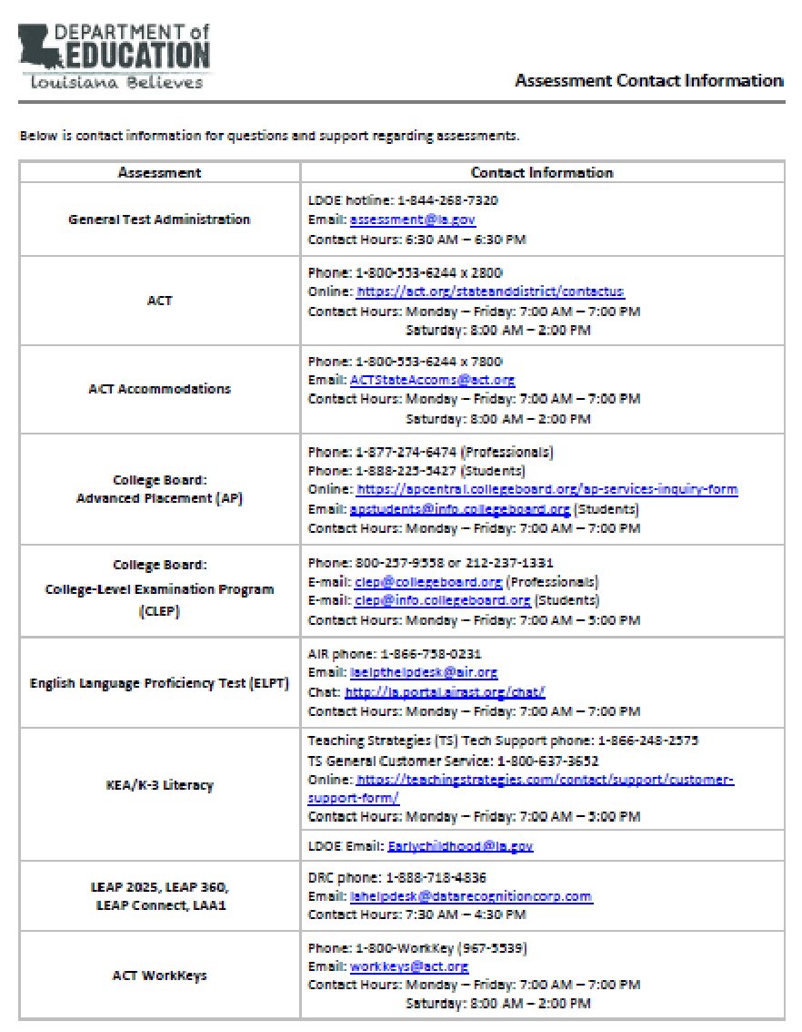
Assessments Customer Service
The Assessments Customer Service Contact Information has been posted to the Assessment Library. This provides all customer service contact information for all assessments.

Slide 122
District Support
The Assessment team offers multiple avenues of support to districts, schools, and teachers seeking information or assistance about assessment administration and accountability.
Weekly Newsletters
Assessment and accountability information and deadlines are released each week in the district newsletter.
Weekly Assessment & Accountability Calls
Each Tuesday at 1:00 PM these webinars are held to provide training, updates, and important information to DTCs and Accountability Contacts.
Assessment Library and Accountability Library
The Assessment Library contains resources for DTCs including the Assessment Schedule and the Assessment and Accountability Month-by-Month Checklist. The Accountability Library contains resources for accountability contacts including the School Performance Score (SPS) calculators as well as information on data certification and federal accountability.

Slide 123
District Support
Monthly Educational Technology Calls
Each month a webinar is held for district technology personnel to provide training, updates, and important information related to technology readiness and digital literacy.
Assessment@
All stakeholders are encouraged to email assessment and accountability questions and/or concerns to assessment@la.gov.
Assessment Hotline
For immediate assistance regarding assessment and accountability, district-level staff may call the Assessment Hotline at 1-844-268-7320.
EdTech@
All stakeholders are encouraged to email technology readiness questions and/or concerns to edtech@la.gov.

Slide 124
Assessment & Accountability Calls
The Assessment and Accountability Calls have a new webinar link for 2018-2019.
Webinar Link: ldoe.zoom.us
Webinar Phone Number: 1 (669) 900-6833
Meeting ID#: 393 463 942
The Zoom link above is the LDOE homepage for all webinars. Participants can enter a webinar’s meeting ID from this page.

Slide 125
Next Steps

Slide 126
Next Steps
Key Dates | Action
July 20 | Deadline to complete End of Year Survey
July 23 | ELPS test setup opens in TIDE; Review all ELPS administration documents
July 31 | Ensure that the AIR Secure Browser has been installed on all devices that will be used for ELPS testing
August 1 | ELPS and Diagnostic windows open
August 7 at 1:00 (public/charter DTCs) August 7 at 2:00 (nonpublic DTCs) | Assessment and Accountability Monthly Call
August 13 | Deadline to receive void appeal request
August 14 at 1:00 | Office Hours resumes
August 31 | Deadline to submit test security plans for review

