Slide 1

Assessment and Accountability Monthly Call

Slide 2
Agenda
Month-by-Month Checklist
2016-2017 Accountability
2016-2017 Assessment Administration
2017-2018 Assessment Updates
Support and Communication

Slide 3
2017-2018 Month-by-Month Checklist
The 2017–2018 Assessment and Accountability Month-by-Month Checklist
  identifies key dates and deadlines for statewide assessment programs and accountability processes for next school year;
  provides action steps to ensure readiness for administering statewide assessments; and
  recommends resources for district and school staff.
The checklist includes information on the following areas:
  Communication and Support
  Accessibility and Accommodations
  Assessment Preparation and Administration
  Accountability
  Reports
The 2017-2018 Assessment Month-by-Month Checklist is located in the Assessment Library.

Slide 4
March Assessment and Accountability Checklist
Communication and Support
Mar: Assessment and Accountability Office Hours—Tuesdays at 1:00 p.m.
Mar 1: Data Coordinator Monthly Webinar at 1:00 pm
Mar 11: School System Monthly Planning Call
Mar 13: DTC Monthly Call
Accountability and Assessment Preparation
Mar: Graduation cohort data certification and exit code review for final calculation of
graduation rates and SPS graduation indices
Mar: Support STCs with delivery of test security, preparation, and administration training for spring
testing to TAs and other school personnel for applicable assessments
Mar: Support STCs to ensure that TAs, proctors, and monitors are appropriately assigned to testing
groups for spring testing
Mar: STCs deliver test security, preparation, administration training to TAs/school personnel for
spring assessments

Slide 5
March Assessment and Accountability Checklist
Accountability and Assessment Preparation
Early–Mid Mar: Access Test Administrator Upload System in eDIRECT for spring testing
Mar: Complete advanced search in Test Accessibility and Accommodations System (TAA) for
students with accommodations
Mar: DTCs receive final ACT Match/No Match Rosters
Mar: Configure INSIGHT on testing devices for LEAP 2025
Mar: Manage users in eDIRECT for Spring LEAP 2025 for high school
Mar: Orders placed for AP exam pre-administration materials
Mar: Utilize scheduling guidance to determine final LEAP 2025 test schedules prior to setting
up test sessions in eDIRECT
Mar: Create test sessions within eDIRECT in preparation LEAP 2025 and print student test
tickets
Mar: Train all staff members involved in testing in test security and administration

Slide 6
March Assessment and Accountability Checklist
Accountability and Assessment Preparation
Late Mar: Download third year cohort file/roster available on data management FTP sites
and distribute to STCs to ensure testing or accountability coding of students who
must participate in Algebra I and/or English II
Mar 3: Finalize IEP, IAP, and LEP accommodations for the ELA, math, SS, and science
Mar 13: Validate configuration and lock down devices (ACT online only)
Feb 5th-Mar 16th: All LEAP Connect and ELPT voids should be emailed to assessment@la.gov
at the end of the week
Once materials arrive-Mar 19: Conduct sessions for examinees to complete non-test
information on the answer documents for paper ACT
Mar 19: LEAP Connect/LAA1 materials pickup.
Mar 20-April 18: Order ACT accommodations materials for makeup testing by calling ACT
Accommodations

Slide 7
March Assessment and Accountability Checklist
Accountability and Assessment Preparation
Mar 20-Apr 6: Order ACT standard time materials for makeup testing
Mar 21-Apr 24: Add students and update student information in PearsonAccess^{next} for Act
makeup testing
Mar 23: Contact courier agency. Scheduled pickup of ACT secure materials from LEA office
Mar 24: Finalize IEP, IAP, and LEP accommodations for the Spring 2016 LEAP 2025 high
school test administration window
Mar 24: Priority Deadline for AP exam ordering
Late Mar–Mid Apr: Order additional test materials in eDIRECT for spring testing

Slide 8
March Assessment and Accountability Checklist
Assessment Administration and Reporting
Mar 20: ACT Initial Paper Testing
Mar 20-29 (Tuesdays-Thursdays only): ACT Online Testing Window
Mar 21-Apr 4:WorkKeys Accommodated Spring Testing Window
Mar 20–April 3: Administer ACT accommodations test (for ACT- approved and non-college
reportable)
Feb 5–Mar 16: ELPT and LEAP Connect test administration
Jan 29–Mar 9: NAEP testing in selected schools
Oct. 3-Apr 13: WorkKeys Online Testing Window

Slide 9
April Assessment and Accountability Checklist
Communication and Support
Apr: Assessment and Accountability Office Hours—Tuesdays at 1:00 p.m.
Apr 12: Data Coordinator Monthly Webinar at 1:00 pm
Apr 11: School System Monthly Planning Call
Apr 17: DTC Monthly Call
Accountability and Assessment Preparation
Apr: Assist as needed all appropriate staff, STCs and school leaders with amendments to
IEPs, IAPs, PNPs that must be final 30 days prior to LEAP 2025 testing; assignment of
appropriate accommodations to students during testing
Apr: Submit makeup orders for standard time ACT test materials
Apr: Access Test Administrator Upload System in eDIRECT for LEAP 2025 high school tests
Late Mar–Mid Apr: Order additional test materials in eDIRECT for spring testing
Early–Mid Apr: LEAP 2025 paper materials delivered to LEAs

Slide 10
April Assessment and Accountability Checklist
Accountability and Assessment Preparation
Mid-Apr: Final deadline for schools to order AP exams
Apr: Order additional test materials in eDIRECT for LEAP 2025
Apr: LEAP 2025 PBT materials delivered to districts
Apr: Final ACT national test date for grade 12 students to earn highest score included the
High School SPS ACT index
Apr 7: Extension Deadline for AP exam ordering
Apr 9: Order additional ACT standard time materials for makeup testing
Apr 14: Final Deadline for AP exam ordering
Apr 16-Apr 20: Receive ACT test materials for makeup testing

Slide 11
April Assessment and Accountability Checklist
Assessment Administration and Reporting
Apr 2-May 31: ICILS and TIMSS testing for selected schools
Once materials arrive-April 4: Conduct sessions for examinees to complete non-test
information for the ACT taken online or provide the information to examinees to
complete on their own
Apr 4–May 4: Administer grades 3-8 computer-based LEAP 2025 assessments
Apr 13: WorkKeys online test administration window closes
Apr 24-30: ACT Paper Accommodated Makeup Window
Apr 23–May 18: Administer high school LEAP 2025 Spring 2017 test
Apr 24: ACT Paper Makeup Test

Slide 12

Accountability

Slide 13
Communicating 2018 Assessment Results
Below is the timeline for the release of the 2017-2018 school- and school system-level assessment results. School systems should develop a plan for communicating these results to principals, teachers, and families.
Assessment | Student Report Timeline and Location | District-Level Results Time and Location
ELPT | spring in AIR Portal | spring in AIR Portal
LAA 1/LEAP Connect | spring in eDIRECT | spring in eDIRECT
LEAP Online Cleanup | not applicable | June in eDIRECT
LEAP 2025 (3-8, HS) | Grade 3-8: June in eDIRECT HS: 5-level ELA and math at end of testing window | June in eDIRECT
EOC (Eng III, Bio, US History) Final Reports | HS 4-level all subjects: In window | summer in eDIRECT
ACT | spring, state administered student and school results from ACT sent to schools | summer iCD and district profile from ACT in summer; additional reporting in FTP
Advanced Placement | summer, sent to schools | early fall in FTP
LEAP 2025 US History | summer in eDIRECT | summer in eDIRECT

Slide 14
ACT Accountability Coding
The ACT Match/No Match lists have been updated and are now posted to ftp. All students in grade 12 must have taken the ACT unless the student participated in LAA 1.
To avoid an assignment of zero in the ACT index component of the School Performance Score, districts and schools must apply an accountability code in PAnext for the students who will not have an ACT score by grade 12.
The codes had to be collapsed in order to fit the format of PAnext. Please see the following:
For all codes 01-42 and 97, students must be exited from enrollment PRIOR to the testing date.
For code 80, students must have a letter from the doctor and this letter must remain on file for at least one year with the District Test Coordinator.
For code 94, students must have participated in LAA 1 testing.

Slide 15
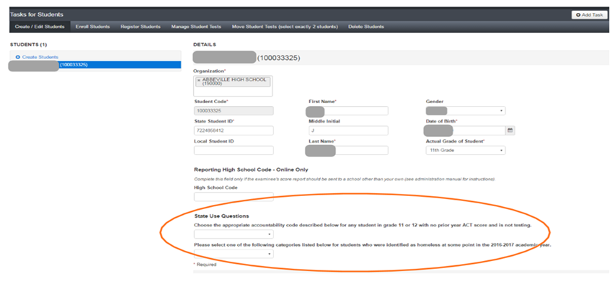
ACT Accountability Coding
Accountability codes can be entered in PANext between March 21 - April 4, 2018 on the Student Detail page under Setup/Students. Use the dropdown arrow for State Use Questions to apply the appropriate accountability code for students who did not test.

Slide 16
2017-2018 Assessment Administration

Slide 17
Technology Readiness

Slide 18
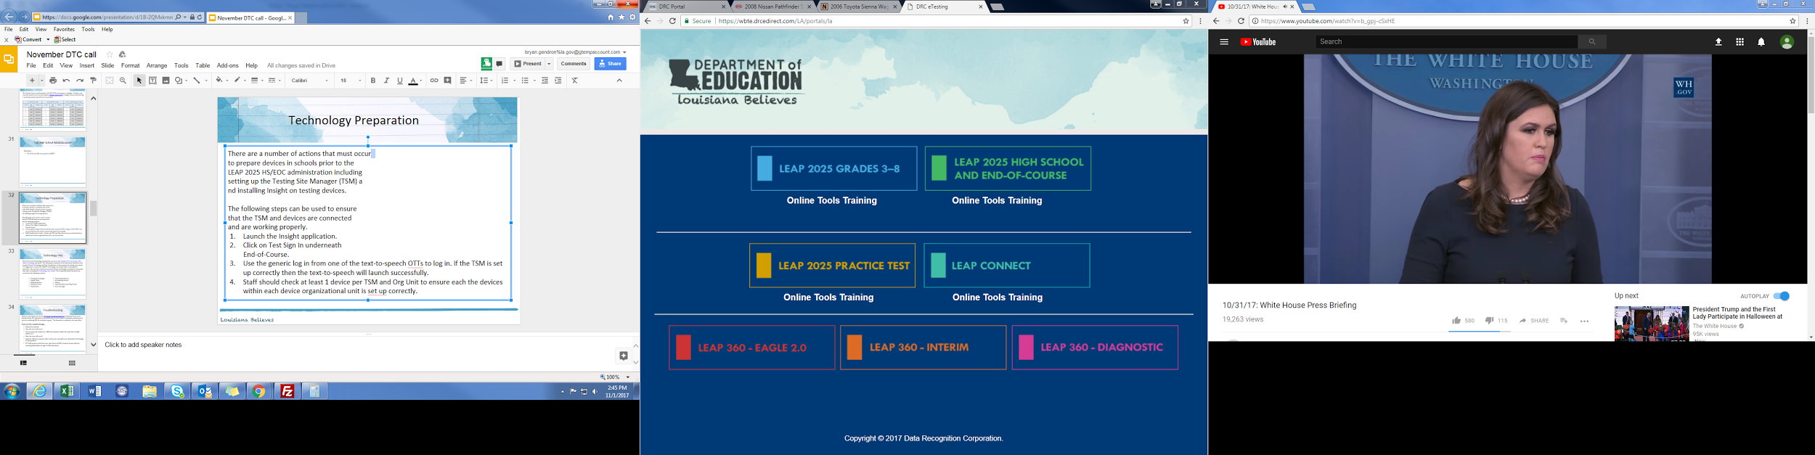
Technology Preparation
There are a number of actions that must occur
to prepare devices in schools prior to the
testing administration including setting up the
Testing Site Manager (TSM) and installing INSIGHT
on testing devices.
The following steps can be used to ensure that the
TSM and devices are connected and are working
properly.
Launch the Insight application.
Click on Test Sign In underneath End-of-Course.
Use the generic log in from one of the text-to-speech OTTs to log in. If the TSM is set up correctly then the text-to-speech will launch successfully.
Staff should check at least 1 device per TSM and Org Unit to ensure each the devices within each device organizational unit is set up correctly.

Slide 19
System Readiness Check
Before testing begins each day, students should run the system readiness check by following the steps below:
Open DRC INSIGHT.
Select the purple check mark in the bottom left corner.
Type 7745.
If the screen does not show all green check marks, alert your STC or technology coordinator.

Slide 20
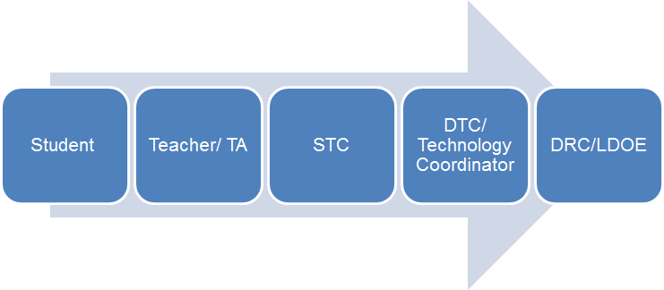
Technical Assistance
If technical problems occur during testing, school and district staff should follow the LEAP 2025 reporting protocol presented below. Technical problems include, but are not limited to, problems connecting INSIGHT, the inability to load test items, or missing buttons.
DRC Louisiana Customer Service AIR Louisiana Customer Service LDOE
1-888-718-4836 1-866-758-0231 1-844-268-7320 LAHelpdesk@datarecognitioncorp.com laelpthelpdesk@air.org assessment@la.gov

Slide 21
Online Scheduling Guidance
The Online Scheduling Guidance in available in the Assessment Library. The guidance allows schools and districts to view best practices for reducing testing time. Districts can decide how long they want their computer-based testing window to be based on the following:
Number of devices
Internet speeds
Number of sessions given in a day
The following guidelines for online administration still apply:
No more than 3 sessions in a day
Extended response sessions should not be given on the same day
Sessions within a content area must be given in order

Slide 22
Technology FAQ
District Test and Technology Coordinators can access the Statewide Assessments FAQ about Technology document. The information contained in this document should be used to guide District Technology and Test Coordinators as they prepare for Spring assessments. It is suggested to review the eDIRECT Technology User Guide before reviewing this document. The questions represent questions District Technology Coordinators frequently have after reviewing the Technology User Guides. The Frequently Asked Questions are sorted into the following sections:
Testing Site Manager
Insight Client
Netbook Devices
Android Devices
iPad Devices
Chromebook Devices
nComputing Devices
eDirect
Load Simulation and Ping Trends
Error Messages

Slide 23
Troubleshooting
Districts and schools can use the Technical Troubleshooting Tips if technical issues occur during testing. This document is for school sites to use in order to eliminate common errors prior to contacting DRC for technical support.
If you run into a system message…
Reboot the machine
Does the error still occur?
Can you move the student to another computer within the same lab or mobile laptop cart?
Does the error still occur?
Mark the affected computer with a sticky note and notify your Information Technology (IT) department.
If IT staff cannot resolve the issue, have them call DRC Customer Service with the reporting information on page 3 of the document.

Slide 24
Training Accounts
Each LEA has a Sample School (777) in eDIRECT to use for training purposes only.
The training school will only be placed in the Practice Test 2018 Administration.
Ten sample students have been added to each 777 site and should be used to practice creating test sessions.

Slide 25
Testing Homebound Students
Policy requires that homebound students participate in state testing unless it is determined by a doctor in writing that they are too ill to test. The doctor’s letter must include all dates of testing, including makeup days.
Secure materials must be checked in and out daily by homebound test administrators. When possible the test administrator should be the regular homebound teacher. Tests should be administered in accordance with all rules for test administration and security. Any accommodations should be documented on an the IEP.
The four options for testing homebound students are:
Install both the TSM and Insight client on a single laptop to be transported to the testing location
Install Virtual Private Network (VPN) software and the client software on a laptop to be transported to the testing location
Utilize the district’s virtual desktop infrastructure (VDI) to set up and deliver a web-based login to access the district’s internal TSM and client software
Purchase a hosted VDI as a service solution to deliver TSM and client software access

Slide 26
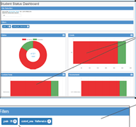
Student Status Dashboard
  The Student Status Dashboard allows you to display student testing status by school and administration. You can filter information on the Dashboard by testing status, grade, content area and assessment (or any combination of these). The Student Status Dashboard User Guide is located in eDIRECT.
  Note: Dashboard data displays in real time as test scores are populated in the database.
  You need the student status permission in eDIRECT to use the Dashboard.

Slide 27
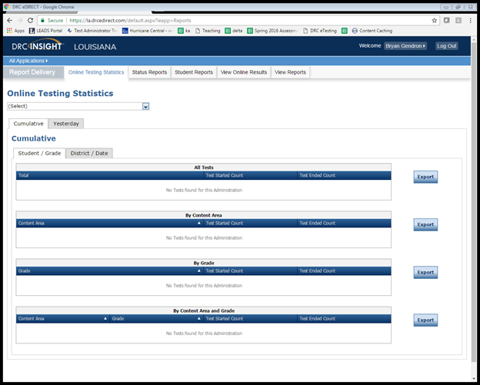
Testing Statistics Reports
eDIRECT has a number of reports to help District Test Coordinators assess the status of their schools during testing. These reports are located in the Online Testing Statistics tab. These reports include:
Online Testing Statistics
Shows the number of students
by school and subject that have
completed testing for the current
and previous day only.

Slide 28
Testing Statistics Reports
Below are other reports that are located under the Status Reports tab.
Daily Cumulative Student Status Reports
Displays all students in a test session and the ticket status of those students
Daily Student Status Report
Displays the start and submit times of each student that logs into a test
Daily School Resets Report
Displays all unlocked test sessions
Excessive Login Report
Shows the number of times a student logged in
Daily State Summary of Test Times Report
Displays the duration in which students completed the test
Daily District Report of Testing Status by School
Displays the number of tests started and ended for the district and school

Slide 29
Online Tools Training
The Online Tools Training (OTT) should be utilized in order to become familiar with the online testing tools (e.g., highlighter, magnification, etc.) used for the operational test. Additionally the OTT:
may be reviewed as many times as desired;
is not to be considered representative of an actual test; and
is available once Insight is installed or by link using Google Chrome browser.

Slide 30
Test Security

Slide 31
ELPT and LEAP Connect
All ELPT and LEAP Connect testing irregularities are due to assessment@la.gov by March 16th.
Voids should be entered directly into eDIRECT for LEAP Connect or TIDE for ELPT.

Slide 32
Test Schedules
LEAP 2025 grades 3-8 test schedules are due to assessment@la.gov by March 16th.
LEAP 2025 High School/EOC test schedules are due to assessment@la.gov by March 23rd.
Online scheduling guidance is posted in the Assessment Library.

Slide 33
LEAP 2025

Slide 34
Accommodations Audit
At the conclusion of each testing administration the Louisiana Department of Education (LDOE) completes an audit to ensure students are receiving appropriate accommodations as documented on the student’s IEP/IAP.
Any student not receiving the appropriate accommodation will have their test voided for accountability purposes only. Additionally, high school tests may be eligible for an administrative error retest.

Slide 35
Testing Home Study Students
State law requires that home study students be provided access to state tests. Districts must offer testing to home study students for LEAP 2025 or EOC testing when it is requested. Districts can charge up to $35.00 for testing; however, if the student enrolls in the district in the fall, the testing fee should be returned to the family.
Districts can set up an application process with a deadline in order to meet any special requirements such as accommodations and to plan for needed materials and technology.
Districts determine where students are tested and when they are tested (within approved window).
When adding home study students in eDIRECT districts/schools should use 998 sitecode.
The LASID for home study students is the SSN with a leading “0”.
Test reports will be returned with other student reports in eDIRECT and should be provided to parents using the district’s policy for distribution (i.e. mail, direct pickup).
Since these students are not enrolled in the district or a school, the scores for students enrolled in a home study program will not count in the SPS or DPS.
If students are uploaded incorrectly using a school site code, their scores will be included in assessment reporting.
The FAQ about Testing Home Study and Nonpublic School Students is available in the Assessment Library.

Slide 36
Testing Students from Nonpublic Schools
State law does not require testing of students in nonpublic schools. The FAQ about Testing Home Study and Nonpublic School Students and Participation Form for Nonpublic School Students are available in the Assessment Library. Some highlights from those documents include:
Nonpublic school students who have a scholarship or TDR should test at their scholarship or TDR school.
Other nonpublic school students can be tested if the district is willing to pay DRC directly for testing them.
The district can determine how and where the students are tested.
The tests must be given in accordance with all guidelines for test administration and test security.
DRC will provide a nonpublic/nonscholarship participation form that will need to be completed by the district, providing the names of students being tested.
These students should be tested under the 997 site code.
The LASID for non-public, non-scholarship students is the SSN with a leading “0”.
Reports will be returned with all other student reports in eDIRECT. If students are incorrectly loaded under a school sitecode, then the scores will be included in the school’s assessment reporting.

Slide 37
LEAP 2025 Grade 3-8

Slide 38
LEAP 2025 Grades 3-8: Key Dates
Action | Key Dates
Manuals posted in eDIRECT | February 2
Manuals Delivered | March 9
Printed accommodation materials for CBT delivered to districts | March 9
Test Setup Opens (TA numbers assigned to CBT and PBT) | March 19
Computer-based Testing Window | April 9 - May 4
PBT materials delivery | April 16
Additional Materials Window opens | March 10 - CBT April 17 - PBT
Last day to order additional materials prior to the paper testing window, including large print, braille, and communication assistance scripts | April 24

Slide 39
LEAP Key Dates
Action | Key Dates
Paper-based testing window (see manual for daily schedule) | April 30 - May 4
Makeup Testing | May 7 – 8
Materials pickup 1 (scorables) | May 8
Test Invalidations and Void Forms due to LDOE | May 9
Materials pickup 2 (scorables and nonscorables) | May 10
Materials pickup 3 (administration materials) | May 12 – 19

Slide 40
LEAP 2025 Test Setup
The 2018 LEAP 2025 administration will be active in eDIRECT on March 19. District and school level users should do the following:
Upload additional students
Move students within the district
Create TA Numbers
Assign, verify, and view accommodations
Create test sessions
Generate and print test tickets
Review the eDIRECT User Guide under the General Information tab.

Slide 41
LEAP 2025 Manuals
There are two Test Coordinator and Test Administrator manuals: paper-based and computer-based. Manuals are posted in eDIRECT and printed versions arrived in districts on March 9.
The next slides include highlights regarding:
Testing Alerts
Test security
Test Schedules
Materials
Other Reminders

Slide 42
Testing Alerts
Accommodated Versions
Each content area has an accommodated version consumable test booklet for use with specific accommodations.
To help ensure the correct form is being administered, the accommodated version is identified on the cover page as “Accommodated Form” and is distributed as single books that are separate from the packs of 10 for consumable test booklets.
The accommodated version is included in the initial materials shipment and available to order as additional materials for students with any read aloud or transferred answers accommodation only. This will also be kitted with braille, CAS, and large print for transferring answers.
Students with read aloud by a human reader, Kurzweil file, or audio file MUST use the accommodated version.
Students having answers transferred from a consumable booklet to another consumable booklet MUST use the accommodated version. Test administrators must also use the accommodated version to transfer answers.

Slide 43
Testing Alerts
Preidentified Students
For CBT, DRC will upload preidentified students who were identified in the Student Information System (SIS) database as of February 1, 2018.
For PBT, students who were identified in the SIS as of October 1, 2017, are considered preidentified. For preidentified students, districts will receive bar-code labels (for use on ELA, Math, Social Studies, and the Science Field Test consumable test booklets) that are preprinted with the student’s information. Nonpreidentified students must have their information hand-coded on the document and then the school system bar code label added. Nonpreidentified bar-code labels must be affixed to consumable test booklets for students who were not preidentified.
Accommodations
Student accommodations must be added prior to putting students in a test session; if accommodations are assigned after a student is put in a test session, the student will not receive the accommodated form.
Students with accommodations in SER and SIS will be uploaded by DRC.
Students with the calculator accommodation must be provided a handheld calculator.

Slide 44
Testing Alerts
Accommodations
STCs should review and verify accommodations for all students in eDIRECT.
School test coordinators must manually select accommodations or accessibility features in eDIRECT for students that have PNP or English Learner accommodations.
Spanish mathematics test materials are only available through an additional materials request.
School test coordinators MUST manually enter Read Aloud accommodations for students with accommodations in SIS. Students with Read Aloud accommodations in SER will be populated in eDIRECT.
Student accommodations will display on the Test Rosters so STCs can verify accommodations before handing out tickets.
Test Read Aloud labels are for consumable test booklets that are used to administer the Read Aloud accommodations. Affix this label to the front cover of the consumable test booklet, on top of the U-Blank barcode on the lower left corner. Do not place over the Security Barcode or the document will not be able to be checked in to DRC. All consumable test booklets with the Test Read Aloud label will not be scored.

Slide 45
Testing Alerts
Void Forms
To report a testing irregularity that might result in a voided test, school test coordinators must complete and submit the updated Void Notification form (page 37) to the district test coordinator. A form should be completed for each student involved in an incident. Void Notification forms and the Void Verification form completed by the district test coordinator must be submitted to the LDOE with other necessary documentation by Wednesday, May 9. Please note that this form has been updated to comply with new student data privacy laws.
Search and Score
Check carefully to ensure all post-administration procedures are followed and tests are submitted to DRC within the designated time frames per the key dates. DRC will charge the school system $100 to research any missing or unsubmitted tests, and, if a test is found, $100 to score it. This will result in a delayed score memo for the student.

Slide 46
Testing Alerts
997 Students
997 students identified as either nonpublic or Tuition Donation Rebate will require payment to participate in LEAP 2025 Spring 2018.
The cost per content area (ELA, Math and Social Studies only) is $50 to receive materials or test online and to score/report.
The participation FAQ and form are posted in the Assessment Library.
998 Students
District test coordinators should set up home study students for CBT in eDIRECT through the 998 school.
District test coordinators must affix bar-code labels for PBT with site code 998.
Monitoring
Ensuring the Proper Monitoring of Students. It is strongly recommended that one test administrator and at least one proctor for every testing group be present in a room during testing. Adding a proctor to the testing situation, even for a small group of students, allows the test administrator to address any issues while still maintaining test security. This is especially important for the computer-based testing due to the nature of the online environment.

Slide 47
Testing Alerts
Scratch Paper
Students must be provided scratch paper (blank, lined, or graph) as directed in the Test Administration Manuals.
Scratch paper used during administration of the assessments must be collected at the end of the administration of each session and turned in to the school test coordinator to be destroyed.
Accountability Codes
A student’s testing codes information cannot be viewed or edited until the student has been added to a test session in eDIRECT.
Accountability codes must be entered by the end of the testing window.
Test Tickets
The ELA, Math and Social Studies assessments each include three sessions or parts.
The Science Field Test assessment includes two sessions or parts.
A separate Test Ticket is required to log in to each session.

Slide 48
Test Security
Training
All staff involved in testing must be trained in test security prior to assessment day. Test security training information for paper-based and computer-based testing can be found in the Assessment Library.
Monitoring
Bulletin 118 requires all LEAs to have a plan to monitor all sites during testing. Monitoring forms for paper- and computer-based testing can be found in the Assessment Library.
Alternate Testing Environment Forms
The Permission to Test in Alternate Environment form is available in the Assessment Library. Forms are due 30 days prior to testing in the alternate environment. Forms should only be submitted if more than 40 students are testing in a single testing setting; or students are testing offsite.

Slide 49
Test Security
Investigations
Districts are responsible to investigate all testing irregularities. Testing irregularities resulting from the following require submission of an investigation to LDOE:
Void
Lost secure material
The Investigation template and forms are available in the Assessment Library.

Slide 50
Test Security
Secure materials must never be left in open areas or unsupervised. Supervision requires a person trained in test security. Test administrators must not be given access to secure test materials before the test administration day.
To the extent it is practicable, precoding and labeling of assessments shall occur at two central locations in a district prior to the assessment.
Security numbers are used to track individual documents. Test booklets have security numbers on the back cover. Answer documents and consumable test booklets have security numbers on the front cover. Security numbers on test booklets and answer documents do not match.
Principals are required to sign each Pre-Administration and Post-Administration School Test Coordinator’s Oath of Security and Confidentiality Statement before and after testing is completed, ensuring that security and test administration procedures were followed.

Slide 51
Test Security
Student tests should be voided if there is an instance of cheating—whether by a student or by anyone else. In the case of student cheating:
The test administrator should give the School Test Coordinator a written account of the incident, with any available additional documentation, including the lithocode number of the answer document or consumable test booklet and the domain to be voided.
The School Test Coordinator should convene a school-level test security committee consisting at a minimum of the principal, the School Test Coordinator, and the test administrator to determine whether a test should be voided. The STC will complete the Void Notification form and notify the District Test Coordinator of any voided test.
The District Test Coordinator should complete and email the Void Verification form by May 10, 2017, to LDOE at assessment@la.gov.

Slide 52
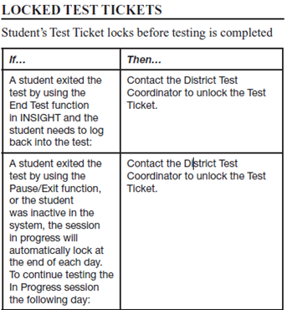
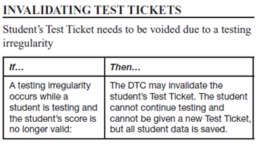
Test Security
Unlocking and Invalidating Test Tickets
Only the District Test Coordinator should have the permission to unlock and invalidate test tickets. Every time a DTC takes either of these actions a Testing Irregularity form must be sent to assessment@la.gov.

Slide 53
Test Schedules
All tests are strictly timed. No additional time is allowed except for students receiving the accommodation Extended Time. TAs will follow the directions in each Test Administration Manual.
Each test session must be administered and completed on the day it is scheduled.
For PBT, School Test Coordinators and principals will schedule makeup test sessions on the designated makeup date. Makeup testing must be completed before the final pickup of answer documents and consumable test booklets for the test administrations.
For CBT, users must enter the designated begin and end dates for each test session in eDIRECT.

Slide 54
Test Materials
PBT materials will be produced and packaged based on the October 1 enrollment. The ELA, Math, Science, and Social Studies test materials, including large print and braille and will arrive in districts according to the delivery schedule.
CBT uploads are based on February 1 enrollment.
To confirm accurate shipment of test materials, complete the Receipt Notice on eDIRECT immediately upon receipt of test materials. If there are any issues with the shipment (e.g., missing or damaged boxes), call DRC Customer Service at 1-888-718-4836 prior to completion of the Receipt Notice.
For each shipment, materials will arrive at the school system in boxes labeled with the district test coordinator’s name and the school system’s shipping address. Each box label references the school name and is sequentially numbered. A School Box Range Sheet indicates which school’s materials are contained in each box.
Boxes used for delivery of materials must also be used to return test materials. The additional shipping boxes may be provided to schools as needed.
District Test Coordinators will receive a packing list for all district materials in each shipment and a copy of each school’s packing list for each content area.

Slide 55
Test Materials
Large-print (PBT) and braille test materials will be boxed by school and delivered to the district in the same shipment as standard print materials. Exception: Spanish large print (PBT) will be provided as an additional materials request only.
Preidentified students using large print (PBT) or braille receive standard print consumable booklets preprinted with their student information and consumable test booklets with preidentified bar-code labels. The students’ responses must be transferred to these consumable test booklets.
For PBT, a Kurzweil DVD, Human Reader MP3 File DVD, and Communication Assistance Scripts must be requested as additional materials.
Each shipment of materials for schools includes overage. District Test Coordinators will also receive district overage materials, which must be inventoried and stored in the locked, secure storage area.
If an answer document, test booklet, or consumable test booklet is soiled, the District Test Coordinator should destroy the document by burning or by shredding if the document can be shredded. The Materials Accountability Form must also be completed in eDIRECT.
UPS is prescheduled to arrive at the district office on pickup days. There is no need to call UPS.

Slide 56
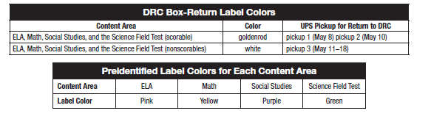
Test Materials
Before PBT begins, preidentified bar-code labels must be affixed to consumable test booklets for ELA, Math, and Social Studies by the STCs. Nonpreidentified bar-code labels must be affixed to answer documents and consumable test booklets for students who were not preidentified.
Colors for return labels and preidentified labels are listed below.

Slide 57
Other Reminders
Ensure your Technology Coordinator is aware of the following responsibilities:
Before Testing:
attending relevant monthly webinars
becoming familiar with Technology User Guide
installing secure web browser
ensuring computers are configured prior to testing
creating a Communication Plan with School Test Coordinator to support test
administrators during testing
During Testing:
being readily available while testing is in process

Slide 58
Other Reminders
DTCs should follow this following protocol regarding student transfers.
If… | Then…
A new student moves into the district | If it is just one student transferring, the designated DTC should email DRC customer support and request the transfer.If you are requesting a transfer for more than one student, the designated DTC should download the Student Transfer Form in eDIRECT, complete the form and then email it to DRC customer support. The DTC will receive an update on the request within 24 hours.
A student moves from one school to another school within the same district prior to testing | The DTC should edit the student’s information in eDIRECT before the student begins testing so that the student’s scores report to the correct school. The DTC must move the student to a different test session in eDIRECT.

Slide 59
LEAP 2025 High School

Slide 60
Spring High School Administration Key Dates
eDIRECT Manage Users available | March 14
eDIRECT Test Setup available with preidentified students | March 26 - May 18
Assign and Enter TA numbers | March 26 - May 18
Materials delivered to School System | April 10
Window for ordering additional materials | April 11 - May 17
End-of-Course/LEAP 2025 HS testing window | April 23 - May 18
Test Ticket invalidations must be completed; Void Notification and Verification forms due to the Louisiana Department of Education | May 21
All secure accommodated materials returned to DRC including braille instructions | May 23
All rescore requests are due to DRC | June 15

Slide 61
Spring High School Administration
The Test Coordinator Manual (TCM) and the Test Administration Manual (TAM) will be available in eDIRECT by March 26.
The next slides include highlights regarding:
Test Schedules
Accommodations
Reports
Testing Statistics
Other Reminders
Technical Assistance Protocol

Slide 62
Spring High School Administration
Scheduling Reminders:
When scheduling test sessions, school test coordinators must enter the designated begin and end dates for each test session.
LEAP 2025 tests are timed; EOC tests are not timed.
The only students who are eligible to take the 4-level U.S. History EOC are students who are graduating in 2017–2018 and retesters who are not repeating the course. EOC tests taken for courses earned prior to 2017–2018 will be accepted. For more information consult the 2017–2018 High School Assessment Frequently Asked Questions.

Slide 63
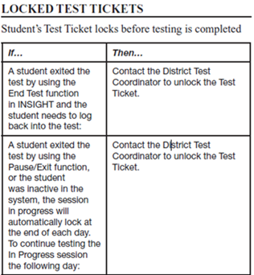

Spring High School Administration
Unlocking and Invalidating Test Tickets:
Only the District Test Coordinator should have the permission to unlock and invalidate test tickets. Every time a DTC takes either of these actions a Testing Irregularity form must be sent to assessment@la.gov.

Slide 64
Spring High School Administration
Accommodations Reminders:
Students with accommodations in SER and SIS will be uploaded by DRC. Nonpreidentified students must be added to eDIRECT manually.
Test coordinators need to manually enter Read Aloud accommodations for students with accommodations in SIS. Students with Read Aloud accommodations in SER will be populated in eDIRECT.
STCs will manually select accommodations or accessibility features in eDIRECT for students that have PNP or LEP accommodations.
School test coordinators must assign and/or verify accommodations of all Education Classification, Section 504, and Limited English Proficient (LEP) students BEFORE students are placed into eDIRECT test sessions so students with accommodations receive the correct forms.

Slide 65
Spring High School Administration
Accommodations Reminders:
STCs should review and verify accommodations for all students in eDIRECT.
New: Student accommodations will display on the Student Test Rosters so STCs can verify accommodations before handing out Test Tickets.
The English III reading passages in sessions 2 and 3 and their related questions may not be read aloud or signed; doing so is a violation of test security, which will result in voiding of the tests. All parts of the LEAP 2025 English I and English II tests are read aloud for students with the read aloud accommodation.

Slide 66
Spring High School Administration
Reports:
Reports for all EOC subjects (EOC English III, EOC U.S. History, EOC Biology) become available four days after a student completes all sessions of a test and exits the test properly.
Seniors receiving an automatic rescore of a 4-level EOC test will receive scores eight days after taking the test.
Reports for 5-level LEAP 2025 high school assessments, except for the LEAP 2025 5-level U.S. History, will be available in window. School test coordinators should use the reports available in eDIRECT to ensure students have completed the LEAP 2025 5-level U.S. History test.
All scores from the LEAP 2025 U.S. History 5-level assessments will be available in the summer of 2018.

Slide 67
Spring High School Administration
Other Reminders:
Students must be provided scratch paper (blank, lined, or graph). Scratch paper used during administration of the assessments must be collected at the end of the administration of each session and turned in to the school test coordinator to be destroyed. Used scratch paper should be treated as secure materials.
The protocol below should be used for students that transfer.
If… | Then…
A new student moves into the district | If it is just one student transferring, the designated DTC should email DRC customer support and request the transfer.If you are requesting a transfer for more than one student, the designated DTC should download the Student Transfer Form in eDIRECT, complete the form and then email it to DRC customer support. The DTC will receive an update on the request within 24 hours.
A student moves from one school to another school within the same district prior to testing | The DTC should edit the student’s information in eDIRECT before the student begins testing so that the student’s scores report to the correct school. The DTC must move the student to a different test session in eDIRECT.

Slide 68
Accountability Codes
District and school test coordinators should wait until the very end of the testing window to complete all accountability coding in the eDIRECT system.
At the end of the window accountability code students should be placed into a test session for each subject and have the appropriate accountability code applied. Documentation for a code should be available for review during an audit.
Steps to pull up list of applied accountability codes:
Manage Test Session
  Select District and School
  Export student details
Applied accountability codes will be in the column labeled testing codes.

Slide 69
Technical Assistance Protocol
If technical problems occur during testing, school and district staff should follow the technical assistance protocol presented below. Technical problems include, but are not limited to, problems connecting to INSIGHT, the inability to load test items, or missing buttons.
DRC Louisiana Customer Service
1-888-718-4836 LAHelpDesk@datarecognitioncorp.com
LDOE
1-844-268-7320
assessment@la.gov

Slide 70
Assessment Resources

Slide 71
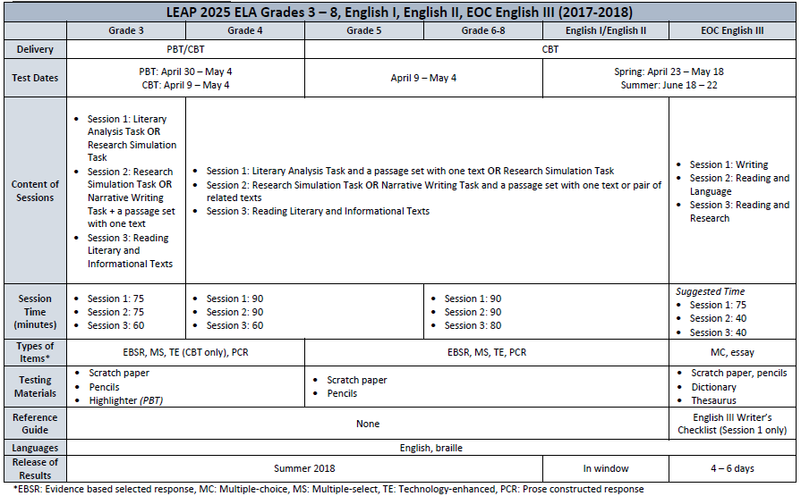
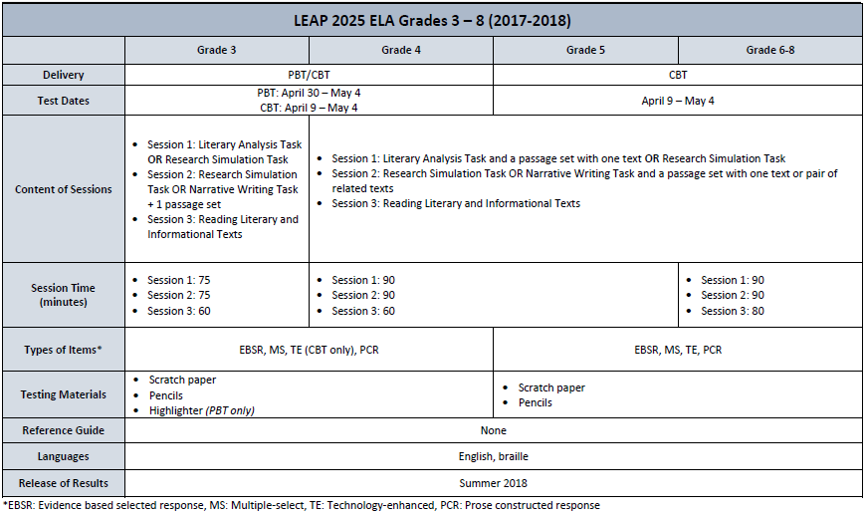
LEAP 2025 At a Glance- Content Area
The LEAP 2025 At A Glance documents provide a test administration summary for LEAP 2025 and EOC. For a detailed summary of each assessment, reference the LEAP 2025 At A Glance - Content Area and LEAP 2025 At A Glance - Grade Band posted in the Assessment Library.

Slide 72
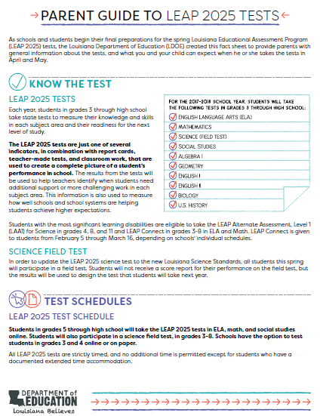
Parent Guide to the LEAP 2025 Tests
The Parent Guide to the LEAP 2025 Tests provides guidance to families on the LEAP 2025 tests for grades 3-8 and high school.
The guide provides information on:
which tests students take;
when students will take the test; and
resources to help parents understand what students should know and be able to do on the tests.
Located within the guide is a Parent Guide to the Practice Tests.
Both of these guides, and all other assessment resources can be found in the Parent Assessment Portal.

Slide 73
LEAP 2025 Practice Tests
Practice Test library
Practice Test Quick Start Guide and guidance documents*
Webinars - presentations and recordings
Paper-based practice tests (grades 3 and 4)*
Practice test answer keys - paper-based and computer-based*
Accommodated practice test materials*
*Also found in eDIRECT
Practice Test Do’s | Practice Test Don’ts
Compare task approach with instructional approach Compare sources to those used instructionally Understand tasks associated with assessable content Guide selection of open-source materials Understand expectations for written responses Facilitate testing discussions with colleagues and students Practice timing/pacing | Gather cumulative data about overall student performance and preparedness Prioritize content based on the standards and GLEs represented on the practice tests Limit instructional strategies to those represented in the practice tests

Slide 74
LEAP 2025 Assessment Resources
Assessment Guidance library
LEAP 2025 Assessment Guides*
Science Field Test Guides*
Reference sheets, rubrics, and checklists*
Webinars - presentations and recordings
Sample social studies item sets and task sets
Equation builder guides
Link to Desmos online graphing calculator
Assessment library
LEAP 2025 Technology Enhanced Item Types
LEAP Accessibility and Accommodations Manual
INSIGHT™
Computer-based practice tests
Online Training Tools
*Also found in eDIRECT

Slide 75
LEAP 2025 Resource Availability Timeline
Resource | Available | Purpose
Assessment Guides | Currently available in Assessment Guidance library | Explain the test designs and types of items included on the assessments. The guides also include information about testing times as well as sample items and links to additional resources.
LEAP 2025 High School Assessment Webinars | Currently available in the Assessment Guidance library | Explain the changes to high school assessments for 2017-2018 and how these changes inform instruction.
Practice Tests | Currently available in INSIGHT and eDirect | Grade- or course-level, paper-based (grades 3 and 4 ELA, math, social studies) and computer-based (grades 3-8 ELA, math, social studies; English I, English II, Algebra I, Geometry, US History) help prepare students for the spring assessments; accessed through INSIGHT.

Slide 76
LEAP 2025 Resource Availability Timeline
Resource | Available | Purpose
Practice Test Guidance | Currently available in the Practice Test library | Provide teachers with information regarding best practices when using the practice tests. Updated to include information about the new high school practice tests.
Practice Test Webinars |  | Provide teachers/district personnel direct links to resources for setup, administration, scoring, reporting, and guidance on how to use practice test results.
LEAP 2025 Social Studies Assessment Framework |  | Demonstrates how the LEAP 2025 social studies assessments connect to classroom instruction. Includes annotated sets from the practice tests showing how content and claims are assessed.
LEAP 2025 Social Studies grades 3-8 Practice Test Answer Keys |  | Updated to include annotated student responses. Demonstrates how to score student responses to social studies constructed-response and extended-response tasks.

Slide 77
LEAP 2025 Resource Availability Timeline
Resource | Available | Purpose
Guides to the Online Equation Builders | Currently available in Assessment Guidance library | Provide information to teachers and students about how to enter equations and symbols in the online platform.
Social Studies Extended-Response Checklists |  | Provide students with support when responding to the extended-response tasks.
ELA Rubrics |  | Define how the prose constructed-response portion of the Literary Analysis, Narrative Writing, and Research Simulation Tasks is scored.
Online Tools Training (OTT) | Available in INSIGHT or here using the Chrome browser | Provide teachers and students examples of interactive, technology-enhanced items so they can become familiar with the computer-based testing format.

Slide 78
Science Online Tools Training and Tutorials
The Science Online Tools Training (OTT) for grades 3-8 and Biology is currently available.
Students and teachers should practice the OTT prior to taking the Science field test.
The OTT can be access by clicking on the INSIGHT icon or using the web link in a Google Chrome Browser.
Tutorials are a video overview of the tools available in the system and they are available in eDIRECT.

Slide 79
ACT and WorkKeys

Slide 80
ACT and WorkKeys Support
The following resources for ACT and WorkKeys can be found on the ACT State Testing Website:
ACT Schedule of Events (PDF)
What’s New with ACT State Testing (PDF)
Using PearsonAccess^{next™} for the ACT® Test
Student Data Upload (SDU) Template (Excel)
Student Data Upload (SDU) File Layout and Loading Instructions (PDF)
Student Data Upload (SDU) Troubleshooting Guide (PDF)
Ordering Additional Materials Guide (PDF)
Welcome to the Accommodations Q&A Session for Spring 2018 Testing (Recorded Webinar)
Welcome to the Louisiana Test Administration Q&A Session for the ACT Test (PowerPoint)
Instructions for Retesting with Accommodations (PDF)
Test Accessibility and Accommodations (TAA) User Guide (PDF)
ACT helpdesk - 800-553-6244 ext. 2800 (standard time) ext. 1788 (accommodations) State Code 19
WorkKeys helpdesk - 800-967-5539 State Code 19

Slide 81
ACT Online Support
The following resources for ACT Online can be found on the ACT State Testing Website:
Technical Requirements for the ACT Test Taken Online
The ACT Online Testing Site Readiness Plan (Graphic) (PDF)
The ACT Administration Manual - Online Testing (PDF)
Preparing for the ACT Test Taken Online (PDF)
ACT helpdesk - 800-553-6244 ext. 2800 (standard time) ext. 1788 (accommodations) State Code 19

Slide 82
ACT and WorkKeys
Important Dates and Resources
Dates | Resources
Available Now | ACT and WorkKeys 2017-2018 Schedule of Events for all dates/deadlines
Available Now | Administration manuals for the ACT and WorkKeys are available here
March 13 | Technical coordinators validate configuration and lock down devices for ACT online testing only
March 14 | Deadline to add students and update student information in PearsonAccess^{next} Deadline to place additional orders for initial ACT and WorkKeys accommodation test materials
March 16 | Deadline to request ACT-approved accommodations for the ACT for eligible examinees through TAA using the ACT-Approved Late Consideration Form
Now - March 19 | Conduct sessions for examinees to complete non-test information on the answer documents for paper testing
Now - March 20 | Train room supervisors and proctors and prepare rooms and material

Slide 83
ACT and WorkKeys
Important Dates and Resources
Dates | Resources
Now - April 4 | Conduct sessions for examinees to complete non-test information for the ACT taken online or provide the information to the examinees to complete on their own
March 20 | Administer the ACT on paper with standard time on the initial test date
March 20 - March 29 | Administer the ACT online with standard time and accommodations and/or supports (Tuesday, Wednesday, and Thursday only)
March 20 - April 3 | Administer the ACT on paper with accommodations and/or supports
March 21 - April 4 | Administer WorkKeys on paper with accommodations and/or supports
March 22 | FedEx pre-scheduled pickup for ACT test booklets, answer documents, and test administration forms from the standard time initial test date (call ACT to reschedule this pick-up if the district will be out for spring break) Deadline for ACT to receive materials is March 30th. Late arriving answer documents will not be scored
March 30 | Purge cached content from all proctor caching computers for ACT online testing only

Slide 84
ACT and WorkKeys
Important Dates and Resources
Dates | Resources
April 5 | FedEx pre-scheduled pickup for ACT test booklets, answer documents, and test administration forms from the accommodation test window and ACT online testing Deadline for ACT to receive materials is April 13th. Late arriving answer documents will not be scored
March 20 - April 6 | Deadline to order ACT standard time materials for makeup testing
April 13 | Close the WorkKeys testing window
March 20 - April 18 | Deadline to order ACT accommodation materials for makeup testing by calling ACT Accommodations 800-553-6244 extension 1788
March 21 - April 24 | Add students and update student information in PearsonAccess^{next} for ACT makeup testing
April 9 - April 18 | Order additional ACT standard time materials for makeup testing

Slide 85
ACT and WorkKeys
Important Dates and Resources
Dates | Resources
April 16 - April 20 | Receive ACT test materials for makeup testing
April 23 | Deadline to conduct sessions for examinees to complete non-test information on the answer document for ACT paper testing
April 24 | Administer the ACT on paper with standard time on the makeup test date
April 24 - April 30 | Administer the ACT on paper with accommodations and/or supports during the makeup testing window
April 26 | FedEx pre-scheduled pickup for ACT test booklets, answer documents, and test administration forms from the standard time makeup test date Deadline for ACT to receive materials is May 4th. Late arriving answer documents will not be scored
May 2 | FedEx pre-scheduled pickup for ACT test booklets, answer documents, and test administration forms from the makeup accommodation test window Deadline for ACT to receive materials is May 10th. Late arriving answer documents will not be scored

Slide 86
ELPT

Slide 87
ELPT Reminders
ELPT testing window closes on March 16.
The last day to order additional materials is March 15.
Any large print or braille test responses must be entered into DEI by March 16.
Test administrators must complete the Post-Administration Oath located in the ELPT Summative TAM.
For issues after testing, contact the AIR Help Desk at 1-866-758-0231 or via email at laelpthelpdesk@air.org.

Slide 88
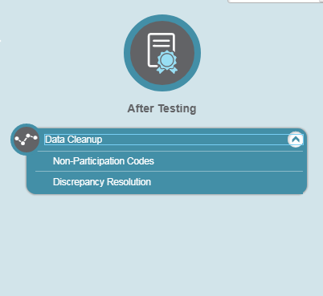
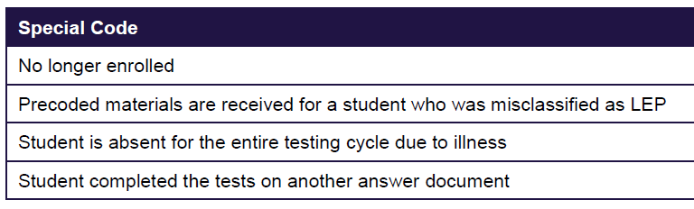
After Testing: Data Cleanup
All students who are entered in TIDE and did not take an ELPT summative test must have an accountability code assigned for each domain.

Slide 89
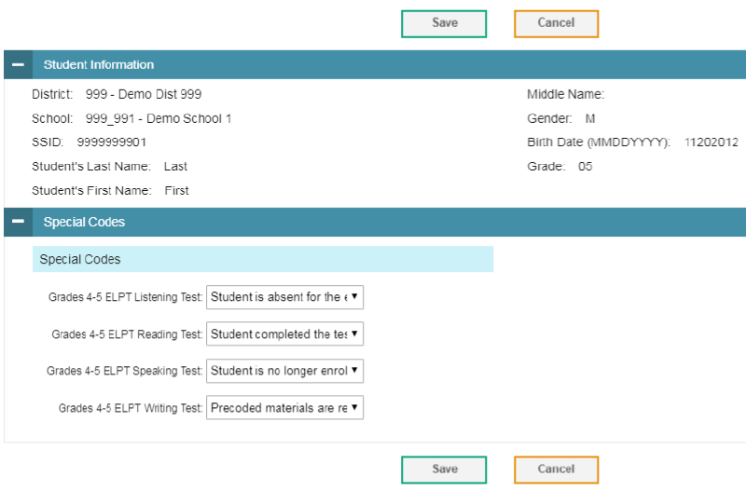
Non-Participation Codes
Within the non-participation code screen, the Student Information panel provides the student’s demographic information.
The student’s available tests and special codes are listed in the Special Codes panel.
To edit the student’s non-participation code, from the drop-down lists in the Special Codes panel, select the special code for each available test, as required, and click Save.

Slide 90
Return of Materials
DTCs are responsible for arranging test materials pickup with FedEx. There is no prescheduled pickup day.
Follow the Packing Materials for Return document for directions regarding packing and shipping both scoreable and non-scorable materials.
Use the return shipping labels provided in the initial shipment to guarantee that boxes are accurately tracked.
Additional return material orders can be placed through March 15 by calling the AIR Help Desk at 1-866-758-0231.

Slide 91
Return of Materials
Materials must be picked up for return by March 23.
Detailed directions can be found on the Packing Materials for Return document.
To initiate a return, use one of the following methods:
Use www.fedex.com: select “Ship,” then select “Schedule and Manage Pickups” from the drop down menu, then click “Schedule Ground Return Pickup.”
Call FedEx Customer Service: 1-800-463-3339; explain that you need a “Package Returns Program” pickup.
Provide materials to your regular FedEx Ground driver.

Slide 92
LEAP Connect/LAA1

Slide 93
LAA1/LEAP Connect Reminders
The LEAP Connect/LAA1 testing window closes on March 16.
The last day to order additional materials is March 15.
Pre-scheduled pickup of materials is March 19.
All test ticket voids must be completed by March 19.
School test coordinators and test administrators must complete the respective Post-Administration Oaths found in the Test Coordinator Manual and Test Administrator Manual posted in eDIRECT.
For issues after testing, contact the DRC Help Desk at 1-866-758-0231 or via email at LAHelpDesk@air.org.

Slide 94
Accountability Codes
District and school test coordinators should wait until the very end of the testing window to do all accountability coding in the eDIRECT system.
At the end of the testing window, students who do not test must be placed into a test session for each subject and coordinators must apply the appropriate accountability code for the student (should have documentation on file). Failure to apply a code could result in a forced zero for each subject test that the students did not complete.
Steps to pull up list of applied accountability codes:
Manage Test Session
  Select District and School
  Export student details
Applied accountability codes will be in the column labeled Testing Codes.

Slide 95
Return of Materials
LEAP Connect and LAA1 materials will be picked up from districts on March 19.
Package all materials according to directions found on page 8 of the LEAP Connect TCM and page 9 of the LAA1 TCM. Both manuals are posted in eDIRECT under General Information.
Complete the Accountability Form and Return Verification Form in eDIRECT as soon as UPS has picked up all test materials.
Collect and properly dispose of all Test Administration Manuals after test administration.

Slide 96
LEAP 360

Slide 97
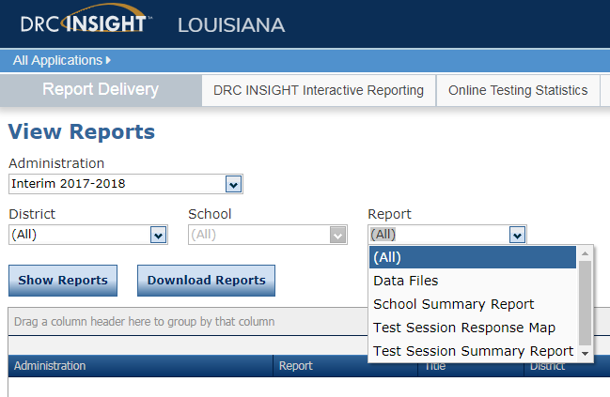
Changes to Report Options
for Interim Assessments
This month, users of eDIRECT will see a change in the options listed in the dropdown box for “Report” for interim assessments.
Test Session Summary reports and Test Session Response Maps will be listed by subject and grade span (3-5, 6-8, HS). The actual report formats will not be changed.

Slide 98
LEAP 360 (2018-2019)
The Department is preparing for the second year of LEAP 360 implementation. School systems that signed a LEAP 360 Memorandum of Understanding (MOU) for the 2017-2018 school year may choose to continue using LEAP 360 through June 30, 2019, under the same terms and conditions.
LEAP 360 will be available to districts in the 2018-2019 at no cost.
Year two provides school systems with an opportunity to:
re-evaluate existing practices,
reduce duplicative testing, and
transition to a more comprehensive assessment system that yields valid and reliable information on student performance throughout the school year.

Slide 99
LEAP 360 (2018-2019)
Next Steps
The Department is continuing to gather feedback from school systems and school level users through focus groups, site visits, and assessment@la.gov. Enhancements across usability, administration, and reporting will be implemented for the 2018-2019 school year.
To opt-in and amend your school system’s existing agreement, each Superintendent must sign an amendment to the original agreement.
Please click here to download the LEAP 360 MOU Amendment (2018-2019) form. Complete, sign, and return an electronic copy to assessment@la.gov by July 7, 2018.
Note: School systems should anticipate a cost for the 2019-2020 school year.

Slide 100
Improvements for 2018-2019
Data Management
Educator Scoring
Reporting
Content
EAGLE
Details about upcoming improvements will be provided at the March Supervisor Collaborations and annual Teacher Leader Summit.

Slide 101
Support and Communication

Slide 102
DTC and Accountability Contact Update
If during the academic year the person appointed as district test coordinator changes, the district superintendent must notify the LODE. The notification must be in writing and must be submitted within 15 days of the change in appointment.
Due to the secure nature of the data accessed by accountability contacts and district test coordinators, changes have been made to the submission process for any updates to DTC and accountability contacts:
Superintendent signature now required
The DTC and Accountability Contact Update Form must be submitted from the superintendent’s district email account.
The revised DTC and Accountability Contact Update Form is located under the Resources + Forms section in the Assessment Library.

Slide 103
District Support
The Assessment team offers multiple avenues of support to districts, schools, and teachers seeking information or assistance about assessment administration and accountability.
Weekly Newsletters
Assessment and accountability information and deadlines are released each week in the district newsletter.
Weekly Assessment & Accountability Calls
Each Tuesday at 1:00 PM these webinars are held to provide training, updates, and important information to DTCs and Accountability Contacts.
Assessment Library and Accountability Library
The Assessment Library contains resources for DTCs including the Assessment Schedule and the Assessment and Accountability Month-by-Month Checklist. The Accountability Library contains resources for accountability contacts including the School Performance Score (SPS) calculators as well as information on data certification and federal accountability.

Slide 104
District Support
Monthly Educational Technology Calls
Each month a webinar is held for district technology personnel to provide training, updates, and important information related to technology readiness and digital literacy.
Assessment@
All stakeholders are encouraged to email assessment and accountability questions and/or concerns to assessment@la.gov.
Assessment Hotline
For immediate assistance regarding assessment and accountability, district-level staff may call the Assessment Hotline at 1-844-268-7320.
EdTech@
All stakeholders are encouraged to email technology readiness questions and/or concerns to edtech@la.gov.

Slide 105
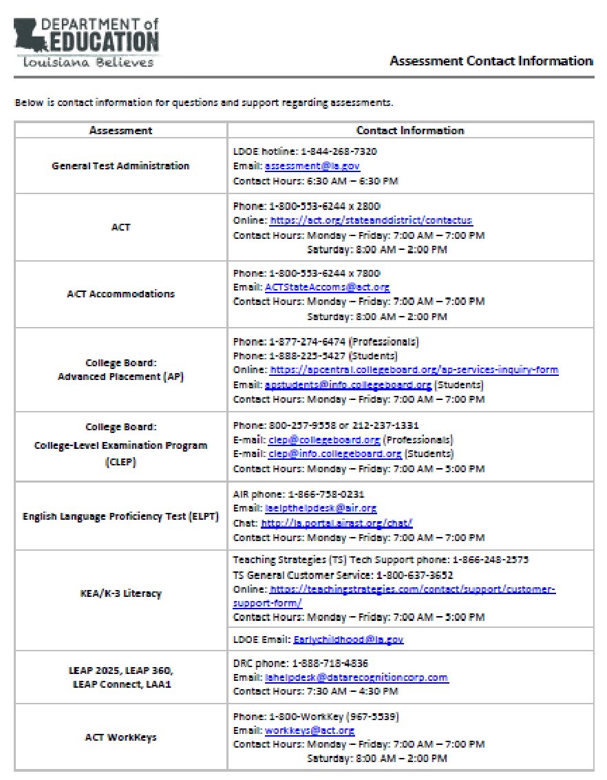
Assessments Customer Service
The Assessments Customer Service Contact Information has been posted to the Assessment Library. This provides all customer service contact information for all assessments.

Slide 106

Professional Development:
Teacher Leader Summit
The 2018 Louisiana Teacher Leader Summit will take place Wednesday, May 30 through Friday, June 1 at the Morial Convention Center in New Orleans.
This event brings together 6,500 educators and content experts who will focus on creating meaningful growth for every student, every day. Educators will share their knowledge, learn new skills, and prepare for the 2018-2019 school year.
Refer to the 2018 Teacher Leader Summit overview for information about the schedule, recommended attendees, and lodging.

Slide 107
Next Steps

Slide 108
Next Steps
Key Dates | Action
March | Train STCs for spring assessments
March 19 | Begin completing Test Setup for grades 3-8 assessments
March 26 | Begin completing Test Setup for high school assessments
March 20 | ACT paper-based testing
March 20-29 | ACT computer-based testing
Next Assessment and Accountability Monthly Call: April 17, 2018

