Slide 1
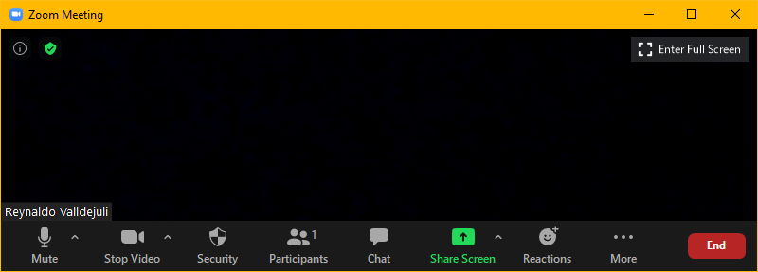
Zoom Meeting Preparation
Please make sure your phone or computer is muted to minimize background noise.
  To do this, hover over the bottom left-hand side of your screen and click “Mute.”
Please make sure you have turned off your camera to save bandwidth and prevent any connectivity issues.
  To do this, hover over the bottom left-hand side of your screen and click “Stop Video.”
Please submit questions during the presentation in the “Chat” function located on the bottom of your screen.
NOTICE: In accordance with the Americans with Disabilities Act, if you need special assistance at this meeting please contact ldoecommunications@la.gov.

Slide 2
AAA: Assessment and Accountability Monthly Call
April 18, 2023

Slide 3
Agenda Items
LEAP 2025
LEAP Connect
ELPS/ELPT
ACT
K-3
VI. Innovative Assessment
VII. Accountability

Slide 4
LEAP 2025

Slide 5
Important Dates for LEAP 2025
April 6-May 16: Accountability Form completion window
April 18-May 24: LEAP HS testing window
April 26-May 2: Paper testing window; makeups May 3 and 4
April 25-May 26: Grades 3-8 computer testing window (makeups in window)
Please see test coordinators’ manuals for complete list of dates.

Slide 6
Test Read Aloud Labels
The department discontinued the use of Test Read Aloud labels for paper tests that were used by teachers to read text to students. When the teacher is finished with the test copy, it should be included with unused test documents.

Slide 7
Document Search for Grade 3 Paper
Each year, the department receive requests for identifying test documents for students who had transferred answers for grade 3 paper testing, or for student booklets that may have not been submitted correctly. Please be reminded that there is a fee for requesting that DRC search for documents and an additional fee for scoring them late.
DRC will charge the school system $100 to research any missing or unsubmitted tests, and, if a test is found, $100 to score it. This will result in a delayed score memo for the student.

Slide 8
LEAP 2025 Evening and Weekend Testing
During spring testing, evening and weekend testing should be limited to very unusual circumstances.
Evening and weekend testing must be pre-approved by the department and a justification must show the need for the request.
Requests must be made no later than 24 hours in advance, but we strongly recommend that you request as soon as you know you will need it. DRC will need time to set this up in INSIGHT.

Slide 9
Social Studies Test Read Aloud Study
Please do not rearrange students that have been assigned to the SS TR groups. A student who is in the SS TR No group that has TTS accommodations should be provided with the accommodation. They should NOT be moved to the SS TR Yes group or removed.

Slide 10
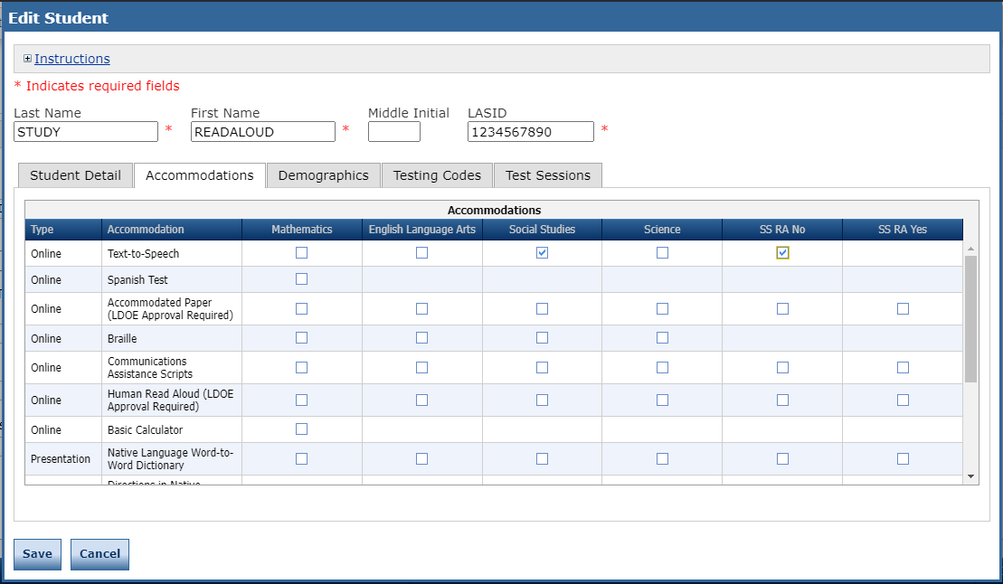
Additional Accommodations Columns Grades 3-8
Additional columns for accommodations have been added as shown below. The SS RA Yes and SS RA No are columns that are only used for schools that were selected for the social studies read-aloud study at grades 3 and 4. Schools not selected can ignore these columns.

Slide 11
Test Security Policy
Test security policy approved by BESE and implemented by the department is included in BESE Bulletin 118, Chapter 53. This policy applies to all statewide-administrations, all public schools, including charters, and all nonpublic scholarship programs.
Chapter 53. Test Security
§5301. Participation
[Formerly LAC 28:CXI.301]
All persons involved in assessment programs must abide by the security policies and procedures established by the LDE and the SBESE.

Slide 12
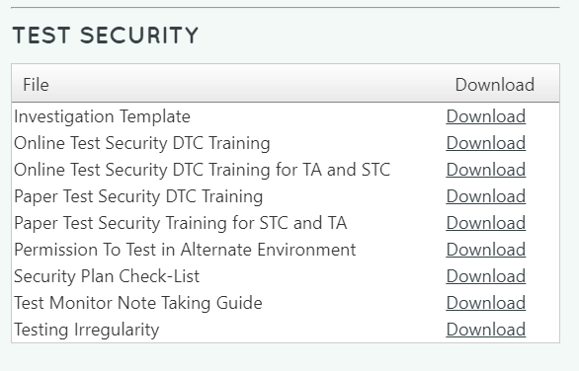
Test Security Resources
The assessment library includes a reserved area for test security resources. They are designed to assist school systems with the required test security training for all persons assisting with test administration.

Slide 13
Test Security Training
All personnel who will be involved with LEAP test administration must be trained on test security. The DTC must train all STCs, and STCs must train all school-level personnel. It is important that DTCs and STCs keep records for when trainings occurred and who was in attendance. Please be sure that the following areas from Bulletin 118 are covered during training:
Testing irregularities and violations of test security
Maintaining the security of materials
Active Monitoring
Reporting irregularities or violations
For assistance with training, please contact Bryan.Gendron@la.gov.

Slide 14
Off Grade Test Voids
All students must take the appropriate grade level or grade span assessments for all state-administered assessments.
Any grade level reassignments that are made after October 1 must be properly recorded in the state’s Student Information System (SIS). The student record should indicate an exit from the original grade using exit code 15 and a new enrollment under the updated grade level no later than February 1.
Tests will be voided for any students who takes a grade level test lower than their enrolled grade or grade span based on the official SIS record.

Slide 15
LEAP Connect

Slide 16
Return Secure Materials
Please ship any final secure documents, including Directions for Test Administration (DTA) to DRC as soon as possible.

Slide 17
ACT

Slide 18
ACT/WorkKeys
April 19:ACT Online Reporting webinar at 12:00 noon. Register here.
April 21: WorkKeys realms close. Please be reminded that seniors must test in the department windows for certificates to be used in accountability. Students may test on other realms after the closing date for other purposes.

Slide 19
K-3

Slide 20
K-3 Screening Updates
Updated Documents:
K-3 Literacy Screener Guidance
K-3-Literacy Screener Scoring Guidance
There will be no statewide screener selected for use at the end of 2022-2023. There is a process underway to select a vendor for 2023-2024. There will be a statewide vendor that will be required from all school systems next year.
End-of-Year literacy screening is required by law using currently-approved literacy screeners. Data managers were provided with information about how and when to report the results in EdLink. The process is the same as it was in the fall.

Slide 21
Innovative Assessment

Slide 22
Innovative Assessment LEAP Rosters
Students must have results from all three end-of-unit IAP assessments to receive an end-of-year result that is used for accountability. The department has posted the LEAP Roster for IAP Schools to the ftp. These rosters identify students who have not participated in one of two windows this academic year and will be required to take LEAP. Students who have taken assessments in all three windows are not eligible to participate in LEAP.
Please note that students who have had a test voided in a previous window will not be identified on the roster. These students may take LEAP for informational purposes but the LEAP score will not be used for accountability.
It is not necessary to apply accountability codes for students who will have scores from all three testing windows or who will have a score reported with the LEAP 2025 ELA assessment.

Slide 23
Math Testlets
If you are participating in the math testlet program, please note that the final administration window runs concurrently with the LEAP testing window. The department recognizes that LEAP testing will be the priority of school systems at this time. Please let us know if you need additional guidance about this administration.

Slide 24
Accountability

Slide 25
Interests and Opportunities Data Certification
I & O data certification opened on April 17 to accept documentation for documentation-based indicators selected by school systems. All documentation must be provided no later than June 7.
School system accountability contacts are the only individuals who can access La Data Review. Contacts should use the same log-in credentials that were sent to them earlier for cohort graduation data certification. There is a unique link to the Interests and Opportunities: www.ladatareview.net/InterestsAndOpportunities/. This link is available in an announcement in the normal portal.
For school systems who did not have cohort graduation data, user names and passwords will be sent from the La Data Review system.
No changes to indicators selected will be accepted.
Indicators that are data-based will be measured through state collections.
Information about indicators and calculations for the I & O index can be found here: Interests and Opportunities Menu-based Approach Guidance-2022-2023.
Send questions to accountability@la.gov.

Slide 26
Login Notification
Accountability contacts who did not have login credentials sent to them from Jennifer Baird as part of data certification have been sent login information directly from the La Data Review system. See sample below of the notification email.
---------- Forwarded message ---------
From: Louisiana Data Review <noreply@mmcsconsulting.com>
Date: Fri, Apr 14, 2023 at 12:11 PM
Subject: Louisiana Data Review - Login Information
To: Jennifer BairdDuplessis <jenwindow@xxxxx.xxx>
Your login information:
User name: jebaird
Password: thistest

Slide 27
Interests and Opportunities 2023-2024
2023-2024 Menu & Guidance
The 2023-2024 Interests and Opportunities Menu and Course Codes will be published on March 31.
A final guidance document for the 2023-2024 school year will be published in June 2023.
There will be sessions at Teacher Leader Summit 2023, as well as information in the School System Leader Newsletter and calls.
The Accountability Division will hold additional Office Hours in the fall to support schools with questions or concerns surrounding the Interests and Opportunities Index.
As always, department staff members are prepared to help you navigate the system or address any policy or data concerns.

Slide 28
Social Studies in 2023-2024
On May 8, the Accountability Council will meet to discuss how to calculate the 2024 SPS without social studies scores. At the last meeting three options were proposed:
Double weight science for one year
Use old social studies index (USDE may not approve)
Do not substitute anything (ELA double, math double, science single weight)
The department will need USDE approval of any changes to the calculation of school performance scores.

Slide 29
Call Summary
Month | Key Deadlines | Support and Resources
April | April 1-30: End of year K-3 literacy screening April 17: Interests and Opportunities Data Cert opened April 18: LEAP High School testing window opens April 25: LEAP grades 3-8 and IAP testing window opens April 26-April 28: LEAP grade 3 paper ELA and math | 2022-2023 Assessment Calendar Assessment Library DTC Resources Page
May | May 1-2: Grade 3 paper science and social studies May 8: Accountability Council May 24: Last day to test high school students May 26: Last day to test grades 3-8 CBT | Office Hours Tuesdays at 3:45: April 4, 25; May 2, 9, 23 Monthly Call: May 16 No Call on May 30 due to Teacher Leader Summit in New Orleans

