Slide 1
Zoom Meeting Preparation
Please make sure your phone or computer is muted to minimize background noise.
To do this, hover over the bottom left-hand side of your screen and click “Mute.”
Please make sure you have turned off your camera to save bandwidth and prevent any connectivity issues.
To do this, hover over the bottom left-hand side of your screen and click “Stop Video.”
Please submit questions during the presentation in the “Chat” function located on the bottom of your screen.
NOTICE: In accordance with the Americans with Disabilities Act, if you need special assistance at this meeting please contact ldoecommunications@la.gov.

Slide 2
AAA: Assessment and Accountability Monthly Call
August 16, 2022

Slide 3
Agenda Items
LEAP 2025
LEAP Connect
ELPS/ELPT
ACT
K-3
V. Accountability

Slide 4
LEAP 2025

Slide 5
LEAP 2025
All student reports should now be distributed along with parent guides. Parent requests sent to the department will be redirected to the school where the student tested.
Please send any documentation related to accommodations audits as soon as possible. Undocumented accommodations will result in a test void.

Slide 6
LEAP Connect

Slide 7
Prioritized Connectors Guide for Students with Significant Cognitive Disabilities
The department approved prioritized LEAP Connectors for English language arts, mathematics, and science to provide instructional support and planning resources for teachers and content leaders.
Please share with special education teachers and supervisors.
The prioritized LEAP Connectors are located in the LEAP Connect Assessment Resources posted on the assessment guidance library on the department website.
Contact tywanna.dushime@la.gov for more information.

Slide 8
ELPS/ELPT

Slide 9
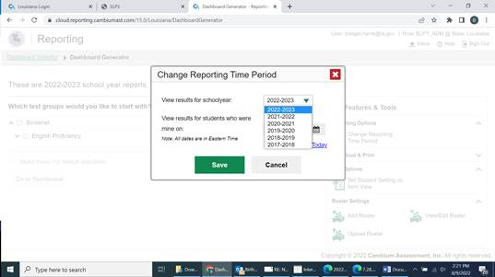
EL Transfers in TIDE
Students have not been uploaded into TIDE because the October 1st enrollment has not been collected. Therefore all students who are new to a district will have to be manually entered in TIDE. Users should enter the student’s LASID in the search bar at the top right of the TIDE dashboard. One of two messages will display:
Message 1: “Student not active” indicates that the student has previously been tested. Manually enter the student in TIDE and obtain the student’s results using “Reporting.” To access the records, go to Change Reporting Time Period and select a prior academic term.

Slide 10
EL Transfers in TIDE, cont.
Message 2: “TIDE does not have a student with ID ##########” indicates that a student with that LASID has not been previously assessed through TIDE. Users must manually enter the student in TIDE and screen the student based on the documentation collected during enrollment.
ELPS scores will begin reporting in the portal later today.

Slide 11
ACT

Slide 12
ACT Announcements
ACT announced
the storage of data for 5 years in the Success platform. The oldest data will be purged every year on September 1 beginning with the 2017-2018 records purge on September 1, 2022, and adding 2022-2023 data
student reports sent to students and returned undeliverable will be mailed to schools for distribution to students
ACT has eliminated training packets
manuals are available online on the ACT State Testing site if testing online; manuals will be mailed for paper testing and also available online

Slide 13
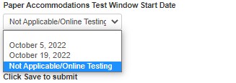
WorkKeys Date for Paper Tests
August 26 is the deadline for
entering fall testing dates for WorkKeys and
adjusting enrollment counts for WorkKeys accommodated paper material in PANext.
All accommodations can be administered online except large print and braille.
If your district has no WorkKeys paper testers, select Not Applicable/Online Testing from the dropdown menu. A Materials Receipt Week must be selected.

Slide 14
K-3

Slide 15
KEA and K-3 Literacy Screening
Kindergarten Readiness Screening:
Must be completed first 30 days of school
Must be reported by October 31
K-3 Literacy Screening
Must be completed first 30 days of school
Must be reported by October 31
The KEA and K-3 Literacy Screener Administration and Reporting Webinar is now posted to the DTC Resources Page of the assessment library under “Assessment Webinars.”

Slide 16
Accountability

Slide 17
Opening of DCAI and ACT Data Certification
La Data Review is now open until August 31 for review of DCAI and ACT rosters.
DCAI
Credits cannot be updated through a request. Changes should be made directly to the transcript in STS.
Requests to change dropout flags for 2020-2021 will not be reviewed. Please submit requests to change 2021-2022 dropout flags when the dropout has been removed from EdLink
ACT
Super scores will not be used in accountability.
ACT score from a June or July 2022 administration will not be used.
LEAP Connect students are not mandated to take ACT, but should be accountability coded with 94 if they participated in high school level LEAP Connect.

Slide 18
WorkKeys
Please remember:
WorkKeys points awards cannot be increased without full testing history of the student. Requests that only include a certificate cannot be reviewed.
All students, except students who participated in LEAP Connect at the high school level, must have an ACT score. A WorkKeys certificate can only be used if a student also has an ACT score.
The last day to test WorkKeys for accountability was April 29 for students on the roster.

Slide 19
Interests and Opportunities
Emails went out to principals on Monday, August 15 with directions and guidance for how to access and complete the survey that indicates the I & O indicators selected by the school. These indicators will be used in the calculation of the I & O index for 2023 school performance scores. Accountability contacts were notified as well.
The survey must be completed by November 4, 2022.
The 2022-2023 Interests and Opportunities Menu is posted to the department website.
Note: Please make sure that principals and superintendents are updated as needed in Sponsor Site.

Slide 20
Call Summary

Slide 21
Call Summary
Month | Key Deadlines | Support and Resources
August | K-3 Screening: KEA and K-3 Literacy administered to all students in the first 30 days of enrollment August 16: Principals received notice regarding opening of Interests and Opportunity surveys Week of August 29: Assessment data certification opens August 31: Data certification closes for DCAI and ACT ELPS screening first 30 days of a student’s enrollment | 2022-2023 Assessment Calendar Assessment Library DTC Resources Page
September | September 5: LDOE Offices Closed Week of September 12: Final updates to STS credits downloaded Week of September 19: Assessment data certification closes | Office Hours Tuesdays at 3:45: August 23, 30 Monthly Call: Sept. 20

