Slide 1
AAA Assessment and Accountability Monthly Call August 20, 2024

Slide 2
Zoom Meeting Preparation
Please make sure your phone or computer is muted to minimize background noise.
To do this, hover over the bottom left-hand side of your screen and click “Mute.”
Please make sure you have turned off your camera to save bandwidth and prevent any connectivity issues.
Please do not enable any AI or other recording device. Per LDOE legal team, recording of this webinar is not permitted. Individuals who launch recording functions, will be removed from the meeting.
NOTICE: In accordance with the Americans with Disabilities Act, if you need special assistance at this meeting please contact ldoecommunications@la.gov.

Slide 3
Assessment and Accountability Office Hours Time Change
The assessment and accountability Office Hours call will be moved to 3:00 p.m. permanently beginning September 3. The link will not change. Please be reminded that this call is designed for district test coordinators and accountability contacts.

Slide 4
Agenda Items
I. LEAP 2025
II. ELPS/ELPT
III. ACT
IV. K-3 Literacy
V. Accountability

Slide 5
LEAP 2025

Slide 6
ELA and Math Assessment Guides
ELA and math assessment guides are still being reviewed. The department does not have a date for their release, but we will communicate their release using office hours and the newsletter.

Slide 7
LEAP 360
LEAP 360 Diagnostic and Interim assessments are available in DRC INSIGHT. The guides to the assessments are posted in the assessment library.
https://www.louisianabelieves.com/measuringresults/leap-360
Eagle is not available as an assessment, but items are posted at the same link for teacher use. The password is Educate2020.

Slide 8
LEAP Grade 3 Paper Option
There will continue to be a paper option for grade 3 in 2024-2025. The option can be selected by school or by district. When DRC INSIGHT opens the Enrollment Verification at the beginning of October, DTCs will be able to make the paper selection. The department will offer specific guidance as we get closer to this opening.

Slide 9
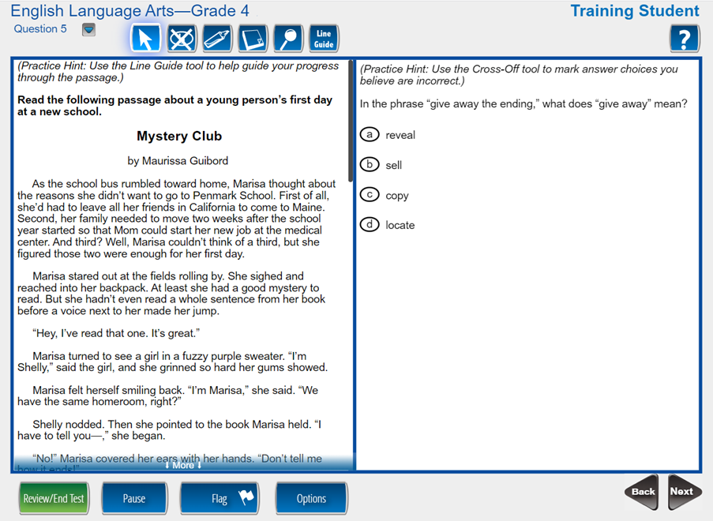
DRC INSIGHT Enhanced Experience
Please see July slide deck for all of the enhancements to the OTT student experience. Make sure teachers and students become comfortable with the changes.
In 2024-2025 DRC Insight will move from the classic student experience (left) to an enhanced student experience (next slides).
Online Tools Training (OTT) is now updated.
Teachers and students should become familiar with the new format in advance of testing.
It is especially important to familiarize students with disabilities with the accommodations tools.

Slide 10
Accessing OTT
Students can access the OTT via DRC Insight or the web portal: https://wbte.drcedirect.com/LA/portals/la/ott3?adminId=510135&index=4

Slide 11
New Testing Irregularity Form in 2024-2025
The department has redesigned the testing irregularity form to better serve users.
The new document contains guidance on a number of common test irregularity issues related to :
Cheating
Administrative Error
Accommodations (the accommodation not received form will no longer be allowed)
Timing
Technology/Testing Interruptions
Link: https://louisianabelieves.com/docs/default-source/assessment/testing-irregularity.pdf?sfvrsn=f3ec8c1f_12

Slide 12
Discontinued Forms for Testing
Testing irregularities that are sent on previous versions of the form will be returned, and senders will be asked to provide information on the new form. Please make sure all STCs remove or discard the old form.
In 2024-2025, the department will no longer allow parents to accept scores for assessments that were given without appropriate documentation. Tests that were administered without appropriate accommodations will be voided. It is extremely important that test administrators be well prepared to provide an optimal testing experience to students before they begin testing.

Slide 13
ELPS/ELPT/ELPT Connect

Slide 14
ELPS
The ELPS (screener) is open in TIDE, and the department signed off on the release of reports beginning Monday, August 19.

Slide 15
ACT

Slide 16
New ACT Law
House Bill 762 that was signed into law by Governor Landry does not go into effect until 2025-2026. All students in grade 12 will continue to need an ACT score in 2024-2025 unless they have LEAP Connect high school level scores.
(g) If state board policy requires a student pursuing a diploma other than a career diploma to take the ACT, the student may also take the WorkKeys test and the Armed Services Vocational Aptitude Battery, and the State Board of Elementary and 2 Secondary Education shall develop a system of equivalent scores for the ACT, the 3 WorkKeys test, and the Armed Services Vocational Aptitude Battery and use a 4 student's highest score achieved on such test or tests for purposes of the school and 5 district accountability system required by R.S. 17:10.1.
Section 2. The provisions of R.S. 17:24.4(F)(1)(g) as enacted by this Act and the provisions of R.S. 17:183.3(B)(3) as amended and reenacted by this Act shall be implemented beginning with the 2025-2026 school year.

Slide 17
New MOUs for 2024-2025
The new ACT MOUs are available in the assessment library. All school systems that plan to administer WorkKeys to students who are not eligible under state contract (see below) as well as students retesting on ACT will need to submit the MOU.
The LDOE ACT contract pays for:
All students in grade 11 and students who are in grade 12 and have no ACT score on record from a previous administration.
One administration of WorkKeys for students who are in grade 11 on a Jump Start diploma pathway.

Slide 18
Links to ACT MOU Documents
2024_2025 ACT MOU Information Sheet
2024-2025 ACT Estimation Worksheet and-ACT MOU for Public and Charter Schools
2024_2025 Estimation Worksheet and ACT MOU for Non Public Schools

Slide 19
Data Sharing Agreements for WorkKeys
Beginning with the August 2025 ACT data certification, WorkKeys scores will only be used from a realm other than the one provided by the department if the school system has a data sharing agreement that allows scores to be reported directly to the department by ACT. Schools and systems that have other realms must be sure to have a data sharing agreement in place prior to the opening of the administration window in early October. Realm numbers for external realms must be send to patricia.newman@la.gov.
The data sharing agreement for non-LDOE realms can be found at this link: https://www.louisianabelieves.com/resources/library/data-center/data-sharing-agreements

Slide 20
K-3

Slide 21
K-3 Literacy Screening
Statewide literacy screening is being opened automatically by district depending on each system’s first day of school. All students, including students who are alternatively assessed using LAAR must have a score in mCLASS.
Students cannot be removed but can be accountability coded if the school has the documentation necessary to support the code. Codes and required documentation are provided in the Louisiana Specific Guide.

Slide 22
Start Date for Screening Students
Reminders:
Paper and remote administrations must continue to be conducted with two devices as if the student is testing online in person. All responses must be entered into mCLASS by student.
Screening is not done in a secure browser for BOY, but the screening should be done following test security guidelines.
All test coordinators and administrators must have a signed oath found in the Louisiana Specific Guide

Slide 23
K-3 Screening Grade Changes
Requests for grade changes should be sent to Jennifer.Baird@la.gov. If you sent in previous requests to assessment@la.gov they have been sent and there is no need to resend. Requests are being forwarded to Amplify on the same day that they are sent. The format for requests must either be in the body of the email or sent as an Excel attachment. Amplify will not accept pdf documents or handwritten documents. The format must be exactly as shown on the following slide.

Slide 24
Changes to Student Data in Amplify
Format for grade changes in an Excel file (no PDF)
Student Name: Partial PII
Sudent LASID: 10-digit state ID
Name of school
Site code of school: 6-digit ID (please send district/school)
Current Grade Level: as shown in Amplify
Requested New Grade Level:
For students who need a name change, please submit a request directly to Amplify using the helpdesk email on the Louisiana mclass page. Please do not send these to any LDOE staff since the submission will require full PII.

Slide 25
Error Code 400
Some school systems have reported a 400 error code during screening. Amplify explained that this will error will be reported when a school tries to screen a student who has not been transferred by them yet. Please note that it takes 24-48 hours to have the transfer completed by them when it is made in mCLASS.

Slide 26
Accountability

Slide 27
Changes to DTC and Accountability Coordinators
It is extremely important that any change to district test or accountability coordinators be provided to assessment@la.gov as soon as possible. During the summer, the department will be providing access to mCLASS, testing platforms, and data certification based on the formal file that is managed by the Assessment Administration team.
All change requests must be submitted by the superintendent using the DTC and Accountability Contact Update Form in the Assessment Library.

Slide 28
Changes to Cohort Graduation Data Certification 2025
Beginning with the 2023-2024 graduation cohort, data certification will no longer permit requests for changes to credentials that should already be on the transcript in STS. This includes IBCs, associate degrees, and dual enrollment courses. The change affects the 2024-2025 data review process.
The system will continue to allow school systems to make updates to transcripts for the application of graduation dates, which are critical to the official student transcript. The system will also continue to review requests for AP and IB updates, CLEP updates, and HiSET updates.

Slide 29
Data Certification Timelines
DCAI and ACT data certification is now open through August 30. All new submissions must be successfully submitted to the department by the deadline.
Late August: Assessment data certification, which includes LEAP 2025, LEAP Connect, ELPT, ELPT Connect and IAP. Progress points will also be reviewed with this certification.
To request changes to the 2023-2024 dropout flag, the dropout must be able to be corrected in EdLink and a submission with the documentation for the exit must also be submitted to La Data Review. The department will not review requests to change credits in La Data Review.

Slide 30
Transcripts
As credits are being reviewed, please note:
The last record of the high school that had access to the transcript has been provided on the spreadsheet. Data managers should work across districts to assist each other. All data managers can run a transcript from STS to confirm credits (do not send a local vendor system transcript.)
Please note that applied credits will only count if the student is on the Jump Start diploma for students who take alternate assessments.

Slide 31
Call Summary
Month | Key Deadlines | Support and Resources
August | August 30: Deadline to submit new requests in La Data Review for DCAI and ACT Week of August 26: Assessment data certification opens Month of August: K-3 Literacy Screening opens based on first day of school. | Assessment Library DTC Resources Page 2023-2024 Assessment Calendar
September | September 30: All IBCs, credentials, DE courses and Associates Degrees are added to the transcript in STS for 2024 graduates. Any missing data cannot be submitted in March/April 2025 cohort graduation data certification. | Office Hours Tuesdays at 3:45: Last date at this time is August 27. Beginning September 3, all calls will begin at 3:00 p.m. Monthly Call: September 17

