Slide 1
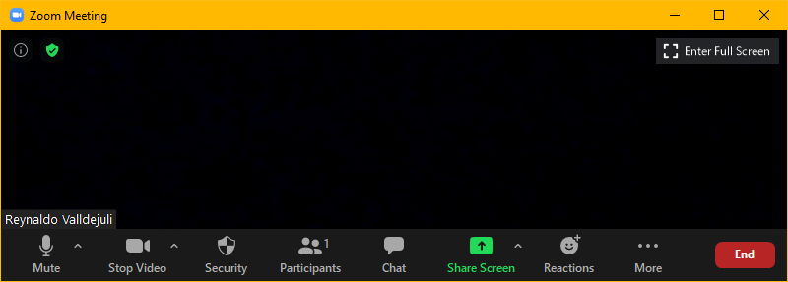
Zoom Meeting Preparation
Please make sure your phone or computer is muted to minimize background noise.
  To do this, hover over the bottom left-hand side of your screen and click “Mute.”
Please make sure you have turned off your camera to save bandwidth and prevent any connectivity issues.
  To do this, hover over the bottom left-hand side of your screen and click “Stop Video.”
Please submit questions during the presentation in the “Chat” function located on the bottom of your screen.
NOTICE: In accordance with the Americans with Disabilities Act, if you need special assistance at this meeting please contact ldoecommunications@la.gov.

Slide 2

AAA: Assessment and Accountability Monthly Call
February 14, 2023

Slide 3
Agenda Items
LEAP 2025
LEAP Connect
ELPS/ELPT
ACT
K-3
VI. Innovative Assessment
VII. Accountability

Slide 4
LEAP 2025

Slide 5
2023-2024 Assessment Calendar
The 2023-2024 assessment calendar is now posted in the assessment library. The calendar:
Reflects grades 3-8 LEAP testing one week earlier than the past two years at the request of many school systems
Provides for only one fall administration for high school
Continues to provide a paper option for grade 3, which must be selected during the October enrollment period in DRC INSIGHT.
Includes information about K-3 screening
Includes schedules for ELPT and LEAP Connect that are not interrupted by Mardi Gras

Slide 6
DRC INSIGHT Platform and Speech-to-Text
Students utilizing speech-to-text on a chromebook will not be able to speak directly into the chromebook. Instead they should follow the instructions in the accessibility and accommodations manual. Students using speech to text on Windows devices can continue to launch the speech to text program, login to DRC Insight and use the speech to text function.

Slide 7
Speech-to-Text Guidance from Accommodations and Accessibility Features Guide
Speech-to-text conversion or voice-recognition software allows students to dictate responses into their computer microphone and have the responses converted to printed text. For this accommodation, students will use their own assistive technology devices at a separate computer station equipped with speech-to-text/voice recognition software in order to respond to multiple-choice, open-ended items, and extended responses on the LEAP 2025 assessments.
Students who use voice recognition software routinely and for whom this accommodation is listed in their IEP may use speech-to-text/voice recognition software as an accommodation on the LEAP 2025 assessments. Students must become familiar with the software and must have opportunities to practice using it prior to testing. It is also important that students who use speech-to-text devices be given the opportunity to develop planning notes using speech-to-text and view what they produce via speech-to-text.
NOTE: Test security must be maintained throughout this process.

Slide 8
Important Dates for LEAP 2025
March 18: All accommodations for high school LEAP assessment are final on IEPs, IAPs, and EL checklists
March 20: LEAP Grades 3-8 Test Setup Opens; TA numbers, print test tickets
March 24: Testing manuals delivered to school systems for grades 3-8.
March 25: All accommodations for grades 3-8 LEAP assessments are final on IEPs, IAPs and EL checklists
April 6: Paper-based test materials delivered to systems, including accommodated materials

Slide 9
LEAP Field Test Sessions
Some schools will be selected to participate in one or more field test sessions.
Field tests do not yield student level results, but they provide important information about test items that may be used in future assessments.
Schools selected for grades 6 and 8 science will be notified by Friday, February 17.
Schools selected for grades 3 and 4 social studies will receive detailed notification of selection in one of two opportunities by the end of February.
  Some grades at schools will participate in a typical field test experiences.
  Some grades at schools will participate in field testing that will include online audio for students.
  The grades 3 and 4 field test will provide data to study the impacts of providing test read aloud to an expanded group of students as part of social studies assessment development.

Slide 10
LEAP 2025 Evening and Weekend Testing
During spring testing, evening and weekend testing should be limited to very unusual circumstances.
Evening and weekend testing must be pre-approved by the department and a justification must show the need for the request.
Requests must be made no later than 24 hours in advance, but we strongly recommend that you request as soon as you know you will need it. DRC will need time to set this up in INSIGHT.

Slide 11
BESE Policy for Geometry Requirement
BESE approved policy that will become rule at the end of the month that now requires Geometry or Applied Geometry for students on the career diploma pathway. See policy below.
2. The minimum course requirements for a career diploma for incoming freshmen in 2023-2024 and beyond shall be the following:
A – b.i.
ii. geometry or applied geometry
https://go.boarddocs.com/la/bese/Board.nsf/files/CK4MP65BF4E8/$file/AGII_5.1_Legis_Updated_at_meeting_Oct2022.pdf

Slide 12
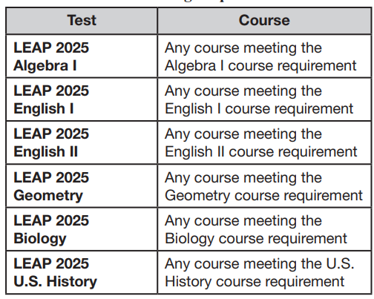
New Geometry Requirement
Students who take Applied Geometry to meet Jump Start diploma requirements beginning in 2023-2024 must take the Geometry assessment. There is only one Geometry assessment for courses that satisfy the requirement. Please see below guidance from the LEAP testing manuals.

Slide 13
Test Security Policy
Test security policy approved by BESE and implemented by the department is included in BESE Bulletin 118, Chapter 53. This policy applies to all statewide-administrations, all public schools, including charters, and all nonpublic scholarship programs.
Chapter 53. Test Security
§5301. Participation
[Formerly LAC 28:CXI.301]
All persons involved in assessment programs must abide by the security policies and procedures established by the LDE and the SBESE.

Slide 14
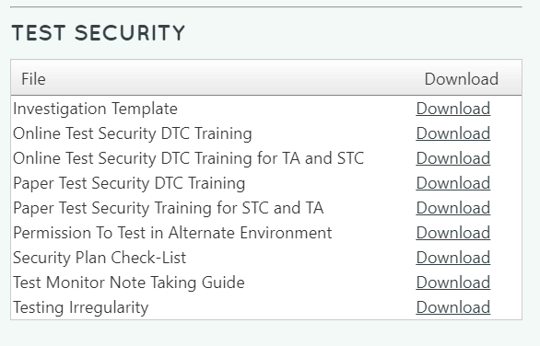
Test Security Resources
The assessment library includes a reserved area for test security resources. They are designed to assist school systems with the required test security training for all persons assisting with test administration.

Slide 15
Test Security Training
All personnel who will be involved with LEAP test administration must be trained on test security. The DTC must train all STCs, and STCs must train all school-level personnel. It is important that DTCs and STCs keep records for when trainings occurred and who was in attendance. Please be sure that the following areas from Bulletin 118 are covered during training:
Testing irregularities and violations of test security
Maintaining the security of materials
Active Monitoring
Reporting irregularities or violations
For assistance with training, please contact Bryan.Gendron@la.gov.

Slide 16
Test Security Components
There are critical components to test security:
Defining access to test materials-who handles, collects, disseminates, stores?
Determining secure materials-what is considered secure? Does the document in any way reveal something about an item on the test or a student’s response to one?
Accounting for materials-is there a clear process for storage, distribution, collection, plans for breaks or emergencies?
Knowing the actions and/or behaviors that are not allowed during testing-how much can teachers assist
Understanding the responsibility of reporting and investigating irregularities-clearly articulating that reporting is required

Slide 17
Secure Test Materials
Definition:
Test materials that contain administration test items or student responses and to which access is restricted
Secure test materials include:
student test booklets and answer documents
student log-in information
any other materials containing test items or student responses (e.g., scratch paper)
Processes to ensure the proper accounting of materials:
Check in and check out procedures that include counting of materials
Procedures for distribution, collection, disposal of materials such as scratch paper
Appropriate training of all involved in assessment administration
Monitoring of processes during administration to ensure maintained security

Slide 18
Violations of Test Security
Violations of test security are defined in Bulletin 118 and include:
Administering tests in a manner that that would give examinees an unfair advantage or disadvantage
Giving examinees access to test questions prior to testing
Examining any test item at any time (except for providing certain accommodations)
At any time reproducing or discussing all or part of any secure materials
Coach or interfering examinees in any manner during testing
Altering or interfering with examinees’ responses in any manner
Administering previously administered or current forms of any statewide assessment
Failing to account for and secure test materials
Conducting testing in alternate environments without approval
Failing to report any testing irregularities
Participating in, encouraging, or failing to report any violation
Violations of test security can result in the revocation of a teaching or leadership certificate as defined in Bulletin 746.

Slide 19
Active Test Monitoring
Definition:
Active monitoring means that test administrators should be actively engaged in observing students’ behavior at all times during the administration of state assessments.
Practices to ensure active monitoring:
Active monitoring involves moving about the testing area so students’ actions can be viewed from multiple vantage points.
Test administrators should not be engaged in other activities that would distract or prevent them from accomplishing this task.
Test administrators should glance at the screen or tops and margins of the test booklets to ensure that students are working in the correct area of the test.
Test administrators must be aware that active monitoring also applies to maintaining test security during breaks by limiting interaction between students.
Test administrators testing in a small group should pay attention to ensure students receive the appropriate accommodations at the appropriate times.

Slide 20
Testing Students with Accommodations
Test administrators testing students with accommodations should be provided with the following:
Training on what accommodations each student will receive
A list of the accommodations each student is set to receive and when they should receive them
Processes for communicating with the testing coordinator should questions or issues arise during administration
Test administrators testing students with accommodations, including small group, are expected to actively monitor during administration including moving about the room and ensuring limited student interaction during any breaks.

Slide 21
Off Grade Test Voids
All students must take the appropriate grade level or grade span assessments for all state-administered assessments.
Any grade level reassignments that are made after October 1 must be properly recorded in the state’s Student Information System (SIS). The student record should indicate an exit from the original grade using exit code 15 and a new enrollment under the updated grade level no later than February 1.
Tests will be voided for any students who takes a grade level test lower than their enrolled grade or grade span based on the official SIS record.

Slide 22
Test Schedules
All tests are strictly timed. No additional time is allowed except for students receiving the accommodation Extended Time. TAs will follow the directions in each Test Administration Manual.
Each test session must be administered and completed on the day it is scheduled.
Test sessions must be given in order.
For PBT, School Test Coordinators and principals will schedule makeup test sessions on the designated makeup dates. Makeup testing must be completed before the final pickup of answer documents and consumable test booklets for the test administrations unless the student will take some or all of the subjects online.
For CBT, users must enter the designated begin and end dates for each test session in eDIRECT. Makeup testing for CBT is done within the testing window.

Slide 23
Technology Coordinator Reminders
Ensure your Technology Coordinator is aware of the following responsibilities:
Before Testing
Attending relevant monthly webinars
Becoming familiar with Technology User Guide
Installing secure web browser
Ensuring computers are configured prior to testing
Creating a Communication Plan with School Test Coordinator to support test
administrators during testing
During Testing
Being readily available while testing is in process

Slide 24
LEAP Connect

Slide 25
Testing Window
The LEAP Connect testing window runs from February 13 through March 24. There will be no extensions approved for this window. The department recommends that school systems make wise use of all days in the testing window to ensure that all students have completed testing by the last day.

Slide 26
LEAP Connect Participation
All students in grades 3-8 and high school must take the ELA and mathematics assessments.
Students in grade 4, 8 and high school must also take the science assessment.
All students who plan to graduate with the Jump Start diploma for students taking LEAP Connect MUST take all LEAP Connect assessments.
  Students must score at level 2, Near Goal, to qualify for graduation; however, schools can pursue a portfolio option for students who cannot earn level 2.

Slide 27
LEAP Connect Accommodations/Eligibility
Students who were not identified as eligible for LEAP Connect by Monday, February 13, will not be included in accountability measures as eligible for LEAP Connect.
Reminder: If a student entered the school system after October 1, 2022 they will not meet full academic year requirements and will not be included in accountability calculations at all for the school or school system.

Slide 28
ELPS/ELPT

Slide 29
ELPT and ELPT Connect Important Dates
Testing Window: February 13- March 24. No extensions will be granted.
ELPS: Screening should continue throughout the academic year. Federal law requires that all students who may be EL be screened in the first 30 days of enrollment.
Students who are identified as EL early in the window should be included in ELPT if time permits. The first year a student tests sets the baseline and does not affect current year accountability.

Slide 30
ELPT Checklist Accommodations
Test accommodations provided to students on other statewide assessments due to limited English proficiency are not allowed on ELPT. Such accommodations would subvert the purpose of ELPT to measure the student’s proficiency in English. More information is available in the ELPS/ELPT Accessibility and Accommodations Manual.
School systems should not submit requests for unique accommodations on ELPT for any accommodation that is only recorded on the EL Checklist.

Slide 31
Test Read Aloud for ELPT
Because the ELPS/ELPT assesses a student's English language proficiency, read aloud is not an available accommodation for these assessments.
Most items on the ELPS/ELPT provide audio support as a universal feature, see Universal Features section. Items without audio support cannot be read aloud in order to ensure items are assessing the appropriate domain of English language proficiency.
For students who are deaf/hard of hearing, signing/cueing of items is permitted for questions without word support. To request a Domain Exemption for a student who has a hearing or speech disability which prohibits participation in an applicable test domain, contact assessment@la.gov.

Slide 32
ELPT Read Aloud
See below the audio supports available to students with test read aloud on an IEP or IAP (not EL checklist) as a designated feature (identified in advance.)
Speaking – most tasks have audio support for most components;
Listening – all tasks have audio support for all components;
Writing – all tasks have audio support for all components except for inline editing tasks; and
Reading – audio support is available only for read-along tasks and for all kindergarten tasks and items.

Slide 33
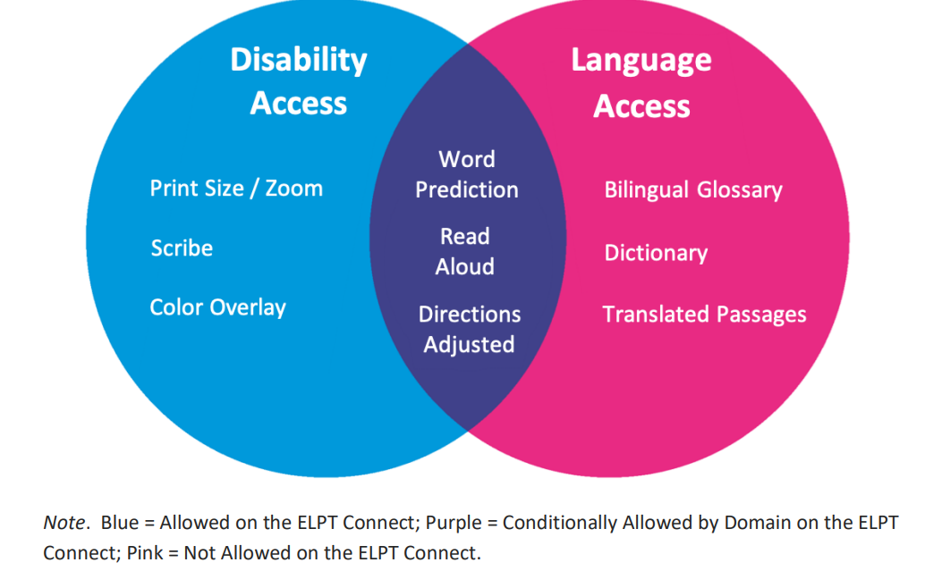
ELPT Connect Read Aloud
All designated supports must be selected in advance of testing. Blue=Allowed Purple=Conditionally Allowed by Domain Pink=Not Allowed

Slide 34
ELPT Connect Second Score Process
Some school systems were notified that a student was selected for a second score process.
The test administrator is responsible for assigning the score that is recorded in TIDE and used for student progress reporting and for accountability.
The second scorer, selected by the school system, will also score 3-point constructed response items in the writing and speaking domains.
Agreement between the two scorers is not required, but up to 5 minutes can be used to discuss scores. The test administrator should decide the final score assigned to the item.
Both scores for each item must be submitted to assessment@la.gov using the Excel ELPT Connect Second Score Report provided by the department by March 28.

Slide 35
ACT

Slide 36
ACT Match/No Match File
ACT Match/No Match Files
ACT Match/No Match files were posted to the ftp on January 20^{th.} The files will be updated one final time in March.
  Students who are on the ACT Match file have a score on record with the department. They can retest at the expense of the school system.
  Students who are on the ACT No Match file do not have a score on record with the department. Students who remain on the final No Match file in March can be retested and the cost of the assessment will be covered under state contract.
  LEAP Connect students have not been removed from the lists. Students who participated in LEAP Connect at the high school level do not have to take ACT but they should be accountability coded.

Slide 37
ACT Accountability Coding
Accountability coding is available with ACT in a state-use question. The numbers are clustered under letter codes:
A=All SIS exit codes for students no longer enrolled (01-44, 97)
B=Code 80: Doctor’s excuse/Documented Covid
C=Code 90: Another ACT document used
D=Code 94: Student participated in LEAP Connect testing at the high school level
E=Code 98: Student is not grade 11 or is grade 12 and already has a prior year ACT score
F=Code 81: EL student in US less than 2 years (student must still test)

Slide 38
ACT Accountability Policy
No change has been made in policy that allows for ACT index points from a WorkKeys certification to be used in the index if the points are greater than those assigned for a student’s highest ACT score. This policy applies to all diploma pathways.
To earn points for WorkKeys certification, a student must have also taken the ACT. This applies to all diploma pathways.
A student who participated in LEAP Connect high school level testing is not required to take the ACT. However, WorkKeys points will not be applied unless the student also takes the ACT.
The ACT index does not allow use of the ACT super score.

Slide 39
ACT Administration Windows
Initial Online Standard Time and Accommodated Window: March 7-9, 14-16
Initial Accommodated Paper Window: March 7-10; March 13-17
Makeup Online Standard Time and Accommodated Window:
March 21-23, March 27-31
Makeup accommodated paper makeup:
March 21-24; 27-31

Slide 40
K-3

Slide 41
K-3 Screening Updates
There will be no statewide screener selected for use at the end of 2022-2023. There is a process underway to select a vendor for 2023-2024. There will be a statewide vendor that will be required from all school systems next year.
End-of-Year literacy screening is required by law using currently-approved literacy screeners. Data managers were provided with information about how and when to report the results in EdLink. The process is the same as it was in the fall.
The K-3 guidance documents are being updated to include information about end of year reporting and end of year scoring. As soon as they are posted, the department will include an announcement, as well as links, to the FAQ and the newsletter.

Slide 42
Innovative Assessment

Slide 43
IAP: Inclusion in VAM and Progress Index
(For school systems participating in the Innovative Assessment Program only)
An FAQ was provided to all superintendents on January 12 to explain inclusion of students participating in the IAP. Until actual results are returned, IAP scores cannot be determined as valid for VAM inclusion. Grade 7 results can now be used in VAM beginning in 2022-2023 for the following cases:
Grade 6 LEAP to Grade 7 IAP
Grade 7 IAP to Grade 8 LEAP
We cannot confirm that grade 6 or 8 IAP assessments can be used in VAM in 2023 until we receive actual test results.

Slide 44
Accountability

Slide 45
Cohort Graduation Data Certification
La Data Review is tentatively scheduled to open on March 1 for the purpose of reviewing all cohort graduation data that will be used to calculate the graduation rates for schools and systems, as well as data that will be used in the strength of diploma index that is 25% of the school performance score (SPS.) The window for new submissions will close on Friday, March 17. Federal timeline requirements prevent the department form providing extensions.
Important Reminders
The only persons who will receive account information by email are accountability contacts. It is extremely important that any changes in accountability contacts be reported to the department as soon as possible.
Rosters should be distributed to schools for review. Some changes will require updates to student transcripts in STS before approval. Please make sure STS data managers are aware that their assistance may be required during this time.

Slide 46
Exit Code and FAFSA Reviews
The department will conduct audits of exit codes 10 (transfer to out of state or country); exit codes 14 (transfer to approved nonpublic school) and exit code 16 (transfer to BESE-approved home study.) Documentation must be submitted in La Data Review for each student flagged. Without documentation, the student status of legitimate leaver will be converted to nongraduate.
FAFSA audits will also be conducted in school systems with high numbers of parental opt-outs.

Slide 47
Cohort Graduation Data Certification Webinar
A webinar has been scheduled for school system accountability contacts to review cohort policy and use of the La Data Review system. The webinar deck will be provided to all accountability contacts as part of the cohort graduation data certification opening and account information emails, and it will be posted to the Accountability Library.
Join Cohort Graduation Data Certification Zoom Meeting
Tuesday, February 28 at 1:00 p.m.

Slide 48

Happy Valentine’s Day and Mardi Gras
Thanks for everything that you do. Hope you enjoy a few moments with the people you love the most.

Slide 49
Call Summary
Month | Key Deadlines | Support and Resources
February | February 13- March 24: LEAP Connect, ELPT and ELPT Connect administration windows February 14-March 27: Schedule UPS pickup of secure LEAP Connect materials February 21 Offices closed and NO Office Hours | 2022-2023 Assessment Calendar Assessment Library DTC Resources Page
March | March 1-March 17: Cohort Graduation Data Certification (Tentative) March 7: ACT online standard time and paper accommodated testing window opens March 18: All high school accommodations for LEAP final March 24: LEAP gr 3-8 test manuals delivered to school systems March 25: All grade 3-8 accommodations final for LEAP | Office Hours Tuesdays at 3:45: February 28, March 7, 14, 28 Monthly Call: March 21

