Slide 1
AAA Assessment and Accountability Monthly Call February 18, 2025

Slide 2
Zoom Meeting Preparation
Please make sure your phone or computer is muted to minimize background noise.
To do this, hover over the bottom left-hand side of your screen and click “Mute.”
Please make sure you have turned off your camera to save bandwidth and prevent any connectivity issues.
Please do not enable any AI or other recording device. Per LDOE legal team, recording of this webinar is not permitted. Individuals who launch recording functions, will be removed from the meeting.
NOTICE: In accordance with the Americans with Disabilities Act, if you need special assistance at this meeting please contact ldoecommunications@la.gov.

Slide 3
Agenda Items
I. LEAP 2025
II. ELPS/ELPT
III. ACT
IV. K-3 Literacy
V. Accountability

Slide 4
2025-2025 Assessment Calendar
The 2025-2026 assessment calendar is now posted to the Assessment Resources section of the department website at this link:
2025-2026 Assessment Calendar.pdf
Thank you so much for your patience.

Slide 5
LEAP 2025

Slide 6
Office Closures and Cancellations of Office Hours
All department offices will be closed on Tuesday, March 4, and Office Hours is cancelled.

Slide 7
LEAP/LEAP Connect Important Dates
February 19: TCM and TAM posted in DRC INSIGHT
March 2: All accommodations finalized for LEAP spring assessments grades 3-high school NOTE: Please do not send requests for late accommodations to Jennifer Baird or to assessment@la.gov.
March 17: Test setup opens for LEAP spring to manage students and assign TA numbers
Test schedules for spring LEAP due to assessment@la.gov

Slide 8
Test Schedules Template
It is extremely important that school systems provide testing schedules to the department for all state test administrations. The department created a template to be used by all school systems for reporting schedules.
The use of the new ACT testing schedule template is optional, but we encourage systems to use it. We do need some form of your ACT schedule. all.
The use of the new LEAP spring schedule and the K-3 EOY schedule is required. It will make it much easier to track changes that are often necessary and known only at the last minute.
The templates will be sent to all DTCs after today’s call. Templates should be completed and returned to assessment@la.gov.

Slide 9
LEAP 360
Many schools are now using the diagnostic and/or interim assessments available for LEAP 360. Please make sure that schools are aware of the Teachers Guide to Leap 360, which includes rubrics, sample reports and suggestions for how to use the results.
The department does not recommend any methodology for assigning achievement levels to results since the assessments were not designed to report out the levels.

Slide 10
LEAP Practice Tests
The department receives daily requests for pdf versions of the practice tests. Since we do not have the capacity to distribute these daily, we are recommending that everyone use the online practice test available at the link included in the guide below.
The Practice Test Quick Start Guide provides user names and passwords need to access the online test.
Pdf copies have to be provided by school test coordinators through DRC INSIGHT.

Slide 11
Camera Policy
Please make sure you have shared this policy with all schools and that they understand its application for all assessments.
ACT strictly forbids the use of cameras in classrooms that are administering ACT. Cameras should be turned off.
For LEAP, LEAP Connect, ELPT and K-3 screening,
In order to ensure compliance with department agreements to maintain the industry standard security on test items no recording of items, derivatives of items, readings of items is permissible.
Any camera which records or broadcasts in any way must be positioned such that any screen being used for the assessment is not visible to the camera.
In any classroom within which “test-read aloud” occurs, students must use headphones. For students who require test-read aloud without headphones, the student is tested in an alternate location where audio recording does not occur. Disabling the audio recording for K-3 and ELPT applies only to external recording, and does not apply to audio recording required in the testing platform.

Slide 12
ELPT/ELPT Connect/LEAP Connect

Slide 13
ELPT Parent Guides
Parent guides are now updated and posted with translated versions of each.
https://doe.louisiana.gov/school-system-leaders/measuring-results/assessment-resources

Slide 14
ELPT/ELPT Connect
The department has received several alerts regarding student responses for ELPT/ELPT Connect. We are forwarding these to DTCs for information. The school system can determine if additional follow-up is needed with the student. This does not affect scoring.

Slide 15
LEAP Connect
The LEAP Connect eligibility deadline was January 10 and we communicated it many times. Students who take LEAP Connect and who were not identified within the timeline required by BESE will be flagged in assessment data certification as a zero for accountability. The department will not overturn the zero if the IEP confirms that the deadline was not met.

Slide 16
LEAP

Slide 17
LEAP Spring Assessments
All accommodations must be assigned no later than March 2. Please do not send any requests for late accommodations to assessment@la.gov or the assessment team.
All accommodations for human reader or paper testing (other than grade 3) must be submitted to assessment@la.gov by March 2. The AAA team is not approving them, but they must be recorded with us. These accommodations are important to decisions regarding on-site monitoring.

Slide 18
New Test Schedule Template
By March 17, all school systems will now use the same template for reporting schedules for LEAP testing. This format will consist of an excel spreadsheet that includes each school and each day of the testing window. DTCs will be required to report the starting times for each day that is applicable to a school.
It is extremely important that schedules are sent to us for all participating sites, included learning pods or alternative sites where students will be testing.

Slide 19
Assessment Development Educator Review Committees
The Division of Assessment Content will convene assessment committees for the LEAP assessment in May and June to
review newly developed items for alignment, content-related criteria, and appropriateness for all Louisiana students (Science and Social Studies); and
develop expectations for the scoring of field-tested LEAP constructed-response items and extended-response tasks (Science, Math, and Social Studies)
Interested educators should access the Assessment Development Educator Review Committees document for information on exact dates, meeting details, and links and deadlines to apply to participate on specific committees. The deadline to complete the applications is March 14th.
Please contact assessment@la.gov with questions.

Slide 20
ACT

Slide 21
ACT Accommodations Requests and WorkKeys
January 27-March 7: Request qualified exceptions to the deadline for ACT-authorized accommodations and/or supports for eligible examinees in TAA using the Qualified Exceptions to the Deadline form. Use the form to identify the very specific exceptions listed on the form.
Please refer to the schedule of events for all important dates.

Slide 22
Accountability

Slide 23
Transitioning to New Accountability Model
As part of transitioning to the new accountability system, both the 2024 and 2025 graduation cohort data will be used in the 2025 SPS. Please note that there will be a much tighter timeline to complete transcripts and dropout cleanup when the lag year is discontinued.
When cohort graduation data certification opens in early spring, school systems will see the normal cohort file but there will be a new group of students added to the roster. Exit code reviews will include 2025 cohort members who were exited through early March. In summer with assessment data certification, another cohort roster for 2025 will be reviewed for all other normal cohort checks (graduation dates, HiSET, AP and CLEP tests.) There will be no submissions reviewed for credentials for either cohort. Additional exit code reviews could be added if students exited from March through May 2024.

Slide 24
Spring Data Certification for Cohort Graduation
Prior to the opening of cohort graduation data certification, the department hosts a webinar for accountability contacts who will be responsible for distributing rosters to their schools and collecting requests for changes to some data and providing documentation for students selected for exit code review. A webinar has been scheduled for accountability contacts on Wednesday, March 12 at 2:00 p.m. Please do not share this link with school staff. Accountability contacts are responsible for the redelivery of training to their schools.
The link is being sent to accountability contacts via email and should not be shared.

Slide 25
K-3

Slide 26
K-3 Student Upload to Amplify for EOY Screening
February 25: EdLink information downloaded for transfer to Amplify for EOY screening. All student data will be updated. To reduce requests for grade changes, name changes, transfers and accountability codes, EdLink should be updated before the file is pulled.
March 3: mCLASS Admin portal will not be available.
March 18: Admin portal reopens to set up for EOY screening.

Slide 27
K-3 Literacy Braille Orders for EOY
K-3 literacy braille orders are due to assessment@la.gov no later than March 4 in order to assure that the order is processed and delivered in time to administer EOY.
If you have no changes to the braille order you requested for BOY/MOY you do not need to make a new order.
If you no longer need the braille order or you have changes to your BOY/MOY order, please use the form to order for EOY.
If you have a new braille request, please use the form available at the link below: K-3 Literacy Braille Order Form-2024-2025

Slide 28
Braille Materials
K-2 braille materials will be secure materials. They will need to be destroyed upon completion of their use for EOY screening. Please note that state law allows the department to charge individuals for costs incurred when secure test content is compromised.
Since the form of the K-2 screening that is used this year will not be used next year, they cannot be kept for future use.

Slide 29
End of Year Screening
End of year screening will be conducted from April 1 through April 30. K-2 screening will include a secure Louisiana form.
No paper or remote testing is permitted for K-2 end of year.
The screening instrument cannot be copied, shared, memorized or photographed.
The only persons who should have access to the screener are the test administrators who have been trained and are administering the screener to students.
DTCs will be the only persons who can invalidate assessments. Please make sure all of your TAs and STCs know your process for requesting them. Submit a testing irregularity form to assessment@la.gov for all invalidations.
All K-2 testing will be administered in the SEB secure browser or Kiosk mode.

Slide 30
Additional Grade 3 Summer Screenings
Students who are at risk of being retained must be offered the EOY grade 3 screening two additional times. The window for these screenings will be named G3 Summer. This will be a single window that allows for 2 administrations which must be scheduled per directives below:
The first grade 3 rescreening can be administered no sooner than the last week of school.
The second grade 3 rescreening may not be given sooner that two weeks after the first rescreening.
All screenings must be completed by June 30.

Slide 31
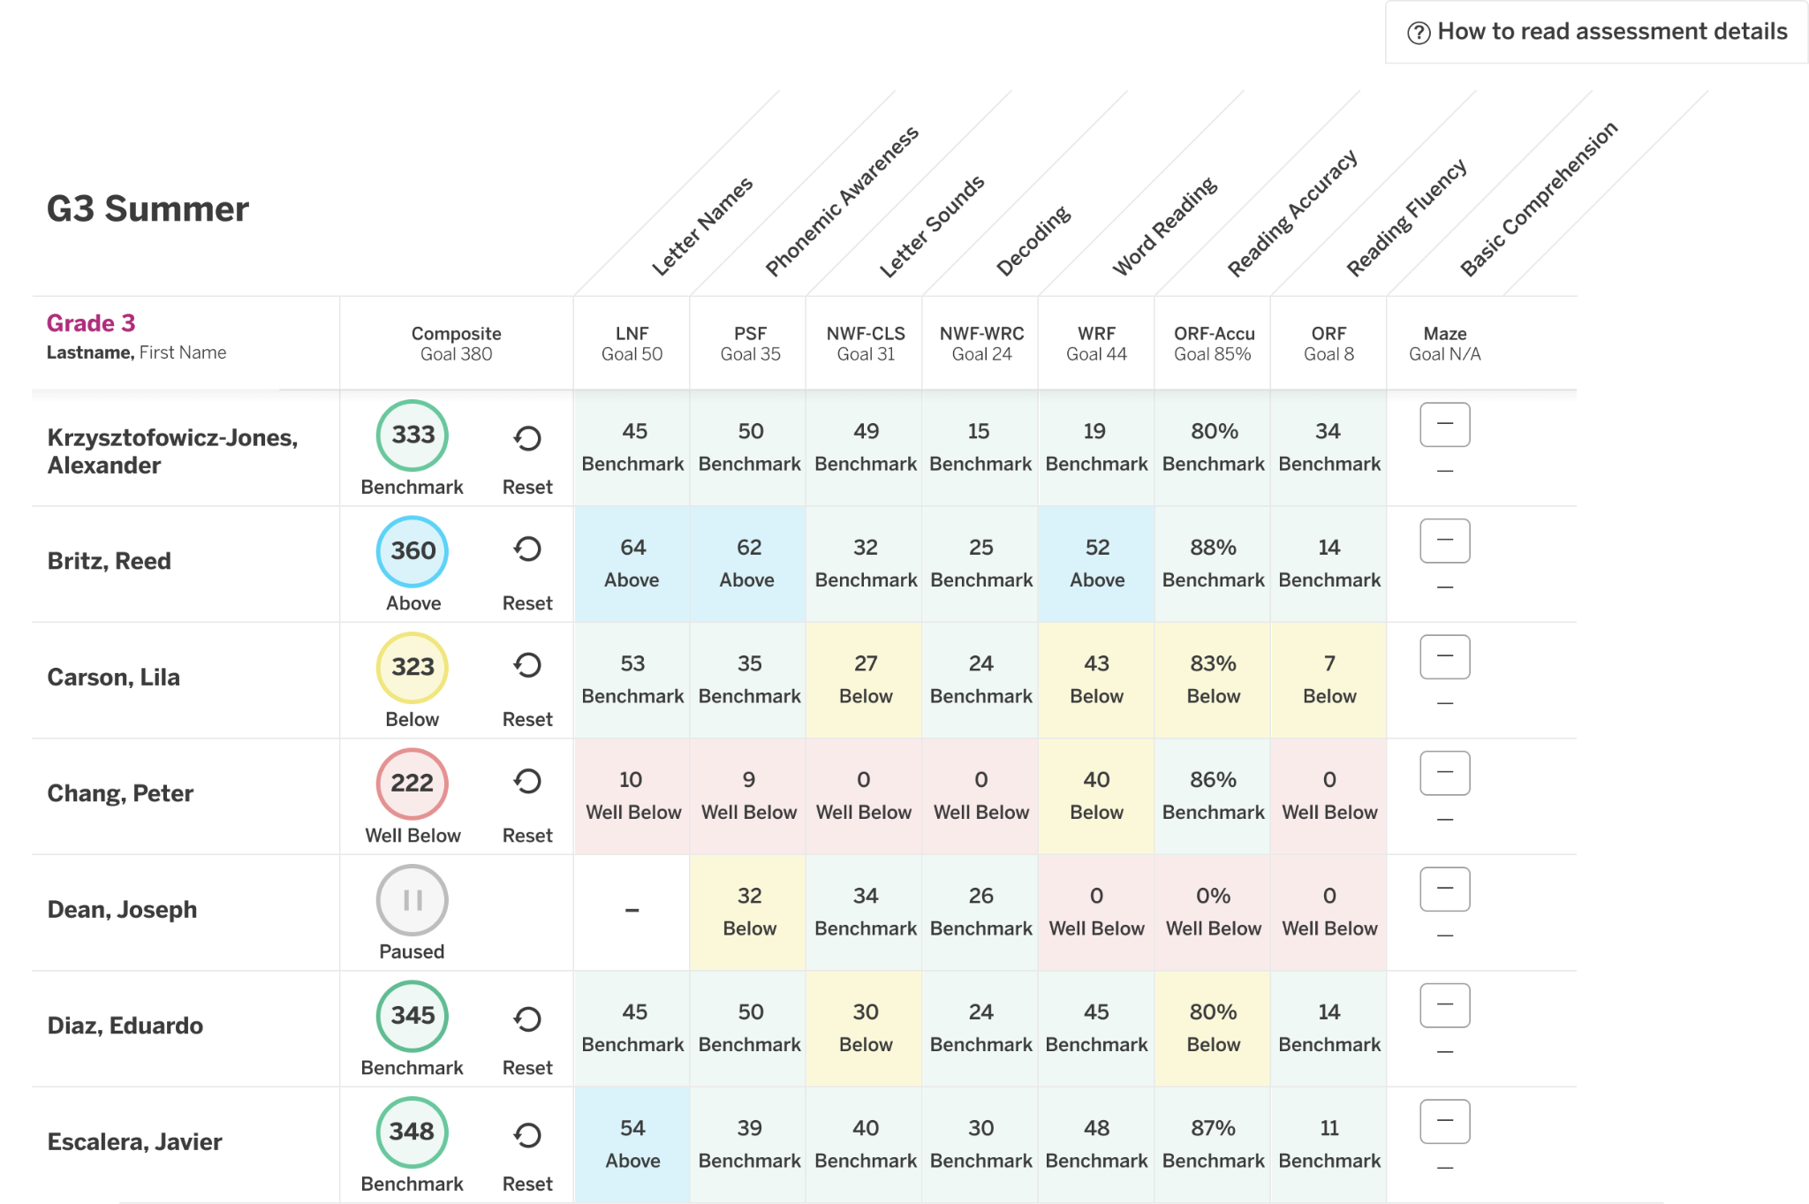
Resetting for Third and Final Attempt
When a DTC logs into Classroom Reporting during the G3 Summer window, they will see a reset button that populates next to G3 student’s composite scores. TAs and other users will not see this button.
If a DTC receives and accepts a request for a student to be assessed for a 3rd attempt, they should tap on the reset icon for that student’s score.

Slide 32
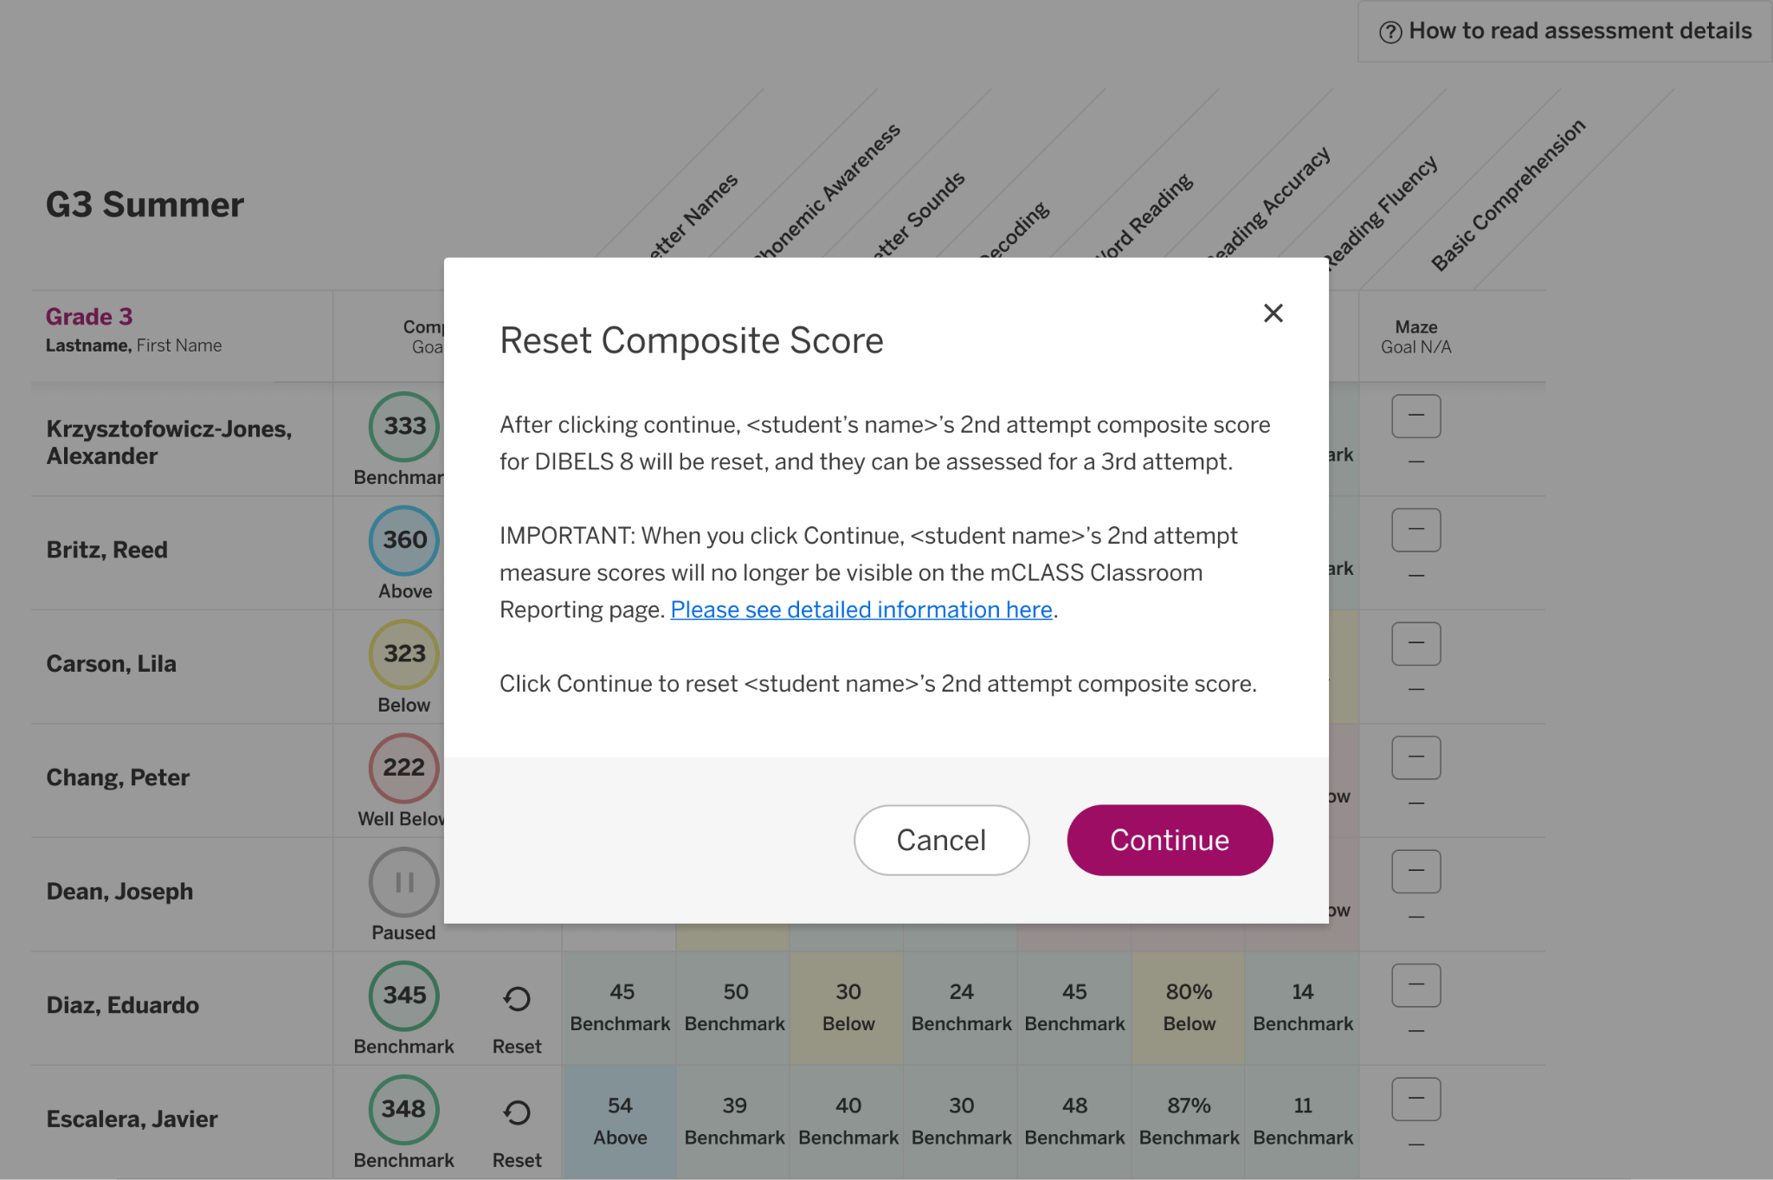
Viewing Reports for Grade 3 Rescreenings
After tapping on the reset button, a pop-up will trigger explaining that the composite score will be reset. This means that the 2nd attempt score will no longer be visible on the classroom reporting page. The score is not deleted from the mCLASS system, but the assessment results will no longer be viewable in Classroom Reporting or the Teacher-Facing Assessment page. Once this action is completed, a TA can assess the student with a 3rd attempt.

Slide 33
Save Reporting for Grade 3
Additional guidance for accessing all reports and receiving custom reports will be shared as soon as they are final. Please be sure to save the reports from all EOY and Grade 3 rescreenings to share in parent meetings or other communications.

Slide 34
K-3 Literacy EOY webinar
The department will host a K-3 Literacy EOY webinar on March 10 at 1:30 p.m. This webinar will not repeat some of the slides that were already shared with BOY and MOY. It will focus on important reminders and a review of how the grade 3 summer administrations will be administered in mCLASS. This webinar is only for district test coordinators and the link should not be shared. The link is being sent to all DTCs via email from Jennifer Baird.

Slide 35
Call Summary
Month | Key Deadline | Support and Resources
February | PAST DUE: LEAP Connect and ELPT testing schedules February 19: TCM and TAM for LEAP spring testing posted in DRC INSIGHT February 25: EdLink data pulled to populate mCLASS for K-3 Literacy Screening | Assessment Resources 2024-2025 Assessment Calendar DTC and Accountability Contact Update Form
March | March 2: FINAL day to apply accommodations to IEPs for all LEAP spring testing March 10: DTC webinar for K-3 literacy EOY screening March 12: Accountability contact webinar for cohort graduation data certification March 17: Spring Test Setup Available in DRC INSIGHT/Test schedules due to assessment@la.gov | Office Hours Tuesday at 3 pm February 25, March 11, 25 Monthly Call: March 18 March 4: Mardi Gras/Office hours canceled

