Slide 1
Zoom Meeting Preparation
Please make sure your phone or computer is muted to minimize background noise.
To do this, hover over the bottom left-hand side of your screen and click “Mute.”
Please make sure you have turned off your camera to save bandwidth and prevent any connectivity issues.
To do this, hover over the bottom left-hand side of your screen and click “Stop Video.”
Please submit questions during the presentation in the “Chat” function located on the bottom of your screen.
NOTICE: In accordance with the Americans with Disabilities Act, if you need special assistance at this meeting please contact ldoecommunications@la.gov.

Slide 2
AAA: Assessment and Accountability Monthly Call
July 26, 2022

Slide 3
Agenda Items
LEAP 2025
Fall Data Certification
ELPS/ELPT
LEAP 360
V. K-3 Guidance
VI. ACT
VII. Accountability

Slide 4
LEAP 2025

Slide 5
LEAP 2025 Key Dates
LEAP 2025 Grades 3-8
Individual student reports, school rosters and data files will be released this week.
Individual student reports should be sent home to families with the parent guide to student reports
No summarized data should be released until after the department media release

Slide 6
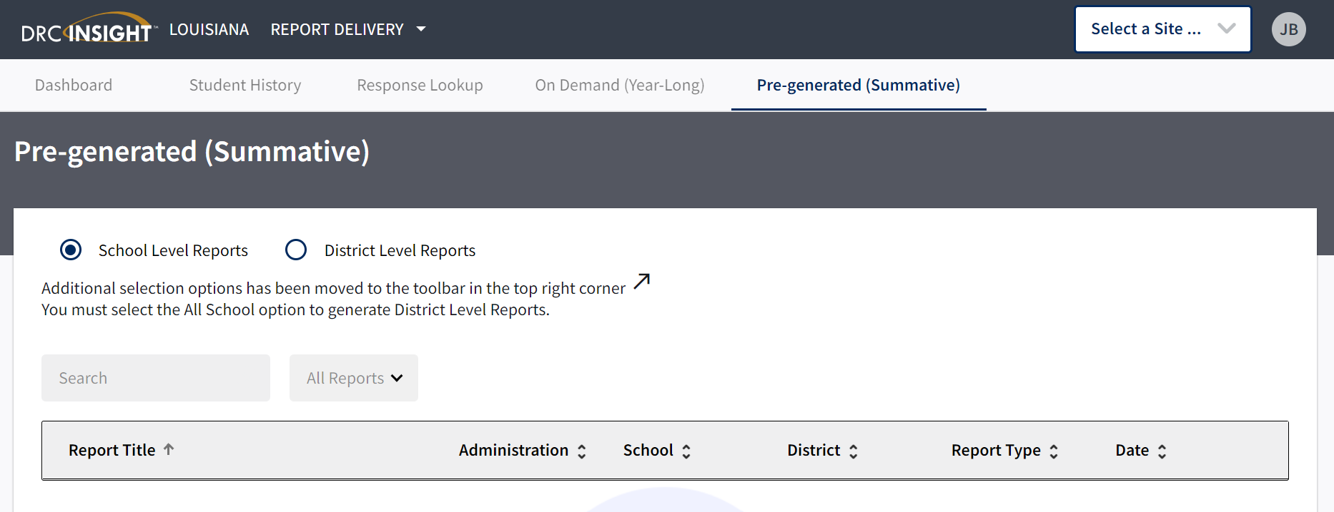
LEAP Scores in DRC INSIGHT
Scores can be found in DRC INSIGHT using the following steps:
Go to My Applications
Select Report Delivery
Select Pre-Generated (Summative)
In the upper right hand corner, users can select site and test administration: LEAP 2025 Grades 3-8 Spring 2022

Slide 7
Additional LEAP Reports
Additional LEAP reports will be released in August. These reports include:
Summarized results for schools, districts and states
Subgroup data for schools and districts
Growth to mastery rosters for grades 4-8

Slide 8
New School Systems Test Security Policy
School systems that are new to testing must have a completed test security policy per Bulletin 118, Chapter 53:
Each local education agency (LEA) as described in this policy shall develop and adopt a LEA test security policy and procedures for handling emergencies during testing that is in compliance with the state's test security policy.
Policies should be send to assessment@la.gov no later than August 31.

Slide 9
Fall Data Certification

Slide 10
Fall Data Certification
District contacts that are new should prioritize attendance at a webinar that will be held on August 3. Due to the volume of assistance that will be needed, it will be very difficult to provide individual training to staff.
The only persons who will have access to the La Data Review System will be accountability contacts and their backups. It is very important to identify any new contacts in order to set up accounts for them in the system.

Slide 11
Fall Data Certification Webinar for DCAI, ACT and Assessments
Please plan to join the data certification webinar.
Time: Aug 3, 2022 02:00 PM Central Time (US and Canada)
Link: https://ldoe.zoom.us/j/93933554945
Meeting ID: 939 3355 4945
One tap mobile
+14702509358,,93933554945# US (Atlanta)
+14703812552,,93933554945# US (Atlanta)
This webinar is designed only for district level contacts. The invitation should not be shared with school-level staff. District contacts should redeliver with specialized instructions for their process.

Slide 12
ELPS/ELPT

Slide 13
ELPS Screening Access
The ELPS (screener) is down and not accessible until August 1. When it is open, students should be screened within the first 30 days of enrollment.
Transfers
Within district transfers can be completed by district test coordinators in TIDE.
Across district transfers must be completed by department staff. Requests should be submitted to assessment@la.gov

Slide 14
ELPT Alternate Assessment
The ELPT Alternate Assessment will be available for the first time in 2022-2023. Students with disabilities who have not scored proficient will no longer be exited from ELPT administration after four years. All students who did not score proficient in 2022 must continue to be identified as English learners.

Slide 15
LEAP 360

Slide 16
LEAP 360 Diagnostic and Interim Assessments
The LEAP 360 Diagnostic and Interim assessments are now available.
Manuals and guides are posted to DRC INSIGHT.
There will continue to be a remote administration of the diagnostic and interim assessments.
There is no remote administration of the LEAP practice test.

Slide 17
K-3 Guidance

Slide 18
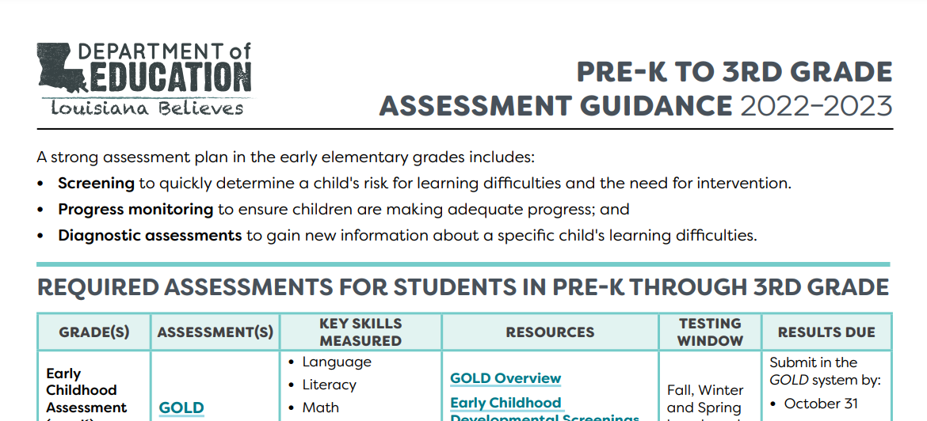
PreK-Grade 3 Guidance
Pre-K to Grade 3 Guidance has been updated and posted to the website.
Per state law and BESE policy:
All kindergarten students must be screened for readiness using DRDP-K or Gold KEA within the first 30 days of school.
All students in grades K-3 must participate in a literacy screening within the first 30 days of school using one of four options: Acadience Reading, DIBELS 8th, STEEP or STEP.

Slide 19
K-Grade 3 Reporting of Assessments
Results from beginning of year screenings must be reported to the department for all students who are enrolled.
For KEA:
Submit DRDP-K results in EdLink 360 by the October 31 snapshot date.
Submit GOLD data in the GOLD system by October 31.
For K-3 Literacy
Submit results in EdLink 360 by the October 31 snapshot date.

Slide 20
ACT

Slide 21
ACT Invoices for 2021-2022
Payment for invoices is now past due. Please make sure that payments are submitted as soon as possible.
Louisiana Department of Education
Division of Appropriation Control
PO Box 94064
Baton Rouge, LA 70804-9064
Overpayments will be sent by July 30, 2022.

Slide 22
ACT MOUs for 2022-2023 Testing
Signed ACT MOUs for 2022-2023 are required for school systems who:
plan to test grade 12 students who may already have an ACT score or
are testing students with WorkKeys that are not first time test takers and in grade 11 on a Jump Start pathway.
Please note that the price for this testing has increased.
ACT testing price has increased from $ 37.00 to $ 37.50
WorkKeys tests are now $ 11.50 per subtest; total for all three tests is $ 34.50
This price reflects the same price that the department will pay for tests per approved ACT contract.

Slide 23
ACT Notice
ACT posted the following notice on the state testing site. Please share with your local data vendor.
ACT recommends that schools do not include ACT scores on school transcripts in effort to avoid student privacy concerns or inconsistent score report data. If your school insists on sending scores on a student transcript, ACT recommends documenting consent from the student in advance. Students can send scores to colleges from their MyACT account which is accessed at myact.org.

Slide 24
Accountability

Slide 25
Interests and Opportunities Superintendent Verification
Every superintendent received a notice regarding the need for a signed Course Requirements Verification Form. If you have not already done so, please make sure your superintendent returns this form as soon as possible to accountability@la.gov.

Slide 26
Call Summary

Slide 27
Call Summary
Month | Key Deadlines | Support and Resources
July | NOW: ACT payments for 2021-2022 due NOW: I & O Course Requirements Superintendent Verification due to accountability@la.gov NOW: ACT MOUs for 2022-2023 now available By July 29: LEAP scores for grades 3-8 released; summary data embargoed | 2022-2023 Assessment Calendar
August | August 3: Data Certification Webinar Week of August 8: Data certification for ACT/DCAI First 30 days of enrollment: Administer ELPS First 30 days of school: Administer KEA and K-3 literacy screeners TBA: LEAP Media Release for Summary Results August 31: NEW LEA test security policy due | Office Hours Tuesdays at 3:45: August 2, 9, 23, 30 Monthly Call: August 16

