Slide 1
Assessments, Accountability and Analytics Monthly Call
July 21, 2026

Slide 2
Zoom Meeting Preparation
Please make sure your phone or computer is muted to minimize background noise.
  To do this, hover over the bottom left-hand side of your screen and click “Mute.”
Please make sure you have turned off your camera to save bandwidth and prevent any connectivity issues.
Please do not enable any AI or other recording device. Per LDOE legal team, recording of this webinar is not permitted. Individuals who launch recording functions, will be removed from the meeting.
NOTICE: In accordance with the Americans with Disabilities Act, if you need special assistance at this meeting please contact ldoecommunications@la.gov.

Slide 3
Agenda Items
1. Important Dates
2. LEAP
3. LEAP Connect/ELPT
5. Accountability
6. K-3 Screening

Slide 4
Important Dates
Now: K-3 Screening schedules; complete setup for administration
September
July-October: Administer state placement test in DRC INSIGHT for students entering grades 5 and 9 without current LEAP scores
July-September: Administer K-3 literacy and numeracy screening to all students in grades K-3 in the first 30 days of school
July 22: DTC screening webinar at 1p.m.
August TBA: Assessment and cohort graduation data certification
September 7: Labor Day; offices closed for department and vendors

Slide 5
LEAP

Slide 6
LEAP Lowest 30% File
On Monday, June 20, lowest 30% LEAP score files were posted to the ftp. The file provides the lowest 30% of spring 2026 LEAP scores, separated by grade and test type. Please note that the file was not created using the same rules as the lowest 25% that will be identified for school and district performance scores. Pre-data certification lowest 25% will be provided to accountability contacts through assessment data certification in late summer.

Slide 7
Updates to Resources
The department is working with the communications team to update links to LEAP supports, including OTT and the suite of LEAP 360 assessments. The new link to OTT and other assessments are below. The updates should be available online by next week.
Link to practice, diagnostic, interim tests: https://portal.te.drcedirect.com/LA/launcher?adminId=510848&linkId=laplace#portal/la/510848/exam
OTT: https://portal.te.drcedirect.com/LA/

Slide 8
LEAP Connect/ELPT/ELPT Connect

Slide 9
English Language Proficiency Screener (ELPS)
The 2026-2027 ELPS window is now open.
School systems should be sure to follow all guidelines for screening PRIOR to administering the screener. Once the student is screened and demonstrates nonproficiency, they must receive services and be tested annually.
English Learners Identification Flowchart

Slide 10
Alternate Assessment Participation
While the department waived the 30 day requirement for BOY, student IEPs must be updated to confirm that students are eligible to participate in K-3 alternate assessment rubrics prior to screening.

Slide 11
Accountability

Slide 12
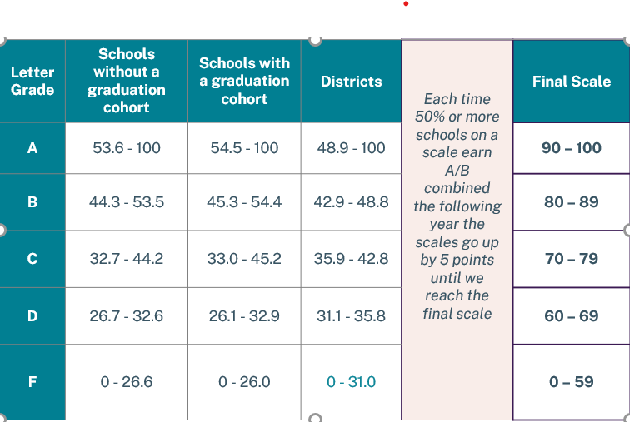
Letter Grade Scale: Grow.Thrive.Achieve
Please see letter grade scales below that will be used for fall SPS release.

Slide 13
Data Certification
Data certification for assessment data that will be used in the 2026 school and district performance scores will take place in August. They will include the following:
Assessment:
LEAP scores grades 3-8, LEAP high school initial scores
LEAP Connect scores grades 3-8 and 11
ELPT and ELPT Connect growth results grades 1-12
K-2 DIBELS end-of-year scores and growth for K to 1 and 1 to 2 end of year growth.
Student full academic year status
Applied accountability codes

Slide 14
Data Certification Cohort Graduation
Data certification for data used to measure all three THRIVE indicators will be conducted in August. It will include the following:
Nationally recognized assessment scores: ACT, SAT, CLT, WorkKeys, ASVAB
Acceleration data: credentials, work-based learning, DE, AP
Graduation Status: on-time diplomas (verified with dates in STS)
Dropout flags
Legitimate leaver status
Student inclusion flags for district and school
The department will not accept requests for changes to exit codes or dropout flags for prior years in cohort.

Slide 15
K through 2 Schools with No LEAP Data
For schools that include only grades from the K-2 range and no LEAP testing grade, both LEAP achieve and growth data will be shared from a school that is paired with them.
The K-2 schools’ achieve and growth indicators will include only their own DIBELS and ELPT data.
Growth will not be calculated using grade 2 DIBELS to grade 3 LEAP, and grade 3 repeaters are not included in LEAP growth. All other repeaters in grades 4-8 will be included using prior year and current year score as for all other students.

Slide 16
K-3 Screenings

Slide 17
K-3 Screening Training Requirements
To serve as a test administrator, individuals must pass training for each screener (literacy and numeracy) with an 80% or higher. Oaths of security require that the passing date be applied to them before they are signed. Literacy screening is now available and numeracy screening training will be available by July 1. The numeracy screener is reset every morning for individuals who do not score 80%.
Literacy: https://elearning.easygenerator.com/5ddb4adc-348d-4373-b655-11bc7d302d4e/
Numeracy: Professional Learning Platform with course code: F81C9F1F

Slide 18
Louisiana Specific Guide for Literacy
The oaths of security and the accountability codes for literacy are included in the Louisiana Specific Guide that will be provided to DTCs by Friday, June 24.

Slide 19
Call Summary
Month | Key Deadline | Support and Resources
July | Now: Submit updated K-3 screening schedules as needed July-September: Administration of K3 screeners July-September: Administration of LEAP State Placement Test for incoming grade 5 and 9 students without LEAP socres | Assessment Calendar DTC and Accountability Contact Update Form
August | TBA: Assessment and Cohort Graduation Data Certification | Join Zoom Meeting Office Hours: July 28, August 4, 11, 25 Monthly Call: August 18

