Slide 1
Assessments, Accountability and Analytics Monthly Call
June 16, 2026

Slide 2
Zoom Meeting Preparation
Please make sure your phone or computer is muted to minimize background noise.
  To do this, hover over the bottom left-hand side of your screen and click “Mute.”
Please make sure you have turned off your camera to save bandwidth and prevent any connectivity issues.
Please do not enable any AI or other recording device. Per LDOE legal team, recording of this webinar is not permitted. Individuals who launch recording functions, will be removed from the meeting.
NOTICE: In accordance with the Americans with Disabilities Act, if you need special assistance at this meeting please contact ldoecommunications@la.gov.

Slide 3
Agenda Items
1. Important Dates
2. LEAP 2025
3. LEAP Connect/ELPT
4: ACT/WorkKeys
5. Accountability
6. K-3 Screening

Slide 4
Important Dates
June 22-26: LEAP High School Summer Test Administration
June 23: Office Hours canceled
June 28-July 14: State Placement Test Outage
By June 30: LEAP grade 3-8 scores released in DRC INSIGHT
June 30: K-3 screening braille orders due to assessment@la.gov
July 7-13: Amplify admin portal closed
July 9: 2025-2026 ELPS window closes
July 13: 2026-2027 ELPS window opens
July 15: 2026-2027 State Placement Test Available
July 15: ACT Invoice Payments Due

Slide 5
Office Closures/Cancellation of Office Hours
Friday, June 19: All department offices closed
Tuesday, June 23: Office hours canceled due to NCSA Conference
Friday, July 3: All department offices closed
Tuesday, July 7: Office Hours canceled

Slide 6
LEAP

Slide 7
LEAP Grades 3-8 Score Release
LEAP Grade 3-8 score reports will be released no later than June 30 in DRC INSIGHT. District test coordinators will be notified as soon as they become available.
School systems are required to provide reports to parents timely.
The department will not release score reports directly to parents.

Slide 8
LEAP Connect/ELPT/ELPT Connect

Slide 9
English Language Proficiency Screener (ELPS)
Federal law requires that all students who may need English language support be screened in the first 30 days of enrollment. The 2025-2026 ELPS administration window will close on July 9, and the 2026-2027 ELPS window will open on July 13.
School systems should be sure to follow all guidelines for screening PRIOR to administering the screener. Once the student is screened and demonstrates nonproficiency, they must receive services and be tested annually.
English Learners Identification Flowchart

Slide 10
LEAP Connect/ELPT/ELPT Connect Reporting
LEAP Connect individual student reports, school rosters and data files are available in DRC INSIGHT.
ELPT/ELPT Connect score reports are available in TIDE.
  Reports should be shared with families as soon as possible.
  The department will not release score reports directly to families.

Slide 11
ACT/WorkKeys

Slide 12
ACT Contact Information
ACT and WorkKeys
Contact number for ACT is the same but the options have changed
There is no longer a designated phone number for accommodations or WorkKeys
The options are as follows when calling 800-553-6244 ext. 2800
  Option 1 for School Officials
  Press 1 for State and District Testing
  Press 2 for State and District Accommodations
  Press 3 for National Accommodations
  Press 4 for High School Reporting
  Press 5 for PreACT or PreACT Secure
  Press 6 for WorkKeys

Slide 13
ACT Invoices and Credit Memos
Invoices and Credit Memos will be emailed to the Superintendents, DTCs, and the Financial Contact who signed the ACT MOU.
Emails including invoice or credit memo will be sent by June 30, 2026
Payments are due by July 15, 2026 and sent to:
  Louisiana Department of Education
  Division of Appropriation Control
  PO Box 94064
  Baton Rouge, LA 70804-9064
Credits will be issued to districts by July 31, 2026

Slide 14
Accountability

Slide 15
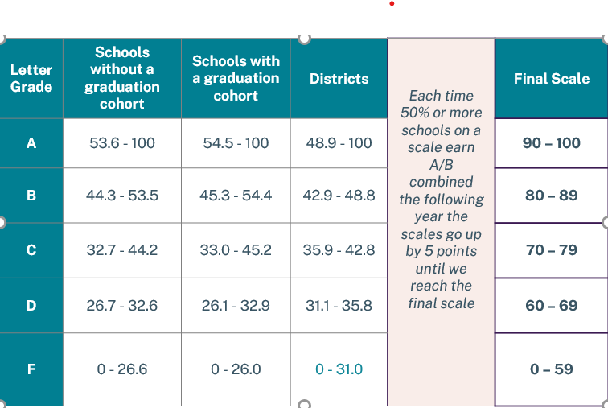
Letter Grade Scale: Grow.Thrive.Achieve
Please see letter grade scales below that will be used for fall SPS release.

Slide 16
Data Certification
Data certification for assessment data that will be used in the 2026 school and district performance scores will take place in August. They will include the following:
Assessment:
LEAP scores grades 3-8, LEAP high school initial scores
LEAP Connect scores grades 3-8 and 11
ELPT and ELPT Connect growth results grades 1-12
K-2 DIBELS end-of-year scores and growth for K to 1 and 1 to 2 end of year growth.
Student full academic year status
Applied accountability codes

Slide 17
Data Certification Cohort Graduation
Data certification for data used to measure all three THRIVE indicators will be conducted in August. It will include the following:
Nationally recognized assessment scores: ACT, SAT, CLT, WorkKeys, ASVAB
Acceleration data: credentials, work-based learning, DE, AP
Graduation Status: on-time diplomas (verified with dates in STS)
Dropout flags
Legitimate leaver status
Student inclusion flags for district and school
The department will not accept requests for changes to exit codes or dropout flags for prior years in cohort.

Slide 18
K-3 Screenings

Slide 19
Grade 3 Additional Literacy EOY Windows
Third grade students who have scored well below grade level are provided with two additional opportunities to retest.
First EOY Attempt: April 1-30
Second EOY Attempt: Last 5 days of school
Third EOY Attempt: At least two weeks after second attempt
The additional testing window for the second and third attempt close at the end of day on June 30. Please be sure all attempts are planned accordingly.

Slide 20
K-3 BOY Screening
Customized windows: All K-3 literacy and numeracy screening windows will be customized to school systems’ first 30 days of school. District test coordinators will receive confirmation of their windows by June 30. Virtual days and half days will be included in the count.
Remote Administration: BOY remote administration materials for all grade levels will be available on the literacy screening page by July 10.
Administration Webinar: A webinar for DTCs has been planned for Friday, July 17 at 11:00 a.m. The link will be shared directly with DTCs via email.

Slide 21
K-3 Screening Training Requirements
To serve as a test administrator, individuals must pass training for each screener (literacy and numeracy) with an 80% or higher. Oaths of security require that the passing date be applied to them before they are signed. Literacy screening is now available and numeracy screening training will be available by July 1. The numeracy screener is reset every morning for individuals who do not score 80%.
Literacy: https://elearning.easygenerator.com/5ddb4adc-348d-4373-b655-11bc7d302d4e/
Numeracy: Professional Learning Platform with course code: F81C9F1F

Slide 22
Call Summary
Month | Key Deadline | Support and Resources
June | June 22-26: High school summer test administration window June 30: K-3 Screening braille orders due June 30: LEAP scores released | Assessment Calendar DTC and Accountability Contact Update Form
July | July 7: Office Hours cancelled July 7: Screening admin portal closed July 13: Administration portal opens for both K-3 screenings July 15: ACT/WorkKeys invoice payment due July 17: DTC K-3 screening administration webinar at 11 a.m. | Join Zoom Meeting Office Hours: June 30, July 14, July 28 Monthly Call: July 21

