Slide 1
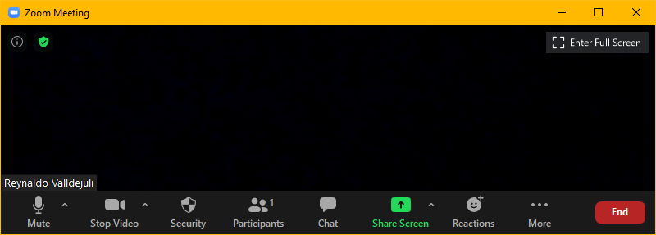
Zoom Meeting Preparation
Please make sure your phone or computer is muted to minimize background noise.
  To do this, hover over the bottom left-hand side of your screen and click “Mute.”
Please make sure you have turned off your camera to save bandwidth and prevent any connectivity issues.
  To do this, hover over the bottom left-hand side of your screen and click “Stop Video.”
Please submit questions during the presentation in the “Chat” function located on the bottom of your screen.
NOTICE: In accordance with the Americans with Disabilities Act, if you need special assistance at this meeting please contact ldoecommunications@la.gov.

Slide 2
AAA: Assessment and Accountability Monthly Call
October 18, 2022

Slide 3
Agenda Items
LEAP 2025
LEAP Connect
ELPS/ELPT
ACT
K-3
VI. Innovative Assessment
VII. Accountability

Slide 4
LEAP 2025

Slide 5
Important Dates for LEAP 2025
October 24: Test setup available for LEAP 2025 high school first testing window
October 24: Testing schedules for Window A due to assessment@la.gov
October 28: Last day to verify enrollment for grades 3-8 and select paper testing for grade 3
October 30: Last day to finalize accommodations for the LEAP 2025 high school fall administration for school systems participating in Window A.
December 5: Last day to finalize accommodations for the LEAP 2025 high school fall administration for school systems participating in Window B.
November 29-December 16: Window A high school testing window
January 5-25: Window B high school testing window

Slide 6
High School Test Setup Functions
DRC INSIGHT will open on October 24 for test setup. For school systems that will test in the second window, January 5-25, activities will be limited. See the table below for the actions that can and cannot be completed beginning 10/24. Additional functions will be available for systems testing in the second window on December 21.
Available on 10/24 for both windows | Assign TA numbers
 | Move students
 | Add New students
 | Verify accommodations
Available on 10/24 only for systems testing in first window beginning November 29 | Place students in testing sessions
 | Print Test Tickets

Slide 7
LEAP Connect

Slide 8
LEAP Connect
The last day to identify students as LEAP Connect and to finalize accommodations on IEPs, IAPs and EL Checklists is January 14th. Beginning in 2022-2023, any request to apply accommodations that were not in place by each assessment deadline will require the completion of the Request for Consideration of Late Changes to IEP/IAP/ELPT Checklist.
This document will need to be completed for each student request and signed by both the district test coordinator and the special education director.

Slide 9
ELPS/ELPT

Slide 10
ELPT and ELPT Connect
All students who did not score proficient on the ELPT in spring 2022 will be required to continue to participate in ELPT regardless of special education status. Policy no longer permits schools or systems to exit students after four years.
The ELPT Connect will be available for students who are eligible for alternate assessment. Eligibility criteria for grades K-12 must be used to identify students who participate in any alternate assessment.
The ELPT and the ELPT Connect administrations will run concurrently during the window published in the assessment calendar: February 13- March 24.

Slide 11
ACT

Slide 12
ACT
An ACT WorkKeys batch loading webinar for online testing is now available on demand. Registration link: Click to register
October 19 – 31 Test Window 2 for accommodated WorkKeys on paper
October 19 – Return test booklets, used answer documents, and test administration forms from the accommodations and/or supports for testing window 1 to ACT.
October 26 - Receipt deadline for ACT to receive these documents. Late arriving documents will not be scored.

Slide 13
WorkKeys
The WorkKeys realm opened on October 6 and will remain open through April 21.
The department requires 30 days between administrations to allow for meaningful remediation before retesting. This includes administrations that may be conducted in other realms. If a system is using two realms to test, the 30 day window applies across both realms.
Policy for using either the ACT or WorkKeys scores for all students has not been changed for 2022-2023.

Slide 14
K-3

Slide 15
KEA and K-3 Literacy Screening
Kindergarten Readiness Screening:
Must be completed first 30 days of school
Must be reported by October 31
K-3 Literacy Screening
Must be completed first 30 days of school
Must be reported by October 31
The KEA and K-3 Literacy Screener Administration and Reporting Webinar is now posted to the DTC Resources Page of the assessment library under “Assessment Webinars.”

Slide 16
Innovative Assessment

Slide 17
IAP: Administrative Procedures
(For school systems participating in the Innovative Assessment Program only)
Replacement of TSDL File Collection
In 2022-2023, school systems no longer submit TSDL files to the department. The department will send a single file with official enrollment from EdLink 360.
The department recognizes that they will need to greatly limit the options for course codes. Jennifer will set up a meeting to discuss with all participating systems after the first administration window closes to discuss and improve the process.
Although student schedules are not due in EdLink until January, it is very important that IAP districts submit them well before the second administration window.

Slide 18
Accountability

Slide 19
Data Certification
Data certification will close for new administrations on Wednesday, October 19. NO additional submissions will be accepted. Please check the system for notes from the department. We expect to have all submissions reconciled by Friday.
All dropout corrections should now have been applied in EdLink. Any additional reviews for dropout correction will be denied if EdLink has not been corrected by Friday, October 21.

Slide 20
La Data Review Data Sharing Agreement
There is a new data sharing agreement for our vendor, MMCS, that provides the platform for La Data Review. All school systems will need to submit this agreement no later than December 1 in order for the department to share data or for school systems to submit student-level documents as part of the data certification process.
MMCS Accountability Data Certification | Data Sharing Agreement https://www.louisianabelieves.com/docs/default-source/data-management/mmcs-accountability-data-certification---2022.pdf?sfvrsn=b7ab6318_2 | Opt In Addendum https://www.louisianabelieves.com/docs/default-source/data-management/mmcs-accountability-data-certification---addendum.docx?sfvrsn=aaab6318_2

Slide 21
Call Summary

Slide 22
Call Summary
Month | Key Deadlines | Support and Resources
October | October 21: Finalize submissions in La Data Review October 24: LEAP 2025 high school test setup opens October 24: LEAP 2025 high school testing schedules due October 28: Last day to verify grades 3-8 enrollment, select paper testing for grade 3. October 30: Last day to finalize accommodations for LEAP 2025 high school Window A. October 31: Submissions for KEA and K-3 screening due | 2022-2023 Assessment Calendar Assessment Library DTC Resources Page
November | November 29-December 16: Window A Fall high school LEAP 2025 testing window | Office Hours Tuesdays at 3:45: October 25, November 1, 8, 29 Monthly Call: November 15 Call cancelled on November 22

