Slide 1
Assessments, Accountability and Analytics Monthly Call
September 15, 2026

Slide 2
Zoom Meeting Preparation
Please make sure your phone or computer is muted to minimize background noise.
  To do this, hover over the bottom left-hand side of your screen and click “Mute.”
Please make sure you have turned off your camera to save bandwidth and prevent any connectivity issues.
Please do not enable any AI or other recording device. Per LDOE legal team, recording of this webinar is not permitted. Individuals who launch recording functions, will be removed from the meeting.
NOTICE: In accordance with the Americans with Disabilities Act, if you need special assistance at this meeting please contact ldoecommunications@la.gov.

Slide 3
Agenda Items
1. Important Dates
2. LEAP
3. LEAP Connect/ELPT
5. Accountability
6. K-3 Screening

Slide 4
Important Dates
September 15: Final day to submit requests for change to cohort graduation data certification.
September 18: Final day to submit requests for change to assessment data certification
September 30: Submit all irregularity forms to assessment@la.gov for K-3 screening
October 16: Final day to select grade 3 paper testing and confirm shipping dates for grades 3-8 LEAP testing materials in DRC Enrollment Verification

Slide 5
LEAP

Slide 6
Updates to Resources
Link to practice, diagnostic, interim tests: https://portal.te.drcedirect.com/LA/launcher?adminId=510848&linkId=laplace#portal/la/510848/exam
OTT: https://portal.te.drcedirect.com/LA/

Slide 7
LEAP Connect/ELPT/ELPT Connect

Slide 8
English Language Proficiency Screener (ELPS)
The 2026-2027 ELPS window is now open.
School systems should be sure to follow all guidelines for screening PRIOR to administering the screener. Once the student is screened and demonstrates nonproficiency, they must receive services and be tested annually.
English Learners Identification Flowchart

Slide 9
Alternate Assessment Participation
While the department waived the 30 day requirement for BOY, student IEPs must be updated to confirm that students are eligible to participate in K-3 alternate assessment rubrics prior to MOY and EOY screening.
Deadline for MOY K-3 literacy screening: November 1
All accommodations deadlines were added to the published assessment calendar for 2026-2027.

Slide 10
Accountability

Slide 11
Data Certification
Data certification for data used to measure all three THRIVE indicators will close on Wednesday, September 16 at 6:00 p.m.
Assessment data certification is open through Friday, September 18 at 6:00 p.m. Alternative school progress points rosters are now available as downloadable roster files along with regular school progress point rosters and ELPT growth rosters.
This is the final opportunity that schools and systems have to review data and requests changes to some data elements. Data that are not corrected through this process cannot be used to justify an appeal of the SPS when it is released in late fall.

Slide 12
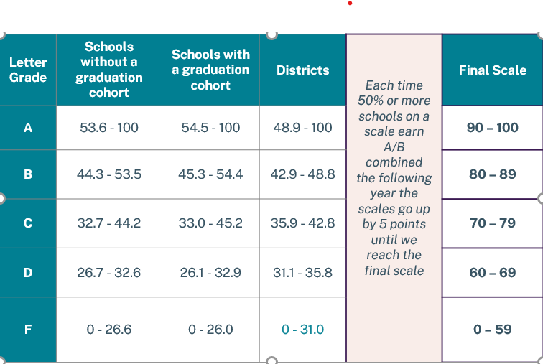
Letter Grade Scale: Grow.Thrive.Achieve
Please see letter grade scales below that will be used for fall SPS release.

Slide 13
K-3 Screenings

Slide 14
K-3 Numeracy CSV File
Today a CSV file will be posted to the district ftp with file name: LEA Code_K3_Numeracy_2627_BOY_Student__CSV
The file contains the same data that was provided on individual student reports in KITE including the HDT flag and item results.
The HDT flag was not set based on a number or percent of correct responses. The flag identifies areas of concern related to targeted skills.
The file will be released again post-window with all final testers populated on them.
All district test coordinators will receive an email with details about the HDT flag and ancillary resources.

Slide 15
K-3 Screening Reminders for Files
The department can never accept full PII through email. Please make sure that no files sent to assessment@la.gov or any member of the team include full PII. For demographic changes, please make sure that the request you are sending can be verified in EdLink.
Please finalize grade changes. We cannot guarantee next day turnaround for grade changes.

Slide 16
Call Summary
Month | Key Deadline | Support and Resources
September | September 16: Cohort graduation data certification closes as 6 p.m. September 18: Assessment data certification closes at 6 p.m. September 30: Submit all irregularities for K-3 screeners | Assessment Calendar DTC and Accountability Contact Update Form
October | October 16: Complete LEAP Enrollment Verification in DRC INSIGHT under the Materials tab, including selection of grade 3 paper testing and shipping dates for grades 3-8 materials. | Join Zoom Meeting Office Hours: September 22, 29; October 5, 12,26 Monthly Call: October 19

