Slide 1
LEAP 360: Accessing EAGLE 2.0

Slide 2
Louisiana’s Approach
Louisiana believes access to the highest quality education allows all students, no matter their zip code, the opportunity for success.
Implementing a high-quality curriculum based on rigorous standards is one of the fastest ways to give this access to all students.
The curriculum must also be connected to standards-aligned assessments and professional development.

Slide 3
Overview of LEAP 360
There are three main purposes for classroom assessment:
Know where students are when they enter a classroom
Monitor how students are learning content over the year
Verify what students have learned
LEAP 360 pairs with LEAP 2025 to reduce overall testing time while realizing all three purposes.

Slide 4
Overview of LEAP 360
The goal of LEAP 360 is to deliver streamlined, high-quality assessments in a comprehensive system for classrooms, schools, and districts.
What is the impact on teachers, principals, and districts?
Teachers will have a more complete picture of student performance.
Principals will identify throughout the system where additional support is needed to focus on the learning that matters most for students.
Districts will reduce overall local testing while helping to monitor progress toward district goals.

Slide 5
Overview of LEAP 360
LEAP 360 is a formative assessment tool designed to help teachers, schools, and school systems monitor student learning and adjust instructional support. In addition, LEAP 360 offers school systems the opportunity to streamline testing and maximize instructional time.
LEAP 360 non-summative tools include the following components:
EAGLE: allows teachers to integrate high-quality questions into day-to-day classroom experiences and curricula
K-2 formative assessments: provide quality tasks focused on critical student skills in ELA and math
Diagnostic assessments: determine student readiness for new course work and assist teachers in setting meaningful and ambitious goals
Interim assessments: evaluate student learning and monitor progress toward year-end goals and allow teachers to target and adjust instruction throughout the year

Slide 6
Today’s Goals
By the end of this session, you should be able to:
Know how to log into EAGLE 2.0
Understand the function of each tab on the EAGLE Dashboard

Slide 7
Accessing EAGLE 2.0

Slide 8
eDIRECT First Time Log On
Test setup is managed through the eDIRECT administrative portal.
District Test Coordinators (DTC) will be uploaded to eDIRECT via the email on record with the Department of Education. If you are a new DTC, complete the DTC and Accountability Contact Update Form and email to assessment@la.gov
School Test Coordinators (STC) must be added to eDIRECT by the District Test Coordinator. For detailed instructions on adding users, reference the eDIRECT User Guide posted in eDIRECT under General Information
Test Administrators and Teachers can be added by either the DTC or STC
Once added to eDIRECT, users will receive an email notice to complete user setup.

Slide 9
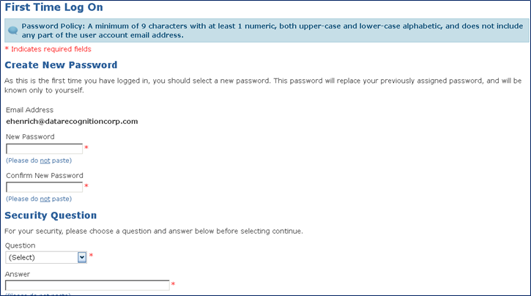
eDIRECT First Time Log On
Once users click on the URL in the email notice, they will be routed to eDIRECT where they will be required to complete the auto-prompt password reset.

Slide 10
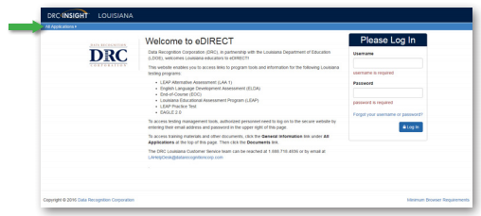
Accessing EAGLE 2.0
EAGLE 2.0 users sign on to the system through the DRC eDIRECT system.
Use a web browser to navigate to the eDIRECT website at https://la.drcedirect.com. Log in with Username and Password.

Slide 11
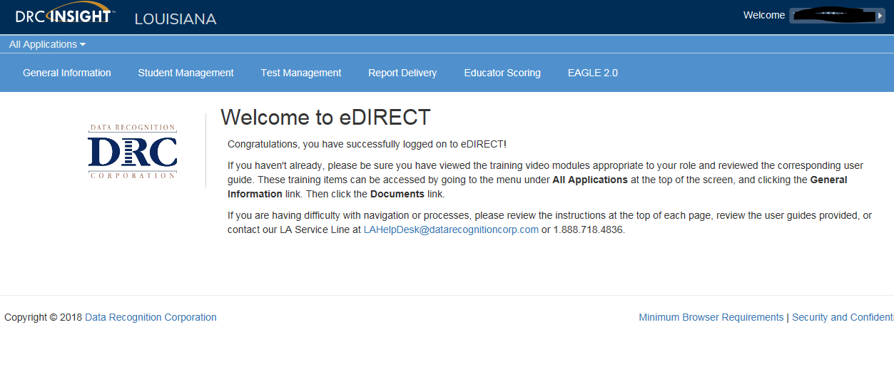
Accessing EAGLE 2.0
Once logged into eDIRECT, choose All Applications → EAGLE 2.0

Slide 12
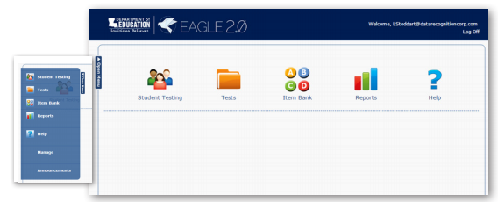
Accessing EAGLE 2.0
The EAGLE 2.0 home page displays icons along the top of the page and in the drop down menu on the left side of the page (the Open Menu button). Use the icons to access the various areas of the EAGLE 2.0 system: Student Testing, Tests, Item Bank, Reports, and Help.

Slide 13
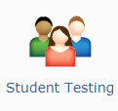
Student Testing
From the Student Testing page you can search, view, edit, create, and delete student groups and test sessions. From the Actions menu, a new test session can be created.

Slide 14
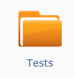
Tests
The Tests page displays a list of the tests that are currently in the system. From the Actions menu, a new test can be created.

Slide 15
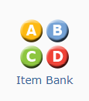
Item Bank
From the Item Bank page, users can add, search for, preview, and display test items and passages.

Slide 16
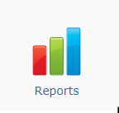
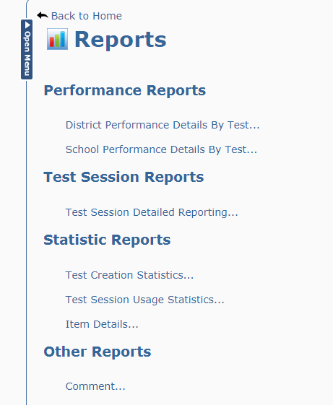
Reports
From the Reports page users can search for, display, and export the various EAGLE 2.0 reports for test sessions under their username.

Slide 17
Support

Slide 18
User Guides
The following user guides are posted in eDIRECT under General Information:
eDIRECT User Guide
Technology User Guide
EAGLE 2.0 User Guide

Slide 19
LEAP 360 Assessments: Resources
The following resources are available to help teachers understand, access, and use the the LEAP 360 assessment tools:
LEAP 360 webpage
A Teacher’s Guide to LEAP 360
A District’s Guide to LEAP 360
EAGLE 2.0 Quick Start Guide: How to Create a Test
EAGLE 2.0 Quick Start Guide: How to Create a Test Session
eDIRECT
Accessibility Features and Accommodations Overview
Teacher Study Guides (available in eDIRECT)
Webinars and Mini-trainings available on the LEAP 360 page

Slide 20
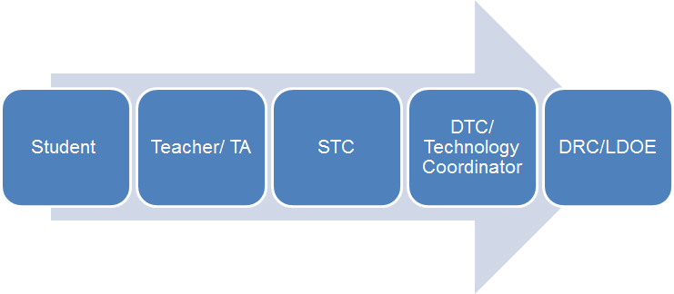
Technical Assistance Protocol
If technical problems occur, school and district staff should follow the protocol presented below.
DRC Louisiana Customer Service
1-888-718-4836 LAHelpDesk@datarecognitioncorp.com
LDOE
1-844-268-7320
assessment@la.gov

