Slide 1
eDIRECT: Completing Educator Scoring

Slide 2
Today’s Goals
By the end of today’s session, you should be able to:
View test sessions
Print student responses
Complete educator scoring
Reset scores after educator scoring has been submitted

Slide 3
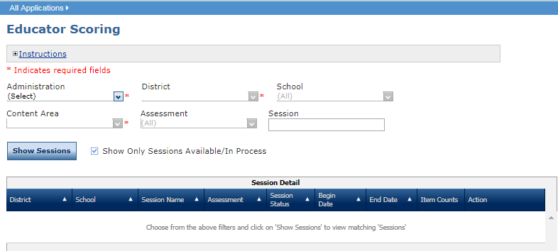
Educator Scoring Overview
Educator Scoring is used with the Diagnostic, Interim, and LEAP Practice Test administrations.
Students’ written responses to constructed response questions must be scored by Test Administrators using the Educator Scoring application.
Although it is a separate application, Educator Scoring is accessed directly from eDIRECT.
Detailed directions for Test Management can be found in the eDIRECT User Guide posted in eDIRECT under General Information.

Slide 4
Completing Educator Scoring
Once logged into eDIRECT, choose All Applications → Educator Scoring.

Slide 5
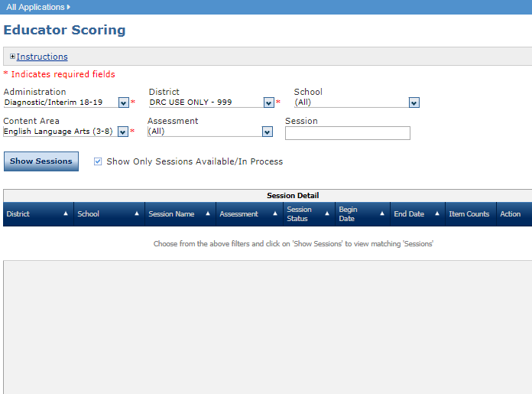
Viewing Test Sessions
From the Educator Scoring tab,
Select an Administration, District, and Content Area (required)
Click Show Sessions

Slide 6
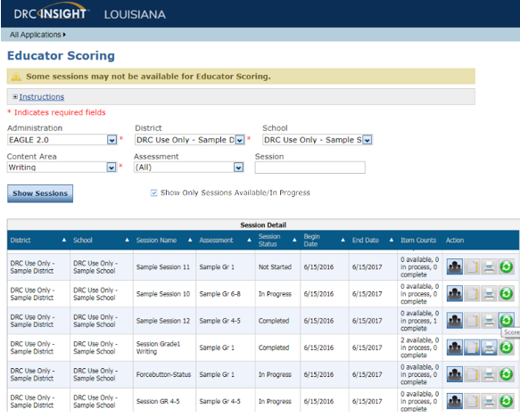
Viewing Test Sessions
Your test sessions, if any, display in the Session Details section.
To view all sessions, unclick Show Only Sessions Available/In Progress
All test sessions will show along with a test session status. There are 3 possible test statuses:
Not Started
In Progress
Complete

Slide 7
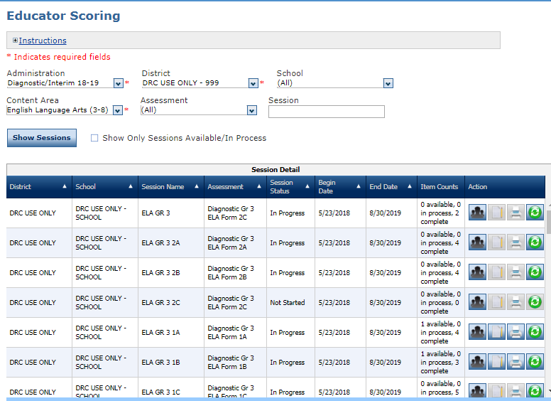
Printing Student Responses
From the Educator Scoring tab,
Select an Administration, District, and Content Area (required)
Click Show Sessions
To print all responses for all students in a test session:
Click the Print Student Responses icon
A .pdf of the selected responses displays
Click the Print icon to print the responses
Printing responses must be done before educator scoring has started.

Slide 8
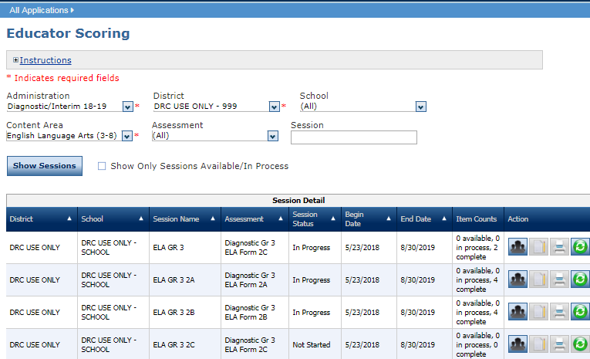
Printing Individual Student Responses
To print responses for a specific student in a test session:
Click the Show Students icon

Slide 9
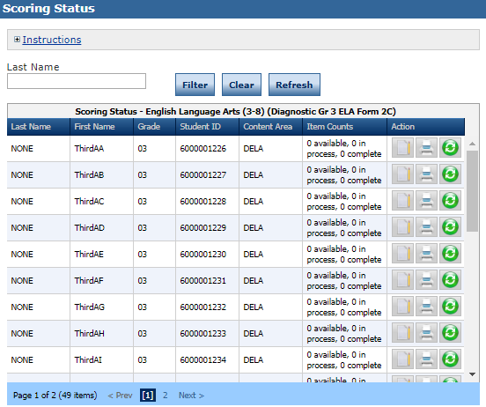
Printing Individual Student Responses
The Scoring Status window displays.
Click the Print Student Responses icon
A .pdf report of the student’s responses displays. Click the Print icon to print the responses
Printing responses must be done before educator scoring has started.

Slide 10
Completing Educator Scoring
When the Score Session or Score Student icons are enabled, you can score student responses for a session or student in Educator Scoring.
Note: Printing student responses is not available after you submit score in Educator Scoring. Print responses prior to scoring or submitting scores.

Slide 11
Completing Educator Scoring
From the Educator Scoring tab,
Select an Administration, District, and Content Area (required)
Click Show Sessions
To score all student responses for a session:
Click the Score Session icon to score all students in a test session. You will be signed in to Educator Scoring to begin scoring

Slide 12
Completing Educator Scoring
To score responses for specific a specific student in a test session:
Click the Show Students icon

Slide 13
Completing Educator Scoring
The Scoring Status window displays.
Click the Score Student icon. You will be signed in to Educator Scoring to begin scoring

Slide 14
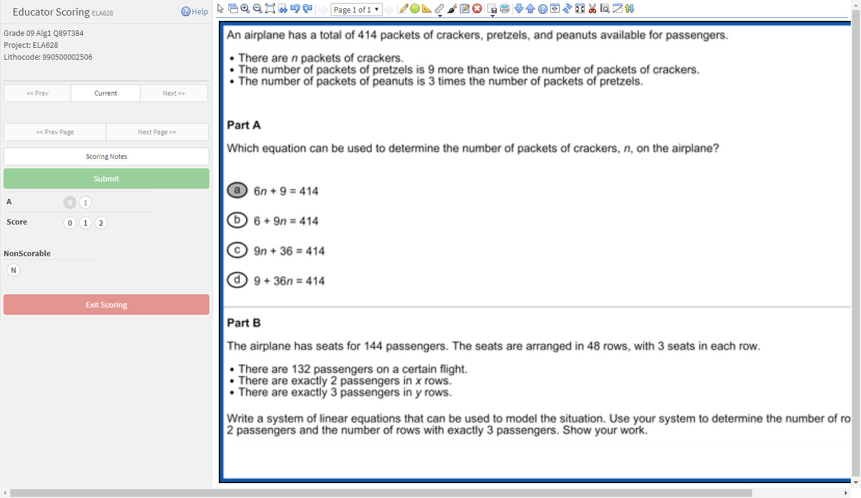
Completing Educator Scoring
Evaluate the student’s responses and select the appropriate score
Click Submit. The next student’s responses display automatically
After you have scored all available responses for the test session, Educator Scoring prompts you to log out of the working session
To end the scoring session, click Exit Scoring

Slide 15
Resetting Scores
To reset scores after Educator Scoring has been submitted:
From the Educator Scoring tab,
Select an Administration, District, and Content Area (required)
Click Show Sessions
To reset all student responses for a session:
Click the Score Reset icon to score all students in a test session. The Score Reset window displays

Slide 16
Resetting Scores
To reset responses for a specific student in a test session:
Click the Show Students icon

Slide 17
Resetting Scores
The Scoring Status window displays.
Click the Score Reset icon. The Score Reset window displays

Slide 18
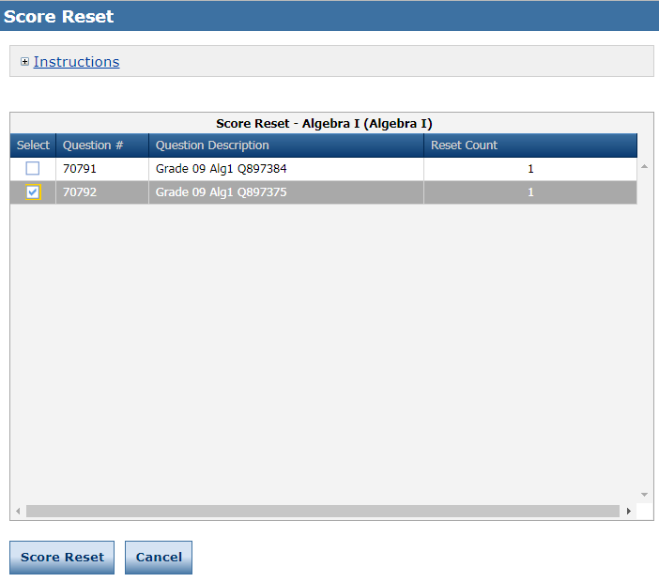
Resetting Scores
Select the question(s) for which you want to reset the score and click Score Reset
Select Reset
Note: Each question with a reset score must be re-scored in Educator Scoring.

Slide 19
Support

Slide 20
User Guides
The following user guides are posted in eDIRECT under General Information:
eDIRECT User Guide
Technology User Guide
EAGLE 2.0 User Guide

Slide 21
LEAP 360 Assessments: Resources
The following resources are available to help teachers understand, access, and use the the LEAP 360 assessment tools:
LEAP 360 webpage
A Teacher’s Guide to LEAP 360
A District’s Guide to LEAP 360
EAGLE 2.0 Quick Start Guide: How to Create a Test
EAGLE 2.0 Quick Start Guide: How to Create a Test Session
eDIRECT
Accessibility Features and Accommodations Overview
Teacher Study Guides (available in eDIRECT)
Webinars and Mini-trainings available on the LEAP 360 page

Slide 22
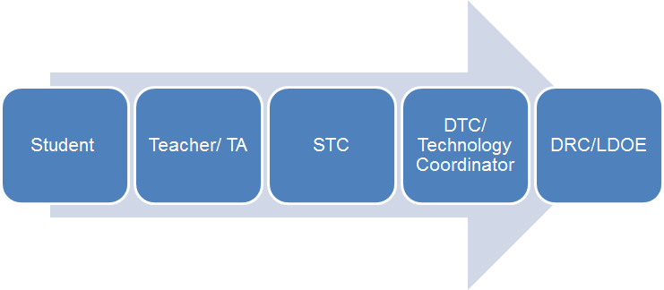
Technical Assistance Protocol
If technical problems occur, school and district staff should follow the protocol presented below.
DRC Louisiana Customer Service
1-888-718-4836 LAHelpDesk@datarecognitioncorp.com
LDOE
1-844-268-7320
assessment@la.gov

