Slide 1
eDIRECT: Managing Students/Accommodations

Slide 2
Today’s Goals
At the end of this presentation, participants will know how to:
Add an individual student/accommodations
Upload multiple students through a .csv
View/Edit an individual student/accommodations

Slide 3
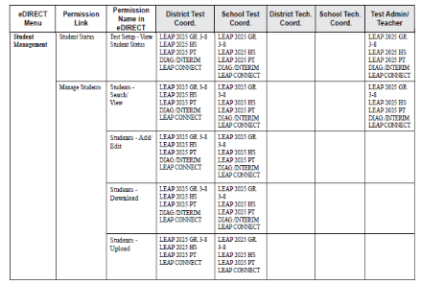
Student Management Permissions
Student Management permissions are pre-set for the following roles:
DTC
STC
Test Administrator/Teacher (viewing only)
Student Management permissions can be added/removed to users through User Management in eDIRECT.
Detailed directions for student management and editing user permissions can be found in the eDIRECT User Guide posted in eDIRECT under General Information.

Slide 4
Summative vs. Nonsummative Student Management
Summative
Prior to testing, students are uploaded by DRC via the precode file
Additional students can be added/uploaded through the Student Management tab
DRC uploads accommodations for precode students; students added after the precode file will need accommodations uploaded
Nonsummative
Student information and accommodations are managed automatically through eScholar and SIS/SER
While students can still be added/edited individually, the Upload Multiple Students function is not be a permission for non-summative assessments
Updates to eScholar and SIS/SER will be refreshed nightly in eDIRECT

Slide 5
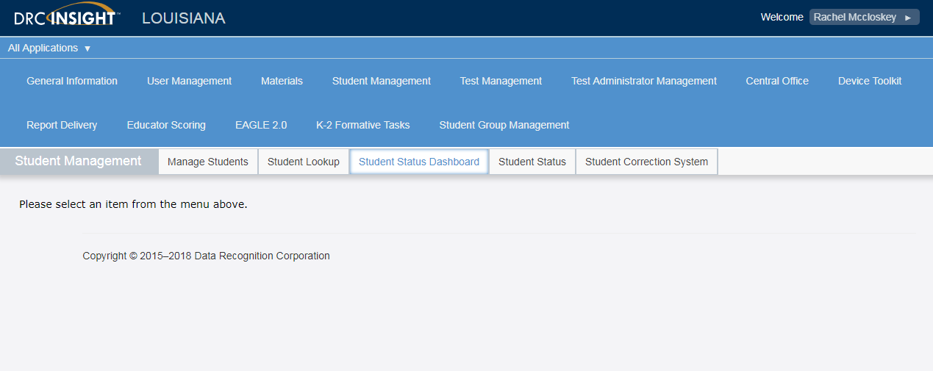
Student Management
Once logged into eDIRECT, select All Applications → Student Management

Slide 6
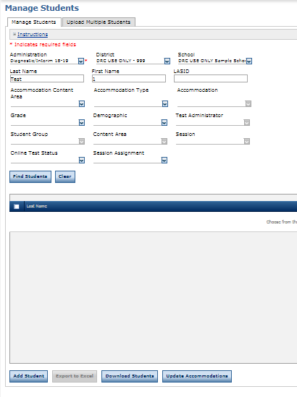
Adding Individual Students
Under the Manage Students tab to add an individual TA:
Choose an Administration
Select a District/School
Click Add Student

Slide 7
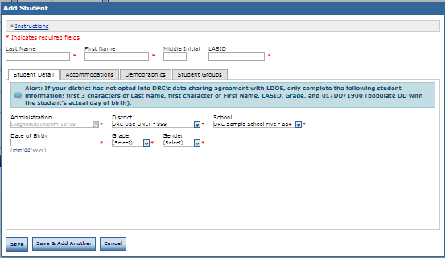
Adding Individual Students
Under the Student Detail tab, enter required information:
Last Name
First Name
LASID
Date of Birth
Grade
Gender

Slide 8
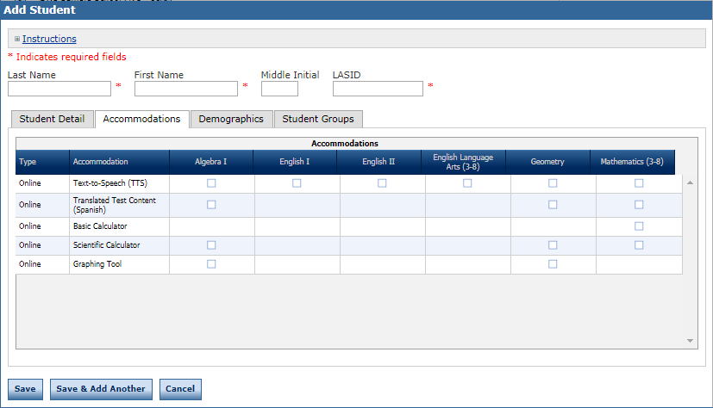
Adding Individual Students
Under the Accommodations tab, enter applicable accommodations for the administration

Slide 9
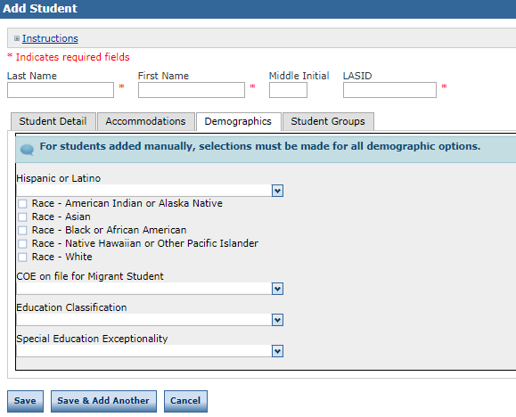
Adding Individual Students
Under the Demographics tab, enter additional demographics
Click Save to save the individual student or Save & Add Another to continue adding students

Slide 10
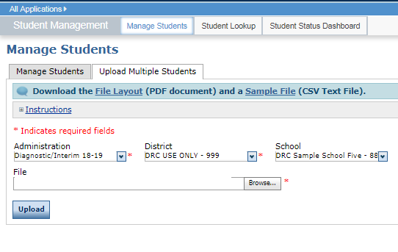
Adding Multiple Students
To upload multiple Test Administrators with TA Numbers, select the Upload Multiple Test Administrators tab.
Download the File Layout (.pdf document) and a Sample File (.csv text file)

Slide 11
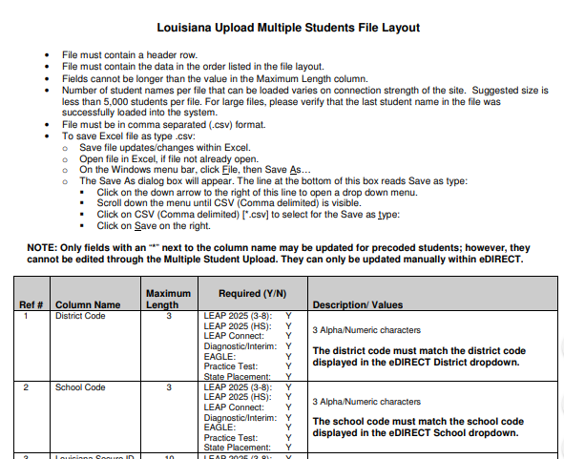
Adding Multiple Students
Enter the student information into the .csv using the Student File Layout as a guide
The Student File Layout will indicate what fields are required for each administration
Save the .csv to your computer

Slide 12
Adding Multiple Students
Use Browse in eDIRECT to find your saved .csv
Click Upload. A message will display indicating the file is in process and is being checked for errors
After the file has been validated, you can review its status. If the file contains errors, you must correct them and repeat Steps 4 and 5

Slide 13
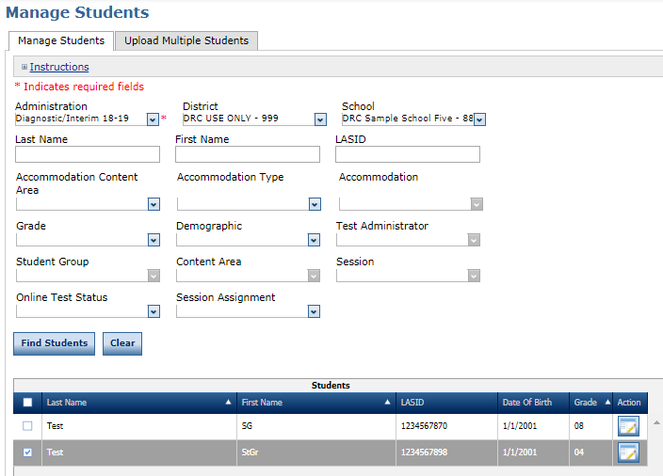
Viewing and Editing a Student/Accommodations
To view/edit a student/accommodations, go to the Manage Students tab.
To view individual students:
Choose an Administration
Click on Find Students
A list of available students will display
To edit individual students/accommodations
Click on the View/Edit icon under the Action column
Make changes under the appropriate tab and click Save

Slide 14
Support

Slide 15
User Guides
The following user guides are posted in eDIRECT under General Information:
eDIRECT User Guide
Technology User Guide
EAGLE 2.0 User Guide

Slide 16
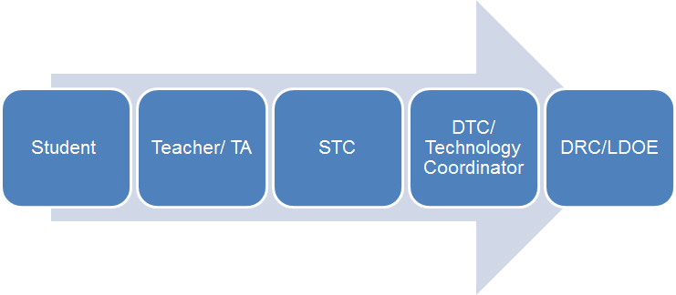
Technical Assistance Protocol
If technical problems occur, school and district staff should follow the protocol presented below.
DRC Louisiana Customer Service
1-888-718-4836 LAHelpDesk@datarecognitioncorp.com
LDOE
1-844-268-7320
assessment@la.gov

