Slide 1
eDIRECT: Managing Test Sessions

Slide 2
Today’s Goals
At the end of this presentation, participants will know how to:
Create a test session and add students to the test session
Upload multiple test sessions
Copy a test session
Edit a test session
Export a test session

Slide 3
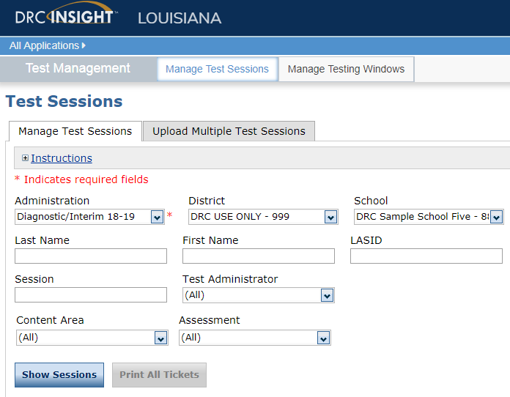
Test Management Overview
Test sessions may either be created individually or in an upload for multiple test sessions. Test sessions must be created for both summative and nonsummative assessments.
Once test sessions are created, students can be added
Test Administrators/Teachers with a TA number can be linked to a test session. TA numbers are managed through the Test Administrator Management tab
Student Groups can be used to create groups of students linked to a TA for test session management
Student groups are managed through the Student Groups tab
Detailed directions for Test Management can be found in the eDIRECT User Guide posted in eDIRECT under General Information.

Slide 4
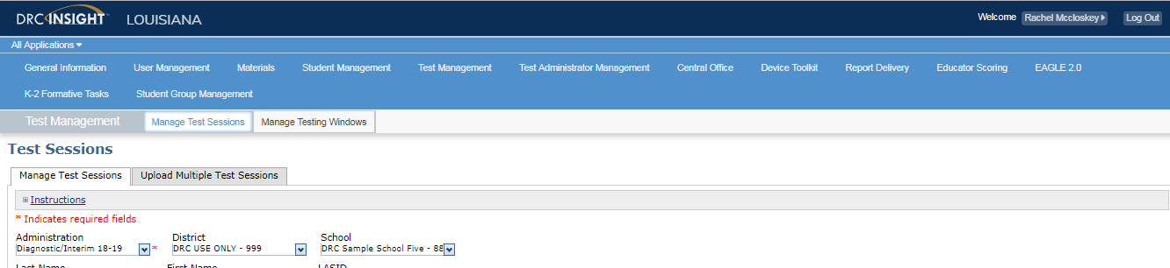
Test Session Management
Once logged into eDIRECT, choose All Applications → Test Management

Slide 5
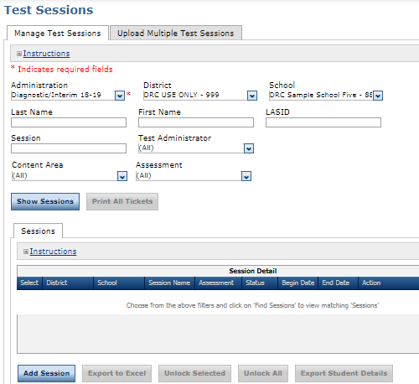
Creating an Individual Test Session
Under the Manage Test Sessions tab:
Choose an Administration
Click Add Session

Slide 6
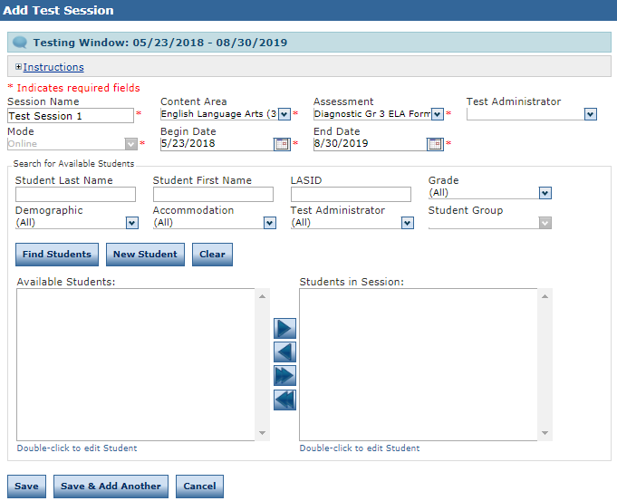
Creating an Individual Test Session
Enter the required information:
  Session Name
  Content Area
  Assessment
  Mode
  Testing Window
Select Find Students
  A list of available students will display
  If a student group is selected, only students within the student group will display

Slide 7
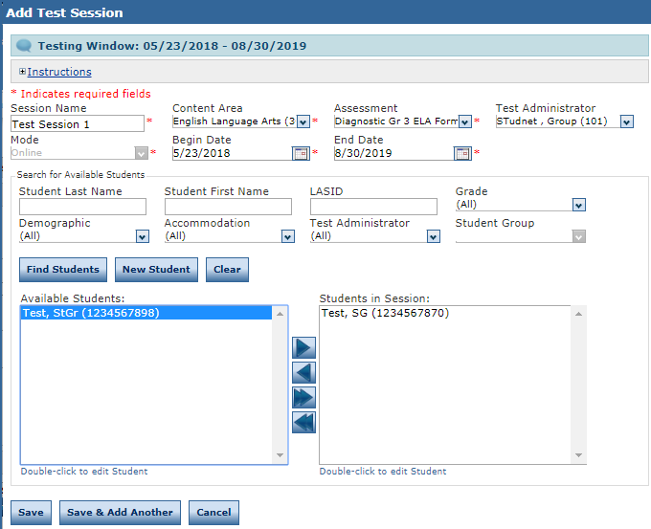
Creating an Individual Test Session
Use the arrows to add or remove students from the students in session list
Click Save or Save & Add Another to continue adding test sessions

Slide 8
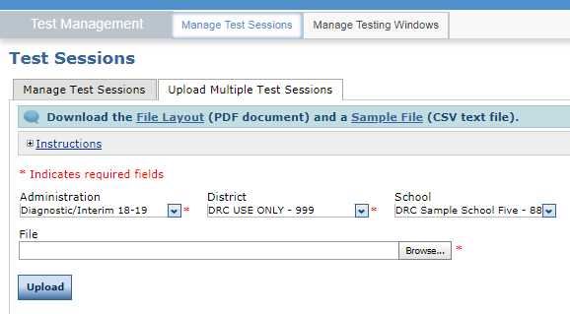
Adding Multiple Test Sessions
To upload multiple Test Sessions, select the Upload Multiple Test Sessions tab.
Download the File Layout (.pdf document) and a Sample File (.csv text file)

Slide 9
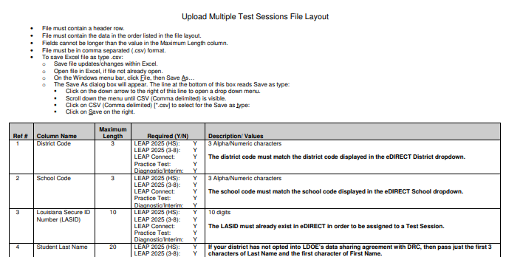
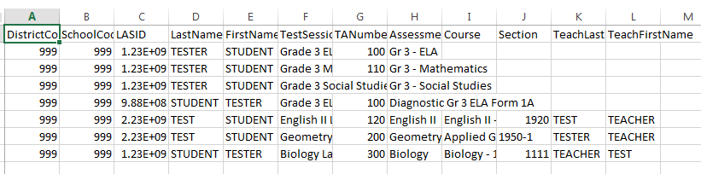
Adding Multiple Test Sessions
Enter the student information into the .csv using the Student File Layout as a guide
  The Student File Layout will indicate what fields are required for each administration
Save the .csv to your computer

Slide 10
Adding Multiple Test Administrators
Use Browse in eDIRECT to find your saved .csv
Click Upload. A message will display indicating the file is in process and is being checked for errors
  After the file has been validated, you can review its status. If the file contains errors, you must correct them and repeat Steps 4 and 5

Slide 11
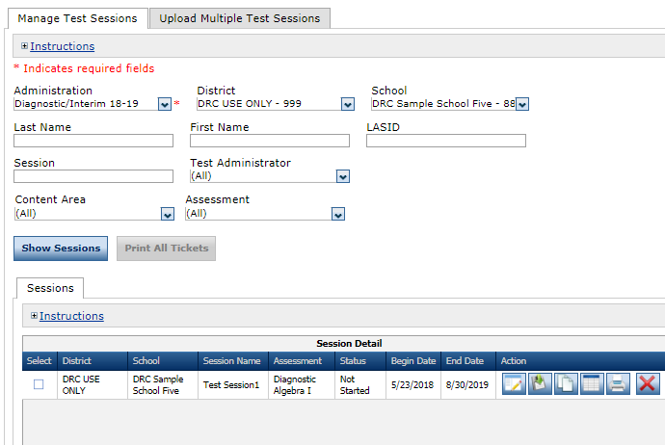
Copying a Test Session
An existing test session can be used as a template to create a new test session.
For example, you can copy the Interim 1 test session to use for the Interim 2 test session
To copy a test session:
From the Manage Test Sessions screen,
Choose Show Sessions
Select the Copy Session icon

Slide 12
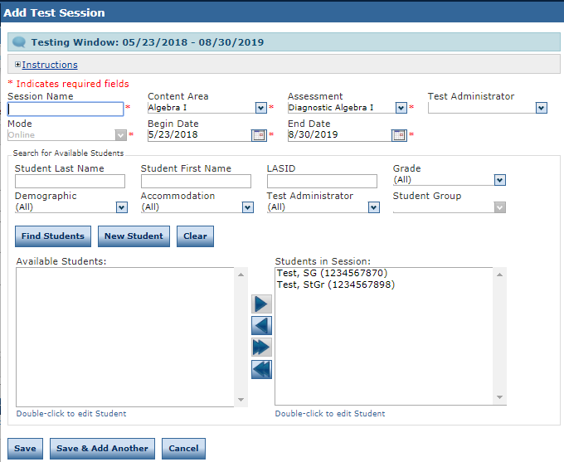
Copying a Test Session
The Add Test Session window displays.
Enter a name for the session in the Session Name field
Edit the required information to match your new session, and add or remove students/student groups if necessary
Click Save to save your changes, Save & Add Another to save your changes and add another student, or Cancel to cancel your changes

Slide 13
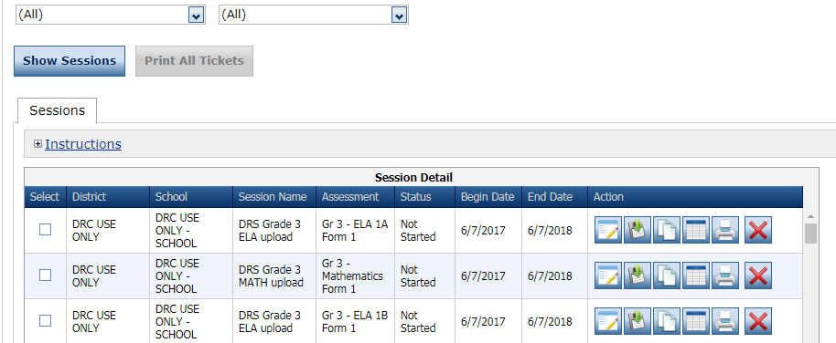
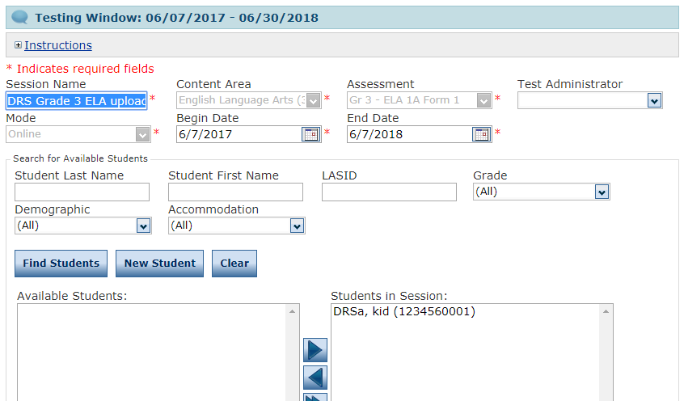
Editing Test Sessions
To edit test session information or assigned students/ student groups:
From the Manage Test Sessions screen,
Choose Show Sessions
Select the View/Edit icon
Update any information
Click Save
  If there is an edit in the testing window, the test tickets will automatically update to access the assessment within the adjusted time frame

Slide 14
Exporting a Test Session
The details of a test session can be viewed as an Excel file (.xls) to save, view, edit, or print in a spreadsheet.
To export a test session:
From the Manage Test Sessions screen,
Choose Show Sessions
Click the Export Details icon

Slide 15
Exporting a Test Session
The exported spreadsheet will include a roster of students and their usernames/passwords.

Slide 16
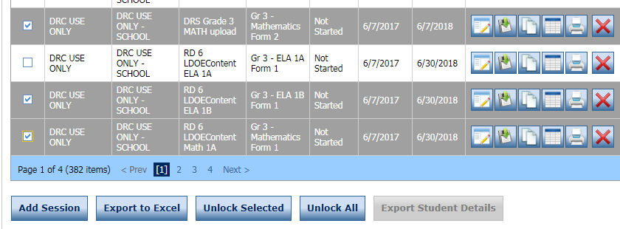
Exporting Multiple Test Sessions
The details of a test session can be viewed as an Excel file (.xls) to save, view, edit, or print in a spreadsheet.
To export multiple test sessions:
From the Manage Test Sessions screen,
Choose Show Sessions
Select the checkbox next to each test session to export
Choose Export to Excel

Slide 17
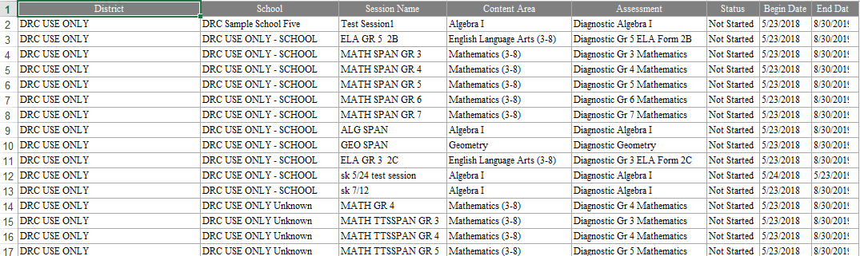
Exporting Multiple Test Sessions
The exported spreadsheet will provide details for each selected session.

Slide 18
Support

Slide 19
User Guides
The following user guides are posted in eDIRECT under General Information:
eDIRECT User Guide
Technology User Guide
EAGLE 2.0 User Guide

Slide 20
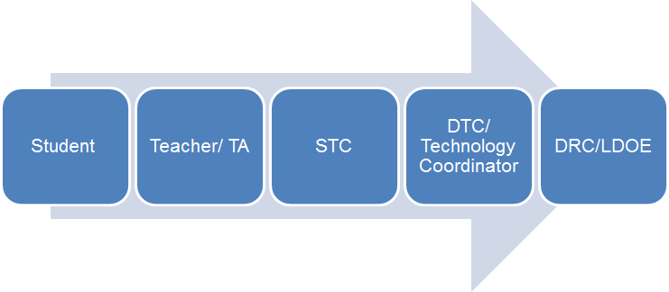
Technical Assistance Protocol
If technical problems occur, school and district staff should follow the protocol presented below.
DRC Louisiana Customer Service
1-888-718-4836 LAHelpDesk@datarecognitioncorp.com
LDOE
1-844-268-7320
assessment@la.gov

