Slide 1
eDIRECT: Printing Test Tickets

Slide 2
Today’s Goals
At the end of this presentation, participants will understand how to:
Print test tickets for an entire test session
Print test tickets for selected students

Slide 3
Test Tickets Overview
For students to access testing through the INSIGHT testing platform, a test ticket is required. Each student will have a test ticket for each session of an assessment.
Test tickets will include:
For a detailed description of printing testing tickets, see the eDIRECT User Guide posted in eDIRECT under General Information.
Test administration Test Ticket/Session Test Session Student Name | Date of Birth LASID Username Password

Slide 4
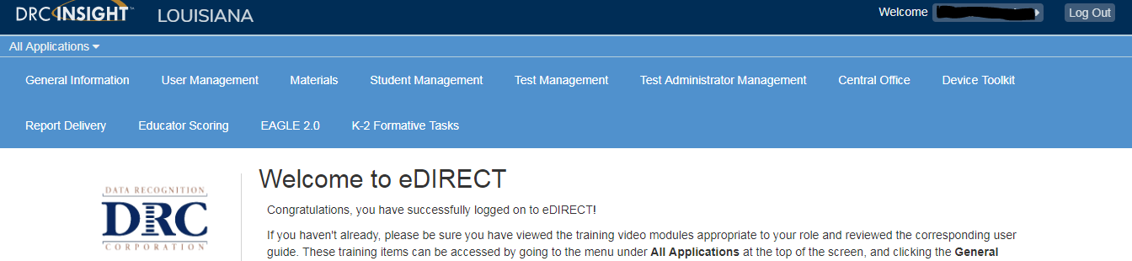
Printing Test Tickets
Once logged into eDIRECT, choose All Applications → Test Management

Slide 5
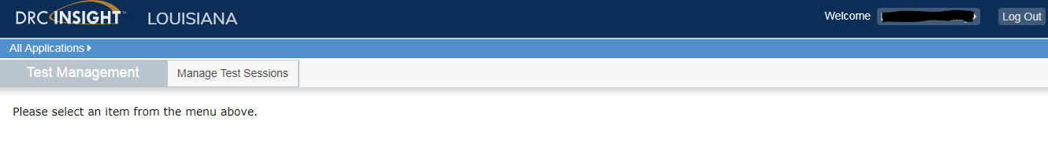
Printing Test Tickets
Choose Manage Sessions

Slide 6
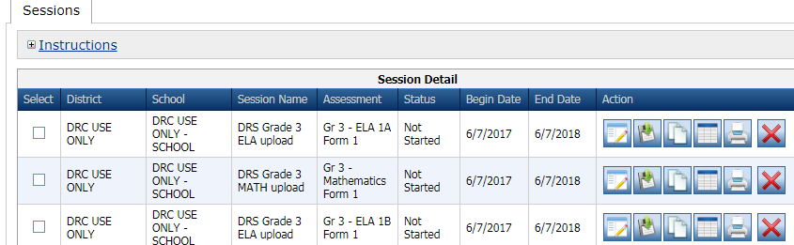
Printing Test Tickets for a Session
From the Manage Test Sessions screen,
Choose an Administration
Choose Show Sessions
Click the Print Test Tickets icon

Slide 7
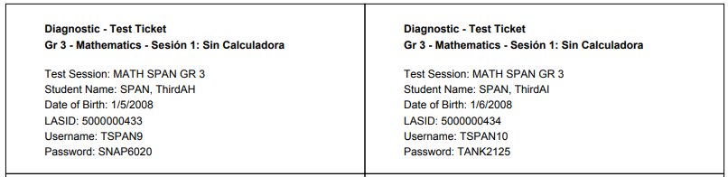
Printing Test Tickets for a Session
A student roster with students’ usernames/passwords will generate with tickets for each session of the assessment.
Test tickets will have to be cut or printed on perforated paper

Slide 8
Printing Test Tickets for Selected Students
From the Manage Test Sessions screen,
Choose an Administration
Choose Show Sessions
Click the Edit/Print Ticket Status icon

Slide 9
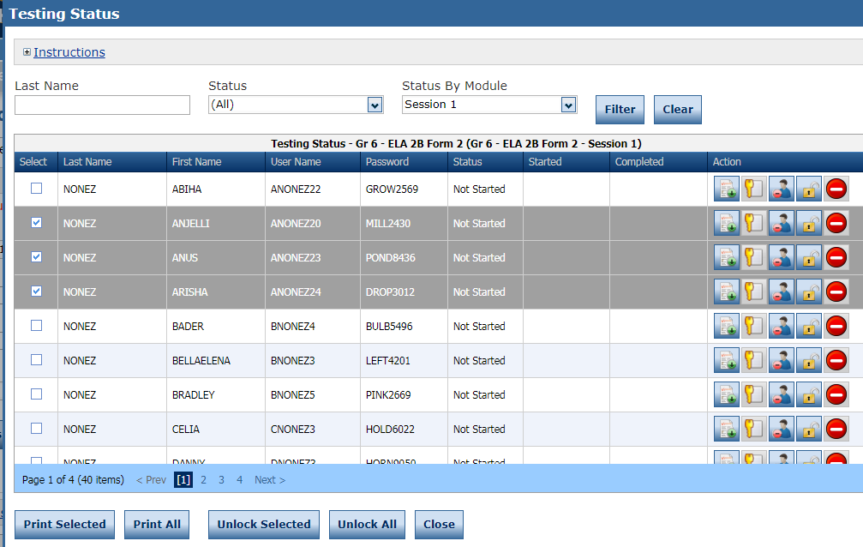
Printing Test Tickets for Selected Students
The Edit/Print Ticket Status page allows the user to sort by testing status and status by session.
Select one or more students by clicking the checkbox in the Select column
Click Print Selected
  All tickets can be printed by selecting Print All.

Slide 10
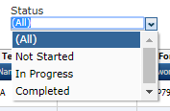
Viewing Test Session Status
Viewing test session status provides the following information:
each student’s testing status
the time the student started the test
the time the student completed the test
This information can be used to verify that all students in a session have completed their tests prior to educator scoring or for use when scheduling makeup testing.

Slide 11
Viewing Test Session Status
Once logged into eDIRECT, choose All Applications → Test Management

Slide 12
Viewing Test Session Status
Choose Manage Test Sessions.

Slide 13
Viewing Test Status
To view all students in a session: From the Manage Test Sessions screen,
Choose an Administration
Choose Show Sessions
Click the Edit/Print Ticket Status icon

Slide 14
Viewing Test Session Status
The Edit/Print Ticket Status page allows the user to sort by testing status and status by session.
The test status for each student in the session will display in the Status column

Slide 15
Support

Slide 16
User Guides
The following user guides are posted in eDIRECT under General Information:
eDIRECT User Guide
Technology User Guide
EAGLE 2.0 User Guide

Slide 17
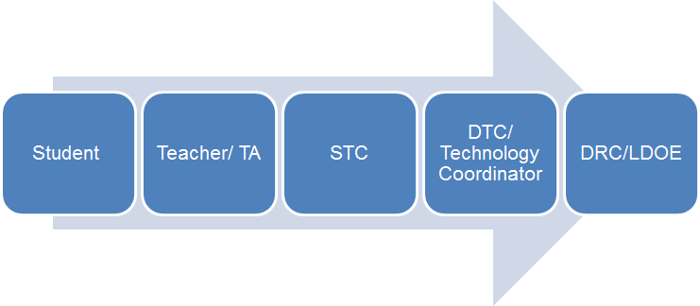
Technical Assistance Protocol
If technical problems occur, school and district staff should follow the protocol presented below.
DRC Louisiana Customer Service
1-888-718-4836 LAHelpDesk@datarecognitioncorp.com
LDOE
1-844-268-7320
assessment@la.gov

