Slide 1
eDIRECT: Managing Test Administrators

Slide 2
Today’s Goals
At the end of this presentation, participants will understand how to:
Add an individual test administrator (TA)
Upload multiple test administrators through a .csv
Create a TA number

Slide 3
Test Administrator vs. Teacher Roles in eDIRECT
Test Administrator Role
Used for summative assessments (LEAP 2025, EOC, LEAP Connect/LAA1)
Requires a 3 digit TA number for test administration
Teacher Role
Used for nonsummative assessments (LEAP 360, Practice Tests)
Requires a 3 digit TA number for the creation of student groups to link teachers with students

Slide 4
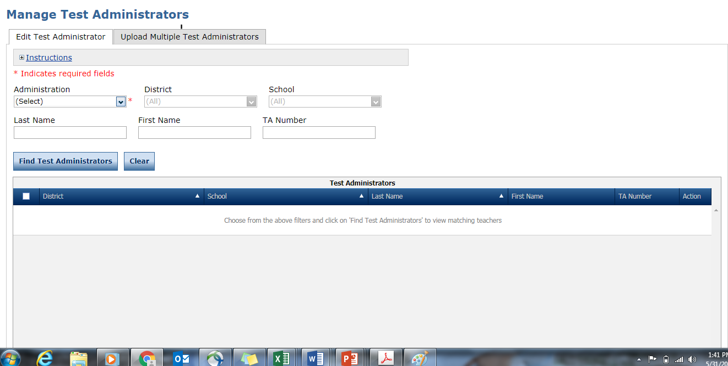
Test Administrator (TA) System
Test Administrators may either be created individually or in an upload for multiple TAs.
Each TA must have a 3 digit TA number in eDIRECT for both computer-based and paper-based testing.
Detailed directions for user management can be found in the eDIRECT User Guide posted in eDIRECT under General Information.

Slide 5
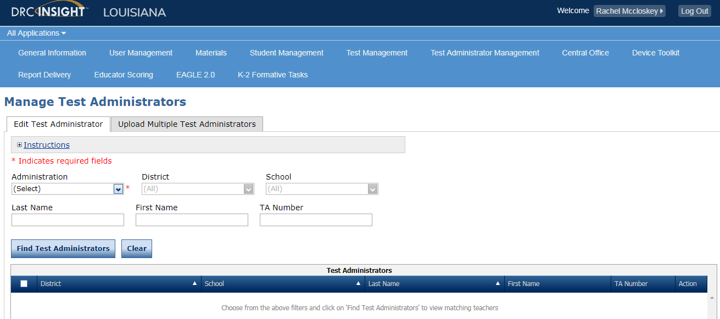
Test Administrator Management
Once logged into eDIRECT, select All Applications → Test Administrator Management

Slide 6
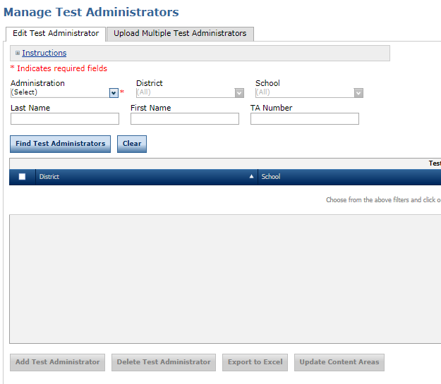
Adding Individual Test Administrators
Test Administrator (TA) Numbers will be captured within eDIRECT Test Administrator Management.
To add an individual TA:
Choose an Administration
Click the Add Test Administrator button
Enter the required fields
Administration
District/School
Last Name
First Name
TA Number (TA numbers must be three digits greater than 100)
Click on Save

Slide 7
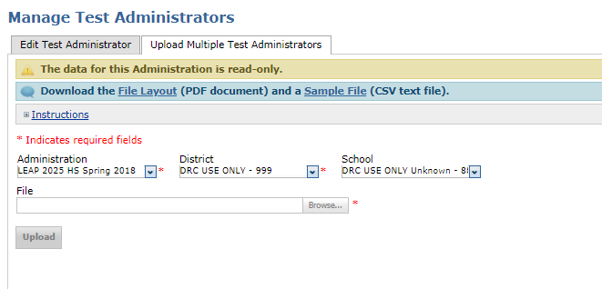
Adding Multiple Test Administrators
To upload multiple Test Administrators with TA Numbers, select the Upload Multiple Test Administrators tab.
Download the File Layout (.pdf document) and a Sample File (.csv text file)

Slide 8
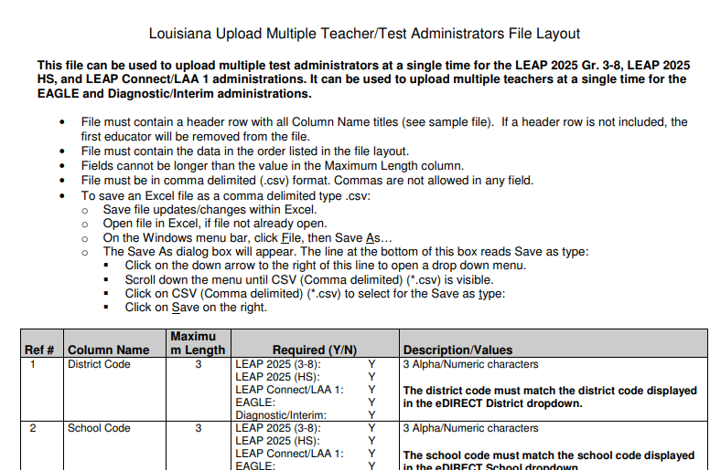
Adding Multiple Test Administrators
Enter the required fields into the .csv
Administration
District/School
Last Name
First Name
TA Number (TA numbers must be three digits greater than 100)
Teacher Email (ensure it matches the email used for User Management)
Save the .csv to your computer

Slide 9
Adding Multiple Test Administrators
Use Browse in eDIRECT to find your saved .csv
Click Upload. A message will display indicating the file is in process and is being checked for errors
After the file has been validated, you can review its status. If the file contains errors, you must correct them and repeat Steps 4 and 5

Slide 10
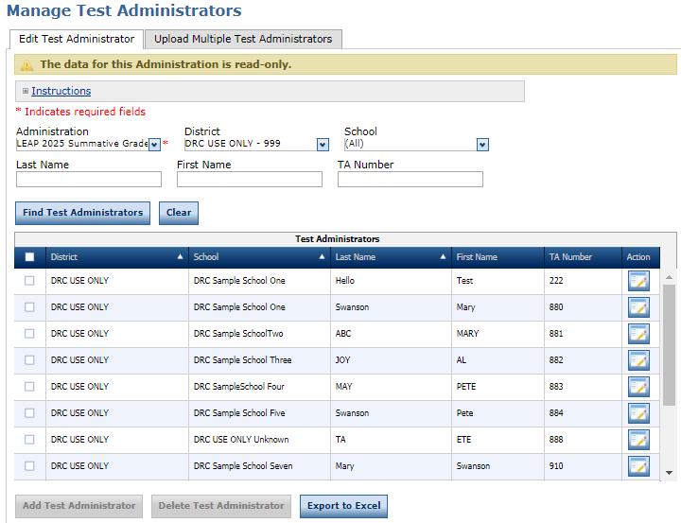
Viewing and Editing Test Administrators
To search individual Test Administrators/TA numbers:
Choose an Administration
Click on Find Test Administrators
To edit individual Test Administrators/TA Numbers:
Click on the View/Edit icon under the Action column
Make changes and click Save

Slide 11
Support

Slide 12
User Guides
The following user guides are posted in eDIRECT under General Information:
eDIRECT User Guide
Technology User Guide
EAGLE 2.0 User Guide

Slide 13
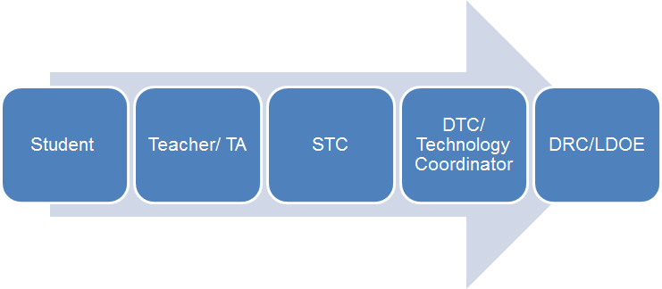
Technical Assistance Protocol
If technical problems occur, school and district staff should follow the protocol presented below.
DRC Louisiana Customer Service
1-888-718-4836 LAHelpDesk@datarecognitioncorp.com
LDOE
1-844-268-7320
assessment@la.gov

