Slide 1
eDIRECT: User Management

Slide 2
Today’s Goals
At the end of this presentation, participants will know how to:
Adding an individual user and permissions
Upload multiple users and permissions

Slide 3
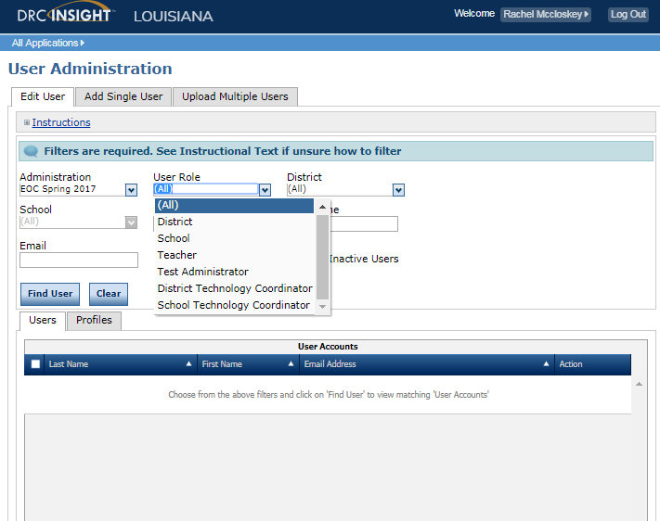
User Management
For online testing, eDIRECT categorizes users into user roles:
District Test Coordinator (DTC),
School Test Coordinator (STC),
District Technology Coordinator,
School Technology Coordinator,
Test Administrator (TA), and
Teacher.
Users can be added by District Test Coordinators (DTCs) and School Test Coordinators (STCs).
Within eDIRECT, users in each role can be assigned permissions to handle the testing responsibilities associated with the role.

Slide 4
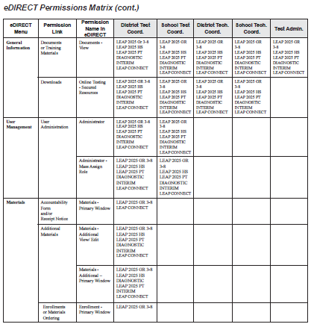
User Management
Permissions will be set during the creation process but can be updated. The system will make recommendations based on user role.
The eDIRECT User Guide posted in eDIRECT under General Information has the following:
a Permissions Matrix that lists the current eDIRECT permissions,
the path in eDIRECT to where the function the permission allows is located,
the permission’s name in eDIRECT, and
the recommended permissions for each role.

Slide 5
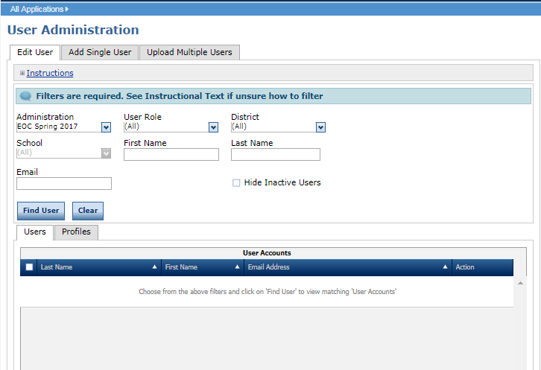
User Management
Users may either be created individually or in an upload for multiple users. Once users are created they will receive an email with a link to set up their password.
Detailed directions for user management can be found in the eDIRECT User Guide posted in eDIRECT under General Information.

Slide 6
User Management
Once logged into eDIRECT, choose All Applications → User Management

Slide 7
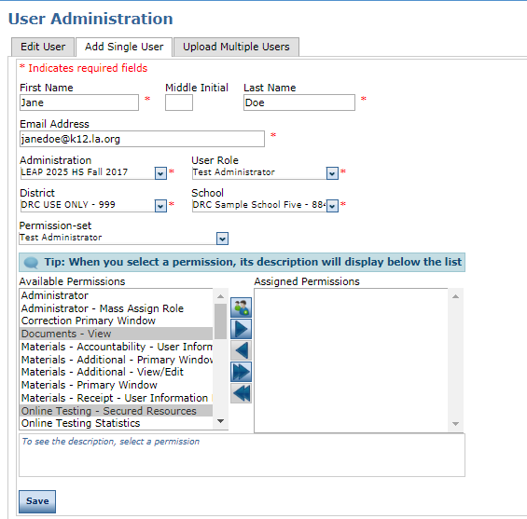
Adding Individual Users
To add a single user from the Manage Users menu:
Click on the Add Single User tab
Fill out the required fields:
First Name
Last Name
Email Address
Administration
User Role
District
School
Select the applicable permission set for the user’s role

Slide 8
Adding Individual Users
When the applicable permission set for the user’s role is selected, the list of recommended permissions will be highlighted under Available Permissions.
Review the Available Permissions and select or deselect any depending on your district’s
Hold the Ctrl key to select multiple permissions at one time

Slide 9
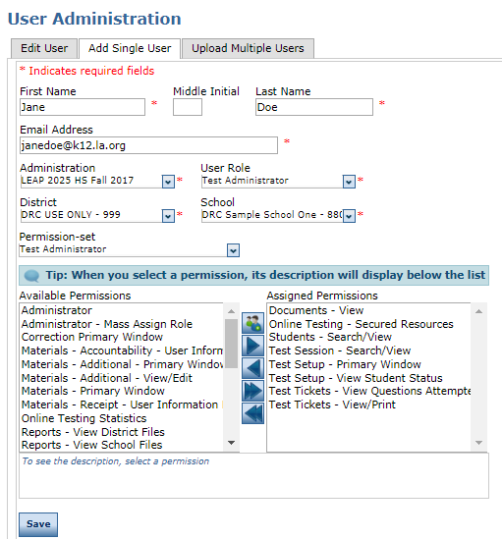
Adding Individual Users
To add the permissions to the user, select the right arrow to move them to Assigned Permissions
To remove any permissions select the left arrow
Click Save

Slide 10
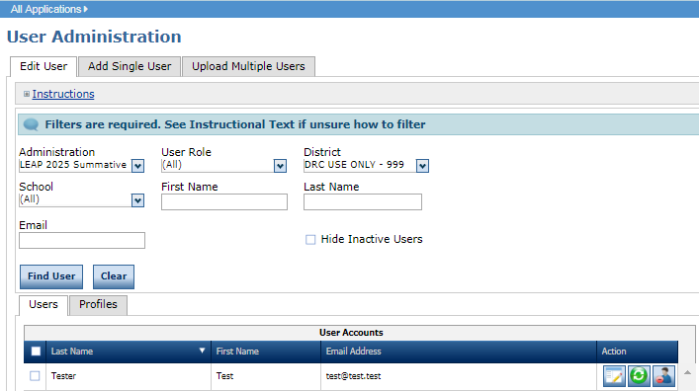
Editing Individual Users
User Permissions can be updated at any point to add/remove user roles and permissions.
To edit a user:
Click on the Edit User tab
Input available information to search the user
Click Find User
Select the View/Edit icon

Slide 11
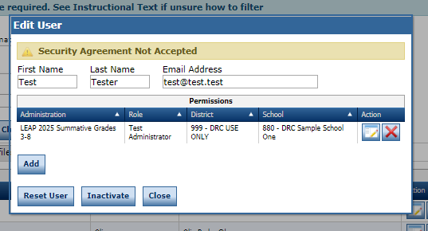
Editing Individual Users
From the Edit User screen:
A user’s permissions for an existing role can be updated by clicking the View/Edit icon
An additional role can be added to the user by selecting Add

Slide 12
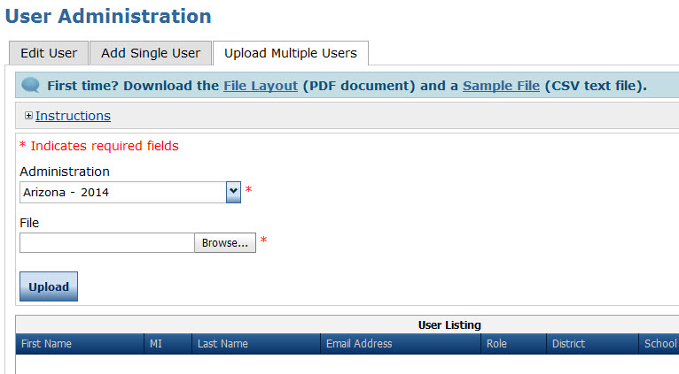
Uploading Multiple Users
To upload multiple users from the Manage Users menu:
Click on the Upload Multiple Users tab
Download the File Layout (.pdf document) and a Sample File (.csv text file)

Slide 13
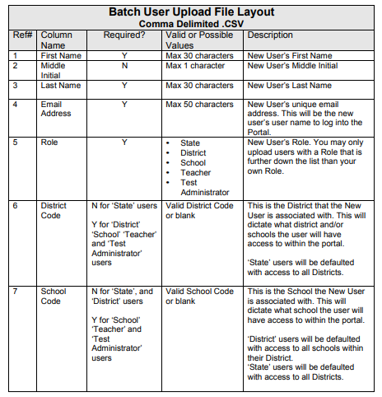
Uploading Multiple Users
Enter the required fields into the .csv
First Name
Last Name
Email Address
Role
District Code
School Code
Save the .csv to your computer

Slide 14
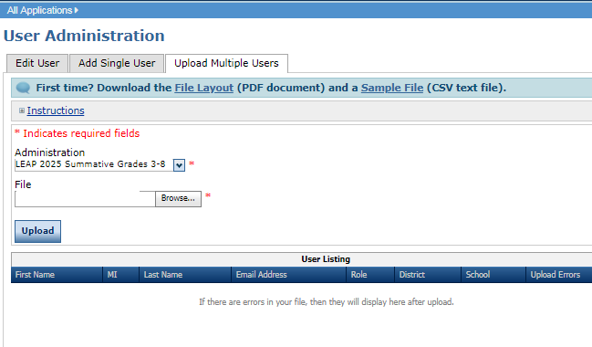
Uploading Multiple Users
Use Browse in eDIRECT to find your saved .csv
Click Upload. A message will display indicating the file is in process and is being checked for errors
After the file has been validated, you can review its status. If the file contains errors, you must correct them and repeat Steps 4 and 5

Slide 15
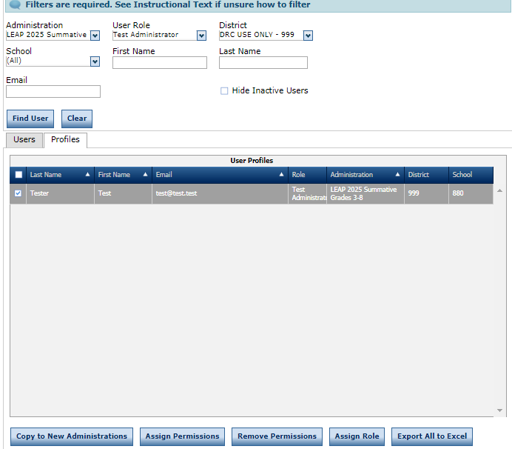
Assigning User Permissions in eDIRECT
Permission sets will need to be assigned to eDIRECT users added through Upload Multiple Users.
Click on the Edit User tab, enter search criteria, click Find User to display a list of users, and select the Profiles tab
Check the checkbox on the left hand column for each user profile you want to edit
Click on Assign Permissions
Select the user role from the Permissions Set dropdown. This will automatically select the appropriate permissions for the user’s role
Click on the single arrow to add the permissions, click on Save

Slide 16
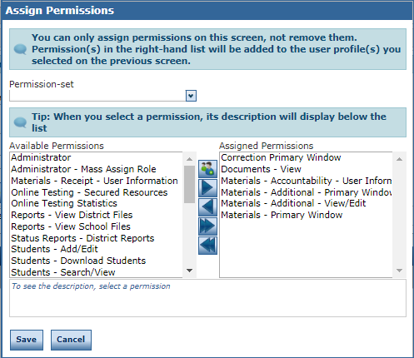
Assigning User Permissions in eDIRECT
Select the user role from the Permissions Set dropdown. This will automatically select the appropriate permissions for the user’s role
Click on the single arrow to add the permissions, click on Save

Slide 17
Assigning User Permissions in eDIRECT
Important permissions by user role:
School Test Coordinator
All test session permissions
View and print test tickets only
View/download reports
Teacher
Educator Scoring
EAGLE 2.0
Reports (if applicable to the school site)
Test Administrators
None

Slide 18
Support

Slide 19
User Guides
The following user guides are posted in eDIRECT under General Information:
eDIRECT User Guide
Technology User Guide
EAGLE 2.0 User Guide

Slide 20
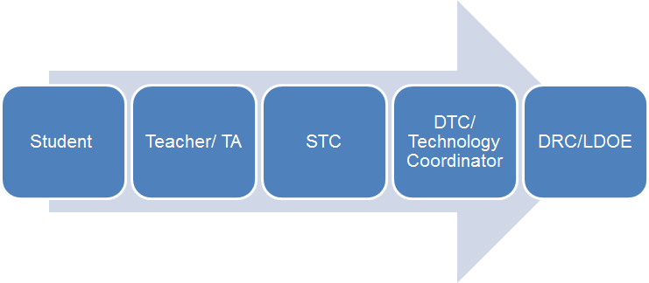
Technical Assistance Protocol
If technical problems occur, school and district staff should follow the protocol presented below.
DRC Louisiana Customer Service
1-888-718-4836 LAHelpDesk@datarecognitioncorp.com
LDOE
1-844-268-7320
assessment@la.gov

