Slide 1
PRESENTED BY ATS
2022-23 KiteTraining
Hosts:
Charles Turner – Service Desk Lead
Katherine Kocen – Service Desk
Brad Hansen – Service Desk Lead

Slide 2
Our Agenda
Kite Educator Portal
Data Set Up
Kite Student Portal

Slide 3
Kite Educator Portal

Slide 4
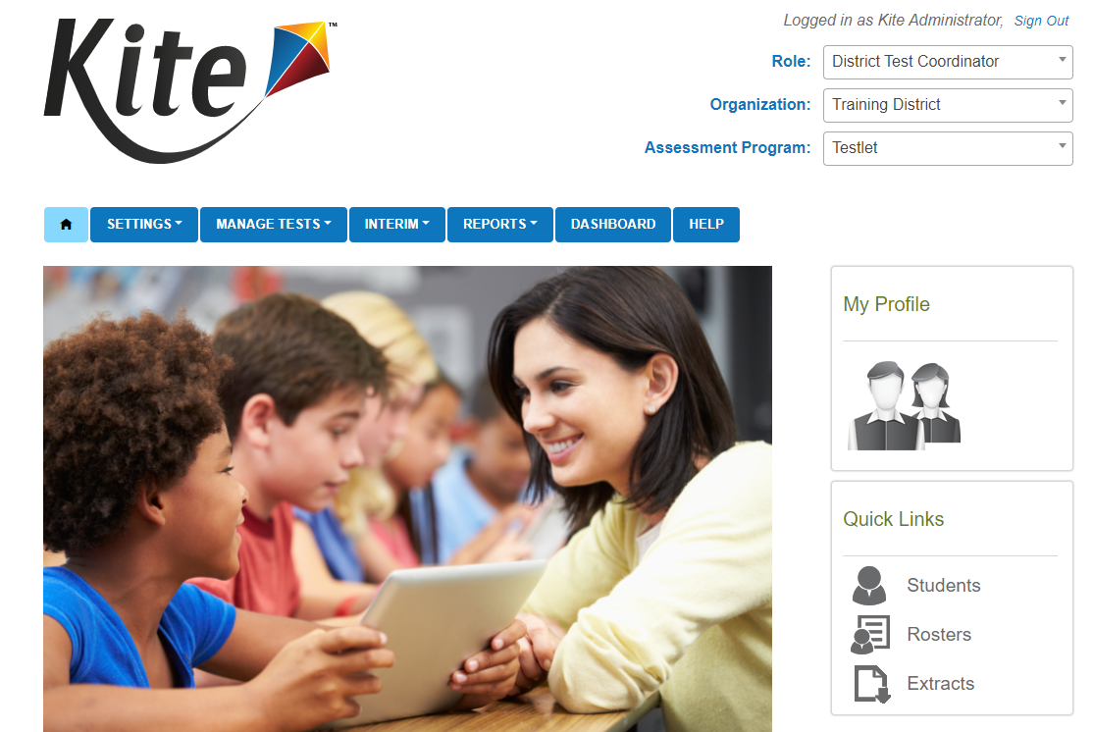
Landing Page

Slide 5
Functions
Facilitates the exchange and management of:
Student data
Score reporting
Student monitoring capabilities
Test administrators
Enter student accommodations
Monitor test sessions
Retrieve data

Slide 6
Data Setup- Users

Slide 7
Users – Hierarchy: District Level
State
District Users
Building Users
Role Function
Role Titles​
DTC- Data Management and coordination at a district and building level. Has to be created by the state.
District Test Coordinator (DTC)

Slide 8
Users – Hierarchy: Building Level
State
District Users
Building Users
Role Function
Role Titles
BTC/STC– Data Management and coordination at a building level
Teacher – View students that are rostered to them. Access to student logins. No access to student reports from prior years.
Building Test Coordinator (BTC)/School Test Coordinator (STC)
Teacher

Slide 9
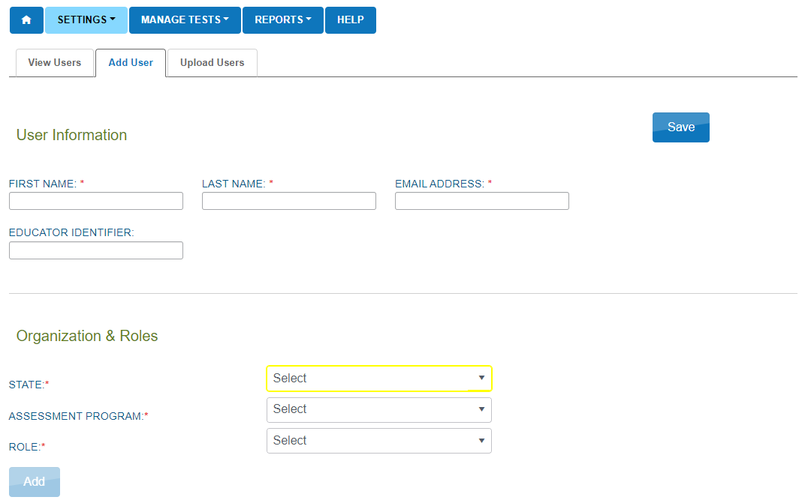
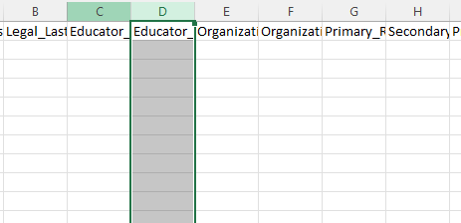
Setting up Users​
There are two methods for creating user accounts in Educator Portal
UI Manual Creation
User Upload

Slide 10
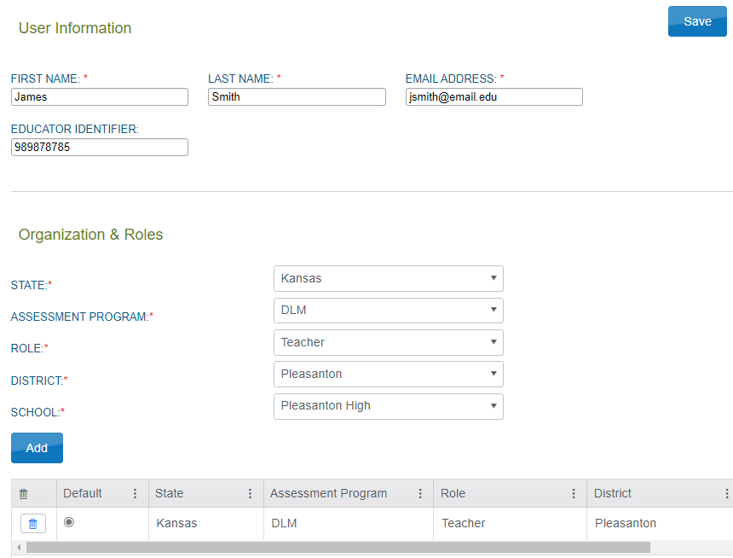
Setting up Users – UI Manual Creation
Settings Users Add User
Fill out all required fields under User Information (Including Educator Identifier if creating a Teacher account)
Use the dropdowns to add the desired role to the user's account at the correct organization
Click Add.
Verify that all information is showing correctly under User Information and table of roles
Click Save
Best when adding small (four or fewer) quantities of users
5
2
3
4

Slide 11
Setting up Users – User Upload
Settings Users Upload Users
Complete csv template* with user information for the accounts being created/modified
Upload template by clicking "Select File" then choosing your file
Click Upload
Look for Complete status
If any errors, open error csv, correct issues then reupload
*New template can be acquired by clicking on blue '?' Next to 'File:'
Multiple users can be added/modified with a single CSV upload. Best when adding ten or more users
3
4
5
6
Example of upload error message:

Slide 12
Data Setup- Student Enrollment

Slide 13
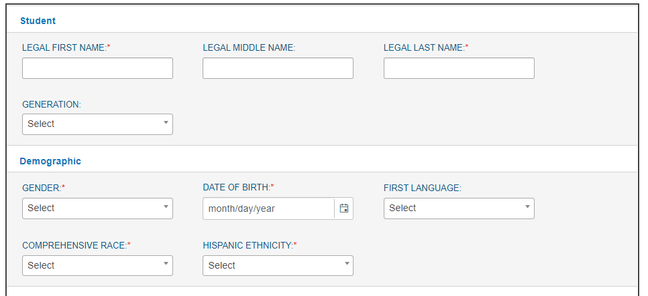
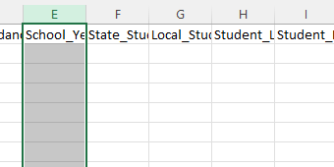
Enrollment Options
There are two methods to enroll students in Educator Portal
Student Enrollment is being handled at the District level
UI Manual Enrollment
Upload Students

Slide 14
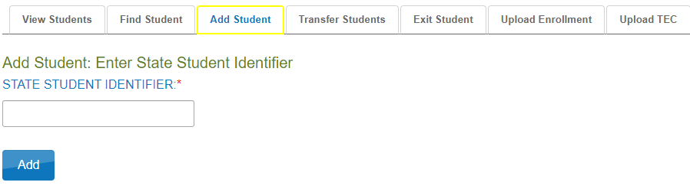
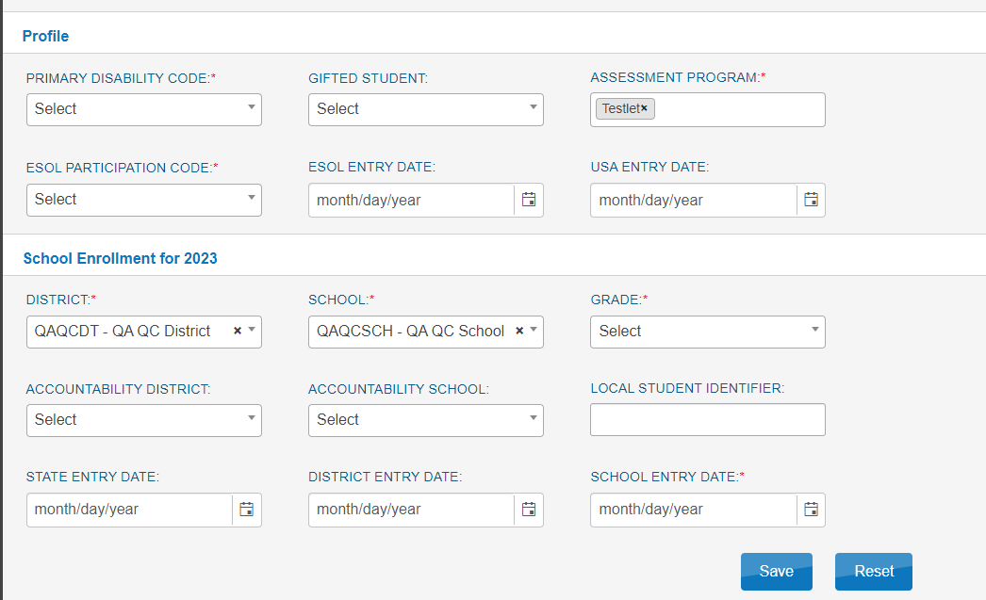
Manually Enroll Students
1
Settings Students Add Student
Enter state student ID number then click Add
If the student is already enrolled for the school year, an error message will display
Fill out fields with student information
Required fields denoted with red asterisk (*)
Click Save
Once the student has been added, student login information will automatically be created.
Best when enrolling small (four or fewer) quantities of students.
2
3
4

Slide 15
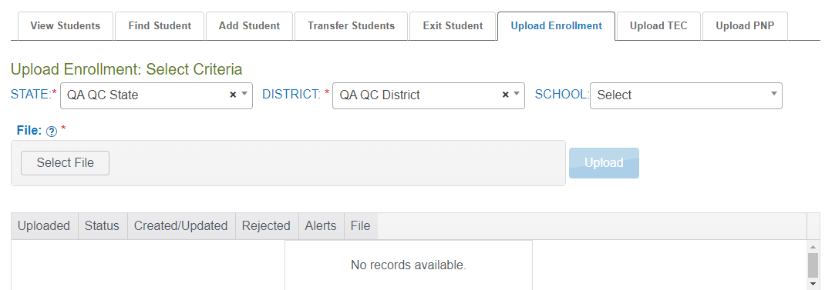
Upload Students
Multiple students can be enrolled simultaneously using a CSV upload
Provides an error file with verbose and clear explanations and recommendations

Slide 16
Manage Student Data
Updating Data
Student demographics such as name, date of birth, and school entry date can be updated at anytime
Can be edited either manually through the UI or the Enrollment Upload process using the State Student ID as the connecting factor
Students can also be transferred to a different organization within the district by the district test coordinator, or a different district by the Kite Service Desk.

Slide 17
Data Setup
Data Setup -Rosters

Slide 18
Roster Overview
Functions of Rostering
Tests are generated using the roster data.
Rosters determine which subjects should be generated for the student
Allows Teachers to access student data such as login information and Personal Needs and Preferences Accommodations
Student
Math Roster
Math Teacher Connection

Slide 19
Roster Creation- Manual
Manual Creation – User Interface on Web
Only one Teacher can be associated with a given roster
Only one Subject can be associated to a given roster
Identifiable
Name
Tested Subject
Specific Location

Slide 20
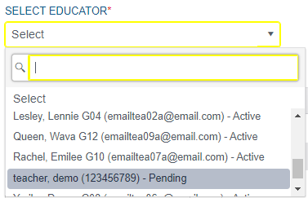
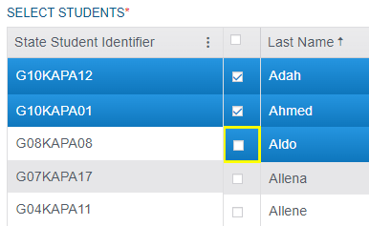
Roster Creation- Manual
Manual Creation – User Interface on Web
Select a Teacher using Dropdown
Select Student using checkbox

Slide 21
Roster Creation- CSV Upload
CSV Upload
Advantages
Allows upload of multiple rosters, simultaneously
Allows verbose explanations of errors in uploads for corrections

Slide 22
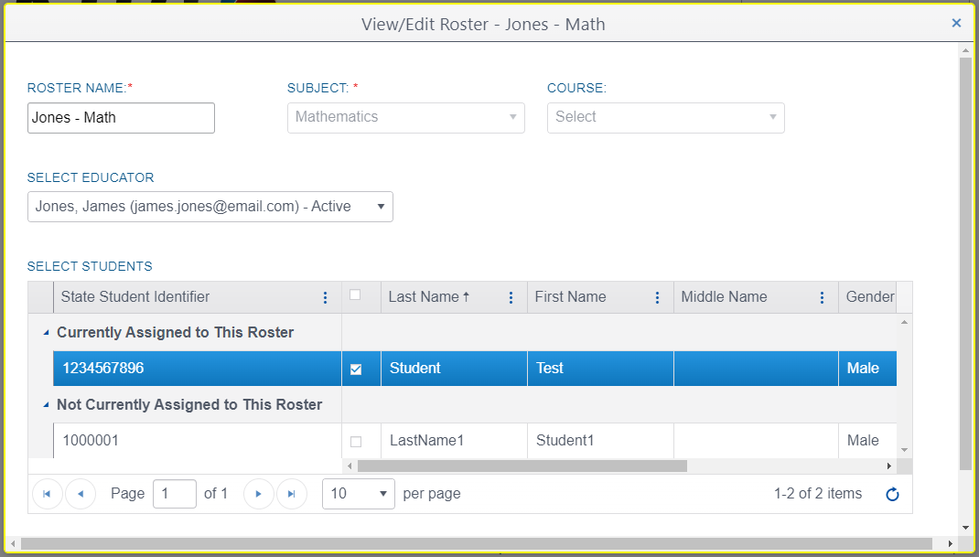
Roster Management
Editing Rosters
Settings > View Roster > Select a Roster
Fast Educator swapping as needed.
Adding/Removal of students individually
Modifying the Roster Subject and Name
You cannot modify the subject or name. A new roster needs to be created
Removing Rosters
Remove/Uncheck all students, Click save, roster disappears

Slide 23
Kite Student Portal

Slide 24
Student Portal Training Link/Logins
Link:
https://student-testlet.kiteaai.org/TDE/logIn.htm
Practice Login:
Username: tech.demo
Password: MAZE8

Slide 25
Any Questions?

Slide 26
Contact
Kite Service Desk
855-277-9752 7:00 a.m. – 5:00 p.m. Central
Kite-support@ku.edu

