Slide 1
PRESENTED BY ATS
2022-23 Test Administration Training
Presenters:
Brad Hansen – Service Desk Lead
Charles Turner – Service Desk
Joseph Kenney – Service Desk
Katherine Kocen – Service Desk

Slide 2
Our Agenda
Kite Educator Portal
User Account Management
Setting Student Accommodations
Roster Management
Retrieving Student Logins and Daily Access Codes
Monitor Test Sessions
Kite Student Portal Navigation

Slide 3
Kite Educator Portal

Slide 4
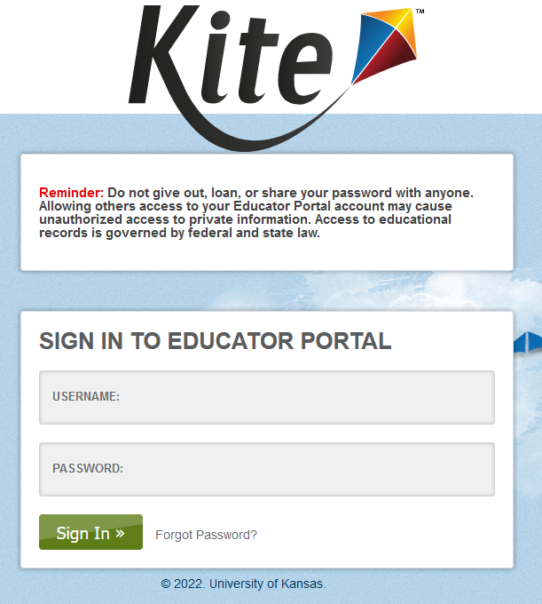
Introduction to Educator Portal
Logging In
Landing Page
Navigation
Announcements

Slide 5
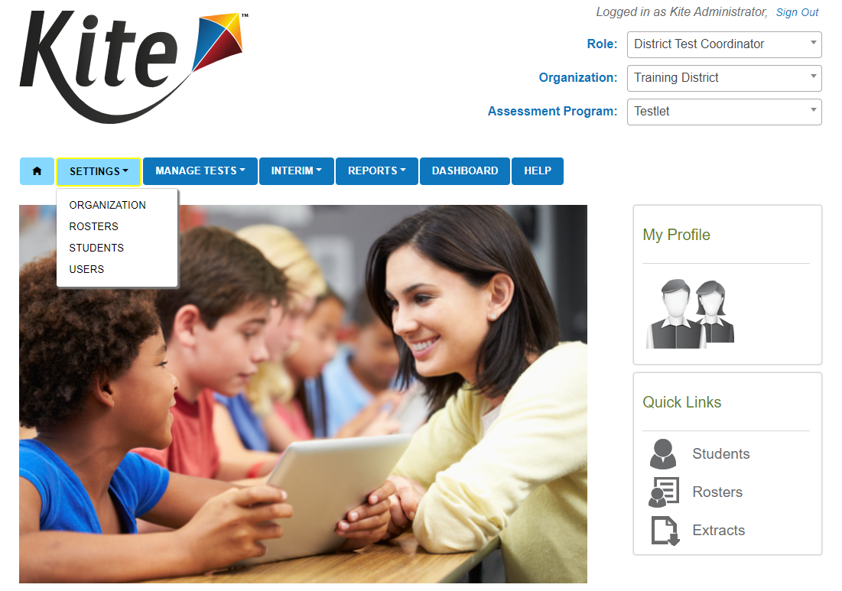
Navigation
Settings Tab
Organization
View the organizations listed in your district
Rosters
Manage rosters
Students
Manage student data
Users
Manage User data

Slide 6
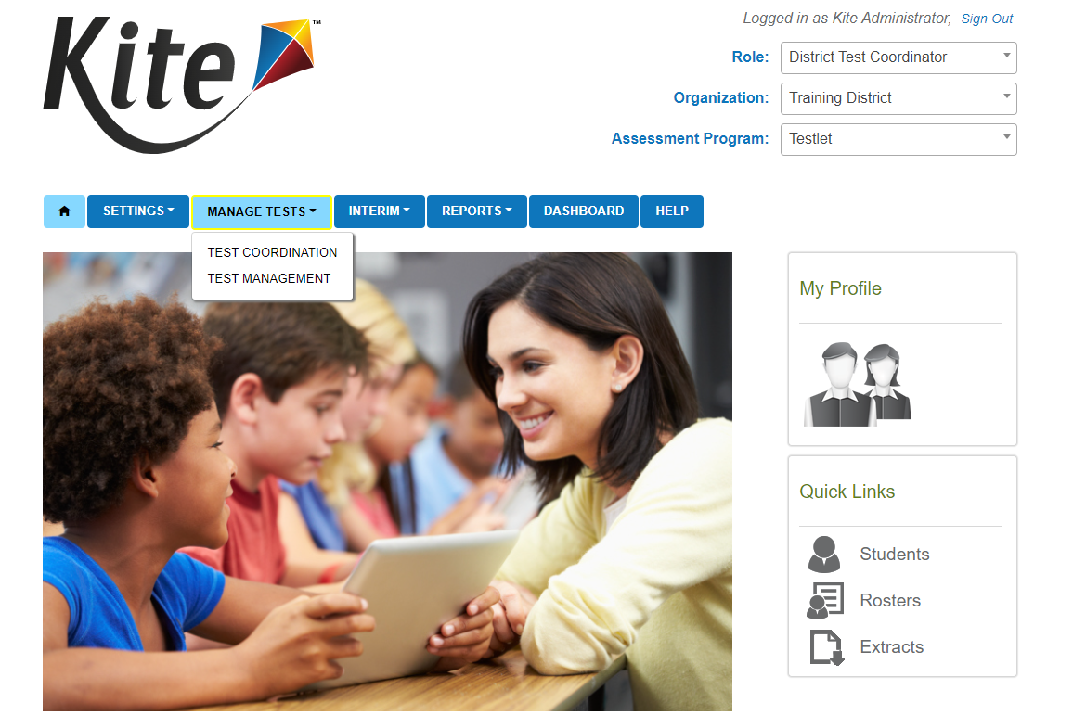
Navigation
Manage Test tab
Test Coordination
View Daily Access Codes
Test Management
Not used for the Testlet Program

Slide 7
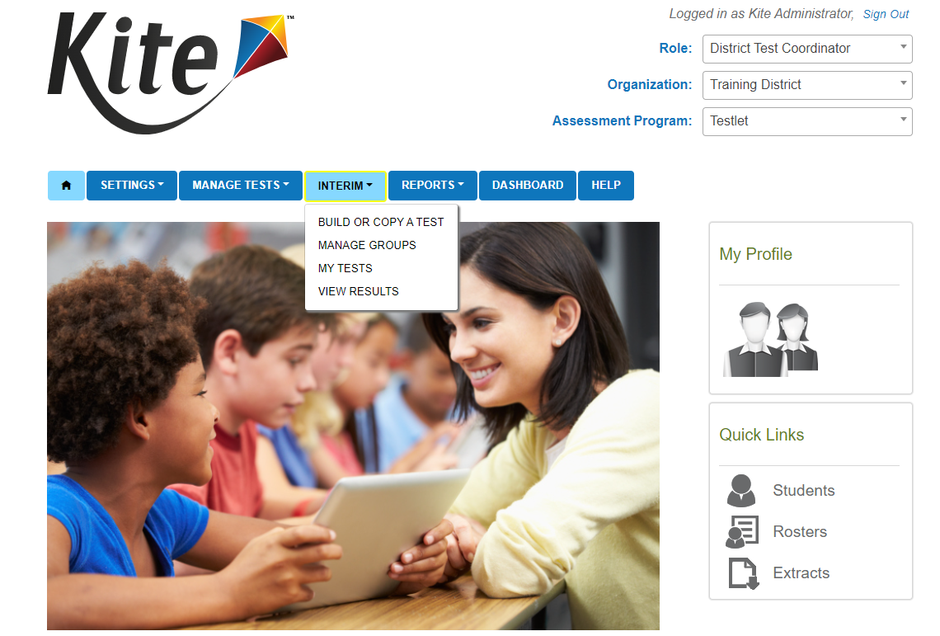
Navigation cont.
Interim Tab
Build or Copy Test
Not used for the Testlet program
Manage Groups
Not used for the Testlet program
My Tests
Assign tests - Not used for the Testlet program
Manage tests
View Results
Not used for the Testlet program

Slide 8
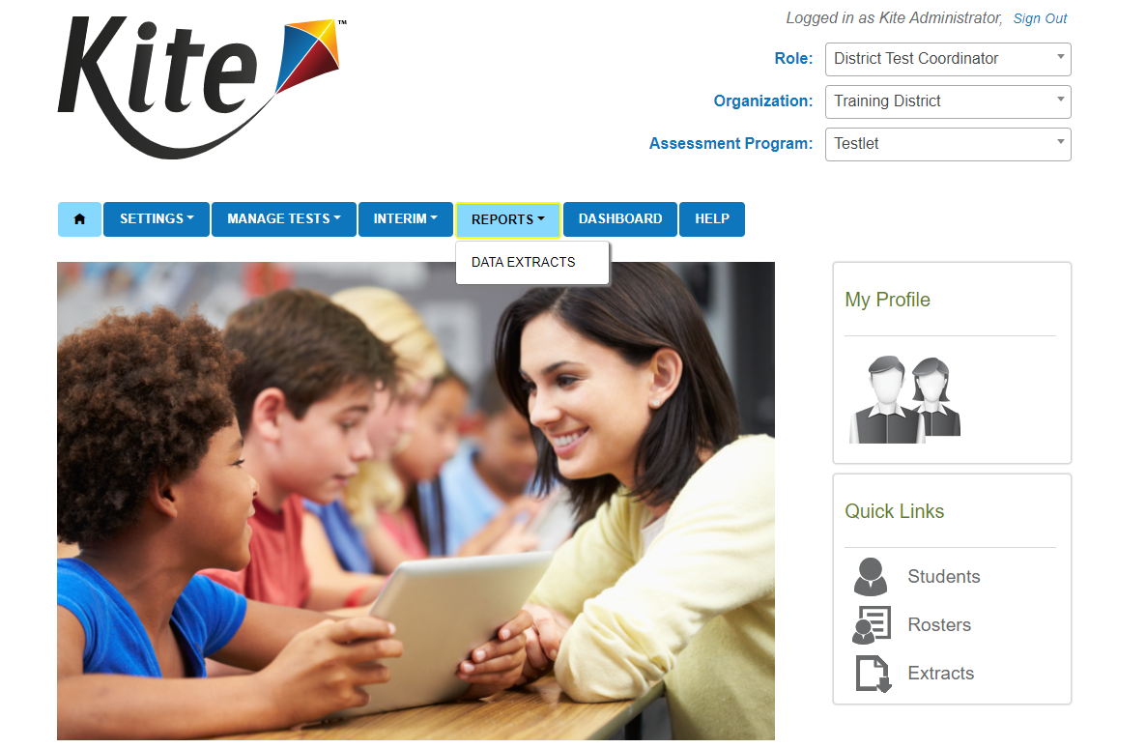
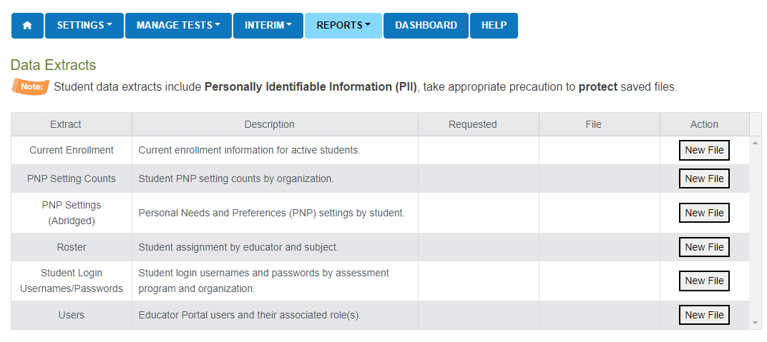
Navigation cont.
Reports Tab
Data Extracts – pull extracts for data management and student logins
Current Enrollment
PNP Setting Counts
PNP Settings (Abridged)
Roster
Student Login Usernames/Passwords
Users

Slide 9
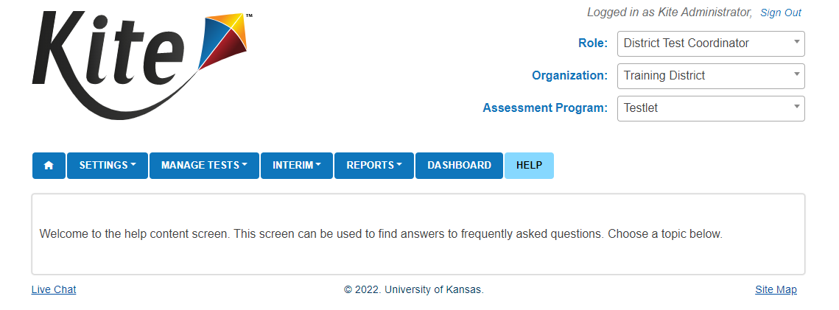
Navigation cont.
Help Tab
Provides FAQs and other helpful information

Slide 10
Setting Student Accommodations

Slide 11
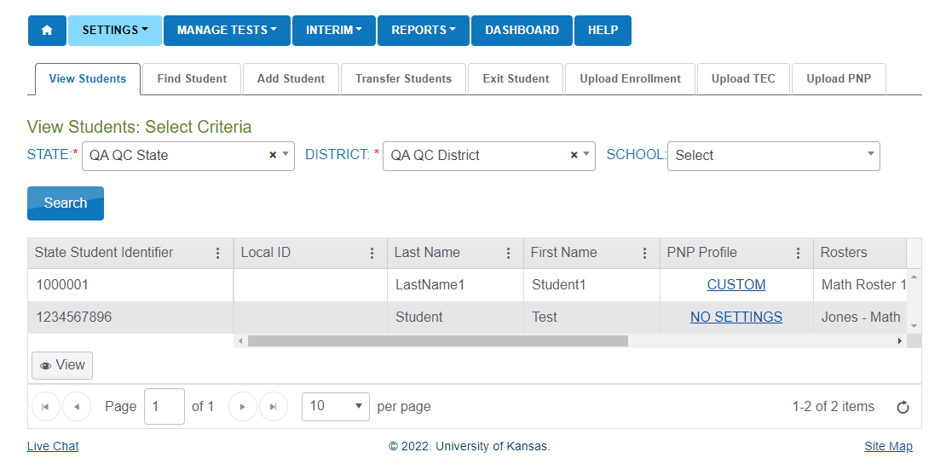
Setting Up Student Accommodations (PNP)
Test Assignment Impact
Accommodations such as Text to Speech and Spanish-language forms (Keyword Translation Display) require different tests be assigned to the student
Overnight Process
Settings > Students > View Students
Select the Organization and enter Search
Statuses
No Settings – Nothing has been set
Custom – Student has accommodations set

Slide 12
Setting Up PNPs Cont.
Find the student you need
Click on the status link under the PNP Profile Column
View the Summary page to see what has been set

Slide 13
Setting Up PNPs Cont.
Review options available and briefly discuss them
Make selections
Save Settings

Slide 14
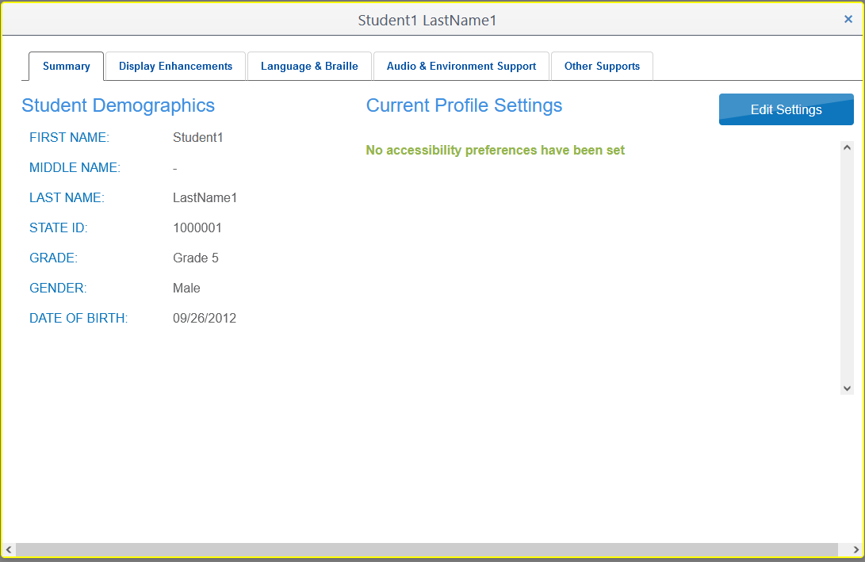
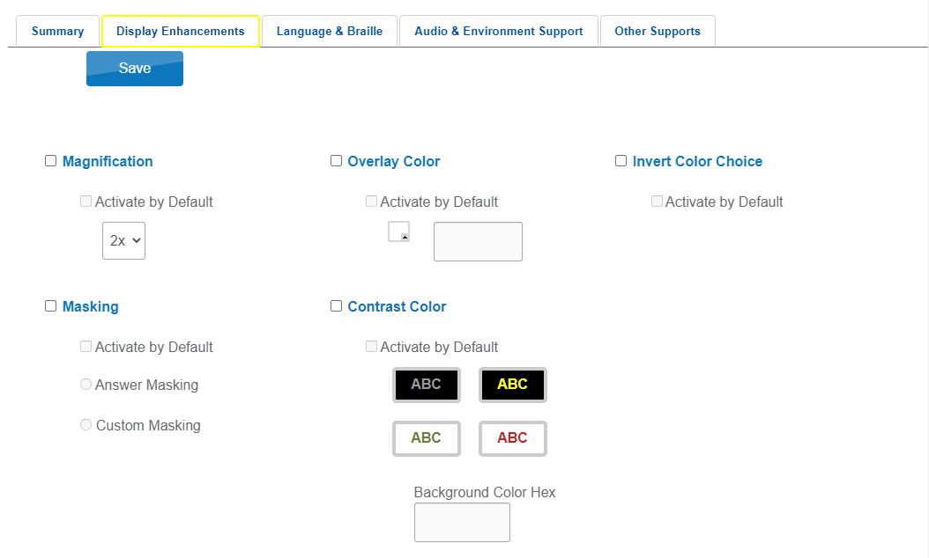
Setting Up PNPs Cont.

Slide 15
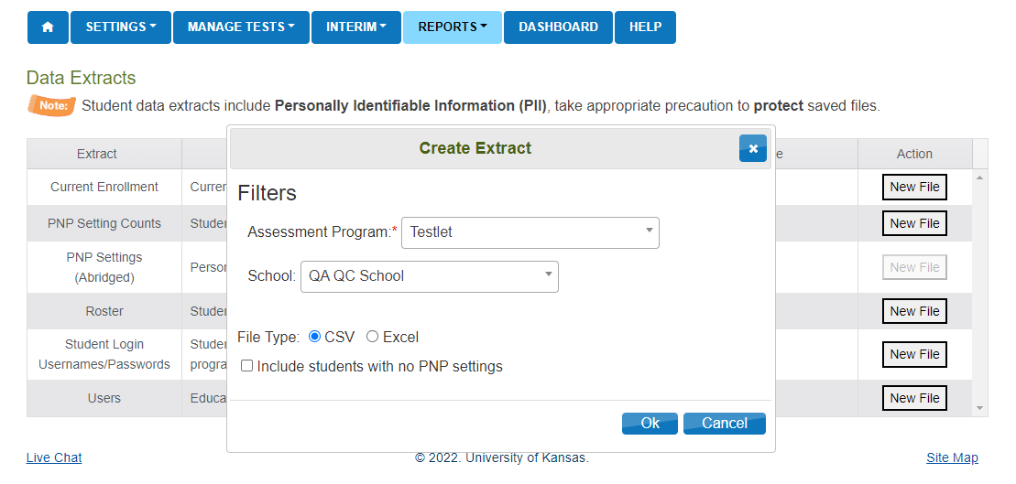
Setting Up PNPs Cont.
PNP Upload Option
Reports > Data Extracts > PNP Settings(Abridged)> Click New File
Select drop downs as needed
Use Excel. This provides the accepted options via drop downs in the file instead of referencing the manual
Select "Include students with no PNP settings"
This shows all students so you can make selections needed for students who did not previously have settings

Slide 16
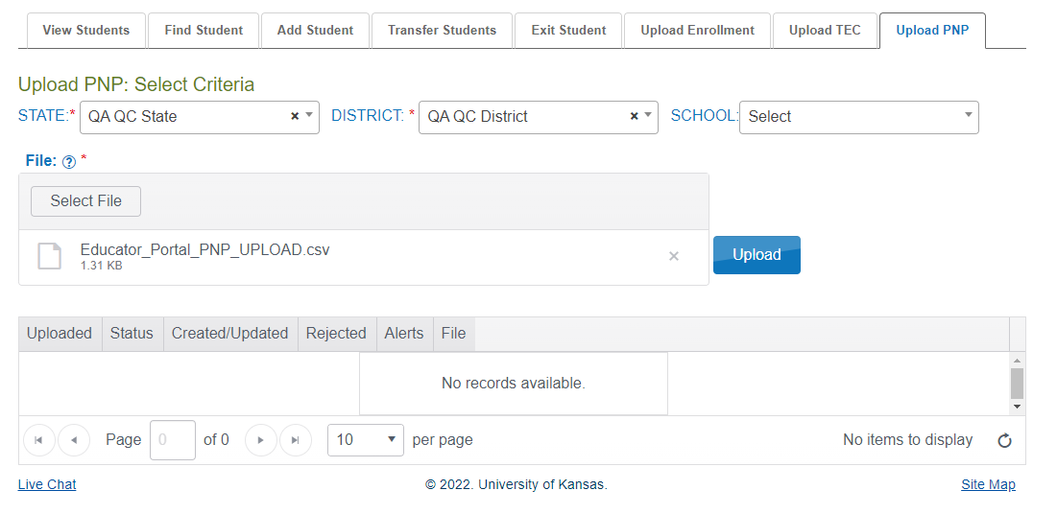
Setting Up PNPs Cont.
PNP Upload Option
Edit the CSV file to include the needed PNP settings
Save the file in the CSV format
Once saved it is ready to be uploaded
Setting > Students > Upload PNP
Click "Select File"
Locate the file that had been edited and saved as a CSV and click open
Click Upload
The file will go in pending and then change to complete once finished. The table will state how many were created and if any were rejected.

Slide 17
Retrieving Student Logins and Daily Access Codes

Slide 18
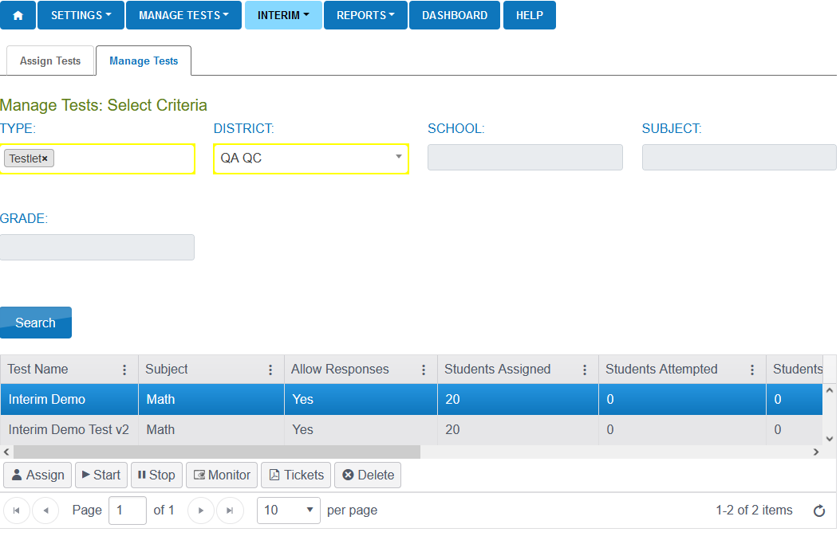
Retrieving Student Logins
Interim
My Tests > Manage Tests
Select the row
Click on the Tickets button
*not used for testlets

Slide 19
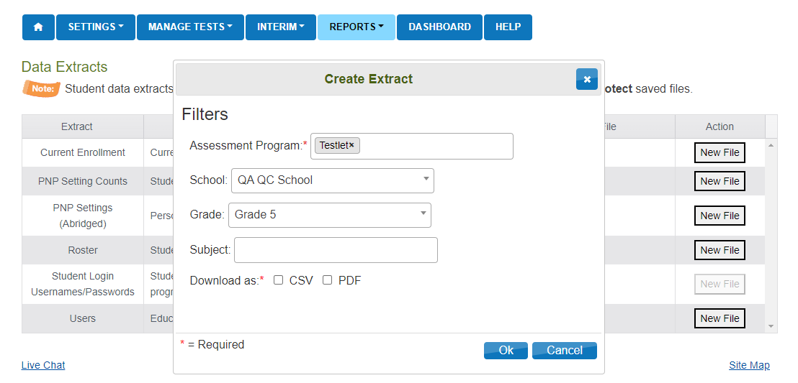
Retrieving Student Logins cont.
Extracts
Reports > Data Extracts > Student Login Username/Passwords
Select New File
Select Dropdowns and file type
Can be downloaded as a .csv or .pdf file

Slide 20
Daily Access Codes
Daily Access Codes (DAC) are alphanumeric values generated in Educator Portal.
The DAC offer an added level of security and is another way to ensure that students are accessing the correct test.
Students would use their login usernames and passwords and the DAC to gain access to the Testlets in Student Portal.
Each grade will have a different DAC.
Each day the DAC will change.
They are available at 2:30 PM central time for the following testing day.

Slide 21
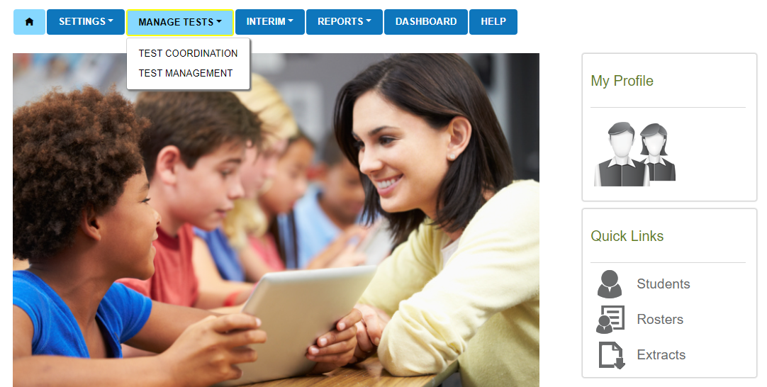
Daily Access Codes
Manage Tests > Test Coordination

Slide 22
Daily Access Codes
Select the View Daily Access Codes tab
Assessment Program will auto populate and select the Test Day from the drop down
This will generate a table with PDF documents with the DAC for each grade
The PDF documents can be downloaded and printed

Slide 23
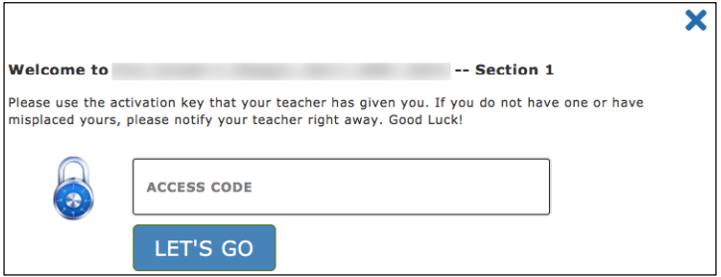
Daily Access Codes Cont.
Students will first log into Kite Student Portal with their username and password
Select Take a Test
Select the Testlet that they are taking
The Student will then get a screen to enter the DAC
Then click Let's Go
The student then has access to the test and is brought to the directions screen

Slide 24
Monitor Test Sessions

Slide 25
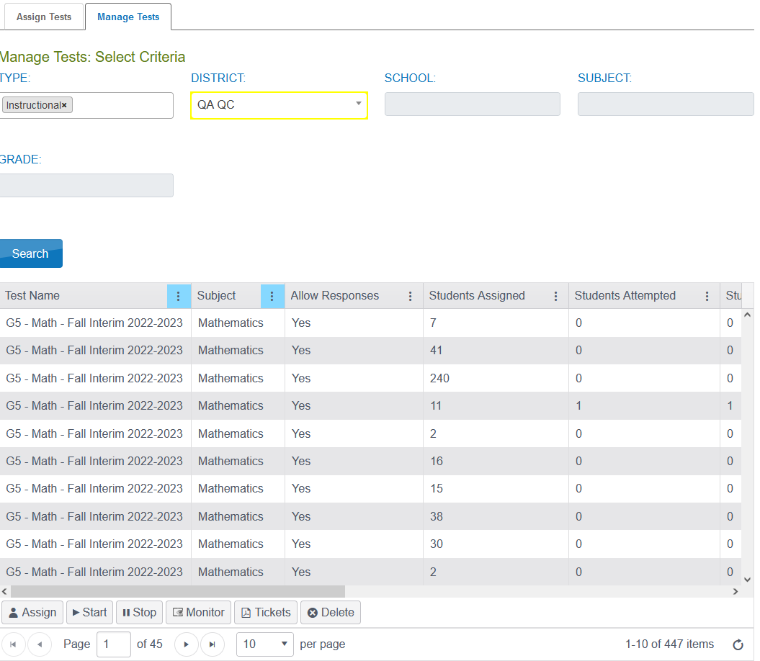
Monitoring Test Sessions
Interim Tab
My Tests > Manage Tests
Select the section to monitor
Click on the Monitor button
*not used for testlets

Slide 26
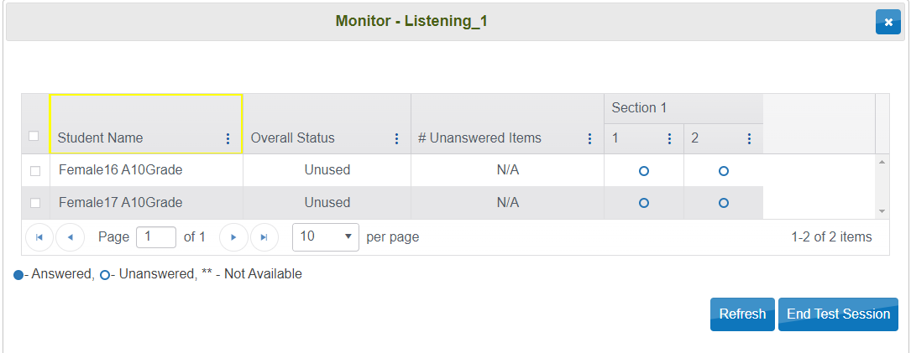
Monitoring Test Sessions Cont.
Understanding the Monitoring screen
Student Name
Lists every student who are assigned to the selected test
Overall Status of the session
Quickly view who hasn’t started, who are currently in the test, and who have completed the test

Slide 27
Monitoring Test Sessions Cont.
Number of unanswered questions
Answer legend
If there are any unanswered items, test administrators can see which specific item has not yet been answered for individual students.
Many test administrators will have the students wait to submit the test until they can confirm everything is answered.

Slide 28
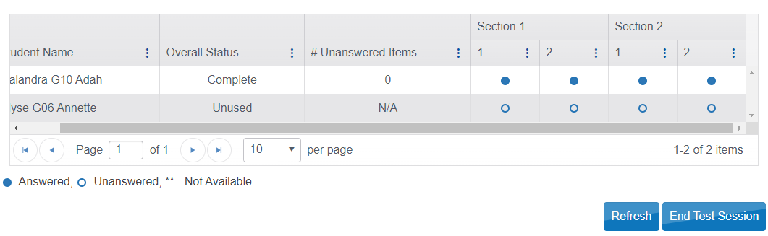
Monitoring Test Sessions Cont.

Slide 29
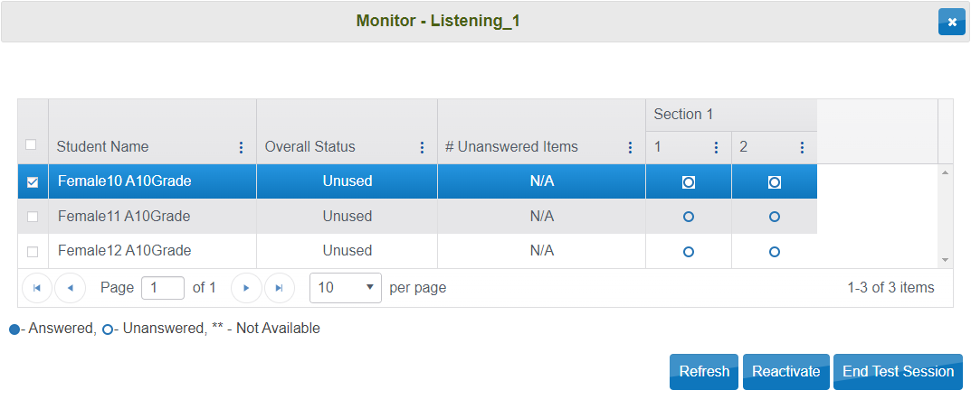
Monitoring Test Sessions Cont.
Different Questions and sections
Indicates the number of questions and the different sections the test may contain
End Test Session
Proctors can manually end the test session for students by clicking on the End Test session button.
Test Sessions can be ended for just 1 student, multiple students, or all students assigned to the test.
Reactivate Test Session
Please contact the Service Desk for Reactivation

Slide 30
Kite Student Portal Navigation

Slide 31
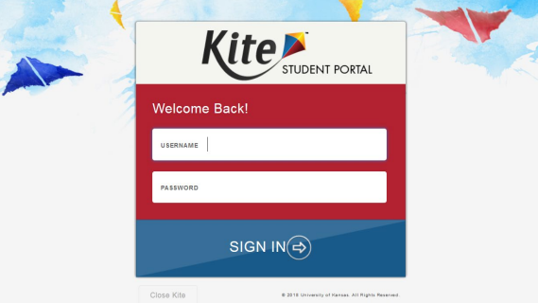
Introduction to Student Portal
Student Portal Login
Enter Username
Enter Password
Sign In

Slide 32
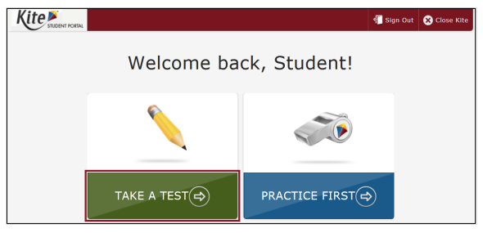
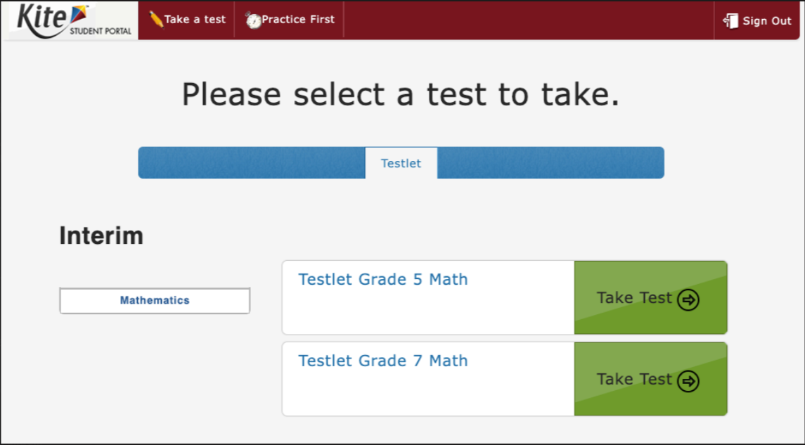
Student Portal Navigation
Student Portal landing page​
Take a Test​
Practice First​
Sign out​
Close Kite​

Slide 33
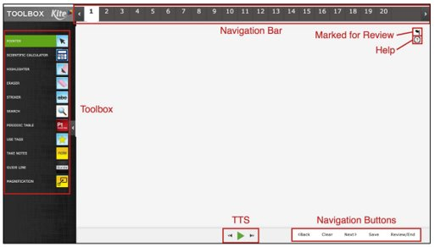
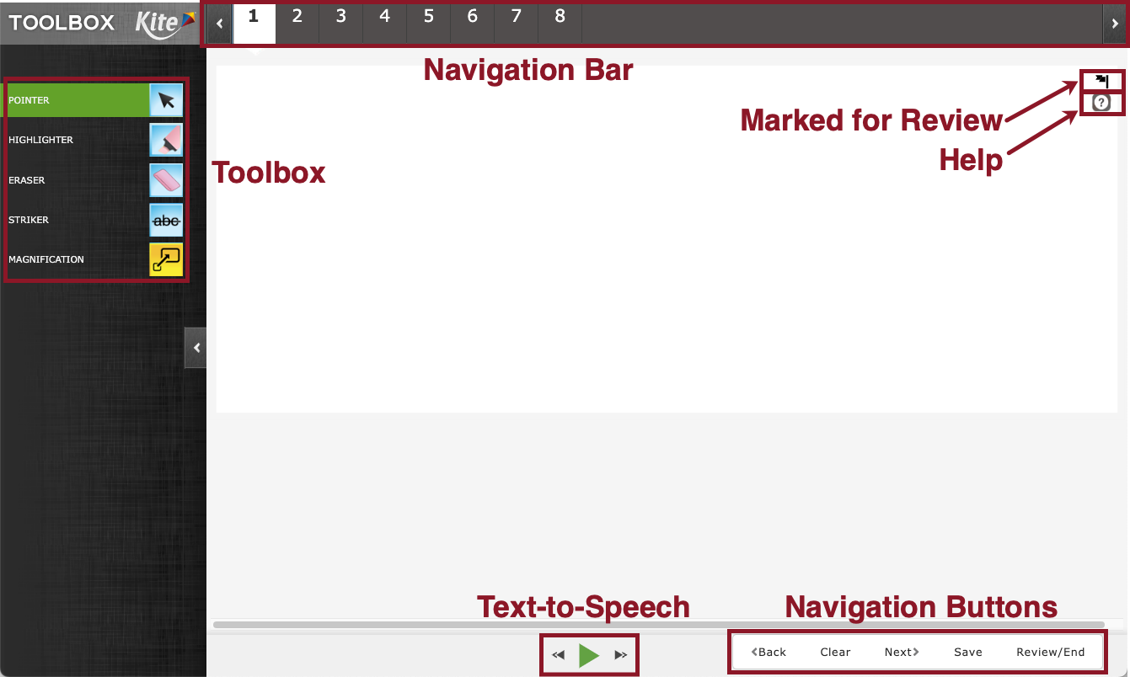
Student Portal Navigation
Test Features and functionality
Toolbox
TTS (Text to Speech)
Help Icon
Flag Questions
Test Navigation
Click on the “Back” and "Next” buttons
Can also choose specific questions with the numbers along the top
Clear will clear the answer that was selected
Save will save the Testlet to be continued later

Slide 34
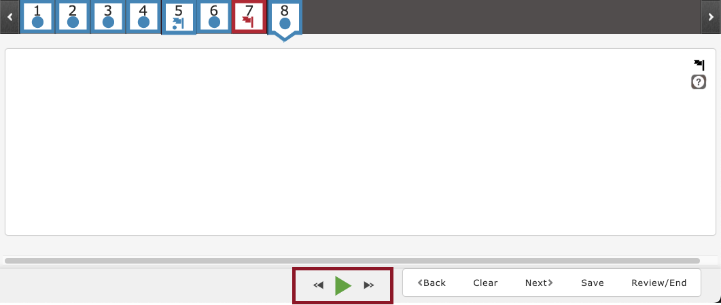
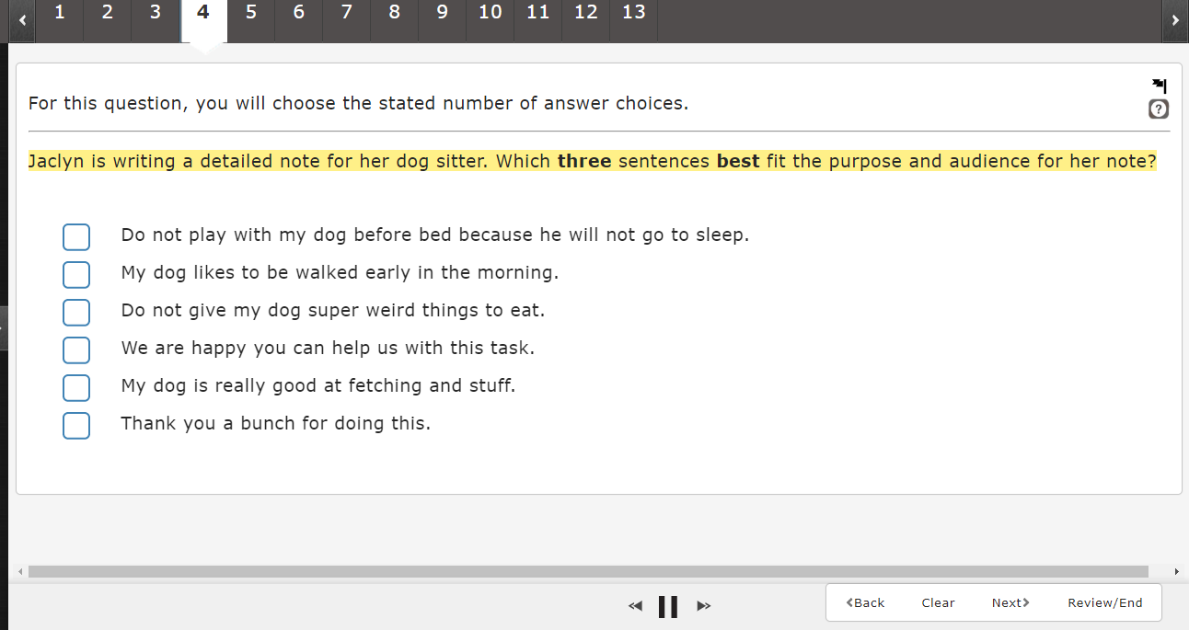
Student Portal Navigation Cont.
TTS (Text to Speech)
Student can select the play button to start the TTS and the pause button to stop the TTS.
The next and back buttons on either side of the play will advance the TTS to the next section of the question.
As the text is read it is highlighted yellow.
Note: Screenshot from practice test.

Slide 35
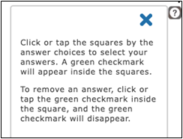
Student Portal Navigation Cont.
Help button
Displays additional information about how to manipulate and respond to the particular question type.
Does not cover content.
Close the help box with the X to continue answering the question.

Slide 36
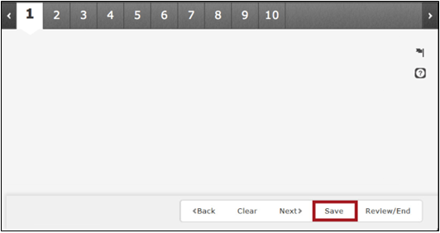
Student Portal Navigation Cont.
Save button
The save button will save the Testlet and all of the work that has been completed
After clicking save the student will receive a pop up to confirm that they are saving the Testlet and not submitting

Slide 37
Student Portal Navigation Cont.
Blue dot: question has been answered
Red box: questions has not been answered
Blue dot and blue flag: question has been answered and has been marked for review
Red flag: question has not been answered and has been marked for review

Slide 38
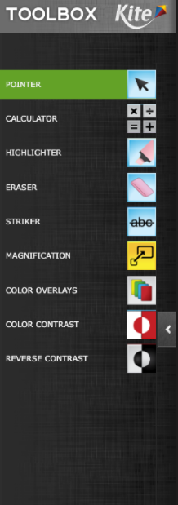
Tool Box
Pointer
Calculator (Grade 7 Math)
Basic
Notes
Highlighter
Eraser
Striker
Magnification
Masking
Color Overlays
Color Contrast
Reverse Contrast

Slide 39
Tool Box Cont.
Pointer
The Pointer tool is the tool that the students will use most.
This tools allows a student to select items and click to answer questions

Slide 40
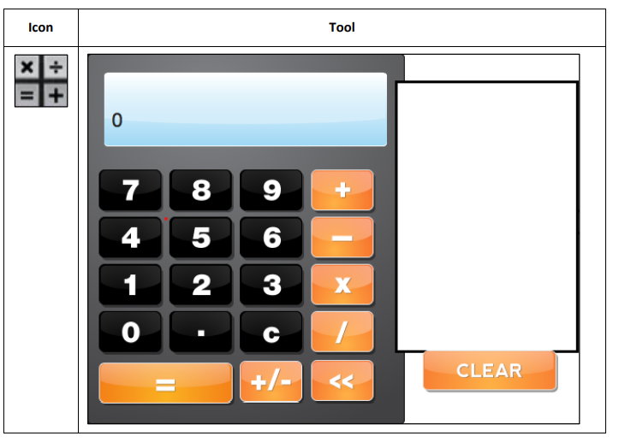
Tool Box Cont.
Basic Calculator
Available for Grade 7 Math
The basic calculator tool allows students to perform simple mathematical calculations

Slide 41
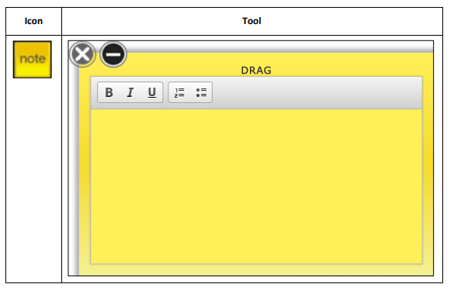
Tool Box Cont.
Notes
The notes tool allows students to make notes about an assessment question.
Student notes are not saved after ending the test.
The student can delete a note by clicking the X in the top left corner.
Notes is available on the math testlets.

Slide 42
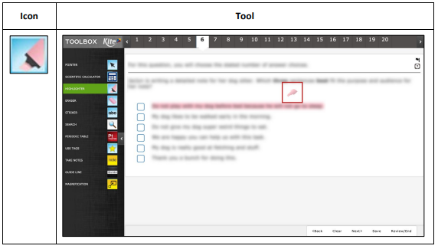
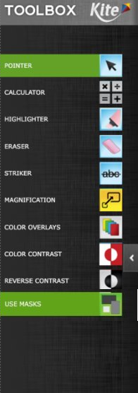
Tool Box Cont.
Highlighter
The highlighter tool allows a student to select and highlight text within the question.
The student can drag the highlight a word or area.
This tool changes the cursor to a pink highlighter.

Slide 43
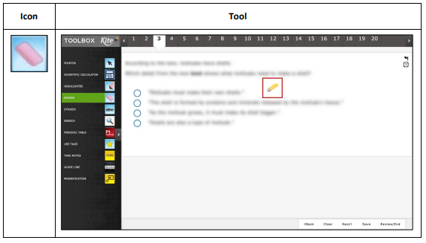
Tool Box Cont.
Eraser
The eraser tool allows the student to remove highlighter and strikethrough effects from the selected text.
To switch off from using the eraser, click the eraser icon or the pointer tool.
This tool changes the cursor from an arrow or marker to pencil.

Slide 44
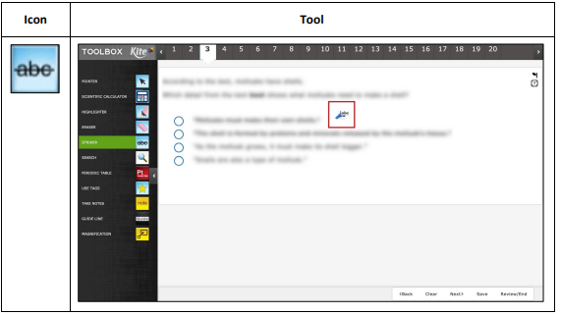
Tool Box Cont.
Striker
The striker tool allows a student to select a multiple choice or muti select answer choice and mark a line through the middle of the text to cross it out.
The striker tool changes the cursor from an arrow to a blue marker.

Slide 45
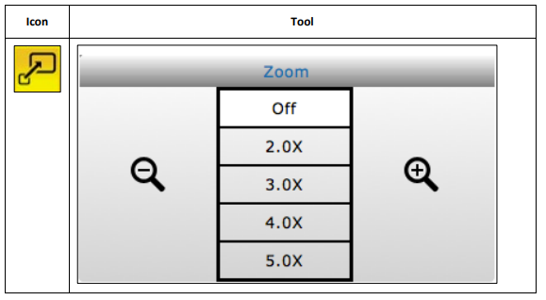
Tool Box Cont.
Magnification
The magnification tool allows a student to enlarge the screen during the test.
Students can click on a magnification level or use the magnifying glass to zoom in and out.

Slide 46
Tool Box Cont.
Color Overlay
The color overlay tool allows a student to change the background color of the test.
The standard background color is white.

Slide 47
Tool Box Cont.
Color Contrast
The color contrast tool allows a student to change the color of the assessment font and the background color.
The upper (left) portion of the circle indicates the text color and the lower (right) portion of the circle indicated background color.

Slide 48
Tool Box Cont.
Reverse Contrast
The reverse contrast tool allows a student to change the assessment back ground to black and the text to white.

Slide 49
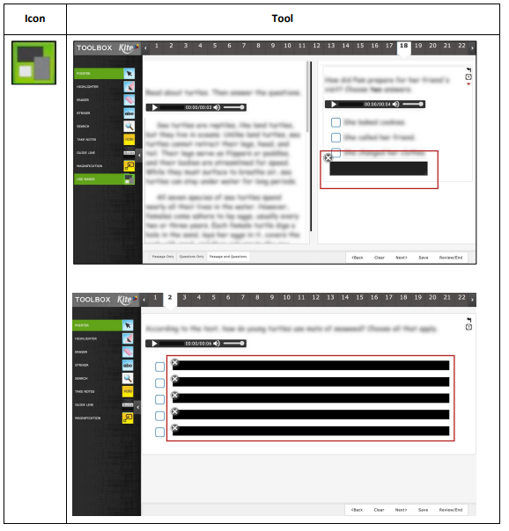
Tool Box Cont.
Masking
The masking tool allows a student to mask, or cover part of the test.
After a student clicks the making button, a black box appears on the screen and the student can move the masking box by dragging it to different areas of the screen.

Slide 50
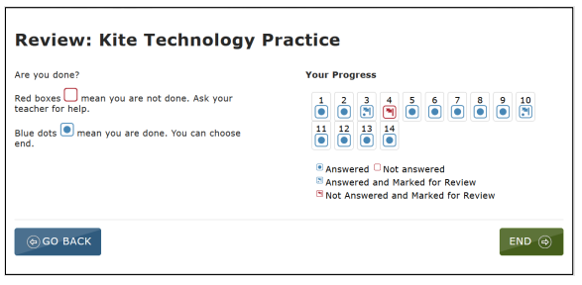
Student Portal Navigation
Ending Test Session
Review and End Page
Answered vs Unanswered
Flagged Items
Once students have reviewed their answers, they will click on the "End" button
Confirm screen to end the session
Taken back to the landing page

Slide 51
Student Portal Navigation Cont.
Log out and closing of Student Portal.
Varies depending on the testing platform
PC, Macs, iPads
Once the test session has been ended, select and then the button or just click the Sign Out button
Chromebook
Reboot the device

Slide 52
Student Portal Navigation Cont.
Test Interruptions
Internet connection issues
Should the internet connection drop during testing, progress will automatically be saved.
Student Portal may lock up if it detects no internet connection and the device might need to be restarted.
Testing can resume once a connection has been re-established.

Slide 53
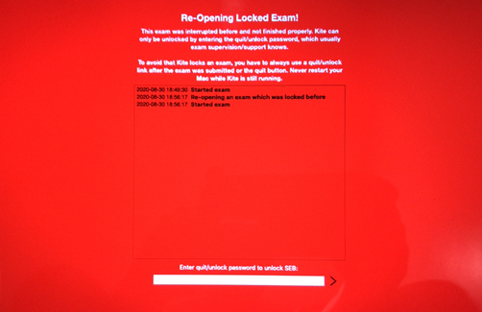
Student Portal Navigation Cont.
Quit Password
If Student Portal is not closed out properly, or if there is no internet connection upon launching the application, users might encounter a screen asking for a Quit Password to unlock the device.
Users with an account in Educator Portal will need to contact the Kite Service Desk in order to obtain the password.

Slide 54
Any Questions?

Slide 55
Contact
Kite Service Desk
855-277-9752 7:00 a.m. – 5:00 p.m. Central
Kite-support@ku.edu

