Slide 1
LEAP 360: Accessing K-2 Formative Tasks

Slide 2
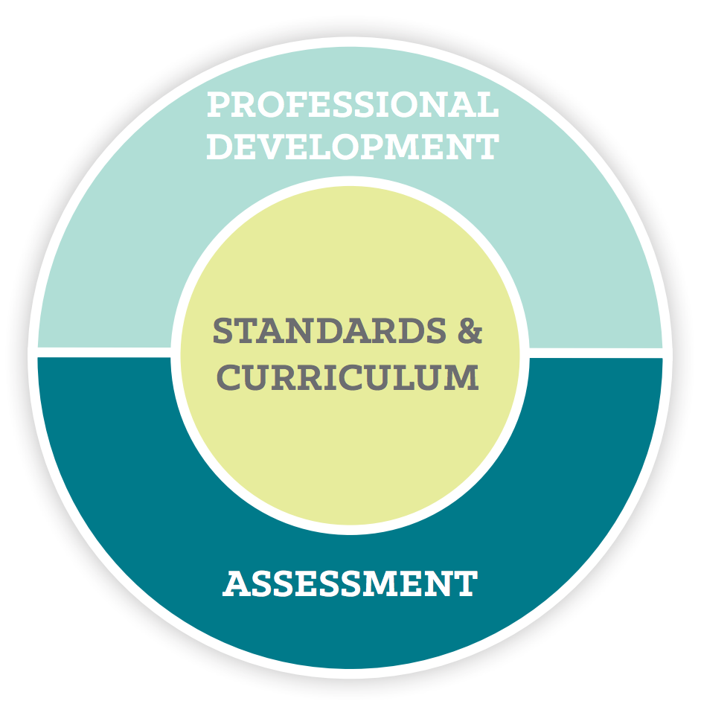
Louisiana’s Approach
Louisiana believes access to the highest quality education allows all students, no matter their zip code, the opportunity for success.
Implementing a high-quality curriculum based on rigorous standards is one of the fastest ways to give this access to all students.
The curriculum must also be connected to standards-aligned assessments and professional development.

Slide 3
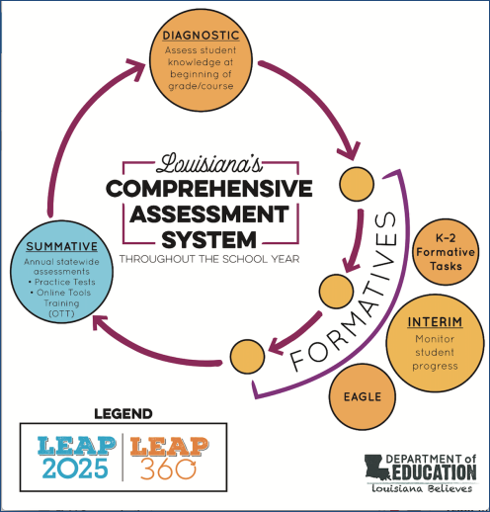
Overview of LEAP 360
There are three main purposes for classroom assessment:
Know where students are when they enter a classroom
Monitor how students are learning content over the year
Verify what students have learned
LEAP 360 pairs with LEAP 2025 to reduce overall testing time while realizing all three purposes.

Slide 4
Overview of LEAP 360
The goal of LEAP 360 is to deliver streamlined, high-quality assessments in a comprehensive system for classrooms, schools, and districts.
What is the impact on teachers, principals, and districts?
Teachers will have a more complete picture of student performance.
Principals will identify throughout the system where additional support is needed to focus on the learning that matters most for students.
Districts will reduce overall local testing while helping to monitor progress toward district goals.

Slide 5
Overview of LEAP 360
LEAP 360 is a formative assessment tool designed to help teachers, schools, and school systems monitor student learning and adjust instructional support. In addition, LEAP 360 offers school systems the opportunity to streamline testing and maximize instructional time.
LEAP 360 non-summative tools include the following components:
EAGLE: allows teachers to integrate high-quality questions into day-to-day classroom experiences and curricula
K-2 formative assessments: provide quality tasks focused on critical student skills in ELA and math
Diagnostic assessments: determine student readiness for new course work and assist teachers in setting meaningful and ambitious goals
Interim assessments: evaluate student learning and monitor progress toward year-end goals and allow teachers to target and adjust instruction throughout the year

Slide 6
Today’s Goals
At the end of this presentation, participants will understand how to:
Access the K-2 Formative Tasks
View and sort K-2 Formative Tasks resources

Slide 7
Accessing K-2 Formative Tasks

Slide 8
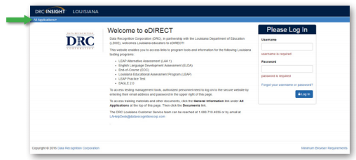
Accessing K-2 Formative Tasks
K-2 Formative Tasks users sign on to the system through the DRC eDIRECT system.
Use a web browser to navigate to the eDIRECT website at https://la.drcedirect.com. Log in with Username and Password.

Slide 9
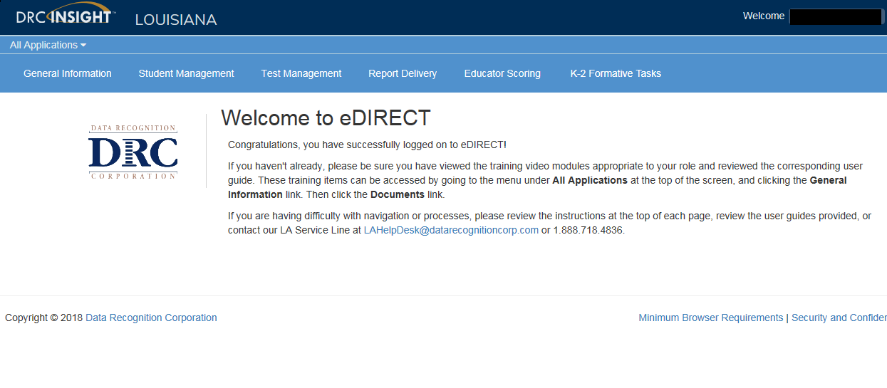
Accessing EAGLE 2.0
Once logged into eDIRECT, choose All Applications → K-2 Formative Tasks

Slide 10
K-2 Formative Tasks
From the K-2 Formative Tasks page, you can access the following resources:
Overview File
FAQ for ELA and Math
K-2 Formative Tasks
Additional Checklists

Slide 11
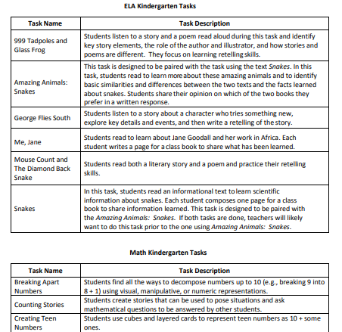
Overview File
The Overview File gives a description of each K-2 formative task and the skills each task assesses.

Slide 12
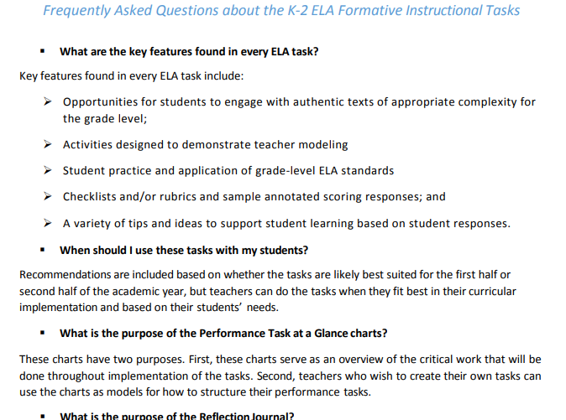
FAQ for ELA and Math
The FAQ addresses frequently asked questions about the purpose, key features, and implementation of the K-2 Formative Tasks.

Slide 13
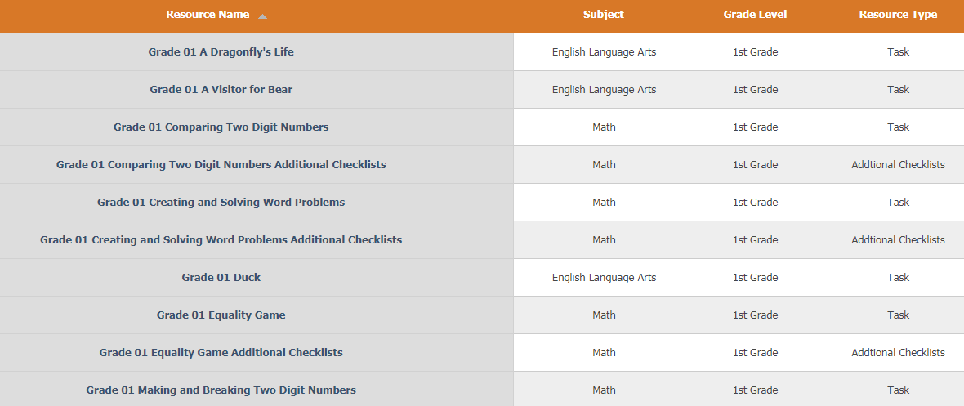
K-2 Formative Tasks
All K-2 formative tasks are listed. They can be sorted by:
Resource Name
Subject
Grade Level
Resource Type

Slide 14
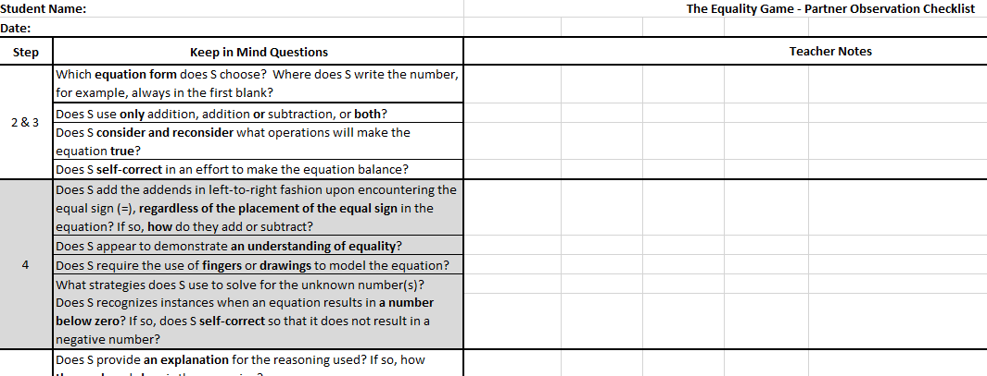
Additional Checklists
Additional checklists are available in excel format. These checklists provide guidance for teachers during observation of task completion. Checklists provide key questions and space for notes. They should be used as tasks are being implemented in the classroom.

Slide 15
Support

Slide 16
User Guides
The following user guides are posted in eDIRECT under General Information:
eDIRECT User Guide
Technology User Guide
EAGLE 2.0 User Guide

Slide 17
LEAP 360 Assessments: Resources
The following resources are available to help teachers understand, access, and use the the LEAP 360 assessment tools:
LEAP 360 site
A Teacher’s Guide to LEAP 360
A District’s Guide to LEAP 360
K-2 Formative Tasks: Overview
eDIRECT
Accessibility Features and Accommodations Overview
Teacher Study Guides (available in eDIRECT)
Webinars and Mini-trainings available on the LEAP 360 page

Slide 18
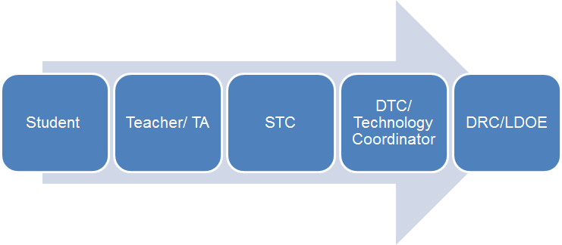
Technical Assistance Protocol
If technical problems occur, school and district staff should follow the protocol presented below.
DRC Louisiana Customer Service
1-888-718-4836 LAHelpDesk@datarecognitioncorp.com
LDOE
1-844-268-7320
assessment@la.gov

