Slide 1
Zoom Meeting Preparation
Please make sure your phone or computer is muted to minimize background noise.
To do this, hover over the bottom left-hand side of your screen and click “Mute.”
Please make sure you have turned off your camera to save bandwidth and prevent any connectivity issues.
To do this, hover over the bottom left-hand side of your screen and click “Stop Video.”
Please submit questions during the presentation in the “Chat” function located on the bottom of your screen. Your chat will only be viewed by hosts.
This presentation cannot be recorded by AI or any other function. Users who enable AI or other recording programs will be removed from the meeting.

Slide 2
AAA: LEAP Connect Administration Webinar
January 24, 2024

Slide 3
Webinar Objectives
At the end of this training, District Test Coordinators will
understand DTC, STC, and TA responsibilities for LEAP Connect administration to effectively communicate those responsibilities;
understand how LEAP Connect assessment administration materials may be used and handled securely by DTCs, STCs, and TAs to effectively train STCs in material usage and secure handling; and
understand how LEAP Connect scores are used in accountability and for graduation

Slide 4
LEAP Connect Overview
Designed for students with significant cognitive disabilities but capped at 1% for all states
Recognizes need for communication supports
Reduced passages
Pictures and graphics
Common geometric shapes
Models
Allows for one-on-one administration by teacher
Provides extended window for testing
Aligned to Louisiana Connectors which should be included on IEPs

Slide 5
DTC, STC and TA Responsibilities

Slide 6
Test Coordinator Responsibilities: Before Testing
Work with technology coordinator to prepare electronic devices for test delivery
Provide training for administration and test security
Assure that test administrators know accommodations and have made preparations for individual testing
Assure that all test administrators use the DIRECTIONS for TEST ADMINISTRATION (DTA) manual when administering the assessment.
Assure that all test administrators have made at least 80% on test administration quiz
Review LEAP Connect Test Administration Manual two weeks prior to training sessions
Sign and collect Pre-Administration Oaths of Security

Slide 7
Test Coordinator Responsibilities: During and After Testing
Receive and return materials that are shipped; request additional materials
Establish communication protocols before, during and after testing
Collect secure materials and store them securely at the end of each day
Sign and collect Post-administration Oaths of Security
Finalize plans for distribution of score reports to schools, school leaders and families upon release in May

Slide 8
Test Administrator Responsibilities: Before Testing
Review test administrator manual at least two weeks prior to testing
Review the following materials in a controlled setting with the STC, and securely store them after review until testing begins
Directions for Test Administration (DTA)
Reference materials for subject tests
Writing Stimuli
Become familiar with Student Tutorials and Online Tools Training (OTT)
Allow students to become familiar with Student Tutorials prior to OTT review
Administer Student Response Check if TA is unfamiliar with student’s mode of communication

Slide 9
Test Administrator Responsibilities: During and After Testing
Use the Directions for Test Administration (DTA) and follow all instructions outlined in the document
Work with STC to collect all test materials prior to testing
Maintain security of materials each day using established protocols

Slide 10
Graphic Files and Constructed Response Suggested Materials in DRC INSIGHT
LEAP Connect Graphics File: This file is available by grade and subject test in DRC INSIGHT.
Each graphics file includes the images from the reference materials in a format that allows TAs to print, enlarge, crop, and/or upload images to communication devices. All test material security protocols must be followed.
LEAP Connect Constructed Response Suggested Materials List: This list is available by grade and subject test in DRC INSIGHT.
Includes suggested materials that can be used by TAs when administering the constructed-response tasks.
Other materials, not listed, may be used as appropriate for individual tester engagement. TAs should determine materials based on individual needs of each tester.
To access these resources in DRC INSIGHT, go to My Applications/General Information/Documents/LEAP Connect Spring 2024/Document Type: Graphics

Slide 11
Selection of Test Forms
Grades 3 and 4 Only
Test sessions will need to be assigned for students in grades 3 and 4 who are verbal or nonverbal due to the Foundation Reading Items assessed in these grades.
When creating test sessions, under the Assessment dropdown, select either the verbal or nonverbal assessments to ensure the group of verbal or nonverbal students receive the correct form.
All ELA, Math, and Science tests at all grades.
For all grades and subjects, students will be automatically assigned a specific test form prior to testing.
Once a student is added to a test session in DRC INSIGHT, the school test coordinator can use “Export Details” to export a list of all students in the test session, along with form assignments. It is important to communicate the form assignments to TAs prior to preparation of materials for testing.

Slide 12
Test Security
All test security policy applies to LEAP Connect.
All personnel involved with testing must be trained.
DTCs train STCs
STCs train school personnel involved with testing
Test materials must be kept in a secure, locked area. They should never be left unattended.
Testing irregularities must be recorded and reported to the department.
Testing must be conducted in the testing window.
Testing must be monitored. Schools must allow state-assigned monitors to observe testing.

Slide 13
Using Additional Test Materials

Slide 14
Student Response Check
For TAs who are unfamiliar with student’s preferred response mode(s), the Student Response Check (SRC) should be done in advance of testing and not on the first day of testing.
STCs should assess SRC need with each TA and schedule time for the TA to administer if necessary.
The Student Response Check is not required of TAs who are already familiar with student’s preferred response mode(s).

Slide 15
Preparing Test Materials for Accessibility
TAs need ample opportunity to read through the DTAs and Reference Materials to:
Collect necessary materials for student use, including downloading materials onto student AT/AAC devices (should be very familiar to students)
Create any additional materials needed
Some TAs will need ample opportunity to read through the Procedures for Assessing Students Who Are Visually Impaired, Deaf, or Deaf-Blind to determine how to make items accessible for the unique needs of these students such as:
Creating tactile graphics
Administering the Reading Foundational items in grades 3 and 4

Slide 16
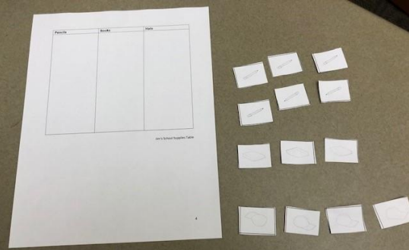
Example of Preparing Materials
For this math CR, the student will need the chart (left) and the cutout tiles (right).
Student with motor difficulty may need pick-up loops attached to the tiles, tiles on heavy cardstock or glued to cardboard, or objects to represent the tiles, such as different colored blocks
Student who is visually impaired may need tactile enhancement of the chart and tiles

Slide 17
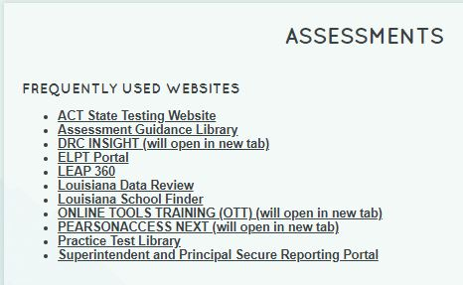
Accessing the Online Tools Training (OTT) Materials
1. To access the Online Tools Training tab seen below, use the link below: https://www.louisianabelieves.com/resources/library/assessment
2. When the user selects OTT, a new window will appear that displays the OTT test types (seen below in navy blue box).

Slide 18
Online Tools Training
The OTT is designed to give students and TAs a chance to become familiar with the testing platform and tools, reinforced through Practice Hints.
TAs should practice in the OTT so they understand how to accurately input student responses during the operational administration. To access the OTTs (use Google Chrome): https://wbte.drcedirect.com/LA/portals/la

Slide 19
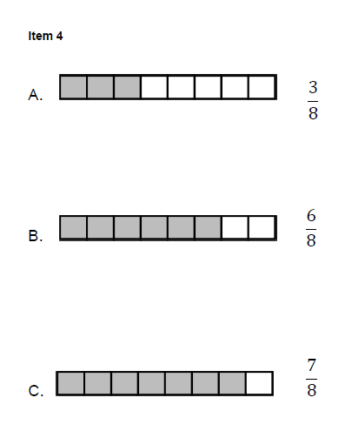
Item Answer Options
Answer options are provided on the computer screen in the testing platform and on paper as part of the Reference Materials.
This is true for the items in the OTTs as well.
TAs are encouraged to use these to practice making test administration more accessible to meet the individual needs of the students they test.

Slide 20
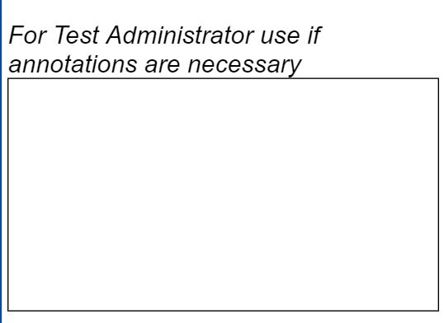
Practice Administering Constructed Response Items
The OTTs provide students and TAs with opportunities to practice the CRs in the testing platform. The format is identical to what is used with the LEAP Connect assessment.
However, the OTT CRs should not be administered without the Directions for Test Administration (DTA) and the Reference Materials/Writing Stimuli.
When administering the ELA CR, the Test Administrator Annotation Box should only be used to clarify unusual spelling, explain symbols, or give specific guidance about the student’s writing. No personal information about students or TAs should be added here. Any feedback about the test itself should be sent to assessment@la.gov.

Slide 21
Practice Using the OTT Directions for Test Administration

Slide 22
Practicing Directions for OTT Items
Jim needs two pencils, 3 books and 1 hat. Select the pictures of the supplies he needs and put them into Jim’s School Supplies Table.
Place Jim’s School Supplies Table from the Sample Mathematics Reference Materials in front of the student. Point to each part as you read the graphic description.
[Graphic description: “This is a table titled Jim’s School Supplies Table.
It is divided into three columns. The first column is labeled Pencils.
The middle column is labeled Books. The last column is labeled Hats.”]
These directions specify when to present the student with the materials to complete the item, and they give the student directions for what to do.

Slide 23
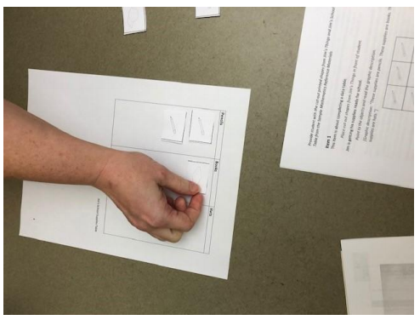
Practice Answering the OTT Item
This picture shows a student completing the chart as directed by the TA.
The student is able to move the tiles onto the chart themselves without assistance.

Slide 24
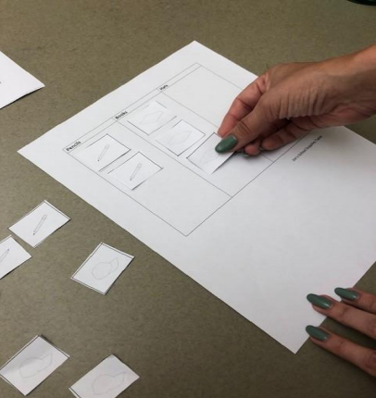
Practice Answering OTT Item, cont.
In this picture, the TA places the tiles for the student because the student cannot move the tiles themselves.
The student must communicate where the tiles should go on the chart without coaching from the TA.

Slide 25
Recording Student Responses
The TA may have to enter all the student’s indicated responses into the test platform.
All TAs will have to score student responses to math and science CR tasks and record the score into the test platform.

Slide 26
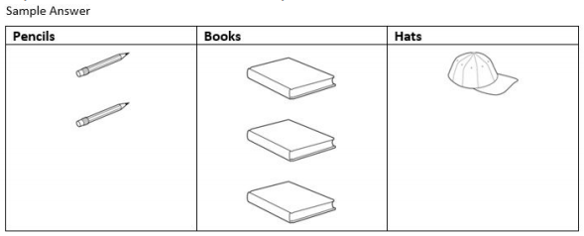
Sample Answer
A sample answer is provided for every math and science CR in the Directions for Test Administration (DTA).
This is one reason why students are not allowed to see or work directly in the DTA. Providing student access to the DTA will result in a void.

Slide 27
LEAP Connect Assessment Guides
LEAP Connect Assessment Guides
Link: https://www.louisianabelieves.com/resources/library/assessment-guidance
Assessment Guide Grade Bands
Grades 3-5
Grades 6-8
High School
Information Provided
Assessment Design
Test Administration
Sample Items

Slide 28
Additional LEAP Connect Resources
LEAP Connect Practice Tests:
ELA, mathematics, and science grades 4, 8, and high school; and mathematics grades 3, 5, 6, 7;
Includes Directions for Test Administration and Reference Materials, .jpg graphics files
Quickstart guide and procedures manual for VI, deaf, and deaf-blind available

Slide 29
Using LEAP Connect in Accountability and for Graduation

Slide 30
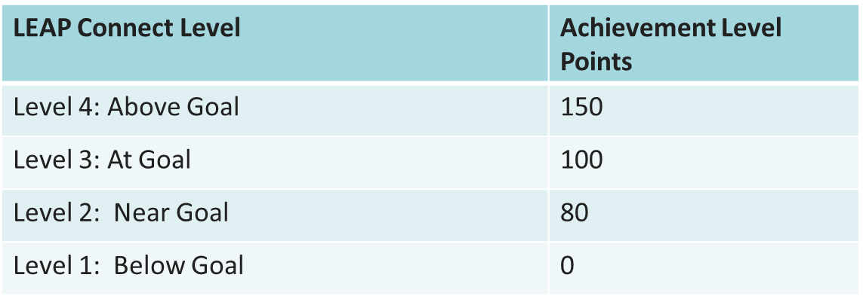
LEAP Connect in the Assessment Index
ALL students must participate in testing and they must be included in accountability calculations if they meet full academic year requirements.
Students must take the test assigned to their official enrollment grade.
LEAP Connect scores are included with LEAP 2025 scores in the assessment index using the scale below to award points.

Slide 31
LEAP Connect and Graduation
All students who meet cohort membership requirements must be included in graduation cohort calculations.
Students who are pursuing a diploma on the Jump Start pathway for alternate assessment must take all three LEAP Connect subject assessments. If they are unable to pass the ELA and/or mathematics tests, then IEP teams can assemble a portfolio.
Students will be included in the cohort the year they graduate or exit for other reasons, or at age 22 as long as the correct pathway is identified in STS.

Slide 32
LEAP Connect Next Steps
Important Dates | Activity
Now through testing | Practice for LEAP Connect using available resources
Now through testing | Administer Student Response Check as necessary
Available now | Test Setup available for user and student management Testing manuals posted to DRC Insight
Closed January 19 | Deadline to Identify students for LEAP Connect/finalize accommodations
February 1 | Printed materials, including manuals, delivered to districts
February 19-March 22 | LEAP Connect Testing Window
February 1-March 19 | Window for requesting additional materials
May | Reports available

Slide 33
Questions?
LEAP Connect Criteria or IEP Questions: SpecialEducation@la.gov
LEAP Connect Administration Questions: assessment@la.gov
LEAP Connect Accountability or Graduation Policy Questions: jennifer.baird@la.gov
Team Lead: Bridget Harris bridget.harris@la.gov

