Slide 1
Online Test Security Training for Districts

Slide 2
Agenda Items
Welcome
Communication and Support
Policy and Key Terms
Scheduling
Monitoring
Preventing Plagiarism
Testing Students with Accommodations
Next Steps

Slide 3
Welcome

Slide 4
Welcome
Purpose
This presentation is designed to provide test coordinators and administrators with an overview of test security procedures for online assessments.
Objectives
Through this overview coordinators and administrators will be prepared to:
Maintain test security during administration of state online assessments.

Slide 5
Communication and Support

Slide 6
Communication and Support
Multiple avenues exist to acquire information and/or receive assistance during test administrations.
Enter local information on who school test coordinators and test administrators should contact regarding issues during testing.

Slide 7
Policy and Key Terms

Slide 8
Access: Definition and Processes
Definition:
Access is defined as handling the materials, reading, reviewing, or analyzing test items or student responses, either before, during, or after testing except where providing approved accommodations.
Processes for limiting access:
Limiting keys to locked secure areas
Conducting all precoding and sorting of materials in central secure locations

Slide 9
Secure Materials:
Definition and Procedures
Definition:
Secure materials are test materials that contain administration test items or student responses and to which access is restricted.
Secure test materials include:
  student test booklets,
  student answer documents, and
  any other materials containing test items or student responses (e.g., scratch paper).
Processes to ensure the proper accounting of materials:
Enter information on local process for check in and check out of secure materials

Slide 10
Violations of Test Security:
Related Policy
Violations of test security are defined in Bulletin 118 and include:
  Administering tests in a manner that that would give examinees an unfair advantage or disadvantage
  Giving examinees access to test questions prior to testing
  Examining any test item at any time (except for providing certain accommodations)
  At any time reproducing or discussing all or part of any secure materials
  Coach or interfering examinees in any manner during testing
  Altering or interfering with examinees’ responses in any manner
  Administering previously administered or current forms of any state-wide assessment
  Failing to account for and secure test materials
  Conducting testing in alternate environments without approval
  Failing to report any testing irregularities
  Participating in, encouraging, or failing to report any violation
Violations of test security can result in the revocation of a teaching or leadership certificate as defined in Bulletin 746.

Slide 11
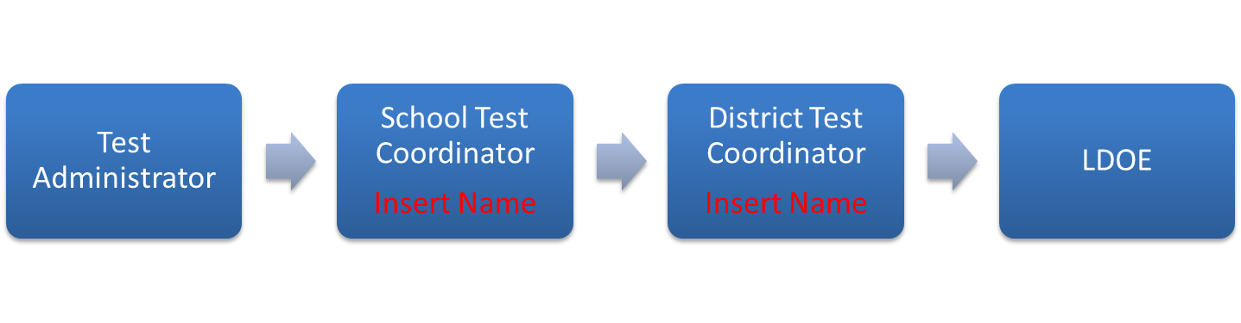
Testing Irregularities:
Definition and Reporting
Definition:
A testing irregularity is any incident in test handling or administration that leads to a question regarding the security of the test or the accuracy of the test data.
Process for reporting:
All testing irregularities must be reported in writing to the School Test Coordinator, who must then send the written reports to the District Test Coordinator.
Districts may only send the following information to LDOE
  Louisiana Secure ID
  First letter of first name
  First three letters of last name
  Birth date only (excluding birth month and birth year)

Slide 12
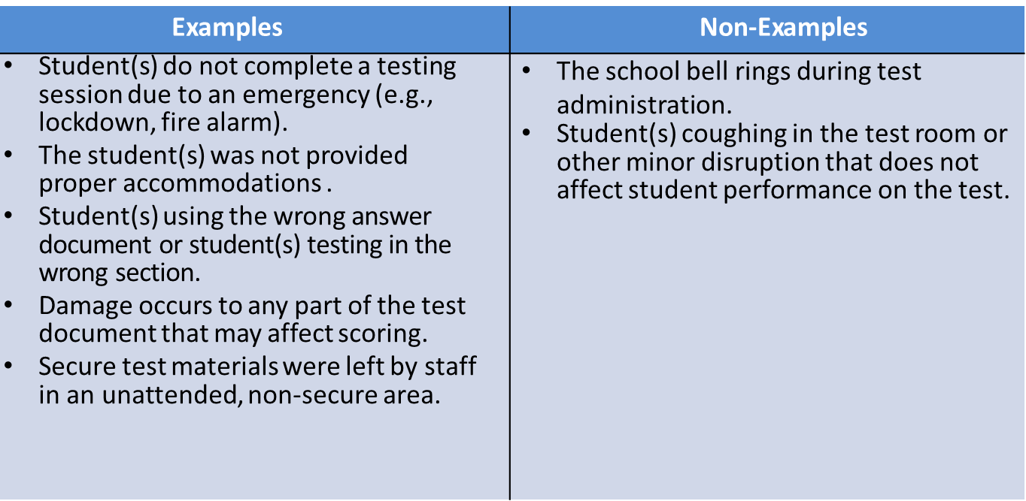
Testing Irregularities: Examples

Slide 13
Scheduling

Slide 14
Scheduling Guidance
Scheduling practices that limit interaction between tested and untested students as well as maintain a secure environment lessen opportunities for testing irregularities to occur. Examples of good scheduling practices include:
  Limiting reopened test sessions by having students complete test sessions within a single seating
  Scheduling students participating in the same test to be assessed at the same time or within the same day with no interaction
  Administering make-up test on the day the student returns in order to eliminate interaction with others already tested
  Utilizing a proctor to maintain security of any student that needs to leave the testing environment during the test

Slide 15
Submitting Schedules
Enter information on how schools are to submit schedules to the DTC.
Schedules must include:
  Dates of testing for the school
  Approximate time testing will begin each day
  Subjects that will be tested that day

Slide 16
Monitoring

Slide 17
Active Monitoring: Definition
Definition:
Active monitoring means that test administrators should be actively engaged in observing students’ behavior at all times during the administration of state assessments.
Practices to ensure active monitoring:
Active monitoring involves moving about the testing area so students’ actions can be viewed from multiple vantage points.
Test administrators should not be engaged in other activities that would distract or prevent them from accomplishing this task.
Test administrators should glance down at the tops and margins of the test booklets to ensure that students are working in the correct portion of the test, but should not read any portion of the test.
Test administrators must maintain test security during breaks by limiting the interaction students have with each other.
Test administrators testing in a small group should pay attention to ensure students receive the appropriate accommodations at the appropriate times.

Slide 18
Active Monitoring:
Violations of Test Security
It is considered a violation of test security for test administrators to do any of the following:
  View test content for any reason other than to ensure students are working on the correct area
  View test content long enough to determine the essence of a question or prompt
  Look at the test booklet to determine if a student marked responses for every question
  View a testing booklet to see if a student used a strategy
  Memorize test questions
  Copy test questions
  Examine a graph or illustration

Slide 19
Preventing Plagiarism

Slide 20
Plagiarism:
Definition and Preventative Practices
Definition:
Plagiarism occurs when a student duplicates another student’s response or an external source. Examples include similar responses across multiple answer documents and use information from internet resources.
Practices to prevent plagiarism:
  Administer the assessment to students taking the same test within the same day
  Limit exposure of the tests by scheduling in such a way that all students are testing at the same time
  Prohibit or limit the presence of cell phones and other electronics within the testing environment
  Limit access to backpacks and other belongings during the administration

Slide 21
Testing Students with Accommodations

Slide 22
Testing Students with Accommodations
Test administrators testing students with accommodations should be provided with the following:
  Enter local information on how teachers testing students with accommodations will be supported to ensure proper testing procedures are maintained.
Test administrators testing students with accommodations, including small group, are expected to actively monitor during administration including moving about the room and ensuring limited student interaction during any breaks.

Slide 23
Next Steps

Slide 24
Next Steps and Resources for Redelivery
Resources available for test security training include:
  Test Coordinator and Administrator Manuals and
Next steps for district test coordinators:
  Provide local information that school test coordinators and test administrators need to do in order to complete testing.

