Slide 1
Paper-Based Test Security Training for District

Slide 2
Agenda Items
Welcome
Communication and Support
Policy and Key Terms
Scheduling
Monitoring
Preventing Plagiarism
Testing Students with Accommodations
Next Steps

Slide 3
Welcome

Slide 4
Welcome
Purpose
This presentation is designed to provide test coordinators with an overview of test security procedures for paper-based assessments.
Objectives
Through this overview coordinators will be prepared to:
Redeliver test security training to school test coordinators and test administrators and
Maintain test security during administration of state paper-based assessments.

Slide 5
Communication and Support

Slide 6
Communication and Support
Multiple avenues exist to acquire information and/or receive assistance during test administrations.
Assessment Hotline
District staff are encouraged to call the hotline if they have questions that require immediate assistance.
The hotline is available from Hotline from 6:30 a.m. – 4:30 p.m.
1-844-268-7320
Assessment@la.gov
All stakeholders are encouraged to email questions and/or concerns to assessment@la.gov.
Assessment Office Hours
District and school staff are encouraged to attend weekly assessment office hours with any questions they have about upcoming Spring assessments.
Office hours are Thursday at 11:00 am
https://louisianaschools.adobeconnect.com/dtc/

Slide 7
Policy and Key Terms

Slide 8
Access: Definition and Processes
Definition:
Access is defined as handling the materials, reading, reviewing, or analyzing test items or student responses, either before, during, or after testing except where providing approved accommodations.
Processes for limiting access:
Limiting keys to locked secure areas
Conducting all precoding and sorting of materials in central secure locations

Slide 9
Secure Materials: Definition and Procedures
Definition:
Secure materials are test materials that contain administration test items or student responses and to which access is restricted.
Secure test materials include:
student test booklets,
student answer documents, and
any other materials containing test items or student responses (e.g., scratch paper).
Processes to ensure the proper accounting of materials:
Check in and check out procedures that include counting of materials
Procedures for distribution, collection, disposal of materials such as scratch paper
Appropriate training of all involved in assessment administration
Monitoring of processes during administration to ensure maintained security

Slide 10
Violations of Test Security: Related Policy
Violations of test security are defined in Bulletin 118 and include:
Administering tests in a manner that that would give examinees an unfair advantage or disadvantage
Giving examinees access to test questions prior to testing
Examining any test item at any time (except for providing certain accommodations)
At any time reproducing or discussing all or part of any secure materials
Coach or interfering examinees in any manner during testing
Altering or interfering with examinees’ responses in any manner
Administering previously administered or current forms of any state-wide assessment
Failing to account for and secure test materials
Conducting testing in alternate environments without approval
Failing to report any testing irregularities
Participating in, encouraging, or failing to report any violation
Violations of test security can result in the revocation of a teaching or leadership certificate as defined in Bulletin 746.

Slide 11
Testing Irregularities: Definition and Reporting
Definition:
A testing irregularity is any incident in test handling or administration that leads to a question regarding the security of the test or the accuracy of the test data.
Process for reporting:
All testing irregularities must be reported in writing to the School Test Coordinator, who must then send the written reports to the District Test Coordinator.
Districts may only send the following information to LDOE
Louisiana Secure ID
First letter of first name
First three letters of last name
Birth date only (excluding birth month and birth year)

Slide 12
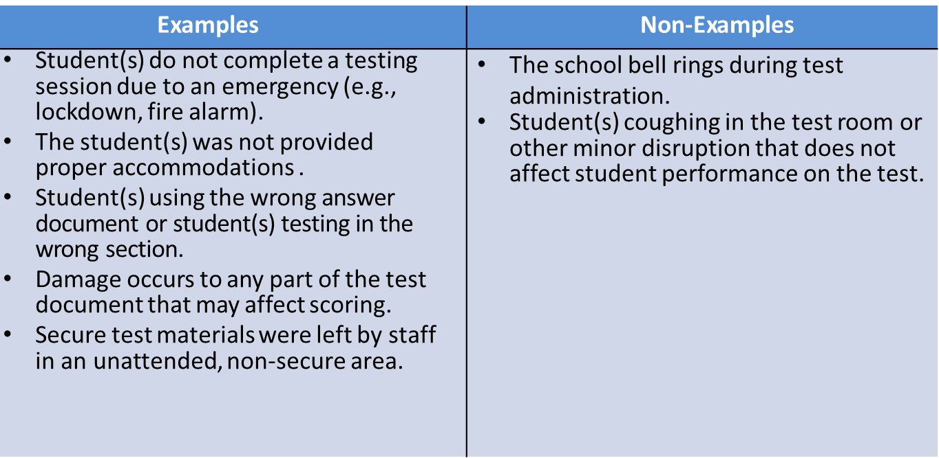
Testing Irregularities: Examples

Slide 13
Scheduling

Slide 14
Scheduling Guidance
Scheduling practices that limit interaction between tested and untested students as well as maintain a secure environment lessen opportunities for testing irregularities to occur.
Examples of good scheduling practices include:
scheduling all students to begin testing at the same time,
isolating students who require a make-up test,
isolating students during break periods, and
isolating students who have not completed testing for the day.

Slide 15
Monitoring

Slide 16
Active Monitoring: Definition
Definition:
Active monitoring means that test administrators should be actively engaged in observing students’ behavior at all times during the administration of state assessments.
Practices to ensure active monitoring:
Active monitoring involves moving about the testing area so students’ actions can be viewed from multiple vantage points.
Test administrators should not be engaged in other activities that would distract or prevent them from accomplishing this task.
Test administrators should glance down at the tops and margins of the test booklets to ensure that students are working in the correct portion of the test, but should not read any portion of the test.
Test administrators must maintain test security during breaks by limiting the interaction students have with each other.
Test administrators testing in a small group should pay attention to ensure students receive the appropriate accommodations at the appropriate times.

Slide 17
Active Monitoring: Violations of Test Security
It is considered a violation of test security for test administrators to do any of the following:
View test content for any reason other than to ensure students are working on the correct area
View test content long enough to determine the essence of a question or prompt
Look at the test booklet to determine if a student marked responses for every question
View a testing booklet to see if a student used a strategy
Memorize test questions
Copy test questions
Examine a graph or illustration

Slide 18
Preventing Plagiarism

Slide 19
Plagiarism: Definition and Preventative Practices
Definition:
Plagiarism occurs when a student duplicates another student’s response or an external source. Examples include similar responses across multiple answer documents and use information from internet resources.
Practices to prevent plagiarism:
Administer the assessment to students taking the same test within the same day
Limit exposure of the tests by scheduling in such a way that all students are testing at the same time
Prohibit or limit the presence of cell phones and other electronics within the testing environment
Limit access to backpacks and other belongings during the administration

Slide 20
Testing Students with Accommodations

Slide 21
Testing Students with Accommodations
Test administrators testing students with accommodations should be provided with the following:
Training on what accommodations each student will receive
A list of the accommodations each student is set to receive and when they should receive them
Processes for communicating with the testing coordinator should questions or issues arise during administration
Test administrators testing students with accommodations, including small group, are expected to actively monitor during administration including moving about the room and ensuring limited student interaction during any breaks.

Slide 22
Next Steps

Slide 23
Next Steps and Resources for Redelivery
Prior to administration of any state assessment district test coordinators are required to train school test coordinators in test security as well as any LEA level staff that may be participating in test administration or monitoring. School test coordinators are required to train school-level staff (e.g., test administrators, proctors, monitors).
Resources available for test security training include:
Test Coordinator and Administrator Manuals (availability will be communicated via newsletter and future webinars), and
Test Security Training for Schools.
Next steps for district test coordinators:
Access Test Security Training for Schools
Schedule school test coordinator and district staff test security trainings
Provide test security training to school test coordinators and district staff
Support school test coordinators in scheduling and providing training to school staff
Plan for the district led monitoring of test administration

