Slide 1
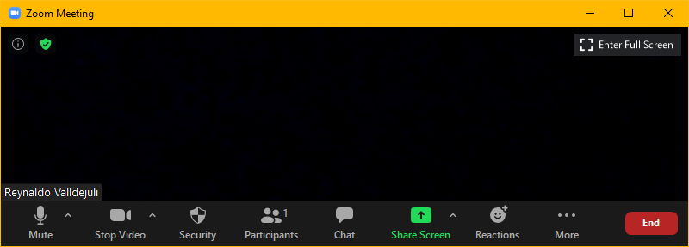
Zoom Meeting Preparation
Please make sure your phone or computer is muted to minimize background noise.
  To do this, hover over the bottom left-hand side of your screen and click “Mute.”
Please make sure you have turned off your camera to save bandwidth and prevent any connectivity issues.
  To do this, hover over the bottom left-hand side of your screen and click “Stop Video.”
Please submit questions during the presentation in the “Chat” function located on the bottom of your screen. The department does not give anyone permission to record this webinar.
NOTICE: In accordance with the Americans with Disabilities Act, if you need special assistance at this meeting please contact ldoecommunications@la.gov.

Slide 2
Using the DRC Student Corrections System
Online Cleanup
May 23, 2024

Slide 3
Agenda Items
Importance of Correcting Data
How to Access the Student Corrections System
Demographic Corrections
Impending Zero Corrections
Saving Corrections and Reviewing Status

Slide 4
Importance of Correcting Data

Slide 5
Importance of DRC Student Corrections
Online Cleanup
DRC will host a one week online cleanup for some elements of assessment data that are used to calculate the assessment and progress indices from June 10 to June 17 and cannot be extended for any reason.
VAM used for Step 2 of the progress index will be calculated prior to the final assessment data certification that takes place in fall.
Connecting data across years for students requires that demographic information and LASIDs match on all assessment data being used.
Paper test administrations often create errors due to incorrect entry of information on test documents.
This cleanup process can reduce the amount of work that is needed during the fall assessment data certification process.

Slide 6
How to Access the
Student Corrections System

Slide 7
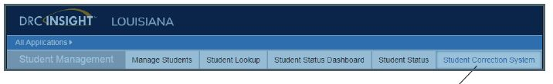
How to Access the Student Correction System
Directions for all of the processes used in DRC Student Corrections are found on pages 126-135 of the DRC Portal User Guide for Louisiana.
To access and display student records that require updates in the Student Records Correction System, do the following:
1. From the All Applications menu, select Student Management.
2. Select Student Correction System. (This will not be available before 6/10.)

Slide 8
Accountability Contact Access
District and school test coordinators have access to DRC INSIGHT. The district test coordinator should provide access to the accountability contact only if needed. However, accountability contacts should be included in discussions related to accountability codes that will directly affect district, school and subgroup performance scores.

Slide 9
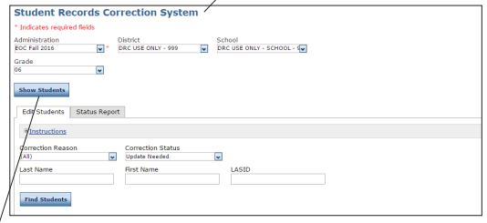
Correcting a Student Record
Select an administration from the drop-down menu (required). You also can select a school and grade to refine the search results.
Click Show Students: The Edit Students tab displays the students that match the search criteria.

Slide 10
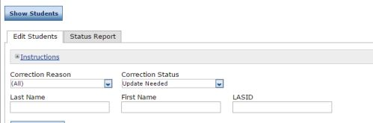
Selecting Students
Additional filtering options include:
Correction Reason (why is this student included here?)
Correction Status (what action should be or has been taken?)
NOTE: To be complete, you
must correct the data for
ALL students. If incomplete, DRC
will still apply changes that have
been saved.

Slide 11

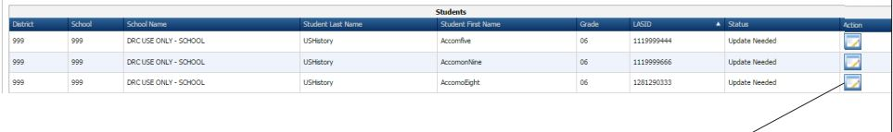
Selecting a Single Student
Click the VIEW and EDIT icon in the Action column next to each student’s record to display the EDIT STUDENT window.

Slide 12
Correction Reasons
Users will see a reason for why the student is included:
Invalid Louisiana Secure Identification Number (LASID)
Impending Zero (student did not test and has no accountability code)
First Name
Last Name
Date of Birth
Limited demographics

Slide 13
Demographic Corrections

Slide 14
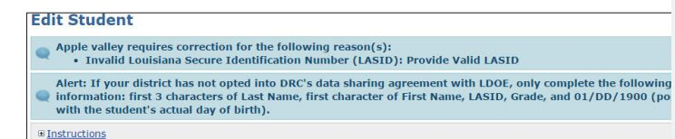
Correcting Demographics
Schools and systems can correct demographics that do not match state records. The correction reason will show as seen below. Demographic records that are not corrected can affect accountability results for multiple years.

Slide 15
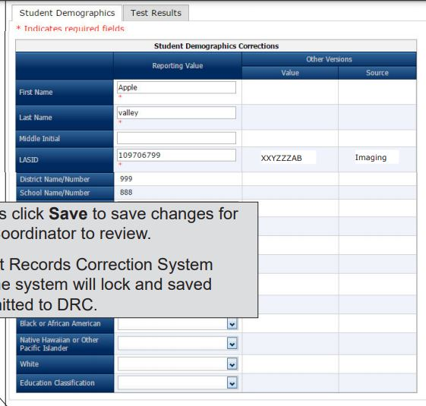
Demographic Corrections Table
A table is provided under the
Student Demographics tab that
Displays 3 columns for specific
Demographic fields. The first
column provides recommended
values or blanks that can be filled
in by the user. The other columns
show what was actually on the
document. Do not assume that the
recommendation provided is correct.

Slide 16
Impending Zeros Correction

Slide 17
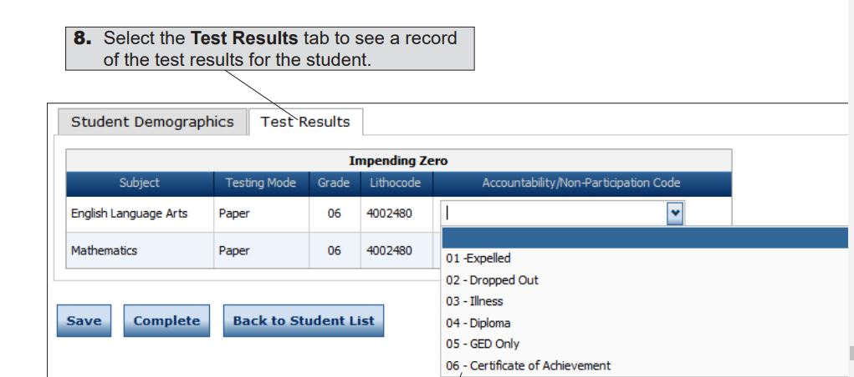
Impending Zeros
The only students who are currently assigned zeros are those listed under Test Results. Zeros are assigned to each subject for which a student did not test. When a code has been applied, the School should click the Save button and the District should click the Complete button.

Slide 18
Impending Zeros
To remove impending zeros, an accountability code should be applied.
Some codes can only be used on selected assessments.
Codes should be documented
  Codes for students no longer enrolled should match an exit code used in EdLink.
    (For example, you cannot use code 97, Unknown, unless the student has also been exited from enrollment in EdLink as unknown exit)
There is no code for students who opted out of testing or did not show up for testing. High school retesters will not be displayed for impending zeros.
Code 99 cannot be used for students selected for third year assessment cohort.
Some impending zeros will be corrected by correcting demographic information. For those cases, use code 90.

Slide 19
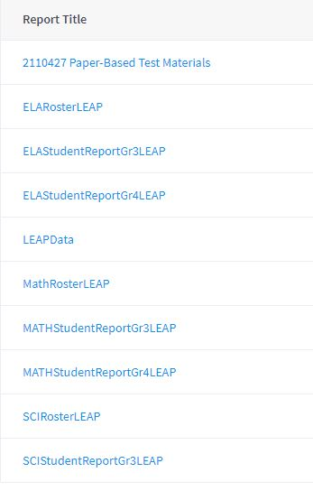
Impending Zeros for Multiple Record Errors
For many students in grades 3
impending zeros may result from the
inability to match testing documents
across subject areas.
IT IS EXTREMELY IMPORTANT THAT
USERS REVIEW THE DATA FILE FOR
POTENTIAL MATCHING ISSUES.

Slide 20
Paper Assessments
All paper assessments for grade 3 are provided in the Student Corrections System for review. The only records that will be flagged for update needed will be those assessment records that require corrections such as impending zeros under the Test Results tab.

Slide 21
Documentation
The DRC Student Corrections System does not accept documentation, so changes are made without submitting justification. However, schools and systems should be reminded that all accountability codes require documentation this is kept on file and available for desk auditing.

Slide 22
Saving Records and Reviewing Status

Slide 23
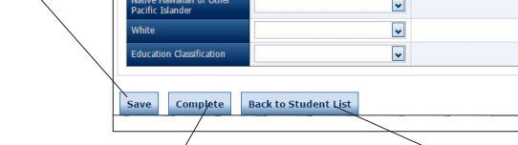
Saving and Completing Data
Once the changes have been reviewed and/or added, there are three buttons below the Student Demographics Corrections table and the Impending Zeros table.
Schools should click the Save button when they are finished.
Districts should click the Complete button when the school is finished.

Slide 24
Save and Complete
Once corrections have been saved, they will be applied by DRC even if the district does not click on the complete button.
Please note that changes made by a school will also be applied to data used to calculate the district performance score as well. It is strongly recommended that a district contact review and approve changes.

Slide 25
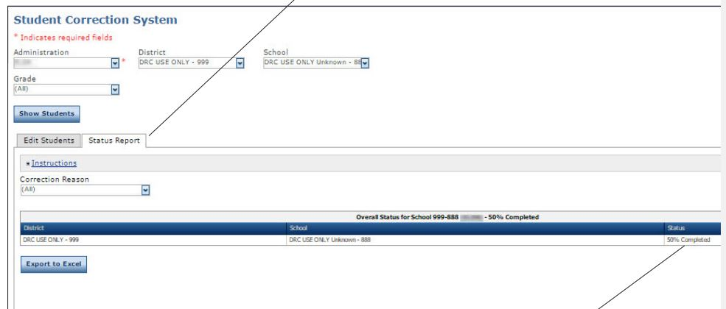
Status Report
Below the Status Report tab (found under the Student Reports tab), a table tracks progress by displaying the percentage of records that have been completed for a school.

Slide 26
Most Common Questions
If I have corrected demographic information that caused an impending zero for a student that did complete testing, do I still need to apply an accountability code?
While it is not necessary to apply a code, the status report will not show as complete. To show 100% complete, use code 90. All saved corrections requests will be applied regardless of completion status when the cleanup period closes.
If I have records that include no name and no LASID, how do I fix this?
Remember that we are putting students in the SPS and not just data. If data are not attached to a student, then it cannot be used at all. The department will not include a zero in calculations for a student with no name.

Slide 27
Most Common Questions, cont.
3. Why is my third grade student showing a zero for a subject when they completed all tests?
The most likely reason is that the demographic information does not match across subjects. Before you call, please refer to your data file.
4. Why can’t I code a student with 81 in this review?
This review is only for impending zeros. Since the only students eligible for code 81 have participated in testing, they will not be displayed for review.
5. What do I do if I have no corrections listed in the system?
Celebrate and be sure to thank everyone at the site for doing a fantastic job with testing!

Slide 28
Resources
In addition to this webinar, the 2023-2024 DRC Student Correction System FAQ will be available in the assessment library.
DRC provided a data file for each system that includes student demographic information as well as a Y or N flag for tests taken. No scores will be available yet on this file, but it can be very helpful with identifying potential issues and explanations for why students are flagged.

Slide 29
Assistance
If assistance is needed, please reach out to Jennifer Baird or assessment@la.gov.
Jennifer Baird’s contact information
Jennifer.Baird@la.gov
Land line: 225.695.6778
Cell phone: 985.981.6445

