Slide 1
Zoom Meeting Preparation
Please make sure your phone or computer is muted to minimize background noise.
To do this, hover over the bottom left-hand side of your screen and click “Mute.”
Please make sure you have turned off your camera to save bandwidth and prevent any connectivity issues.
To do this, hover over the bottom left-hand side of your screen and click “Stop Video.”
Please submit questions during the presentation in the “Chat” function located on the bottom of your screen.
NOTICE: In accordance with the Americans with Disabilities Act, if you need special assistance at this meeting please contact ldoecommunications@la.gov.

Slide 2
Innovative Assessment Program Winter Window Administration
January 10, 2022

Slide 3
Agenda Items
Overview and Purpose
Key Dates
Technology Preparation
Test Administration Creation
Administration
Test Security
Communications and Next Steps

Slide 4
Overview and Purpose

Slide 5
Overview and Purpose
Selected school systems will participate in operational, field, and pilot testing of the ELA Guidebooks or ELA Wit and Wisdom assessments using the ADAM platform. The purpose of this webinar is to provide schools and systems with important information about test setup, test administration and test security.

Slide 6
Key Dates

Slide 7
Key Dates
Due Now | School Testing Schedules | Send to assessment@la.gov. Use template provided.
Available Now | Online Tools Training | www.adamexam.com/tester
January 10 | TCMs and TAMs available | https://www.louisianabelieves.com/resources/library/assessment See Innovative Assessment Program section
January 12 | Student rosters available | In platform. Student rosters are based on the file submitted by the system.
January 24-February 11 | Testing Window | In platform. All make-ups must be completed in window.
February 11 | Void forms due | Send to assessment@la.gov IAP Void Form

Slide 8
Technology Preparation

Slide 9
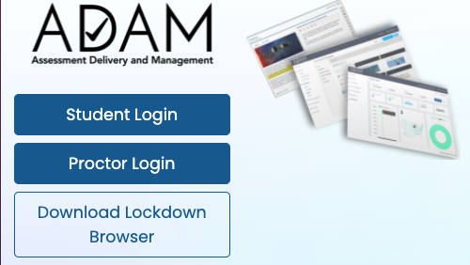
Lockdown Browser Installation
Lockdown Browser Installation (Windows and Mac)
Navigate to https://adamexam.com.
Click the Download Lockdown Browser button.
Choose your installation type (Mac/Windows)
Install package should be downloaded.
Double-click on the downloaded package and follow installation instructions.
After the installation is complete click on the ADAM icon to launch the application.
https://www.louisianabelieves.com/docs/default-source/assessment/adam_lockdown_browser_install_10-1-19_final.pdf?sfvrsn=9a309d1f_6

Slide 10
Technology Specifications
Operating System
macOS: version 10.13 to 11.1.
iOS: version 12.1 to 14.5.
Windows: Windows 10 or later.
Chrome OS: version 72 to 89.
Minimum Device Capacities
Cumulative processor speed is greater than 233MHz.
Total RAM available is greater than 256MB.
At least 50 MB of available storage.
URL Whitelist
*adamexam.com
*learnosity.com
*loggly.com
*speachstream.net
*.zendesk.com
*community.nwea.org
*sentry.io
*s3.amazonaws.com
*unpkg.com

Slide 11
System Requirements Check
Some system requirements are verified by the ADAM lockdown browser. If a device fails one of these checks, a summary of the issue is displayed on the screen, and when possible, the user will have an opportunity to resolve it (see next slide for summaries).
For example, if the lockdown browser detects that a device has two monitors, an alert will be displayed on the screen with the option for the user to unplug one monitor and then click. Retry to run the checks.
Display
Only one attached monitor.
Minimum resolution of 1024x768. (Warning)
Minimum color depth 24-bit.

Slide 12
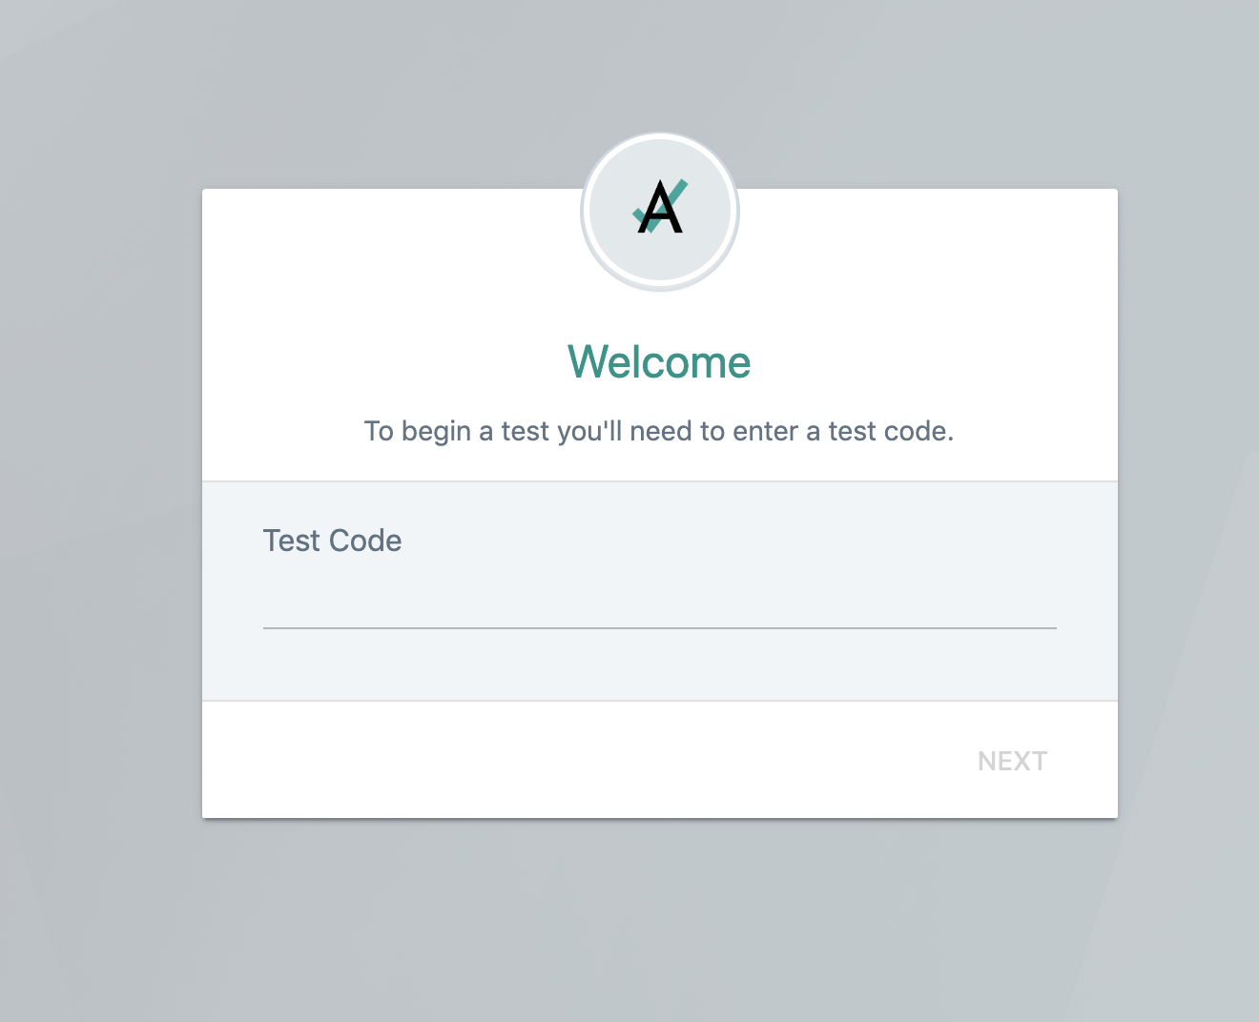
Online Tools Training Access
Students navigate to www.adamexam.com/tester or open up the lockdown browser on their device. Students will be directed to the screen below.

Slide 13
Test Administration Creation

Slide 14
Administration Logins and Accounts
District Test Coordinators are provided with a user name and password for ADAM.
District Test Coordinators will login with their credentials by going to (www.adamexam.com).
District Test Coordinators are responsible for creating School Test Coordinator ADAM accounts.

Slide 15
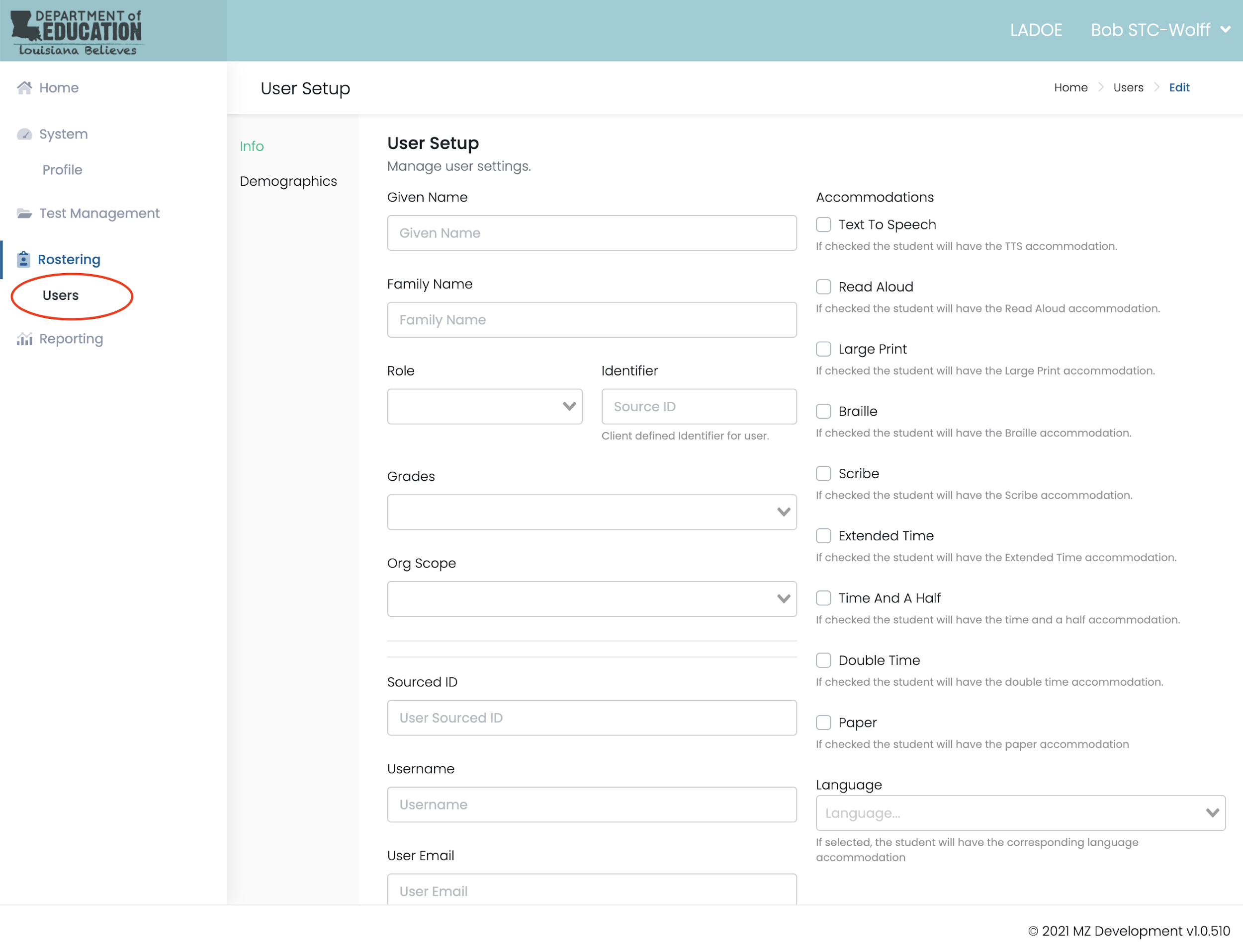
Creating Accounts for School Test Coordinators
The DTC should log in to ADAM and begin creating School Test Coordinator (STC) accounts for any new test coordinators.
Once a DTC creates a School Test Coordinator account an email will be sent to the STC with instructions to log in to ADAM.

Slide 16
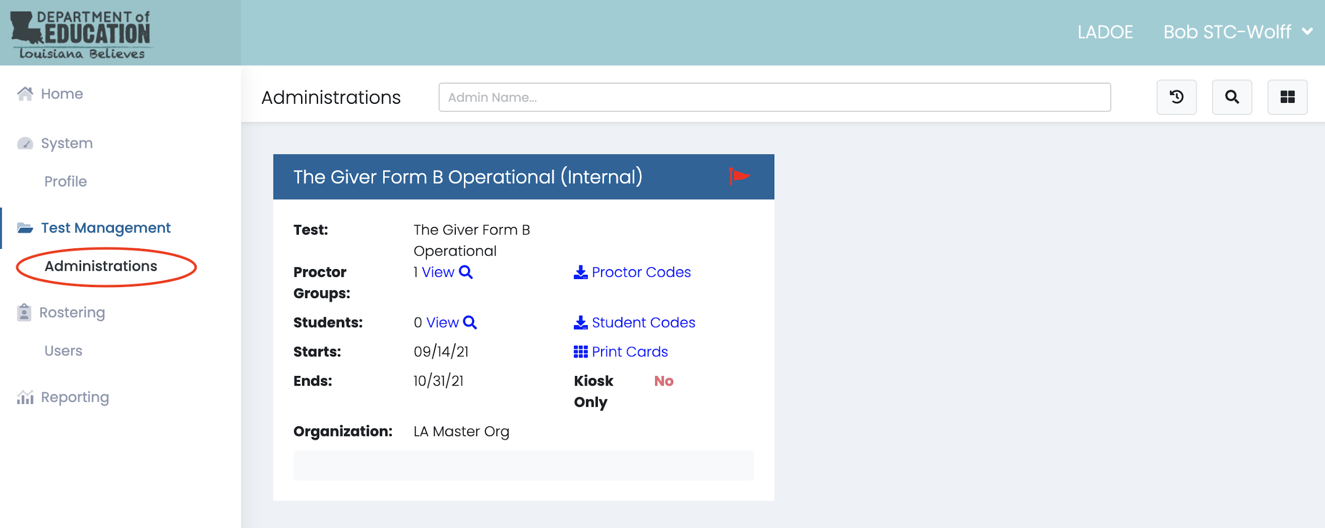
Accessing Test Administrations
School Test Coordinators or District Test Coordinators will see an Administrations menu option in the Test Management Folder of the left hand menu.
Once the user clicks into Administrations, the available administrations (tests) will be displayed as pictured. Forms will be assigned by the test vendor in advance by the week of January 17.

Slide 17
Student File Upload
It is the responsibility of all school system data managers to provide a file per protocols outlined in the TSDL file layout prior to each assessment window. The next data file will be due on March 25. The file should:
Include all students who are participating in the LEAP Innovative Assessment (Operational, Field Test, and Pilot).
Include each student only one time (the most common error is multiple records for a single student)
Use the course code that best corresponds to the course in which the unit is taught.

Slide 18
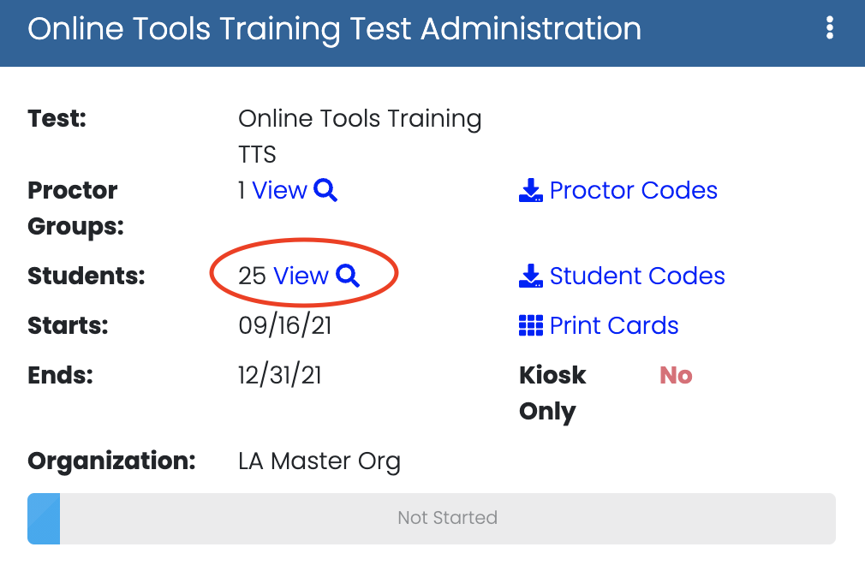
Verifying Class Rosters
STCs verify the class roster
Review the students listed in the roster.
If the roster is incorrect, adjust the class roster. The test administrations update within an hour after the class is updated.

Slide 19
Student Transfers
If… | Then…
A student moves from one classroom to another classroom: | The school test coordinator has the ability to update the Class Roster through ADAM. Then, the school test coordinator must select the “scan for new students” option on the test administration card in ADAM. This removes the student from the previous roster and places them on the roster for the new classroom.
A new student moves into the school system prior to or during the school system test window: | The district test coordinator and school test coordinator have the ability to manually add new students or move students who have transferred to a new school within the same school system.
A student moves from one school to another school within the participating school system prior to testing:
A student moves into the school system or out of the school system to another system that is also participating in the assessment: | Please contact the Help Desk for assistance by calling 855-866-5778.

Slide 20
Add a Student
Students have been preloaded into ADAM from the TSDL files that were submitted by participating school systems in December. For new students, test coordinators can add them using the instructions below:
Log into ADAM www.adamexam.com
Navigate to the Rostering menu, then click Users.
Click the Create New button in the top right of the page.
Fill out
Given Name with the student's First Name. Use proper case 'Jeremy'
Family Name with the student's Last Name. Use proper case 'Smith'
Role choose Student Role from the drop down list
Identifier with the state student id of the student This is a 10 digit number
Grades choose ONE grade from the drop down list for the student

Slide 21
Adding a Student, cont.
Fill Out, cont.
Org Scope choose the school the student is attending from the drop down list The student should only be in a single school.
Classes choose ONE class from the drop down list to enroll the student The class is used to deliver the grade and school appropriate test to the student
Sourced ID with the state student id of the student This is the 10 digit LASID number and should match what you set in the Identifier field
Username leave blank
User Email set this field to blank. We do not capture student email address
Accommodations set the check box if the student has a Text To Speech accommodation This is found on the top right of the page. Do not use the Set Password feature.
Press the Submit button to Save.

Slide 22
Printing Test Cards
After verifying the class roster
Print the test cards (includes roster + proctor pw and student cards)
View Proctor Groups

Slide 23
Roster Versions of Print Cards
The roster version of the Print Card includes:
Page for the Proctor with full roster
Individual Cards for each student with test code and identification

Slide 24
Accountability Coding
It is not necessary to apply accountability codes to students who are participating in the field or pilot tests. The only codes that must be applied are for students who are participating in grade 7 operational assessments and who do not test.

Slide 25
Administration

Slide 26
Grade 5 Pilot Administration
Sections | Time | Materials
Section 1: (Unit Texts and Unit Related Texts) | 45 minutes | No text allowed
Section 2: Writing Task | 60 minutes | No text allowed
NOTE: Section 2 for grade 5 has been changed from a 45 minute administration to a 60 minute administration.

Slide 27
Grade 7 Operational Administration
TEST SECTION | FOCUS OF EACH SECTION | TESTING TIME | TEST ADMINISTRATION | TESTING MATERIALS
Section 1 | Questions about Unit Text(s) and Unit-Related Text(s) | 60 minutes | Sections 1 and 2 must be administered on the same day. Students will use the same Student Login Ticket for both sections. | Scratch Paper and Pencils Only [Students are not allowed to have copies of unit texts for any part of the assessment.]
Section 2 | End-of-Unit Essay | 60 minutes
Section 3 | Questions about an ELA Passage Set | 20 minutes | Students will use a new Student Login Ticket.

Slide 28
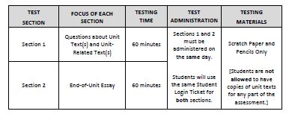
Grade 6-8 Field Test Administrations

Slide 29
Timed Tests
All LEAP ELA Guidebooks Operational Assessment sections are timed, but exceptions are made for students with the accommodation Extended Time.
Unless a student has Individual or Small Group Administration as an accessibility feature, all students in a testing group must begin testing on a section at the scheduled time. If a student arrives late, the student may not join that section. The student must wait until makeup testing to complete the missed section and must take the sections in the proper order (Section 1, Section 2, Section 3).

Slide 30
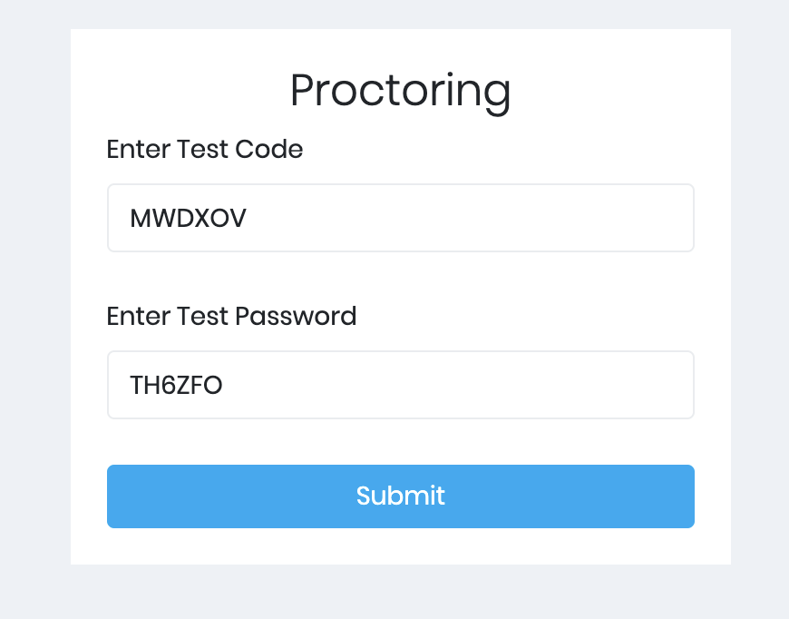
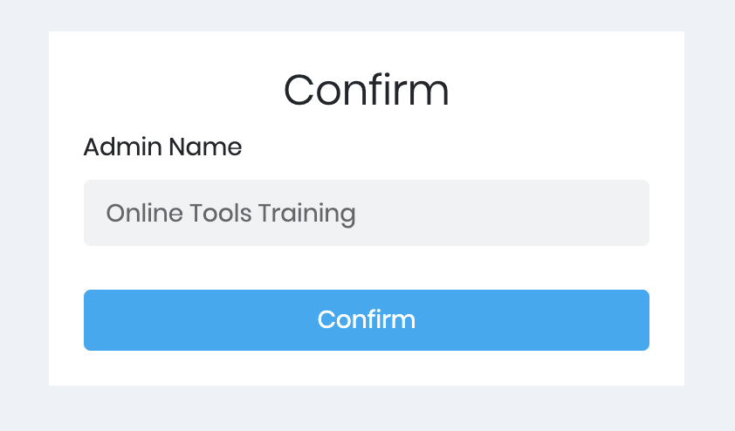
Teacher Proctor Login
Teacher Proctors will access https://adamexam.com
Choose Proctor Login
Proctors will enter the test code and test password provided by the School Test Coordinator.
Proctors will be asked to confirm the administration that they are about to begin.

Slide 31
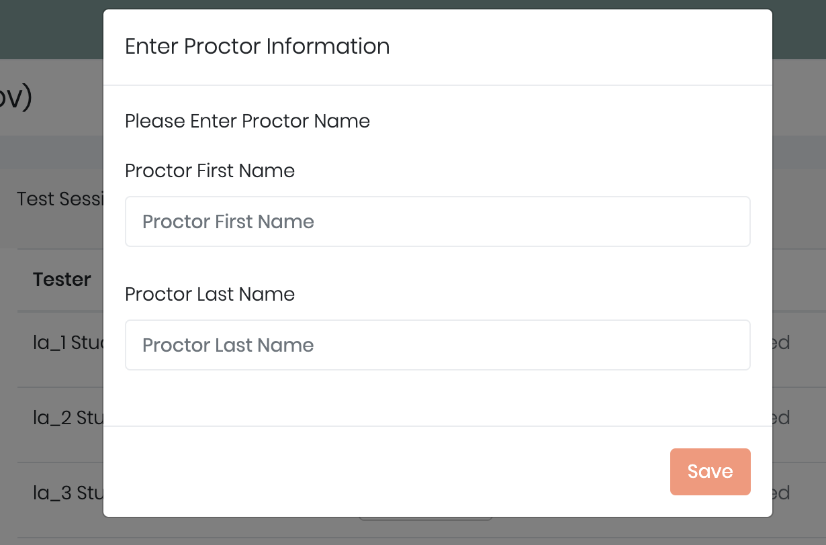
Teacher Proctor Instructions
Proctors will then be asked to type in their first and last name.

Slide 32
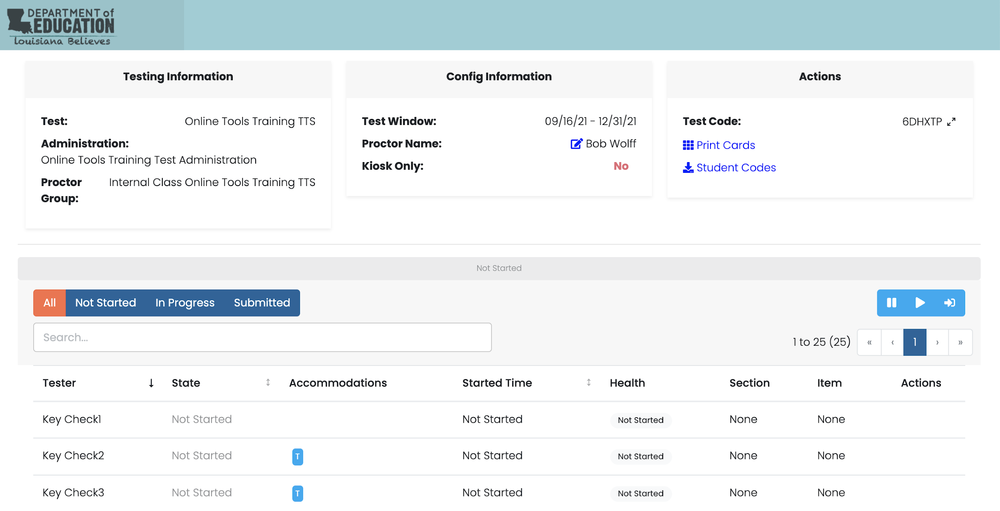
Teacher Proctor Monitoring Features
Proctors will be directed to the screen shown here where monitoring features are available.

Slide 33
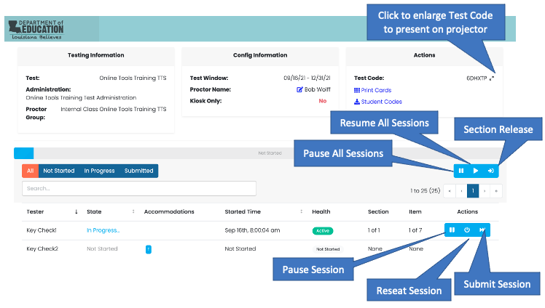
Proctor Instructions for Monitoring Students
The proctor can control and monitor students.
Section Release – Click to start Section 2 of the test. This should only be done when all students are completed with Section 1.
Pause Session – Proctors can pause an individual student’s session. Proctors must unpause the session for the student to resume testing.
Reseat Session – To be used if a student’s session has been ‘interrupted’ (computer issue, session timeout, unexpected error).
Submit Session – To be used if a student finishes their test but fails to submit the test.

Slide 34
Secure Browser
Students will only be able to access the assessment through the ADAM secure browser. The icon on the right should be available to students regardless of their device.

Slide 35
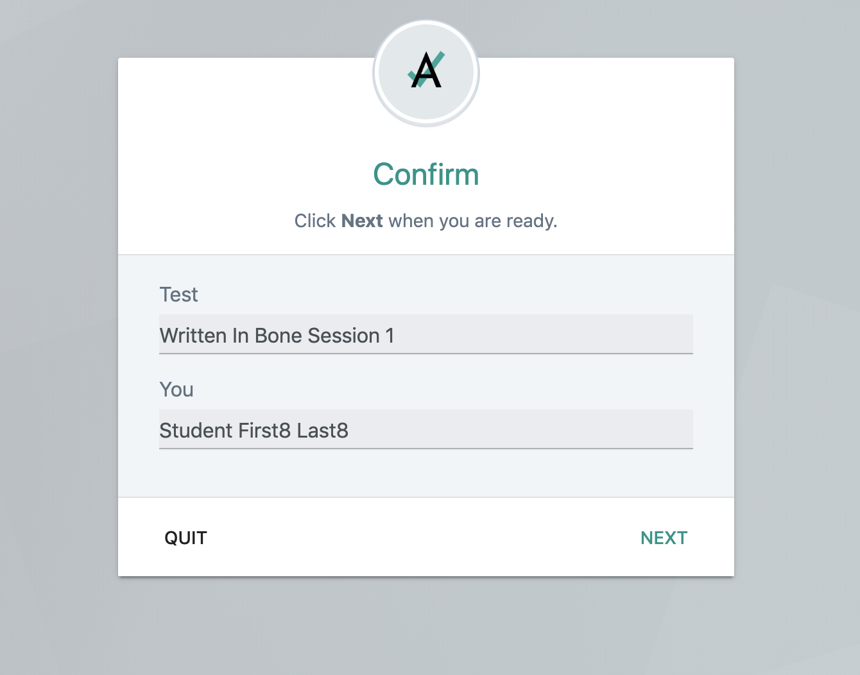
Student Testing Experience
Students will see the screen to the right confirming they are about to begin their test. If their first and last names are not correct, they should alert their proctor.
After the student clicks the NEXT button, the student will be directed to the assessment instructions page.

Slide 36
Materials Provided to Students
The test administrator must provide students the following:
Blank or lined scratch paper
Students can request more scratch paper during the test, if needed. All scratch paper—used and unused—must be collected after testing.
Pencils
Testing devices that meet the minimum technology specifications set forth by LDOE (NOTE: A student should not supply their own device for testing.)
Headphones (for students who require them)
Materials necessary for accessibility features
Timing devices such as a clock or watch, to keep track of time during testing (if one is not clearly visible in the testing room)

Slide 37
Break Between Sections
The Innovative assessment includes more than one section. When Section 1 is completed, the test administrator should provide students with a break before they begin Section 2.
Please note that students cannot return to Section 1 after the break.

Slide 38
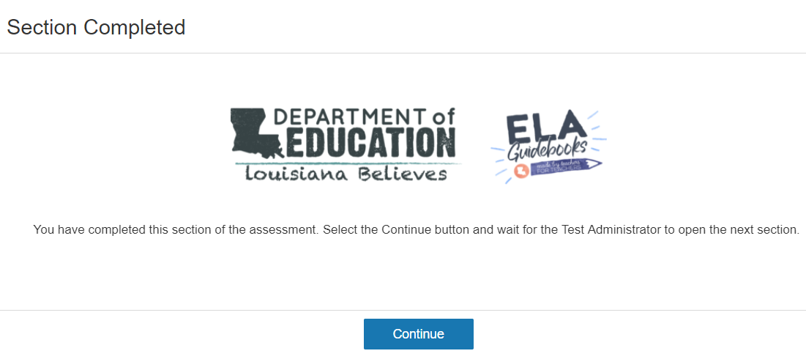
Continue to Section 2 Screen
Once students complete Section 1, they will be presented with the following screen:

Slide 39
Handling Materials for Extended Breaks
After each day’s scheduled testing, all secure materials must be returned to the school test coordinator for storage in the locked, secure storage area.
If an extended break is scheduled for any reason, secure materials must be returned to the school test coordinator to be stored in the locked, secure storage area during the extended break.

Slide 40
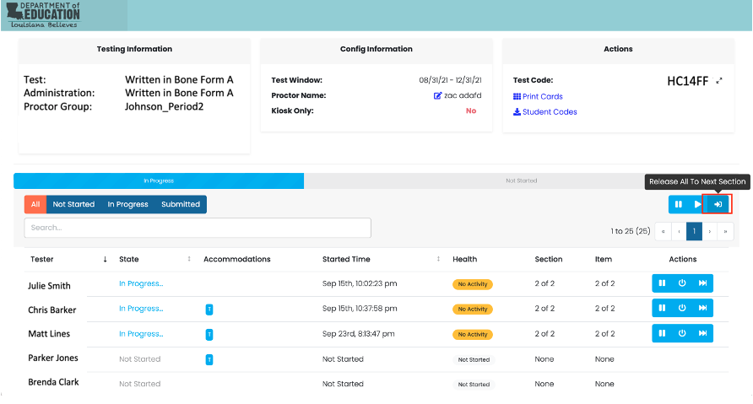
Release to Next Section Button
After the break, the proctor must click the Release to Next Section button (shown below) from the proctoring screen to allow students to start Section 2.

Slide 41
Interruptions in Testing
If… | Then…
A student exited the test by using the End Test function and the student needs to log back into the test: | Test administrator/proctor can un-submit the student section. NOTE: This action will only allow students to resume Section 2 of the test. If the student exited the test on Section 2, the student will start on Section 2 and will not be allowed back into Section 1.
A student exited the test by using the Pause/Exit function, or the student was inactive in the system. For example, this may occur when a student becomes ill and the test section is suspended. In this case, the section in progress will automatically lock at the end of each day. To continue testing the In-Progress section: | Test administrator/proctor must reseat the student using the Reseat action in the proctor dashboard. Once the student has been reseated, the original test code may be used to resume the test. It is critical that the administrator monitor the student as the student is NOT allowed to return to previously answered items within the In-Progress section.
A testing irregularity is detected (student exits the section in a way that the secure browser detects an irregularity): | Test administrator/proctor must resume the student test section using the Resume action in the proctoring dashboard. If a testing irregularity is detected it is important for an administrator/proctor to document what occurred with the student section that caused the testing irregularity.

Slide 42
Pausing a Test
Tests can be paused in two ways:
Student Screen Pause: can be used in a single student needs a break for up to 20
minutes.
Proctor Pause: can be used for breaks that are longer than 20 minutes or if a student needs to move to a new testing location.

Slide 43
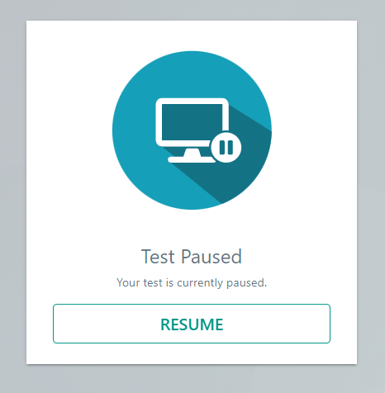
Student Screen Pause
The Student Pause function should be utilized if students have to leave their computer station for any reason for a period of less than 20 minutes.
Upon resuming, students are returned to the portion of the test where they were prior to the pause.
Notes or markings students made using the online tools before pausing the test will remain.

Slide 44
Proctor Pause
The Proctor Pause function should be utilized if a student needs to exit the test without submitting the answers for scoring.
If a student needs to move to a new location to continue the assessment, the test administrator should use the Proctor Pause button to pause the test until the student is ready to resume testing at the new location.
The Submit button should not be clicked if the student has not completed the assessment. The only time the Submit button should be used is when a student exits a test section and forgets/fails to submit the test.

Slide 45
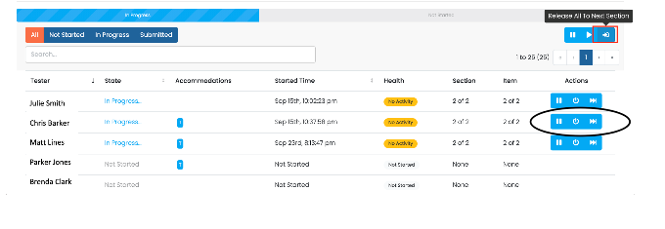
Reseating
There are specific reasons why a proctor might need to reseat a student, like the student exited the lockdown browser and is in a 'Breached' state or their computer session expired. There are other non-specific reasons where reseating can resolve an issue a student is having with navigation in the test.
From the proctor dashboard, click the reseat student button from the action buttons to the right of the student’s name.

Slide 46
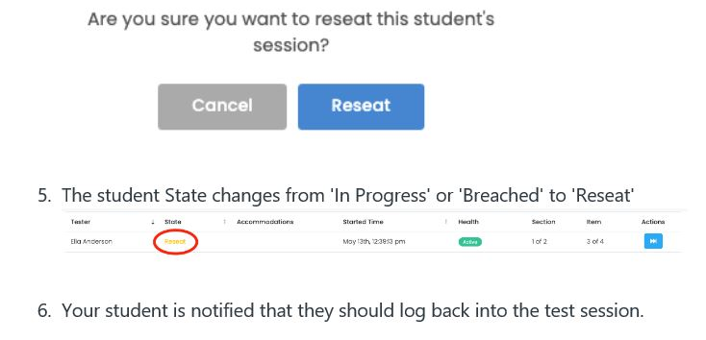
Reseat Confirmation
The system will ask the proctor to confirm the reseating action.

Slide 47
Proctor Dashboard Support Desk
For more information about the proctor dashboard, consult the LDOE ELA Innovative Assessment Pilot Support Desk.

Slide 48
Accommodations

Slide 49
Students with Accommodations
The testing platform does not provide for all accommodations to be listed. Text-to-speech is listed because it is needed to activate a recording for the student. All accommodations that are listed on a current IEP, IAP or EL checklist must be given to students, even though users will not be able to select them as part of a list.
A testing void is appropriate when:
Students are tested without accommodations
Students are tested with incorrect accommodations

Slide 50
Text-to-Speech
The Text-to-Speech (TTS) function is available for students who have the Tests Read Aloud accommodation on an IEP, IAP, or EL checklist. TTS allows students testing online to listen via headphones or speakers to test information displayed on the screen. Words and numbers, including test directions, items, answer choices, and other information, will be read aloud and can be repeated as necessary.
If TTS is enabled for a student’s test, the student will see the Text-to-Speech tool bar (shown below) when starting the test. Student must select the first button to enable TTS.

Slide 51
Testing Students with Accommodations
Test administrators testing students with accommodations should be provided with the following:
Training on what accommodations each student will receive
A list of the accommodations each student is set to receive and when they should receive them
Processes for communicating with the testing coordinator should questions or issues arise during administration
Test administrators testing students with accommodations, including small group, are expected to actively monitor during administration including moving about the room and ensuring limited student interaction during any breaks.

Slide 52
Test Security

Slide 53
Violations of Test Security: Related Policy
Violations of test security are defined in Bulletin 118 and include:
Administering tests in a manner that that would give examinees an unfair advantage or disadvantage
Giving examinees access to test questions prior to testing
Examining any test item at any time (except for providing certain accommodations)
At any time reproducing or discussing all or part of any secure materials
Coach or interfering with examinees in any manner during testing
Altering or interfering with examinees’ responses in any manner
Administering previously administered or current forms of any statewide assessment
Failing to account for and secure test materials
Conducting testing in alternate environments without approval
Failing to report any testing irregularities
Participating in, encouraging, or failing to report any violation
Violations of test security can result in the revocation of a teaching or leadership certificate as defined in Bulletin 746.

Slide 54
Testing Irregularities: Definition and Reporting
Definition:
A testing irregularity is any incident in test handling or administration that leads to a question regarding the security of the test or the accuracy of the test data.
Process for reporting:
All testing irregularities must be reported in writing to the School Test Coordinator, who must then send the written reports to the District Test Coordinator.
Districts may only send the following information to LDOE
Louisiana Secure ID
First letter of first name
First three letters of last name
Birth day only (excluding birth month and birth year)t Adminis

Slide 55
Access to Test Materials: Definition and Process
Definition:
Access is defined as handling the materials, reading, reviewing, or analyzing test items or student responses, either before, during, or after testing except when providing approved accommodations.
Processes for limiting access:
Limiting keys to locked secure areas
Conducting all precoding and sorting of materials in central secure locations

Slide 56
Secure Materials
Secure test materials include the following:
ADAM test codes
Student rosters
Student Login Tickets—LASID (if school elects to print for student use)
Lists of students being provided accommodations
Scratch paper written on by students
Any other materials including electronic formats that may contain test items or student responses

Slide 57
Test Security: Active Monitoring
Definition:
Active monitoring means that test administrators should be actively engaged in observing students’ behavior at all times during the administration of state assessments.
Practices to ensure active monitoring:
Active monitoring involves moving about the testing area so students’ actions can be viewed from multiple vantage points.
Test administrators should not be engaged in other activities that would distract or prevent them from accomplishing this task.
Test administrators should glance at the screen to ensure that students are working on the correct portion of the test.
Test administrators must be aware that active monitoring also applies to maintaining test security during breaks by limiting interaction between students.
Test administrators for a small groups must ensure that students receive the appropriate accommodations at the appropriate times.

Slide 58
Active Monitoring: Violations of Test Security
While it is essential to actively monitor during test administration, it is considered a violation of test security for test administrators to do any of the following.
Unauthorized viewing of test content for any reason other than to ensure students are working on the correct area is a violation and can include:
Viewing test content long enough to determine the essence of a question or prompt
Looking at the screen to determine if a student marked responses
Viewing the screen to see if a student used a strategy
Memorizing test questions
Copying test questions
Examining a graph or illustration

Slide 59
Test Security: Next Steps
Prior to administration of any state assessment district test coordinators are required to train school test coordinators in test security as well as any LEA level staff that may be participating in test administration or monitoring. School test coordinators are required to train school-level staff (e.g., test administrators, proctors, monitors).
Resources available for test security training include:
Test Coordinator and Administrator Manuals and
Test Security Training for Schools.
Next steps for district test coordinators:
Ensure testing rooms are prepared for testing.
Schedule school test coordinator and district staff test security trainings.
Provide test security training to school test coordinators and district staff.
Support school test coordinators in scheduling and providing training to school staff.
Plan for district monitoring of the test administration.

Slide 60
Accountability

Slide 61
Accountability
All students in grades 3-8 must participate annually in a statewide test administration. The state of Louisiana received permission to administer a different kind of assessment to grades as part of the Innovative Assessment Program. However, students must continue to participate in testing and be included in accountability.
The only assessments that will be used to replace LEAP ELA grade level assessments is the IAP Grade 7 operational assessment. All students who are participating in field tests and pilot tests MUST take the regular LEAP ELA grade-appropriate assessment in the spring.

Slide 62
Accountability, Cont.
Students who participate in all three Innovative Assessment Grade 7 Operational windows will receive a final report that will include an achievement level comparable to the achievement levels earned in LEAP 2025.
If a student misses one or more Grade 7 Operational test windows, the student must also take the regular LEAP 2025 grade 7 ELA assessment. All students who participate in Grade 7 Operational assessment must take all other LEAP 2025 grade 7 subjects: mathematics, science and social studies.
Special Note: If a test from any of the three IAP windows is voided for any reason, the student will not be permitted to take LEAP 2025 to replace the void. This would create an inequitable opportunity not available to other students in grade 7.

Slide 63
Accountability Coding
Accountability codes should be applied to each assessment that is not taken by a student who is expected to participate in the Grade 7 Operational assessment. As with all accountability codes, documentation should be available for department audit.

Slide 64
Communication and Next Steps

Slide 65
Administration Forms
Two updated administration forms are now available in the assessment library.
For requesting unique accommodations, please use the same form that is available for all other LEAP testing.
IAP Additional Materials Request Form
IAP Void Request Form

Slide 66
Department Monitoring
Site Visits
During the first window beginning January 24, the department will conduct site visits to gather feedback and monitor test administration.
Please send your testing schedule to assessment@la.gov as soon as possible.
Technical Support
If you have any questions, please contact ADAM support at 855-866-5778 or LDOE at 1-844-268-7320 or email: assessment@la.gov.

Slide 67
Next Steps
Date | Action
Past Due | Send test schedules to assessment@la.gov
Available Now | Install locked down browser. Teachers and students use OTT.
January 10 | Test coordinator and administration manuals available
January 12 | Student rosters available
By first day of testing | Train all test administrators in security and administration
Testing Window | January 24-February 11

