Slide 1
Louisiana Models of Excellence
Overview
2026-2027 School Year

Slide 2
Agenda
Introduction to Models of Excellence
Meet Past Models of Excellence Recipients
Timeline
Nomination Process
Models of Excellence Awards Ceremony
Questions

Slide 3
Introduction to Models of Excellence

Slide 4
Louisiana Models of Excellence Overview
The Louisiana Models of Excellence initiative was created in an effort to acknowledge, honor, and spotlight schools serving as exemplary models for implementing the Department’s educational priorities that leads to the advancement of student success. This initiative has three main goals.
  To celebrate excellence in Louisiana schools
  To share stories of success and provide models for others to see
  To create high-impact partnerships across school systems

Slide 5
Criteria
What does it take to be recognized as a Model of Excellence?
  An exemplar for outstanding or innovative strategies
  Addressing a priority focus area
    Early childhood leading to kindergarten readiness
    Literacy instruction aligned to the Science of Reading
    Math instruction from foundational to advanced skills
    Opportunities ensuring a meaningful high school experience
    An effective teacher for every student
    Expand educational choice for students and families
  Advancement of student learning
  Rapid Improvement

Slide 6
Meet Past Models of Excellence Recipients

Slide 7
Phillis Wheatley Community Schools (FirstLine Schools)
Phillis Wheatley Community School’s leadership team and staff are improving literacy outcomes through dedicating an instructional coach to literacy, tracking student data, and a commitment to professional growth through their Early Literacy initiative.
Learn more about the Early Literacy initiative.

Slide 8
East Feliciana Public Schools
East Feliciana Public Schools is committed to accelerating learning recovery by providing students with additional opportunities for learning and growing through the summer months. Their summer learning program, EF Accelerate, focused on providing deeply engaging experiences, strong academics, and a balance of enrichment activities and field trips.
Learn more about EF Accelerate.

Slide 9
Rapides Parish Schools
Rapides Parish Schools is guiding young people on a path to becoming accomplished teachers through a district level strategy for implementing a pre-educator pathway, collaborating with a university to offer dual enrollment classes and providing clinical experiences for future educators.
Learn more about their Pre-Educator Pathway.

Slide 10
Mansfield Elementary School (DeSoto Parish)
Mansfield Elementary School is making great gains in literacy with their initiative for literacy interventions, Strategic Literacy Focus. Along with incorporating a "Whatever I Need (WIN)" literacy program, the leadership team and staff ensure all students receive intervention and extensions based on individual student needs.
Learn more about Strategic Literacy Focus.

Slide 11
Lafourche Parish School District
Lafourche Parish School District was named as a Models of Excellence recipient for the success of their innovative science initiative, Making the Impossible Possible Through Science, and their perseverance through Hurricane Ida. There approach to science includes strong instruction and engagement that’s even adaptable for emergency shifts to virtual instruction.
Learn more about Making the Impossible Possible Through Science.

Slide 12
Calcasieu Parish School Board
Calcasieu Parish School Board is ensuring students at every high school have access to challenging courses taught by highly qualified teachers. Their Virtual Instruction Program (VIP) provides students at all high schools with access to high quality courses such as STEM, Dual Enrollment, and Advanced Placement.
Learn more about their Virtual Instruction Program.

Slide 13
Central Community School System
Central Community School System is ensuring every student is on track to a professional career, college degree, or service through their Response to Intervention (RTI) program, Wildcats W.I.N.
Learn more about Wildcats W.I.N.

Slide 14
West Feliciana Parish Schools
West Feliciana Parish Schools is strategically addressing gaps in learning for literacy and math through high-dosage tutoring.
Learn more about their High-Dosage Tutoring initiative.

Slide 15
Plaquemines Parish School System
Plaquemines Parish School System demonstrates how intentional implementation of Louisiana's new social studies standards, through aligned policies, high-quality instructional materials, robust professional learning, and a literacy-focused approach, can improve student outcomes and ensure access to grade-level mastery.
Learn more about their Freedom Framework Initiative.

Slide 16
Timeline

Slide 17
Timeline Overview
August- Begin accepting nominations
  While the portal will remain open, nominations need to be submitted by February 1, 2027 to be considered for the 2026-2027 school year
September-May
  Interviews on Zoom may be held with schools/school systems
  Selected schools/school systems will be notified
  Assembly planning call(s) with recipient will be conducted- 3 weeks
  Hold award ceremony and learning walks- 1 day

Slide 18
Nomination Process

Slide 19
Nomination Process Overview
Step One
  Preview the Portal Questions
    Note
      You may use this preview document to prepare your responses.
Step Two
  Complete the information in the Nomination Portal.
    Note
      Copy and paste your responses from the preview document into the portal or respond directly in the portal.

Slide 20
Models of Excellence Award Ceremony

Slide 21
Celebrations: What to expect?
Educational stakeholders, dignitaries, neighboring districts, and aspiring leaders will be invited to attend.
School assembly will be convened.
Assembly includes performances by students and introductions/acknowledgements.
A representative from the Louisiana Department of Education will present the award.
Learning walks to see the initiative in action will take place on the day of the ceremony.
Photos and videos will be taken throughout the day.

Slide 22
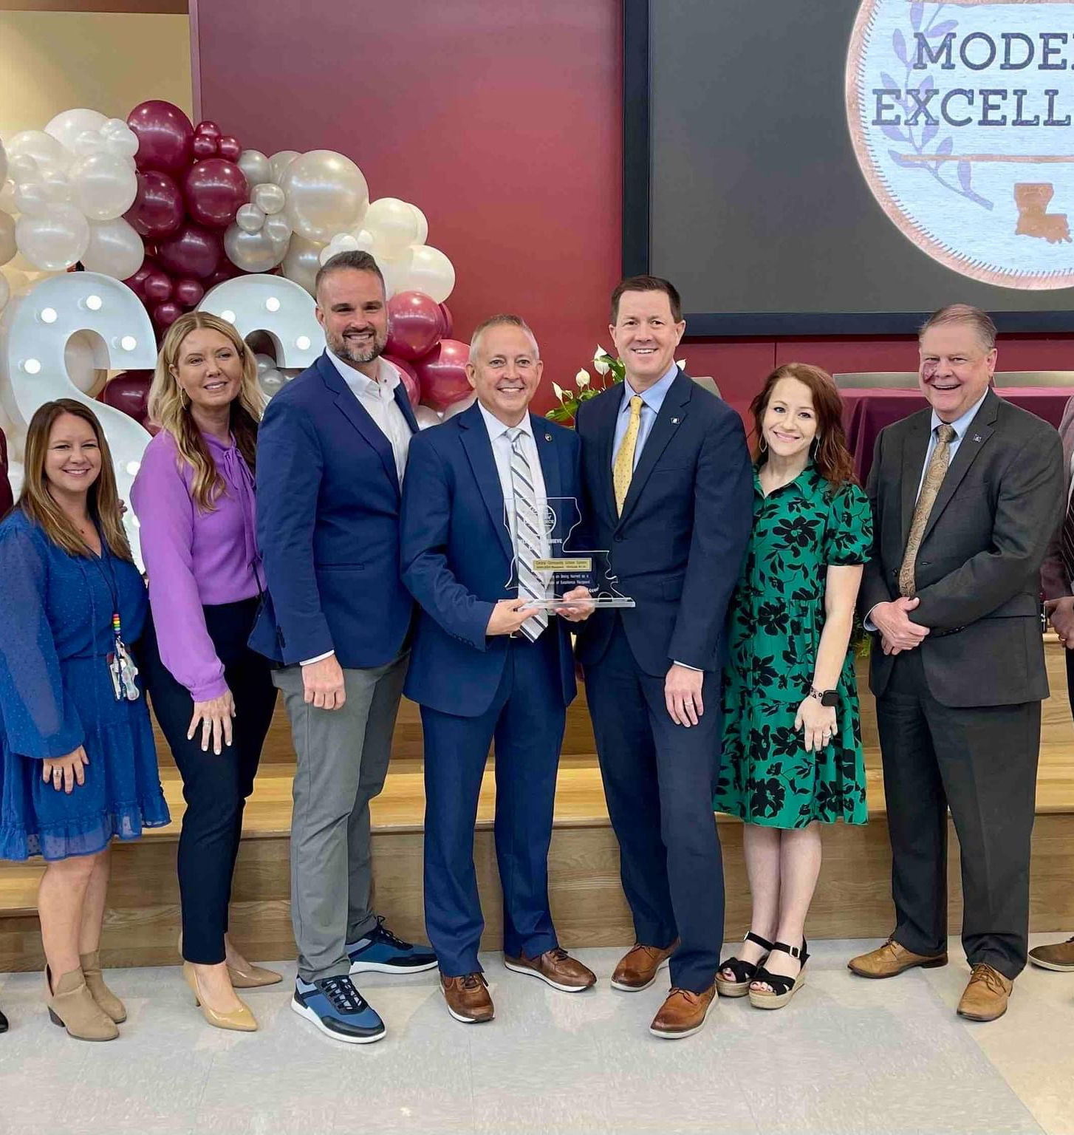
Celebrations Continued
Educational stakeholders, dignitaries, neighboring districts, and aspiring leaders will be invited to attend.
School assembly will be convened.
Assembly includes performances by students and introductions/acknowledgements.
A representative from the Louisiana Department of Education will present the award.
Learning walks to see the initiative in action will take place on the day of the ceremony.
Photos and videos will be taken throughout the day.

Slide 23
Next Steps and Questions

Slide 24
Next Steps and Questions Overview
Next Steps
  Complete the information in the Nomination Portal.
    Nominations need to be submitted by February 1, 2027, to be considered for the 2026-2027 school year.
Questions
  Questions may be submitted to modelsofexcellence@la.gov.

