Slide 1
Teacher and Principal of the Year Programs
Application Process Overview
2026-2027 School Year

Slide 2
Agenda
Welcome & Introductions
Programs Overview
Meet Our Partners
Benefits of Participation
Celebrating Current Honorees
Timeline & State-Level Application Materials
Local & State-Level Processes
Informational Calls & Next Steps
Online Portals, Resources & Questions
Thank You

Slide 3
Teacher/Principal, New Teacher + Early Childhood Teacher/Leader of the Year Programs

Slide 4
Louisiana’s Teacher/Principal, New Teacher + Early Childhood Teacher/Leader of the Year Programs
The Louisiana Department of Education recognizes that great teachers and school leaders are critical to student success.
Annually, the Department, in partnership with Dream Teachers and the Louisiana Association of Principals, honors the state’s most exceptional educators through the Teacher/Principal, New Teacher, + Early Childhood Teacher/Leader of the Year programs.
These award programs provide an opportunity to acknowledge those educators who are making exceptional gains with students.
Please join us in celebrating exemplary educators in your school system.

Slide 5
Meet Our Partners

Slide 6

Dream Teachers
Visit the Dream Teachers website to learn more.
For questions, email theresa@dreamteachers.org.

Slide 7

Louisiana Association of Principals (LAP)
For more information about LAP, visit the LAP website.
For questions, contact Karen Triche, LAP Executive Director, at karen.triche@laprincipals.org.

Slide 8
Benefits of Participation

Slide 9
Benefits to Schools/School Systems/Communities
Participating in Teacher and Principal of the Year provides schools and school systems with the opportunity to:
Celebrate, honor and recognize outstanding educators for their dedication, leadership and impact.
Elevate statewide awareness of the exceptional work taking place in your school, school system and community.
Highlight innovative practices and leadership that can inspire and influence others.
Strengthen recruitment and retention by recognizing and elevating the educators who are making a difference.

Slide 10
Benefits to Candidates
Provides educators with the opportunity to:
Develop and amplify their voice to advocate for students, educators and the profession.
Engage in policy discussions and contribute their perspectives to improve education for all students.
Strengthen teaching and leadership skills through meaningful professional learning and leadership opportunities.
Represent and promote Louisiana educators and the education profession on a statewide stage.
Build relationships with other exemplary educators and expand their professional network across Louisiana.

Slide 11

2028 Louisiana Public Interest Fellowship
Launched in 2018, the fellowship allows recipients to spend the upcoming school year advocating for a key education initiative of their choosing.
2028 Louisiana Public Interest Fellowship recipient(s) will be chosen from the previous year’s list of Teacher of the Year semifinalists and finalists.
The fellowship is supported by a $50,000 state stipend.
Learn more about the fellowship.

Slide 12
21st Annual Cecil J. Picard Educator Excellence Awards Gala
On Saturday, July 24, 2027, the Department, in partnership with Dream Teachers, will host the 21st Annual Cecil J. Picard Educator Excellence Awards Gala at the National WWII Museum in New Orleans.
The evening will bring together honorees from multiple statewide educator recognition programs to celebrate their accomplishments, leadership and impact.
During the Gala, division-level and overall honorees will be announced and celebrated.

Slide 13
Educator Excellence Awards Gala Continued
The Educator Excellence Awards Gala is Louisiana’s premier celebration of educational excellence, honoring the educators and school support professionals who are making a meaningful difference for students, schools and communities.
Identify and nominate your strongest candidates for the opportunity to be recognized on this prestigious statewide stage.

Slide 14




Honorees at the Gala

Slide 15
Meet the Current Overall State-Level Honorees

Slide 16

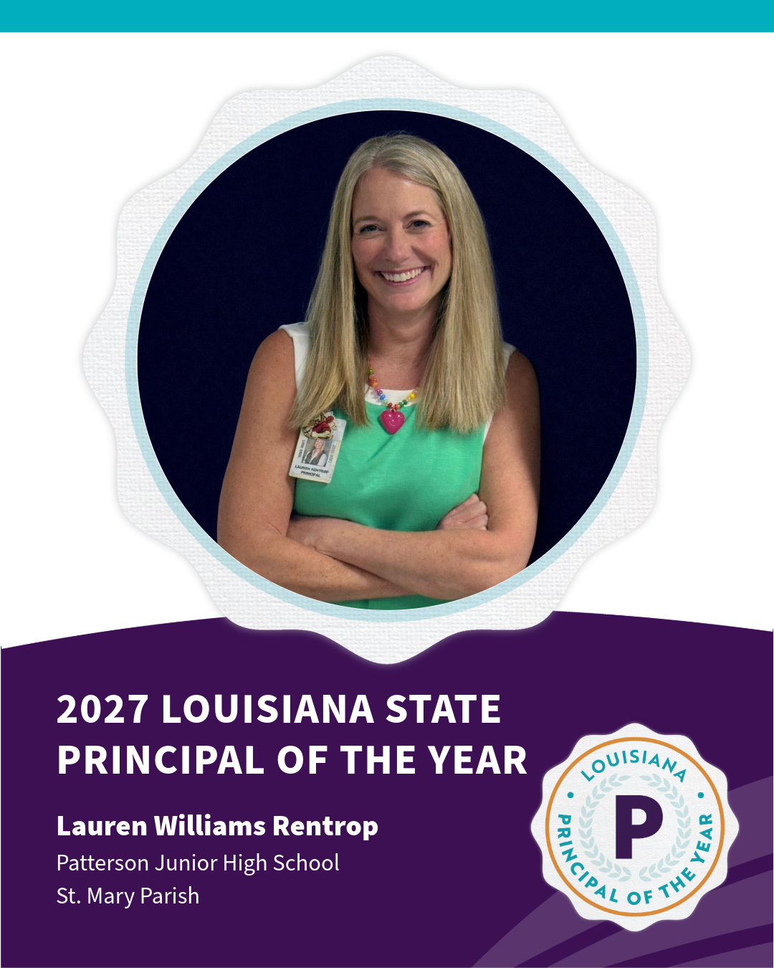
Meet the Overall State Teacher and Principal of the Year

Slide 17
Timeline

Slide 18
Timelines
Teacher/Principal of the Year
Early Childhood Teacher/Leader of the Year
New Teacher of the Year

Slide 19
Rubric Criteria

Slide 20

Teacher and Principal of the Year Competencies

Slide 21
Rubric Criteria Descriptors
Two-Word Descriptors & Descriptions
Visionary Leader — Creates vision, inspires action, and drives meaningful improvement.
Instructional Expert —Transforms learning through deep expertise and intentional practice.
Capacity Builder — Develops others, builds trust, and empowers growth.
Community Connector — Builds partnerships that expand opportunities and student success.
Education Ambassador — Inspires others, advocates for education, and elevates the profession.

Slide 22
Teacher of the Year Criteria
School systems are encouraged to select candidates who most closely match the criteria to participate in the state-level process.
An exemplary candidate for Teacher of the Year is one who:
Competency 1: Visionary Leader- Demonstrates leadership and innovation by expanding their influence beyond the classroom, empowering students and colleagues, sharing expertise, and developing, implementing, or improving practices, programs, or initiatives that strengthen teaching, learning, and the profession.
Competency 2: Instructional Expert- Demonstrates deep content knowledge and instructional expertise by designing and refining intentional, evidence-based learning experiences that engage diverse learners, accelerate student growth, and reflect a clear vision for teaching and learning.

Slide 23
Teacher of the Year Criteria Continued
Competency 3: Capacity Builder- Builds authentic relationships with students, colleagues, and families to foster trust, belonging, respect, and shared responsibility where students feel valued, supported, and empowered to thrive.
Competency 4: Community Connector- Creates meaningful connections between the classroom and the broader community through authentic partnerships and real-world experiences that expand learning opportunities, student voice, agency, and success.
Competency 5: Education Ambassador- Communicates with authenticity, professionalism, and purpose while inspiring others, advocating for students and educators, and elevating the teaching profession through their voice, leadership, and actions.
View the Teacher of the Year Rubric.

Slide 24
Principal of the Year Criteria
School systems are encouraged to select candidates who most closely match the criteria to participate in the state-level process.
An exemplary candidate for Principal of the Year is one who:
Competency 1: Visionary Leader- Establishes and communicates a clear vision for teaching and learning while developing leadership capacity, fostering continuous improvement, and implementing systems that improve instruction, educator effectiveness, and student outcomes.
Competency 2: Instructional Expert- Demonstrates instructional leadership by building teacher effectiveness through high-quality instructional practices, coaching, professional learning, and data-informed decision-making that results in measurable improvements in teaching and student learning.

Slide 25
Principal of the Year Criteria Continued
Competency 3: Capacity Builder- Builds a collaborative environment and organizational capacity through instructional leadership teams, professional learning, and meaningful collaboration that foster trust, shared responsibility, educator growth, and continuous improvement for student success.
Competency 4: Community Connector- Develops meaningful partnerships with families, businesses, and community organizations that expand access, enrich learning experiences, and create opportunities that improve student achievement, college and career readiness, and community engagement.
Competency 5: Education Ambassador- Communicates with authenticity, professionalism, and integrity while inspiring others through a clear vision for teaching and learning and serving as an effective ambassador for Louisiana educators, public education, and instructional excellence.
View the Principal of the Year Rubric.

Slide 26
Application Process and Materials

Slide 27
Principal of the Year Application
The Principal of the Year application consists of the following components:
Basic Information, including a professional bio (third person), six-word story and social media quote
  View the Professional Bio Guidelines.
Résumé (limit: two pages)
Two years of recent student success data (SLTs or other relevant data)
  Do not include student personally identifiable information (PII) in submitted data.
Up to three letters of recommendation, including one from the candidate’s supervisor

Slide 28
Principal of the Year Application Continued
Honoree Headshot — see the Honoree Photo Guidelines
Candidate Consent Form (teacher waiver)
Student Consent Forms — one for each student featured in submitted videos, photos or other materials
Three written reflection responses and one video response
Supplemental Materials — some required; others optional
View the Principal of the Year Application for complete application requirements.

Slide 29
Teacher of the Year Application
The Teacher of the Year application consists of the following components:
Basic Information, including a professional bio (third person), six-word story and social media quote
  View the Professional Bio Guidelines.
Résumé (limit: two pages)
Two years of recent student success data (SLTs or other relevant data)
  Do not include student personally identifiable information (PII) in submitted data.
Teacher Video- see Teaching Video Guide
Lesson Plan corresponding to the submitted teaching video

Slide 30
Teacher of the Year Application Continued
Up to three letters of recommendation
Honoree Headshot — see the Honoree Photo Guidelines
Candidate Consent Form (teacher waiver)
Student Consent Forms — one for each student featured in submitted videos, photos or other materials
Three written reflection responses and one video response
Supplemental Materials (optional)
View the Teacher of the Year Application for complete application requirements.

Slide 31
Teacher/Principal of the Year Certification
In the application portal, candidates are asked to upload their teaching/educational leadership certificate.
Certificates may be accessed on the Louisiana Educator Portal website.
A candidate does not have to be certified to participate in the state-level Teacher and Principal of the Year process. However, a strong candidate is one who demonstrates a commitment to the education profession, as well as meets the criteria.

Slide 32
Teacher and New Teacher- Teaching Video
The teaching video is an opportunity to demonstrate excellent teaching in an authentic classroom setting.
Videos should not exceed 15 minutes and may be edited.
Teaching may take place in person, virtually, or in a hybrid learning environment.
Candidates should select a lesson that reflects who they are as educators and demonstrates how they intentionally plan for, facilitate, and respond to student learning.
The video should demonstrate the candidate’s instructional decision-making, interactions with students, responsiveness to student learning, and reflection on teaching and learning.

Slide 33
Teaching Video Continued
Suggested Video Structure: Candidates may divide the video into three segments. Suggested times are provided as a guide only; candidates may adjust the time allotted to each section while remaining within the 15-minute limit:
  Lesson Context & Instructional Decisions — 3 minutes or less
  Teaching & Learning in Action — 10 minutes or less
  Instructional Reflection — 3 minutes or less
At the state level, videos must be submitted as a YouTube video link.

Slide 34
Teaching Video Scoring
The state review team will evaluate the teaching video based on four criteria:
Lesson Context & Instructional Decisions
Teaching & Learning in Action
Instructional Reflection
Professional Presence & Communication
Reviewers will evaluate the video holistically. The lesson plan provides context for interpreting the video but is not scored.
View the Teacher Video Guide and Teaching Video Rubric.

Slide 35
Candidate and Student Consent Forms
Candidates must sign and submit the Department’s Candidate Consent Form through the state-level online application portal.
Students featured in the state-level application—including in video, film, audio, photography, or other recordings—must have a parent/guardian sign and submit the Department’s Student Consent Form.
Whenever possible, combine all Student Consent Forms into a single PDF and upload the document to the state-level online application portal.
An alternative submission option is available for candidates who do not have access to a scanner.
View the Candidate Consent Form.
View the Student Consent Form.

Slide 36
School System-Level Process

Slide 37
Teacher/Principal + New Teacher School System-Level Process
School systems are encouraged to:
Select up to three honorees in each program—one representing each division (elementary, middle, and high)—to advance to the state-level process.
Submit at least one teacher and one principal to the state-level process.
Use the state’s application materials or their own local process to identify and select local-level honorees.

Slide 38
School System-Level Process Continued
School systems determine:
Division and grade-level assignments within their local selection process. At the state level, candidates who serve multiple divisions—such as a principal of a K–12 school—may select the multi-division option.
Who may participate in the local selection process, such as librarians and other educators or school-based professionals.

Slide 39
School System-Level Considerations
Important considerations for state-level candidates:
LEADS/LES and past Compass data, when available, are considered in the state-level Teacher and Principal of the Year selection process.
School systems should ensure that state-level candidates demonstrate evidence of success with students.

Slide 40
Informational Calls for
Candidates and Stakeholders

Slide 41
Candidate and Stakeholder Calls
At key phases throughout the process, the Department will offer informational and help desk calls for school system coordinators, candidates and stakeholders.
Informational Calls
Provide updates and guidance on the Teacher/Principal, New Teacher, and Early Childhood Teacher/Leader of the Year programs.
Cover the application process, timeline, requirements and other key information.

Slide 42
Candidate and Stakeholder Calls Continued
Help Desk Calls
Provide technical support and assistance with the online application portal.
Stay Informed
Call information will be shared with school system coordinators and through Department communications, including the LDOE Weekly Newsletter.

Slide 43
Next Steps

Slide 44
Next Steps for Coordinators
Review the application materials and resources available on the Staff and Educator Awards page.
Conduct your local selection process and identify your system-level honorees.
Submit your selected candidates to the appropriate state-level process by the established deadlines.
Ensure candidates are properly vetted and approved by the school system before submission.
Know that every candidate submitted to the state-level process is eligible for consideration as an overall state-level honoree.

Slide 45
Next Steps for Candidates
Review the application requirements and resources available on the Staff and Educator Awards page.
Begin preparing application materials early and maintain electronic copies for future use and submission.
Participate in informational and help desk calls to receive guidance and support throughout the state-level application process.
When the online portal opens, submit your completed application through the appropriate state-level application portal.
Start early. Tell your story. Showcase your impact. Enjoy the process!

Slide 46
Online Portals

Slide 47
Application Submission
Program coordinators will be notified when the state-level application submission process opens.
Teacher, Principal and New Teacher of the Year: Applications will be submitted through the state’s online application portals. Links will be available on the Staff and Educator Awards page when the portals open.
Early Childhood Teacher/Leader of the Year: Application submission information and instructions will be provided to stakeholders.
School systems will be asked to verify the names of their state-level candidates.

Slide 48
Submission Dates
State-level candidates are responsible for submitting their application materials by the applicable deadline.
Applications for Teacher/Principal of the Year, New Teacher of the Year, and Early Childhood Teacher/Leader of the Year are due by 11:59 p.m. on January 14.

Slide 49
Resources

Slide 50
Resources for Award Programs
Application materials, timelines, and information about the Teacher/Principal, New Teacher, and Early Childhood Teacher/Leader of the Year programs may be found on the Staff and Educator Awards page.
See also the next slides which contains hyperlinks to all application materials.

Slide 51
Teacher and Principal of the Year Materials
Please share the links below with your candidates for easy access to all application materials.
Application- Principal of the Year
Application- Teacher of the Year
Consent Form- Candidate
Consent Form- Student
Candidate Recommendation Form (Optional)
Example Bios
Professional Bio Guidelines

Slide 52
Teacher and Principal of the Year Materials Continued
Rubric- Teacher of the Year
Rubric- Principal of the Year
Rubric- Teaching Video
Teaching Video Guide- Teacher of the Year
Timeline- Teacher and Principal of the Year

Slide 53
Contact for Questions

Slide 54
Questions? We’re Here to Help
Teacher/Principal of the Year: excellenteducators@la.gov
New Teacher of the Year: mentorandcontentleaders@la.gov
Early Childhood Teacher/Leader of the Year: brandee.david@la.gov

Slide 55
Thank You For Your Participation

Slide 56

Thank You
We appreciate your partnership in celebrating excellence.
Together, we celebrate the educators and school support professionals who make a difference for Louisiana students every day.
We look forward to working with you throughout the year!

