Slide 1
Micro-Enterprise Credential
the purpose of the
Principles of Business course

Slide 2
Micro-Enterprise
Means
“Small business”

Slide 3
Micro-Enterprise Credential objective
To provide Louisiana students with the fundamental skills and knowledge they need to be effective small business employees, and (one day) small business owners/entrepreneurs

Slide 4
What’s in it for you?
If you earn the Jump Start Micro-Enterprise Credential you will . . .
Master critical workplace behaviors and communication skills
Learn how to access credit, and what different types of credit cost
Learn how to process critical small business forms and paperwork
Learn essential financial concepts and terms, the “language of business”
Have a very valuable credential to put on your resume
Have a greater chance of getting a job because the employer knows you understand how business works
Learn how to be a better employee
Have knowledge of how to start your own small business

Slide 5
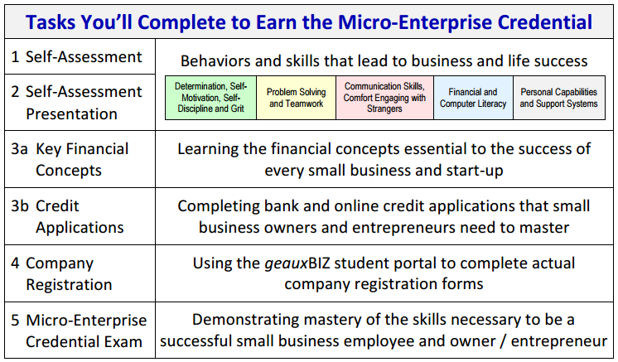
What do you have to do?

Slide 6
Requirement 1:
Complete a Self-Assessment
You will learn about the key behaviors associated with business success, and then make an honest self-assessment of where you have strengths and where you have areas of improvement

Slide 7
Requirement 2:
Make a Self-Assessment Presentation
You will meet—either face-to-face or over a computer video conference—a small business leader who will listen to your presentation.
This might sound scary, but I guarantee you this will be a great opportunity for you to practice your communication skills with a real business expert.

Slide 8
Requirement 3:
Complete Credit Applications
Almost every business needs to obtain credit to succeed. In today’s business world, there are many different sources of credit that small businesses can apply for. You will complete actual credit applications, some of which are complicated and intimidate small business owners. Together, we’ll make sure you learn how to complete these applications completely and confidently.

Slide 9
Requirement 4:
Register a Small Business Online
with the Louisiana Secretary of State
You will go to a specially-designed student portal to complete some of the actual forms businesses need to complete to start up operations in Louisiana.

Slide 10
Requirement 5:
Pass the Micro-Enterprise Credential Exam
This online test will be challenging but you will be well-prepared to succeed. Part of our work together will teach you key financial concepts that will be on the test, using plain English that makes each financial concept totally understandable.

Slide 11
Why I know we will succeed together
We will complete several hands-on exercises that will teach you about “pitching” your business to potential investors.
We will work with industry experts—watching videos and video conferencing with Nepris
You will complete carefully developed exercises that help you build key business skills

Slide 12
Why being in this class is an amazing opportunity
You are enrolled in a completely new credential program—You are a trail blazer in Louisiana, the US, and the world!
You will be amazed at the improvement in your business knowledge, your communication skills, and your ability to easily complete tasks that others find intimidating and difficult.

