Slide 1

School System and Charter School
Business Manager and Financial Officer
Monthly Call Meeting
April 2024

Slide 2
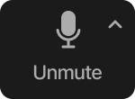


Zoom Meeting Preparation
Please make sure your phone or computer is muted to minimize background noise.
  To do this, hover over the bottom left-hand side of your screen and click “Mute.”
Please make sure you have turned off your camera to save bandwidth and prevent any connectivity issues.
  To do this, hover over the bottom left-hand side of your screen and click “Stop Video.”
Please submit questions during the presentation in the “Chat” function located on the bottom of your screen.
If you require an interpreter or have other accessibility needs for future LDOE meetings, please contact LDOEcommunications@la.gov.

Slide 3
Agenda
Welcome
Required Submissions and Reminders
Required School Lunch Match
State and Federal Grants Update
Maintenance of Effort and Fiscal Monitoring
MFP Update
Single Audit Due Date
2024-2025 Retirement Contribution Rates
Call Dates and Slide Deck Links
Resources

Slide 4
Required Submissions

Slide 5
Upcoming Required Submissions
Periodic Expenditure Report
FY 24 Fiscal Year End Deadlines
Charter Schools 3rd Quarter Budget Report
Allocation Review
Please contact schoolfinancehelpdesk@la.gov

Slide 6
Periodic Expenditure Reports (PERs)
PERs are currently not being submitted by many school systems on or before deadline.
Non-submission is a problem because PERs support education requirements for federal grants.
Tools are being implemented to encourage school systems to comply with the due dates to include but not limited to reminder emails from eGMS.
      PER Submission Deadlines are:
        3/31 due 4/15
        6/30 due 7/15
        9/30 due 11/15
        12/31 due 1/15
Please arrange your work plans such that compliance with the required deadlines can be improved.
Please contact ldoe.federalclaims@la.gov

Slide 7
FY 24 Fiscal Year End Deadlines
The deadlines noted below have been established by the Department to ensure all grants funding for FY 2023-24 is utilized. Failure to meet these deadlines risks funding availability for school systems and schools. The Department cannot guarantee the payment of late reimbursement claims and/or late claims might have to wait until the following fiscal year (June 2024) for funds to be available.
We appreciate your cooperation and thank you for helping us be good stewards of these funds.
June 19 8g claims due in eGMS
July 5 Carl Perkins and LDH claims for June expenses are due in eGMS
July 15 All other state and federal awards (excluding 8g, Carl Perkins, and LDH) ending
June 30, 2024, are due in eGMS
Please contact ldoe.federalclaims@la.gov

Slide 8
Charter Schools
3rd Quarter Budget Submission
The Third Quarter Financial Budget Report for FY 2023-2024 is due by April 30, 2024.
If your organization operates more than one charter school, you must submit the financial report for each individual school.
For more details see the Instructions for Quarterly budgets tab in the Annual Budget Workbook.
Please contact charterfinancehelpdesk@la.gov

Slide 9
Allocation Review
A review of the implementation and administration of the 2023-24 Differentiated Compensation Allocation will conducted by the SSFS Office.
The purpose of the review is to verify compliance of the State Funded Program with program administration guidance and assess utilization of State funds.
The Review Document will posted in the weekly newsletter on April 30 to school system business officials for completion and must be completed and returned no later than by May 8th.
SSFS will analyze responses and follow-up with any outstanding questions.
Please contact schoolfinancehelpdesk@la.gov

Slide 10
Required School Lunch Match

Slide 11
Required School Lunch Match
The United States Department of Agriculture (USDA) requires an annual match of state funds for the school lunch program.
The Louisiana Department of Education is provided a total state match amount by the USDA each year that must be divided into individual school system match amounts.
A memorandum explaining the requirements and a FY 2024-25 schedule containing the required match amount for each school system will be available in the MFP Library under the USDA REQUIRED SCHOOL LUNCH MATCH section on May 1, 2024.
Please contact ldoemfphelpdesk@la.gov

Slide 12
State Grants

Slide 13
State Grants
Computer Science Allocation
  The Computer Science Allocation provides funding for 6-12 teachers to receive comprehensive training to prepare for the Computer Science Praxis Exam. For more details, refer to the Computer Science Allocation guidance document in the Business Manager Support Library under State Allocations.
  These funds should be expended by June 30, 2024.
  Contact stem@la.gov regarding allowability of expenditures.
Please contact LDOEmfphelpdesk@la.gov

Slide 14
State Grants
Non-public Textbooks and Textbooks Administration
  Allocations for non-public textbooks and textbooks administration were released through eGMS in October 2023. Districts should collaborate with non-public schools to ensure that textbook purchases and payments have been made for this school year.
  These funds must be expended by June 30, 2024.
Please contact nonpublicfinancehelpdesk@la.gov

Slide 15
State Grants
Automated External Defibrillator (AED) Funding
  Allocations for AEDs administration were released through eGMS in January 2024. Districts should purchase AEDs from a state contract vendor. For more details, refer to the AED Guidance document in the Business Manager Support Library under State Allocations.
  These funds must be expended by June 30, 2024.
Please contact schoolfinancehelpdesk@la.gov

Slide 16
Federal Grants

Slide 17
Amended Liquidation Protocols

Slide 18
Amended Liquidation Protocols
In an effort to afford LEAs the fullest range of flexibility in drawing down the ESSER III funding, LDOE is implementing amended liquidation protocols.
  These amended protocols apply to the ESSER III funding (formula and incentive) only.
The amended protocols will allow LEAs additional time to liquidate:
  Goods
  Services
  Construction projects

Slide 19
Amended Liquidation Protocols
ESSER III Obligation Date: 9/30/2024
  Amendment liquidation does not change the obligation date of the funding.
Amended Liquidation Date: 12/16/2024
  LEAs now have until 12/16/2024 to receive goods and services
    All reimbursement claims and PERs should be submitted on or before 12/16/2024.
Note: subscription costs - if subscription costs are obligated on or before 9/30/2024, and the invoice is paid on or before 12/16/2024, services may continue through the 2024-25 school year.

Slide 20
Maintenance of Effort

Slide 21
Maintenance of Effort
Heads up on MOE availability in eGMS.
  Reviewing to determine if actual 2023 general fund expenditures exceeded prior year required level of effort for special education
  Look out for announcement in newsletter
Please contact schoolfinancehelpdesk@la.gov

Slide 22
Fiscal Monitoring

Slide 23
Fiscal Monitoring
FY 2020-2021
Auditors wrapping up reviews.
LEAs should respond promptly to additional documentation requests.
Reports are being issued.
FY 2021-2022
Auditors receiving an reviewing documentation.
LEAs should follow Audit Review Instructional to ensure sufficient documentation is provided for review.
Policies and Procedures - documents should be provided
Internal Controls Checklist should be completed and submitted for review.
Please contact schoolfinancehelpdesk@la.gov

Slide 24
MFP Formula Update

Slide 25
MFP Formula Update
Proposed FY 2024-25 MFP Formula Additions/Revisions:
Employee Pay
  Allocation of $25 million provided as a block grant to allow districts the flexibility to address market needs in 4 broad categories.
Workforce Development
  Allocation of $2 million to provide support for apprenticeships and internships.
Tutoring
  Allocation of $30 million to provide a block grant for tutoring in literacy and/or math.
Operational Costs
  Allocation of $14.3 million to provide an increase of $22 in the per pupil allocation for operational expenses.
Please contact schoolfinancehelpdesk@la.gov

Slide 26
MFP Update
International Associate Teacher’s Stipends
  Allocations for 2nd and 3rd year stipends will be issued by May 31, 2024.
  The amounts by LEA will be included in the May 2024 Budget Letter.
  For more details, refer to the document in the MFP Library.
Please contact schoolfinancehelpdesk@la.gov

Slide 27
Audit Submission to LDOE

Slide 28

Audit Submission to LDOE
The Single Audit Report Submission Portal is available for business managers and school finance officials to assist with timely submittals of annual single audits. A Quick Link to the portal is also available at www.louisianabelieves.com.
Please contact schoolfinancehelpdesk@la.gov

Slide 29
2024 - 2025
TRSL Contribution Rates

Slide 30
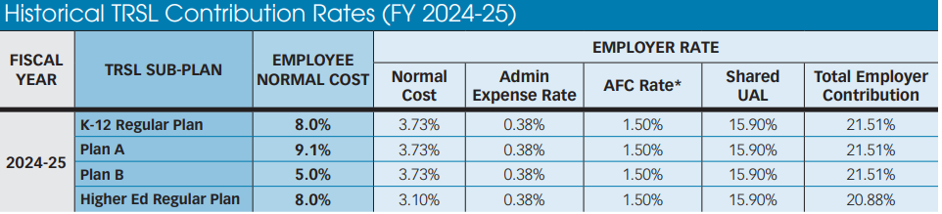
2024 - 2025 TRSL Contribution Rates
The employer contribution rate will decrease from 24.10% to 21.51%, a difference of 2.59%, for FY 2024 - 2025.

Slide 31
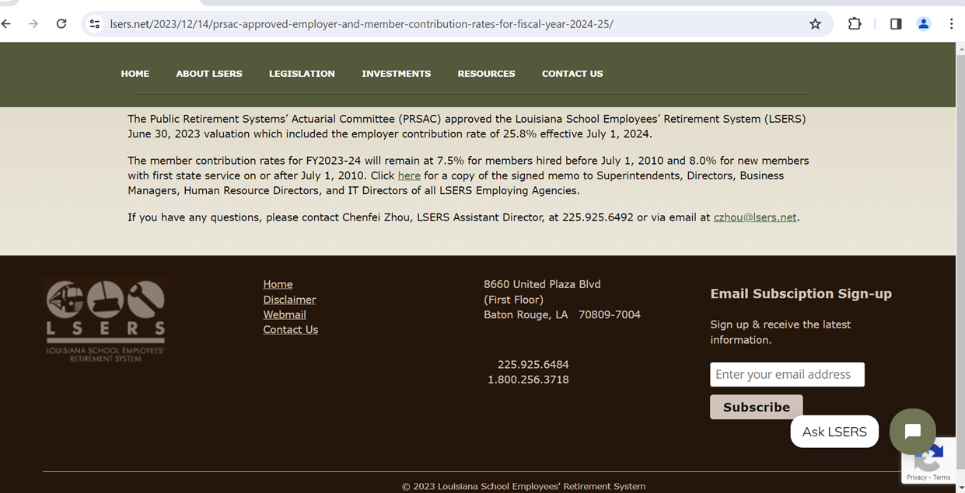
2024 - 2025 LSERS Contribution Rates
The employer contribution rate will decrease from 27.6% to 25.8%, a difference of 1.8% for FY 2024 - 2025.

Slide 32
Reminders
The May Business Manager Monthly Call will be held on Wednesday, May 22nd at 2:00 p.m.
Reminder with date and link will be posted in LDOE Weekly Newsletter
The slide decks for the monthly call can be found in the Business Manager Support Library on the website.
Please contact schoolfinancehelpdesk@la.gov

Slide 33

Resources

Slide 34
Resource Index
Weekly Newsletters
New Business Manager Survey
edfin FTP Secure Site
Annual Financial Report (AFR)
MFP - Related Data Collection
70% Expenditure Requirement
Please contact schoolfinanceheldpesk@la.gov

Slide 35
Weekly Newsletters

Slide 36
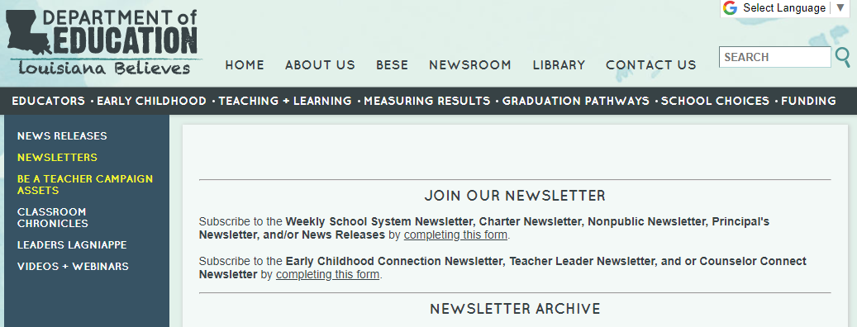
Weekly Communications - Newsletters
How to receive weekly LDOE Newsletters - Go to https://www.louisianabelieves.com/newsroom/newsletters to sign up for newsletters important for your role and to find archived newsletters.
Please contact schoolfinanceheldpesk@la.gov

Slide 37
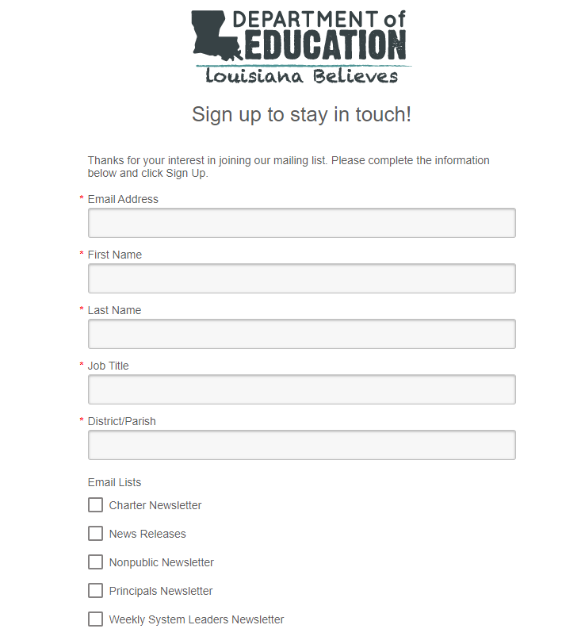
Sign Up for Weekly Newsletters
This form applies to system, charter and nonpublic newsletters.
Important notices and materials are posted in these weekly newsletters.

Slide 38
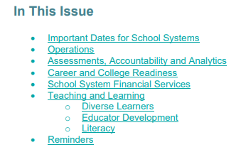
Weekly Communications - Newsletters
Newsletters include information by LDOE Office
Items will specifically mention the school system staff who would benefit from the information provided
Entries and reminders draw attention to important timelines
Click School System Financial Services link to go directly to the relevant entries.
Please contact schoolfinanceheldpesk@la.gov

Slide 39
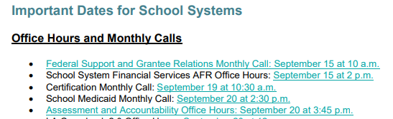
Weekly Communications - Newsletters
Special section addresses dates, times and links to monthly calls, office hours
and webinars
Please contact schoolfinancehelpdesk@la.gov

Slide 40
New Business Manager Survey

Slide 41
Minimum Qualification Requirement for
Business Managers
Continuing Education: must acquire either a Certified Louisiana School Business Administrator (CLSBA) or Certified Louisiana Charter School Business Administrator (CLCSBA) certification through the Louisiana Association of School Business Officials (LASBO). An active CPA may substitute for the required certification.
Shared Services Provision: Statute allows school systems to enter into an agreement to share business services, including contracting a business professional that meets the minimum requirements established by BESE.
See page 96 of the LAUGH Guide for additional details or visit:
https://www.louisianabelieves.com/resources/library/charter-schools
Please contact schoolfinanceheldpesk@la.gov

Slide 42
New Business Manager Survey
All new Business Managers or Financial Professionals must submit a New Business Manager survey. Contact schoolfinancehelpdesk@la.gov for assistance.
This information is required for the annual Fiscal Risk Assessment.

Slide 43
edfin FTP Secure Site

Slide 44
Secure Communications - edfin FTP Secure Site
Certain information to be shared with business managers requires the use of a secure transmission method rather than email
SSFS uses this secure site to provide school systems information that may contain PII or other private information related to MFP, PIP, AFR and other financial topics
edfin FTP Secure Site established for this purpose
This is a different site and should not be confused with other FTP sites provided by other LDOE offices; for example, Data Coordinators have a specific data FTP site
Notices will appear in the weekly newsletters when files are placed in edFin
Please contact schoolfinanceheldpesk@la.gov

Slide 45
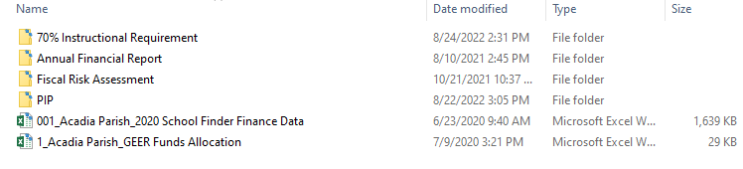
edfin FTP Secure Site
Secure information is saved in this “folder” and systems may access the folder with proper security access.
Business Manager/Financial Officer must contact schoolfinancehelpdesk@la.gov to secure access.
Please contact schoolfinanceheldpesk@la.gov

Slide 46
Annual Financial Report (AFR)

Slide 47
Annual Financial Report (AFR) Training
AFR comprehensive presentation is available for reference.
Presentation includes information on:
  Louisiana Accounting & Uniform Governmental Handbook (LAUGH) Defined
  Annual Financial Report (AFR) Defined
  AFR Uses
  AFR Financial Data
  AFR Submission Process
  AFR Submission Required Data
  AFR Submission - FY 2021-2022 Data Collection
  Post Submission of AFR
  AFR Ratings
Please contact schoolfinanceheldpesk@la.gov

Slide 48
2021-22 Annual Financial Report (AFR)
AFR data collection opened September 1, 2022 and is ongoing
AFR data collection will remain in LEADS for the FALL 2022 collection period
FY 2021-2022 AFR documents & templates are located on the AFR LEADS Support Page
  FY 2021-2022 Coding for State & Federal Grant information has been updated
For questions on fiscal data and auditor review process, contact staudit@la.gov
For questions on technical support, contact systemsupport@la.gov
Please contact schoolfinanceheldpesk@la.gov

Slide 49
Annual Financial Report (AFR) to EdLink
AFR System will transition to EdLink in Fall 2023
System design will remain the same but with improved functionality
Methods for submission will remain the same for those systems utilizing the
text file process
Systems using Filebuilder will be offered a similar and improved process for submission
Please contact schoolfinanceheldpesk@la.gov

Slide 50
Annual Financial Report (AFR) to EdLink
Development is underway currently for the new EdLink AFR System
Internal testing has begun to verify build meets requirements of current AFR system
Additional testing will proceed for the next six months
Tentative release to school systems with training will begin in Spring 2023

Slide 51
MFP

Slide 52
MFP - Related Data Collections
Student and staff data collections are supported through school system Data Coordinators
  Communications surrounding data collections are sent to the Data Coordinators
  Monthly calls are held to disseminate instructions and guidance to Data Coordinators
    Details on monthly calls, Office Hours and Webinars (louisiana.gov) may be helpful
  Consult with your Data Coordinator on any questions regarding data submissions
    Data submission benchmark calendar can be viewed on EdLink 360 Support (louisiana.gov) to maintain awareness of timelines
Please contact schoolfinancehelpdesk@la.gov

Slide 53
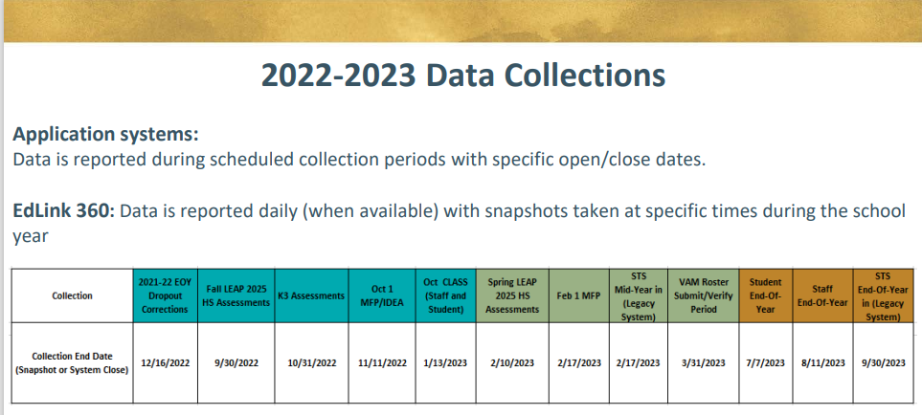

Slide 54
MFP - Related Data Collections
Student Data Collection via EdLink 360:
October 1, 2022 MFP student count data collection drives the October MFP Mid-Year Adjustment to funding which takes effect in March 2023
Student counts are being submitted through the new EdLink system this year
  EdLink student data collection is underway and closes November 11, 2022
  All student data must be submitted by November 11, 2022 to be considered in MFP calculations
Students must be counted and reported per the official MFP Membership Definition located in the MFP Library

Slide 55
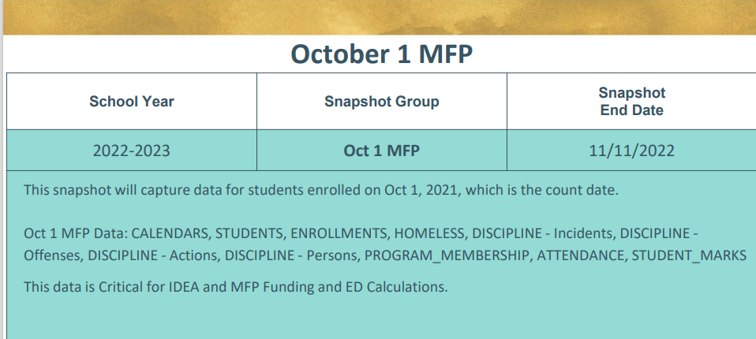
MFP Updates

Slide 56
MFP - Related Data Collections
Staff Data Collection via EdLink 360 (October 1 Class: Student and Staff)
EdLink staff data collection is underway and closes January 13, 2023
  NEW: EdLink staff collection now allows object code 130 and object code 150 to be accepted for all function codes
October 1 staffing data collection drives the following funding allocations:
  Pay Raises - 2019-20, 2021-22, & 2022-23 certificated staff and support workers
    Projected pay raise cost calculated in July will be reconciled to the October staffing data to create a final allocation in March
    Pay raise guidance may be viewed in the MFP Library

Slide 57
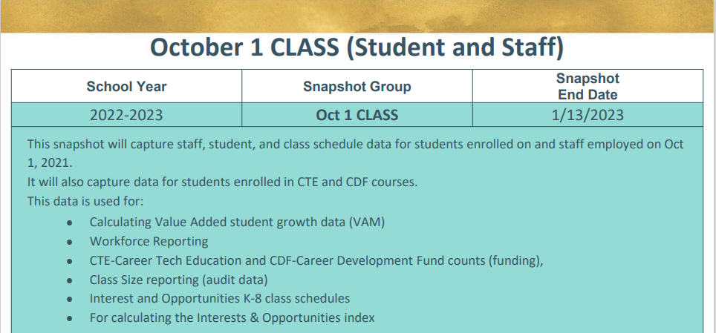
MFP Updates

Slide 58
MFP - Related Data Collections
Mentor Teacher Stipends - new in 2022-23
  $2,000 allocated for mentors who support year-long undergraduate residents and post-baccalaureate candidates
  School systems report mentor teacher data in EdLink 360 Staffing in October
  Resident Teacher and Mentor Teacher Compensation Process webinar

Slide 59
70% Expenditure Requirement
The FY 2020-21 70% Requirement results were reported to BESE at the October 12 meeting.
Individual school system calculations were released the week of October 3 through the school system specific efin FTP secure sites.
School systems that do not meet the Requirement will receive communications from the SSFS staff to begin work on an action plan to address challenges in meeting this requirement. Responses will be summarized and reported to BESE later this year.

Slide 60
70% Expenditure Requirement Defined
The 70% expenditure requirement states that city, parish, or local public school systems or other public schools must ensure that:
at a minimum 70% of the city, parish, or local public school system or other public school general fund expenditures are in the areas of instruction and school administration at the school building level.
Detailed 70% Expenditure Requirement presentation
For questions contact LDOEMFPHelpdesk@la.gov

