Slide 1
A Class Act! Set the Stage!
Centsible
LLC

Slide 2
Welcome, Session & Group Introductions

Slide 3
Learning Objectives

Slide 4
LEARNING OBJECTIVES
Develop an awareness of the relationship between space and the resultant behavior of those who live and play
Understand the need to balance a daily schedule with teacher-directed and student-initiated activities
Connect developmentally appropriate materials and activities to standards-based, intentional teaching and learning that offer concrete experience relevant to children’s lives
Understand the cycle of ongoing instruction and assessment

Slide 5
Test Your Knowledge

Slide 6
TRUE OR FALSE?
Early childhood classrooms should be mainly teacher-directed | T F
The physical arrangement of the classroom is one way of conveying to children what they may or may not do and what we expect of them | T F
Teachers embed learning goals in play | T F
Research does not support the idea of play as a means of learning in early childhood classrooms | T F
Materials in centers should be rotated frequently to maintain student interest | T F
Assessment of student learning should be in formal, planned sessions | T F

Slide 7
Physical Space

Slide 8
“Happy Place”
Think of a place you enjoy visiting
Ex. vacationing, shopping, eating, etc.

Slide 9
Consensus Map

Slide 10
ACTIVITY INSTRUCTIONS
Using the chart paper that is divided as shown here, select one section (not the circle) in which to write
Individually, list all the aspects or characteristics that create this feeling of enjoyment in your “Happy Place”

Slide 11
ACTIVITY INSTRUCTIONS
Come to a consensus on the characteristics you all agree upon being necessary to create a “Happy Place”
Write these in the center circle of the chart

Slide 12
Share Your Thoughts

Slide 13
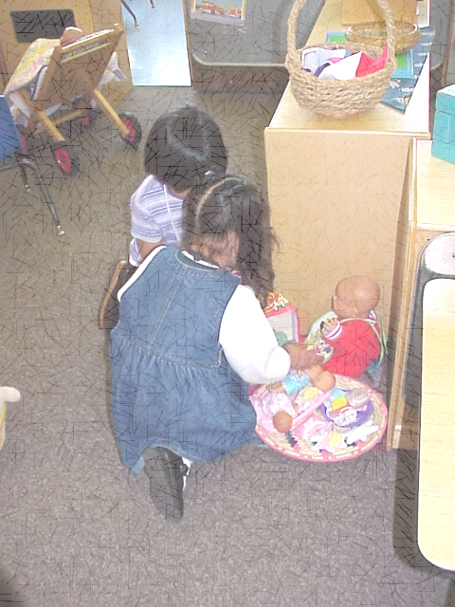
PHYSICAL SPACE
Physical space was identified as one of the most effective predictors of program quality*
When space invites us to do what we want to do, life is experienced as more satisfying and interesting, and is therefore more meaningful and conducive to growth
*Kritchevsky, S. et al, 1977, p. 5.

Slide 14
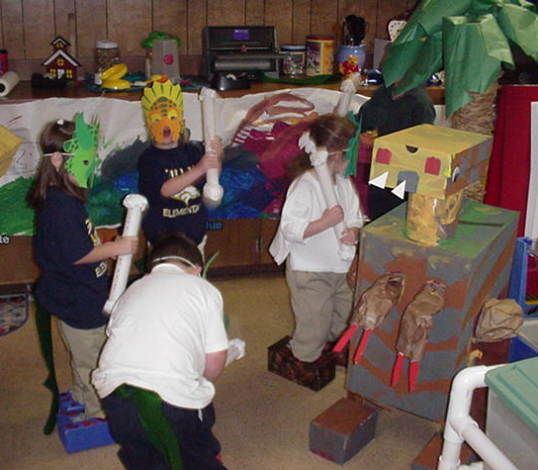
PHYSICAL SPACE
How the space is arranged can affect the behavior of people
The amount of space influences the number and types of activities that children can engage in at the same time

Slide 15
PHYSICAL SPACE
Depending on how it’s arranged, the physical environment can elicit either aggressive or prosocial behavior
Too many people in a space leads to frustration and aggression Too much noise or loud music Too many or not enough materials
Too much open space inspires running, chasing, and chaos
Research tells us aggressive behavior occurs more often in the dramatic play, woodworking, and block areas
Competitive games, violent toys, and playing violent roles (like superheroes) incites aggressive behavior

Slide 16
PHYSICAL SPACE
Arrangement of furniture and materials in a room also organizes the play space for children. This offers:
Many different learning centers for a variety of learning and play opportunities
Play spaces that are protected from unnecessary interruptions so children can engage in activities with more concentration
Clarity of organization that promotes independence and care for the environment
Places to play and learn in smaller groups, with a friend, or individually

Slide 17
PHYSICAL SPACE
Organization of play space includes:
Creating clear paths A path is the empty space on the floor through which people move in getting from one place to another. A clear path is broad, elongated, and easily visible.
Ease of supervision Arrangement of furnishings allow teacher to see or be seen with ease
Placement of storage units Materials need to be placed close to their point of use

Slide 18
Physical Space
Why is it important to place materials close to their point of use?

Slide 19
PHYSICAL SPACE
There is an intimate relationship between the goals of any group and its use of space
When teachers select goals for children and develop space to support these goals, children are involved and interested in their play
Thus, allowing the teacher to observe or interact with children without unnecessary interruptions
Kritchevsky, S. et al, 1977, p. 6.

Slide 20
Program Management

Slide 21
Dimensions of Program Management
Scheduling
Classroom management
Social context

Slide 22
SCHEDULING
Establish a consistent, yet flexible, daily routine
Allow for a variety of activities
Use a variety of groupings
Allow just enough time for each type of activity
Provide smooth transitions between activities

Slide 23
True or False?
Early childhood classrooms should be mainly teacher-directed.

Slide 24
SCHEDULING
“In Developmentally Appropriate Practices, teachers make sure that there is a balance between explicit, thematic, spontaneous, and playful instruction.”
Morrow, 2004, as cited in Morrow & Gambreii, 2004; Neuman & Roskos, 1993; Vukelich, 1994.

Slide 25
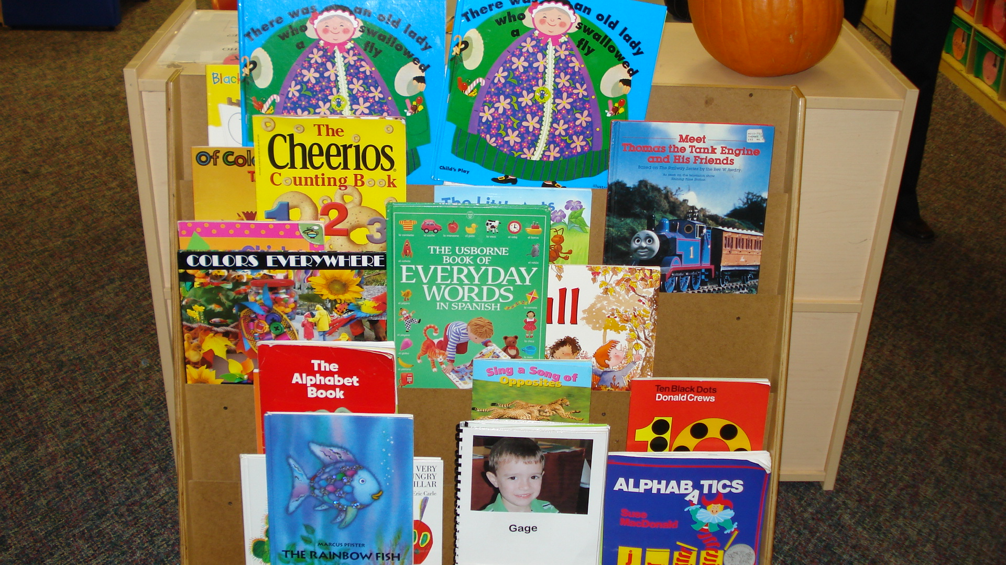
CIRCLE AND STORY TIME
Consider the length of time. Are they too long?
Are they interesting and varied enough?
Do the children get enough opportunities to participate actively?

Slide 26
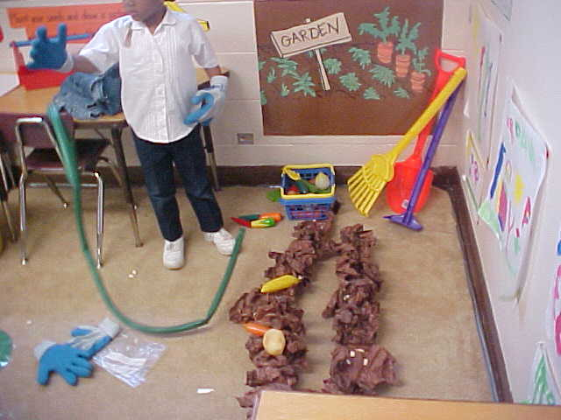
FREE PLAY
Some children with challenging behaviors may struggle during free play
Some need more structure and guidance during free play. Give them a limited choice or break activities into smaller bits.
Use a peer play partner or teacher play partner
Role play the appropriate behavior during free play
Create a special place

Slide 27
TRANSITIONS
Give children a few minutes’ warning
Post a picture schedule or checklist to help them understand what comes next
Make the transition fun. Sing songs. Become mice, robots, frogs, airplanes, etc.
Plan to be the partner of a child who tends to lose self-control during transitions
Prepare your materials for the next activity before the children arrive

Slide 28
CLASSROOM MANAGEMENT
Teach routines systematically:
Model
Practice
Review
Reinforce
Notes:
Stock photo ID:475663916

Slide 29
PRE-PLAN MANAGEMENT ROUTINES
Room arrangement
Think not only of the skill you want to teach, but also of the behavior you are trying to encourage as you set up an activity
Too many limits will make children feel fenced in, so it is a good idea to set up your room so that all children can move about without reminders
Put toys, games, and puzzles within reach to prevent climbing
Put art activities near the sink so that children do not have to walk across the room carrying containers of water or brushes covered in paint
Think about “empty” space as well

Slide 30
PRE-PLAN MANAGEMENT ROUTINES
Clear expectations
Rules: general expectations, ex. respect others at all times
Procedures: how you want something done, ex. going to lunch, recess, restroom
Quick transitions: ex. timer, music, countdown
Reduce teacher talk
Use hand signals, cues

Slide 31
INFLUENCE OF CLASSROOM MANAGEMENT ON ENVIRONMENT
According to Lemlech (1988), classroom management can be compared to conducting an orchestra. Well-managed classrooms can be seen as a harmony of decisions and physical factors.
Thus, classroom management includes various decisions such as the student seating plan, planning of classroom activities in terms of time and content, organizing materials, and encouraging the active participation of each student. (Emmer & Gerwels, 2005)

Slide 32
SOCIAL CONTEXT
One of the primary goals of a quality early childhood program is to foster healthy social and emotional development in young children
To be successful, children must be able to develop relationships with others, cooperate with peers and adults, understand others’ feelings and perspectives, and maintain some control of their behaviors and emotions
These characteristics help to ensure that children are able to get along and participate with others in the classroom
LDOE ELDS, p. 76

Slide 33
Don’t Push My Buttons!

Slide 34
SOCIAL CONTEXT
The most obvious way to alter the social context is to address the needs of individual children
If needed, give permanent compatible partners for transitions or assign seats at lunch and snack (to separate those who fight)
Model and teach the three basic rules: respect the rights of others, avoid danger, and take care of the environment (toys, materials, rooms, etc.)
If you have more than one educator for the group, divide the children into smaller groups to keep certain children apart and give them the chance to learn from their more socially adept peers
Kaiser, B. & Rasminsky, J.S., 2007.

Slide 35
Social Context
You can change the social context for everyone by creating rules and policies that are developmentally appropriate.

Slide 36
SOCIAL CONTEXT
“Play is often talked about as if it were a relief from serious learning. But for children, play is serious learning. Play is really the work of childhood.”
Fred Rogers

Slide 37
PLAYFUL LEARNING
Play is a very powerful and efficient learning and teaching strategy. However, it is not enough for teachers simply to provide opportunities for play. Teachers need to engage with children while they play to facilitate optimal development.
Kieff, J.E. & Casbergue, R.M., 2000.

Slide 38
Intentional Teaching

Slide 39
INTENTIONAL TEACHING
Intentional teaching does not happen by chance, it is planful, thoughtful, and purposeful
Children learn best through manipulation of materials and hands-on experiences carefully planned and facilitated by knowledgeable teachers
Intentional teachers integrate and promote meaningful learning in all domains

Slide 40
INTENTIONAL TEACHING
To optimize learning, intentional teachers:
Consider what children should be able to know, understand, and be able to do across:
Domains (cognitive, social-emotional, motor)
Academic disciplines (literacy, math, science, social studies, art)
Possess a wide range of knowledge
Content, strategies, research
Balance instruction between teacher-guided and child-guided experiences
Use a play format in early childhood classrooms

Slide 41
INTENTIONAL TEACHING
Play and other activities in which children explore and conduct ideas are vital to their development and learning
Teachers must know what to do to enhance the quality of these child-initiated experiences
Ex.: meeting the learner where they are and helping them to reach challenging and achievable goals
It is important that teachers know what other experiences and what other instruction children require in order to learn knowledge and skills in all domains

Slide 42
INTENTIONAL TEACHING
Intentional teachers are those who are purposeful and thoughtful about the actions they take – from:
Setting up the environment,
Creating meaningful experiences in which they interact with children, observing, and assessing student learning,
Planning the curriculum based on standards, to
Responding to “teachable moments”
All actions are guided by the children’s learning outcomes
In order to do this, teachers must be knowledgeable about Developmentally Appropriate Practices

Slide 43
Developmentally Appropriate Practice

Slide 44
DEVELOPMENTALLY APPROPRIATE PRACTICE
Developmentally appropriate practice does not mean making things easier for children
Rather, it means ensuring that goals and experiences are suited to their learning and development and challenging enough to promote their progress and interest
Good practices acknowledge that 3-, 4-, and 5-year-olds are wigglers and doers
Intentional teachers work with, instead of against, individual developmental styles to help children stay with tasks and learn important concepts and skills

Slide 45
ACTIVITY INSTRUCTIONS
Remove contents from envelope
Locate the two headings in BOLD
Spread out remaining statements
As a team, decide which statement belongs under each heading
Discuss why you feel this way as you sort out the statements

Slide 46
Check Your Answers

Slide 47
DEVELOPMENTALLY APPROPRIATE PRACTICES
Learning centers/free choice centers | Use a variety of materials that are changed frequently to meet the needs and interests of the children
Concrete learning experiences with real items | Adult-child interactions encourage learning through open-ended questions, extending conversations, reasoning, etc.
Balance of student-initiated and teacher-directed activities in instructional day | Use of TV, videos, and computers are related to classroom events, appropriate, limited to short periods of time and adult interaction occurs
Actively engaged learners | Teacher uses a variety of strategies and meaningful activities to develop skills and concepts
Language/literacy rich activities that encourage phonological awareness | Assessment is ongoing/portfolios are used that include anecdotal records, work samples, photographs, etc.
Hands-on math activities

Slide 48
NOT DEVELOPMENTALLY APPROPRIATE PRACTICES
Timed rotation/teacher selected | Rote drill of numbers, shapes, colors, etc.
Workbooks or ditto sheets | Alphabet letters taught through rote drill or letter of the week
Teacher-directed activities are more than 35% of the instructional day | Same materials and equipment used daily
Passive quiet learners | Adult-child interactions are minimal, unpleasant, non-responsive, inappropriate, or only to control behavior
Classrooms are quiet most of the day | Isolated testing/worksheets
Sterile cold environments | Teacher uses direct instruction to teach and isolates the skills and concepts
Recess/adults are on duty | TV, videos, and computers are not related to classroom events, no alternative activities are used, and no adult interaction occurs
Patterned art/art projects are uniform (all look the same) | TV, videos, and computers are not related to classroom events, no alternative activities are used, and no adult interaction occurs

Slide 49
DEVELOPMENTALLY APPROPRIATE PRACTICE
There are three kinds of knowledge to keep in mind as we determine what is a developmentally appropriate practice
Age appropriateness
Individual appropriateness
Social and cultural contexts

Slide 50
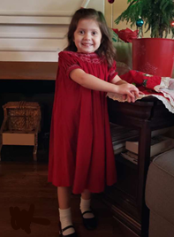
DEVELOPMENTALLY APPROPRIATE PRACTICE
Age appropriateness
Ex. 4-year-old daughter, “Girls 4-6” department
Individual appropriateness
Ex. size, color preference
Social and cultural contexts
Ex. peer group, family background

Slide 51
DEVELOPMENTALLY APPROPRIATE PRACTICE
Taken together, all three considerations result in developmentally appropriate practice
Age appropriateness
Individual appropriateness
Social and cultural contexts
The core of developmentally appropriate practice lies in this intentionality

Slide 52
Intentionally Planning the Environment

Slide 53
INTENTIONALLY PLANNING THE ENVIRONMENT
According to NAEYC, teachers should:
Provide extended blocks of time for sustained play and exploration
Present children with opportunities to make meaningful choices, especially in child-choice activity periods
Provide experiences, materials, and interactions
NAEYC, p. 18

Slide 54
Interest Areas/Learning Centers
Collection of materials, designed purposefully, with a goal in mind
Places where the work can be made to fit the learner’s needs, ranging from basic learning to remediation to enrichment

Slide 55
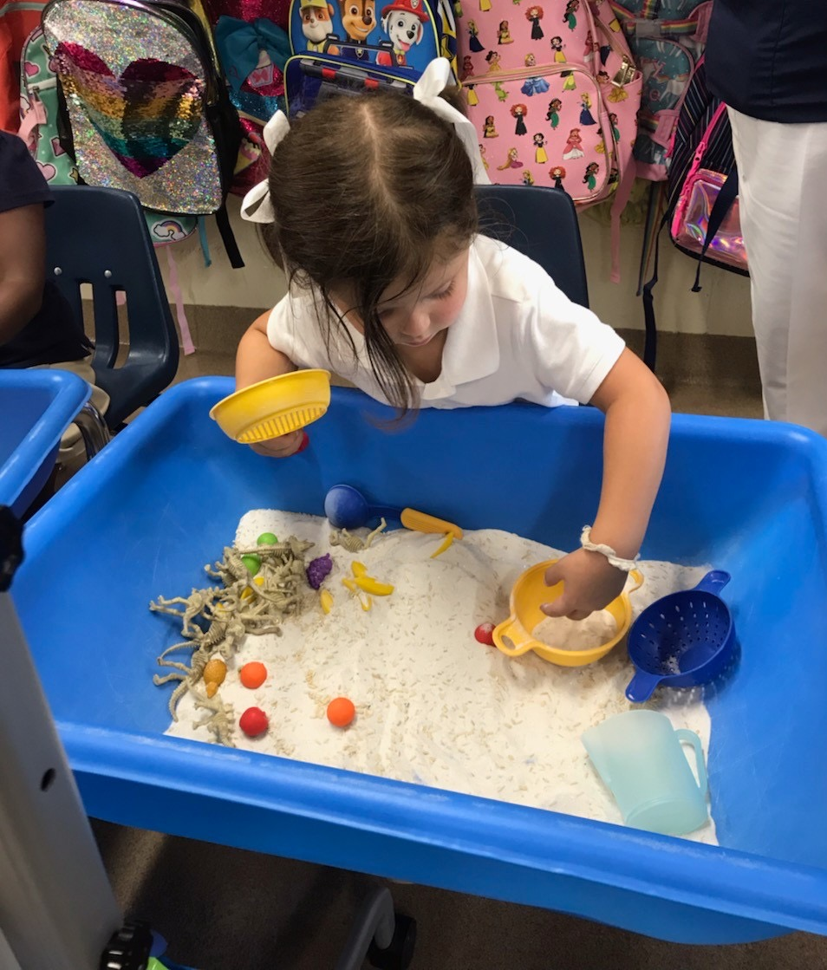
INTEREST AREAS/LEARNING CENTERS
Student benefits:
Allow students to be actively involved in the learning process and work at their own pace
Enable students to explore a subject in as much depth as they desire
Enable learners to make decisions, follow directions, work independently, and evaluate themselves
Give students an opportunity to learn responsibility and organization

Slide 56
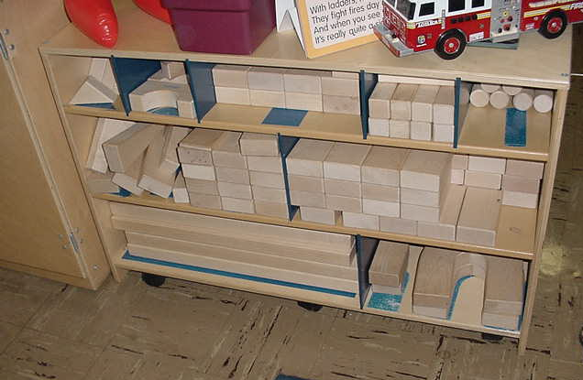
INTEREST AREAS/LEARNING CENTERS
Teacher benefits:
Provide opportunities for instructors to incorporate student interests when planning instruction
Provide a structure that integrates all content areas
Allow instructors to gain more information about students

Slide 57
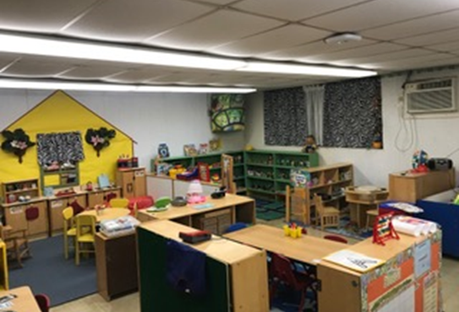
INTEREST AREAS/LEARNING CENTERS
Known as free choice center time – as children are allowed to choose where they want to play, who they want to play with, and what they want to play
Management system must be used to teach children the procedures and limits within which to use their freedom (ex. only three fit in the block center)
How to make choices must be taught – start with two choices and move up to three

Slide 58
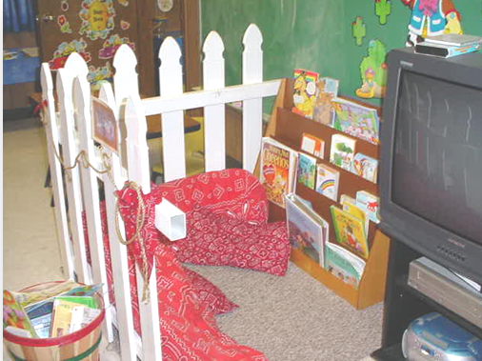
INTEREST AREAS/LEARNING CENTERS
Organize the space into interest areas or centers
Supply plentiful and diverse equipment and materials
Display work created by and of interest to children
Choose activities that allow children to demonstrate achievement of the standards

Slide 59
Use of Standards
Allows a teacher to be intentional in planning all activities, especially in interest areas
Addresses what is important for children to know and be able to do
Intertwines all developmental domains, allowing more content to be taught and assessed at the same time

Slide 60
Ongoing Assessment and Instruction

Slide 61
ONGOING ASSESSMENT AND INSTRUCTION
As we embed the standards into the children’s activities, we need to know where each child is with respect to learning goals in order to be intentional about helping children to progress
The process of gathering information about children in order to make decisions is assessment
Teachers use assessment results to plan for individual children and the group as a whole
What can this child do and not do?
What is he or she ready to learn?
What are his or her strengths and learning needs?

Slide 62
ONGOING ASSESSMENT AND INSTRUCTION
This process is intentional:
Setting up the schedule
Planning the environment and physical space
Designing the setup of interest areas
Creating activities for students to be able to demonstrate the performance of standards-based skills
Assessing the student’s ability to perform in relation to the standards-based skills
Planning the next steps in instruction
PURPOSE: SET GOALS BASED ON CURRICULUM/ STANDARDS
PLANNING:
CREATE THE ENVIRONMENT AND ACTIVITIES
REFLECTION: WHAT ARE THE NEXT STEPS BASED ON INDIVIDUAL AND CLASS NEEDS?
ASSESSMENT: WHAT DO THE STUDENTS KNOW AND ARE ABLE TO DO?

Slide 63
ONGOING ASSESSMENT AND INSTRUCTION
What does this cycle look like in an interest area?
Age
Domain(s)
Sub-domain(s)
Purpose/standard (#)
Assessment

Slide 64
ONGOING ASSESSMENT AND INSTRUCTION
ART CENTER
Age: 4-years-old
Domain(s): Physical Well-Being and Motor Development (PM2), Cognitive Development and General Knowledge (CC2)
Sub-domain(s): Motor Skills & Physical Fitness, Creative Thinking and Expression
Purpose/standard (#): Using play dough to develop small muscle control and coordination (4.2) Develop an appreciation for visual arts by creating various forms of 3D art (4.3)
Assessment: Work sample

Slide 65
ONGOING ASSESSMENT AND INSTRUCTION

Slide 66
ONGOING ASSESSMENT AND INSTRUCTION

Slide 67
ONGOING ASSESSMENT AND INSTRUCTION
ART CENTER
Age: 4-years-old
Domain(s): Physical Well-Being and Motor Development (PM2), Cognitive Development and General Knowledge (CC2) and Language and Literacy (LL7)
Sub-domain(s): Motor Skills & Physical Fitness, Creative Thinking and Expression, and Writing
Purpose/standard (#):
Using play dough to develop small muscle control and coordination (4.2)
Develop an appreciation for visual arts by creating various forms of 3D art (4.3)
Use a combination of drawing, dictating, and/or writing in response to a text read aloud, or to tell a story about a life experience or event (4.2)
Assessment: Work sample

Slide 68
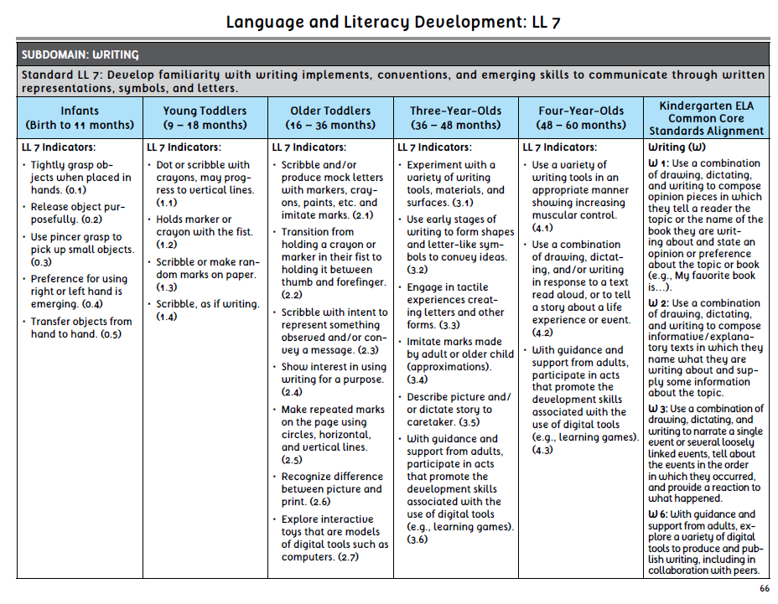
ONGOING ASSESSMENT AND INSTRUCTION

Slide 69
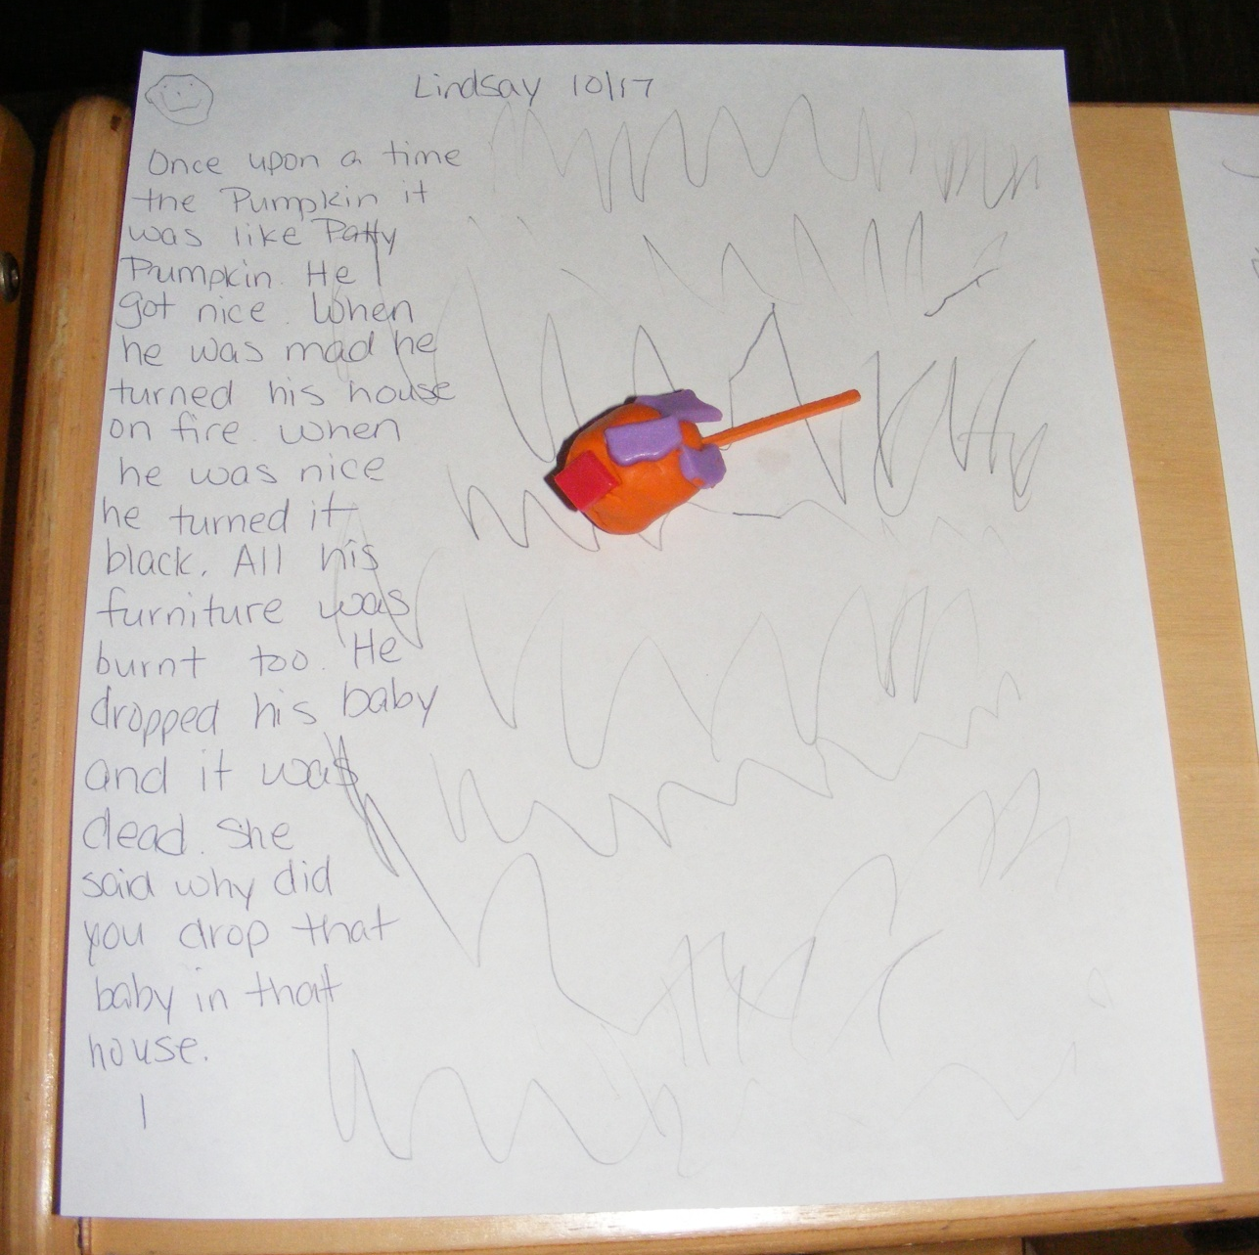
Lindsay’s Artwork and Story

Slide 70
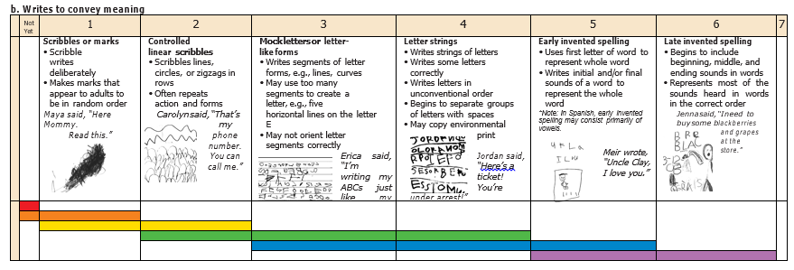
ASSESSMENT: HOW WOULD YOU SCORE?
(Teaching Strategies Gold, 2010)

Slide 71
ASSESSMENT: HOW WOULD YOU SCORE?
(Teaching Strategies Gold, 2010)

Slide 72
ONGOING ASSESSMENT AND INSTRUCTION
Assessments:
Are ongoing, strategic, and purposeful
Reflect growth over time
Are appropriate to the age and experiences of young children
Rely heavily on demonstrated performance during authentic – not contrived – activities
Should be based on what children can do independently and with support from peers or adults

Slide 73
BACK TO THE BEGINNING
ART
DRAMATIC PLAY
SCIENCE
BLOCKS
SKILL
SAND
LIBRARY
TABLE TOYS/
WRITING
MUSIC

Slide 74
Interest Areas/Learning Centers Activity

Slide 75
Session Review

Slide 76
REVIEW LEARNING OBJECTIVES
Develop an awareness of the relationship between space and the resultant behavior of those who live and play
Understand the need to balance a daily schedule with teacher-directed and student-initiated activities
Connect developmentally appropriate materials and activities to standards-based, intentional teaching and learning that offer concrete experience relevant to children’s lives
Understand the cycle of ongoing instruction and assessment

Slide 77
Reflections, Questions, & Comments

Slide 78
Please complete the Post-Assessment Evaluation. Thank you!

Slide 79
REFERENCES
The Center on the Social and Emotional Foundations for Early Learning. (2010). Promoting Children’s Social Emotional Competence. www.Vanderbilt.edu/csefel.
Copple, C. & Bredenkamp, S. (2006). Basics of Developmentally Appropriate Practice: An Introduction for Teacher of Children 3 to 6. Washington DC: National Association for the Education of Young Children.
Emmer, E.T. & Gerwels, M.C. (2005) Establishing classroom management for cooperative learning. Annual Meeting of the American Educational Research Association, Montreal, Canada announcement, April 2005. (ERIC Document Reproduction Service No. ED 490 457).
Epstein, A.S. (2014). The intentional teacher: Choosing the best strategies for young children’s learning. Washington, DC: National Association for the Education of Young Children.
Heroman, C., Burts, D.C., Berke, K., & Bickart, T.S. (2010). Teaching Strategies GOLD: Objectives for Development & Learning: Birth Through Kindergarten. http://www.teachingstrategies.com/page/assessment-early-childhood-overview.cfm
Kaiser, B. & Rasminsky, J.S. (2007). Challenging Behavior in Young Children. Boston: Pearson Education, Inc.
Kieff, J.E. & Casbergue, R.M. (2000). Playful Learning and Teaching: Integrating Play into Preschool and Primary Programs. Boston, MA: Pearson.
Lemlech, J.K. (1988). Classroom management: Methods and techniques for elementary and secondary teachers. New York: Longman.
Louisiana Department of Education. (2012). Louisiana birth to five early learning and development standards (ELDS). www.louisianabelieves.com
Morrow LM. Developmentally Appropriate Practice in early literacy instruction. Reading Teacher. 2004;58(1):88-89. http://search.ebscohost.com.proxy.cecybrary.com/login.aspx?direct=true&db=ehh&AN=14387236&site=ehost-live&scope=site.
NAEYC. (2009). Developmentally-appropriate practice in early childhood programs serving children from birth through Age 8. A position statement of the National Association for the Education of Young Children. Retrieved from https://www.naeyc.org/sites/default/files/globally-shared/downloads/PDFs/resources/position-statements/PSDAP.pdf

