Slide 1
Taking a Closer Look at Early Childhood Development & Learning: A Standards-Based Approach

Slide 2
Welcome, Session & Group Introductions

Slide 3
Learning Objectives

Slide 4
LEARNING OBJECTIVES
Increase knowledge of the theories and basic principles of child development and learning
Demonstrate an understanding of the essential components of developmentally appropriate practice
Identify factors that influence development and learning
Demonstrate a foundational understanding of the Louisiana Early Learning and Development Standards (ELDS)
Connect classroom practices to early learning and learning and development standards

Slide 5
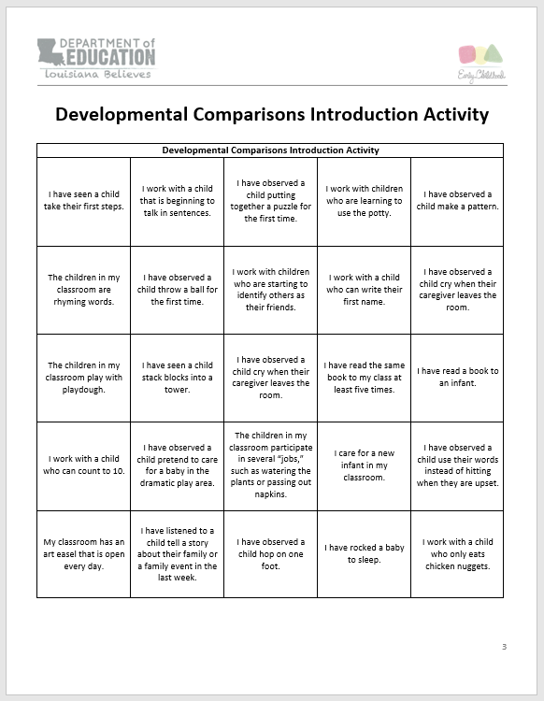
Developmental Comparisons Introduction Activity

Slide 6
ACTIVITY INSTRUCTIONS
Look over the Developmental Comparisons Introduction Activity.
Circulate the room looking for individuals who have experienced some of the scenarios listed on your page.
If they have seen the developmental scenario in action, ask them to tell you a bit more about it and then request that they sign the square containing the scenario. Make sure to try to fill out a square for them as well.
Your goal is to get as many squares signed as you can in the time allowed.
Let’s do one together.

Slide 7
What We Have Learned About You
Notes:
All learning begins by finding out where we are before we begin.

Slide 8
SUCCESSFUL LEARNING EXPERIENCES
Successful learning experiences begin by finding out what we currently know and then working to expand and develop our knowledge of what is best.

Slide 9
PRE-ASSESSMENT RESULTS
WHEN
WHERE
WHAT
WHO
HOW
WHY

Slide 10
Reflections
What have you learned about one another?
What would you like to learn about development and learning?
What do you hope to get out of this course?
What questions do you have?

Slide 11
Theories and Basic Principles of Child Development and Learning and Developmentally Appropriate Practices

Slide 12
Individual Early Childhood Beliefs Survey

Slide 13
ACTIVITY INSTRUCTIONS
This tool evaluates your beliefs on early childhood development and learning.
Rate each item quickly
Rate every item
Complete the score sheet when you finish

Slide 14
REFLECTIVE DISCUSSIONS
Complete the reflective questions on your score sheet.
Once you are finished discuss with those around you.
As a group, determine how each of these beliefs affect your views of child development and learning.
Notes:
Stock photo ID:1096013738

Slide 15
What We Know About How Children Learn

Slide 16
WHAT WE KNOW ABOUT HOW CHILDREN LEARN: THEORY
Piaget
Erikson
Vygotsky
Gardner
Dewey
Maslow
Bronfenbrenner

Slide 17
WHAT WE KNOW ABOUT HOW CHILDREN LEARN: PRACTICE
Play
High-Quality Interactions
Safety & Trust
Practice
Opportunities
Hands-on Learning
Quality Environments
Notes:
Stock photo ID:636672368

Slide 18
GUIDING PRINCIPLES OF HOW CHILDREN LEARN & DEVELOP
Early learning and development are multidimensional; developmental domains are highly interrelated.
Young children are capable and competent.
There are individual differences in ranges of development among children.
Children will exhibit a range of skills and competencies in any domain of development.
Families are the primary caregivers and educators of their young children.
You children learn through active exploration of their environment through children-initiated and teacher-selected activities.
Louisiana Birth to Five Early Learning and Development Standards

Slide 19
ESSENTIAL COMPONENTS OF DEVELOPMENTALLY APPROPRIATE PRACTICE
Knowing about child development and learning
Knowing what is individually appropriate
Knowing what is culturally important
Taken together, all three considerations result in
developmentally appropriate practice.
Developmentally Appropriate Practice in Early Childhood Programs Serving Children from Birth through Age 8" (PDF), adopted in 2009

Slide 20
Factors that Influence Development & Learning

Slide 21
Identifying Factors that Affect Development & Learning
Notes:
Stock photo ID:1005282482

Slide 22
ACTIVITY INSTRUCTIONS
Divide your paper in half
Label one side positive factors
Label the other negative factors
With your group, determine factors that both positively and negatively affect child development
List them on the corresponding sides of your paper
Once you are finished, hang your paper on the wall
Be prepared to share

Slide 23
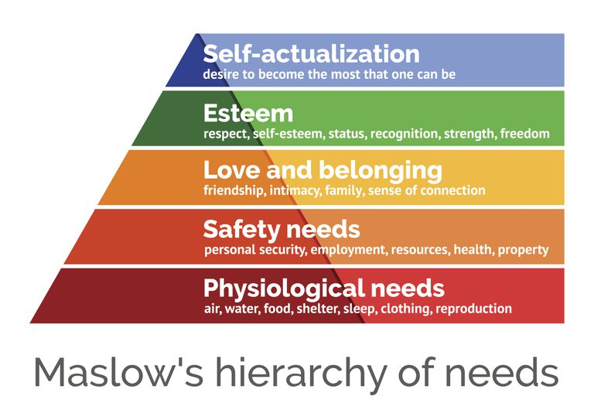
FACTORS THAT NEGATIVELY AFFECT LEARNING & DEVELOPMENT
Hopper, E. (2019). Maslow’s Hierarchy of Needs Explained. Retrieved May 30, 2019 from https://www.thoughtco.com/maslows-hierarchy-of-needs-4582571

Slide 24
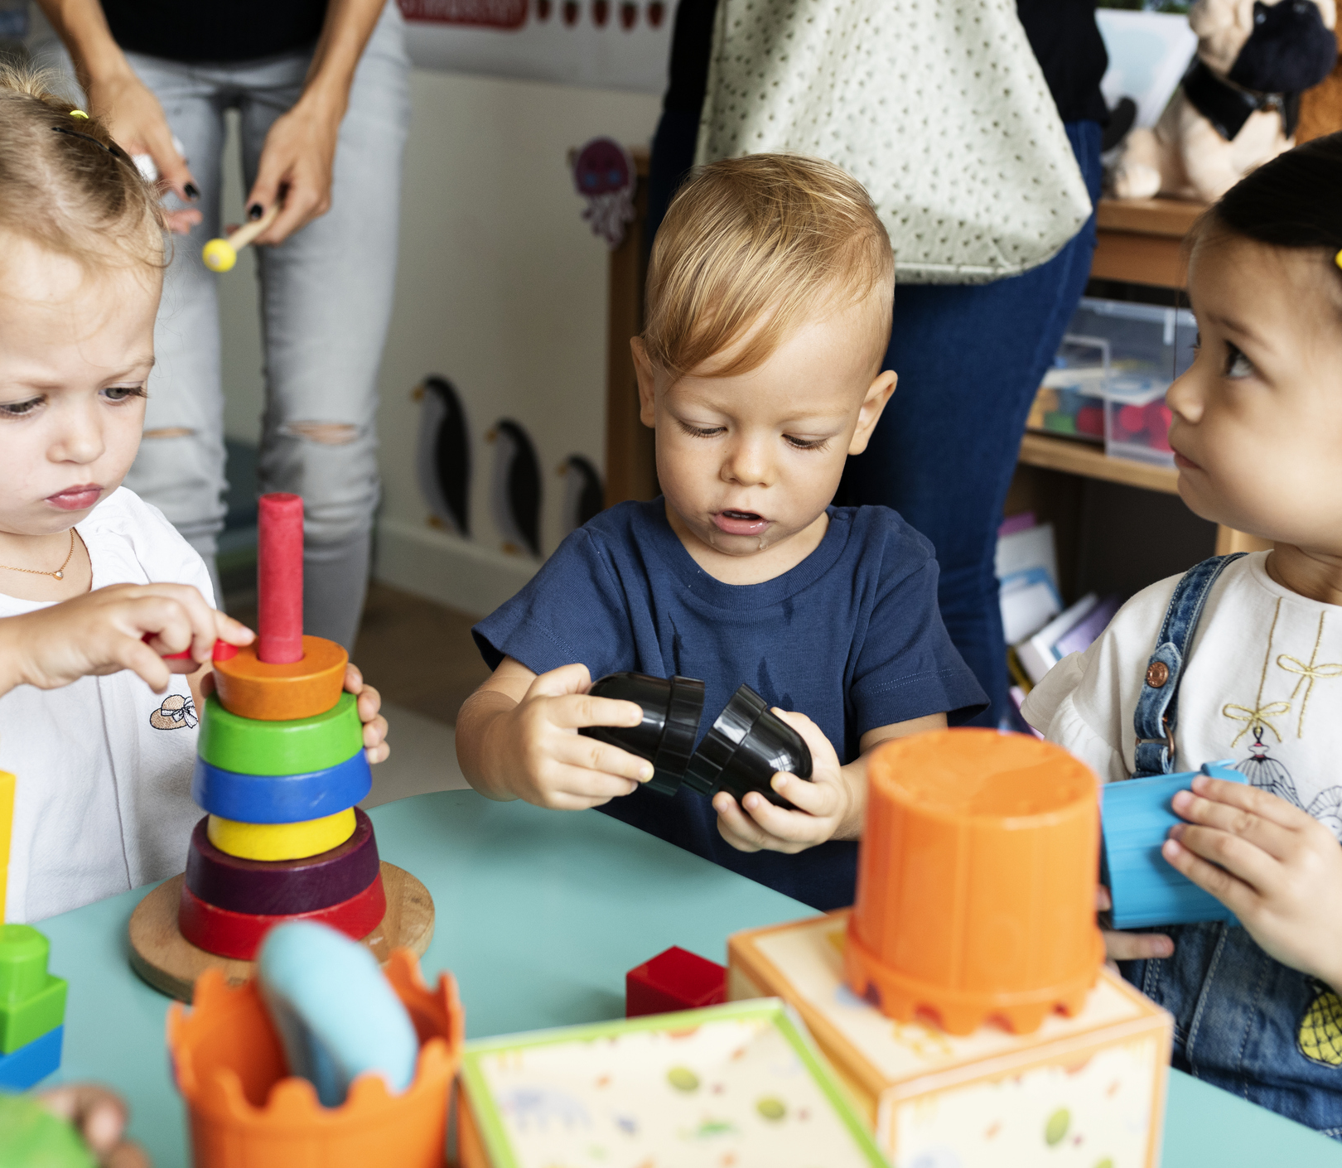
FACTORS THAT POSITIVELY AFFECT LEARNING & DEVELOPMENT
Provision and maintenance of basic needs
Trust
Continuity & Consistency
Sensitivity, Responsiveness, and Regard
Developmentally appropriate expectations
Developmentally appropriate high-quality:
Environments
Interactions
Experiences
Activities
Notes:
Stock photo ID:1054793552

Slide 25
Introduction to the Louisiana Birth to Five Early Learning and Development Standards

Slide 26
WHAT IS THE ROLE OF THE STANDARDS?
FRAMEWORK
Common vision
Age-appropriate goals
GUIDE
Importance and integration
Identify present performance
Meet individual needs
Skill focus by age
Experience ideas

Slide 27
Standards Represent
What children need to
KNOW and DO
by the end of an age range.
Louisiana Department of Education, CONNECT Training
Notes:
Stock photo ID:524860587

Slide 28
WHO ARE THE STANDARDS DESIGNED FOR?
The standards apply to all Louisiana children who are not yet age eligible to enter kindergarten, including:
Children with and without disabilities
Children who are learning English
Children who are participating in any type of early care and education program
Notes:
Stock photo ID:1054793552

Slide 29
HOW ARE THE STANDARDS ORGANIZED?
DOMAINS
SUBDOMAINS
STANDARDS
INDICATORS

Slide 30
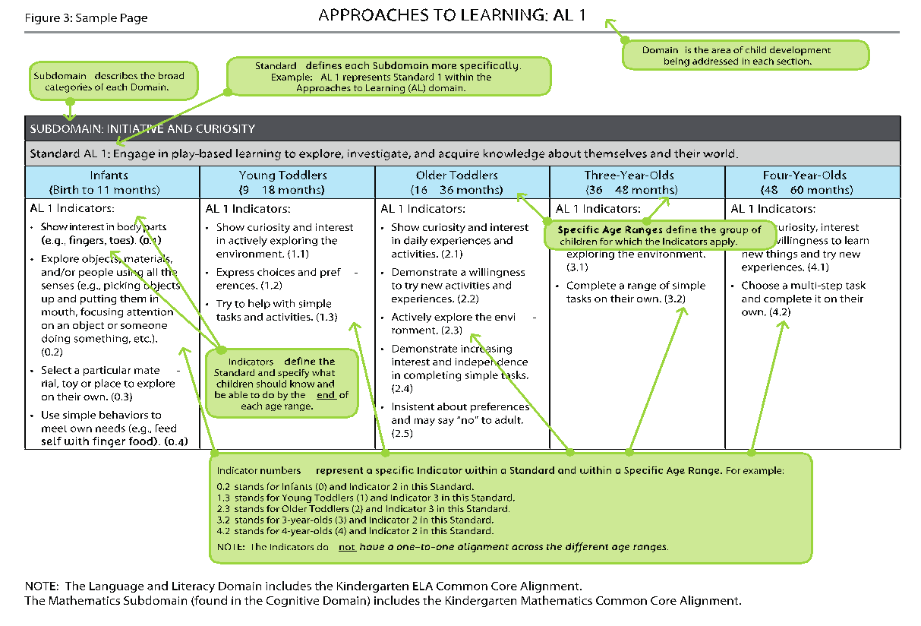
WHAT ARE THE DOMAINS?
Approaches to Learning
Cognitive Development and General Knowledge
Creative Thinking and Expression
Mathematics
Science
Social Studies
Language and Literacy Development
Physical Well-Being and Motor Development
Social-Emotional Development

Slide 31
Connecting Classroom Practices to the Louisiana Birth to Five Early Learning and Development Standards

Slide 32
HOW CAN YOU USE THE STANDARDS?
Notes:
Structure: photo ID: 1004613022
Observation & Assessment : photo ID: 886186340
Planning: photo ID:687830448
Sub-category image: Environment
Sub Category image: Schedule

Slide 33
THAT AND MORE!
Structure
Environment
Schedule
Observation and Assessment
Level of development
Goal setting
Planning
Activities
Experiences

Slide 34
STRUCTURE
Environment
Furnishings
Materials
Schedule
Routine activities
Transitions
Notes:
photo ID:998670532

Slide 35
EXAMPLES
AL 2:3.1 Maintains focus on objects and activities of interest while other activities
are going on in the environment.
CM 1:4.5 Identify written numerals 0-10 in the everyday environment.
PM 2:3.2 Coordinate eye and hand movement to accomplish simple tasks.
LL 6:4.1 With prompting and support, recognize and produce rhyming words.

Slide 36
OBSERVATION
Level of Development
Cite standards when making observations
Goal Setting
Use the continuum when creating classroom and individualized goals

Slide 37
Video Observations
Which Standards Do You See Being Represented?
Notes:
Stock photo ID:947906878

Slide 38
PLANNING
Interactions, Activities, & Experiences
Individual
Center & Group Based
Outdoor play
Special activities

Slide 39
PLANNING
When planning activities and experiences, consider incorporating:
Multiple domains
Multiple settings
Individualized goals
Classroom goals
Royalty-free stock photo ID: 664170823

Slide 40
THE INTENTIONAL TEACHING PROCESS
OBSERVATION
IMPLEMENTATION
GOAL SETTING
PLANNING

Slide 41
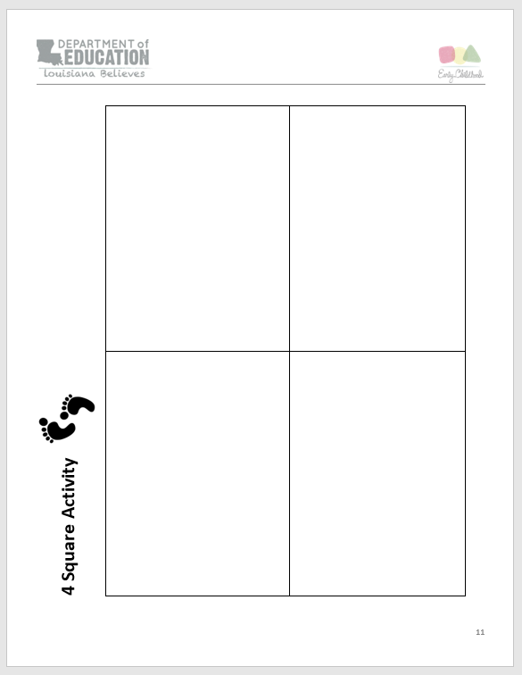
Connecting Classroom Practices: Four Square Activity

Slide 42
Activity Instructions
Complete the 4 Square Activity Page
Outline how you plan to use the Louisiana Birth to Five Early Learning and Development Standards in your own daily practices in each of the following areas:
Environment & Scheduling
Observation & Planning
Curricular Activity Review
Activities and Interactions with Children
Feel free to share with those at your table when you finish

Slide 43
Session Review

Slide 44
REVIEW LEARNING OBJECTIVES
Increase knowledge of the theories and basic principles of child development and learning
Demonstrate an understanding of the essential components of developmentally appropriate practice
Identify factors that influence development and learning
Demonstrate a foundational understanding of the Louisiana Early Learning and Development Standards (ELDS)
Connect classroom practices to early learning and learning and development standards

Slide 45
Reflections, Questions, & Comments

Slide 46
Please complete the Post-Assessment Evaluation. Thank you!

Slide 47
REFERENCES
Copple, C., & Bredekamp, S. (Eds.). (2009). Developmentally Appropriate Practice in Early Childhood Programs Serving
Children from Birth to Age 8 (3rd ed.). Washington, DC: National Association for the Education of Young Children.
Getstwicki, C. (2017). Developmentally Appropriate Practice: Curriculum and Development in Early Education (6th ed.). Boston, MA: Cengage Learning.
Hart, C. H., Burts, D. C., & Charlesworth, R. (1997). Integrated developmentally appropriate curriculum: From theory and research to practice. In C. H. Hart, D. C. Burts, & R. Charlesworth (Eds.), Integrated developmentally appropriate curriculum and developmentally appropriate practice: Birth to age 8. (Pp. 1-27). Albany, NY: State University of New York Press.
Heroman, C., Burts, D.C., Berke, K., & Bickart, T.S. (2010). Teaching Strategies GOLD: Objectives for Development & Learning: Birth Through Kindergarten. http://www.teachingstrategies.com/page/assessment-early-childhood-overview.cfm
Hyson, M.C., Hirsh-Pasek, K., & Rescorla, L. (1990). The classroom practices inventory: An observation instrument based on NAEYC’s guidelines for developmentally appropriate practices for 4- and 5-year-old children. Early Childhood Research Quarterly 5: 475-94.
Louisiana Department of Education. (2012). Louisiana birth to five early learning and development standards (ELDS). www.louisianabelieves.com
Marshall, B. (2011). Scaffolding children’s learning at small group time. Ypsilanti, MI: HighScope Educational Research Foundation.
Pianta, R.C., La Para, K.M., Hamre, B.K. (2008). Classroom assessment scoring system manual: Pre-K. Baltimore, MD: Brookes Publishing Co.
Purcell, T., Rosemary C. (2007). Differentiating instruction in the preschool classroom: Bridging emergent literacy and developmentally appropriate practice. New York, NY: Guilford Press.
Schickedanz, J.A. (2008). Increasing the power of instruction: Integration of language, literacy, and math across the preschool day. Washington, DC: National Association for the Education of Young Children.
Schiller, P., Ada A.F., Campoy, F.I., Mowry, B. (2012) Splash into prek: Strategies for intentional instruction. Orlando, FL: Houghton Mifflin Harcourt Publishing Company.
Trister Dodge, D., Heroman, C., Colker, L.J., Bickart, T.S. (2010). The creative curriculum for infants, toddlers & twos: Volume 1 the foundation. Washington, DC: Teaching Strategies.
Trister Dodge, D., Heroman, C., Colker, L.J., Bickart, T.S. (2010). The creative curriculum for preschool: Volume 1 the foundation. Washington, DC: Teaching Strategies.
Washington, V. (Ed.). (2007). Essentials for Working with Young Children (2nd ed.). Washington, DC: Council for Professional Recognition.

