Slide 1
The Art and Science of Accommodations
Created by
Kreative Spaces, LLC

Slide 2
Welcome, Session & Group Introductions

Slide 3
Learning Objectives

Slide 4
LEARNING OBJECTIVES
Adjust our perspective to better identify with each child as an individual
Understand and define accommodations
Explore why is it important to be able to accommodate
Identify when to use accommodations
Understand how to use individualization and accommodations to help children succeed

Slide 5
DEFINITION OF INDIVIDUAL
Individual: A single human being as district from
a group, class, or family.
Merriam-Webster Dictionary

Slide 6
Seeing a Child as an Individual Means…

Slide 7
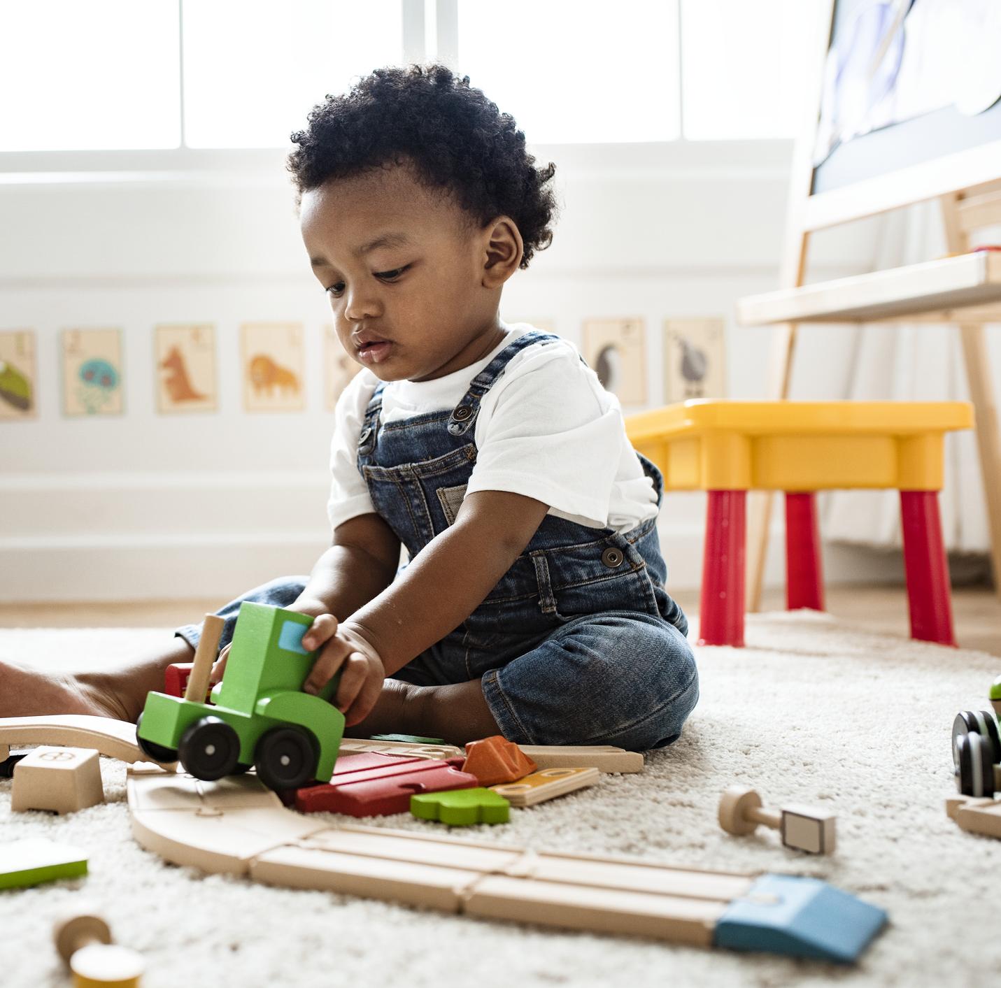
CHILDREN AS INDIVIDUALS
Unique
Have different needs
Have different learning styles
Have different interest and connections
Come from different communities
Identify with different cultures and customs
Speak different languages
Different abilities/disabilities
Notes:
Stock photo ID:1141049737

Slide 8
Why is it important to see each child as an individual and approach learning and support from this perspective?

Slide 9
Activity: Learning Styles

Slide 10
LEARNING STYLES
Predominant Styles
Visual | Auditory | Kinesthetic
Other Styles
Verbal | Logical or Mathematical | Social/Solitary

Slide 11
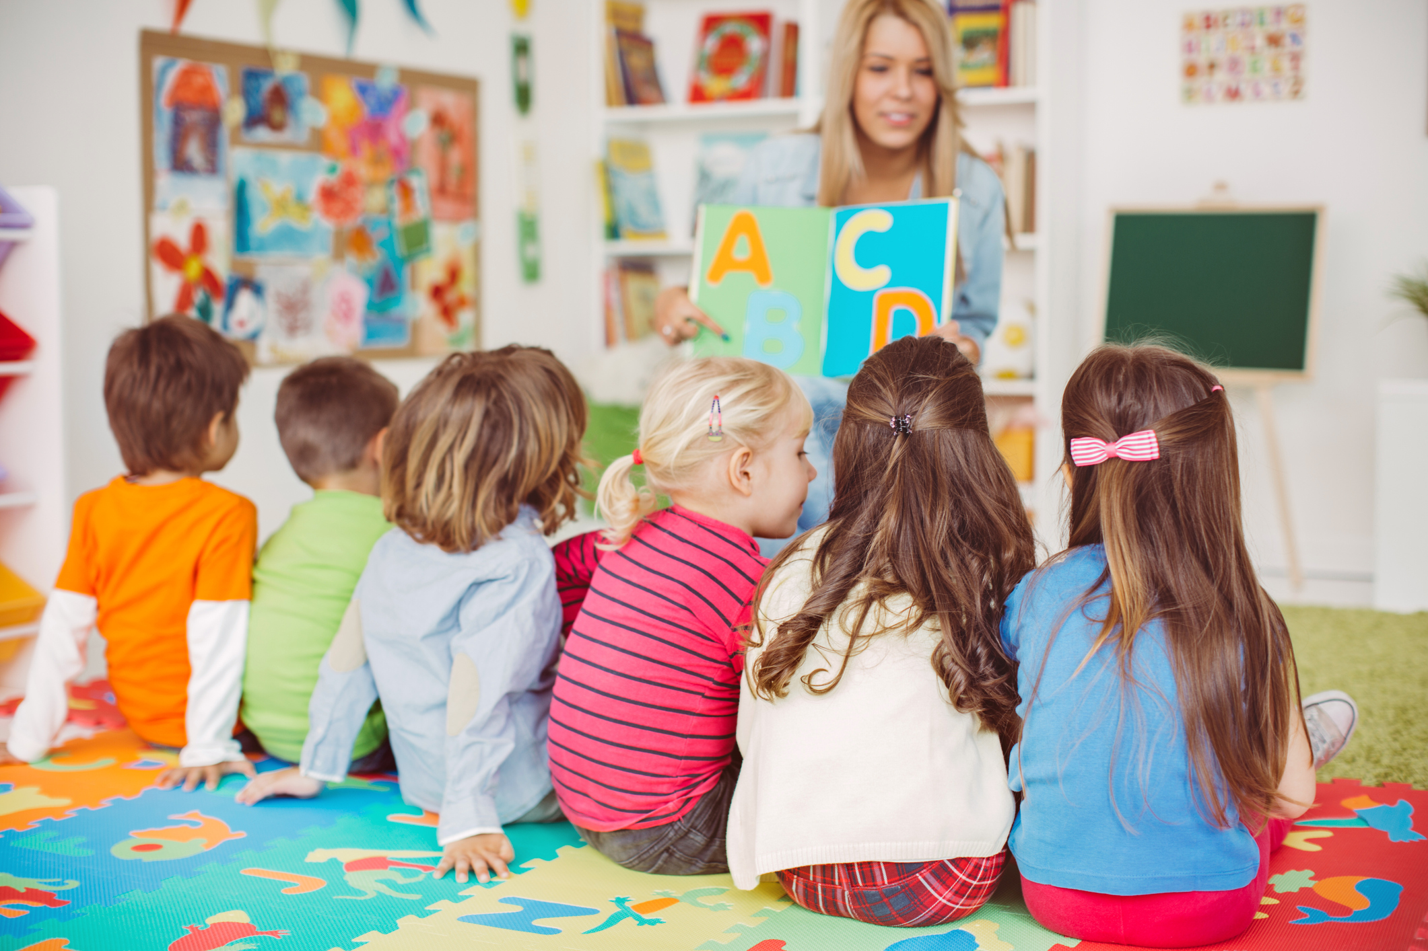
Visual
Children with a visual style of learning will remember information best when presented with pictures or graphics. Visual learners will often recognize numbers and letters better than peers with another type of learning style.

Slide 12
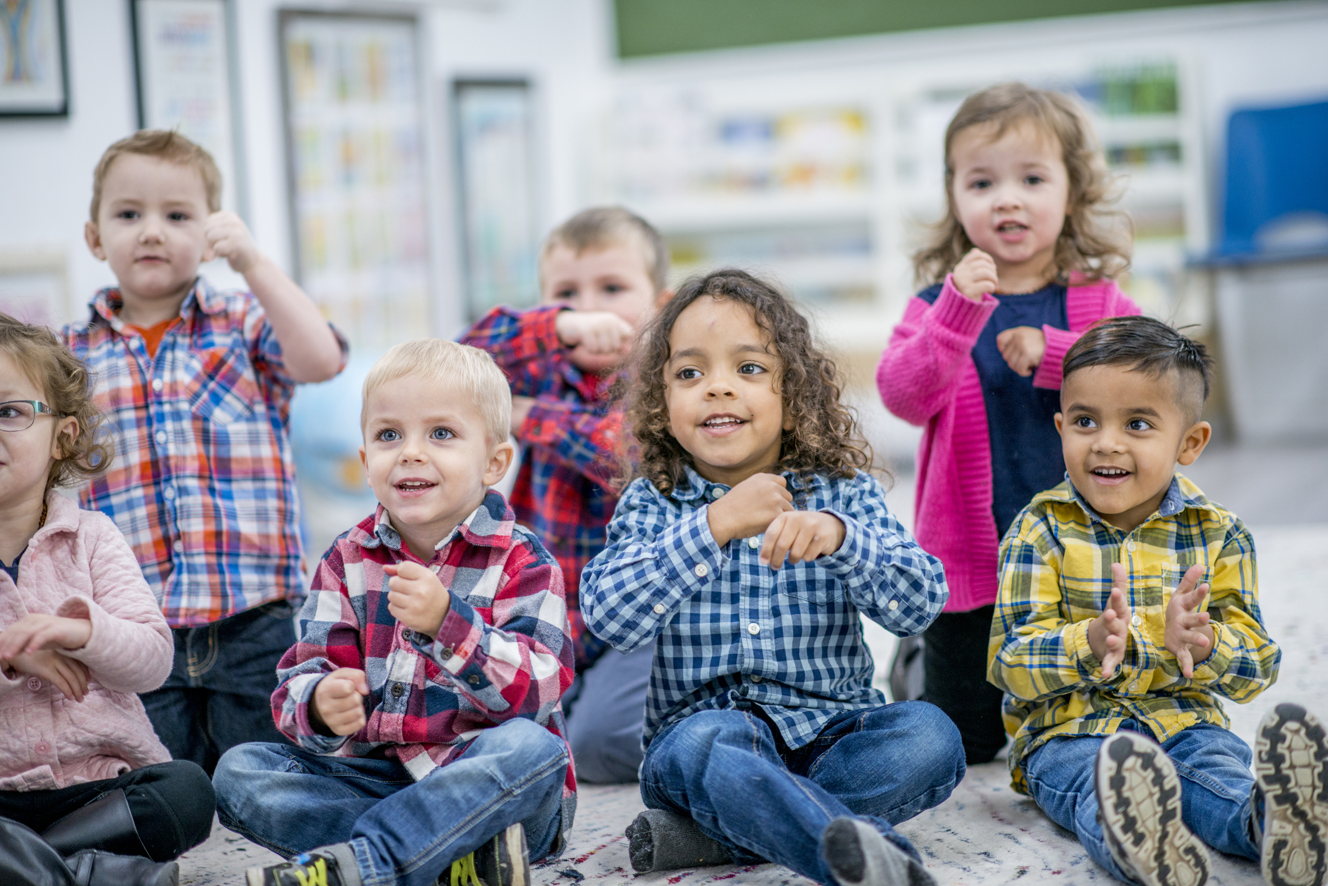
Auditory
Auditory learners are best able to understand when they hear information. In early education, auditory learners are more likely to prefer telling and listening to stories or music as a way to understand information.

Slide 13
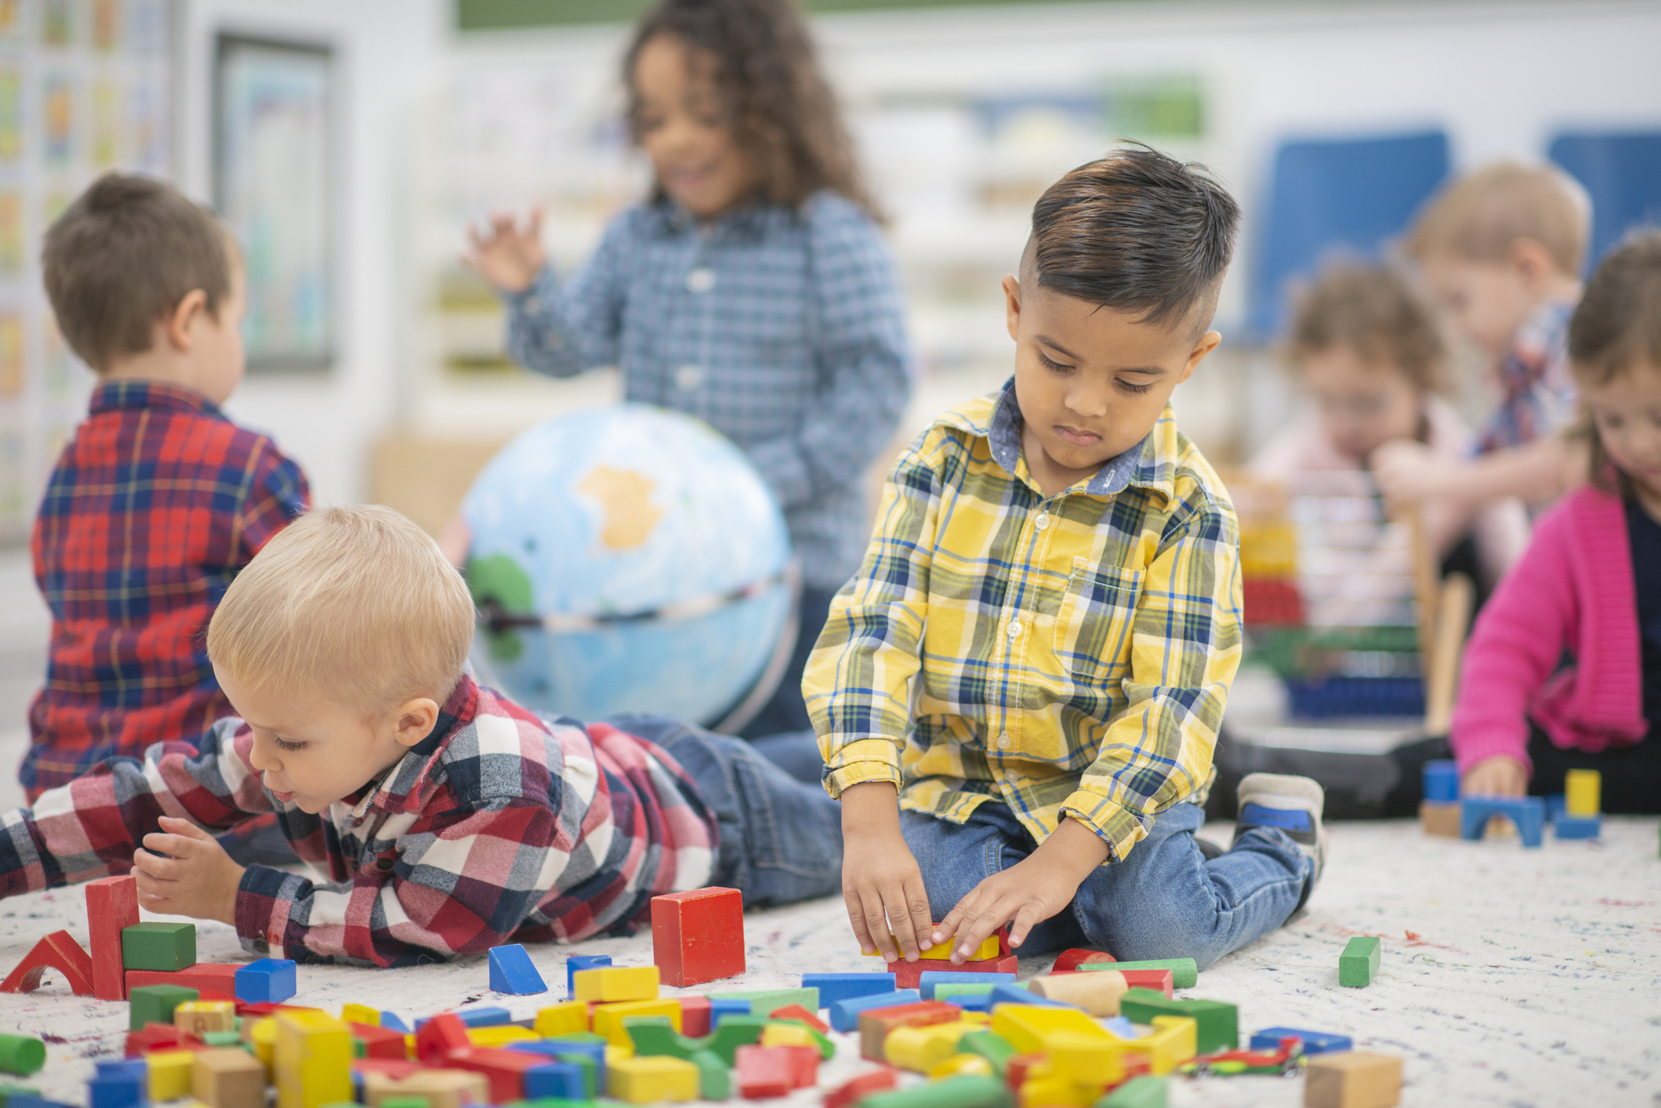
Kinesthetic
Children with a kinesthetic learning style learn best by manipulating objects and engaging in physical activities to learn the material.

Slide 14
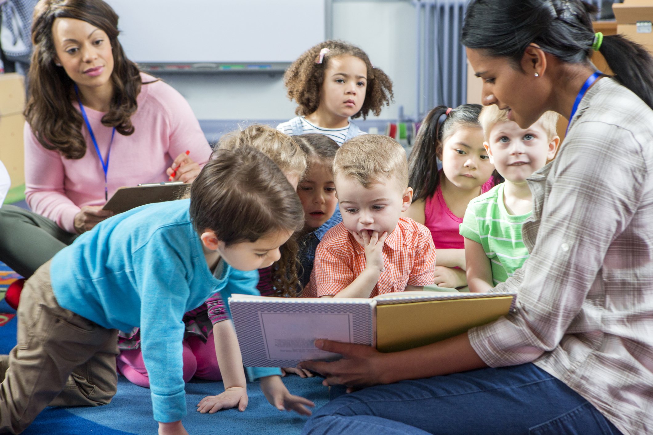
Verbal
In early childhood education, verbal learners and auditory learners have similarities because they learn best from stories. As children get a little older, verbal learners prefer learning through reading, writing, and listening to information. Auditory learners focus on music and sound but will not necessarily enjoy reading or writing.

Slide 15
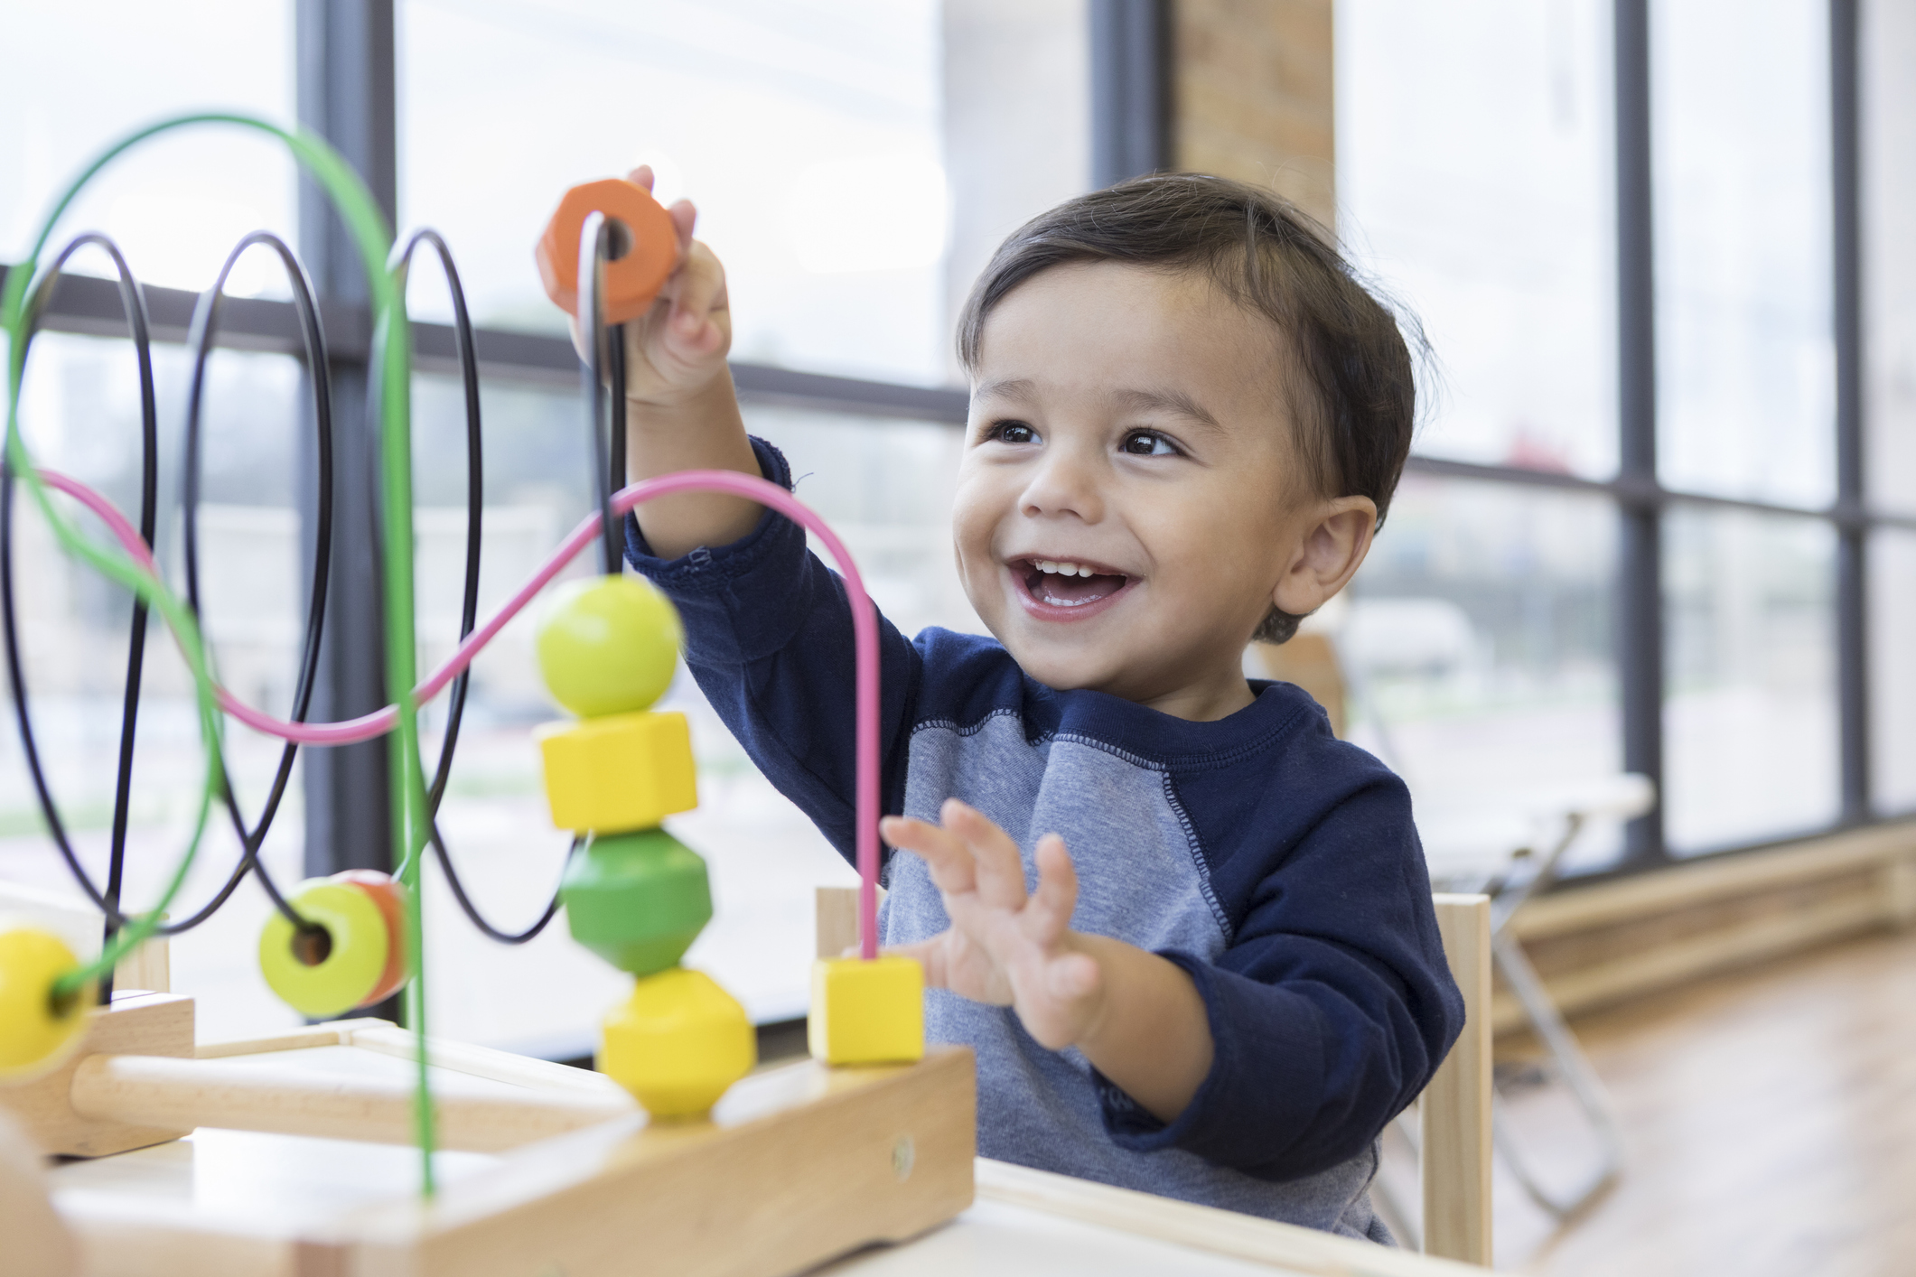
Logical or Mathematical
These children understand math and science better than other children and focus on finding a pattern. As a teacher, you could use reasoning to provide answers that help these types of children learn information.

Slide 16
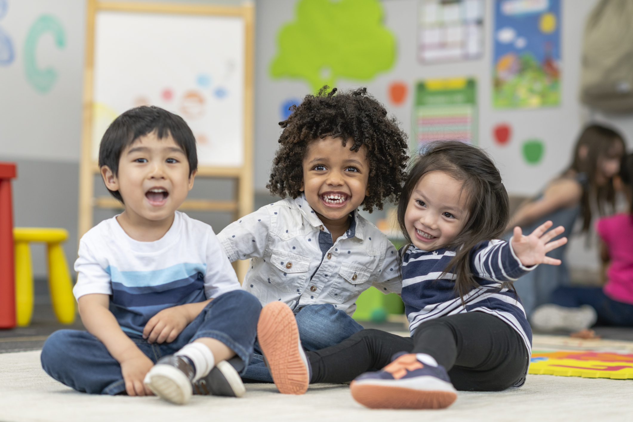
Social/Solitary
Some children learn better in group settings—something to keep in mind when arranging your classroom. On the flip side, others are solitary learners. They understand information best when allowed to work out the problems without others offering input. You’ll notice that these children prefer playing alone rather than spending time with peers.

Slide 17
LEARNING STYLES – activity
Predominant Styles
Visual | Auditory | Kinesthetic
Other Styles
Verbal | Logical or Mathematical | Social/Solitary

Slide 18
Understanding Accommodations

Slide 19
What
Accommodations are any adjustments to activities, lessons, routine, etc. for the benefit of a child.

Slide 20
When
Whenever you see that a child is having difficulty, adjust the experience to make it less challenging or more challenging to create more learning opportunities and to be more inclusive.

Slide 21
How
There are a variety of ways to adjust and modify activities. Teachers need to be creative and use the tools and knowledge they have acquired to best help their children.

Slide 22
HOW UNDERSTANDING INDIVIDUALISM AND ACCOMMODATIONS ENHANCE INTERACTIONS
Relationships are the basis of any learning experience
Accommodations become a bridge to help children get from where they are to where you are trying to take them

Slide 23
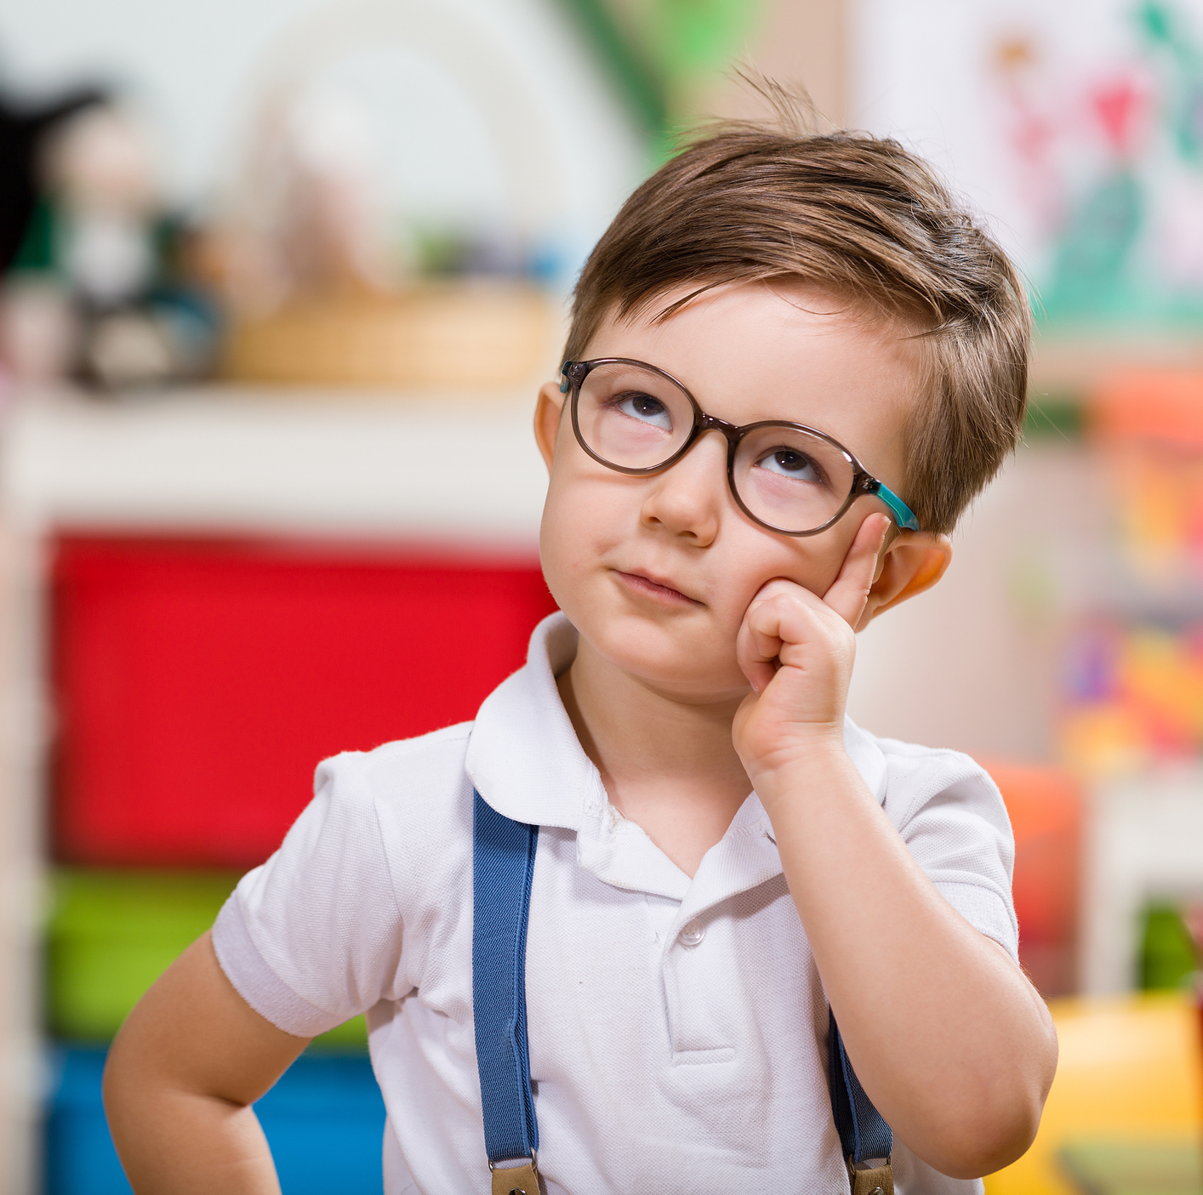
Think, Pair, Share

Slide 24
Benefits of Inclusion

Slide 25
INCLUSION
“Early childhood inclusion embodies the values, policies, and practices that support the right of every infant and young child and his or her family, regardless of ability, to participate in a broad range of activities and contexts as full members of families, communities, and society. The desired results of inclusive experiences for children with and without disabilities and their families include a sense of belonging and membership, positive social relationships and friendships, and development and learning to reach their full potential. The defining features of inclusion that can be used to identify high quality early childhood programs and services are access, participation, and supports.”
Definition according to Division of Early Childhood (DEC) and NAEYC

Slide 26
BENEFITS OF INCLUSION
FOR CHILDREN WITH EXCEPTIONALITIES
Greater opportunities for interactions
Peer role models for academic, social, and behavioral skills
Families are more integrated into community
Enhance skill acquisition and generalization
FOR CHILDREN WITHOUT EXCEPTIONALITIES
Increased appreciation and acceptance of individual differences
Increased understanding and acceptance of diversity
Opportunities to master activities by practicing and teaching others
Greater academic outcomes

Slide 27
Session Review

Slide 28
REVIEW LEARNING OBJECTIVES
Adjust our perspective to better identify with each child as an individual
Understand and define accommodations
Explore why it is important to be able to accommodate
Identify when to use accommodations
Understand how to use individualization and accommodations to help children succeed

Slide 29
Reflections, Questions, & Comments

Slide 30
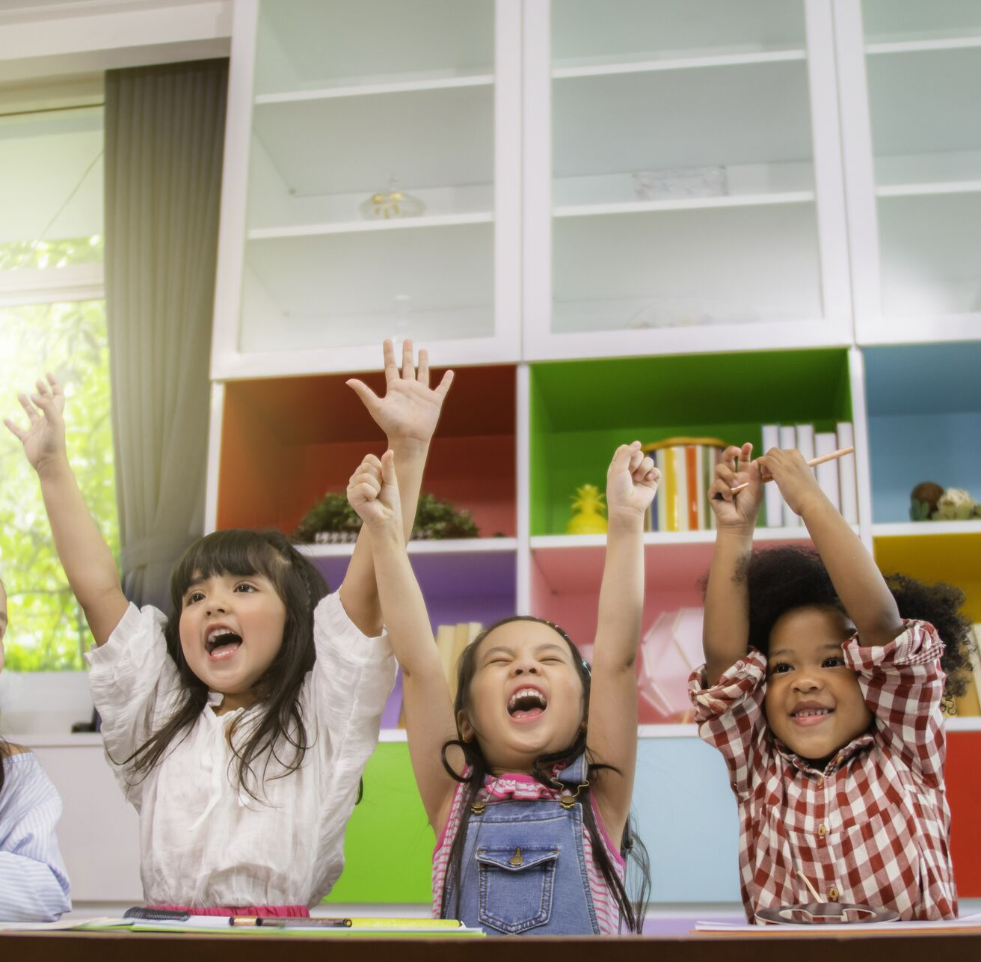
Please complete the Post-Assessment Evaluation. Thank you!

