Slide 1
Connecting the Pieces: Using Standards with Preschoolers
Notes:
Slide 1
Welcome to Connecting the Pieces: Using Standards with Preschoolers. I am ______________________ and I have the pleasure of being your trainer today. Today we are going to learn how to use the Birth to Five Standards to plan meaningful and developmentally appropriate experiences for preschoolers. You will have the opportunity to share ideas with one another and engage in activities related to today’s content. The more you participate the more you gain from the session. If you haven’t already done so, please complete the pre-assessment survey and I will collect them.
Provide any information about restroom locations, policies (cell phones on silent), and emergency exits.
Alternative Option for Pre-Assessment
Prior to training, use a free online tool such as Surveymonkey.com for participants to complete the pre and post assessment online. Use the same questions and answer choices.

Slide 2
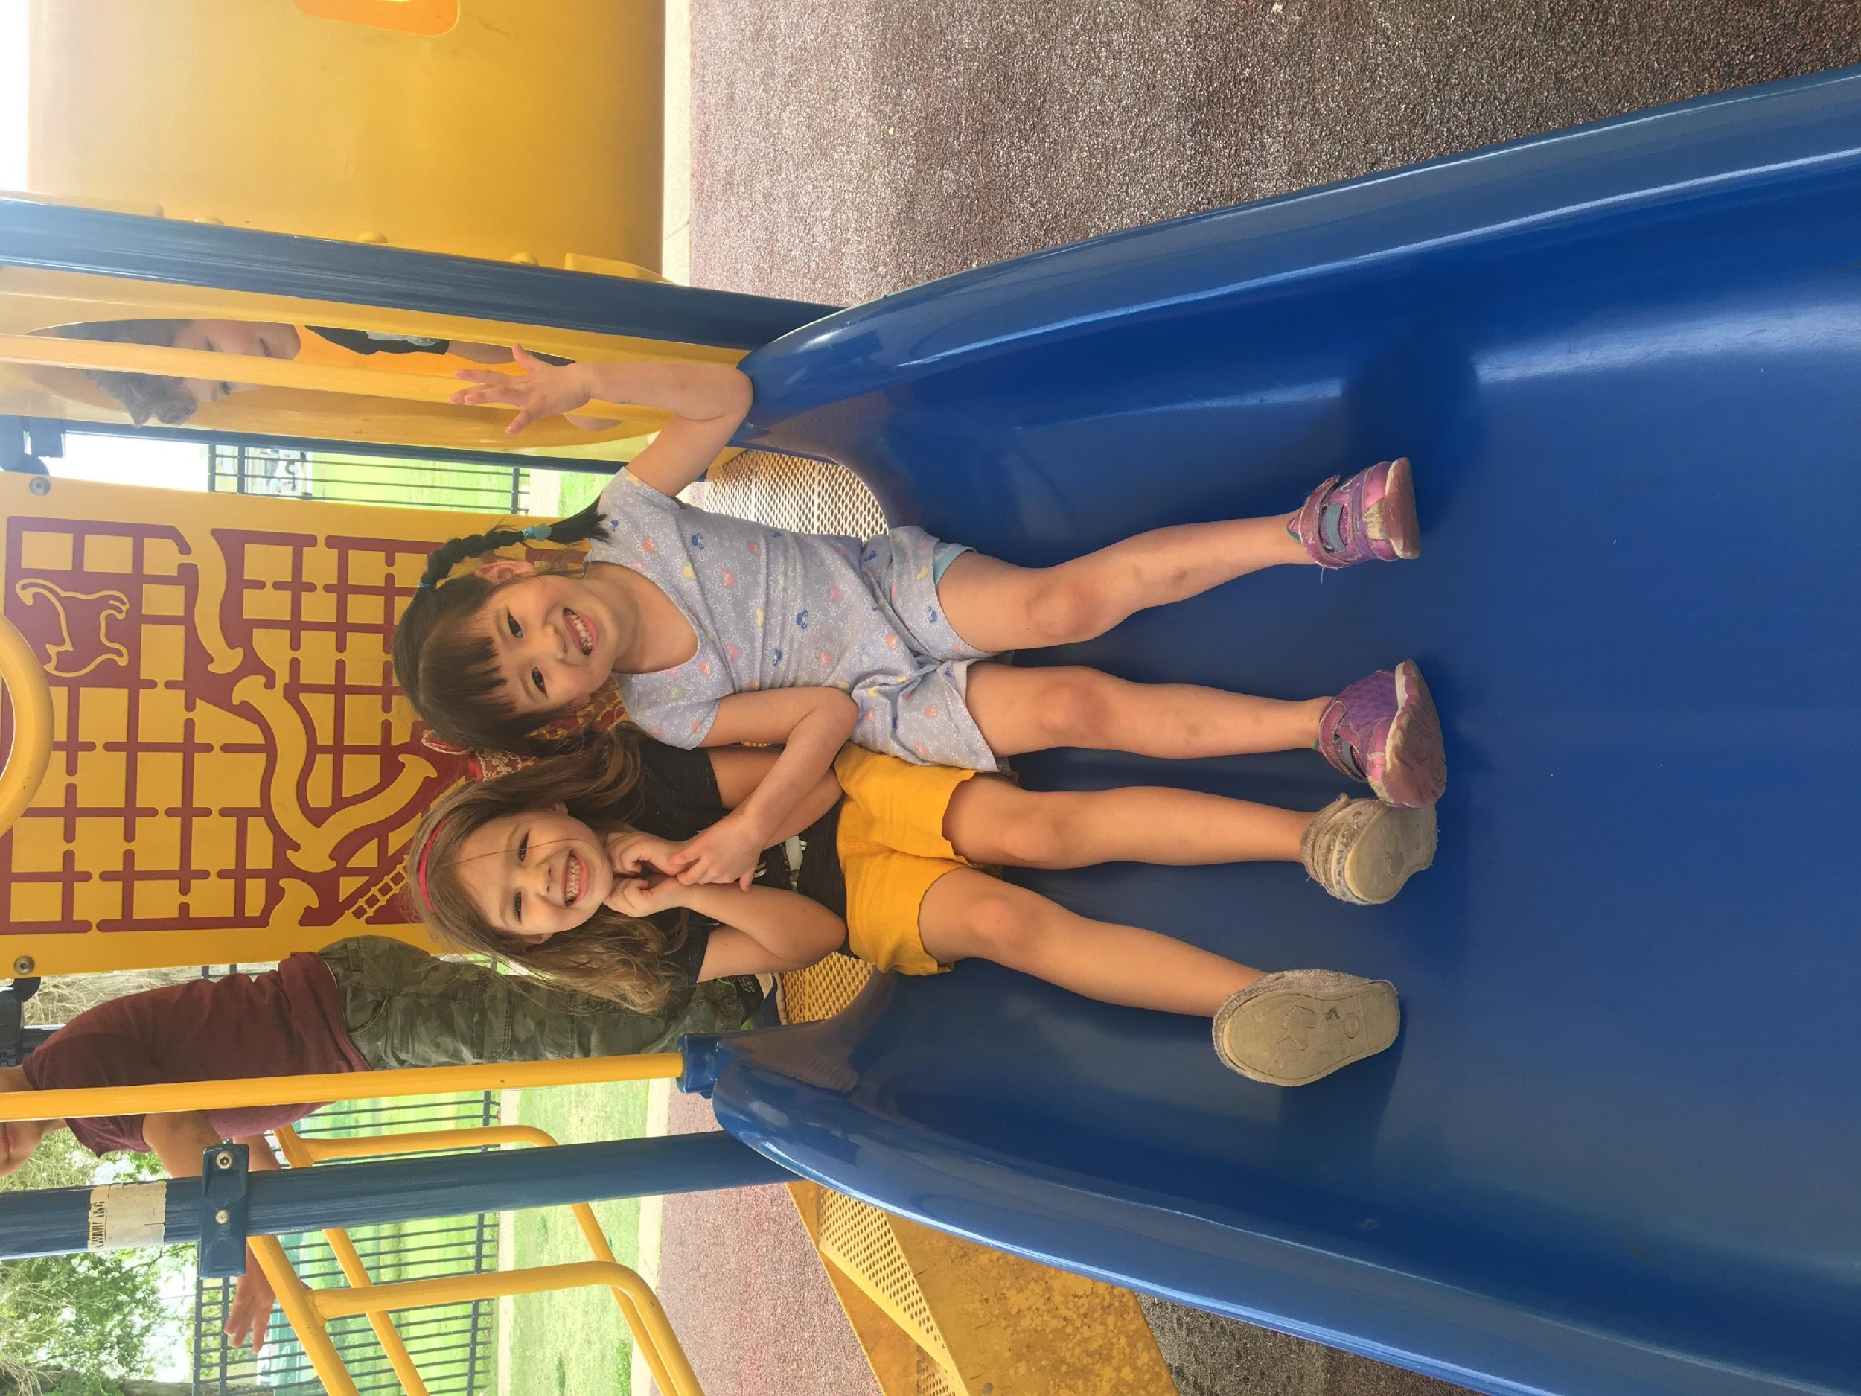
Icebreaker
Notes:
Slide 2
Let’s get started by getting to know a little bit about each other.
Conduct your selected icebreaker from the guidebook.

Slide 3
Overview of Training
Getting Started: The Value of Early Childhood Education
Examining Key Components
Participants will develop an understanding of the teaching learning cycle and multiple influences on early
development and learning
Participants will identify key terms
Taking A Closer Look: An Overview of the Louisiana’s Early Learning & Development Standards (ELDS)
Participants will identify the domains in the Louisiana’s Birth to Five Early Learning & Development Standards
Putting It All Together: Planning for Preschoolers Using Standards
Participants will learn to design learning outcomes for preschoolers
Participants will practice methods for aligning standards, curriculum, and assessment for preschoolers
Participants will plan experiences for preschoolers that align with Louisiana’s Birth to Five ELDS and Tier 1
curriculum
Notes:
Slide 3
This training will provide you with ideas on how you can use these standards to improve upon the work you do with young children.
The training is divided into the four areas listed.
First, in “Getting Started” we will review why your work with young children is important.
During “Examining Key Components”, you will develop an understanding of the teaching learning cycle and multiple influences on early development. You will also identify key terms such as assessment and learning outcomes.
After that we will cover “Taking a Closer Look: An Overview of the Louisiana Early Learning & Development Standards” which will provide you an opportunity to learn more about standards and the opportunity to identify the five domains in the ELDS.
We will end with “Putting It All Together: Planning for Preschoolers Using Standards” where you will have an opportunity to learn to design learning outcomes for preschoolers; practice methods for aligning standards, curriculum, and assessment for preschoolers; and plan experiences for preschoolers that align with Louisiana’s Birth to Five ELDS and Tier 1 curriculum.
If you think about putting together a puzzle, we will follow a similar approach. We will start with the big picture (similar to looking at the complete picture on a puzzle box), then review individual components before connecting the information to develop meaningful plans for preschool children. What do you hope to gain from today’s session?
Take notes on chart paper on other things mentioned by the group.
While I realize that each program may have their own curriculum, lesson plan formats, and assessment tools, you will see how the Louisiana Birth to Five Early Learning & Development Standards can be used as a resource to further guide your work with preschoolers. Let’s get started!

Slide 4
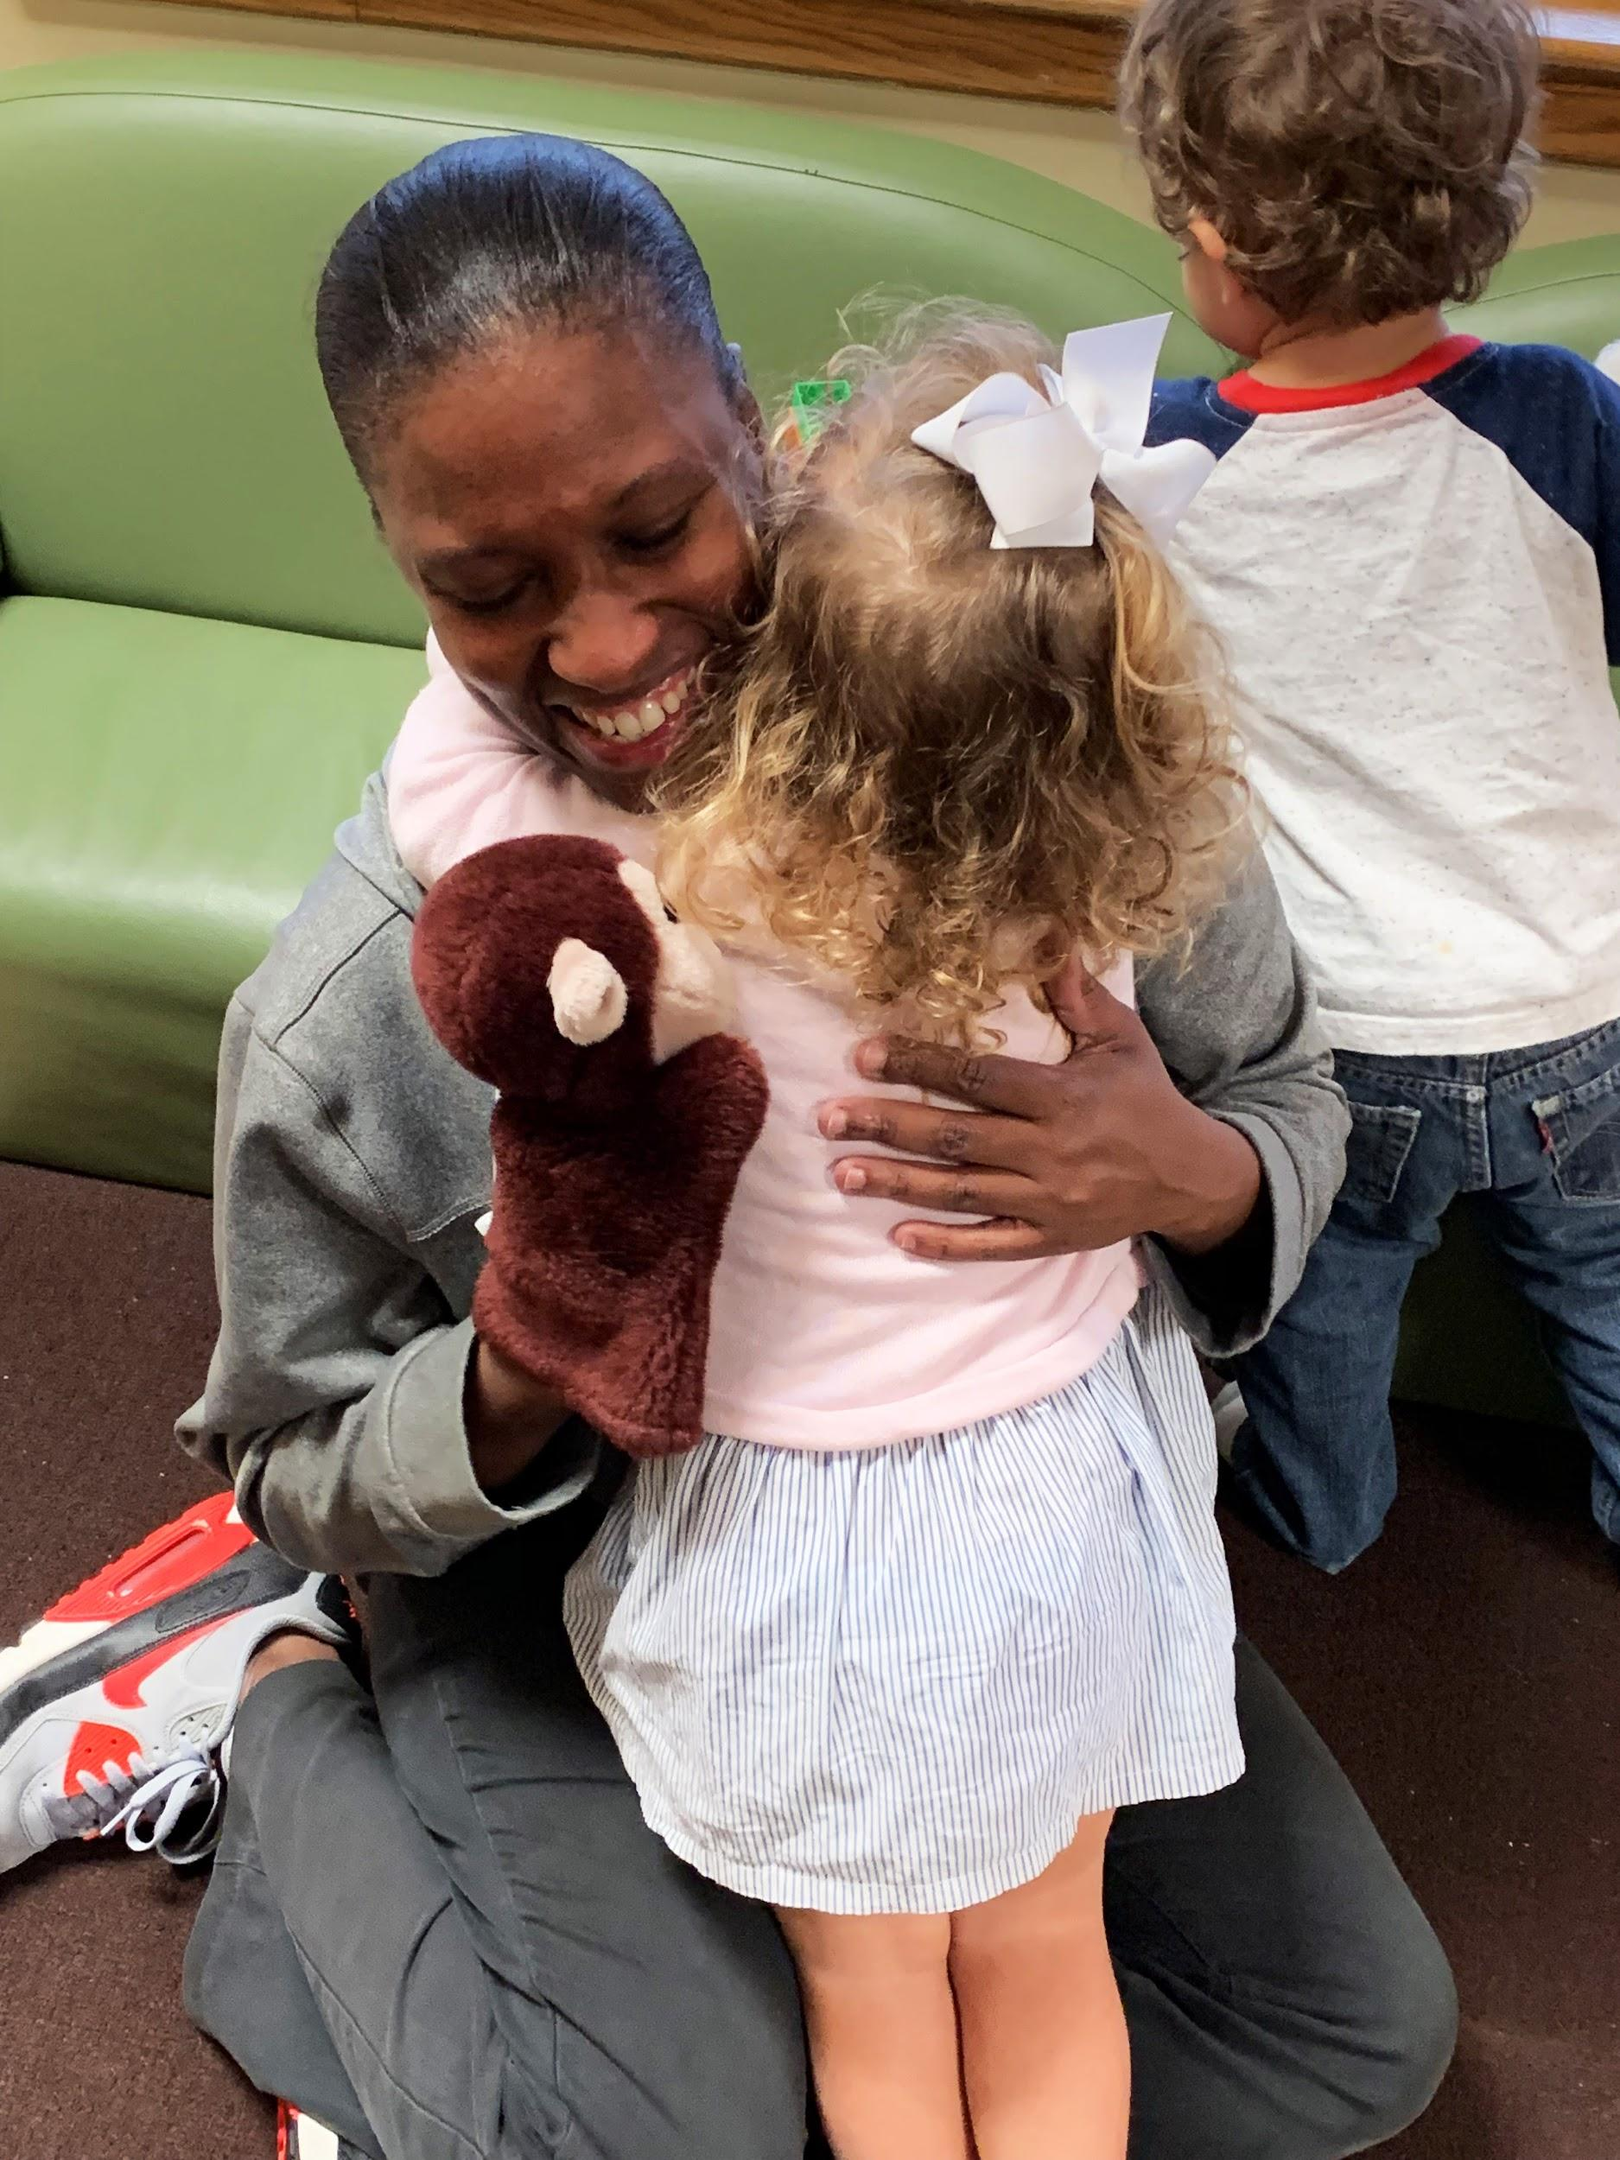
The Value of Early Childhood Education
High-Quality Early Childhood Experiences
Academic Success
Child Development
Knowledge
High-Quality
Interactions
Notes:
Slide 4
As we start this session, I would like to stress the importance of your work with young children. You make a difference in the lives of young children each day! Educational research has consistently shown a strong correlation between the quality of early childhood experiences and later academic success (ELDS, pg. 8). It is important that we provide children with the foundational experiences needed for them to become successful learners. Also, your knowledge and expertise in child development directly impacts your interactions and experiences with children. By attending trainings such as this one today, you can continue to build upon your professional knowledge which will impact your interactions with children in the classroom.
Reference:
Louisiana Department of Education (2013). Louisiana Birth to Five Early Learning & Development Standards.

Slide 5
Examining Key Components
Notes:
Slide 5
Now we will take a look at some of the key components and background information for using standards with young children.

Slide 6
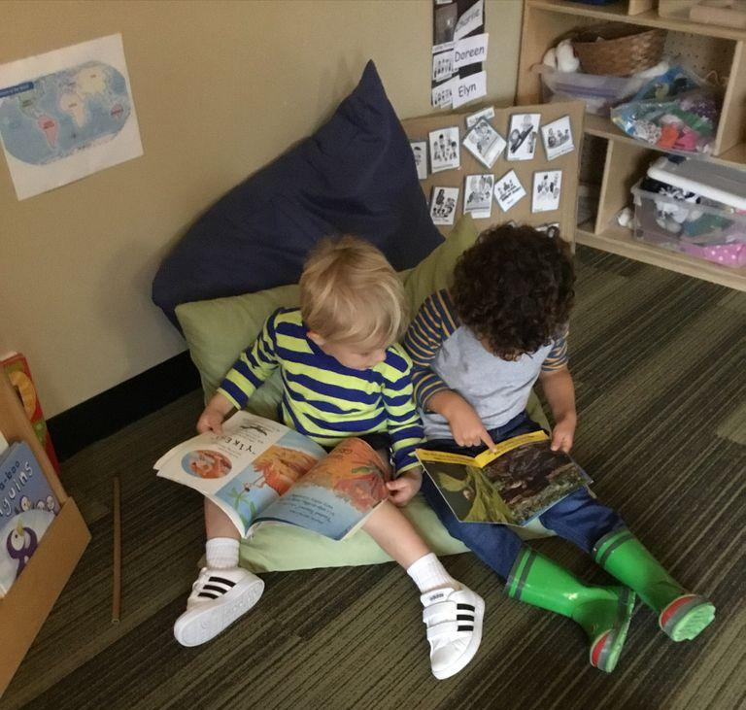
Multiple Influences on Development
Family
Culture, language, siblings
Life Experiences
Previous child care attendance, exposure to specific activities, traumatic experiences
Disability
Down syndrome, autism, hearing loss
Notes:
Slide 6
When planning experiences for young children, it is important to get to know the children and families in your class. What are their interests? What are their strengths? In which developmental domain does a child need the most support? Every child is unique and will come to you with different needs. Research shows that there are multiple influences upon a child’s development (Copple & Bredekamp, 2009). Family, life experiences, and a disability are all factors that can affect a child’s development.
More information about each of the factors listed is below. You may ask participants to share professional experiences related to the information on this slide. Can you think of other examples of factors that may influence how a child learns and develops?
Family
Families may have certain cultural beliefs or practices that influences what children are exposed to or what children are expected to learn. For example, if a family’s culture discourages children from initiating conversations with adults, a child may need more support with the social-emotional and language standards that involve interactions with trusted adults.
Note – the related standards/indicators for this example include:
Standard SE1: Develop healthy relationships and interactions with peers and adults; Indicator 4.9 Demonstrate positive relationships by seeking out trusted adults for emotional support, physical assistance, social interaction, approval, and problem solving. (pg. 79)
Standard LL1: Comprehend or understand and use language; Indicator 4.2 Listen and respond attentively to conversations (pg. 58)
Children who are learning to speak multiple languages may be able to communicate better in one language over another. This is good to keep in mind for assessment purposes. Many of the strategies you use for children who only speak English are also appropriate to use for children who are English Language Learnings. For example, labeling actions and feelings, using visual cues and gestures, and using environmental print in English and the child’s home language. More strategies for English Language Learners can be found in Appendix F of the ELDS (pg. 94).
Other relatives in the home can also influence children’s development. This includes if a child has siblings or other relatives that live in the home. A child who has a sibling may have more opportunities to interact with other children whereas a child without siblings may need more support interacting with peers. Family influences may also include interactions with extended family members who live in the home.
Life Experiences
The 12 Principles of Child Development states “children’s experiences shape their motivation and approaches to learning” (Copple & Bredekamp, 2009, pg. 15-16). For example, a new preschooler in your class who previously attended a high-quality early learning program may enter your classroom ready to learn and easily adapt to the daily classroom routines and schedule.
Traumatic experiences such as abuse or neglect can have a negative impact on a child’s motivation and approach to learning. According to Maslow’s hierarchy of needs (Maslow, 1943), children need to have their basic needs met in order to reach their full potential.
Disability
A child’s development may be influenced by a disability. Conditions such as autism, down syndrome, hearing loss, and spina bifida can cause a delay in various areas of development such as cognitive, motor, or language development. Planning for children with a disability is often a team approach which includes the family and the child’s therapists. A teacher may use a child’s Individualized Education Plan (IEP) to plan experiences related to the individual goals for the child with a disability.
Additional Resource
12 Principles of Child Development
Citations:
Copple, C., & Bredekamp, S. (Eds.) (2009). Developmentally appropriate practice in early childhood programs: Serving children from birth through age 8. Washington, DC: NAEYC.
Maslow, A. H. (1943). A theory of human motivation. Psychological Review, 50(4), 370-96

Slide 7
Standards
Key Term | Definition | Example
Standards (ELDS) | Concise, written descriptions of what students are expected to know and be able to do at a specific stage of their education | Comprehend and use increasingly complex and varied vocabulary
Notes:
Slide 7
Throughout this presentation, you will hear various terms. It is important for you to know what these terms mean and how they are relevant to your work with young children. We will take a look at 4 key terms – standards, learning outcomes, curriculum and learning experiences, and assessment.
Standards are concise, written descriptions of what students are expected to know and be able to do at a specific stage of their education. Program may use various standards that may align with the Louisiana Birth to Five Early Learning & Development Standards. During the training today, when we talk about standards we are referring to the Louisiana Birth to Five Early Learning & Development Standards, also known as ELDS. If your program uses a curriculum identified as a Tier 1 curriculum by the state of Louisiana, they have shown how the standards in the curriculum align to Louisiana’s standards. Comprehend and use increasingly complex and varied vocabulary is an example of a standard found in the ELDS.
The Louisiana Birth to Five Early Learning & Development Standards, also known as the ELDs, can help you determine what experiences to offer based on your age group and give you guidance on how to support children’s learning and development throughout the day. We will use the Birth to Five ELDs throughout the training today.

Slide 8
Learning Outcomes
Key Term | Definition | Example
Learning Outcomes | Statements regarding what children will learn through an activity (not what they will do) | The preschooler will learn characteristics of various types of bears.
Notes:
Slide 8
Learning Outcomes are statements regarding what children will learn through an activity (not what they will do). Learning outcomes should be based upon the standards and should be appropriate for diverse learners. An example of a learning outcome is “The preschooler will learn characteristics of various types of bears”. Notice that the statement is written in terms of the goal or outcome for the child. You will have an opportunity today practice writing learning outcomes.

Slide 9
Curriculum & Learning Experiences
Key Term | Definition | Example
Curriculum and Learning Experiences | The lessons and content being taught in a classroom or program; often includes recommended materials for the classroom environment. | Ask children to identify similarities and differences between a panda bear and koala bear
Notes:
Slide 9
The term curriculum refers to the lessons and content being taught in a classroom or program. Curricula often includes recommended materials for the classroom environment. When referring to one specific activity that you may do with children, this referred to as a learning experience. A curriculum usually includes multiple learning experiences that teachers can provide to children. An example of a learning experience is “Ask children to identify similarities and differences between a panda bear and koala bear”. Throughout the day, you engage in numerous learning experiences with children, even during your daily routines such as washing hands. What curriculum do some of you use in your program?
Allow participants time to respond.
Curricula may differ in the amount of resources and depth of the material. However, it is important to note that in Louisiana, all Tier 1 curricula should align with the standards for our state and include developmentally appropriate experience. Today we will not discuss a specific curriculum. We will discuss how to use standards to support the learning experiences you offer no matter which curriculum your program uses.

Slide 10
Assessment
Key Term | Definition | Example
Assessment | Methods or tools that educators use to evaluate, measure, and document the academic readiness, learning progress, skill acquisition, or educational needs of students. | The child pointed to the picture of the koala bear in the book and stated, “The koala bear eats eucalyptus leaves”.
Notes:
Slide 10
Lastly, the term assessment refers to the methods or tools that educators use to evaluate, measure, and document the academic readiness, learning progress, skill acquisition, or educational needs of students. An example of an anecdotal record used for assessment is
The child pointed to the picture of the koala bear in the book and stated, “The koala bear eats eucalyptus leaves”.
Documentation is required to accurately assess young children. Many early childhood classes use anecdotal notes, pictures or videos, and/or work samples to document children’s knowledge. Many Tier 1 curricula have their own assessment tools. What are some of the assessment tools you use in your program?
Allow participants time to respond. Possible answers include Teaching Strategies Gold, COR Advantage, and Battelle Developmental Inventory.
Although we will not discuss assessment in detail in today’s session, it is important to know the relationship between learning outcomes, learning experiences, and assessment.

Slide 11
Identifying Key Terms
Example: Understands numbers, ways of representing numbers, and relationship between numbers and quantities
Color | Term
Blue | Standard
Yellow | Learning Experience
Pink | Learning Outcome
Orange | Assessment
Notes:
Slide 11
Let’s practice identifying some of the terms we just learned. On your table your will find various color sticky notes. The blue sticky note is for a standard, the yellow is for a learning experience, the pink is for a learning outcome, and the orange is for assessment. Posted around the room are various examples on chart paper. On the chart that is labeled Example 1, it says “Understands numbers, ways of representing numbers, and relationship between numbers and quantities”. You will place the sticky note that represents the term you believe best defines this example. For example, if you think “Understands numbers, ways of representing numbers, and relationship between numbers and quantities” is a learning experience, you will place a yellow sticky note on the chart. You can use your handout on key terms to assist you. You may now get up and go to the various charts and place your colored sticky note on the chart. Please return to your seat when you are finished.
Alternative Activity Options:
1. Print multiple sets of the matching activity handout and pre-cut the examples and terms. Divide participants into pairs and have each
group match the examples with the terms. Review answers with participants after activity. Ask them why each term was selected and
have them share their reason. Answers are below.
2. Read each example one at a time and have participants identify the corresponding term and why they selected the term.
Review answers with participants.
1. Understands numbers, ways of representing numbers, and relationship between numbers and quantities
Answer: Standard
2. The child will learn to count a set of 5-10 objects.
Answer: Learning outcome
3. While reading a book in the reading center, the child pointed to a question mark and said “Look, there’s a question mark at the end of the sentence!”
Answer: Assessment
4. The teacher will place a large set of blocks and several toy animals in the block center. The teacher will encourage children to work together to build a habitat for the animals.
Answer: Learning experience
5. Develop appropriate health and hygiene skills
Answer: Standard
6. Ask children to predict what they think will happen when you mix yellow and blue colored water.
Answer: Learning experience
7. The child will learn how to retell a story using props.
Answer: Learning outcome
8. The child identified 20 lowercase letters.
Answer: Assessment

Slide 12
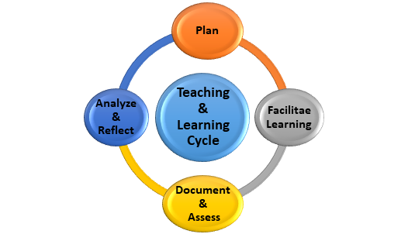
Teaching & Learning Cycle
Notes:
Slide 12
Now that you know the key terms related to planning, let’s see how they are interrelated and connect to what you do each day. This is the teaching and learning cycle. It shows the ongoing cycle of planning, facilitating learning (or teaching), documenting and assessing students’ knowledge and skills, and reflecting on children’s strengths, interests and needs. Engaging in this process helps educators make meaningful connections with children that supports their growth and development.
Point to each component of the cycle as you discuss it.
Planning refers to the process of preparing the environment, materials, and learning experiences that you will offer children. This may include developing a lesson plan, making changes to how you set up your room, and planning how you will transition children to one activity to another. It is important to note that the teaching learning cycle does not always start with planning. For example, you may analyze assessment data received for a new child in your class and then incorporate some of the information into your next lesson plan. What resources do you use to help you plan?
Allow participants time to respond.
Planning is an important part of the process and using the standards can help guide you on the selection of meaningful and appropriate experiences to preschool children.
Facilitating learning refers to the language and interactions between teachers and children throughout the day. It does not only occur during teacher-guided experiences, it should occur throughout the day during daily routines and natural interactions. For example, an impromptu conversation with a child about a leaf he found on the playground is an opportunity to facilitate learning. The CLASS observation tool provides strategies for facilitating learning. What is a strategy that you use to facilitate learning?
Allow time for participants to respond and thank them for sharing.
Throughout the day you may use several teaching strategies like asking questions, providing assistance, or modeling ways to solve problems. New strategies can be learned by attending professional development and receiving feedback from early childhood administrators and coaches.
Documenting and assessing children’s knowledge is critical for creating meaningful experiences for children that support their growth and development. We have previously defined and discussed assessment and how it is used in early childhood programs. No matter which tool you use, assessment is an important part of the process in helping children move to the next level of development.
Analyzing and reflecting upon documentation and assessment is an important step that to guides your plans with children. This involves reviewing documentation on a regular and ongoing basis to determine children’s strengths, needs, and interests. It will help answer the questions:
What skills have children mastered?
What is still challenging for children?
What are children’s interests?
Reflection may occur at other times during the process. For example you may reflect after a learning experience to determine what went well or what changes you would make if you repeated the experience in the future.

Slide 13
Taking A Closer Look: An Overview of the Louisiana Early Learning & Development Standards (ELDS)
Notes:
Slide 13
Now we will begin to take a look at the Louisiana Early Learning & Development Standards, also known as the ELDs. For this part of the training, you will need access to the ELD’s. A paper copy or an electronic copy is acceptable.

Slide 14
Overview: Louisiana Birth to Five ELDS
There are 5 domains in the ELDs
Approaches to Learning
Cognitive Development and General Knowledge
Language and Literacy Development
Physical Well-Being and Motor Development
Social-Emotional Development
Notes:
Slide 14
The Early Learning and Development Standards are organized into five domains:
Approaches to Learning
Cognitive Development and General Knowledge.
Cognitive development & general knowledge includes the subdomain areas of Creative Thinking and Expression, Mathematics, Science, and Social Studies.
Language and Literacy Development;
Physical Well-Being and Motor Development;
Social-Emotional Development
On pages 13 of the ELDS you will find more information about the five domains. This includes the following information:
The five domains include “essential learning for school readiness and children’s long-term success” (pg. 13)
The domains are “interdependent and include all areas of children’s learning and development” (pg. 13)
A brief description of each domain and why it is important to children’s development is included at the beginning of each section
If you have a book, it is helpful to place a tab at the page where each domain begins.

Slide 15
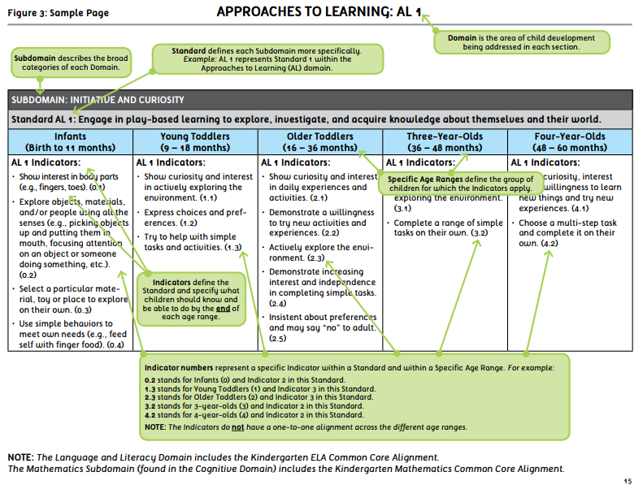
Notes:
Slide 15
Point to each item on the slide as it is discussed. This information is provided in the ELDS on pg. 13.
Point to chart. Each domain includes a table called the standards continuum. The continuum includes standards and indicators for each age level. You can “look across the age levels to see the progression that a child might make toward the standard” (pg. 13). Since we are learning about preschoolers, we will primarily focus on the last two columns (the one for 3 year olds and the one for 4 year olds).
Point to dark gray shaded area labeled “Subdomain”. Each continuum is organized into subdomains which “capture the specific areas of learning that make up the domain” (pg. 13). For example, the physical domain includes the following subdomains: Motor Skills and Physical Fitness, Health & Hygiene, and Physical Well-Being.
Point to the light gray box with the word Standard. Within each subdomain is a set of standards and indicators. As we learned earlier, the standard is a concise, written description of what students are expected to know and be able to do at a specific stage of their education. The Mathematics Subdomain and the Language and Literacy Domain also include the alignment to the Kindergarten Common Core State Standards as part of the continuum.
Point to a column with indicators. The indicators provide “more specific information about what children should know or be able to do at each age level” (pg. 13). They also indicate progress toward the standard. The indicators “typically reflect what children should know and be able to do at the end of each age level” (pg. 13). It is important to note that the indicators do not have a one-to-one alignment across the different age ranges. Point and show how some columns have more indicators than others.
Reference:
Louisiana Department of Education (2013). Louisiana’s Birth to Five Early Learning & Development Standards (ELDS).

Slide 16
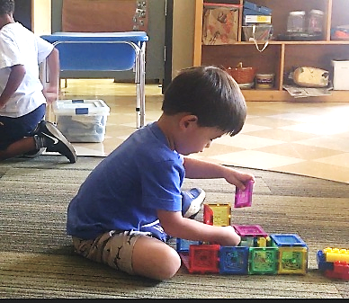
Approaches to Learning
Includes the following subdomains:
Initiative & Curiosity
Attention, Engagement, & Persistence
Reasoning, Problem-Solving, & Creative Thinking
Notes:
Slide 16
This information can be found on pages 18-19 of the ELDS.
Now let’s take a look at each domain. Approaches to Learning is the first domain and it refers to behaviors and attitudes that show how children approach tasks/activities and how they learn. This includes the subdomains Initiative & Curiosity; Attention, Engagement, & Persistence; and Reasoning, Problem-Solving & Creative Thinking. Research has shown that approaches to learning is a distinct aspect of children’s school readiness and is a strong predictor of their later success in school (National Education Goals Panel, 1991).
The ELDS description states, “at around age three, children are able to complete short-term, concrete tasks and activities. As they move closer to age five, they are able to concentrate for longer periods of time, and perform more long-term and abstract tasks such as finishing a project they started the previous day” (pg. 19).
This is important to note as you plan your daily schedule and experiences for children in your preschool class.
References:
Louisiana Department of Education. (2013). Louisiana’s Birth to Five Early Learning & Development Standards (ELDS).
National Education Goals Panel. (1999). The National Education Goals report: Building a nation of learners, 1991. Washington, DC: U.S. Government Printing Office.

Slide 17
Standards for Approaches to Learning
Use your Louisiana Birth to Five Early Learning Development Standards to answer the questions below:
The indicator “choose a multi-step task and complete it on their own” is part of which standard? During which age range does this typically occur?
The indicator “use a variety of strategies to solve a problem when the first try is unsuccessful” is part of which standard? During which age range does this typically occur?
What verbs are used within the indicators for preschoolers within this domain (e.g. explore, show, look)?
Notes:
Slide 17
Now let’s look at how children demonstrate knowledge/skills as described in this standard. Use your Louisiana Birth to Five Early Learning Development Standards to answer the questions.
Allow 3 - 5 minutes for participants to look for answers and then review answers. Participants can work individually or in pairs.
1. The indicator “choose a multi-step task and complete it on their own” is part of which standard? During which age range does this typically
occur?
Pg. 20 Standard AL 1: Engage in play-based learning to explore, investigate, and acquire knowledge about themselves and their world.
Indicator 4.2 Choose a multi-step task and complete it on their own.
Age range - 48-60 months
2. The indicator “use a variety of strategies to solve a problem when the first try is unsuccessful” is part of which standard? During which age
range does this typically occur?
Pg. 22 Standard AL 3: Recognize, understand, and analyze a problem and draw on knowledge or experience to seek solutions.
Indicator 3.3 Use a variety of strategies to solve a problem when the first try is unsuccessful
Age group- 36-48 months
3. What verbs are used within the indicators for preschoolers within this domain (e.g. explore, show, look)?
Demonstrate, show, choose, complete, maintain, stay, plan, remember, apply, use, ask, experiment, make, express.
It is important to be familiar with these words (the verbs) to know what to observe and document for assessment of children’s development in this domain.

Slide 18
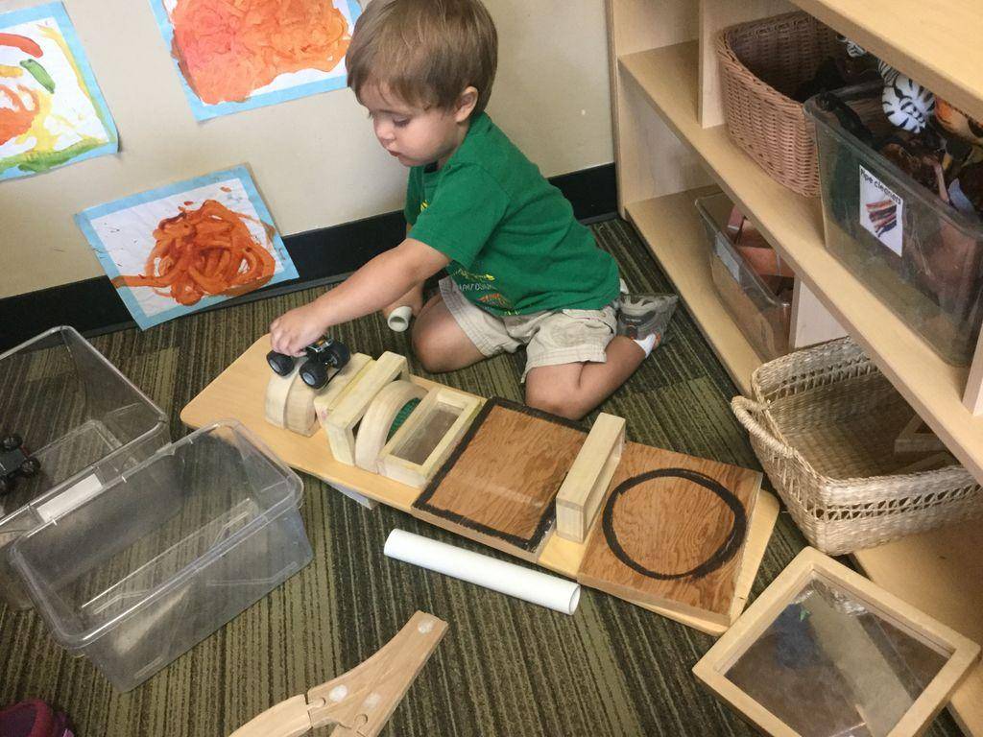
Cognitive Development and General Knowledge
Includes the following subdomains:
Creative Thinking and Expression
Mathematics
Science
Social Studies
Notes:
Slide 18
The next domain in the ELDS is Cognitive Development and General Knowledge. Cognitive Development and General Knowledge is divided into the following subdomains: Creative Thinking and Expression, Mathematics, Science, and Social Studies. Take a second and find each of these sections in your ELDS resource.
Pause and allow participants to search for each section.
The mathematics subdomain includes the alignment to the Kindergarten Common Core State Standards as part of the continuum. It’s important not to think of these areas as “subject areas” that are taught independent of one another. All of these areas can be incorporated into play and other daily routines such as meal time and outdoor play. Can anyone share an example of how you incorporate math or science into daily routines?
Allow a few participants time to respond and thank them for sharing.
Possible answers: counting during table setting, talking about weather, taking care of class pet or garden.
Additional information from the ELDS on each content area can be provided if time permits.
Creative Thinking and Expression – pg. 25
Mathematics- pg. 31
Science – pg. 40
Social Studies- pg. 47
Reference:
Louisiana Department of Education (2013). Louisiana’s Birth to Five Early Learning & Development Standards (ELDS).

Slide 19
Standards for Cognitive Development & Expression
Use your Louisiana Birth to Five Early Learning Development Standards to answer the questions below:
Which standard includes an appreciation of various languages of children in the classroom?
Which standard includes an understanding of basic patterns”?
The indicator “explore and use simple tools and machines (e.g., hammers, levers, pulleys, ramps)” is part of which standard?
The indicator “use a simple map to find specific locations within a familiar environment” is part of which standard?
Notes:
Slide 19
Now let’s look at how children demonstrate knowledge/skills as described in this standard. Use your Louisiana Birth to Five Early Learning Development Standards to answer the questions. The sections of the ELDS needed for these questions are found on pages 25 - 54.
Allow 5 minutes for participants to look for answers and then review answers. Participants can work individually or in pairs.
Answers to the questions on this slide.
1. Which standard includes an appreciation of various languages of children in the classroom?
Pg. 28 Standard CC 1 Develop an appreciation for music and participate in music and movement activities that represent a variety of the cultures and the home languages of the children in the classroom.
2. Which standard includes the understanding of basic patterns, concepts and operations relates to what standard?
Pg. 34 Standard CM 2 Understand basic patterns, concepts, and operations.
3. The indicator “explore and use simple tools and machines (e.g., hammers, levers, pulleys, ramps)” is part of which standard?
Pg. 43 Standard C7 2 Acquire scientific knowledge related to physical science (properties of objects and materials).
4. The indicator “use a simple map to find specific locations within a familiar environment” is part of which standard?
Pg. 50 Standard CSS 3 Develop an awareness of geographic locations, maps, and landforms.

Slide 20
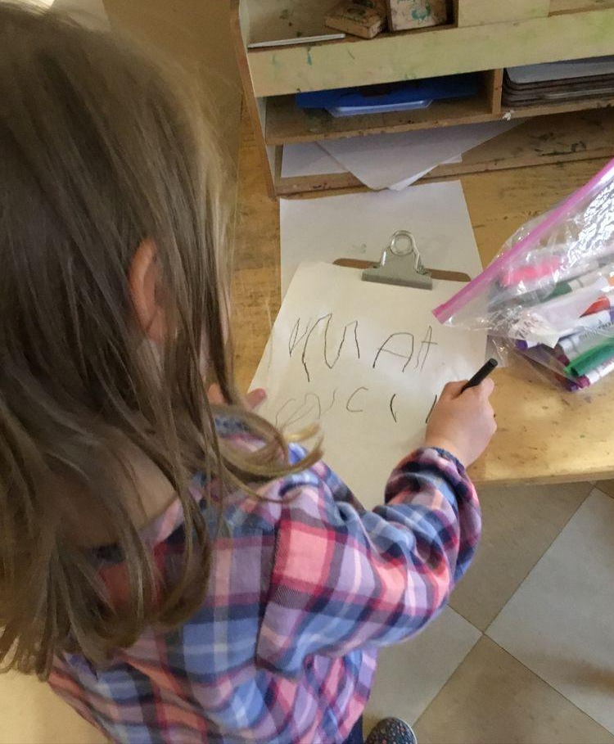
Language and Literacy Development
Includes the following subdomains:
Speaking & Listening
Language
Reading, Literature & Information in Print
Reading Foundational Skills
Writing
Notes:
Slide 20
Additional information can be found on pages 55-56 of the ELDS.
The third domain in the ELDS is Language and Literacy. This domain includes the following subdomains: Speaking and Listening; Language; Reading, Literature & Information in Print; Reading Foundational Skills; and Writing.
Many preschoolers know the purposes and conventions of communication. For example, they can engage in back-and-forth conversations on a specific topic for an extended period of time. It’s important for adults to support preschoolers’ language development so that children can continue to grow as skillful communicators. Singing songs and reciting simple nursery rhymes are ways to promote children’s language development. They help to give children a sense of the natural rhythm of the language and its sentence patterns.
Literacy refers to the pre-reading skills that are important in preschool such as showing an interest in books and beginning to recognize letters. During the preschool years, teachers can support early literacy during children’s daily interactions with books. Providing children opportunities to use books to find information about a topic, retelling a child’s favorite story, or identifying print concepts while reading book are all ways that you can support early literacy. What are some of the other ways that you support language and literacy in the classroom?
Pause and allow time for participants to respond. Possible responses include: reading to children,having conversations, introducing new words, and writing children’s words.
A solid foundation in language development in the years before a child enters school will promote success in reading and writing in the future. Studies have linked the number of words a child hears before the age of four to future academic achievement (Hart & Risley, 1995). The more often parents and caregivers talk to their children in everyday situations, the more opportunities children have to learn new words and practice their communication skills. Early literacy can be supported through natural experiences like retelling a
References:
Louisiana Department of Education (2013). Louisiana’s Birth to Five Early Learning & Development Standards (ELDS).
References:
Hart, B. & Risley, T. (1995). Meaningful differences in the everyday experience of young American children. Baltimore: Paul H. Brookes Publishing.
Louisiana Department of Education (2013). Louisiana’s Birth to Five Early Learning & Development Standards (ELDS).

Slide 21
Standards for Language & Literacy Development
Use your Louisiana Birth to Five Early Learning Development Standards to answer the questions?
The indicator “use pictures and illustrations of a text to tell a story” is a part of which standard?
English Language Learners rely on nonverbal communication during which stage of progression in learning a second language?
What is the expected number of letters that children should know when they are between 36 and 48 years old?
Notes:
Slide 21
Now let’s look at how children demonstrate knowledge/skills as described in this standard. Use your Louisiana Birth to Five Early Learning Development Standards to answer the questions.
Allow 3 - 5 minutes for participants to look for answers and then review answers. Participants can work individually or in pairs.
1. The indicator “use pictures and illustrations of a text to tell a story” is a part of which standard?
pg. 62 Standard LL 4: Comprehend stories and information from books and other print materials.
2. English Language Learners rely on nonverbal communication during which stage of progression in learning a second language?
pg. 57 Stage 2
3. What is the expected number of letters children should know when they are between 36 and 48 years old?
pg. 64 Standard LL5, Indicator 3.4 – Name at least 10 of the 52 upper-and lower-case letters of the alphabet (any combination of upper-and
lower-case letters); Age range 36-48 Months

Slide 22
Physical Well-Being and
Motor Development
Includes the following subdomains::
Motor Skills & Physical Fitness
Health & Hygiene
Safety
Notes:
Slide 22
The information below and additional background information can be found on page 68-69 of the ELDS.
The fourth domain is Physical Well-Being and Motor Development. The three subdomains in the physical domain are: Motor Skills & Physical Fitness; Health & Hygiene; and Safety.
In the subdomain “Motor Skills and Physical Fitness”, there are two general types of motor skills: gross motor skills and fine motor skills. Gross motor refers to “the movement of the large muscles in the upper and lower body” (pg. 68). This includes skills such as climbing, running, and jumping. Fine motor refers to “movement of the small muscles of the hand and arm that control the ability to scribble, write, draw, and do many other activities that require finger, hand, and hand-eye coordination” (pg. 68). Gross motor skills usually develop before fine motor skills. Although movement skills develop naturally in most young children, it is important that children have ample opportunities to practice their motor skills. What type of motor activities do you offer to children in your class?
Pause and allow participants time to respond. Possible answers may include dancing, parachute play, stringing beads, and pouring milk.
The physical domain also includes the subdomains related to health practices and safety. Teachers and other adults in the child’s life can help preschool children develop good nutrition and safety practices. Daily routines such as washing hands, eating lunch, and playing outside provide numerous opportunities for teachers to discuss health and safety topics.
Reference:
Louisiana Department of Education (2013). Louisiana’s Birth to Five Early Learning & Development Standards (ELDS).

Slide 23
Standards for Physical Well Being & Motor Development
Use your Louisiana Birth to Five Early Learning Development Standards to answer the questions below:
Which standard includes children enhancing their stamina?
The indicator “carry out most personal care routines with minimal adult guidance and assistance” is part of which standard? During which age range should this occur?
During which age range should children be able to identify and alert others of potentially hazardous objects, substances, behaviors, and/or situations?
Notes:
Slide 23
Now let’s look at how children demonstrate knowledge/skills as described in this standard. Use your Louisiana Birth to Five Early Learning Development Standards to answer the questions.
Allow 3 - 5 minutes for participants to look for answers and then review answers. Participants can work individually or in pairs.
1. Which standard includes children enhancing their stamina?
Pg. 72 Standard PM 3: Participate in a variety of physical activities to enhance strength and stamina.
2. The indicator “carry out most personal care routines with minimal adult guidance and assistance” is part of which standard? During which age
range should this occur?
Pg. 73 Standard PM 4: Develop appropriate health and hygiene skills.
Indicator 3.3 Carry out most personal care routines with minimal adult guidance and assistance.
Age Range 36-48 months
3. During which age range should children be able to identify and alert others of potentially hazardous objects, substances, behaviors, and/or
situations?
Pg. 74 Age 48 – 60 months

Slide 24
Social-Emotional Development
Includes the following subdomains:
Social Relationships
Self-Concept & Efficacy
Self-Regulation
Notes:
Slide 24
Additional information found on pages 76-77 of the ELDS.
The last domain is social-emotional development which includes the subdomains of social relationships, self-concept and efficacy, and self-regulation. Social relationships involves children’s interactions with adults and their peers. “Research has found that children who have secure, trusting relationships with their caregivers get along better with their peers and have an easier time adjusting to the demands of formal schooling” (ELDS, pg. 76).
Self-concept and efficacy includes how children feel about themselves. Self-concept develops very early as children interact with others. Doing simple things like addressing children by their name, showing appreciation of their home language, and recognizing their strengths can help promote the development of a positive self-concept.
Self-regulation includes children’s ability to manage their impulses, desires, and emotions. Preschool children may still need support in managing their feelings. You can support them by modeling appropriate behaviors, encouraging acceptable ways to express feelings, and helping children to get along with others. Young children will need your consistent support and guidance to help regulate their emotions.
How do you help support preschoolers’ social-emotional development?
Pause and allow time for participants to respond. Possible answers include: teaching children to take turns, encouraging children to use their words, and positive feedback when a child accomplishes a task.
Reference:
Louisiana Department of Education (2013). Louisiana’s Birth to Five Early Learning & Development Standards (ELDS).

Slide 25
Standards for Social Emotional Development
Use your Louisiana Birth to Five Early Learning Development Standards to answer the questions below:
The indicator “express empathy and sympathy for others” is included in which standard?
During which age range should a child be able to resolve conflict with peers by following suggestions from an adult?
During which age range should a child be able to demonstrate control of their impulsive behaviors but sometimes require adult support and guidance?
Notes:
Slide 25
Now let’s look at how children demonstrate knowledge/skills as described in this standard. Use your Louisiana Birth to Five Early Learning Development Standards to answer the questions.
Allow 3 - 5 minutes for participants to look for answers and then review answers. Participants can work individually or in pairs.
The indicator “express empathy and sympathy for others” is included in which standard?
pg. 78 SE1 Develop healthy relationships and interactions with peers and adults.
During which age range should a child be able to resolve conflict with peers by following suggestions from an adult??
pg. 78 Age 36 – 48 months
During which age range should a child be able to demonstrate control of their impulsive behaviors?
pg. 83 Age 48 – 60 months
As we wrap up our overview of the domains, remember that even though the standards are divided into domains, the domains are highly interrelated. Development in one domain influences the development in other domains. For example, children’s language skills impact their ability to engage in social interactions. When planning for young children, the dynamic interaction of all areas of development must be considered.

Slide 26
Connecting the Pieces: Planning with the ELDS
Notes:
Slide 26
Now that we have learned how the ELDS are organized and the five domains, it’s time to put all you have learned thus far together. We will use the ELDS to plan for preschoolers. We will look at three different ways to make connections using standards. First, we will connect standards to play. Then we will connect standards to your classroom environment and routines. Lastly, we will connect standards to your lesson plans

Slide 27
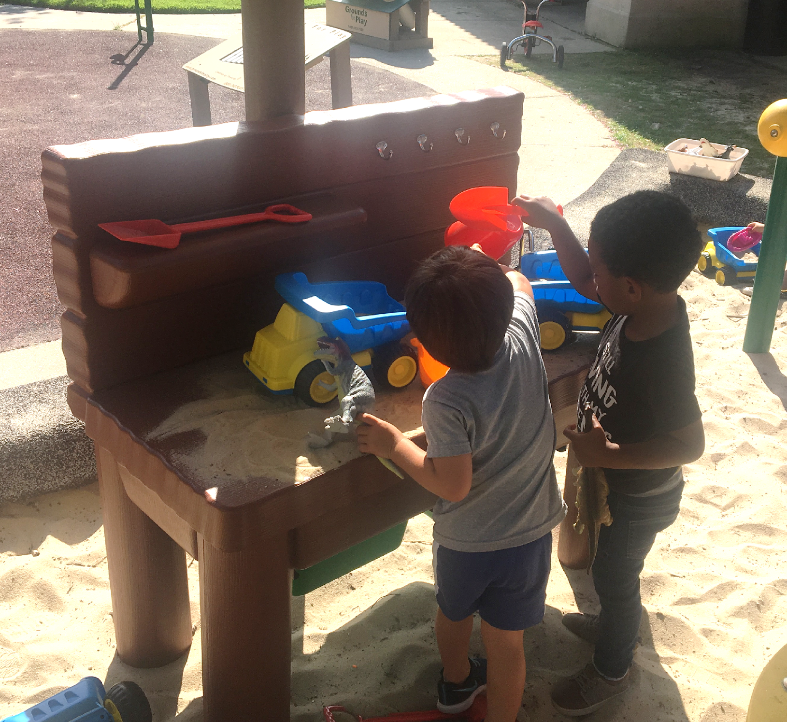
Connecting Standards to Play
Play provides children opportunities to learn and practice new skills.
Multiple standards across domain areas can be addressed simultaneously through
play!
Notes:
Slide 27
Play is what children do naturally. Play provides children opportunities to learn and practice new skills. They can explore, try new skills, woand problem-solve during play. Multiple standards across domain areas can be addressed simultaneously through play. For example, a child playing in the block center may incorporate math skills as they decide the placement of blocks, social skills as they work with other children, and motor skills as they move the blocks. Think about the type of play that occurs in your classroom. How can play support the various development domains?
Pause and allow time for participants to reflect. The presenter can describe the following examples:
Approaches to Learning - taking turns playing the cook in the dramatic play center
Cognitive – using math to count money in a pretend grocery store Physical – throwing a basketball on the playground Language – pretending to read a book in the reading center
Social skills – building a tower in the block center with a peer
Literacy skills – writing a message to a parent in the writing center
As you can see within these examples of play, all of the developmental domains can be incorporated during children’s play. It’s important to keep this in mind when you plan for preschoolers.
Additional Activity (if time permits)
Assign participants into 5 groups based on the 5 domains.
• Approaches to Learning
• Cognitive Development and General Knowledge
• Language and Literacy Development;
• Physical Well-Being and Motor Development; and
• Social-Emotional Development
Have each group identify activities for preschoolers that relate to their assigned domain. Have each group share one or two activities they discussed. After a group shares, ask other groups to add information about how the activity can relate to their domain also. Depending on the time and size of the group, you can assign groups to a specific age range (3 or 4 year olds). For example, playing with puzzles can support cognitive development but another group may say it can also support motor development.

Slide 28
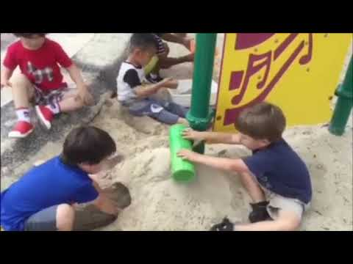
Video
Notes:
Slide 28
We will practice connecting standards and play as we observe children playing in their natural environment. During the video, observe and document what the children are doing and think about how it relates to the domains within the ELDS.
Video Introduction
Presented is a video from the Louisiana State University Early Childhood Education Laboratory Preschool. This video shows a three year old child (left) and a four year old child (right) engaged in sand play. Watch the clip and look for examples of play in the five domains.
Show video using captions. Allow participants 3-5 minutes to discuss the video with a partner and identify the corresponding domains. Allow participants to share.
Examples of what a participant may observe children doing and the corresponding domains.
Approaches to Learning - children explore the classroom and materials freely and in different ways
Cognitive Development and General Knowledge – problem solving on how to make something occur; pouring and filling
Language and Literacy Development-engaged in conversation; vocabulary used
Physical Well-Being and Motor Development- manipulating objects with hand; eye-hand coordination
Social-Emotional Development- interacting with peers

Slide 29
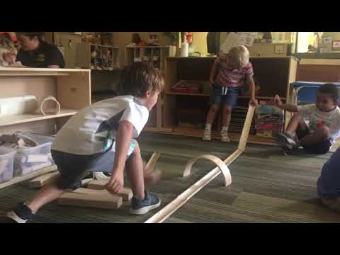
Video
Notes:
Slide 29
Let’s do another example. Presented is a video from the Louisiana State University Early Childhood Education Laboratory Preschool. This video shows four year olds engaged in block play. During the video observe and document what the children are doing and identify the related domains of development.
Show video using captions. Allow participants 3-5 minutes to discuss the video with a partner and identify the corresponding domains. Allow participants to share.
Examples of what a participant may observe children doing and the corresponding domains.
Approaches to Learning – sustaining attention
Cognitive Development and General Knowledge – problem solving; using tools
Language and Literacy Development – using language; engaging in conversation
Physical Well-Being and Motor Development- manipulating objects with hand; eye-hand coordination
Social-Emotional Development- interacting with peers; expressing feelings

Slide 30
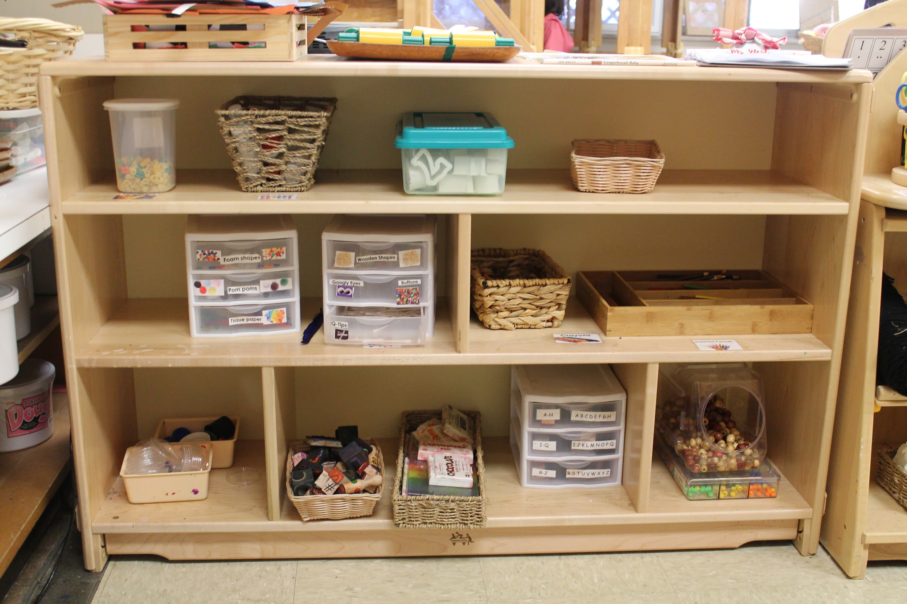
Connecting Standards to the Classroom Environment
Standards can be used to plan the materials you provide in the classroom.
Some standards may require specific types of materials
Example: Develop an appreciation for visual arts from different cultures and create various forms of visual arts.
Notes:
Slide 30
You can also use the standards to help guide you on materials to will provide in your classroom. For example, Standard CC 2 says “develop an appreciation for visual arts from different cultures and create various forms of visual arts”. To support children’s development in this area, you may provide various art materials and allow time for children to create artwork. Remember, domains will often overlap. For example, the art center can also support Standard PM2 which is “develop small muscle control and coordination”.

Slide 31
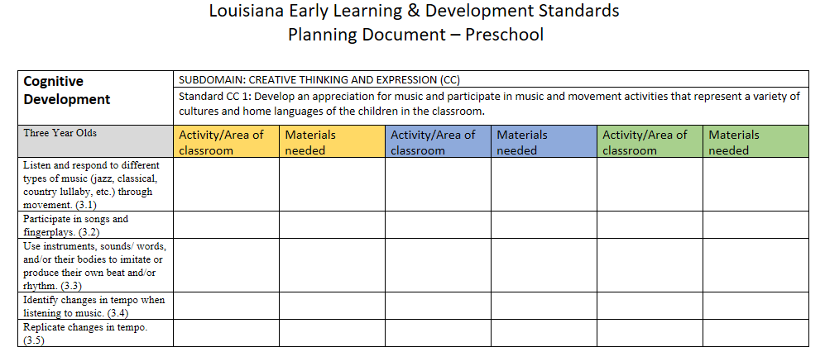
Connecting Standards to the Classroom Environment
Notes:
Slide 31
This is a form that can be used to incorporate the standards into your classroom. This planning document shows indicators for preschoolers and provides teachers and programs q way to plan opportunities to incorporate standards into various activities or areas in the classroom. Let’s try an example:
Standard CC1 says “Develop an appreciation for music and participate in music activities that represent a variety of cultures and home languages of the children in the classroom”. An indicator under that standard says three year olds should be able to “listen and respond to different types of music (jazz, classical, country lullaby, etc.) through movement.” What activities and materials you could you provide to support children’s development in this area?
Pause and allow time for participants to respond. They can find the standard in their ELDS book on page 27. Possible answers include CDs or playlist with various types of music, musical instruments such as maracas and drums, scarves, opportunities for children to dance to music.
Access to this document can be provided to participants. See supporting materials.

Slide 32
Connecting Standards to Lesson Plans
Standards can be used to help plan and provide meaningful experiences for children.
Tier 1 curricula provide correlations between their standards and the ELDS.
Example:
Frog Street Three Year Old Correlation
Notes:
Slide 32
Standards can be used to help plan and provide meaningful experiences for young children. Although most curricula already provide learning experiences that connect to standards, some teachers may develop their own learning experience or find experiences that support a specific standard. For example, if you want to support a three-year old’s ability to communicate with peers, you may refer to the standards to see what indicators are expected for their age range. Then you can plan learning experiences to support the child’s development in the specific area.
Many Tier 1 curricula provide correlations between their curriculum and Louisiana’s ELDS. This is an example of a curriculum that links to the Louisiana Birth to Five ELDS.
Click on the link to show an example.
Programs may find these resources useful in showing the correlation between their curriculum and the ELDS.

Slide 33
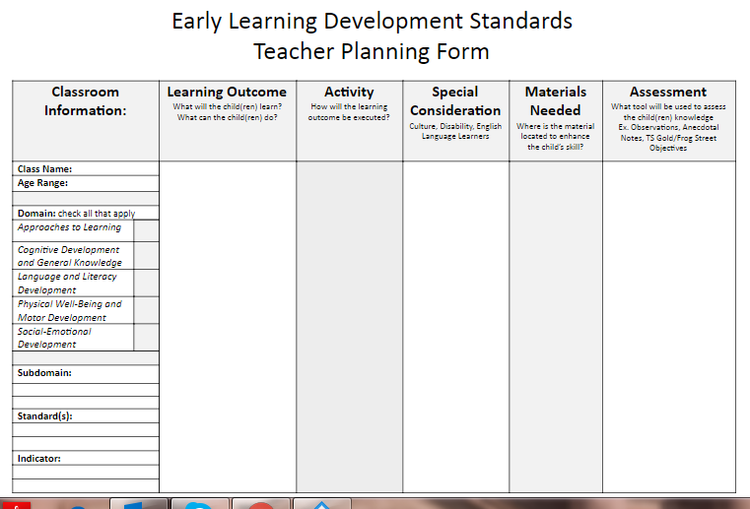
Activity
Early Learning Development Teacher Planning Form
Notes:
Slide 33
Now we will spend some time developing a lesson plan that incorporates all of the components we have learned today.
Divide participants into small groups of 2-4 people. Each group should focus on either three or four year olds. Provide each group with a copy of the teacher planning form. The group will choose one activity and expand upon it using the ELD Planning Form. It can be an activity that was discussed during the presentation (art, music, blocks, etc.). Note, this activity can also be done individually instead of in groups.
Review the form and instructions.
Instructions:
1. Each group should select either 3 or 4 year olds as their target age group.
2. Each group will discuss/reflect on what the child(ren) can do or not do at this time
3. Select a skill on which your group would like to focus.
4. Discuss/reflect on the domain(s) the skill relates.
5. Identify the corresponding standard, subdomain, and indicator related to the skill. Record this information in the appropriate spots on the
left side of the form.
6. Discuss/reflect on what you want the child(ren) to learn-or do (learning outcomes). Record this information on the corresponding column
labeled “learning outcome”.
7. Discuss/reflect on what type of activity can promote this particular skill. Record this information on the corresponding column labeled
“activity”.
8. Discuss any special considerations based on children in your class. This may include children with special needs and children who are
English Language Learners. Complete the column labeled “Special Considerations”.
9. Discuss what materials are in the class to enhance that skill (or maybe what materials you need to add to the class to enhance that skill).
Record this information on the corresponding column on the planning form.
10. Based on your curriculum assessment system, identify how will you assess and document the child’s knowledge related to the learning
outcome. Record this information on the corresponding column on the planning form.
Programs using the Frog Street Curriculum or Teaching Strategies Gold can use the correlation charts to see how their curriculum objectives or assessment items align with the ELDS.
Allow 15-20 minutes for groups to complete the form. Allow each group to share.

Slide 34
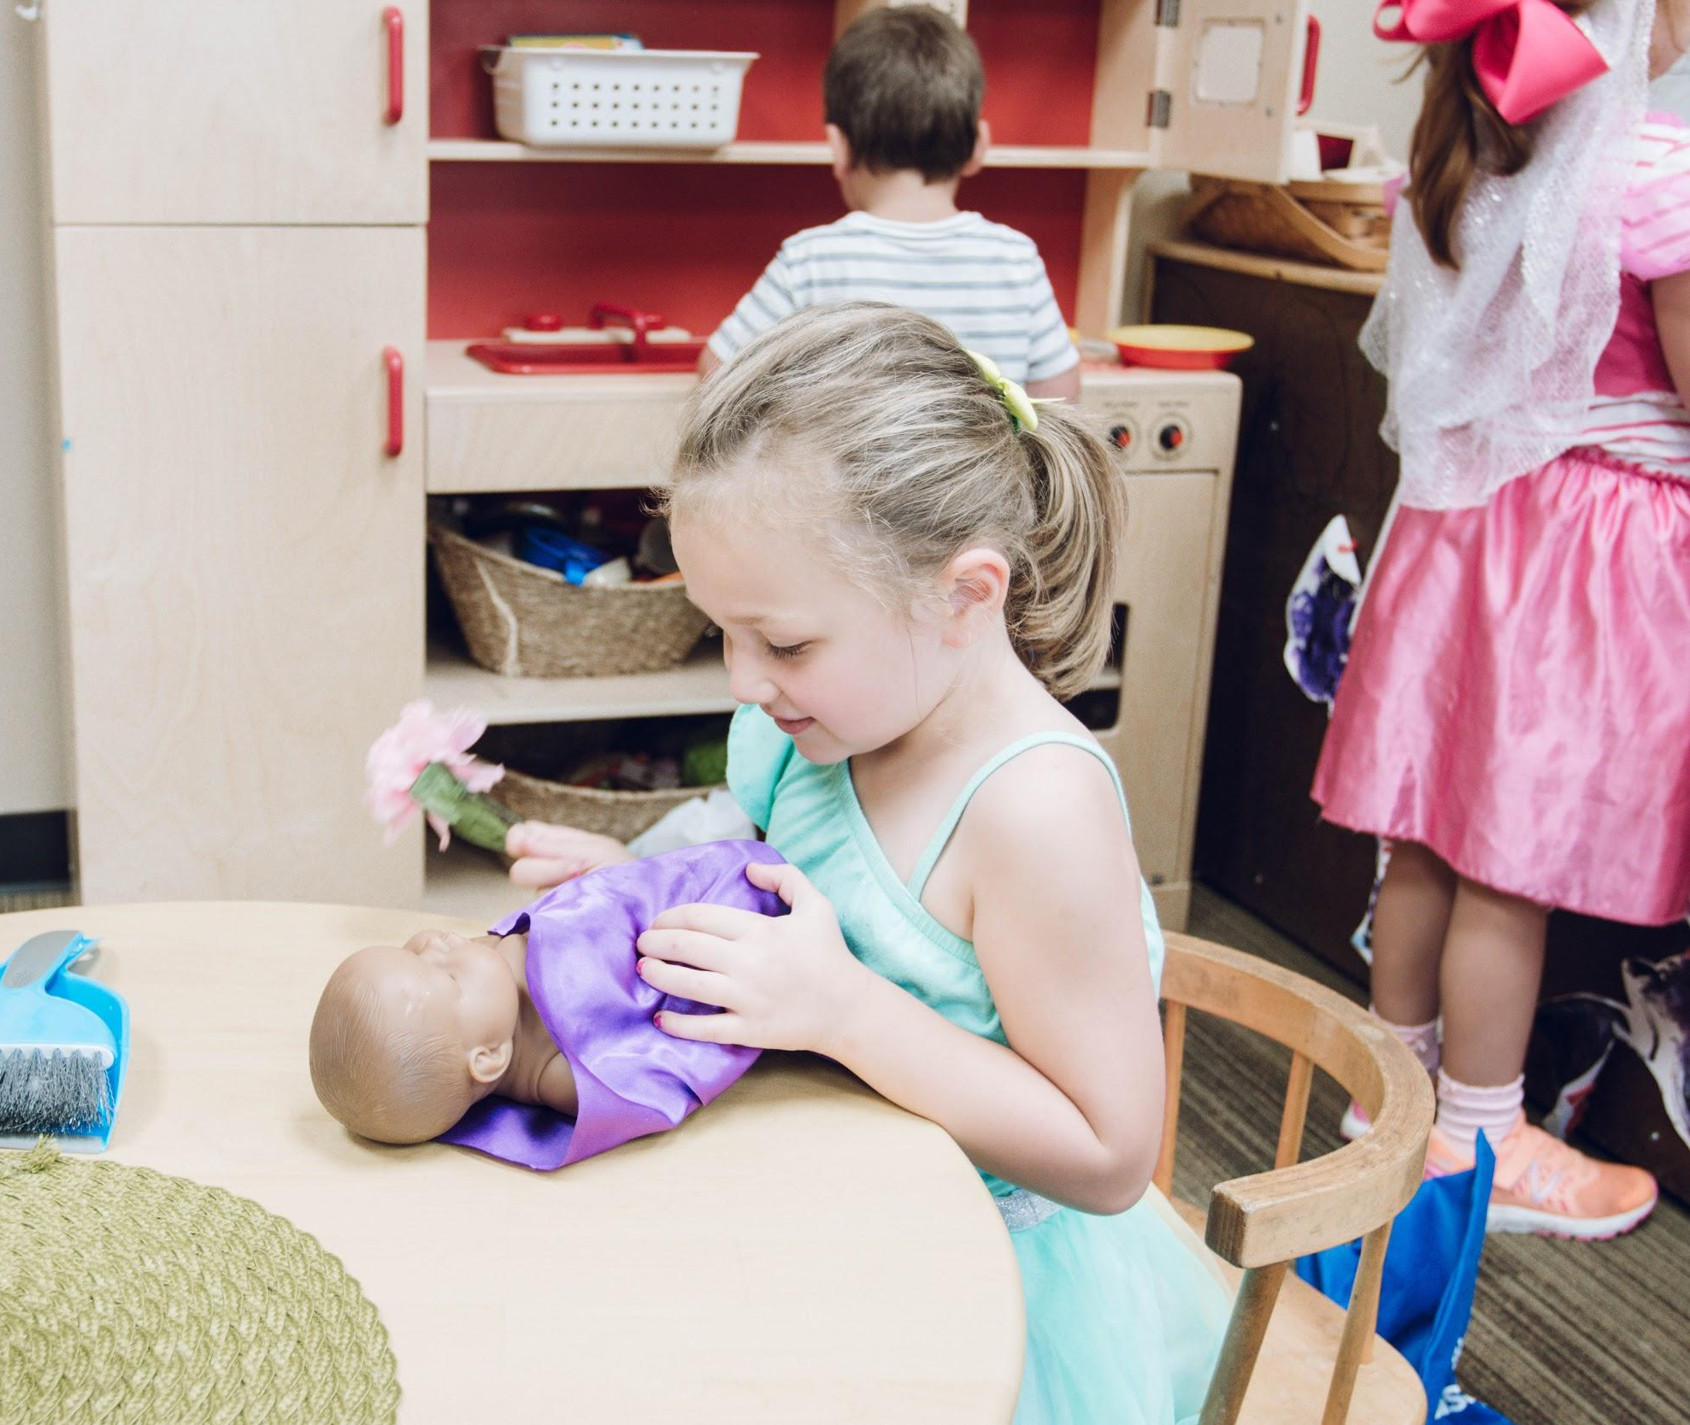
Closing
Notes:
Slide 34
Thank you all for participating in the activities. I hope you have developed a better understanding of how to utilize standards in your everyday work with children. To review, we covered the multiple influences on children’s development, key terms, and how to use standards for play activities, setting up your classroom environment, and for planning activities for children. Does anyone have any questions about the material we covered today?
Pause and allow participants time to respond.
Before we do our post-assessment, please think of one thing you learned today that you will implement in the future. Would anyone mind sharing?
Allow participants time to respond. The action plan handout can also be used if time allows.

Slide 35
Post-Assessment
Notes:
Slide 35
Please complete the post-assessment to see if any of your responses have changed.
Pass out the post-assessment handout. Allow participants 1-2 minutes to complete. Collect them to review after the training.
Thank you all for coming today and for the work you do with young children and families.

