Slide 1
Making Every Moment Count: Creating High-Quality Adult-Child Interactions Throughout the Day

Slide 2
Welcome, Session & Group Introductions

Slide 3
Learning Objectives

Slide 4
LEARNING OBJECTIVES
Increase their knowledge of best practices related to supporting high-quality adult-child interactions
Demonstrate an understanding of the essential components of high-quality adult-child interactions
Align the essential components of high-quality adult-child interactions to indicators of quality from the Classroom Assessment Scoring System (CLASS®): Infant, Toddler, and Preschool
Demonstrate knowledge of best practices in implementing CLASS®-aligned adult-child interactions

Slide 5
SUCCESSFUL LEARNING EXPERIENCES
Successful learning experiences begin by finding out what we currently know and then working to expand and develop our knowledge of what is best.

Slide 6
PRE-ASSESSMENT RESULTS
WHEN
WHERE
WHAT
WHO
HOW
WHY

Slide 7
What a High-Quality Adult-Child Interaction Looks Like: Serve and Return

Slide 8
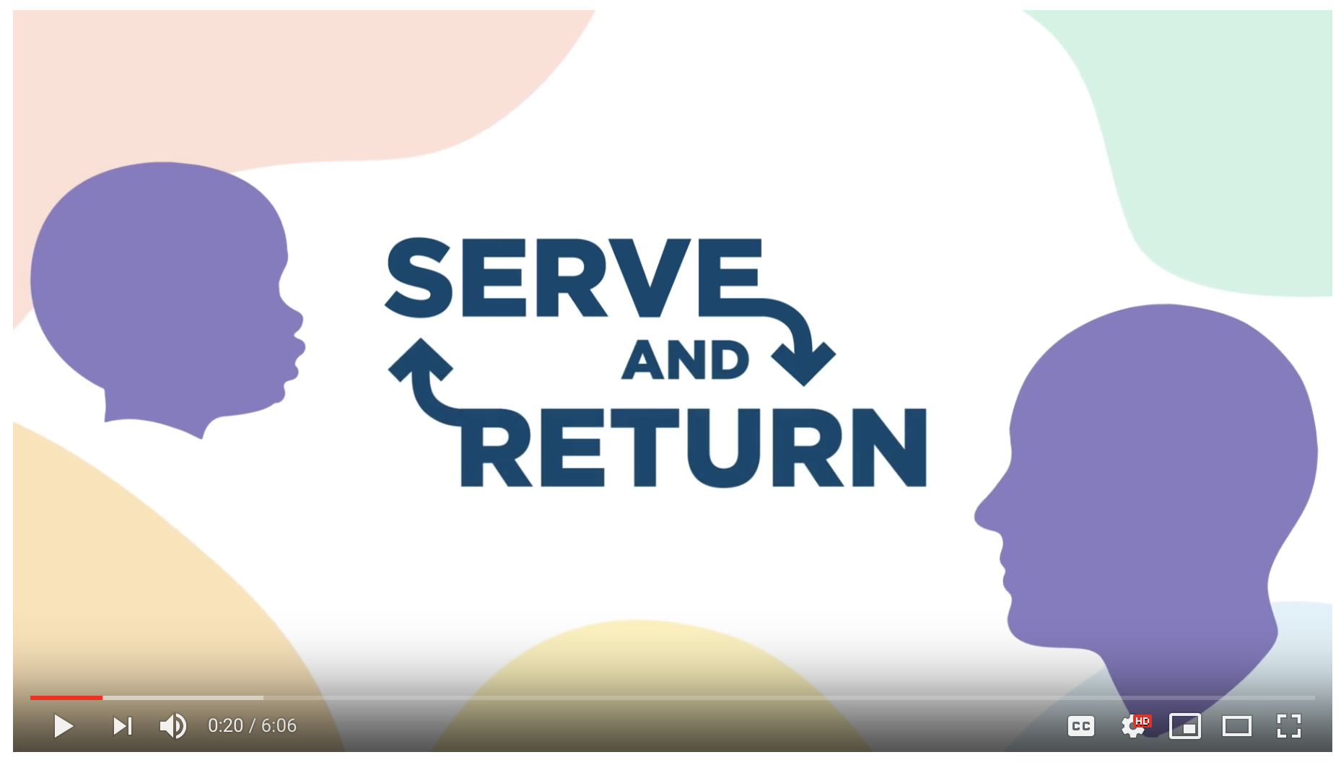
SERVE AND RETURN
Hold CTRL and click the picture to play video.
Notes:
https://www.youtube.com/watch?time_continue=12&v=KNrnZag17Ek

Slide 9
FIVE STEPS FOR SERVE AND RETURN
Share the Focus
Support and Encourage
Name It
Take Turns
Practice Endings and Beginnings

Slide 10
Step One: Share the Focus
https://developingchild.harvard.edu/resources/5-steps-for-brain-building-serve-and-return/

Slide 11
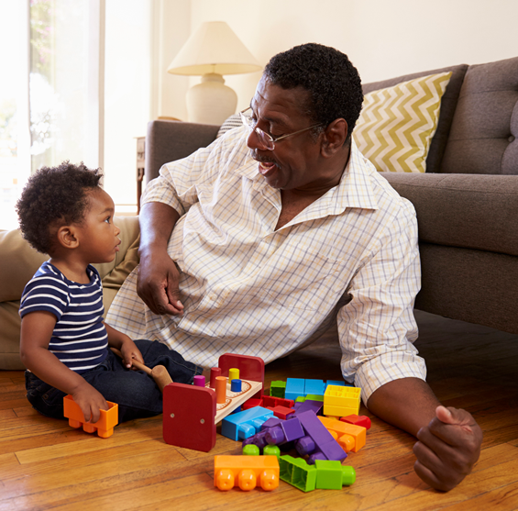
Step Two: Support and Encourage
https://developingchild.harvard.edu/resources/5-steps-for-brain-building-serve-and-return/

Slide 12
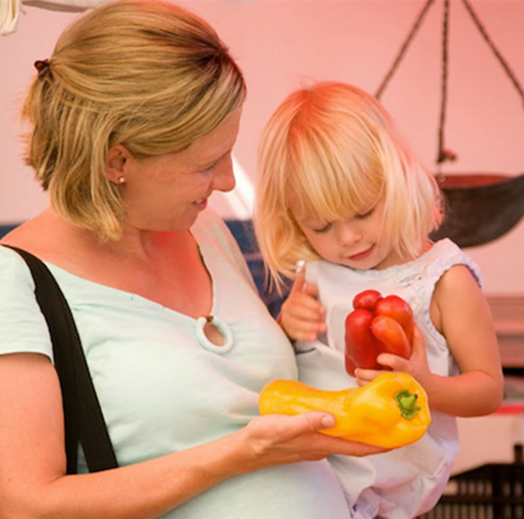
Step Three: Name It
https://developingchild.harvard.edu/resources/5-steps-for-brain-building-serve-and-return/

Slide 13
Step Four: Take Turns
https://developingchild.harvard.edu/resources/5-steps-for-brain-building-serve-and-return/

Slide 14
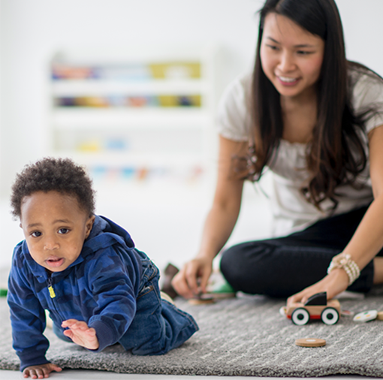
Step Five: Practice Endings and Beginnings
https://developingchild.harvard.edu/resources/5-steps-for-brain-building-serve-and-return/

Slide 15
SERVE AND RETURN
“Serve and return interactions make everyday moments fun and become second nature with practice. By taking small moments during the day to do serve and return, you build up the foundation for children’s lifelong learning, behavior, and health – and their skills for facing life’s challenges.”
Center on the Developing Child, 2019

Slide 16
Essentials at Every Age Activity

Slide 17
ACTIVITY INSTRUCTIONS
After watching each video:
With your group, identify elements of high-quality interactions within the video.
Which element do you find to be the most successful and why?
What would you change, if anything, and why?
What other thoughts do you have?
Be prepared to share!

Slide 18
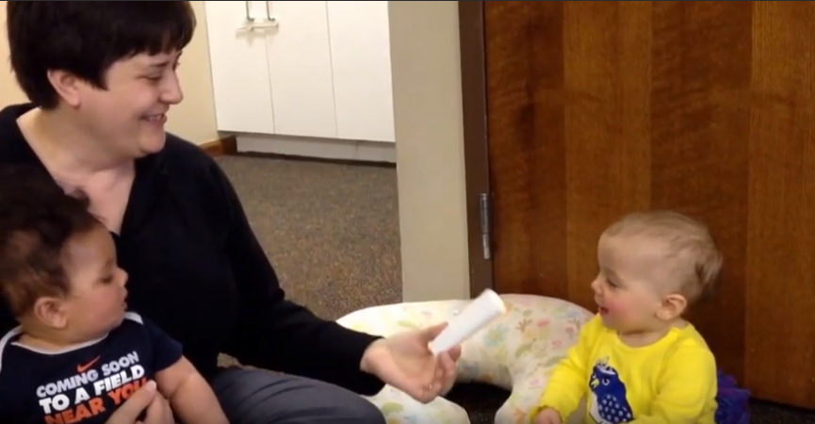
ADULT-INFANT INTERACTION
Hold CTRL and click the picture to play video.
Notes:
https://www.youtube.com/watch?v=aYQSWYzFCaU

Slide 19
REFLECTION
Which elements did you find to be the most successful and why?
What would you change, if anything, and why?
What other thoughts do you have?

Slide 20
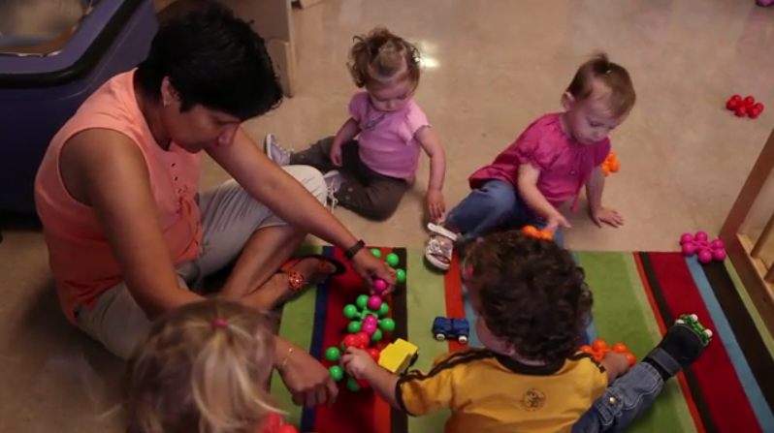
ADULT-TODDLER INTERACTION
Hold CTRL and click the picture to play video.
Notes:
http://toddlers.ccdmd.qc.ca/video/show/An-interesting-toy

Slide 21
REFLECTION
Which elements did you find to be the most successful and why?
What would you change, if anything, and why?
What other thoughts do you have?

Slide 22
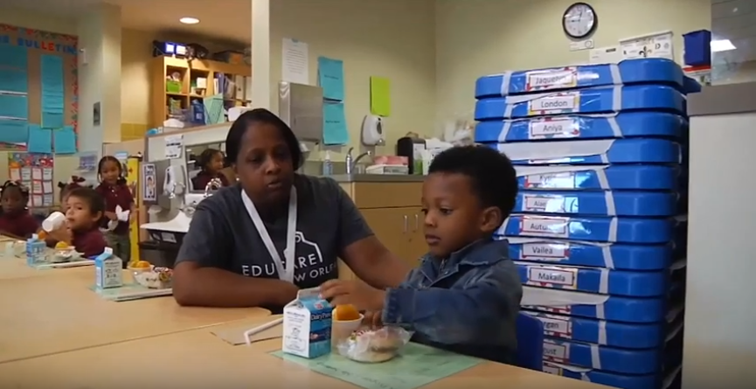
ADULT-PRESCHOOLER INTERACTION
Hold CTRL and click the picture to play video.
Notes:
https://www.youtube.com/watch?v=yLsgsc2d2zo&feature=youtu.be

Slide 23
REFLECTION
Which elements did you find to be the most successful and why?
What would you change, if anything, and why?
What other thoughts do you have?

Slide 24
FIVE STEPS FOR SERVE AND RETURN
Share the Focus
Support and Encourage
Name It
Take Turns
Practice Endings and Beginnings

Slide 25
A Quick Look at CLASS®

Slide 26
MEASURING CLASSROOM QUALITY
Louisiana uses the CLASS® rating tool to measure, inform and support improvement on the core elements needed for early childhood classroom quality.
As a research-based, nationally regarded early childhood quality measure for all young children, CLASS® assesses how well teachers interact with children, including how well they:
Expectations for the Classroom: | Pre-K Domains | Toddler Domains | Infant Domains
Warm, positive environment with trusting relationships | Emotional Support | Emotional & Behavioral Support | Responsive Caregiving
Daily routines are organized and disruptions are minimal | Classroom Organization
Children are supported to learn concepts, develop language, and connect ideas through dialogue and play | Instructional Support | Engaged Support for Learning

Slide 27
Examining Serve and Return Through a CLASS® Lens

Slide 28
CLASS®-Aligned Interactions

Slide 29
CLASS®: Notice and Share
Share the Focus
“Notice the serve and share the child’s focus of attention.”

Slide 30
CLASS®: NOTICE AND SHARE
Indicator: Relational & Positive Climate
Behavioral marker: Relationships – Close proximity
Indicator: Teacher Sensitivity
Behavioral marker: Awareness
Indicator: Regard for Child Perspectives
Behavioral marker: Child-focused

Slide 31
SERVE AND RETURN IN ACTION
Hold CTRL and click the picture to play video.
Notes:
https://www.youtube.com/watch?v=aYQSWYzFCaU

Slide 32
CLASS®: Support and Encourage
“Return the serve by supporting and encouraging.”

Slide 33
CLASS®: SUPPORT AND ENCOURAGE
Indicator: Relational & Positive Climate
Behavioral markers: Matched positive affect, Reciprocal interactions
Indicator: Teacher Sensitivity
Behavioral markers: Responsiveness, Child comfort
Indicator: Regard for Child Perspectives
Behavioral markers: Flexibility, Support of independence
Indicator: Quality of Feedback
Behavioral markers: Scaffolding, Providing information, Encouragement and affirmation

Slide 34
SERVE AND RETURN IN ACTION
Hold CTRL and click the picture to play video.
Notes:
http://toddlers.ccdmd.qc.ca/video/show/An-interesting-toy

Slide 35
CLASS®: Name It
“Give it a name!”

Slide 36
CLASS®: NAME IT
Indicator: Early Language Support & Language Modeling
Behavioral markers:
Teacher, self- and parallel talk
Communication support and supporting language use
Repetition and extension
Advance language
Frequent conversations and higher-order questioning

Slide 37
SERVE AND RETURN IN ACTION
Hold CTRL and click the picture to play video.
Notes:
https://www.youtube.com/watch?v=yLsgsc2d2zo&feature=youtu.be

Slide 38
CLASS®: Take Turns
“Take turns…and wait. Keep the interaction going back and forth.”

Slide 39
CLASS®: TAKE TURNS
Descriptors of High-Quality Interactions:
Frequently
Consistently
Often
Many

Slide 40
CLASS®: Practice Endings and Beginnings
“Practice endings and beginnings.”

Slide 41
REPEAT THE PROCESS
Share the Focus
Support and Encourage
Name It
Take Turns
Practice Endings and Beginnings

Slide 42
Session Review

Slide 43
REVIEW LEARNING OBJECTIVES
Increase their knowledge of best practices related to supporting high-quality adult-child interactions
Demonstrate an understanding of the essential components of high-quality adult-child interactions
Align the essential components of high-quality adult-child interactions to indicators of quality from the Classroom Assessment Scoring System (CLASS®): Infant, Toddler, and Preschool
Demonstrate knowledge of best practices in implementing CLASS®-aligned adult-child interactions

Slide 44
Reflections, Questions, & Comments

Slide 45
Please complete the Post-Assessment Evaluation. Thank you!

